Slide 1
HYPERTENSION AND ANTIHYPERTENSION DRUGS
Dr.Dinesh Chauhan,
Professor &Head,
Dept.of Anaesthesia,
S.B.K.S.M.I.R.C.,Piparia

Slide 2
HISTORY :
1700 BC: Description of blood pressure appeared when Chinese were aware that “ if large amount of salts are taken , the pulse will stiffen or harden”.
1773 : Stephen Hales measured blood pressure for the first time.

Slide 3
WHY IS HTN IMPORTANT
It is a risk factor for CVD
Causes end organ damage which affects perioperative course – heart, brain, kidneys
May indicate presence of serious endocrine related diseases and serious renal disease
Increases risk of adverse anesthetic outcome
Perioperatively it may be due to
-Anxiety
-Inadequate anesthesia
-Inadequate analgesia

Slide 4
PATHOPHYSIOLOGY OF ESSENTIAL HTN
BP is typically defined as lateral pressure exerted by blood on vessel wall mainly in arteries
90% have essential HTN where pathophysiology is increased SVR
70-80% have family history of HTN suggesting genetic influence
ANS – plays central role in maintenance of Cardiovascular homeostasis, disturbance of ANS, sympathetic nervous system overactivity, increases BP and contributes to development and maintenance of HTN

Slide 5
Sympathetic Nervous System
CHEMOREFLEX
PATHWAY
ARTERIAL AORTIC
BAROREFLEX PATHWAY
AG-2, ENDOTHELIN AND REACTIVE O2 RADICLES

Slide 6
PERIPHEREAL VASCULATURE:
High ratio of wall thickness to internal diameter.
Relative hypovolemia-> Vascular relaxation -> Hypovolemia->decrease BP.
Vascular contraction – increase BP.
HEART
Increase afterload
Increase LEFT ventricular myocardium hypertrophies.

Slide 7
-Cardiac dilatation – heart failure
- ECG- LVH .
BRAIN
- Shifts cerebral and renal autoregulation to right,requiring higher maintenance of high BP to maintain cerebral blood flow compared to normotensive patients.
KIDNEYS

Slide 8
10-25 %
in rural
and urban
HH population.
Higher prevalence in non- white population and in females after the age of 50 yrs.
The ratio of F: M increases from 0.6-0.7 at age 30 to 1.1- 1.2 at age 65
PREVALENCE

Slide 9
White coat hypertension
( BP high when measured in the office by a proffesional than when done at home or under casual circumstances
labile hypertension
Patients with BP readings in the hypertensive range at times and not always. They are considered to have borderline hypertension
Reverse white coat hypertension
- Normal office, but elevatd ambulatory findings

Slide 10
Pseudo hypertension
Elderly patients having marked sclerotic arteries that are not occluded until very high pressure are exerted by the balloon.
Hypertensive Emergency
BP more than 160/90 mm Hg with associated end organ damage
They require immediate IV therapy .
Hypertensive urgencies
Sudden increase in BP more than 169/ 90 mm of Hg with out any features of end organ damage.
Treatement : Oral antihypertensives.
Hypertensive crisis
A systolic BP more than 200 mm Hg and diastolic over 120 mm Hg

Slide 11
JNC -8 ( Classification of blood pressure)
New guidelines
NORMAL | Less than 120/80 mm Hg
Elevated | Systolic between 120-129 and diastolic less than 80.
Stage 1 | Systolic between 130-139 or diastolic between 80-89
Stage 2 | Systolic at least 140 or diastolic at least 90 mm Hg

Slide 12
Hypertensive crisis | Systolic over 180 and / or diastolic over 120 , with patients needing prompt changes in medication if there are no other medications if there are other indications of problems, or immediate hospitalization if there are signs of organ damage.

Slide 13
CLASSIFICATION ACCORDING TO ITS SUBTYPES – SYSTOLIC , DIASTOLIC AND PULSE PRESSURE
SYSTOLIC- Macrovascular ds. ( Atherosclerosis ) … large artery
DIASTOLIC – Microvascular ds. ( Coronary heart disease ) …. Vessele < 1mm size

Slide 14
ETIOLOGY
Essential hypertension
Renal- Chronic pyelonephritis
Acute and chronic GN.
Reno vascular stenosis
Renin producing tumour
Endocrine – Oral contraceptives
Adreno cortical hyperfunction
Pheochromocytoma
Myxedema
Acromegaly
Hyperparathyroidism
Neurogenic
Psychogenic
Polyneuritis
Miscellaneous
Coarctation of Aorta
Hypercalcemia
OSA
Unknown etiology
Toxemia of pregnancy
Acute intermittent porphyria

Slide 15
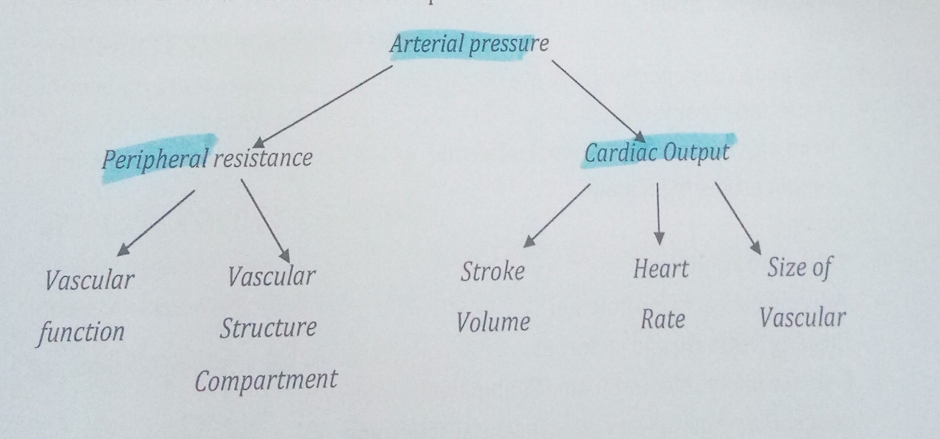
MECHANISM

Slide 16
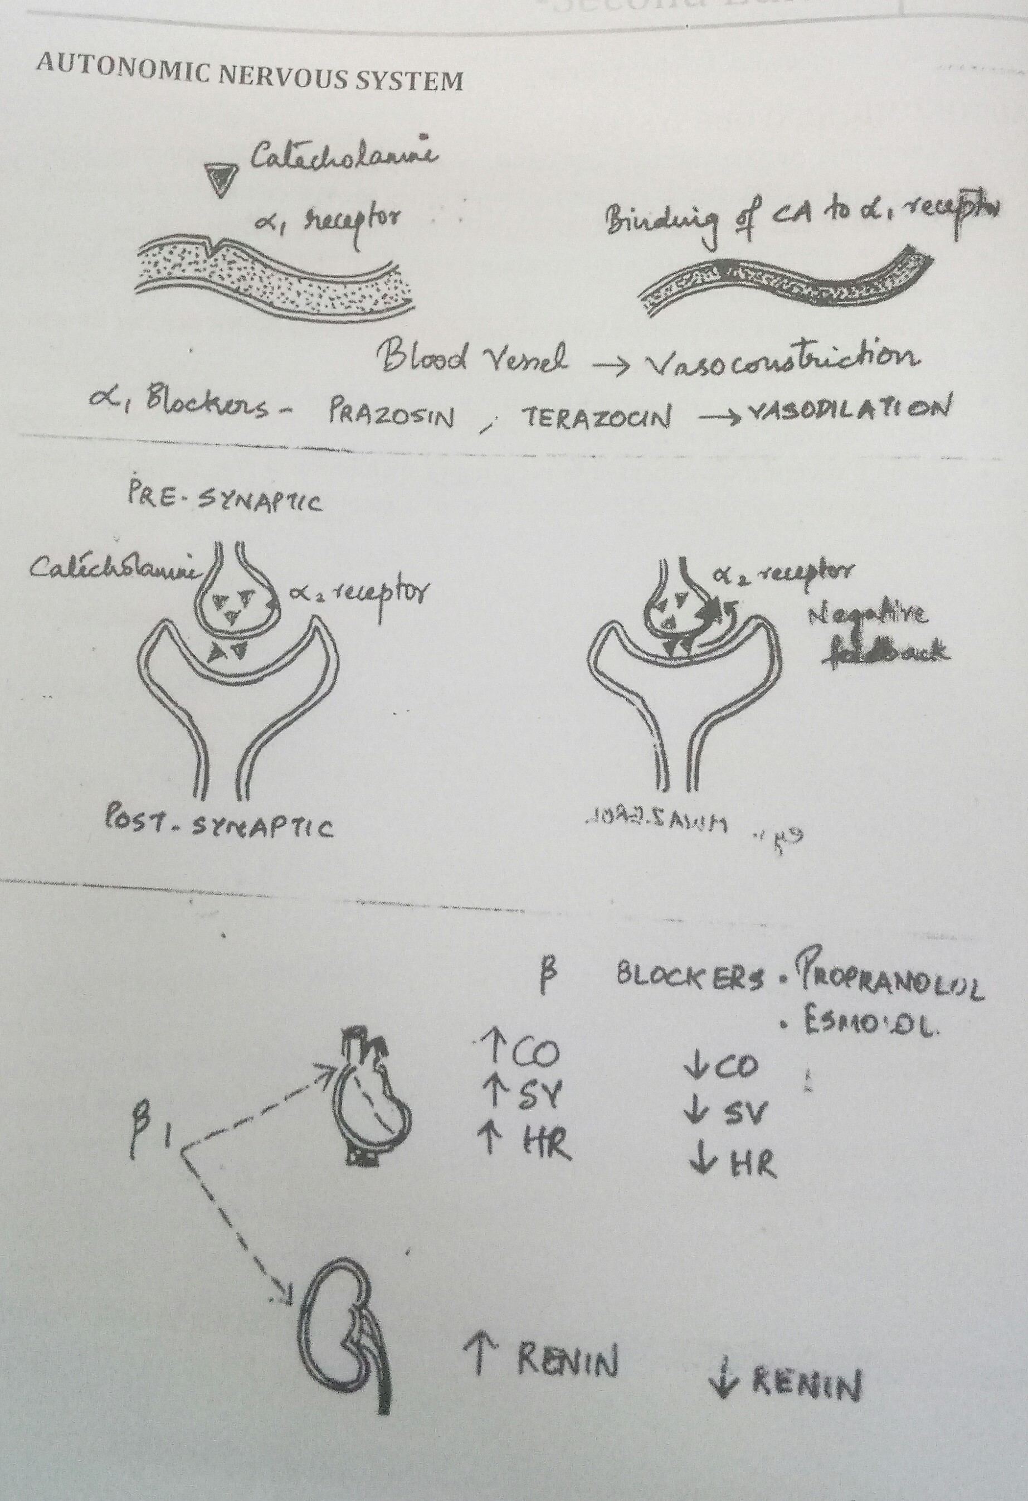
AUTONOMIC NERVOUS SYSTEM

Slide 17
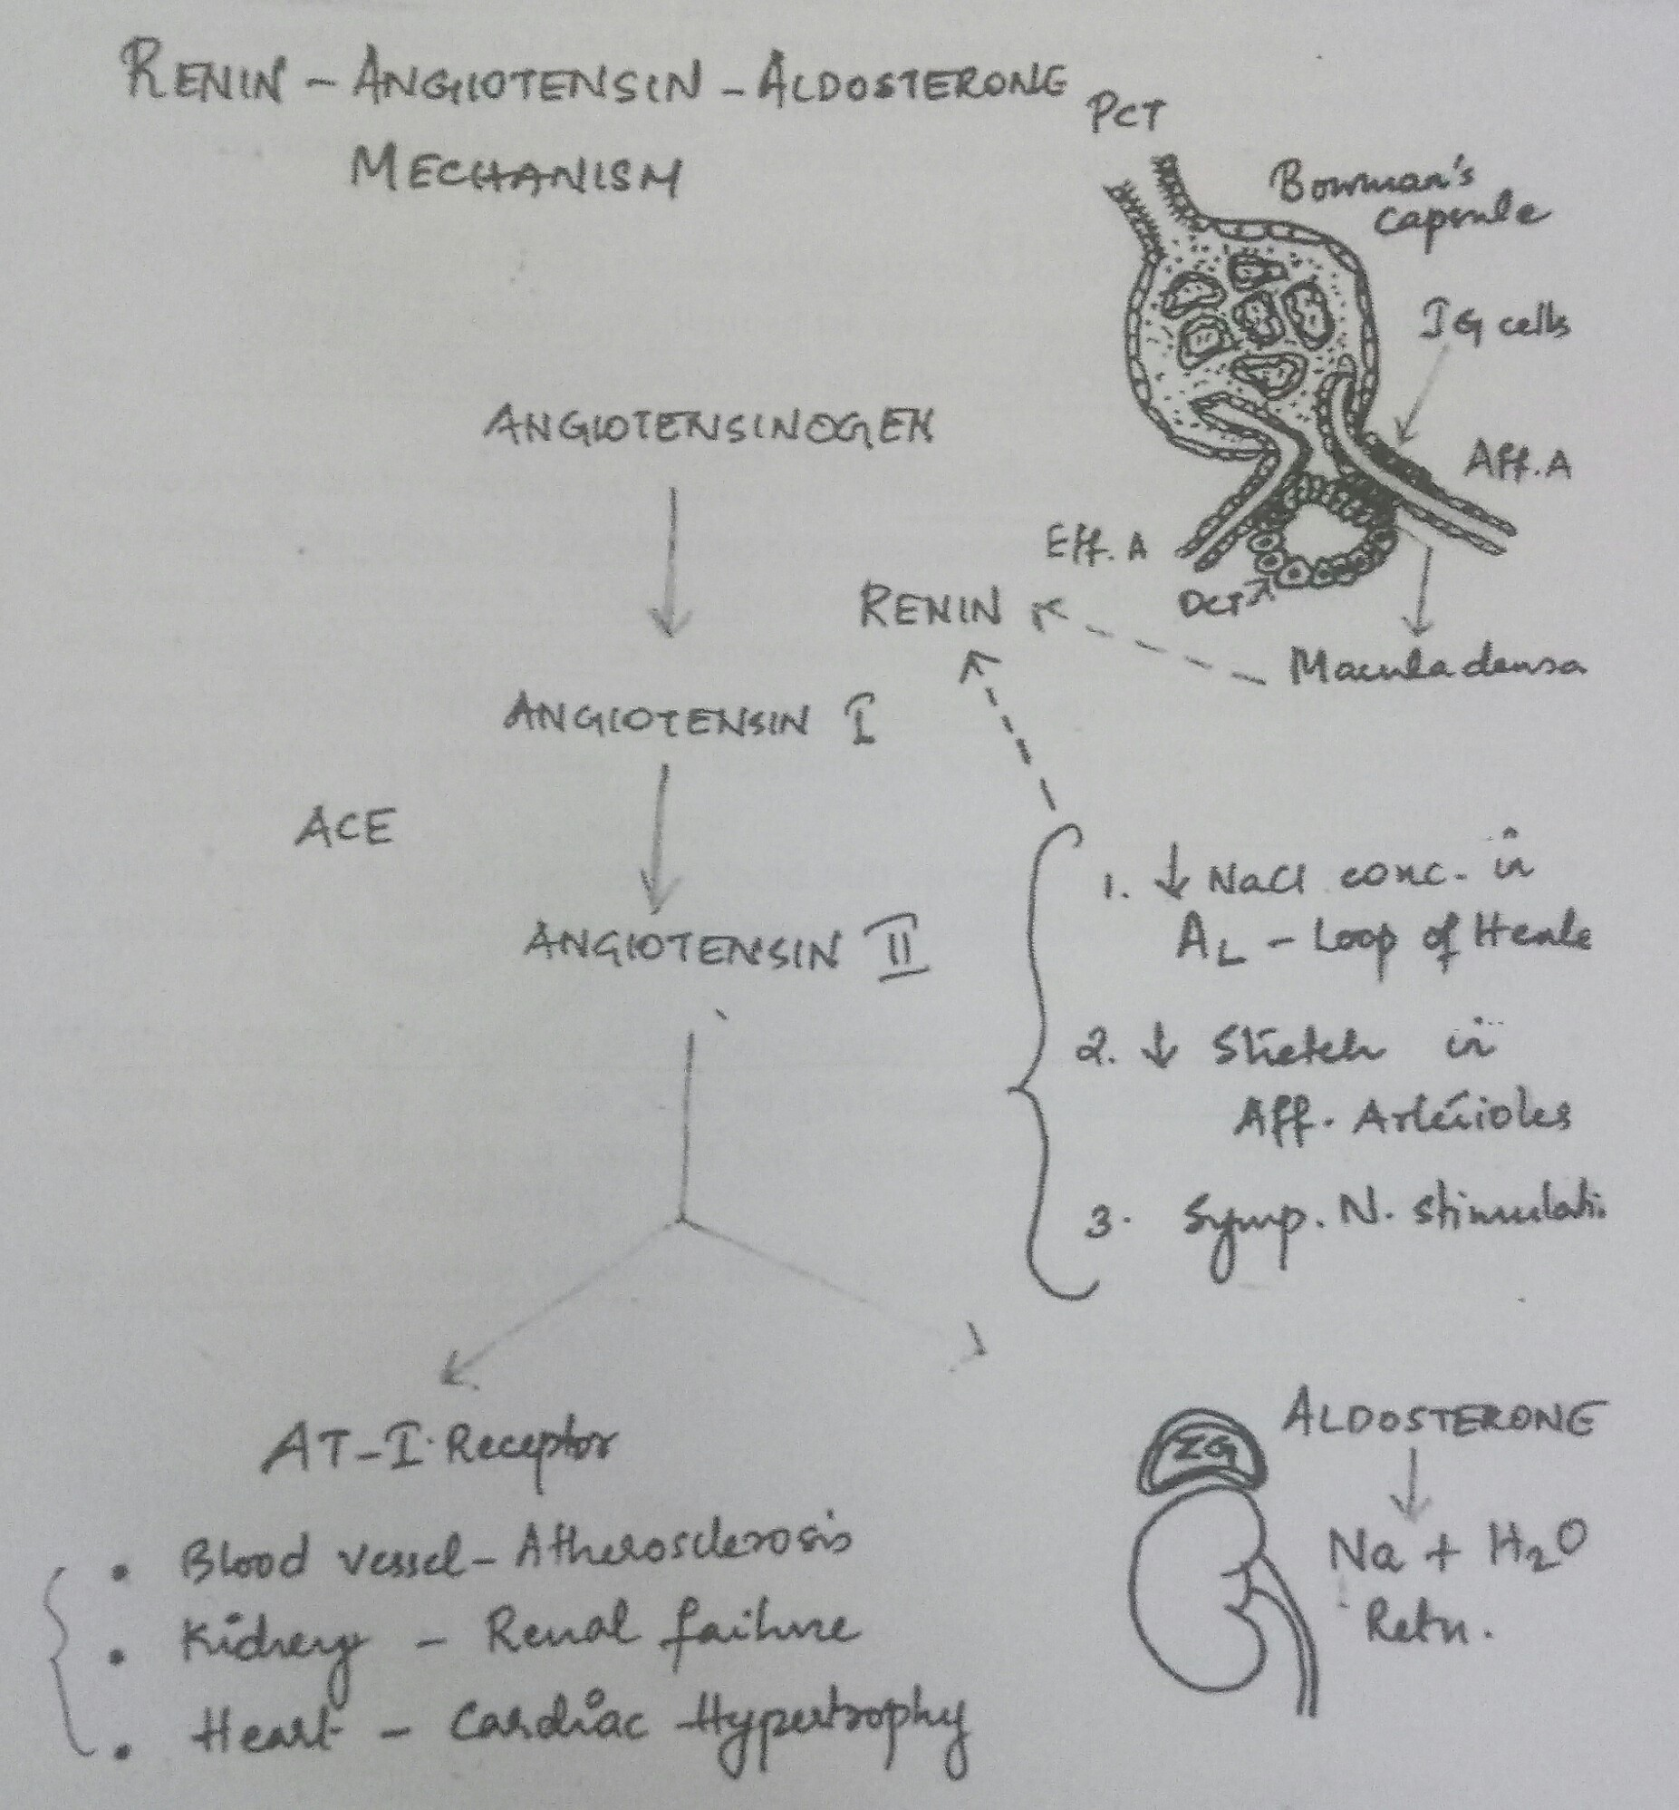

Slide 18
VASCULAR MECHANISM
Vascular radius compliance and elasticity are imp. Determinant of arterial pressure.
In hypertensive patients structural,mechanical,or functional changes may reduce lumen diameter of small arteries and arterioles.
Remodeling
Vascular remodelling
Lumen diameter is also related to elasticity of the vessel.

Slide 19
Pathological consequences of hypertension
HEART -
BRAIN
KIDNEY

Slide 20
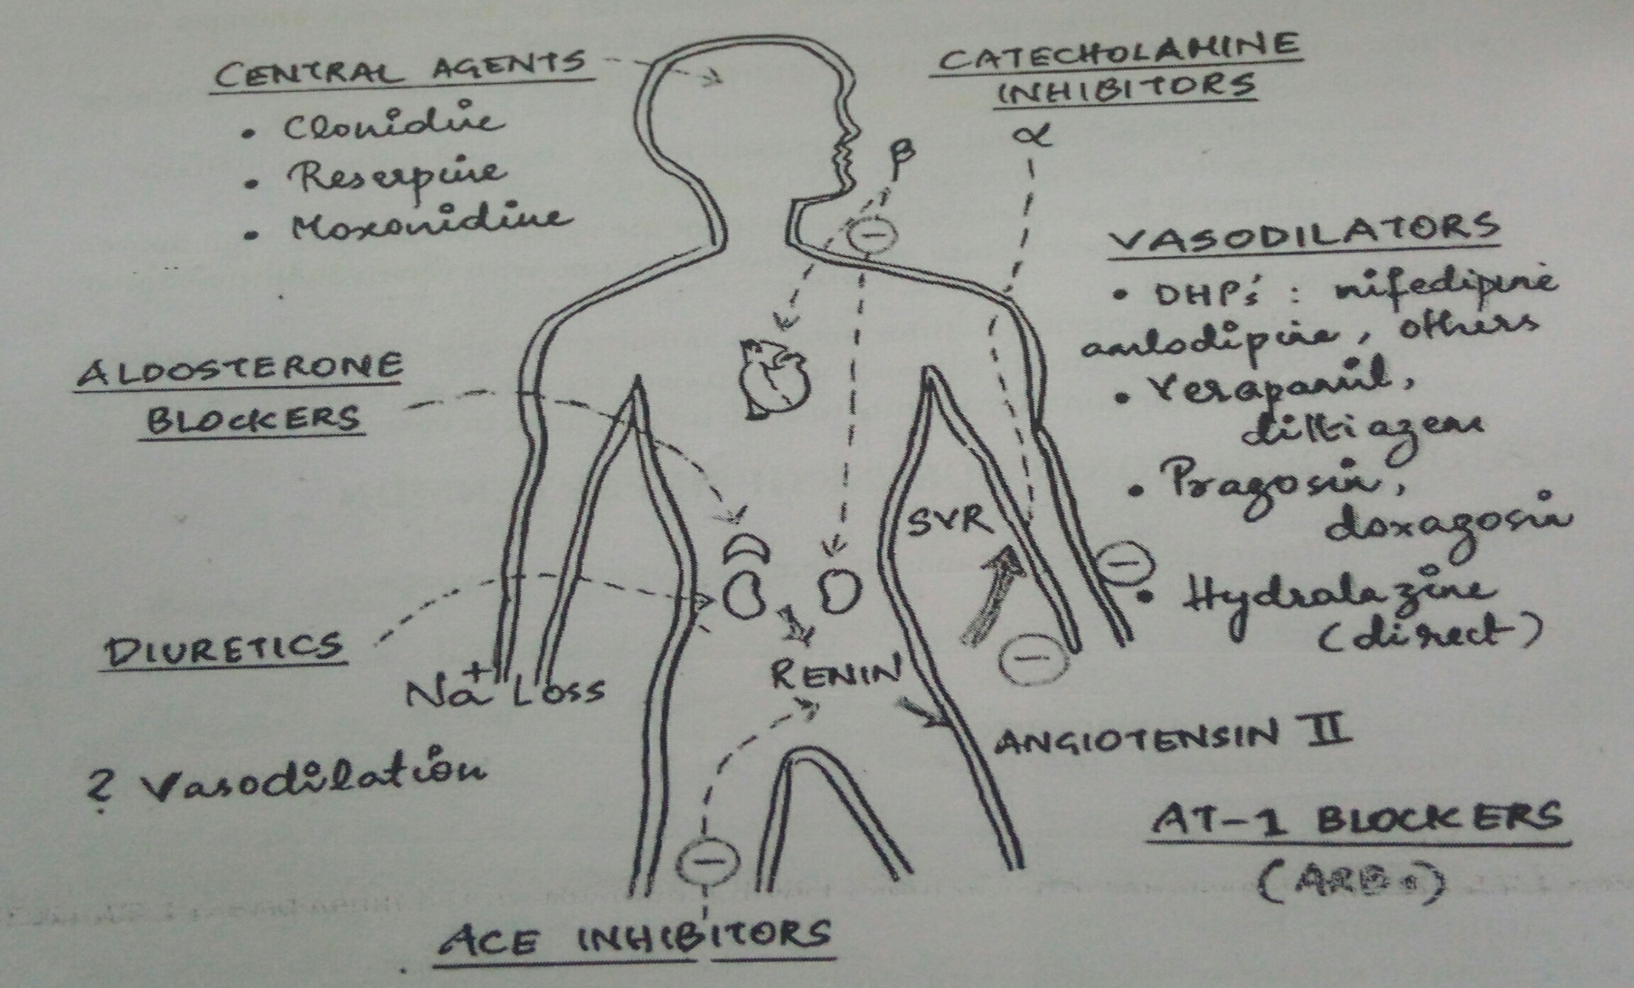
ANTIHYPERTENSIVE DRUGS

Slide 21
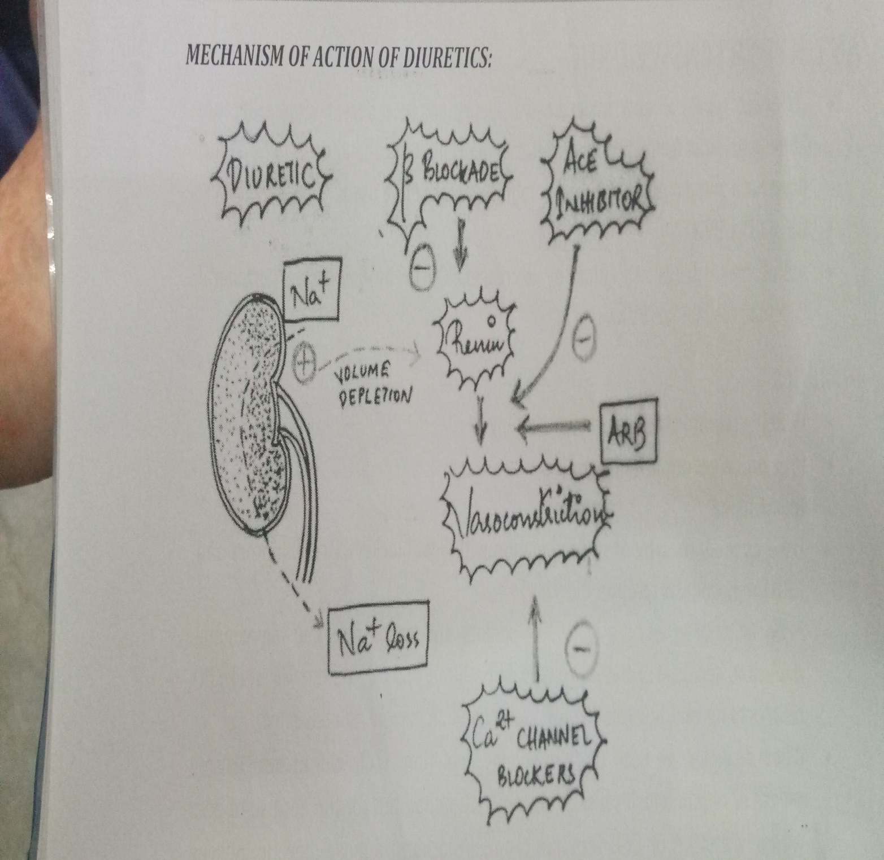

Slide 22
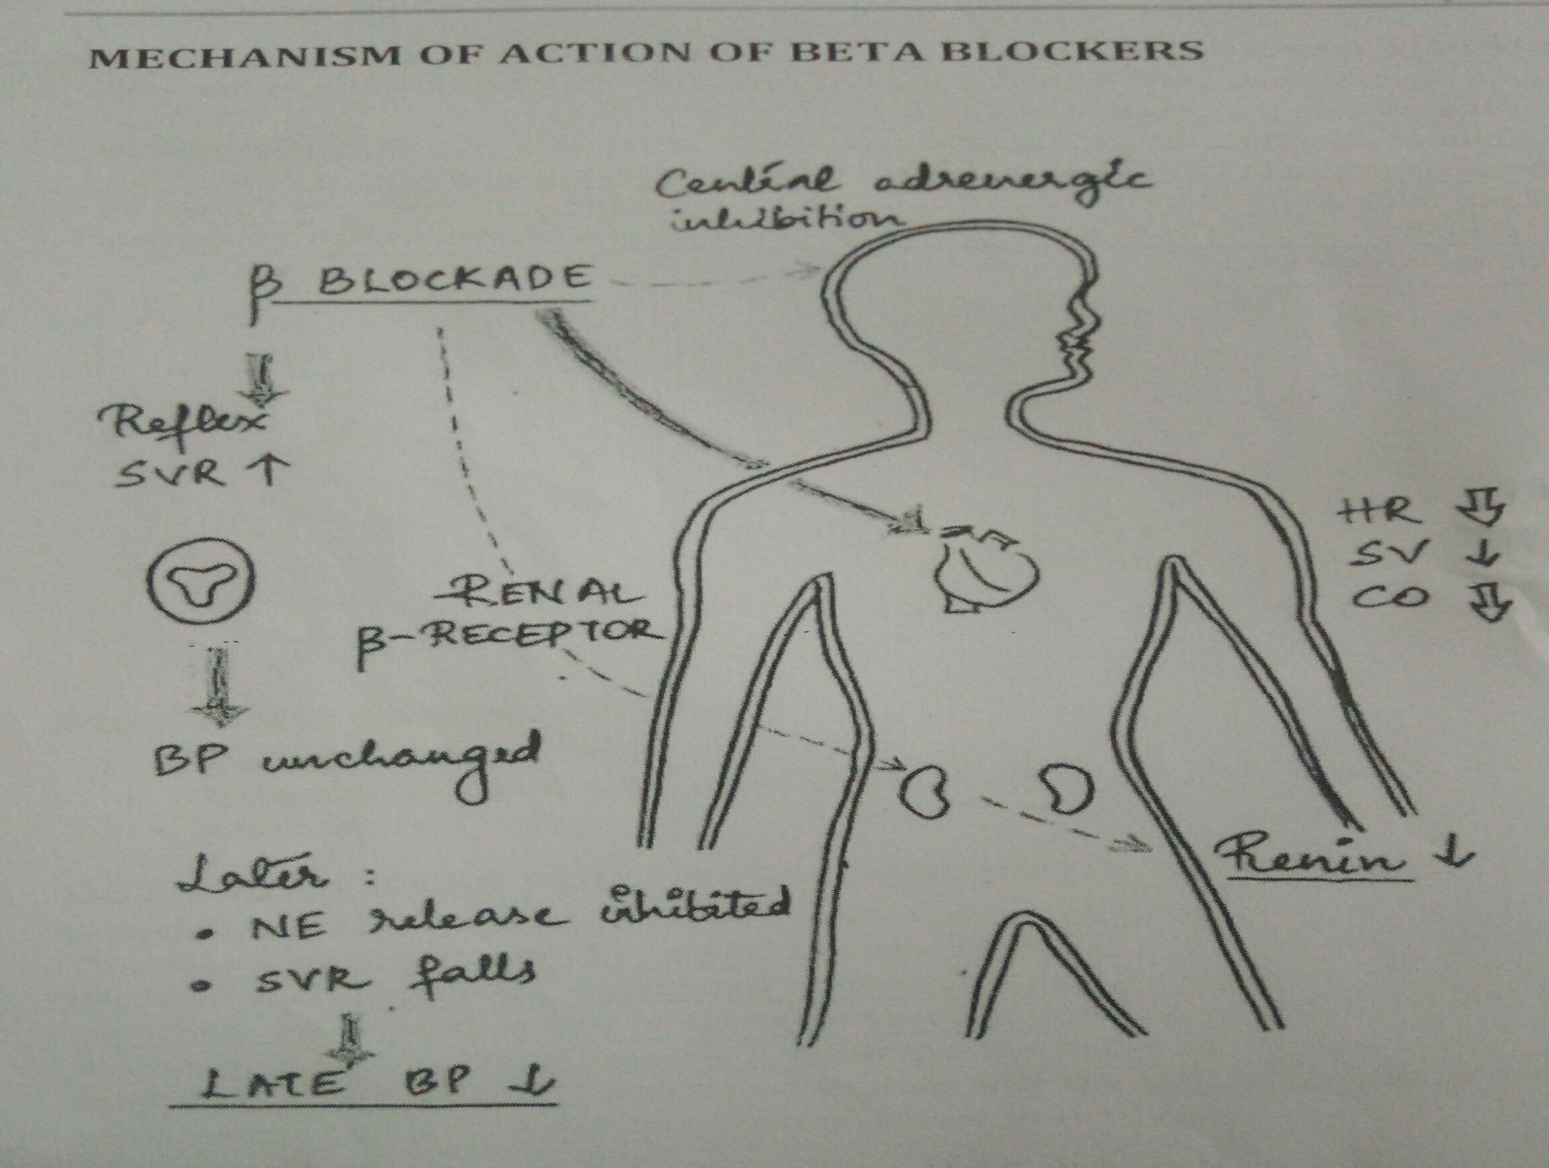

Slide 23
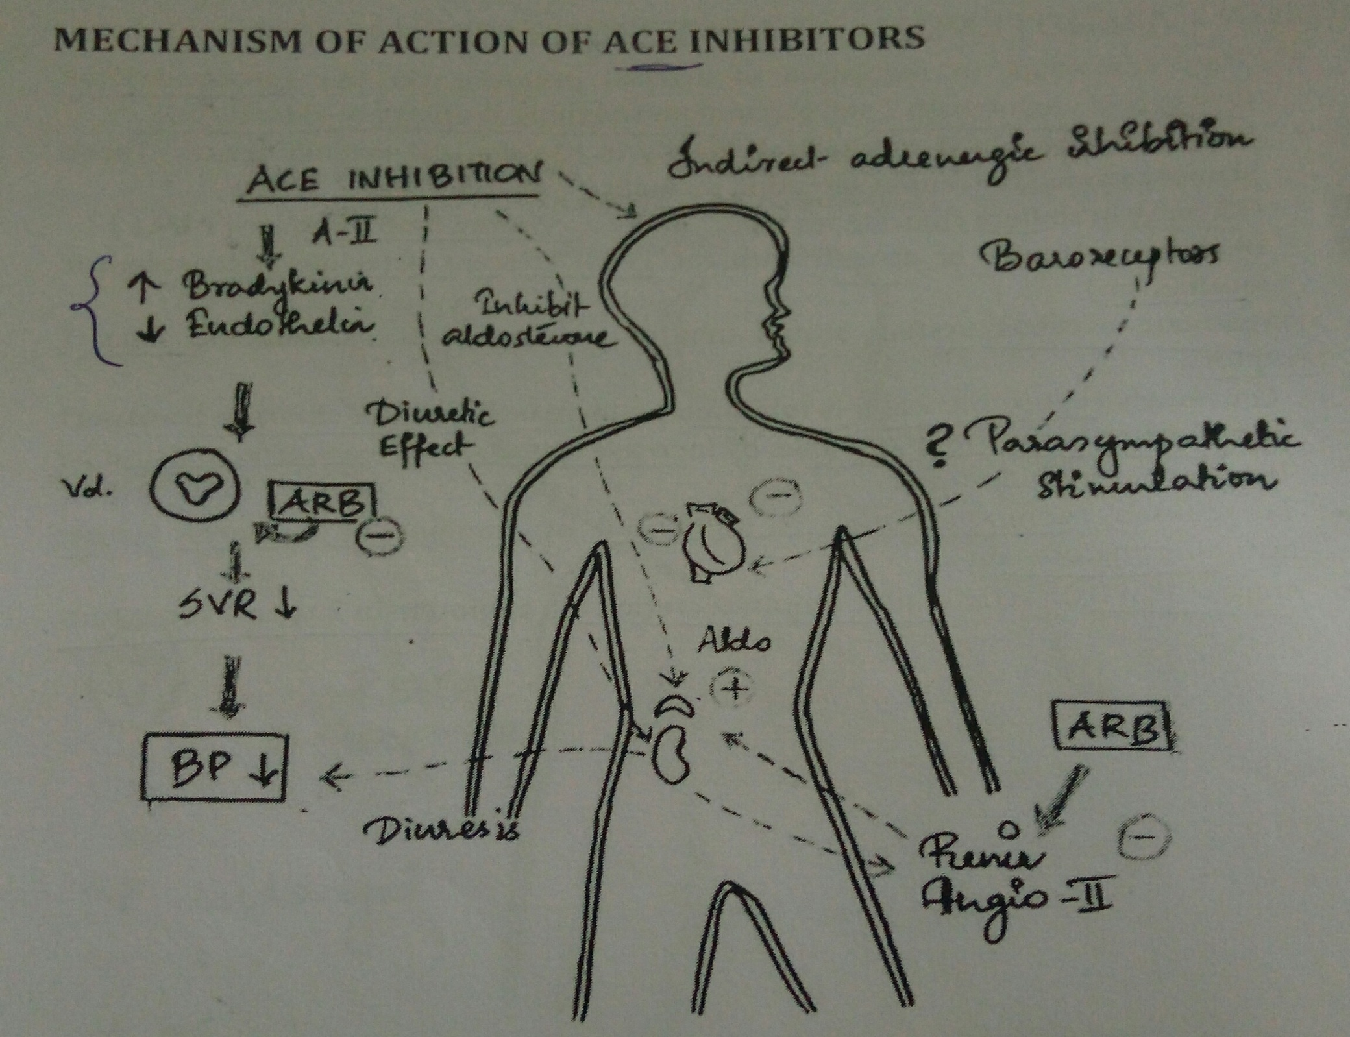

Slide 24
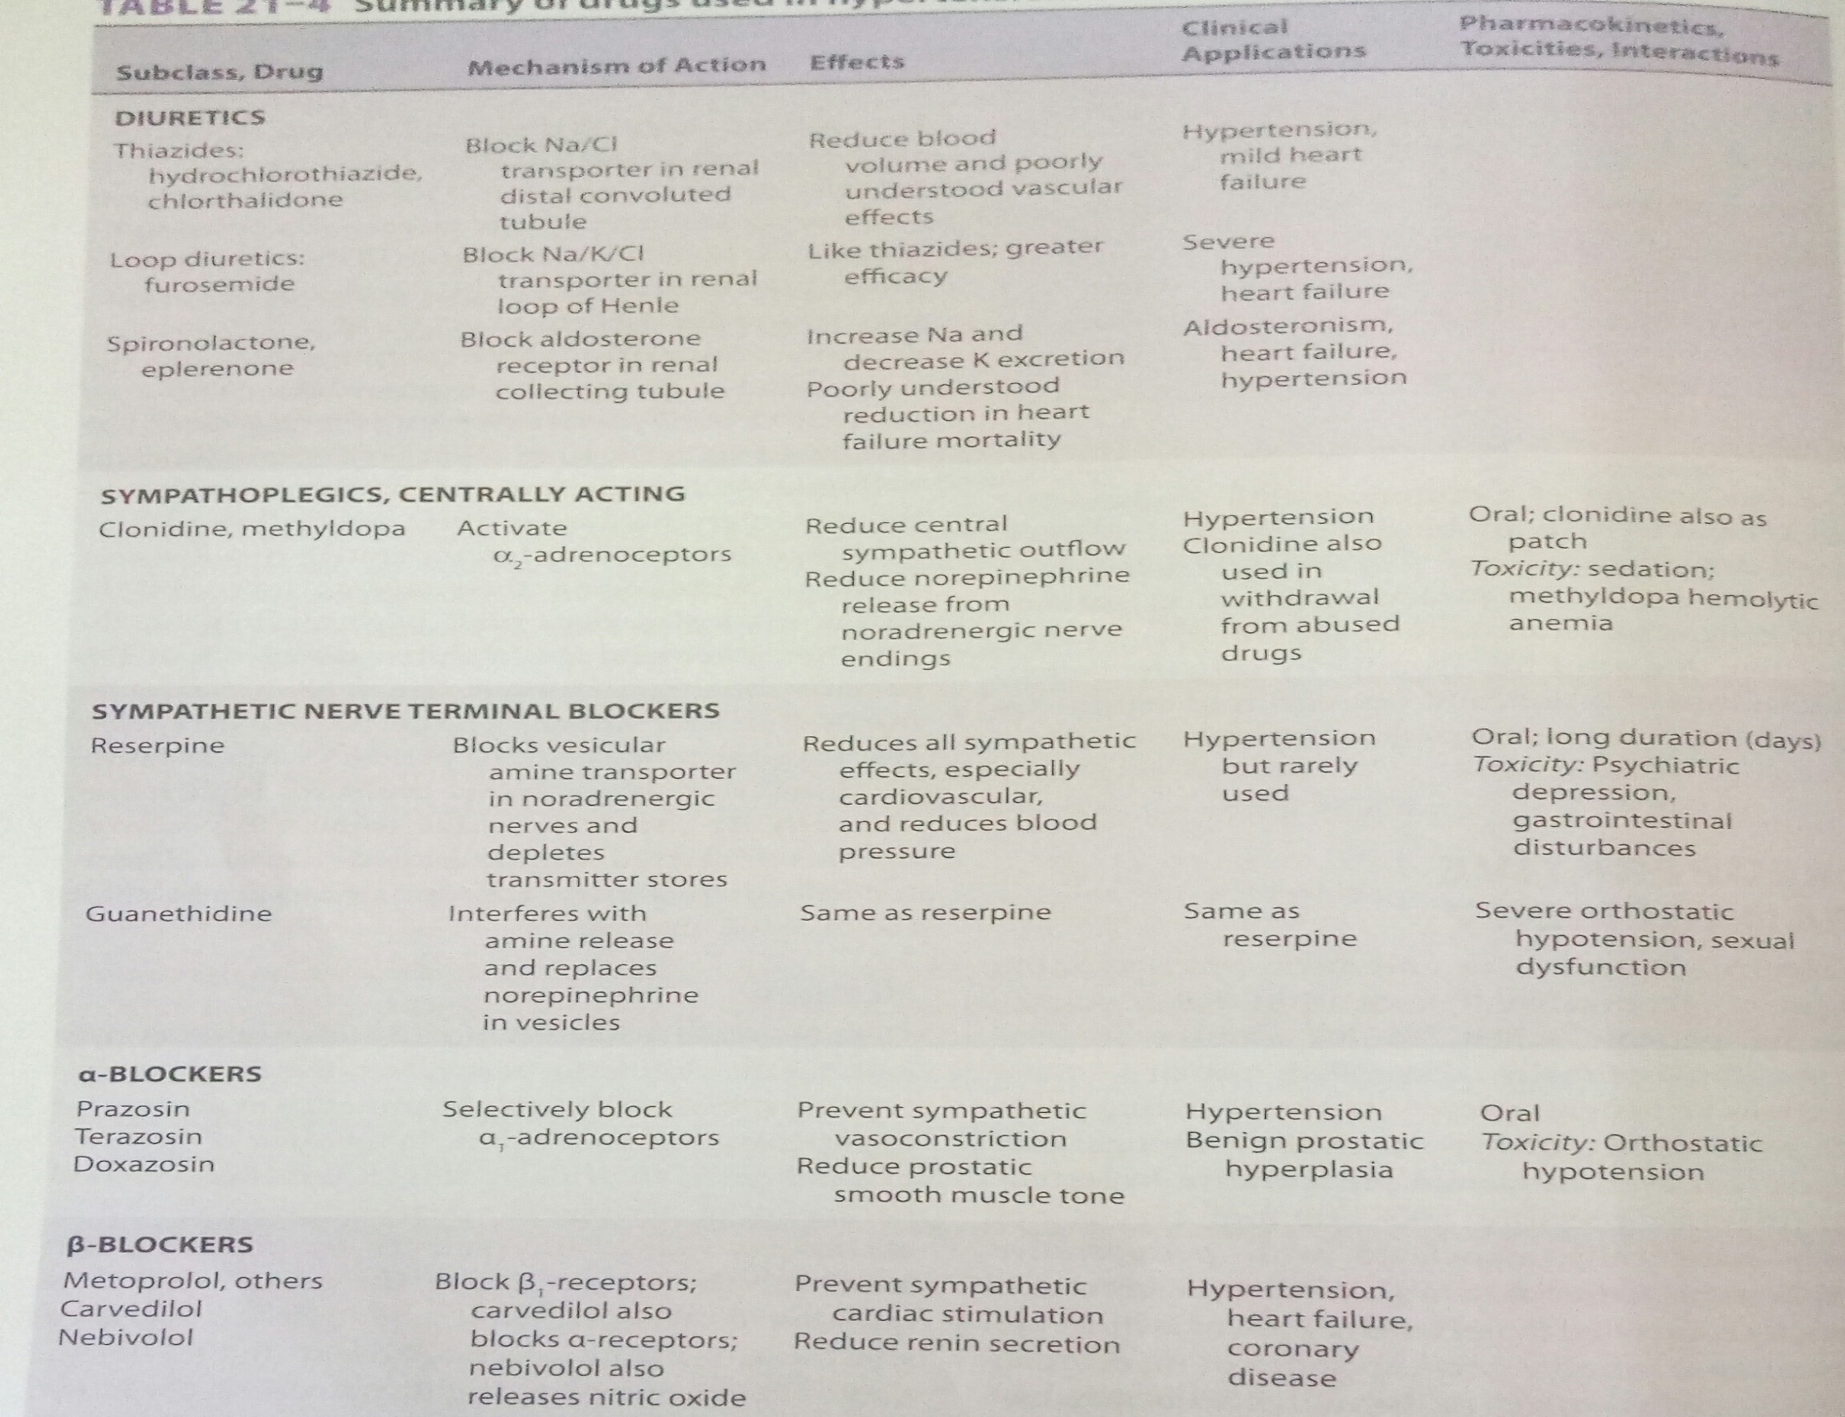

Slide 25
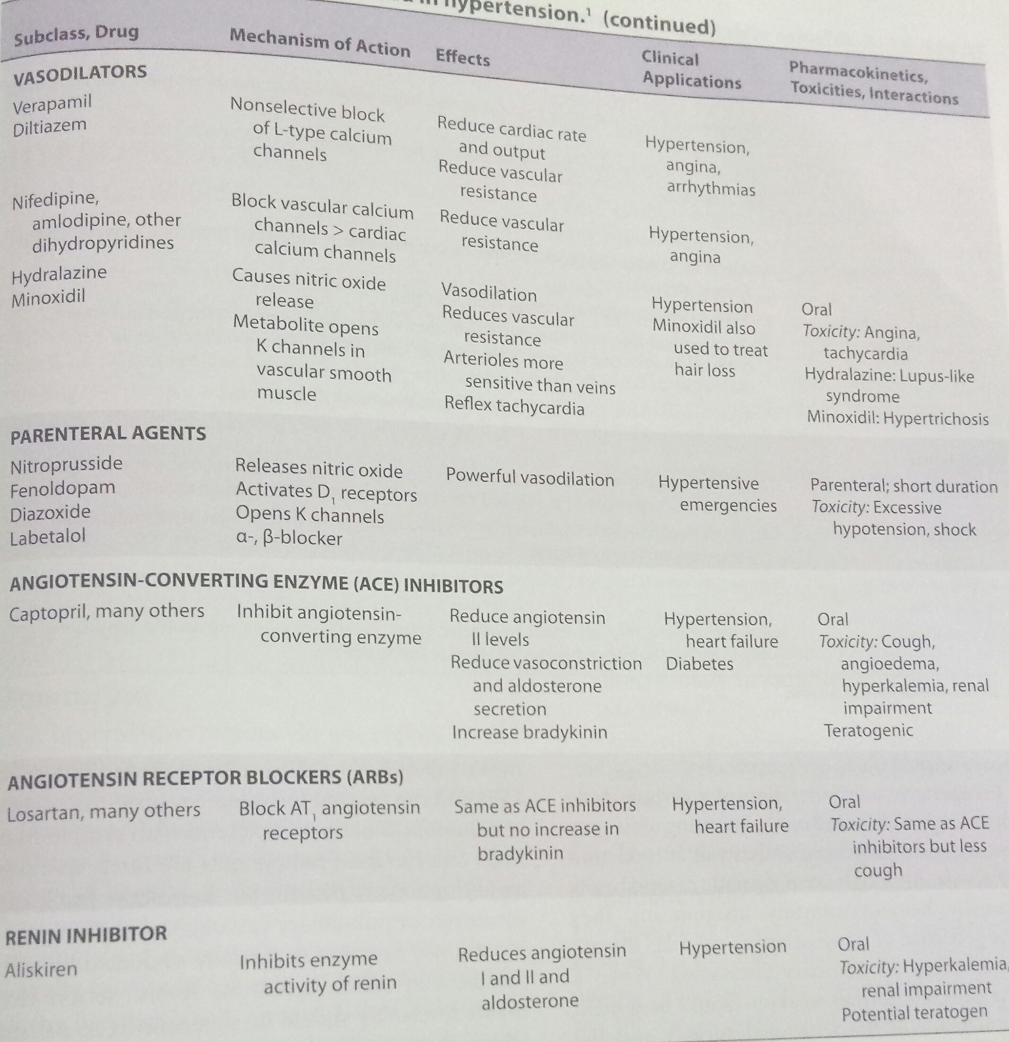

Slide 26
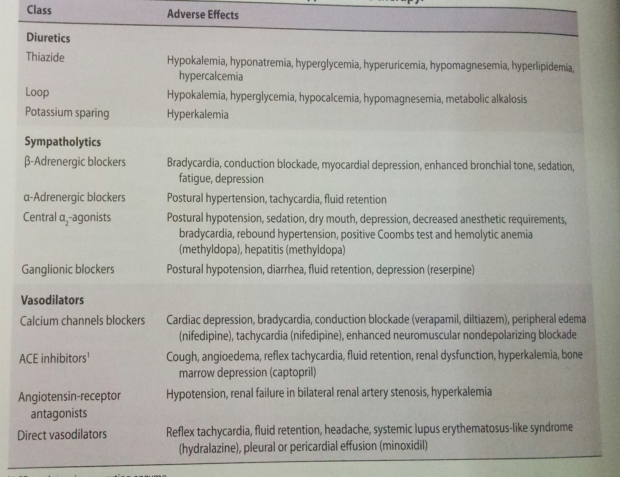

Slide 27
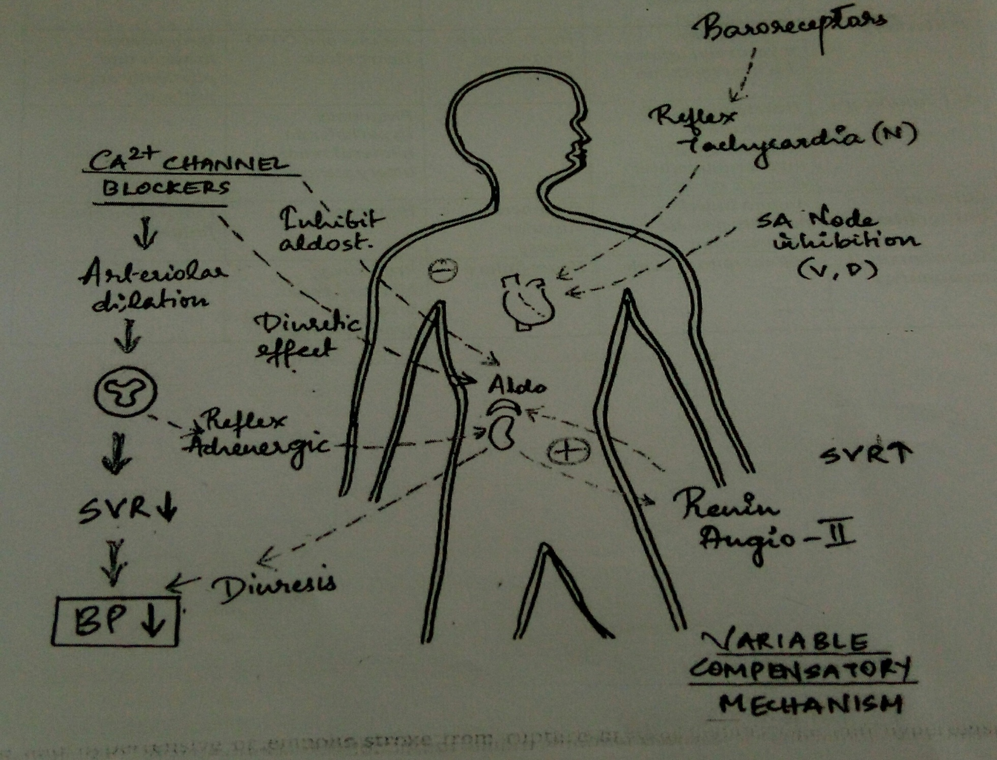
CALCIUM CHANNEL BLOCKERS

Slide 28
DRUGS CAUSING HTN
SYMPATHOMIMETIC DRUGS
- AMPHETAMINES
- COCAINE
- MIGRAINE MEDICATIONS
STEROIDS
CYCLOSPORINS, ESTROGEN AND OCPs

Slide 29
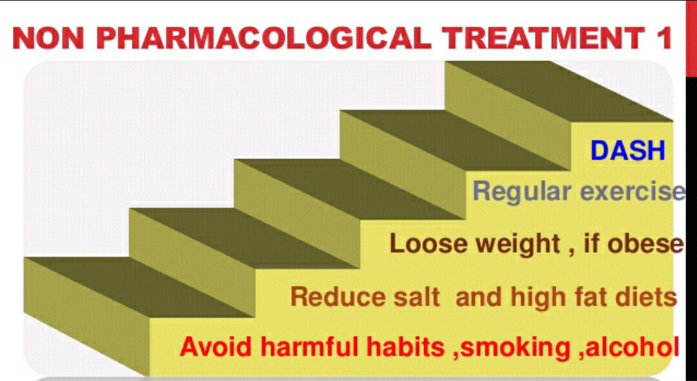

Slide 30
GOALS OF ANAESTHESIA MANAGEMENT
Preoperative consideration and evaluation
Perioperative risk reduction
Premedication
Balanced anaesthesia
Proper monitoring
Parenteral medications

Slide 31
PERIOPERATIVE RISK REDUCTION
The presence of LVH in hypertensive patients may be an important predictor of cardiac mortality.
Increased cardiac mortality has also been reported in patients with carotid bruits even in absence of symptoms.

Slide 32
EARLY MARKERS OF HYPERTENSIVE CARDIOVASCULAR DISEASE
BLOOD PRESSURE
Loss of nocturnal blood pressure dipping
Exaggerated responses to exercise
CARDIAC
LVH
Increased atrial filling pressure
VASCULAR
Increased central arterial stiffness or pulse wave velocity
Salt sensitivity
Widened pulse pressure
Decreased diastolic relaxation
Small artery stiffness
Increased SVR
Coronary calcification
Endothelial dysfunction

Slide 33
RENAL
Microalbuminuria
Elevated serum creatinine
RETINAL
Hypertensive retinal changes
Reduced estimated GFR

Slide 34
Evaluation of Hypertensive patients for surgery
In preoperative evaluation – special attention to
Cause and severity of HTN
Current therapy
Evidence of end organ damage
Screening for secondary hypertension and extent of target organ dysfunction related to long standing hypertension
HTN is also risk factor for CAD and cardiac myopathy

Slide 35
Ask about related illnesses such as IHD, renal failure and CVD
WHITE COAT hypertension- This patients have not been shown to be at higher risk from anesthesia than controls and therfore surgery should not be delayed unnecessarily

Slide 36
TARGET ORGANS AND SIGNS OF ORGAN DAMAGE IN HTN
CARDIAC
VASCULAR
RENAL
CEREBROVASCULAR

Slide 37
BLOOD PRESSURE RESPONSE TO PERIOPERATIVE PROCEDURES IN HYPERTENSIVE PATIENT
Can be considered in 2 phases:-
During anesthesia
During post-operative period
Sympathetic activation during induction of anesthesia cause rise in BP and heart rate in normotensive individuals
This responses are more pronounced in patients with untreated and inadequately treated hypertensive individuals

Slide 38
This excessive swings in BP and heart rate can increase risk of ischemia
In chronic uncontrolled and poorly controlled HTN, reset cerebral autoregulation at higher level, so that in these patients even moderate fall in BP in perioperative period may lead to cerebral ischemia

Slide 39
CAUSES OF INTRAOPERATIVE HTN AND ITS MANAGEMENT
Drug errors
Infiltration with vasopressors
Awareness or light plane of anesthesia
Pre-existing HTN
Airway problems
Endobronchial intubation
Surgical Factors
Hypercarbia
Raised ICP and fluid overload

Slide 40
Management
Confirm that BP change is real
Check for ventilation malfunction
Ensure adequate alveolar minute ventilation
Give adequate analgesia
Deepen plane of anesthesia
Recheck drug errors
After all these steps ; consider anti-hypertensive drugs (nitroglycerine)
If tachycardia – beta blockers(metoprolol)

Slide 41
Nitroprussside – Moderate to severe HTN.
Nitroglycerine –effective in treating MI.
Nifedipine – reflex tachycardia associated with sublingual nifedipine has been associated with MI and delayed ondet in antihypertensive action.
Hydralazine –
Labetalol-IN controlling HTN and tachycardia

Slide 42
PERIOPERATIVE ISSUES IN PATIENTS ON ANTI-HYPERTENSIVE DRUGS
ACE-inhibitors :- Block ACE
ACE inhibitors and ARBs will usually be continued prior to anesthesia
Careful monitoring of RFT
NSAIDs should be used with caution
BETA blockers :- Increase CNS mortality and morbidity
Avoided in patients with reactive airway disease
Masks manifestation of tachycardia which may be due to pain, reduced CO, awareness, anaphylaxis or malignant HTN during anesthesia

Slide 43
PROBLEMS OF ANESTHETISING PATIENTS WITH UNCONTROLLED HTN
CARDIAC ISCHEMIC EVENTS
ARRHYTHMIAS
CVA
EXAGERRATED CVS RESPONSE TO INTUBATION AND EXTUBATION
PRESENCE OF DIASTOLIC DYSFUNCTION
EXCESSIVE
SURGICAL
BLEEDING

Slide 44
HOW TO ANESTHETISE THE PATIENT
PRE-MEDICATION:-
ANXIOLYTICS
BZDs
Alpha2 adrenoreceptor agonists
Avoid atropine
INDUCTION:-
If significant HTN in pre induction area – IV sedation midazolam
Use of opioids – attenuate response to laryngoscopy and intubation and reduce amount of induction agent required
To prevent nausea and vomiting – Ondansetron, Metaclopramide

Slide 45
Etomidate – most cardiostable
Thiopentone – given slowly and titrated against response
Propofol – precipitous hypotension
Ketamine – raises arterial pressure and HR ; should be avoided

Slide 46
Perform smooth, gentle and fast (<30 seconds)
To attenuate sympathetic response
Muscle relaxants (atracurium, rocuronium)
Monitoring of ECG and oxygen saturation
Intraoperative BP monitoring may be invasive or non invasive depending on type of surgery

Slide 47
MAINTENANCE:-
Balanced technique of opioid + nitrous oxide + muscle relaxant
Isoflurane, desflurane and sevoflurane – possesses the advantage of more peripheral vasodilation and are less cardiac depressants.
RECOVERY :- Coughing on tracheal tube during emergence will increase arterial pressure. Opioids given during anaethesia reduce this tendency
EXTUBATE :- In deeper planes of anaesthesia, if aiways is safe.

Slide 48
ROLE OF REGIONAL ANAESTHESIA :
- Spinal and epidural anaesthesia
- Periphereal nerve blocks
… During emergency surgery ain for intraoperative blood pressure around 140/90 mm of HG but avoid swings >± 20 %from baseline BP.
- Urine output should be closely monitored.

Slide 49
POSTOOPERATIVE MANAGEMENT :
- Causes ;
Pain
Emergency excitement
Hypoxemia
Hypercarbia
Reaction to ET tube

Slide 50
Post operative hypertension can lead to :
Damage to vascular anastomosis
Postoperative bleeding
Intracranial bleeding
MI

Slide 51
Depending on cause of hypertension – IV analgesic and anti hypertensive or diuretics
CCB’S – If both tachycardia + hypertension

Slide 52
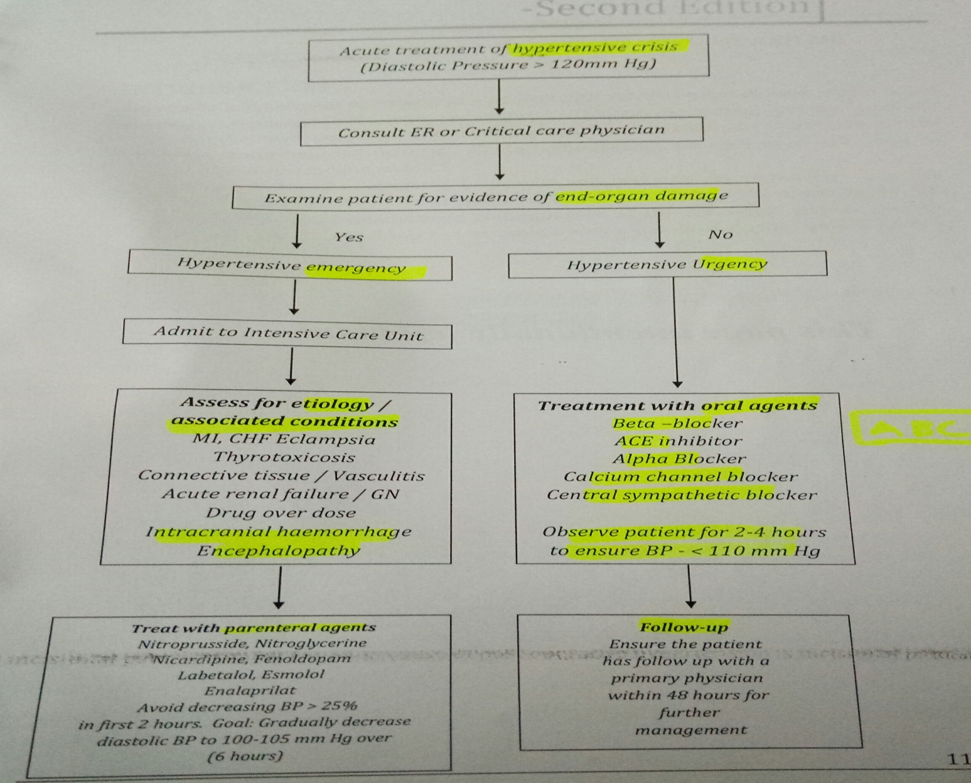
HYPERTENSIVE CRISIS

Slide 53
THANK YOU

