Slide 1

Dr.Sara Mary Thomas,
Assoc. Professor
Dept. of Anaesthesia,
S.B.K.S & M.I.R.C.,
PIPARIA

Slide 2




At the end of discussion,we will know-
Oxygen transport
Oxygen cascade
Oxygen content of arterial blood
Oxygen flux
Delivery and extraction of oxygen at periphery
Oxy-Hb dissociation curve
Shunt equation

Slide 3


Slide 4

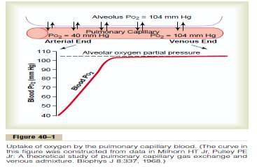
Oxygen transport
2 form-
1.Dissolved in plasma 3%
2.Bound to Hb (Oxy Hemoglobin) 97
Oxygen diffuses into the plasma of the pulmonary capillary blood, driven by- its concentration gradient from the alveolus.
Then taken up by partially desaturated Hb in the RBC of mixed venous blood to form- Oxyhemoglobin.
%

Slide 5

Dissolved O2 in Plasma-
3% is dissolved in plasma
The quantity of O2 dissolved in plasma is directly proportional to its partial pressure.(Henrys law)
Gas Concentration=Solubility Coefficient X Partial Pressure.
0.003ml/mmHg/100 ml Blood (Solubility Coefficient)
Thus, for a PaO2 of 100 mm Hg, there will be 0.3 mL of
dissolved O2 in 100 mL of blood
Acts as a pathway for supply of O2 to Hb
At tissue levels- it is first transferred to cells
Dissolved O2 is a linear function of PAO2
Dissolved oxygen can approach 1.5 mL with an FIO2 =1.0 and can be clinically even more important in hyperbaric environments.

Slide 6

Oxy-Hemoglobin
 97 % of O2 is transported in combination with Hb
 1.34ml/g Hb(if Hb is 15 gm—OxyHb=1.34 X 15=20.1ml)
Reaction of Hb with O2 occurs in 4 stages-HB4+O2=HB4O2> HB402+O2=HB4O4>HB4O4+O2=HB4O6>HB4O6+O2=HB4O8
O2 binding of Hb is determind by- local oxygen tension.
This is affected by- pH ,temperature ,CO2, 2-3 DPG
Relaxed(oxygenated) and tense (deoxygenated) form

Slide 7


Slide 8

Oxygen Cascade
The process of declining oxygen tension from atmosphere to mitochondria
Atmosphere air (dry) (159 mm Hg)
↓ Humidification
Lower resp tract (moist) (150 mm Hg)
↓
Alveoli PAO₂
↓
O2 uptake+CO2 addition + alveolar ventilation
(104 mm Hg)
Venous admixture
Arterial blood PaO₂ (100 mm Hg)
↓ Tissue extraction
Venous blood P_{V}O₂ (40 mm Hg)
↓
Mitochondria PO₂ (7 – 37 mmHg)

Slide 9

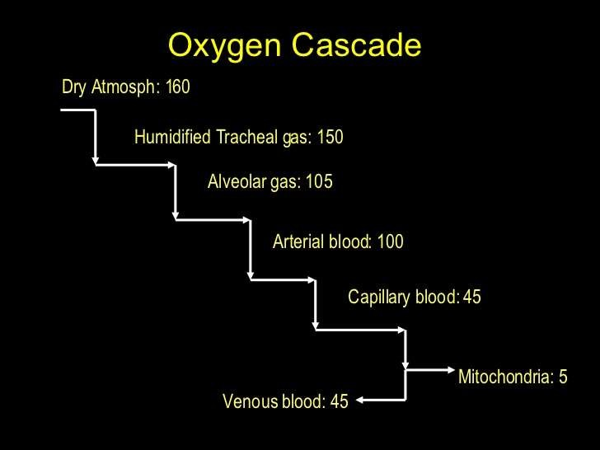

Slide 10

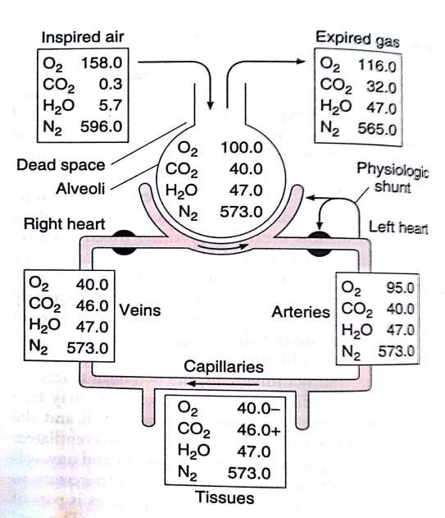

Slide 11

What is Pasteur point ?
The critical level of PO₂ below which aerobic
metabolism fails.
(1 – 2 mmHg PO₂ in mitochondria)

Slide 12


Slide 13
O₂ content of the blood
Amount of O₂ carried by 100 ml of blood-
Co₂ =[Dissolved O₂ ]+ [O₂ Bound to hemoglobin]
Co₂ =[PO₂ × 0.0031 ]+ [SaO₂ × Hb conc × 1.34 ]
Normal Arterial O2 Content =Cao₂ = 20 ml/100ml blood Normal Venous O2 Content=Cvo₂ = 15 ml/100ml blood C(a-v)o₂ = 5 ml/100ml blood
Thus, 5ml of O2 is transported by each 100 ml of blood through tissues per cycle(250 ml/5L/ min=VO2=O2 Uptake).
Co₂ = arterial oxygen content (vol%) Hb = hemoglobin (g%)
1.34 = oxygen-carrying capacity of hemoglobin Po₂ = arterial partial pressure of oxygen (mmHg) 0.0031 = solubility coefficient of oxygen in plasma

Slide 14
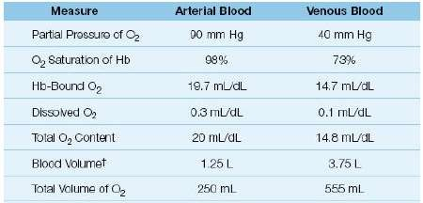

Slide 15


Slide 16

Oxygen Flux
Amount of oxygen leaving the left ventricle per minute in the arterial blood has been termed the oxygen flux.
It represents the oxygen delivered to tissues.(DO2)
O2 flux=Cardiac Output x (arterial O2 saturation x Hb conc x 1.34)
=5000ml/min x (100/100 x 15/100 x 1.34 )
=1000ml/min
250ml of this is used in cellular metabolism & rest is returned to the lungs in mixed venous blood
O2 flux decrease in –Anaemia ,CCF, Metabolic acidosis, Respiratory acidosis
O2 flux increase in- Exercise, Thyrotoxicosis, Pain, Shivering, MH

Slide 17


Slide 18
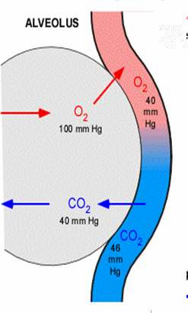
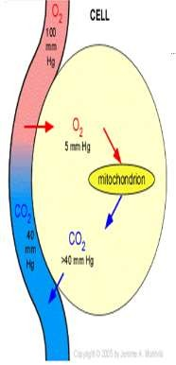


Gas Exchange
 Sites of Gas exchange:
At tissues
(between blood & tissues).
At the lungs
(between blood & air).
 Mechanism of Gas exchange:
- Simple diffusion.
i.e. down partial pressure gradient. from high to low partial pressure.

Slide 19
Factor affecting Diffusion of Gases Across the Alveolar Membrane
Fick’s law of diffusion states that gas transfer across a membrane is directly proportional to the concentration gradient.
Graham’s law states that diffusion of a gas is inversely proportional to the square root of the molecular weight of the molecule.
Other factors which increase diffusion:
Large surface area
Thin membrane
High solubility

Slide 20

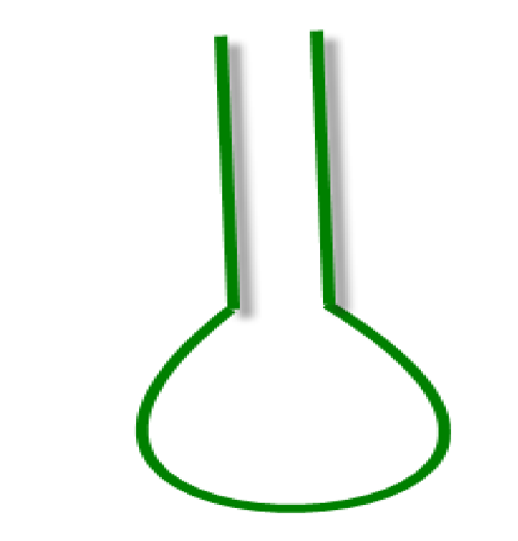
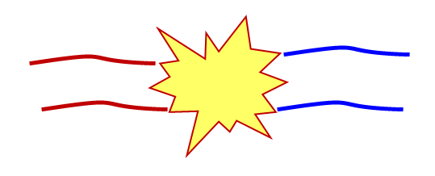
Gas Exchange
LEFT VENTRICLE
Alveolar
PO₂ = 100
mmHg
Pulm. Art. PO₂
= 40 mmHg
(venous blood)
Pulm. Venous
PO₂ = 100 mmHg
(arterial blood)
Back to the
left atrium
O
2

Slide 21
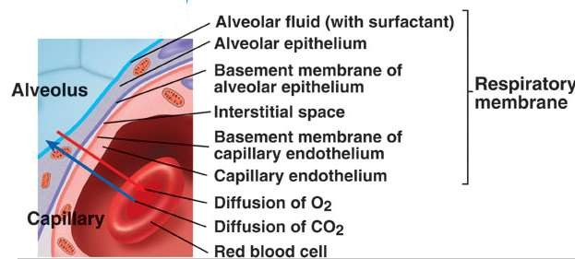
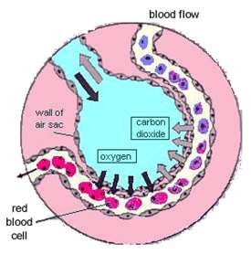
Alveolar-Capillary membrane (Respiratory membrane)

Slide 22

Tissue Oxygenation-
Delivery(DO2) v/s Uptake(VO2) v/s Demand(MR)
Adequacy of tissue oxygenation- O2 supply adapted to demand Oxygen demand- varies according to tissue type and over time. Problem is -Oxygen demand cannot be measured or calculated,
Oxygen Delivery (DO2) and Uptake /consumption (VO2) both can be quantified.
O2 supply/Delivery = DO2 = Q X CaO2 = Q X (Hb X SaO2 x 1.39)
Relation b/w Uptake & Delivery- VO2 = DO2 X O2ER
Under physiologic control,
  O2 demand equals VO2 (≈2.4 mL O2/kg/min)
  DO2=12 mL O2/kg/min
o O2ER= 20% (0.2-0.3)
↑O2 demand / VO2: DO2 has to increase and adapt
↓DO2 (Shock / hypoxia): O2ER has to increase and adapt

Slide 23

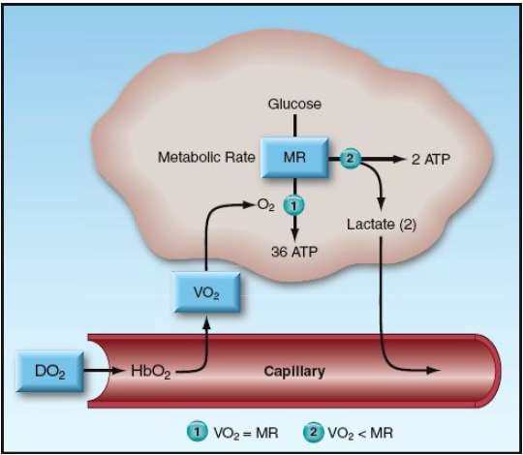
Factors that determine the energy yield from
glucose metabolism
When the rate of oxygen uptake (VO2) unable to match the metabolic reuirement(MR), glucose metabolism is diverted to lactate production, and the energy yield drops dramatically.
DO2 = rate of O2 delivery; VO2= O2 Uptake MR=Metabolic Rate/Demand
HbO2 = oxygenated hemoglobin; ATP = adenosine triphosphate.

Slide 24
How to measure Oxygen Delivery(DO2)?
Oxygen delivery(DO2) is the product of cardiac output (CO) and the Oxygen content of arterial blood.
DO2= CO×[(1.34×Hb× SaO2)+(PaO2×0.003)].
Normal = 1000ml/min (900-1100 ml/min)
CO=Cardiac Output
Hb=haemoglobin concentration (g/L),
SaO2=arterial Hb saturation(%)
PaO2=arterial oxygen partial pressure.
1.34=O2-carrying capacity of Hb.(1gm Hb carry 1.34ml O2)
O.003=Solubility of O2 in plasma(0.003ml o2/100ml plasma/mm Hg PaO2)
Decreased oxygen delivery occurs when there is:
↓ Cardiac output
↓ Hemoglobin concentration
↓ Blood oxygenation(decrease SaO2 & PaO2)

Slide 25

Role of Cardiac Output-
Cardiac Output(CO)-is the main determinant of DO2 (Assuming adequate arterial oxygen content).
CO, in turn, is the product of heart rate (HR) and stroke volume (SV).
Preload, Afterload and Myocardial contractility determining SV.
CO = HR × SV (preload, afterload, contractility)

Slide 26

How to measure O2 Uptake/Consumption(V02)?
The amount of oxygen extracted by the peripheral tissues during the period of one minute is called oxygen Uptake/Consumption (VO2).
 Normal-250 ml/min (200-300)
VO2 = Q x (CaO2 - CvO2) x 10 [Q=Cardiac Output]
VO2 = Q x [1.34 x Hb x (SaO2-SvO2)] x 10
O2 consumption is commonly indexed by the patients body
surface area (BSA) and calculated by:
VO2Index=VO2 / BSA
Normal VO2 index is between 110-160ml/min/m2.
Problem-SvO2 is ideally measured in mixed venous blood in the pulmonary arteries, which requires a pulmonary artery catheter.
Oxygen consumption (Vo2) increases gradually from 200 to 250 mL/min at term (up to 500 mL /min in labour).

Slide 27

Venous Oxygen saturation
Mixed Venous Oxygen Saturation (SvO2)
measured in mixed venous
blood in the pulmonary arteries
requires a pulmonary artery catheter.
Normal=65% to 75%
<65%=decrease in O2 delivery
(anemia or low cardiac output)
<50%=either threatened or inadequate tissue oxygenation
>75%=defect in O2 utilization in tissues, which is usually the result of inflammatory cell injury in severe sepsis or septic shock.
Central Venous Oxygen Saturation(ScvO2)
The ScvO2 is monitored with central venous catheters, but the tip of the catheter must be in the superior vena cava
eliminates the need for a PA catheter.
ScvO2 generally mirror those in
the SvO2
Normal=70% to 89%(ScvO 2 is higher than the SvO2 by an average of 7±4%.)
ScvO2 >70% as one of the early goals of management in severe sepsis or septic shock

Slide 28

Oxygen Extraction Ratio (O2ER)
The oxygen extraction ratio (O2ER) is the amount of oxygen extracted by the peripheral tissues divided by the amount of O2 delivered to the peripheral cells.
Also known As: Oxygen coefficient ratio &
Oxygen utilization ratio.
Index of efficiency of O2 transport .
O2ER = VO2 / DO2
Normally ~ 25% but increases to 70-80% during maximal exercise in well trained athletes

Slide 29

Factor affecting O2 Extraction.
Increase ER
•Decreased CO
•Increased VO2
•Exercise
•Seizures
•Shivering
•Hyperthermia
Anemia
•Low PaO2
Decrease ER
Increased Cardiac Output
Skeletal Muscle Relaxation
Peripheral Shunting
Certain Poisons
Hypothermia
Increased Hemoglobin
Increased PaO2

Slide 30

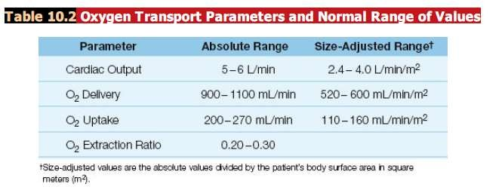

Slide 31

DO2–VO2 RELATIONSHIP
In Adult (At rest)-
Delivery or Supply(DO2)=1000mL/min(approx) and
Uptake or Consumption (VO2)=250mL/min(approx)
If DO2 decreases, VO2 initially remains unchanged as the reserve O2 is utilised.
If DO2 falls further, oxygen extraction from Hb is increased to maintain adequate oxygen supply to the tissues.
Once O2 is maximally extracted from Hb, any further reduction of DO2 will limit O2 supply (O2 supply dependency)

Slide 32

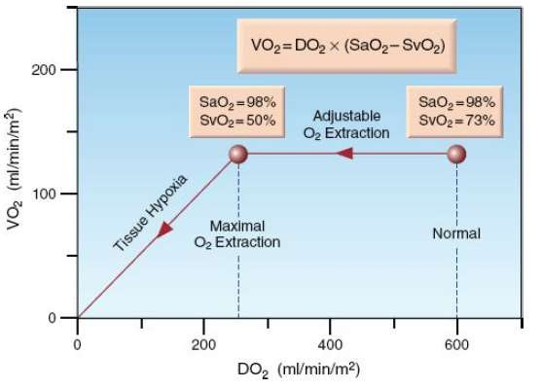

Slide 33

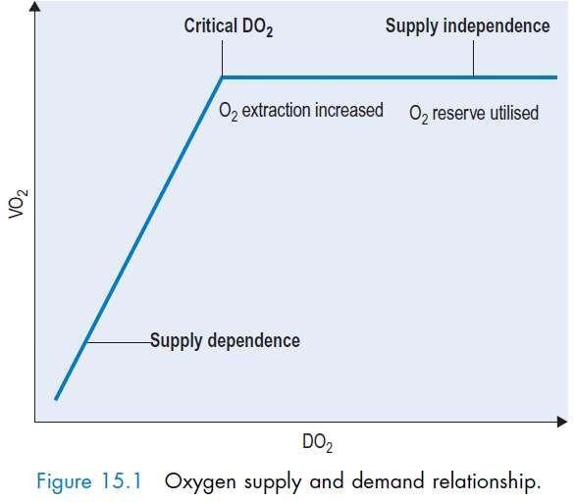

Slide 34

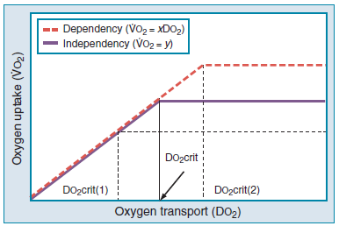
Critical DO2
This is the DO2 with maximum O2 Extraction ,below which Uptake decrease & Tissue hypoxia occur.
Critical DO2(DO2crit): DO2 at which VO2 starts to decraese & become Supply dependant on DO2 , which corresponds to dysoxia (insufficient ATP synthesis as per need)
Anaerobic metabolism start Lactate Synthesis occur )
DO2crit increases / decreases with increase / decrease in VO2.
when VO2 is decreased (e.g., by rest, sedation, hypothermia), the DO2 crit is decreased as well (lower dotted line; DO2 crit 1); conversely,
increased VO2 (e.g., by increased muscle activity, awakening, hyperthermia,sepsis) is associated with increased DO2 crit (upper dotted line; DO2crit 2)

Slide 35

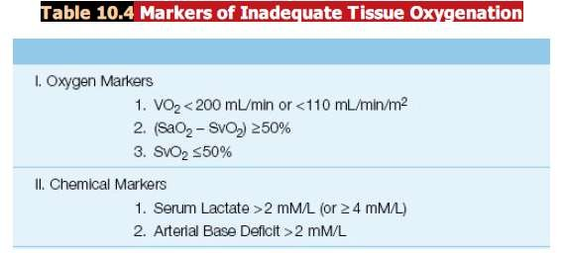

Slide 36


Slide 37

Oxy-hemoglobin Dissociation Curve
It is a curve represents the relationship between blood PO₂ ( X axis) and Hb saturation % (Y axis)
PO2 values of 40, 50, and 60 will correspond (approximately) to saturations of 70%, 80%, and 90%
It is an S-shaped curve that has 2 parts:
upper flat (plateau) part.
lower steep part.

Slide 38

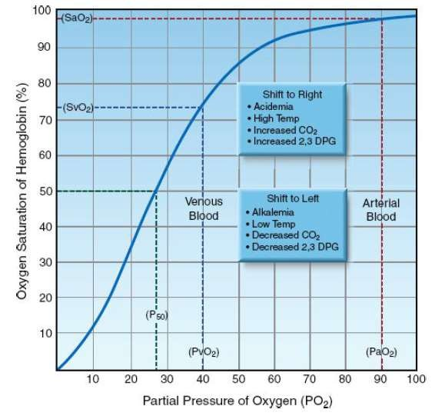
Oxy Hb Dissociation Curve
The “S” shape of the curve offers
two advantages.
First, the arterial PO2 (PaO2) is normally on the upper, flat part of the curve, which means that a large drop in PaO2 (down to 60 mm Hg) results in only minor changes in the arterial O2 saturation (SaO2).
Secondly, the capillary PO2 (which is equivalent to the venous PO2 or PvO2 after equilibration with the tissues) is on the steep lower portion of the curve, which facilitates the exchange of O2 in both the pulmonary and systemic capillaries.

Slide 39

^{P}50
It is the PO₂ at which 50% of Hb is saturated with O₂.
It is an index for Hb affinity to O₂.
Normally, P₅₀ is 26.7 mmHg
(At PCO₂=40mmHg, pH=7.4, 37 deg C).
Increased P₅₀ =
decreased affinity of Hb to O₂
shift of O₂-Hb dissociation curve to the right.
 Decreased P₅₀ =
increased affinity of Hb to O2
shift of the curve to the left.

Slide 40

Factors affecting O₂-Hb dissociation curve
Right shift - High P50 (>26.7mmHg)
Hb has decreased affinity for O2
O2 delivery facilitated at tissue level
Causes:
Increase in H+
Increase in temperature
Increase in 2,3 DPG
Increase in PCO2
Exercise
Anaemia
Drugs : propranalol , digoxin etc
Left shift - Low P50 (<26.7mmHg)
Hb has ↑ed affinity for O2
O2 delivery at tissues is decreased
Causes:
Low H+
Low temperature
Low 2,3 DPG
Low PCO2
Variants of normal Hb (Fetal-
Hb ,carboxy -Hb, met -Hb)
Hypophosphatemia(Critically ill)

Slide 41
Factor affecting 2,3-DPG
FACTORS INCREASING 2,3 DPG
Anaemia
Hypoxemia
Cardiac failure
Chronic acidosis
Hyperthyroidism
Uremia
Cirrhosis liver
FACTORS DECREASING 2,3 DPG
Polycythemia
Hyperoxia
Chronic alkalosis
Hypothyroidism
Blood storage

Slide 42

Anaesthetic Implications Of Oxy-Hb Dissociation Curve
All inhalational agents including N2O causes shift to right
Intravenous agents have no demonstrable effect on ODC
other drugs : propranalol , steroids have been found to be associated with shift to right and improved tissue oxygenation
Blood transfusion : whenever possible, ACD anti- coagulated fresh blood (<5-7 days old) should be used and avoid massive transfusions.

Slide 43

Oxy-Hb dissociation curve of fetal Hb
Fetal Hb (HbF) contains 2α and 2γ polypeptide chains and has no β chain which is found in adult Hb (HbA).
So, it cannot combine with 2, 3 DPG that binds only to
β chains.
So, fetal Hb has a dissociation curve to the left of that of adult Hb. P50=19 mmHg.
So, its affinity to O₂ is high increased O₂ uptake by the fetus from the mother

Slide 44

STORED BLOOD
CPD anticoagulated blood delays fall In 2,3 DPG for 10 days.
ACD Blood delays fall in 2,3 DPG till 2-3 days.
Valtis Kennedy Salt Effect-
In 1956 voltis and kennedy found –blood stored more than few days in acid-citrate-dextrose shows significant increase in oxygen affinity,which gradually abated several hour after transfusion.

Slide 45


Slide 46

THE ‘IDEAL’ ALVEOLUS AND THE
THREE-COMPARTMENT LUNG MODEL
1. The ideal compartment, consisting of alveoli with perfectly matched perfusion and ventilation(V/Q=1)
2. The venous admixture or shunt compartment,
containing perfused non-ventilated alveoli (V/Q=0)
3. The alveolar dead space compartment, consisting of ventilated non-perfused alveoli (V/Q=∞).

Slide 47

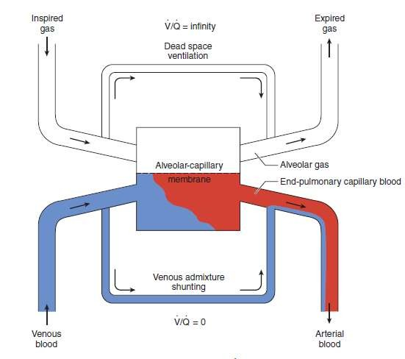
3 Compartment Lung Model

Slide 48

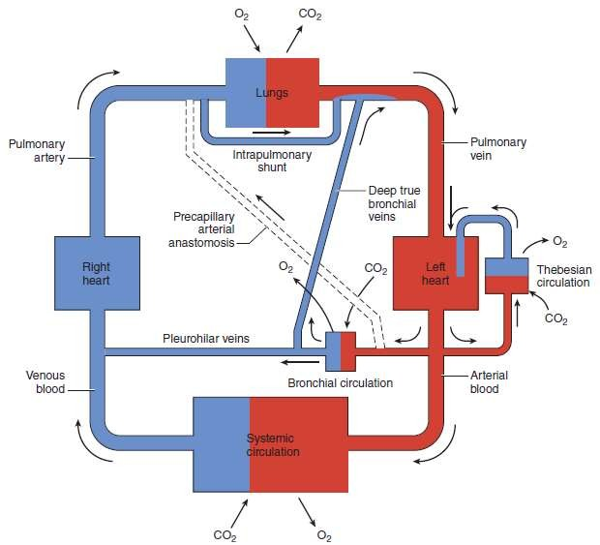
Component of Normal Venous Admixture
Intrapulmonary shunts - 1.Absolute shunt refers to a)anatomic shunts (Thebesian, Pleural, and Bronchial Veins) and b)lung units where V/Q is zero.
2.Relative shunt is an area of the lung with a low V/Q ratio.
Clinically, hypoxemia from a relative shunt can usually be partially corrected by increasing the inspired O2 concentration; hypoxemia caused by an absolute shunt cannot.

Slide 49

Shunt
True shunt refers to a V/Q = 0 (blood has passed through areas
of the lung where no ventilation is occurring.)
Physiological shunt refers to the amount of venous admixture which is directly added to main circulatory blood without having passed through the oxygenating mechanism of the lung.
  Blood from the bronchial veins draining the lung parenchyma and 2.the thebesian veins draining the cardiac muscle represent the physiological shunt (around 5% of cardiac output.)
Normal Shunt: 3 to 5%
Shunts above 15% are associated with significant hypoxemia.

Slide 50

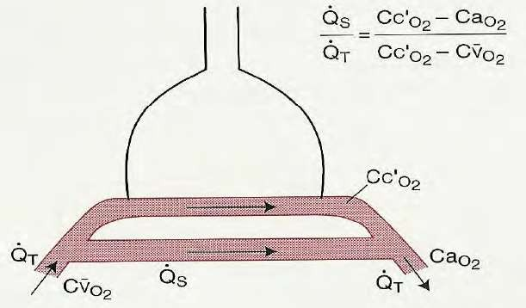

The Shunt Equation:
The shunt equation allows calculation of the amount of shunt present in an individual subject.
Qs = Shunted blood flow
Qt = Cardiac output
Qt-Qs = Blood flow through the lungs minus the shunted blood
CcO2 = Oxygen content of end pulmonary capillary blood
CaO2 = Oxygen content of arterial
blood
CvO2 = Oxygen content of mixed venous blood
When these equations as rearranged it provides the classic shunt equation:
Qs/Qt = CcO2 – CaO2/ CcO2 – CvO2

Slide 51

How to Calculate Shunt Equation ?
Qs/Qt can be calculated clinically
by obtaining –
  mixed venousO2 Content (require PA Catheter) .
  arterial blood gas(ABG).
The alveolar gas equation is used to derive pulmonary end-capillary O2 tension.
Pulmonary capillary blood is usually assumed to be 100% saturated for an Fio2 ≥ 0.21.

Slide 52

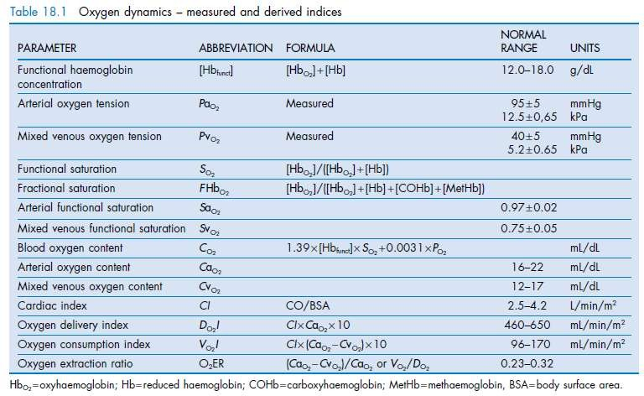

Slide 53


THANK YOU

