Slide 1
REGIONAL ANAESTHESIA
IN PAEDIATRICS
Dr. Akhilesh Chhaya,
Professor,
Dept.Of Anaesthesia,
S.B.K.S.M.I.R.C.,
Piparia.

Slide 2
INTRODUCTION

Slide 3
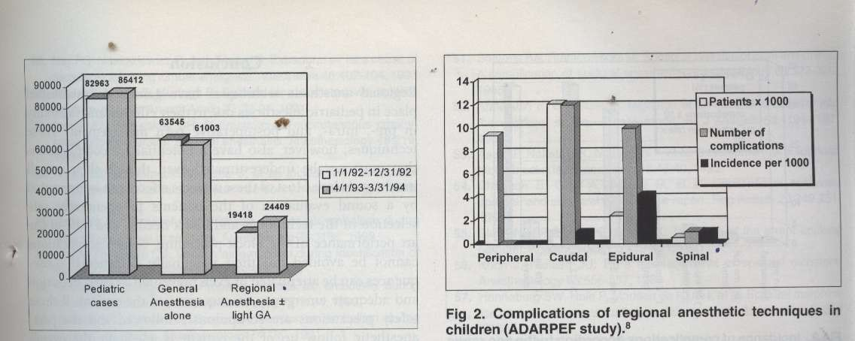
Rarely done procedure
French study – RA in paediatrics-12%, infants-1%, neonates and prematures-very rare

Slide 4
ESSENTIAL THINGS REQUIRED

Slide 5
Skill in performing RA in adults for long time.
Supportive surgical nursing facilities.
Assistance in OR
Proper equipment
PACU
Policies and procedures

Slide 6
HOW CHILDREN DIFFER FROM
ADULT

Slide 7
Psychological and parents psychology
Physiological
Pharmacological
Anatomical

Slide 8
PSYCHOLOGICAL:
More apprehensive
Separation phobia
Universal needle phobia
Pain and disfigurement in older children

Slide 9
PSYCHOLOGICAL:
Parents and grand parents:
Loss of control over the situation
Dependency behavior
Financial constraints
Concern about the child’s problem and outcome

Slide 10
PHYSIOLOGICAL
Post OP APNOEA is common in premature infants.
Immature CNS
Immature BBB
Immature Sympathetic system
Nerve fibre are thin, less myelinated, less nodes of Ranvier

Slide 11
PHARMACOLOGICAL:
Volume distribution is more
CSF volume high 4ml/kg.
Total body water high
Protein binding less
Metabolism of drugs-
Less than six months metabolism is less
More than six months metabolism is active.

Slide 12
Rate of absorption of local Anaesthetic
AIRWAY > INTERCOSTEL > CAUDAL > EPIDURAL >BRACHIAL > DISTALPERIPHERAL> SUBCUTAENIOUS

Slide 13
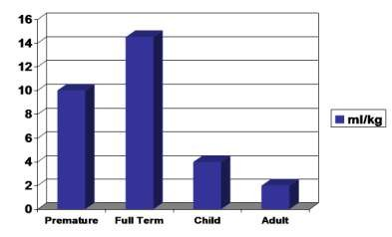
CSF Volume

Slide 14
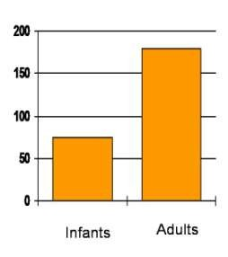
Duration of action of LA

Slide 15
Protein binding
It is low at birth
Albumin and alpha acid glycol protein less
Comes to adult level at one year
Clearance –
•
•
•
Liver: phase 1 and phase 2
reactions decreased
Kidney: GFR 30 % of adults Adult level by 3-5 years of age.

Slide 16
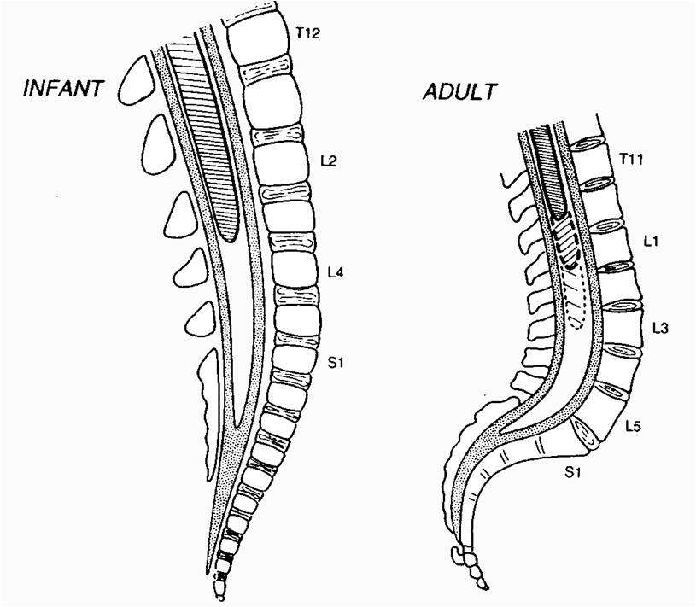
Anatomical:

Slide 17
Anatomical:
Spinal cord is at lower level ( L3-L4)
Laminae are not well developed
CSF volume is high, turnover is high, shorter duration of LAs action
No hypotension up to 6-8 yrs as sympathetic system is not well developed
Epidural fat is like gel
Ligaments are not well developed

Slide 18
REGIONAL ANAESTHESIA PROCEDURES

Slide 19
REGIONAL ONLY
COMBINED REGIONAL AND GENERAL

Slide 20
RA only :
  Reduces the risk of post operative apnoea in pre mature children.
  0.25 %Bupivacaine for caudal 0.5 to 1ml per kg for lower limb. 1-1.2ml/kg lower abdomen . 1.5ml/kg for upper abdomen surgeries. Total volume 1 -1.5ml/kg
  Spinal bupivicaine 0.5 % heavy depending on the weight 0-5kg – 0.1ml or 0.5 mg/kg, 5-15kg – 0.08 ml or 0.4mg/kg, >15kg – 0.06 ml or 0.3 mg/kg

Slide 21
COMBINED RA + GA :
Usually RA for anaesthesia and also for post operative pain relief
Single caudal
Continuous epidural / caudal
Peripheral nerve blocks
Field blocks
Local infiltration.

Slide 22
Indications: All blocks which are possible in adults can be done. PNS can be used; ultra sounding also can be done.
MH
Avoiding need of OPIOIDS
Better analgesia
Epidural infusions
  Pulmonary diseases, fracture ribs
  Bladder surgery
  Abdominal and thoracic surgeries

Slide 23
Contra-indications:
Parent refusal
Sensory nervous system diseases
Bleeding disorders
Vertebral malformations
Previous surgery on spines
Allergy to LA.
Uncontrolled convulsions
Infection at the local injection site.
Severe hypovolemia.

Slide 24
Caudal anaesthesia and analgesia
  Single Dose
  Continuous Infusions
  Adjuvants
Spinal anesthesia

Slide 25
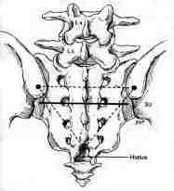
Caudal Anesthesia – Technique

Slide 26
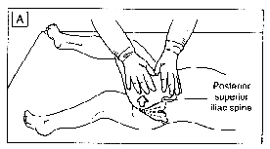

Slide 27
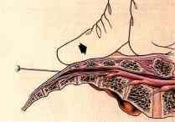
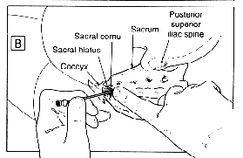

Slide 28
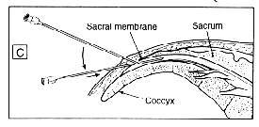

Slide 29
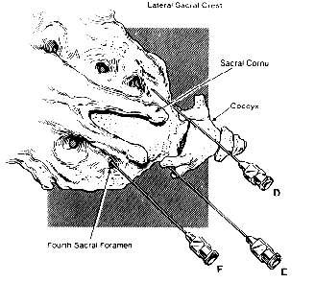
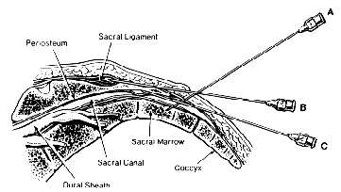
Where can a caudal go?
Periosteum
Sacral ligaments
Dural sheath
Sacral marrow
Intra vascular
Sacral foraminae

Slide 30
Commonly used drugs
DRUG | BOLUS DOSE | INFUSION
Bupivacaine | 2.5 mg/kg | 0.25 mg/kg/hr
Ropivacaine | 3 – 4 mg/kg | 0.4 mg/kg/hr
Levobupivacaine | 2.5 mg/kg | 0.25 mg/kg/hr
Lidocaine | 7 mg/kg | 2 mg/kg/hr

Slide 31
LA volumes:
Traditional
  0.05ml/seg/kg
  0.5 ml/kg upto T-10 segments Bupi
  1 ml/kg upto T-6 segments
For longer duration
0.25%
Lower concentrations with higher dosage
– 1.5ml/kg upto T-2 segments

Slide 32
Concentration of local anaesthetics:
Balance analgesia with risk of motor block, 0.25% Bupivacaine, maximum dose of 1mg/kg gives excellent analgesia, less motor blockade and shorter duration of action.
0.175% Bupivacaine, 1.5mg/kg causes less motor blocked, good analgesia with higher level and longer duration of action (10ml = 7 ml of 0.25 + 3 ml of NS)

Slide 33
Continous infusions:
Caudal 16 G angio-cath with 19 G epidural catheter can be threaded up to thoracic level and covered with sterile drape.
Volume of drug:
Less than 1 yr.: 0.1-0.2 ml/kg/hr
More than 1 yr. 0.1-0.4 ml/kg/hr + Fentanyl:
< 0.5 mcg/kg/hr
Concentration of drug:
Less than 1 yr.: 0.1% Bupivacaine
More than 1 yr.: 0.1% Bupivacaine + Fentanyl

Slide 34
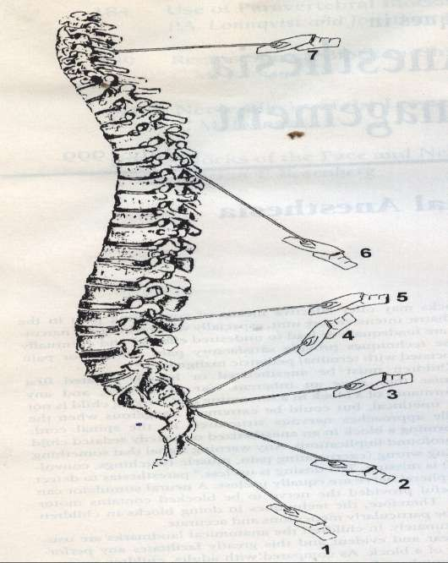
Epidural anaesthesia: Technically similar to adults except for
Depth of epidural space is less
Ligaments are thinner and difficult to feel the resistance
Midline approach is preferred as laminae are not well developed
Epidural fat is like gel and catheters can be passed very easily

Slide 35
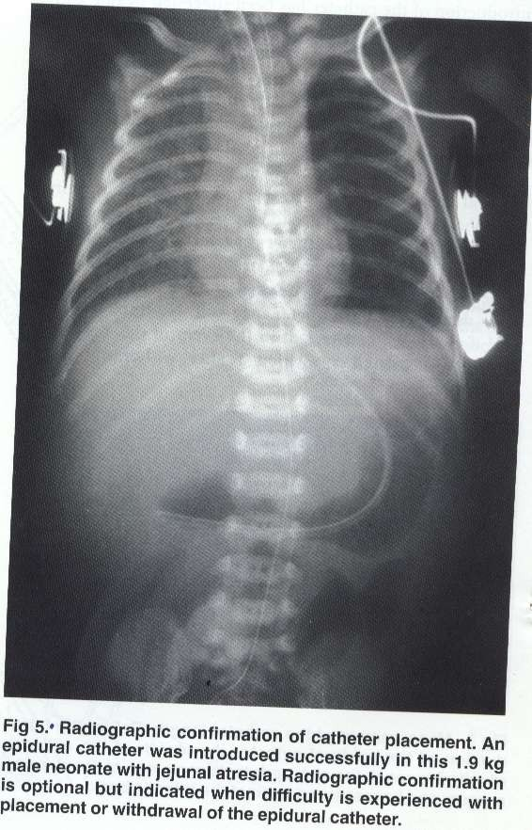

Slide 36
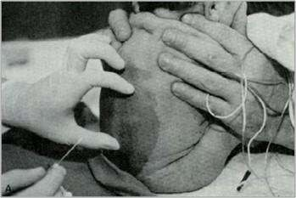
Spinal anaesthesia: Technically similar to adults. Not very commonly done procedure, must have IV access, 1.5 inch 25 G beveled needle.
Dose: 0.3-0.6 mg/kg of 0.5 % Bupivacaine heavy. Higher the age, lower the dose and vice versa

Slide 37
Spinal cord is at lower level ( L3-L4)
Laminae are not well developed
CSF volume is high, turnover is high, shorter duration of LAs action
No hypotension up to 6-8 yrs as sympathetic system is not well developed
Do not flex the head
25-30 G needle
Lateral or sitting position

Slide 38
Combined spinal epidural (CSE):
This overcomes shorter duration of action.
Major procedures can done and
post-operative analgesia well maintained.

Slide 39
COMPLICATIONS

Slide 40
Complications due to the needle:
Wrong needle
Imprudently inserted
Symptoms can be delayed by several hours
Spinal haematoma

Slide 41
Complications related to technique:
Location of nerve and space –
electrical burns
LOR syringe
  Saline
  Air
Accidental PDPH

Slide 42
Complications due to catheters:
Misplacement
Kinking
Knotting
Migration
Delayed lumbar stenosis
Shearing
Bacterial contamination

Slide 43
Complications due to LA solutions:
Local toxicity :
  Injection of wrong solutions
  Continuous infusions
  Preservatives and additives
  High concentrations

Slide 44
Systemic toxicity
  CNS toxicity
  Cardiac
  Methhaemoglobinemias
Most LAs are anticonvulsants mcg)
(1-5
High concentartions convulsant and respiratory arrest
Drug interactions – digoxin , bilirubin, cimetidine and propronolol.

Slide 45
Methaemoglobinemia :
Can occur after several hours
With prilocaine and benzocaine and rarely lidocaine.
Predisposing factors
  G6p deficiency
  Aniline dyes
  Oxidants
Treatement – inj methyline blue 1- 5 mg/kg

Slide 46
Complications due to adjuvants:
Preservatives like metabisulfate, antioxidants can produce severe toxicity
Narcotics can produce respiratory depression , pruritis , bladder distension.

Slide 47
Complications resulting from inadequate management:
Bacterial contamination
Unsafe technique of injection – high pressure epidural injection
Injection in the wrong space

Slide 48
Complications wrongly attributed to regional blocks:
Hypotension , blood loss, position, surgical manipulation
Sickle cell disease
Sudden infant death syndrome

Slide 49
THANK YOU

