Slide 1
HYPOVOLEMIC SHOCK
Dr.Malini Mehta (Prof.)
Dept. Of Anaesthesia,
S.B.K.S. & M.I.R.C.,Piparia

Slide 2
INTRODUCTION
Shock is defined as the state in which profound and widespread reduction of effective tissue perfusion leads first to reversible, and then if prolonged, to irreversible cellular injury.
It is classified as hypovolemic/hemorrhagic shock, cardiogenic shock, obstructive shock, and distributive shock.
Hypovolemic shock is defined as the rapid fluid loss or blood loss which results in multiple organ dysfunction due to inadequate circulating blood volume and perfusion. It is caused by a loss of intravascular fluid which is usually whole blood or plasma. Whole blood loss from an open wound is an obvious cause for hypovolemic shock. An intravascular volume depletion may occur with any condition which leads to excessive extracellular fluid loss with or without loss of plasma protein.

Slide 3
INTRODUCTION continue…
Hypovolemic shock is secondary to hemorrhagic shock (rapid blood loss) which is rare but cause serious complications and mostly occurs in obstetrical situations. Hypovolemic shock is associated with disorders that cause an underlying hemodynamic defect of a low intravascular volume and a reduction in myocardial contractility.
It is a consequence of decreased preload due to intravascular volume loss. The decreased preload diminishes stroke volume, resulting in decreased cardiac output (CO). The systemic vascular resistance (SVR) is typically increased in an effort to compensate for the diminished CO and maintain perfusion to vital organs. The early stage of recognition and intervention will help to prevent death.

Slide 4
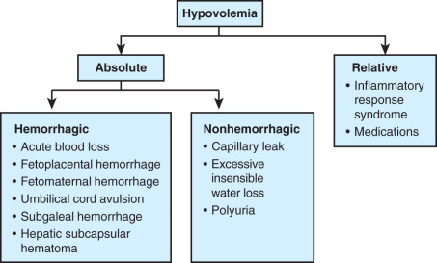

Slide 5
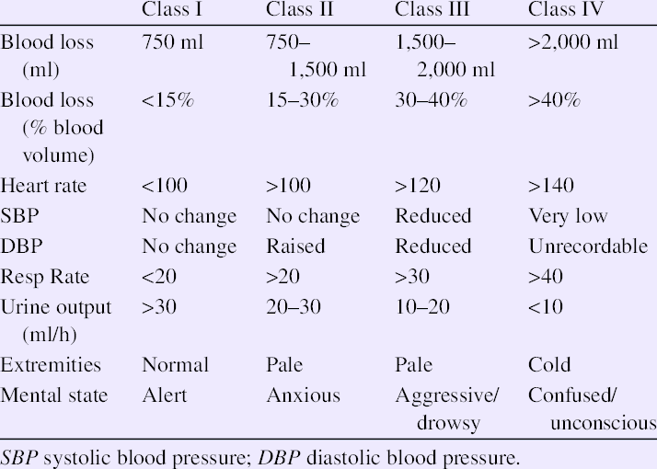

Slide 6
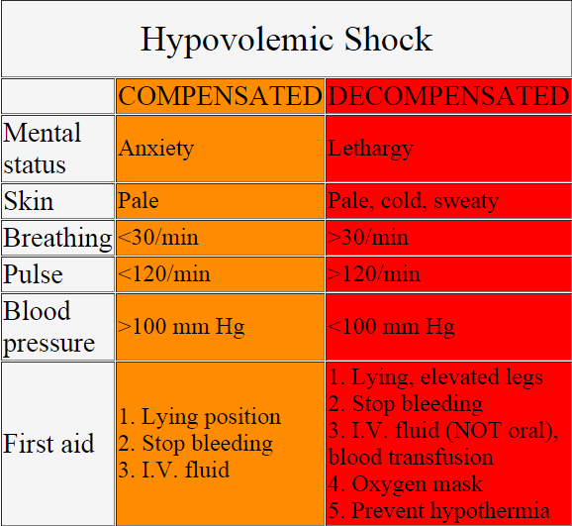

Slide 7
ETIOLOGY
Hypovolemic shock is caused by sudden blood or fluid losses within your body.
The most common clinical causes of hypovolemic shock are hemorrhage, vomiting, diarrhea, severe burns, and excessive sweating.
Since arterial blood pressure (BP) is dependent on the CO and SVR, marked reduction in either of these variables without a compensatory elevation results in systemic hypotension.
In hypovolemic shock, the volume loss is exogenous or endogenous. Restoration blood volume is both simple and effective if applied before irreversible tissue damage occurs.The external fluid losses and the internal sequestration will cause reduced venous return and decreased CO. This leads to set of reflex responses designed to maintain the oxygen to critical organs such as brain and heart. However, these responses may limit perfusion of other organs such as gut as to produce necrosis. The consequences of reduced tissue perfusion are similar in all forms of shock.

Slide 8
SYMPTOMS
The symptoms can vary with the previous level of organ function, compensatory mechanisms, severity of organ dysfunctions, and the cause of shock syndrome.
The symptoms of hypovolemic shock include pallor, tachycardia, hypotension, dyspnea, diaphoresis, tachypnea, cyanosis, faint heart sounds, agitation, mental status changes, pinpoint pupils, cool and clammy skin, lactic acidosis, and poor urine output
Right-heart catheterization will usually reveal a low central venous pressure (CVP), pulmonary artery occlusion pressure (PAOP), CO, and mixed venous oxygen content.

Slide 9
SYMPTOMS
During spontaneous ventilation, pulsus paradoxus may occur, whereas during mechanical ventilation, the systolic BP only transiently increases during the inspiratory phase followed by a rapid decrease (with a systolic pressure variation of >10 mmHg) being suggested as a method to diagnose hypovolemia in a mechanically ventilated patient with normal pulmonary compliance.
The presence of cardiovascular disease, autonomic neuropathy or anemia, or prior treatment with β-adrenergic blockers or calcium channel blockers may worsen the cardiovascular response to blood loss.

Slide 10
EFFECTS ON CEREBRAL AND OTHER REGIONAL CIRCULATIONS
.

Slide 11
Cerebral Circulation
Although central nervous system neurons are extremely sensitive to ischemia, the vascular supply is highly resistant to extrinsic regulatory mechanisms.
Patients without a primary cerebrovascular impairment support their cerebral function well until the mean arterial pressure falls below approximately 50–60 mmHg.
At this point, irreversible ischemic injury may occur to the most sensitive areas of the brain, i.e. cerebral cortex and watershed areas of the spinal cord. Before such injury, an altered level of consciousness varying from confusion to unconsciousness may be seen depending on the degree of perfusion deficit. Electroencephalographic recordings demonstrate nonspecific changes compatible with encephalopathy.

Slide 12
Cardiovascular System
Initially, the cardiovascular system responds to hypovolemic shock by increasing the heart rate, constricting peripheral blood vessels, and increasing myocardial contractility.
This occurs secondary to an increased release of norepinephrine and decreased baseline vagal tone regulated by the baroreceptors in the carotid arch, aortic arch, left atrium, and pulmonary vessels.
Further redistribution of the blood to the brain, heart, kidneys and the skin, muscle, and gastrointestinal tract, the cardiovascular system responses to shock.

Slide 13
Respiratory System
Increased respiratory drive resulting from peripheral stimulation of pulmonary receptors and carotid body chemoreceptors as well as hypoperfusion of the medullary respiratory center results in increased minute volume (tachypnea and hyperpnea), hypocapnia, and primary respiratory alkalosis.
With increased minute volume and decreased CO, the V/Q ratio is increased. Coupled with an increased workload, respiratory, and diaphragmatic muscle impairment caused by hypoperfusion may lead to early respiratory failure.
If shock is not promptly reversed and the initiating condition controlled, adult respiratory distress syndrome may develop.

Slide 14
Renal System
It responds to hemorrhagic shock by stimulating an increase in renin secretion from the juxtaglomerular apparatus.
Renin converts angiotensinogen to angiotensin I, which subsequently is converted to angiotensin II by the lungs and liver.
Angiotensin II has two main effects, both of which help to reverse hemorrhagic shock, vasoconstriction of arteriolar smooth muscle, and stimulation of aldosterone secretion by the adrenal cortex. Aldosterone is responsible for active sodium reabsorption and subsequent water conservation.

Slide 15
Neuroendocrine System
In neuroendocrine system, an increase in circulating antidiuretic hormone is responds to shock which is released from the posterior pituitary gland in response to a decrease in BP (as detected by baroreceptors) and a decrease in the sodium concentration (as detected by osmoreceptors).
It leads to an increased reabsorption of water and salt (NaCl) by the distal tubule, the collecting ducts, and the loop of Henle.

Slide 16
INVESTIGATIONS
The diagnostic evaluation should occur as same as resuscitation if patient is suspected of having shock.
Laboratory tests may help identify the cause of shock and early organ failure. They should be performed early in the evaluation of undifferentiated shock which include complete blood count with differential, basic chemistry tests (sodium, potassium, chloride, and serum bicarbonate), blood urea nitrogen, creatinine, liver function tests, amylase, lipase, prothrombin time or international normalized ratio, partial thromboplastin time, fibrinogen, fibrin split products or dimer, cardiac enzymes (troponin or creatine phosphokinase isoenzymes), urinalysis with a detailed sediment analysis, arterial blood gas (ABG), toxicology screen, and lactate level.

Slide 17
INVESTIGATIONS continue…
A chest radiograph, abdominal radiograph for intestinal obstruction, abdominal computed tomography (CT), head CT scan, electrocardiogram, echocardiogram, or urinalysis may also be helpful.
Gram stain of material from sites of possible infection (sputum, urine, and wounds) may give early clues to the etiology. of infection while cultures are incubating.
Blood should be taken from two distinct venipuncture sites and inoculated into standard blood culture media.

Slide 18
INVESTIGATIONS continue….
Arterial pressure catheter is a must for all patients suspected of having circulatory shock. Marked peripheral vasoconstriction may make the assessment of BP by manual sphygmomanometry or automated non-invasive oscillometric technique inaccurate. Furthermore, continuous monitoring of the rapidly changing hemodynamic status of unstable patients and access for ABG samples is available with arterial catheter in place.
Pulmonary artery catheterization is a hemodynamic measurements obtained by pulmonary catheterization which can be helpful in determining the type of shock that exists, particularly the CO, PAOP, and systemic vascular pressure.

Slide 19
INVESTIGATIONS continue…
CVP monitoring is not an accurate means of monitoring volume resuscitation and should be used only as a rough guide.
An initially low CVP (i.e. ‹5mmHg) may indicate hypovolemia, and it is inadequate for the hemodynamic assessment of critically ill patients.
The other non-invasive monitoring devices include pulse oximetry which has a limited use in the acute management of circulatory shock and more helpful in the post-resuscitation monitoring. Nearinfrared spectroscopy to detect oxygen availability and utilization at tissue level for continuous CO measurements.

Slide 20
TREATMENT
The basic goal of circulatory shock therapy is the restoration of effective perfusion to vital organs and tissues before the onset of cellular injury.
There are three goals in emergency with hypovolemic shock including maximizing oxygen delivery, control further blood loss, and fluid resuscitation.
The patient should be treated in a properly equipped intensive care unit where continuous intra-arterial monitoring, pulmonary artery wedge, and central venous is possible, and determination of ABG, pH, and serum electrolyte is also necessary.
The most effective means of restoring adequate circulation are by rapid infusion of volume expanding fluids.

Slide 21
TREATMENT continue…
The most effective means of restoring adequate circulation are by rapid infusion of volume expanding fluids.
Shock is secondary to or accompanied by cardiac failure. So here attention must be directed toward restoring cardiac function with cardiotonic drugs such as digitalis glycosides and isoproterenol to support arterial pressure.
Intra-aortic balloon counterpulsation with a sympathomimetic amine may be used to treat this state. A Swan-Ganz balloon-tipped catheter is best means for continuously monitoring ventricular filling pressure.Medicines such as dopamine, dobutamine, epinephrine, and norepinephrine may be needed to do increase BP and CO.

Slide 22
CONCLUSION
In general, people with milder degrees of shock tend to do better than those with more severe shock.
Even with immediate medical attention, severe hypovolemic shock may lead to death.
Older adults are more likely to have poor outcomes from shock.
Mortality due to hypovolemic shock is more variable. It depends on the cause and the duration until recognition and treatment.
Successful treatment of patients with shock requires prompt recognition of the shock state and a thorough understanding of various types of shock to reduce the mortality.

Slide 23


