Slide 1
ANAESTHESIA IN MAXILLO-FACIAL SURGERIES
Dr. Jayshri Desai,
Professor,
Dept. of Anaesthesia,
S.B.K.S.M.I.R.C.,Piparia

Slide 2
Introduction
Clinical effects of Maxillofacial trauma
Fracture Classification
Airway Problems in Maxillofacial Sx
Anaesthesia For Maxillofacial Surgery
. Preop Evaluation And Preparation
. Perioperative Management

Slide 3
Maxillo Facial trauma
Major concern for anaesthetists since Maxillofacial traumas are usually associated with compromised airway.
Surgery often carried out as emergency, full stomach. Bleeding into upper airway passages is common.
AIRWAY CONTROL is first priority.
Associated head trauma and cervical spine injuries should be considered delicately while securing airway .

Slide 4
CLINICAL EFFECTS OF MAXILLOFACIAL TRAUMA
Lacerations or fractures of facial skeleton- immediate or delayed respiratory obstruction.
Immediate obstruction may arise from:
> Inhalation of tooth fragments
>accumulation of blood and secretions
>loss of control of tongue in unconcious /semiconcious pt’s
Pt’s with facial injuries should not be allowed to lie supine.
They should be nursed in semiprone position with head supported in bent arm.

Slide 5
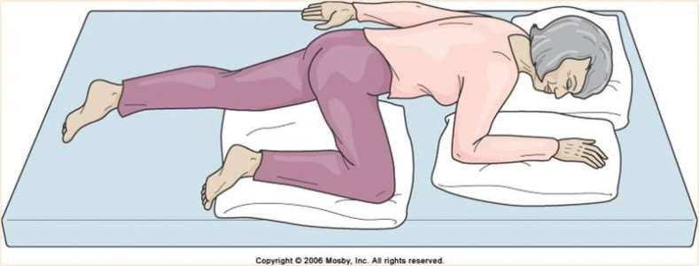
Semiprone position> damaged teeth, blood and secretions, can fall out of mouth and gravity pulls the tongue forward.
Pt should be manoeuvered into the semiprone recovery position.
Neck should be held in neutral position.
Protective collar is advisable until a fracture of cervical spine has been excluded.
An intracranial injury should be considered as possiblity however minor injury to face.

Slide 6
Complications
Airway compromise
Haemorrhage
Trismus
Cervical spine injury
Pneumoencephalus
Injury to oesophagus
Subcutaneous emphysema and pneumomediastinum
  Laryngeal injuries
  Head injury- intracranial haemorrahge
  Eye injury-simple corneal abrasion to open eye injury
  Abdomen injury- rupture of spleen,liver,intestine

Slide 7
Emergency management
A patent airway should be immediately established.
If unconscious give chin lift or jaw thrust.
Fractured teeth, foreign bodies, and blood should be cleared from oral cavity.
Attempts to control bleeding including direct pressure, acute reduction of fractures, and placement of nasal packs.
Nasopharyngeal bleeding controlled with nasal packing or a balloon-tipped catheter placement.
Use airway adjuncts- oral & nasopharyngeal airways- displace tongue & soft tissue- patient can breath through or around them.
Significant maxillofacial injury with anatomic disruption or severe haemorrhage may require immediate airway protection with endotracheal intubation/ tracheaostomy.

Slide 8
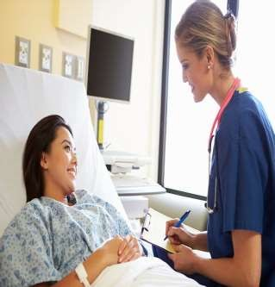
Pre Anaesthetic Evaluation
Thorough airway evaluation.
Same as for any other major operation
Patients can have swelling of face, missing or loose teeth, pain and trismus limiting mouth opening or a maxillo-mandibular fixation may be in situ.
The nasal patency should be done to facilitate nasal intubation.
Complete evaluation including all lab investigations, ECG, chest X-ray, cervical spine X-ray.

Slide 9
Pre Anaesthetic Evaluation
Neurological evaluation in patients with co-existing head injury.
Medical problems e.g. acute myocardial infarction, acute alcohol intoxication and drug abuse.
Cervical spine injury, intracranial injury, pneumothorax, flail chest and abdominal trauma to be excluded.
Relevant biochemical and radiological assay including blood crossmatch essential.

Slide 10
Challenges faced during FACIOMAXILLARY FRACTURES.
Difficult intubation due to anatomical disruption.
Sharing of airway between anaesthetist and surgeon.
Long procedure with significant blood loss.
Detailed discussion with surgeon regarding securing airway, route of intubation, alternative methods of intubation.
IMF preclude oral intubation; so nasal intubation is choice if nasal intubation not possible in certain cases like basal skull # ,then tracheostomy has to be done.

Slide 11
Difficult airway management in maxillofacial surgery
Fiberoptic bronchoscope
Bougie
ETT changer with jet ventilation capability
Sanders jet ventilator
Cricothyroidotomy kit
Tracheostomy tray
Retrograde intubation
Retromolar intubation
Submental intubation
Supraglottic airway devices

Slide 12
Difficult airway management in maxillofacial surgery
Throat pack to prevent aspiration of blood
A reinforced or flexo-metallic tube most commonly
Steroids perioperatively to reduce airway oedema.
Proper fixation of ETT-Displacement due to close proximity to surgical field.
Different routes of tracheal intubation should be considerd.
Early tracheostomy/ cricothyroidotomy are definitive procedures for securing airway.

Slide 13
Different methods
1.Awake vs anaesthetized patient 2.Orotracheal / nasotracheal intubation
3.Direct /blind nasal intubation/ fiberoptic laryngoscopy 4.Anterograde /retrograde
5.Cricothyroidotomy, transtracheal jet ventilation, tracheostomy

Slide 14
Advantages
Provides secure airway
Unobstructed intraoral surgical field
Allows intraoperative maxillo-mandibular fixation
Avoids complications of tracheostomy
Disadvantages
Can cause trauma to submandibular duct, sublingual gland or duct and facial nerve or lingual nerve
Superficial infection of the submental wound can occur - can result in oro-cutaneous fistula

Slide 15
Blind nasotracheal intubation
Contraindications
Basal skull fractures with/without
CSF rhinorrhoea.
Bleeding diasthesis
Upper aiway foreign body
Large bilateral nasal polyps
Abscesses and severe laryngeal trauma
Complications
Nasopharyngeal haemorrhage
Laryngeal trauma
Retropharyngeal perforation
Paranasal sinusitis

Slide 16
RETROGRADE INTUBATION
-Useful in TM joint ankylosis as an alternative to nasal intubation.
Cricothyroid membrane is punctured with needle inserted horizontally (so that the vocal cords are not damaged) with bevel directed cephalad.
The intratracheal position of needle confirmed by aspiration of air.
COMPLICATIONS
-Bleeding
-Subcutaneous emphysema
-Pneumomediastinum
-Pneumothorax

Slide 17
Orotracheal intubation with south polar preformed tracheal tube is usually the technique of choice with isolated midface fractures.
Nasotracheal route in is commonly employed in patients undergoing maxillofacial surgery.
Intubation with north polar preformed tracheal tubes for mandibular fractures allows intermaxillary fixation and assessment of dental occlusion.

Slide 18
ANAESTHETIC PRINCIPLES
The use of neuromuscular blocking agents should generally be avoided until airway is secured.
Positive pressure ventilation by mask may become impossible in severe facial trauma and may worsen subcutaneous emphysema requiring immediate tracheostomy.

Slide 19
Monitors : Pulse oximeter, NIBP/ IBP, ECG, SpO2,
EtCO2.
IVL: - Secure peripheral lines with widebore cannulas. Central line can be secured for monitering JVP/fluids.
Premedications:
-Benzodiazipine like midazolam,
-Antisialagogues – Glycopyrrolate,
-Anti emetic- Ondansetron/ metaclopramide,
-H2 blockers/proton pump inhibitors: Ranitidine, omeprazole, pantoprazole

Slide 20
Preoxygenation – by 100% oxgen
Full stomach/unprepared pt’s- rapid sequence intubation
I/v induction agent agents should be used with caution in
patients with airway compromise. Propofol /TPS.
uses –reduce agitation,smooth induction.
  I/V midazolam for agitated patients
  ketamine is not useful in patients with concomitant intracranial & ocular trauma
  In hypovolemic patients I/V agents administered in small bolus doses.

Slide 21
Inhalational agents
-Potent,safe & widely used.
-Sevoflurane is preffered.
-Desflurane & halothane csan also be used.
-Reduction in CMRO2 & metabolic rate is more with isoflurane, enflurane than halothane.
Muscle relaxant
-Succinyl choline ( avoided in patients with hyperkalemia, raised IOT, k/c/o malignant hyperthermia)
Fentanyl, sufentanyl, alfentanyl may be given intraoperatively for analgesia & prior to inducing agents to supress pressor responses.
Large dose is avoided.

Slide 22
-After securing endotracheal tube muscle relaxant- vecuronium /atracurium/rocuronium.
-Maintain with inhalational agents.
-N2O is best avoided( in midface fracture & in penetrating eye injury, pneumocephalus).
-Opiods –fentanyl, sufentanyl or alfentanyl can be used.

Slide 23
INTRAOPERATIVE MANAGEMENT
Most patients with maxillofacial # doesn’t require emergency surgery unless significant haemorrhagege ,airway compromise present
Most techniques of induction & maintanance of aneasthesia are acceptable as long as airway is secured
N2o is best avoided( in midface # & in penetrating eye injury)
I/V fluids – should be titrated to have adequately hydrated patients with stable vital signs & urine out put of 1ml/kg/hr Patients having adequate airway
Induction with Thiopentone, propofol,Etomidate
Muscle relaxant –Succinyl choline atracurium/ vecuronium/

Slide 24
Indication for post operative ventillation
- considerable edema of airway.
- lengthy surgical procedures & extensive manipulation.
-Use narcotic / Bzd if post operative ventilation is needed.
Post operative care
Antiemetics in patients with Inter Maxillary Fixation (IMF).
If IMF in place, wire cutter must be available next to patient.
Post operative pain is releived by NSAIDS & Narcotics.
Maintenance of airway with nasopharyngeal airway.

Slide 25
EXTUBATION
-Carried out when patient is fully conscious & with intact airway reflexes.
-Indication for post operative ventilation:
- considerable edema of airway
- lengthy surgical procedures & extensive manipulation

Slide 26


