Slide 1
Paraduodenal hernia
- Dr. Anil Ratwa

Slide 2
Clinical History
Male 75 years old presented with repeated episodes of illeus.
On clinical examination of the abdomen there was abdominal tenderness and generalized abdominal pain combatable with acute abdomen. The abdominal pain initiated before two days with loss of appetite and vomits.

Slide 3
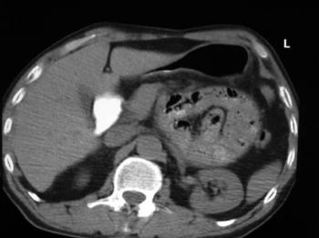
Imaging Findings
CT scan shows a saclike mass of jejunal loops between the pancreatic head and stomach. The descending mesocolon and stomach are displaced laterally. (fossa of Landzertl)

Slide 4
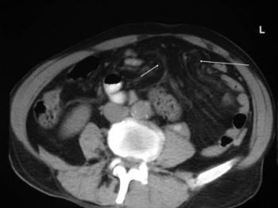
CT scan revealed an engorged, stretched, and displaced mesenteric vascular pedicle and of converging vessels at an orifice between the pancreas and the stomach (the hernia orifice fossa of Landzert)

Slide 5
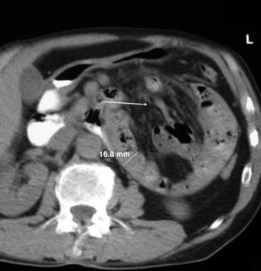

Slide 6
Discussion
There are two main types of hernias, external and internal. While external hernias refer to prolapse of intestinal loops through a defect in the wall of the abdomen or pelvis, internal hernias are defined by the protrusion of a viscus through a normal or abnormal peritoneal or mesenteric aperture within the confines of the peritoneal cavity.
The orifice can be either acquired, such as a post surgical, traumatic or post-inflammatory defect, or can be congenital, including both normal apertures, such as the foramen of Winslow and pathological apertures arising from anomalies of internal rotation and peritoneal attachment.

Slide 7
Within the broad category of internal hernias, there are several main types, as traditionally described by Meyers, based on location. Specifically, these consist of paraduodenal (53%), pericecal (13%), foramen of Winslow (8%), transmesenteric/ transmesocolic (8%), intersigmoid (6%) and retroanastomotic (5%), with the overall incidence of internal hernias between 0.2-0.9%, they comprise up to 5.8% of all small bowel obstructions, which, if left untreated, have been reported to have an overall mortality exceeding 50% if strangulation is present.

Slide 8
Final Diagnosis
Left paraduodenal hernia

Slide 9
THANK YOU

