Slide 1
CASE OF POLYCYSTIC KIDNEY DISEASE
- Dr. Shreedevi B. Patel

Slide 2
Case History
A female patient age 40yr/F presented in casualty department with the complaints of pain in abdomen for past 9 months which has aggravated since last 15 days with assosciated distention of abdomen since 8 months.
Personal history reveals hypertention since 10years. Family history reveals grand mother, mother and one sister of the patient had similar complaints (Diagnosed cases of PCKD)

Slide 3
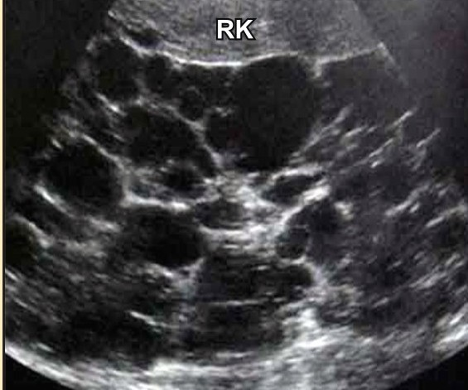
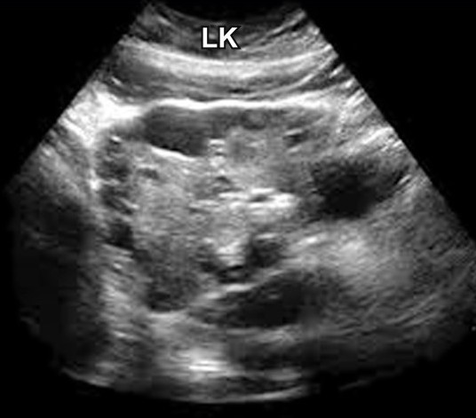
Investigations(USG)
Ultrasound shows bilateral grossley enlarged kidneys with irregular margins.Right kidney measures 18x 11 cms and left kidney measure 19x 12 cms.Both kidneys show multiple asymmetric cyst of variable sizes largest being 5 cm in the right kidney and 4 cm in left kidney.

Slide 4
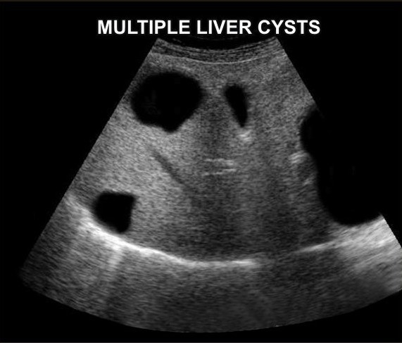
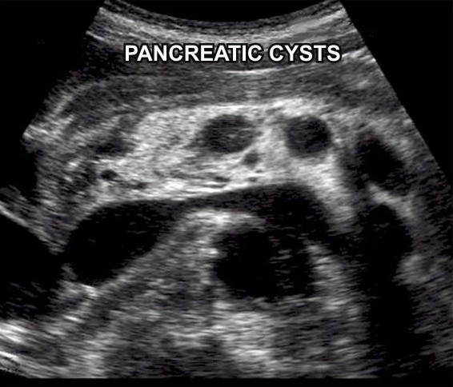
Investigations(USG)
Liver and pancreas shows multiple cysts.

Slide 5
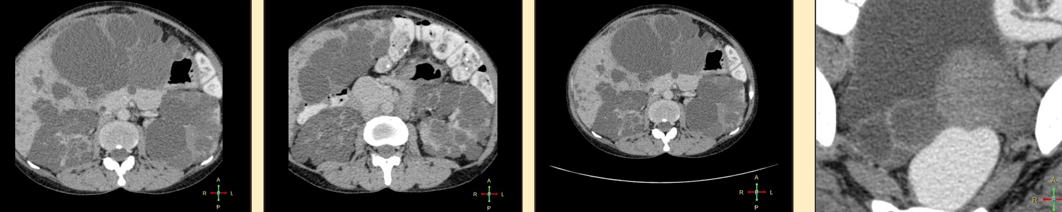
CECT whole abdomen
CECT whole abdomen shows bilateral enlarged kidneys due to multiple cysts of variable size and shape. Liver also appears enlarged with multiple cysts of variable size. Few cysts also seen in pancreas. Cystic mass with septation seen in right adenexa measuring 4633mm inseparable from right ovary.

Slide 6
DIAGNOSIS
POLYCYSTIC KIDNEY DISEASE

Slide 7
DISCUSSION
PKD is a common and often lethal multiorgan disease in which multiple cysts develop in bilateral kidneys and sometimes in liver(50%),pancreas,spleen,lungs. 15%cases may have assosciated berry aneurysm and abdominal aortic aneurysm. It has 2 principal types- 1.autosomal recessive 2.autosomal dominant. Autosomal recessive also known as infantile PCK but there are 4 types- perinatal, neonatal, infantile and juvenile of which infantile is the most common. In autosomal dominant, there are three genetic mutations in the PKD-1, PKD-2 and PKD-3 gene with similar phenotypical presentations. Gene PKD-1 is located on chromosome 16 and codes for a protein involved in regulation of cell cycle and intracellular calcium transport in epithelial cells, and is responsible for 85% of the cases of ADPKD

Slide 8
A group of voltage – linked channels are coded for by PKD-2 on chromosome 4. PKD recently appeared in research papers as a postulated 3rd gene. Approximately 50% of people with this disease will develop end stage kidney disease and require dialysis or kidney transplantation. Progresssion to end stage kidney disease usually happens in the 4th to 6th decades of life. Autosomal dominant polycystic kidney disease occurs world wide and affects about 1 in 400 to 1 in 1000 people. Despite significant research, prognosis of this disease has changed little overtime. It is suggested that avoidance of caffiene may prevent cyst formation. Although not well-proven, treatment of hypertention and low protein diet may slow progression of the disease. Between PKD1 and PKD2, the former has the worse prognosis.

Slide 9
Thank You!

