Slide 1
Primary Ewing’s Sarcoma of the left kidney
- Dr. Chandra Raychaudhari

Slide 2
CLINICAL HISTORY
A 26-year-old male patient presented with left lower quadrant pain. Initial computed tomography (CT) of the abdomen and pelvis was performed to rule out diverticulitis. Follow up CT of the abdomen and pelvis was performed to further delineate the left renal mass found on initial imaging.

Slide 3
IMAGING FINDINGS
Initial CT of the abdomen and pelvis showed an irregular, hypodense, mildly exophytic mass within the lower pole of the left kidney measuring 3.3 cm (AP diameter), 2.9 cm (craniocaudal) and 2.9 cm (transverse diameter). No hydronephrosis was appreciated and the left renal vein showed no filling defects. Aorta and IVC were normal. No lymphadenopathy was appreciated. Adrenals were normal (Fig. 1).
Secondary imaging showed the mass to have an inhomogeneous pattern of contrast enhancement. Areas of lower density were within the medial aspect of the lesion suggestive of necrosis. No calcifications were identified within the lesion. The lesion involved both the cortex as well as the medulla of the kidney and extended into the region of the renal sinus (Fig. 2). Obliteration of the perisinus fat as well as displacement of the calyces was noted. There was no evidence of distant metastases.

Slide 4
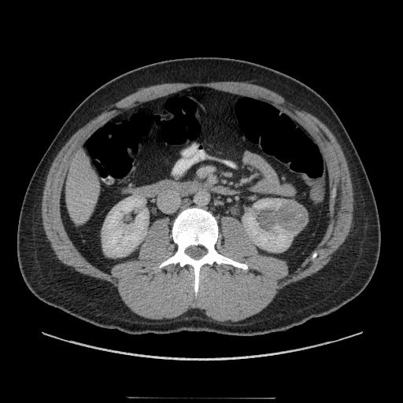
Axial CT acquired in the venous phase showing an irregular, hypodense, mildly enhancing and slightly exophytic mass in the lower pole of the left kidney

Slide 5
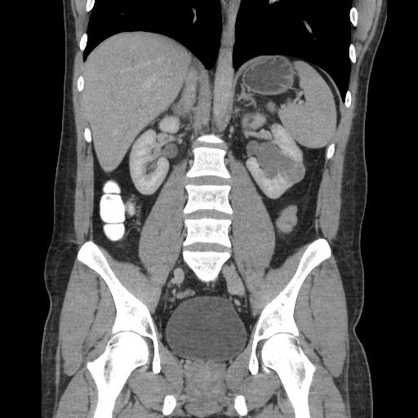
Coronal CT acquired in the venous phase showing an irregular, hypodense, mildly enhancing and slightly exophytic mass in the lower pole of the left kidney.

Slide 6
Discussion
EES is a rare diagnosis, but has a male preponderance of 1.6:1, and most often occurs in patients between 3 and 25 years of age (mean: 13 years) . Primary Ewing’s sarcoma is an aggressive neoplasm with very poor prognosis. The 5-year disease free survival rate is estimated to be 45-55%, and 25-50% of patients first present with metastatic disease. Although it is exceedingly rare, a limited number of cases have shown EES infiltration of the kidney . Due to its rarity, this is often mistaken for a number of other round cell tumours such as Wilms tumour, monophasic synovial sarcoma, lymphoma, clear cell sarcoma of the kidney, neuroblastoma, and most commonly, renal cell carcinoma (RCC) . It is important to note that primary Ewing’s arising of the kidney appears to behave even more aggressively than EES at other sites.
.

Slide 7
Thank You!

