Slide 1
Recurrent Wilms tumour in young girl
- Dr. Pradeep Jhala

Slide 2
Clinical History
An 18-year-old woman came to our attention because of recurrent abdominal pain arising after the
right nephrectomy performed for Wilms' tumour of the right kidney. At age of 14 the girl was
diagnosed with Sertoli-Leydig cell tumour of the right ovary and treated surgically.

Slide 3
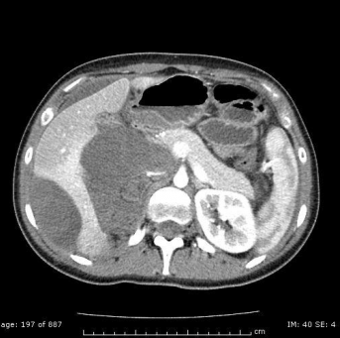
The biggest masses with upper hydric density and poorly enhanced (arterial phase): below the liver, below the Glisson's capsule and at the VI liver segment.

Slide 4
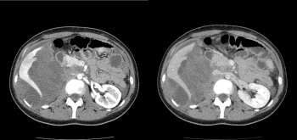
CT images with contrast enhancement during arterial and venous phase: mass at a lower level of the previous images.

Slide 5
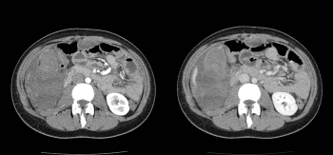
CT images with contrast enhancement during arterial and venous phase: mass at a lower level of the previous images. Notice the previous right nephrectomy

Slide 6
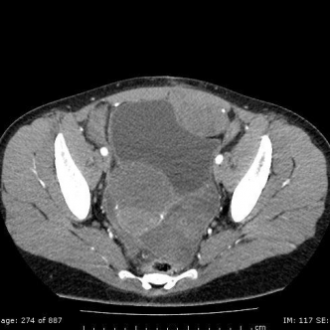
Other masses in iliac fossa, in front of the bladder, between the bladder and the uterus.

Slide 7
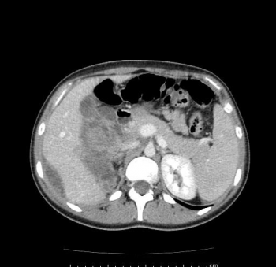
CT image with contrast enhancement (CE) during venous phase: The masses have a heterogeneous CE

Slide 8
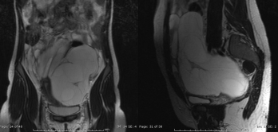
T2-wt coronal and sagittal images, that show the craniocaudal and anteroposterior diameters

Slide 9
Discussion
Wilms' tumour (or nephroblastoma) is the most frequent abdominal tumour in children [1].
Generally it is an isolated sporadic tumour, but approximately 10% of cases are associated with
some genetic syndromes (WAGR syndrome and Denys-Drash syndrome). Wilm s' tumour arises
from immature kidney cells.
Usually it affects children aged 3 to 4 and becomes much less common after age 5; it is extremely
rare in the adults (les than 1% of all renal tumours).
Most children present with a palpable abdominal mass. Other common signs are haematuria (in
20-30% of the patients), hypertension (in 25 % of children, presumably because of increased renin
activity), abdominal pain and fever.

Slide 10
Differential Diagnosis
Neuroblastoma
Multilocular cystic nephroma
Polycystic kidney disease

Slide 11
Final Diagnosis
Recurrent Wilms' tumour

Slide 12
THANK YOU

