Slide 1
Renal haemangioma
- Dr. Tushar Vaishnav

Slide 2
CLINICAL HISTORY
A 56-year-old man presented with fever and left flank pain.
He had a history of horseshoe kidney and urolithiasis. He had no other relevant medical history.
Emergency abdominal ultrasound was performed.

Slide 3
IMAGING FINDINGS
USG shows a lobulated predominately cystic mass with thick wall and internal septa located in the left renal sinus.

Slide 4
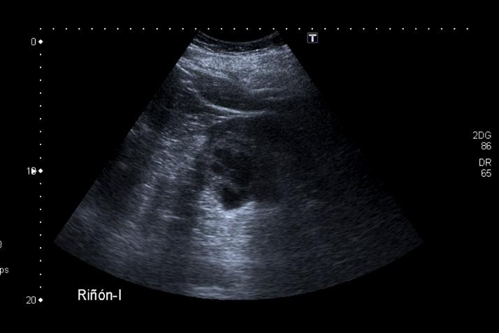
US shows a lobulated predominately cystic mass with thick wall and internal septa located in the left renal sinus.

Slide 5
DISCUSSION
Renal haemangioma is a rare benign mesenchymal neoplasm that consists of multiple endothelium-lined, blood-filled vascular spaces [1-5]. Most renal haemangiomas occur as single unilateral tumours without any sex predilection; the peak age group for diagnosis is young to middle-aged adults. The most common locations of haemangiomas in kidney are the medulla and the renal pelvis and most of them are smaller than 2 cm [2, 4]. Larger lesions may cause displacement of the renal vessels and collecting system [2].
Haemangioma is usually asymptomatic and discovered incidentally. Symptomatic cases usually present recurrent episodes of haematuria and colicky abdominal pain, hypertension by segmental renal ischaemia and less frequently haematoma (subcapsular or intraparenchymal

Slide 6
Treatment options include observation, partial nephrectomy, papillectomy, embolization, and total nephrectomy; the choice of treatment depends on the size of the tumour, its location, and the patient’s symptoms

