Slide 1
Renal lymphoma
-Dr. Jayesh Shah

Slide 2
CLINICAL HISTORY
A 71-year-old female patient, with hypertension and oesophageal hiatus hernia, is admitted to the ER with a febrile syndrome of unknown origin.

Slide 3
IMAGING FINDINGS
Ultrasound was performed, defining the presence of multiple hypoechoic nodules (Fig. 1). CT shows multiple hypodense and low contrast enhancement lesions (Fig. 2). The findings on MR are overlapping (Fig. 3).
Surgical biopsy is performed and the histological result was: high-grade mitotic centroblastic B-cell lymphoma (CD20, CD10).
The patient starts chemotherapy, with complete remission

Slide 4
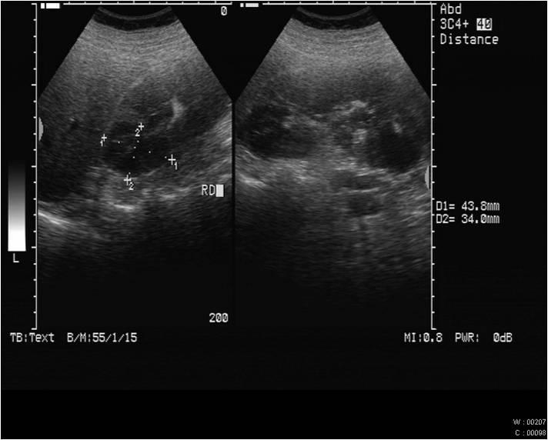
Nodular lesions in both renal poles.

Slide 5
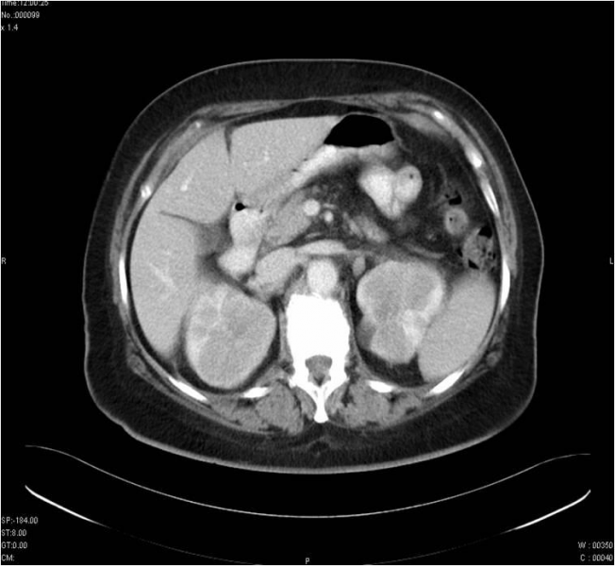
Multiple hypodense and low contrast enhancement renal lesions, with diffuse distribution.

Slide 6
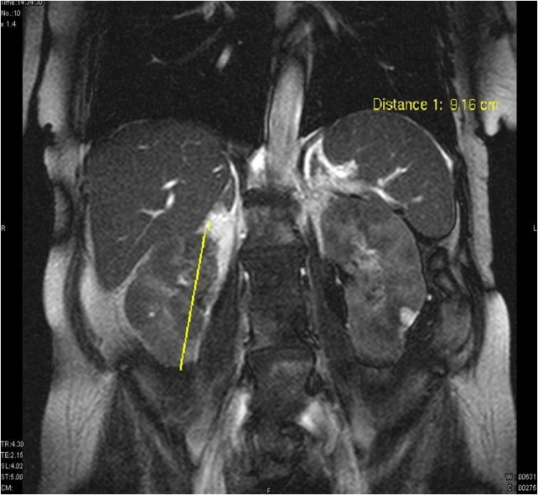
Multiple renal pseudo-nodular areas.

Slide 7
THANK YOU

