Slide 1
Right Cardiac Torsion
- Dr. Mayur Khandhedia

Slide 2
Clinical History
Right mesothelioma treated by pleuro-pneumectomy and pericardiectomy. 12 hours after surgery, the patient presented an ill defined dizziness with global insufficiency cardiac signs.

Slide 3
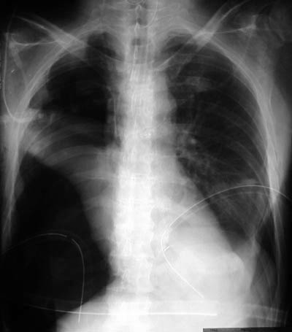
Imaging Findings
First control after pleuro-pneumectomy for right mesothelioma. The right upper opacity corresponds to the thoracoplasty. Normal cardiac contour.

Slide 4
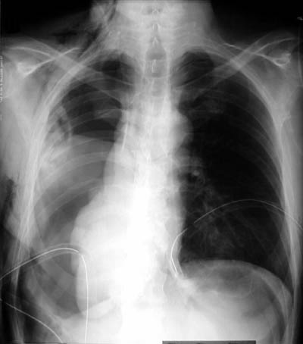
Chest radiograph obtained after sudden ill defined dizziness without perturbation of vital signs. Displacement and rotation of the heart in the right thoracic cavity.

Slide 5
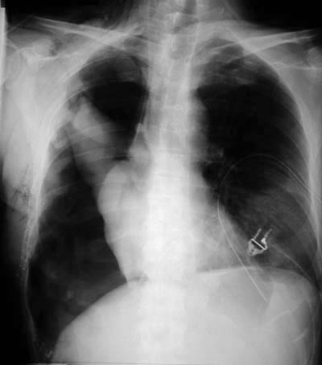
Control after surgical reduction of the cardiac torsion through a postoperative pericardial defect.

Slide 6
Discussion
Cardiac herniation with subsequent torsion is a rare life threatening complication after pneumectomy that requires an urgent surgical reduction. This clinical situation must be rapidly recognized, to allow prompt adequate treatmentdue to its high mortality rate. Etiology: Cardiac torsion can be seen in three conditions. After radical pneumectomy, in congenital pericardial anomaly and in post-traumatic conditions after rupture of the pericardium. The most common cause of cardiac torsion is due to pericardialectomy during pneumectomy without closure of the defect.

Slide 7
THANK YOU

