Slide 1
Septic jugular vein thrombophlebitis (Lemierre syndrome)
- Dr. Kalpesh Patel

Slide 2
Clinical History
A young woman without significant past medical history presented to the emergency department with persistent fever (38.5°C) and associated painful, tender right cervical and supraclavicular swelling. Eight days earlier she manifested sore throat accompanied by high fever and shivers, interpreted as pharyngo-tonsillitis and treated with oral antibiotics by the family physician.

Slide 3
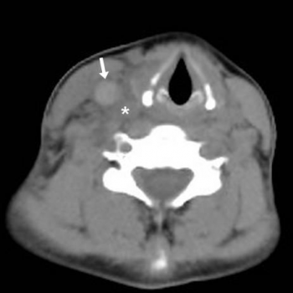
Imaging Findings
Unenhanced images (A to C in cranio-caudal order) show right internal jugular vein dilatation with hyperattenuating lumen (arrow) indicating acute thrombosis, and hypodense oedema of the surrounding soft tissues (*).

Slide 4
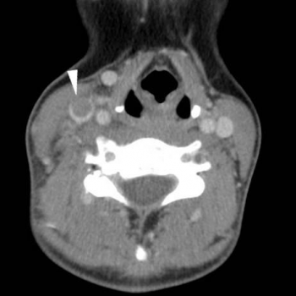
Contrast-enhanced images (D to F in cranio-caudal order) show right internal jugular vein subtotal non-opacification (arrowheads) consistent with occlusive thrombosis.

Slide 5
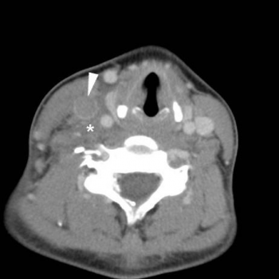
Contrast-enhanced images (D to F in cranio-caudal order) show right internal jugular vein subtotal non-opacification (arrowheads) consistent with occlusive thrombosis. Associated hypodense oedema of the surrounding soft tissues (*).

Slide 6
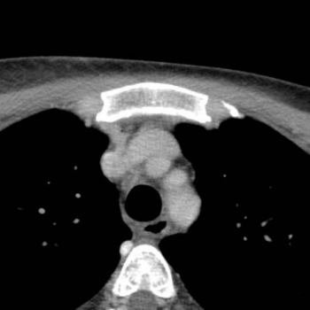
Thoracic images show normally patent brachiocephalic veins and superior vena cava. Septic lung embolisation and pleural effusions are excluded.

Slide 7
Discussion
Lemierre syndrome (LS) involves septic thrombophlebitis of the internal jugular vein (IJV) following an oropharyngeal infection, with subsequent metastatic dissemination. Although exceptional compared to the preantibiotic era, LS is encountered nowadays due to decreased tonsillectomy rates and antibiotics use for respiratory infections. The anaerobic Gram-negative rod Fusobacterium necrophorum, found in the normal oropharyngeal flora, is the most common causative organism. Infection invades the deep neck spaces from a primary oropharyngeal infection, through venous or lymphatic channels, to cause ipsilateral IJV septic thrombophlebitis.

Slide 8
Differential Diagnosis
Aseptic venous thrombosis
Deep cervical abscess
Infectious adenopathies
Suppurative thyroiditis,
Septic sterno-clavicular arthritis
Intravenous drug abuse

Slide 9
THANK YOU

