Slide 1
Thromboangiitis obliterans or Buerger's disease.
- Dr. Vishal Bharadava

Slide 2
Clinical History
A 40-year-old male smoker presented with a history of Raynaud's phenomenon, two-month ischemic pain followed by gangrene of distal portion of the left index finger and the right index and medium fingers.

Slide 3
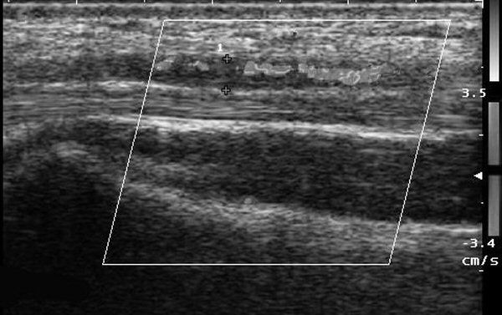
Imaging Findings
The scan showing the presence of a severe caliber reduction and of an obstruction in the right ulnar artery at the wrist

Slide 4
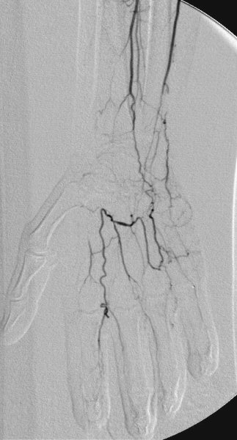
Angiogram confirming the severe caliber reduction and the obstruction of the distal ulnar artery. The palmar arch, supplied by collateral artery from the interosseous artery, presents with multiple segmental obstructions.

Slide 5
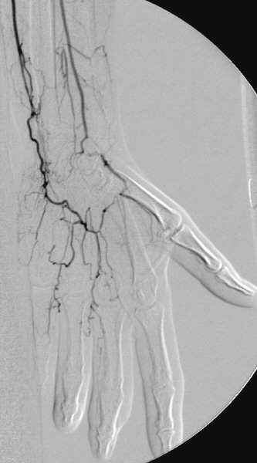
Angiogram depicting obstruction of ulnar and radial arteries at the level of the wrist. Palmar arch is supplied by ulnar artery collateral.

Slide 6
Discussion
Thromboangiitis obliterans (TAO) or Buerger's disease is a non-atherosclerotic, segmental, occlusive inflammatory disease of the small and medium-sized arteries and veins. This disease mainly affects the extremity vessels and rarely affects the visceral and cerebral ones. TAO is more prevalent in the Far East and Middle East than in North America and Western Europe. It usually occurs in 20-50-year-old male smokers, but its prevalence among women is increasing.
TAO is characterized, in the acute phase, by occlusive, highly cellular, inflammatory thrombi with lymphocytic infiltration of the intima and media. Internal elastic lamina and structures of vascular wall are relatively preserved. In the chronic phase, organized thrombi with partial recanalization and mild vascular wall fibrosis are observed.

Slide 7
THANK YOU

