Slide 1
FEVER OF UNKNOWN ORIGIN
BY
DR. PRASHANT MODI
SBKS MIRC

Slide 2
INTRODUCTION
Normal body temperature -36.6℃ – 37.2℃
Regulated by thermosensitive neurons in Preoptic and ant hypothalamus
Thermoregulatory responses
    Redirecting blood to or from hypothalamus
    Increased or decreased sweating
    Ecf regulation
    Behavioral responses
    Circadian rythym or diurnal variation result in lowering body temperature in early morning

Slide 3
DEFINITION OF FEVER
Controlled increase in body temperature above the normal hypothalamic set point
  Rectal temperature > 38℃
  Hyperpyrexia - > 40℃

Slide 4
PATHOGENESIS OF FEVER
Infections and toxins
Inflammation
Malignancy
Fever
Heat conservation,
Heat production
Monocytes, macrophages, endothelial cells, b lymphocytes, mesangial cells, keratinocytes, glial cells
Elevated set point of febrile levels
Hypothalamus- thermoregulatory centres
Endogenous pyogens –cytokines, IL-1,6, TNF
Prostaglandins

Slide 5
FEVER
With Other symptoms
Without other symptoms
Fever without Localization
Fever of Unknown Origin

Slide 6
Fever Without Localizing Signs
Short duration fever (<7 days)
No signs or symptoms that could indicate involvement of particular system or a probable etiology.

Slide 7
CLASSICATION OF FUO
CLASSIC FUO
HEALTHCARE ASSOCIATED FUO
IMMUNE DEFICIENT FUO
HIV RELATED FUO

Slide 8
Classic Fever Of Unknown Origin (FUO)
Children with
  Temperature ≥ 38.3°C (101 °F)
  Recorded on several occasions occurring >3 weeks
  Undiagnosed in spite of investigations on
    3 OPD visits
    3 days of stay in hospital stay
    1 week of invasive ambulatory investigations

Slide 9
Nosocomial (Health Care Associated) FUO
  Temperature ≥ 38.3°C (101 °F)
  Recorded on several occasions in a hospitalized patients who is receiving acute care
  in whom infection was not manifest or not incubating at admission
  Three days of investigations, including at least 2 days incubation of cultures is the minimum requirement for this diagnosis

Slide 10
Neutropenic (Immunodeficient) FUO
  Temperature ≥ 38.3°C (101 °F)
  Recorded on several occasions in a hospitalized patients
  whose neutrophil count is less than 500 cells/mm3
  No identifiable specific cause after 3 days of investigations including at least 2 days incubation of culture

Slide 11
HIV Associated FUO
  Temperature ≥ 38.3°C (101 °F)
  Recorded on several occasions over a period of 4 weeks for outpatients or more than 3 days for hospitalized patients with HIV infection
  when appropriate investigations for 3 days, including 2 days incubation of cultures reveal no source

Slide 12
ETIOLOGY OF FUO
NON INFECTIOUS
INFECTIOUS
FUO

Slide 13
1. SPECIFIC INFECTIONS
1.BACTERIA
2.SPIROCHETES
BORRELIA BURGDORFERI LEPTOSIROSIS
3.PARASITE
AMOEBIASIS MALARIA
BRUCELLOSIS MYCOPLASMA PNEUMONIAE
TB ACTINOMYCOSIS
SALMONELLA MENINGOCOCCEMIA
RELAPSING FEVER SYPHILIS
BEBESIOSIS TOXOPLASMOSIS
GIARDIASIS
4.VIRAL
CYTOMEGALOVIRUS
HEPATITS
HIV INFECTIOUS MONONUCLEOSIS

Slide 14
5. FUNGI
BLASTOMYCOSIS
6. CHLAMYDIA
7. RICKETTSIA
Q FEVER
COCCIDIODOMYCOSIS
HISTOPLASMOSIS
PSITTACOSIS
ROCKY MOUNTAIN SPOTTED FEVER
TICK BORN TYPHUS

Slide 15
2. LOCAL SPECIFIC INFECTIONS
Dental abscess
Hepatitis
Subphrenic abscess
Bronchiectasis
Sinusitis
Mastoditis
Tonsilitis

Slide 16
3. LOCAL INFECTION WITHOUT PUS FORMATION
UTI
Phlebitis
Ulcerative enteritis
Diverticulitis

Slide 17
NON INFECTIOUS CAUSES
1. COLLAGEN VASCULAR DISORDERS
JRA
BEHCETS DISEASE
JUVENILE DERMATOMYOSITIS
SLE
2. NEOPLASTIC
LEUKEMIA
LYMPHOMA
NEUROBLASTOMA
WILLMS TUMOUR
3.METABOLIC
GOUT
PORPHYRIA

Slide 18
4. ENDOCRINE
THYROTOXICOSIS
ADDISON DISEASE
5. HYPERSENSITIVE REACTION
SERUM SICKNESS
DRUG FEVER
6. MISCELLANEOUS
CIRRHOSIS OF LIVER
SARCOIDOSIS
FAMILIAL MEDITERRANEAN FEVER
POISONING
FACTITIOUS FEVER
MALINGERING

Slide 19
ETIOLOGICAL OUTCOME OF THE STUDY
DIAGNOSIS | FREQUENCY | PERCENTAGE
INFECTIONS | 83 | 69.1
MALIGNANCIES | 20 | 16.7
CONNECTIVE TISSUE DISORDERS | 6 | 5
MISCELLANEOUS | 7 | 5.8
UNDIAGNOSED | 4 | 3.4
TOTAL | 120 | 100
Govindarajulu S et al: Clinical profile and etiological spectrum of fever of unknown origin in children aged 2 months to 12 years. Int J Contemp Pediatr. 2017 Jan;4(1):62-67

Slide 20
Comparison of leading etiologies in various Indian studies
STUDY | LEADING INFECTIOUS ETIOLOGY
Kejariwal, et al | Tuberculosis (24%) | Abscesses (7%) | Enteric fever(5%)
Joshi , et al | Enteric fever(41%) | Leshmaniasis(29%) | Tuberculosis (15%)
Mir T, et al | Enteric fever(32.3%) | Brucellosis(32.3%) | Tuberculosis (22.6%)
Govindarajulu S,et al | Enteric fever(26.5%) | Leptosirosis(12%) | Scrub typhus(12%) UTI(12%)
Govindarajulu S et al: Clinical profile and etiological spectrum of fever of unknown origin in children aged 2 months to 12 years. Int J Contemp Pediatr. 2017 Jan;4(1):62-67

Slide 21
Observations of various studies outside India
STUDY | INFECTIONS (%) | MALIGNANCY (%) | COLLAGEN VASCULAR DISEASE (%) | MISCELLANEOUS (%) | UN DIAGNOSED (%)
Mc Clung | 29.3 | 11.1 | 8 | 30.4 | 21.2
Pizzo et al | 52 | 6 | 20 | 10 | 12
Chantada et al | 36.3 | 10 | 13.2 | 22 | 19.5
Cogulu et al | 57.7 | 2.5 | 6.3 | 20 | 12.5
Bakasvilli | 61.5 | 4 | 4 | 17.3 | 13.5
Govindarajulu S et al: Clinical profile and etiological spectrum of fever of unknown origin in children aged 2 months to 12 years. Int J Contemp Pediatr. 2017 Jan;4(1):62-67

Slide 22
COMPARISION OF ETIOLOGICAL CATEGORIES OF FUO IN VARIOUS STUDY DONE IN INDIA
Study | No of cases | Infection | Malignacy | Collagen vascular disease | Miscellaneous | Undiagnosed
Kejariwal, et al | 100 | 53 | 17 | 11 | 5 | 14
Joshi, et al | 49 | 69.4 | 12.2 | 2.1 | 4.1 | 12.2
Mir et,al | 91 | 44 | 12 | 12 | 7 | 25
Govindarajulu S et al: Clinical profile and etiological spectrum of fever of unknown origin in children aged 2 months to 12 years. Int J Contemp Pediatr. 2017 Jan;4(1):62-67

Slide 23
Clinical differentiation between viral and bacterial infections
Viral infections | Bacterial infections
Abrupt onset | Insidious onset
Duration usually 3-5 days | May last for more than 7 days
Prodrome usually present | No prodrome
Rashes mostly + with viral etiology | Very few bacterial infections + with bacterial infections
No localizing findings | Systemic localization and organomegaly
Seasonal incidence | No seasonal variation
Many members in the family may be affected simultaneously | Isolated cases
Ix usually normal | CRP positive culture positive Xray positive in pneumonia
Self limiting | Require antibiotic therapy

Slide 24
FUO Is Common Disease With Uncommon Presentation
APPROACH OF FUO
History
Examination
Laboratory

Slide 25
HISTORY IN FUO

Slide 26

FEVER:
  Duration
  Onset and progress,
  Types of fever
  Documentation

Slide 27
Temperature :
Intermittent type | Quotidian fever | Juvenile Rheumatoid Arthritis
 | Tertian fever | Plasmodium vivax malaria
 | Quartan fever | Plasmodium malariae malaria
Countinuous type |  | Typhoid Miliary tb Sbe Pneumonia
Relapsing fever | Pel ebstein fever | Hodgkin disease
Hyperpyrexia |  | Heat stroke Pontine hemorrhage Septicemia Malignant hyperthermia

Slide 28
Many a times, in cases of undocumented fever, the child may be afebrile but the mother may wrongly perceive fever due to warm forehead and palms as compared to rest of the body.
GENDER:
Chronic granulomatous disease and Bruton’s agammaglobulinemia are X-linked disorders restricted to boys
Pelvic inflammatory disease occurs more often in girls.

Slide 29
Neonates and young children
Listeria monocytogenes
Adolescents
Neisseria gonorrhea infection
JIA are four times more common
Group B Streptococcus
Inflammatory bowel disease, autoimmune processes, lymphoma or tuberculosis
AGE :

Slide 30
AGE DISTRIBUTION OF DIFFERENT CATEGORIES OF FEVER OF UNKNOWN ORIGIN OF CHILDREN
CAUSES | <1 year | 1 – 5 year | 6 – 12 year | > 12 year | TOTAL
INFECTIOUS DISEASE | 7 (77.8) | 8 (25.8) | 12 (38.7) | 8 (36.4) | 35 (37.6)
MALIGNANCY | 0 (0) | 7 (22.6) | 6 (19.4) | 3 (13.6) | 16 (17.2)
COLLAGEN VASCULAR DISEASE | 0 (0) | 4 (12.9) | 5 (16.1) | 4 (18.2) | 13 (14.0)
MISCELLANEOUS | 1 (11.1) | 4 (12.9) | 6 (19.4) | 4 (18.2) | 15 (16.1)
UNDIAGNOSED | 1 (11.1) | 8 (25.8) | 2 (6.4) | 3 (13.6) | 14 (15.1)
TOTAL | 9 (9.7) | 31 (33.3) | 31 (33.3) | 22 (23.7) | 93 (100)
Journal of Microbiology, Immunology and Infection (2017) 50, 893e898

Slide 31
History of fever in the family members or neighbors → infectious cause of fever.
Pets in the house → Toxoplasmosis, visceral larva migrans and cat scratch disease
History of contact with cattles or raw milk ingestion → Brucelosis
History of pica or ingestion of dirt → Toxocara or Toxoplasma infections.
Presence of epidemics in the community Leptospiral infections
History of recent travel to endemic areas
        Asia, sub-Saharan Africa — malaria, typhoid
        North America — Rocky mountain fever, Lyme’s disease
        East Asia — ﬁlariasis, dengue
Family History& Recent contact with infectious disease :

Slide 32
Accompanying symptoms :
Excessive crying | Meningitis, pyogenic focus
Diarrhea, vomiting | Gastroenteritis
Loss of appetite, nausea, pain in abdomen | Hepatitis
Cough and fast breathing | Bronchioloitis, bronchopneumonia
Burning micturition, dysuria, crying during micturition | Urinary tract infection

Slide 33
Predisposing Factors :
Vesicoureteric reflux,
Cardiac disease,
Ventricular shunt and immunodeficiency state.
Recent history of surgery suggests possibility of occult infection.

Slide 34
Immmunisation and drug history
Drug fever:
    It is considered if patient is taking any drugs.
    The temperature tends to remain elevated at a relative constant level.
    Withdrawal of the drug is associated with resolution of fever within 72 hours.
    Drugs commonly implicated include penicillin and phenytoin.
    Use of medication should be looked into especially over the counter preparation and topical agents such as atropine(Atropine fever).

Slide 35
PHYSICAL EXAMINATION IN FUO

Slide 36
Pulse rate :
  Relative bradycardia
      Typhoid, meningitis
      Weil’s disease

Slide 37
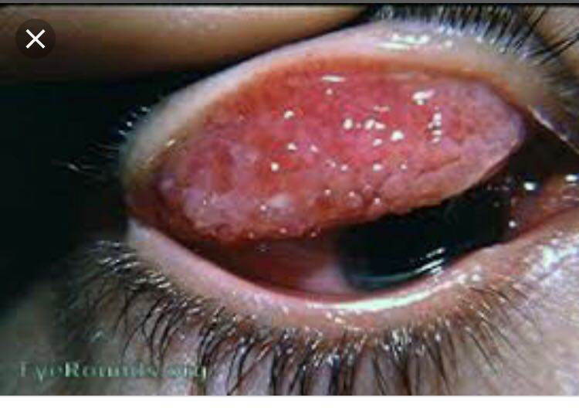
    1.EYES
Red weeping eyes | Connective tissue disorders mostly polyarteriris nodosa
Palpebral conjectivitis | Measles Coxsackievirus infection Tb Infectious mononucleosis Lymphogranuloma venerum Cat scratch disease
Bulbur conjectivits | Kawasaki disease Leptospirosis
Petechial conjuctival haemorrhage | Infective endocarditis
Uveitis | Sarcoidosis Jia Sle Kawasaki disease Behcet disease

Slide 38
Chorioretinits | Cmv Toxoplasmosis Syphilis
Proptosis | Orbital tumour Thyrotoxicosis Metastasis (neuroblastoma) Orbital infection
Jaundice | Acute hepatits Leptospirosis
Fundus Choroid tubercle | Tb

Slide 39
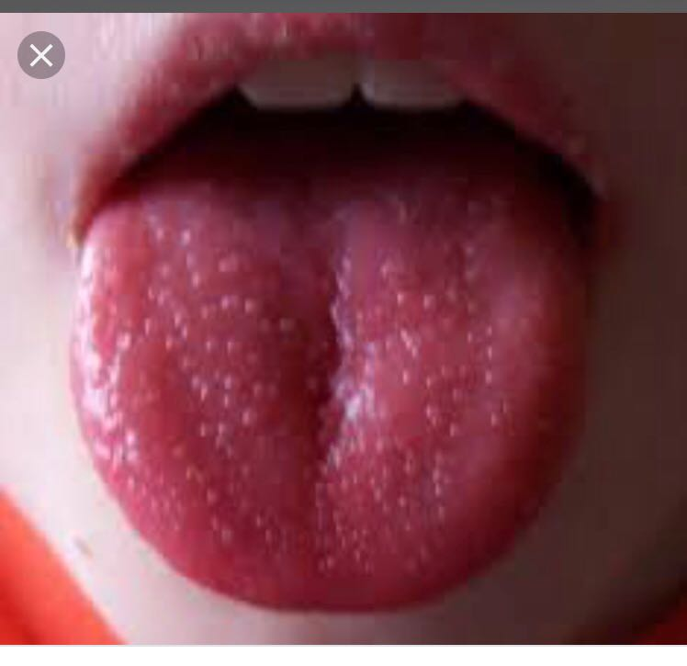
2. ORAL CAVITY :
Pharyngitis
Fissured lips-
Strawberry tongue Kawasaki Disease
Oropharyngeal congestion

Slide 40
3. Lymphadenopathy :
Generalized
Viral- Infectious mononucleosis, CMV, HIV
Bacterial- Septicemia, typhoid fever, tuberculosis
Protozoal- Toxoplasmosis
Autoimmune disorders- JRA, SLE
Neoplastic- acute leukemias, lymphomas(hodgkin, non-hodgkin
Localized
Sarcoidosis
Brucellosis
Cat scratch disease

Slide 41
4. ANEMIA :
Malaria
        Kala azar
Subacute bacterial endocarditis
Acute leukemia
5. CLUBBING :
        Lung abscess
Brochiectasis
SBE
Liver abscess
6. THYROID :
Look for ENLARGMENT and TENDERNESS
Thyroiditis

Slide 42
7. RASHES
Kawasaki disease
Polymorphous
Evanescent maculopapular rash with central clearing is seen in systemic onset idiopathic rheumatoid arthritis.
Malar rash is characteristic of systemic lupus erythematous.
Presence of petechial rash purpura and ecchymosis suggests meningococcemia, dengue hemorrhagic fever or leukaemia

Slide 43
8. Arthritis
      Meningoccemia
      Leukemia
      Rheumatic fever
      SBE
9. Bony tenderness
      Septic arthritis
      Leukemia
10. Weight loss
      Tuberculosis
      Malignancies
      Inflammatory bowel disease
      Eschar is specific physical finding in Ricketssial disease

Slide 44
INVESTIGATIONS IN FUO

Slide 45
INVESTIGATIONS
Routine Investigations
Advanced Investigations

Slide 46
Routine Investigations
Complete blood count
ESR
C-reactive protein
Peripheral smear
Mantoux test
Urine analysis
Blood and urine cultures
Stool examination including occult blood
LFT
USG

Slide 47
CSF analysis
Bone marrow aspiration and biopsy
Lymphnode biopsy
Liver biopsy

Slide 48
Advanced Investigations
Serum for virological studies
Autoimmune work up (RA and ANA factors)
Ecg / Echo
CT / MRI
Barium studies
Isotrope scans
Lymphangeography to localize retroperitoneal ,aortic ,iliac lymphnodes
Exploratory laprotomy

Slide 49
STAGE | MEASURERMENT | %
1 | CBC / DC, CRP, PERIPHERAL BLOOD SMEAR, ROUTINE BIOCHEMISTRY CHEST / SINUS RADIOGRAPHY URINE/STOOL/BLOOD CULTURE | 2.5 %
2 | VIRUS CULTURE , ANA ,C3 / C4, C – ANCA, SEROLOGICAL TEST FOR BACTERIA AND VIRUS , IMMUNOGLOBULIN LEVEL, ABDOMINAL/CHEST/LYMPHNODE USG | 35.4 %
3 | CT , MRI , GALLIUM SCAN , BONE MARROW ASPIRATION AND BIOPSY , BIOPSY OF LYMPHNODES / MASS, PCR FOR CMV AND HIV ECG LUMBAR PUNCUTRE MOLECULAR DNA | 45.6 %
4 | ANTIMICROBIAL THERAPY NSAID / STEROID THERAPYB | 16.5 %

Slide 50
Hb | Total WBCs | Polymorphs | Lymphocytes | Eosinophils | Platelets | Disease
N | +++ |  |  | 0 | N or + | ACUTE BACTERIAL INFECTION
N | ++ |  |  | 0 | N | ACUTE VIRAL INFECTION
N | Low | ++ | ++ | 0 | N or Low | TYPHOID FEVER
N | + |  | ++ | + | N | CHRONIC INFECTION/ TB
N | +++ | +++ |  | + | High | SYSTEMIC INFLAMMATORY DISEASE
Low | +++ |  | +++ |  | Low | ACUTE LYMPHATIC LEUKEMIA
Low | +/- |  |  | + | Low | MALARIA

Slide 51
ESR
ESR is a good screening test to consider in cases of pyrexia of unknown origin.
It is of no help in a fever of a short duration.
Mild to moderate elevation of ESR is seen in many diseases and is non-specific.
A high ESR (close to 100) suggests a systemic inflammatory disease or malignancy and may also be seen in tuberculosis.

Slide 52
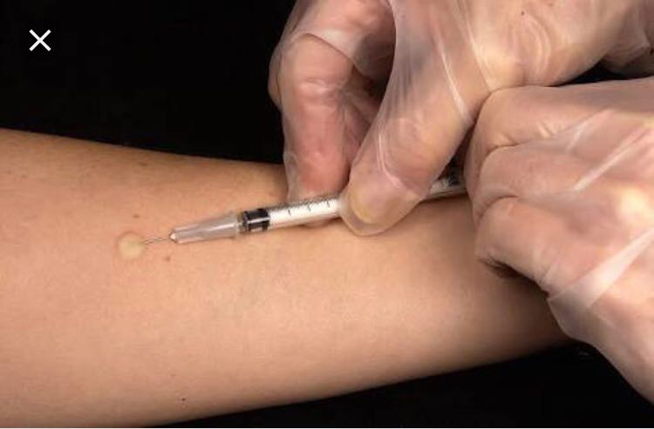
Blood smear with giemsa or wright stain –
organisms of malaria, trypanosomiasis, babesiosis, or relapsing fever.
Serological tests
Widal test – typhoid fever
Brucella micro agglutination test- brucellosis
Paul-bunnell test- infectious mononucleosis
Weil felix test- ricketssial infections
Skin tests
Mantoux test- tuberculosis
Dick test- scarlet fever

Slide 53
C-reactive protein is another acute-phase reactant that becomes elevated and returns to normal more rapidly than the ESR.
Multiple or repeated blood cultures may be required to detect bacteremia associated with infective endocarditis, osteomyelitis, deep-seated abscesses, septicaemia, typhoid fever.
Urine Examination- Urine examination must be done in all cases of fever especially if fever is without a focus.
Presence of pus cells and/or bacteriuria would suggest urinary tract infection.However,it needs confirmation by doing a urine culture.

Slide 54
Cerebrospinal Fluid Examination
suspected meningitis
Neonates and infants with bacterial sepsis
Chest X-Ray
Pneumonias
Tuberculosis.

Slide 55
Liver Function Tests and Viral Markers- viral hepatitis.
Bone Marrow Examination- Essential for the diagnosis of leukemic leukemia, typhoid, etc.
Ultrasonography/CT scan/MRI Imaging- cases of suspected abscess, lymphoreticular malignancies, tubercular abdomen and tumors.
Seroimmunological Tests – suspected autoimmune disorders for detection of autoantibodies.
Molecular Diagnostic Techniques – Polymerase chain reaction (PCR) is now available for diagnosis of several infectious agents.

Slide 56
SOME INFECTIOUS CAUSES OF FUO :
1. Tuberculosis :
      it is an important cause of FUO in children.
      Non-pulmonary tuberculosis (disseminated, peritoneal, hepatic, or genitourinary) presents as fuo more commonly than pulmonary tuberculosis.
      Active disseminated tuberculosis has been documented in children with normal chest x-ray and negative mantoux test.
2. Salmonellosis :
      serological tests are generally not useful.
      Moderate grade fever, abdominal pain and severe watery diarrhea.
      Repetitive blood and stool cultures are useful to establish diagnosis

Slide 57
3. Brucellosis :
      Classic triad
          undulant fever,
          arthralgia, arthritis
          hepatosplenomegaly.
      Enquire carefully for the exposure to animals or animal products such as cheese made from unpasteurized animal milk.
      Enzyme immunoassay is sensitive to detect Brucella antibodies.
4. Leptospirosis :
      Transmission of infection from animals to humans may follow direct contact with the blood, urine, or organs of infected animals.
      The classical features such as fever, jaundice, hepatosplenomegaly, renal manifestations and, bleeding tendencies.

Slide 58
5. Bone and Joint Infections :
      Infection of pelvic bone is more common
      bone scanning is required to locate the site of infection
6. Liver Abscess :
      Pyogenic liver abscesses are encountered most frequently in immunocompromised patients but can occur in normal children
      Blood cultures are usually sterile and liver function tests (LFT) are usually within normal limits.
      Diagnosis is established by CT scan or ultrasound (USG) of abdomen

Slide 59
SOME NONINFECTIOUS CAUSES
1. Malignancy :
      Second most frequent cause of FUO in children.
      Most cases are caused by leukemia or lymphoma.
      Rarely neuroblastoma, hepatoma, atrial myxoma and rhabdomyosarcoma can present as FUO

Slide 60
2. Connective Tissue Diseases :
    Third leading cause of FUO in children
    juvenile rheumatoid arthritis (JRA) accounts for most of the cases.
    Systemic form of jra most commonly presents as fuo.
    The classic fever has one or two spikes daily. Serology may be negative in children rendering diagnosis difficult.
    Diagnosis is made clinically by observation over a prolonged period.
    Classical fever in association with evanescent rash with objective arthritis is highly suggestive of systemic jra.
    Malignancy They are the third most frequent cause of FUO in children. Most cases are caused by leukemia or lymphoma. Rarely neuroblastoma, hepatoma, atrial myxoma and rhabdomyosarcoma can present as FUO

Slide 61
3. Factitious Fever :
If the patient is an infant or young child, parent or caretaker is the one who is fabricating. In most cases, factitious fever is excluded by recording of temperature by healthcare worker. Occasionally temperature is recorded rectally or measuring temperature of freshly voided urine.

Slide 62
CASE 1
A 10-month-old infant presented with fever for the last 2 months. The fever had been high and continuous, temporarily responding to antipyretics for a few hours. He had been very irritable and difficult to manage at times. He had lost his appetite and weight over the last 2 months.
There were no significant symptoms other than fever.
The bowel pattern and urination had been normal.
He had undergone many laboratory tests without any clue to the diagnosis. These tests included a hemogram, urinalysis, chest X-ray, blood culture, urine culture, Widal’s test, Paul- Bunnell test, tests for brucellosis, leptospirosis, dengue fever, and a Mantoux test.
He had been treated empirically with different antibiotics and antimalarials without benefit.
No relevant past or family history
No history of contact with any specific infection.
Birth history normal.
His growth and development had been normal until the onset of this illness

Slide 63
History Analysis
It is most unlikely that this infant has an acute bacterial infection, as the fever has lasted too long without any localizing symptoms or any complications and there has also been no response to multiple antibiotics.
A chronic infection such as tuberculosis may present with continuous high fever as seen in disseminated/miliary disease. However, at this age the disease would have lead to many other manifestations by now.
Other chronic infections without localizing symptoms include CMV, toxoplasmosis, malaria, EB virus, brucellosis.
High persistent fever may be the only initial manifestation of systemic inflammatory disorders also, and therefore should be considered in this child though such diseases are not common at this age.
Similarly, infiltrative disorders (malignancy/histiocytosis/sarcoidosis) are also a possibility, though there is no definite clue on the history.
Thus, the history alone does not offer any specific clue to the diagnosis in this child and a chronic infection or an infiltrative disorder is equally possible. Physical examination may help to localize the disease.

Slide 64
PHYSICAL EXAMINATION
Fairly built, poorly nourished Sick looking Irritable
Weight 6 kg Length 70 cm Head 44 cm
Temp. 102°F Pulse 130/min RR 35/min
No respiratory distress
Moderate pallor No lymphadenopathy
Two nodular swellings on the scalp, firm to hard, not mobile, fixed to the underlying bone, not tender
Other bones normal Joints normal No skin rash
Liver just palpable, soft Spleen not palpable
Other systems normal

Slide 65
Analysis of Examination
The only positive findings on physical examination in this infant are nodular swellings on the skull and moderate pallor. Obviously, the cause of fever is related to the bony swellings.
Etiologically, such a nodular swelling may be due to tubercular osteomyelitis, histiocytosis or malignancy.
Tuberculosis at this age, manifests either as a primary lesion in the lung or disseminates to other organs, as in miliary tuberculosis or TBM. Isolated tuberculosis of bone is rare at this age. Therefore, this is likely to be either histiocytosis or a malignancy.
A primary bone malignancy involving the skull is rare at this age and hence it is likely to be secondary spread from a distant malignancy such as a neuroblastoma. Most other malignant diseases do not present with secondaries but are localized to an organ (Wilm’s tumor/ hepatoblastoma/ retinoblastoma/ brain tumor) or present as hematological disorders. Acute leukemia may involve the periosteum and cause bony pain but not a nodular bony swelling. A soft tissue swelling is known with leukemia (chloroma in a myeloid leukemia).

Slide 66
Analysis of Examination
Anemia without hepatosplenomegaly (a just palpable, soft liver is normal) may be a deficiency anemia, marrow aplasia or anemia of chronic disease. In relevance to bony swellings in this child, it may either be deficiency anemia or related to a chronic disease.
Chronic infections that were considered on history are unlikely, considering the physical findings in this child.
Class I histiocytoses usually presents only with bony lesions and only when the disease is extensive, the child may have systemic manifestations like fever or a multisystem involvement and therefore less likely in this child. While class II histiocytoses can present as a generalized disease with fever, irritability and weight loss(as in this child), they are usually associated with hepatosplenomegaly and symptoms of CNS involvement (aseptic meningitis).
Between histiocytosis and neuroblastoma, it is the latter that is more subtle and occult in presentation. Thus it may favor a diagnosis of neuroblastoma.

Slide 67
INVESTIGATIONS
Hb 8 gm% Microcytic hypochromic anemia
WBC 20,000/c.mm P 75 L 20 E 3 M 2 ESR 120 mm
Biopsy from the nodule over the skull confirmed the diagnosis of neuroblastoma.

Slide 68
CASE 2
HISTORY
An 8-year-old child presented with fever for the last 2 months. He was apparently well 2 months ago when he developed fever. The fever had been high grade, coming in two spikes per day with a normal intervening period. There were no other symptoms at that time. After initial symptomatic therapy, he was prescribed amoxicillin for 5 days without any response. At that stage he was investigated. His laboratory test results were as follows: Hb 11 gm% WBC 23,000/cmm P 72 L 24 E 4 ESR 80 mm Platelets 4.5 lacs/cmm Routine urine normal Widal test negative

Slide 69
Considering it to be an acute bacterial infection, based on the neutrophilic leucocytosis, he was prescribed IV Cefotaxime and Amikacin for the next 7 days. He was partially better and hence, the same drugs were continued. However in spite of continuation of antibiotics, the high fever appeared again and he started complaining about a vague pain in the joints without any swelling. This was ascribed to the high fever.
He was reinvestigated at this juncture, and the results were as follows: Hb 9 gm% WBC 35,000/cmm P 82 L 14 E 3 M 1 ESR 105 mm Platelets 5.4 lacs/cmm Chest X-ray normal Blood and urine culture normal Widal test negative Abdominal USG normal He was advised a CSF examination and CT scans of the chest, abdomen and brain. The parents decided not to investigate further, and preferred hospitalization at a referral center

Slide 70
Analysis of History
Any fever of a long duration, with increasing neutrophilic leucocytosis but without any localization should arouse the suspicion of a non-infective fever, especially if two sets of antibiotics have failed.
In this setting, a bacterial infection is possible only in the form of a hidden abscess, such as a subdiaphragmatic, perirenal or intraspinal abscess or deepseated muscle abscesses or osteomyelitis. Even then, it is expected to manifest with local symptoms over a period of 2 months. In such cases, antibiotic therapy can fail, and the fever would abate only after drainage of the abscess.
If this is not a bacterial infection, neutrophilic leucocytosis is a feature of a severe ongoing inflammation. A falling hemoglobin and an increasing platelet count, without any other positive laboratory tests, support the diagnosis of a systemic inflammatory disorder.

Slide 71
Analysis of History
In the absence of a definite history of swelling, the vague pain in the joints does not have any interpretive value.
Since there are no other specific symptoms, it may evolve into any of the systemic inflammatory disorders. However, systemic lupus erythematosus (SLE) seems less likely since the leukocyte counts are usually normal or low (as against this case), and it is more common in females.
Considering the pattern of fever, systemic onset juvenile idiopathic arthritis (formerly known as systemic onset JRA) can be a possibility.

Slide 72
PHYSICAL EXAMINATION
Fairly built and nourished
Weight 24 kg Height 120 cm
Temp. 102°F Pulse 118/min RR 26/min
Looks sick
No lymphadenopathy Mild pallor
Joint examination - Minimal fullness of few interphalangeal joints. Mild restriction of movements of left wrist and right ankle joint
No bony tenderness No skin rash No mouth ulcers
Liver not palpable Spleen not palpable
Other systems normal

Slide 73
Analysis of Examination
There is definite evidence of involvement of two major joints and a few small joints in the form of either restriction of movements or fullness. Hence, the diagnosis is probably evolving into a systemic onset juvenile idiopathic arthritis.
The clinical findings of joint involvement may have appeared recently, and thereby facilitated the diagnosis.
However, even prior to the development of such signs, a diagnosis of systemic inflammatory disorder could have been definitely considered (as analysed after the history).

Slide 74
INVESTIGATIONS
Hb 8 gm% Normocytic normochromic anemia
WBC 38,000/c mm
P 85 L 10 E 5
ESR 120 mm
Platelet count 7.5 lacs
ANA weakly positive Anti-dsDNA negative
RA factor negative

Slide 75
Analysis of Investigations
High neutrophilic leucocytosis, high platelet count and a high ESR suggest an active systemic inflammatory disease.
A weakly positive ANA is non-specific and is seen in a variety of inflammatory and other disorders. Anti-dsDNA is also negative (this test is specific for systemic lupus and should be ordered only when ANA is strongly positive).
A negative RA factor is no surprise, as it is present only in 5% of cases of juvenile chronic arthritis (the polyarticular variety) and not in systemic onset disease.
The diagnosis of systemic onset juvenile idiopathic arthritis is clinical; there is no specific test. Moderate anemia with a normocytic, normochromic morphology indicates an anemia of chronic inflammation.

Slide 76
DIAGNOSIS
Systemic onset juvenile idiopathic arthritis

