Slide 1
GROWTH & DEVELOPMENT
BY:
Dr. Manish rasania
Professor
SBKS MIRC

Slide 2
Definition
Growth – increase in size/mass – due to increase in number of cells (multiplication) or increase in size of cells
Development – maturation/differentiation of functions, acquiring various skills

Slide 3
Factors Affecting Growth & Development
Genetic Factors – Parental traits (height, body structure, I.Q), Race, Sex, Chromosomal (Turner, Down, Klienfelter), Genetic disorders (MPS, Galactosemia, etc)
Environmental Factors
Prenatal Period – maternal undernutrition, maternal anemia, maternal hypertension, diabetes, maternal tobacco and alcohol abuse, maternal use of teratogenic drugs, maternal infections (TORCHS, HIV)

Slide 4
Postnatal Period – protein energy malnutrition, anemia and vitamin deficiencies, infections, chronic diseases, socioeconomic status, emotional disturbances (parental discord/separation/death, alcohol abuse), cultural factors (infant feeding and child rearing practice)
Hormonal Influence – thyroid hormones, growth hormone, sex hormones

Slide 5
Laws of Growth
Growth and development is a continuous and orderly process
Growth of every individual is unique
Different tissues of the body grow at different rates –Somatic growth (general body growth) is rapid during fetal life, during first year of life, and during puberty.
Brain growth is maximum during first year of life. Gonadal growth is maximum during puberty.
Lymphoid growth is maximum during mid-childhood (between 4 to 8 years of age)

Slide 6
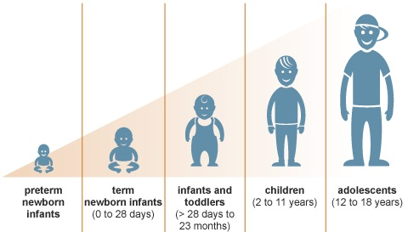
Periods of Growth

Slide 7
Periods of Growth
Prenatal Period
Ovum – 0 to 14 days
Embryo – 14 days to 9 weeks
Fetus – 9 weeks to birth
Postnatal Period
Newborn – birth to 4 weeks of life
Infancy – first year
Toddler – 1 to 3 years

Slide 8
Preschool – 3 to 6 years
School – 6 to 10 years (girls), 6 to 12 years (boys)
Adolescence – 10 to 19 years
Periods of fast growth – first year and adolescence

Slide 9
Pattern of Weight Gain
Birth weight – 2.5 to 3.5 kg
First 4 months – 30 gm/day
Second 4 months – 20 gm/day
Last 4 months – 10 gm/day
Then about 2 kg/year up to 6 years
Then about 3 kg/year till pubertal growth spurt
Mid adolescence – 3-4 kg/year
Late adoleacence – 1 kg/year
Birth weight doubles at 5 months, triples at 1 year, four times at 2 years of age

Slide 10
Pattern of Height Gain
Birth – 45 to 55 cm
6 months – 65 – 67 cm
1 year – 75 cm
2 year – 87 cm
Then about 5 cm/year till puberty
Mid adolescence – about 8 to 10 cm/year
Late adolescence – little increase (2-3 cm/year)

Slide 11
Pattern of Head Growth
Birth – 35 cm
First 3 months – 2 cm/month
3 to 9 months – 1 cm/year
9 to 12 months – 0.5 cm/year
2nd and 3rd year – 2 cm/year
4th and 5th year – 1 cm/year
Then – little/no increase

Slide 12
Assessment of Growth
Weight measurement
Height measurement
Head size measurement
Plotting them on appropriate growth charts. (between 97th percentile and 3rd percentile is considered as normal)

Slide 13
Expected Weight for Age
< 1 year of age – (age in months + 9)/2
2 to 6 years – (2 × age in years) + 8
7 to 12 years – ((7 × age in years) – 5)/2
Up to 80% of expected is considered as normal.

Slide 14
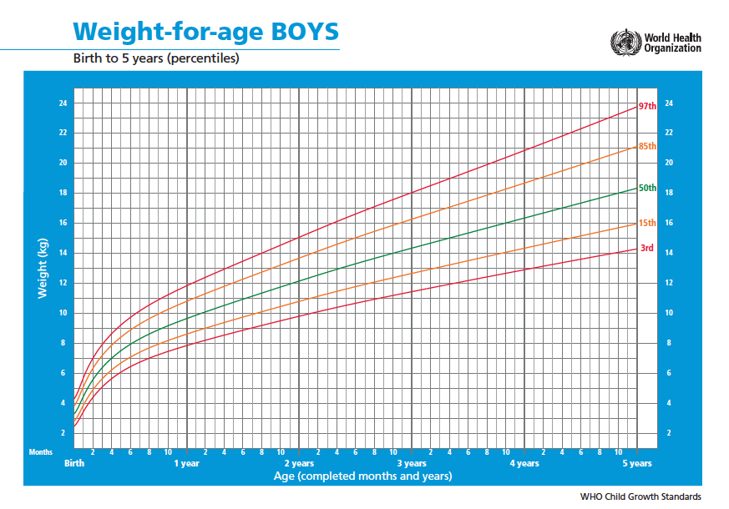

Slide 15
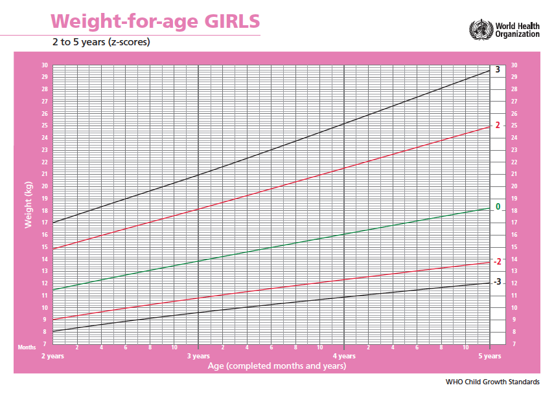

Slide 16
Expected Height for Age
After 2 years of age – (6 × age in years) + 77
< 90% of expected is considered as abnormal.

Slide 17
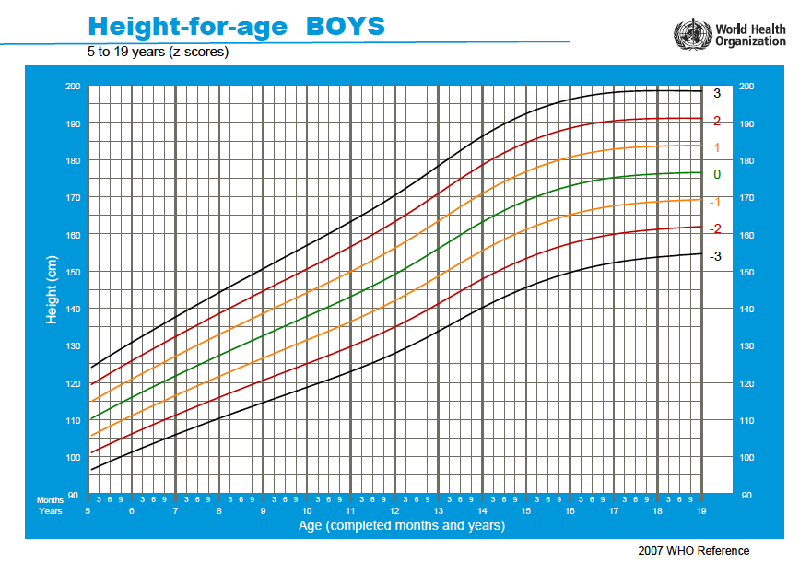

Slide 18
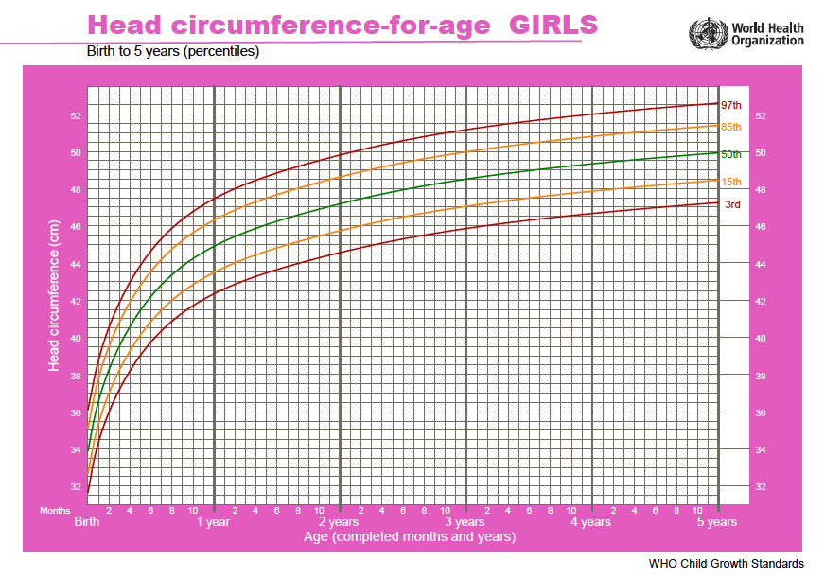

Slide 19
Disorders of Growth
Malnutrition
Obesity
Short stature
Tall stature

Slide 20
Key Gross Motor Milestones
3 months – neck (head) holding
5 months – rolls over (first from prone to supine)
6 months – sitting with support, rolls from supine to..
8 months – sitting without support
9 months – crawling
10 months – standing with support
12 months – standing without support, walking with support
13 months – walking without support

Slide 21



Head Holding – 3 Months

Slide 22


Sitting with Support – 6 Months

Slide 23

Sitting without Support – 8 Months

Slide 24
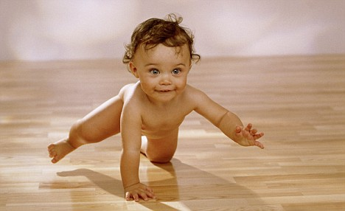

Crawling – 9 Months

Slide 25



Standing with Support – 10 Months

Slide 26
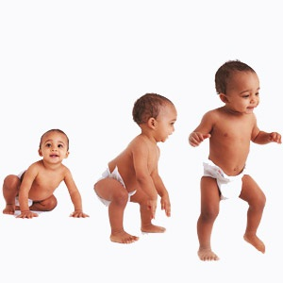


Standing without Support, Walking with Support – 12 Months

Slide 27
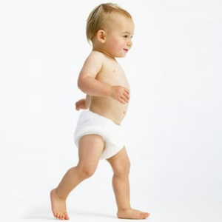
Walking without Support – 13 Months

Slide 28
15 months – walks backwards or sidewise pulling a toy
18 months – running crudely
24 months – runs well, walking upstairs one step at a time
36 months – climbs upstairs one foot per step, tricycle riding, jumps with both feet
4 years – standing with one foot
5 years – hopping – on one feet - & both feet
7 years – skipping rope

Slide 29
Key Fine Motor Milestones
3 – 5 months – hand regard
4 months – grasps a rattle or rings when placed in hand
5 months – reaches out to an object and holds it with both hands (bidextrous approach)
6 months - unidextrous approach, transfers objects from one hand to other. Plays with feet, takes feet to mouth. Mouthing
7 months – holds object with crude grasp from plam – palmar grasp (ulnar grasp) (8 mo – radial grasp)
9 months – holding small objects like a pellet between index finger and thumb – pincer grasp (with ulnar support) (1 year – without ulnar support) (1 year – releases object on request, casting)
1 year – tries self feeding with spoon with spilling
15 months – self feeding with spoon without spilling
18 months – self feeding with cup

Slide 30
13 months – can turn 2 to 3 pages of a book at a time
24 months – can turn one page of a book at a time
12 months – scribbling
2 years – horizontal or vertical line
3 years – circle
4 years – + sign, rectangle
5 years - × sign, triangle
3 years – dresses and undresses, takes off shoes & socks
5 years – tie shoelace

Slide 31
Key Language Milestones
3 months – cooing, babbling
4 months – laughs aloud
6 months – monosyllables (ma, ba)
9 months – bisyllables (mama, baba)
12 months – 2 words with meaning
18 months – 10 words with meaning
24 months – simple sentences
36 months – tells a story, nursery rhyme
48 months – narrate recent event

Slide 32
Key Personal Social Milestones
2 months – social smile (watches mother when spoken to, and smiles)
3 months – recognizes mother
4 months – excited at the sight of food
6 months – smiles at mirror image, shows displeasure when toy is pulled off
7 months – stranger anxiety
9 months – waves bye-bye, responds to name, stops in response to “no”
12 months – plays a simple ball game. Indicates his wants, mainly by pointing. Kisses parents on request.

Slide 33
18 months – mimics action of others. Calls mother when he wants potty. Points to three parts of body on request.
24 months – points to four parts of body on request. Listens to stories.
36 months – knows age & gender, parallel play
4 years – washes face, brushes teeth. Use toilet by self.
5 years – domestic role play

Slide 34
Overall Developmental quotient
Separate quotient of each domain
Up to 85% is considered as normal
Motor age – gross motor & fine motor
Mental age – language & social

Slide 35
Causes of developmental delay
Prenatal – genetic disorders (Down’s), maternal drugs, alcohol abuse, smoking, radiation, malnutrition, maternal infections, obstetric problems
Neonatal – prematurity, asphyxia, kernicterus, hypoglycemia, meningitis
Postnatal – malnutrition, hypothyroidism, meninigitis, encephalitis, environmental toxins – lead & mercury, emotional & psychological problems, lack of stimulation

Slide 36
Patterns of Developmental Delay
Global delay – Cerebral palsy, Down’s syndrome, congenital hypothyroidism
Isolated motor delay – cerebral palsy, spinal muscular atrophy, myopathies, neuromuscular disorders
Isolated speech delay

Slide 37
THANK YOU !

