Slide 1
Takayasu’s Arteritis
Dr Cinosh Mathew
Associate Professor
Dept of Cardiology
SBKS MI & RC

Slide 2
Definition
Rare, systemic, inflammatory large-vessel vasculitis of unknown etiology.
Commonly affects women of childbearing age.
It is defined as "granulomatous inflammation of the aorta and its major branches“.

Slide 3
Synonyms
Takayasu’s Arteritis
Aortoarteritis
Pulseless Disease
Young female Arteritis
Occlusive thromboaortopathy
Aortic arch syndrome

Slide 4
History
1908- Takayasu, professor of ophthalmology - 21 yrs. woman with characteristic fundal arterio- venous anastomoses and absent radial pulse.
1921- Shikare- first case report in India
1962 & 1971 –Sen – Middle Aortic Syndrome and association with TB in 101 cases.
1993- Chappel Hill - Takayasu Arteritis as granulomatous inflammations of Aorta and its major branches.

Slide 5
Epidimiology
Worldwide incidence: 2.6 cases per million per year.
More frequent in Asian countries - Japan, Korea, China, India, Thailand, Singapore and Turkey.
Japanese patients with Takayasu arteritis → higher incidence of aortic arch involvement.
In contrast, series from India report higher incidences of abdominal involvement.
Age:
Predominantly a disease of young females: 2nd or 3rd decades.
Mean age:
  European study - 41yrs
  Japan - 29yrs
  India – 24yrs
Sex:
F>M (~80% women)
India – F : M = 1.6 : 1

Slide 6
Pathophysiology
Inflammatory disease of large- and medium-sized arteries.
Predilection for the aorta and its branches.
Advanced lesions demonstrate a panarteritis with intimal proliferation, fibrosis, scarring and vascularisation of media.
Lesions → stenotic, occlusive, or aneurysmal.
Vascular changes → complications
  Hypertension - renal artery stenosis, stenosis of the suprarenal aorta;
  Aortic insufficiency due to aortic valve involvement;
  Pulmonary hypertension;
  Aortic or arterial aneurysm.

Slide 7
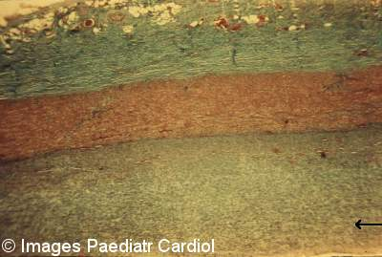
Chronic phase of Takayasu’s Arteritis - fibrosis in all the layers of the vessel wall and markedly thickened intima.

Slide 8
Other pathophysiologic consequences include:
  Hypertensive ischemic retinopathy,
  Vertebrobasilar ischemia,
  Microaneurysms,
  Carotid stenosis,
  Hypertensive encephalopathy.

Slide 9
Etiology
Exact etiology is unknown.
Underlying pathologic process is inflammatory.
Several etiologic factors having been proposed:
  Spirochetes,
  Mycobacterium tuberculosis,
  Streptococcal organisms,
  Circulating antibodies due to an autoimmune process.
Genetic factors may play a role in the pathogenesis.
Raised ESR, leucocytosis, arthralgia and high titers of anti-aorta antibodies.
Rheumatic: A study showed some patients had raised ASO titre.
  Female predilection: Urinary estrogens elevated.
  Estradiol and progesterone (but not testosterones), enhance leucocyte adhesion to endothelial cells in the presence of TNF.

Slide 10
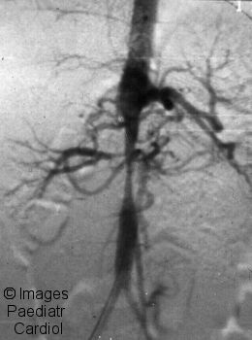

Slide 11
Antigen → Stimulates aortic tissue → Expression of heat shock protein-65
Major histocompatibility (MHC) class I–related chain A (MICA)
Natural killer and T-cells
Release of Proinflammatory cytokines
Matrix metalloproteinases (MMPs)
Inflammatory response

Slide 12
In a case report, M tuberculosis and its heat shock protein 65 was implicated in the etiology.
Patients with Takayasu arteritis were found to have higher IgG, IgM, and IgA titers against the M tuberculosis extract than did patients without the condition.

Slide 13
Clinical Presentation
~10% of patients are asymptomatic, with the disease detected based on abnormal vascular findings on examination.
Constitutional symptoms:
  Headache (50%-70%)
  Malaise (35%-65%)
  Arthralgias (28%-75%)
  Fever (9%-35%)
  Weight loss (10%-18%)

Slide 14
Cardiac and vascular features:
  Bruit, with the most common location being the carotid artery (80%)
  Blood pressure difference of extremities (45%-69%)
  Claudication (38%-81%)
  Carotodynia or vessel tenderness (13%-32%)
  Hypertension (28%-53%; 58% with renal artery stenosis in one series)
  Aortic regurgitation (20%-24%)
  Raynaud’s syndrome (15%)
  Pericarditis (< 8%)
  Congestive heart failure (< 7%)
  Myocardial infarction (< 3%)

Slide 15
Neurologic features:
  Headache (50%-70%)
  Visual disturbance (16%-35%) - Strong association with common carotid and vertebral artery disease
  Stroke (5%-9%)
  Transient ischemic attacks (3%-7%)
  Seizures (0%-20%)
Dermatologic manifestations:
  Erythema nodosum (6%-19%)
  Ulcerated subacute nodular lesions (< 2.5%)
  Pyoderma gangrenosum (< 1%)

Slide 16
PREGNANCY
Pregnancy per se does not exacerbate the disease
Management of hypertension is essential.
Maternal complications:
  Superimposed pre- eclampsia,
  Congestive cardiac failure,
  Progressive renal impairment.
Abdominal aortic involvement and a delay in seeking medical attention predicted a poor perinatal outcome.

Slide 17
On Examination
Particular attention to peripheral pulses.
Blood pressure in all 4 extremities.
Ophthalmologic examination.
The most discriminatory finding is a systolic blood pressure difference (>10 mm Hg) between arms.
Hypertension due to renal artery involvement (and sometimes leading to hypertensive encephalopathy) (~50% of patients).

Slide 18
Carotidynia may be present.
Aortic regurgitation is a common finding.
Absent or diminished pulses are the clinical hallmark of Takayasu arteritis.
Pulses can be normal in many patients.
Upper limbs are affected more often than lower limbs.
When pulselessness occurs, patient monitoring can be difficult or impossible → calf blood pressures must be obtained.

Slide 19
Ophthalmologic examination:
Retinal ischemia,
Retinal hemorrhages,
Cotton-wool exudates,
Venous dilatation and beading,
Microaneurysms of peripheral retina,
Optic atrophy,
Vitreous hemorrhage, and
Classic, wreathlike peripapillary arteriovenous anastomoses (extremely rare).

Slide 20
Dermatologic findings: resembling erythema nodosum or ulcerating nodular lesions may be seen.
Other significant findings include the following:
Vascular bruits – carotid, abdominal, subclavian and femoral arteries
Amaurosis fugax
Focal neurologic deficits consistent with cerebral infarction or TIA
Eclampsia
SAH, probably secondary to hypertension
Myocardial infarction, DCM
Pedal edema due to renal failure secondary to renal artery stenosis and glomerulonephritis

Slide 21
Differential Diagnosis
Takayasu arteritis is rare and difficult to diagnose.
Initially, symptoms are vague.
Disease may have progressed considerably on presentation and diagnosis.
  Aortic Coarctation
  Atherosclerosis
  Buerger Disease (Thromboangiitis Obliterans)
  Giant Cell Arteritis
  Sarcoidosis
  Systemic Lupus Erythematosus
  Wegener Granulomatosis

Slide 22
Approach & Work UP
Laboratory tests
Nonspecific.
ESR may be high (>50 mm/h) in early disease but normal later.
TLC: normal or slightly elevated.
A moderate, normochromic anaemia may be present in individuals with active disease.
Raised levels of soluble vascular cell adhesion molecule-1 (VCAM-1).
Hypoalbuminemia is common.
Urinalysis may be consistent with nephrotic syndrome.

Slide 23
Imaging studies
CT scanning and MRI:
  patterns of stenosis or aneurysms of the arteries.
Angiography:
  standard for diagnosis and evaluation of the extent of disease.
Studies show that noninvasive imaging modalities - MRI, USG and 18F-FDG-PET allow diagnosis of Takayasu arteritis earlier in the disease than standard angiography and provide a means for monitoring disease activity.
Angiography is used to evaluate only the appearance of the lumen and cannot be used to differentiate between active and inactive lesions.

Slide 24
Diagnostic Criteria
Ishikawa criteria (1986)
Obligatory: Age <40yrs; at the time of diagnosis, at onset of characteristic symptoms & signs of 1 month duration.
Major: 2 major
  Lesions in the left and right midsubclavian artery.
  The most severe stenosis or occlusion present in the mid portion of the artery from a 1 cm point proximal to the left and right, respectively, of the vertebral artery orifices to a 3-cm distal point to the orifice as determined by angiography.

Slide 25
Minor: 9 minor
  High ESR
  Common carotid artery tenderness
  Hypertension
  Aortic regurgitation or annuloaortic ectasia
  Lesions of the pulmonary artery
  Left mid common carotid artery
  Distal brachiocephalic trunk
  Thoracic aorta
  Abdominal aorta
Diagnosis:
  Obligatory criteria + 2 Major criteria or 1 Major and ≥ 2 Minor criteria or ≥4 Minor criteria.
Sensitivity of 60.4% and specificity of 95%.

Slide 26
Modified Ishikawa's Criteria for Takayasu's Arteritis (Modified According to Sharma et al.), 1996
The proposed modifications include:
removal of the obligatory criteria of age less than 40 years;
inclusion of characteristic signs and symptoms as a major criteria;
removal of age in defining hypertension;
deletion of the absence of aorto-iliac lesion, in defining abdominal aortic lesion; and
an addition of coronary artery lesion in absence of risk factors.

Slide 27
Three major criteria:
Left mid-subclavian artery lesion
Right mid-subclavian artery lesion
Characteristic signs and symptoms of at least 1 month duration
  claudication,
  pulselessness or pulse differences in limbs,
  unobtainable or significant blood pressure difference (> 10 mmHg systolic blood pressure difference in limb),
  fever,
  neck pain,
  transient amaurosis,
  blurred vision,
  syncope,
  dyspnea or
  palpitations.

Slide 28
Ten minor criteria:
1. High ESR (>20 mm/h)
2. Carotid artery tenderness
3. Hypertension
4. Aortic regurgitation or annuloaortic ectasia
5. Pulmonary artery lesion
6. Left mid common carotid lesion
7. Distal brachiocephalic trunk lesion
8. Descending thoracic aorta lesion
9. Abdominal aorta lesion
10. Coronary artery lesion
Diagnosis: (a) two major or (b) one major and two minor criteria or (c) four minor criteria.
Sensitivity of 92.5% and specificity of 95%.

Slide 29
1990 Criteria of American College of Rheumatology (ACR) for the Classification of Takayasu Arteritis
Criteria | Definition
1. Age at disease onset in year | Development of symptoms or findings related to Takayasu arteritis at age <40 years.
2. Claudication of extremities | Development and worsening of fatigue and discomfort in muscles of one or more extremity while in use, especially the upper extremities.
3. Decreased brachial artery pulse | Decreased pulsation of one or both brachial arteries.
4. BP difference >10mmHg | Difference of >10mmHg in systolic blood pressure between arms.
5. Bruit over subclavian arteries or aorta | Bruit audible on auscultation over one or both subclavian arteries or abdominal aorta.
6. Arteriogram abnormality | Arteriographic narrowing or occlusion of the entire aorta, its primary branches, or large arteries in the proximal upper or lower extremities, not due arteriosclerosis, fibro-muscular dysplasia, or similar causes: changes usually focal or segmental.

Slide 30
Diagnosis:
  3 of these 6 criteria. (Sensitivity 77.4%, specificity 95%)
  >3 criteria yields a sensitivity of 90.5% and a specificity of 97.8%.

Slide 31
Takayasu arteritis can be divided into the following 6 types based on angiographic involvement:
Type I - Branches of the aortic arch
Type IIa - Ascending aorta, aortic arch, and its branches
Type IIb - Type IIa region plus thoracic descending aorta
Type III - Thoracic descending aorta, abdominal aorta, renal arteries, or a combination
Type IV - Abdominal aorta, renal arteries, or both
Type V - Entire aorta and its branches

Slide 32

Type I - Branches of the aortic arch.

Slide 33

Type IIa - Ascending aorta, aortic arch,
and its branches.

Slide 34
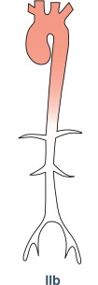
Type IIb - Type IIa region plus thoracic
descending aorta.

Slide 35
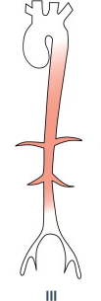
Type III - Thoracic descending aorta,
abdominal aorta, renal arteries, or
a combination.

Slide 36
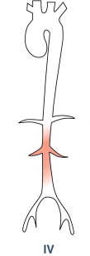
Type IV - Abdominal aorta, renal arteries,
or both.

Slide 37

Type V - Entire aorta and its branches.

Slide 38
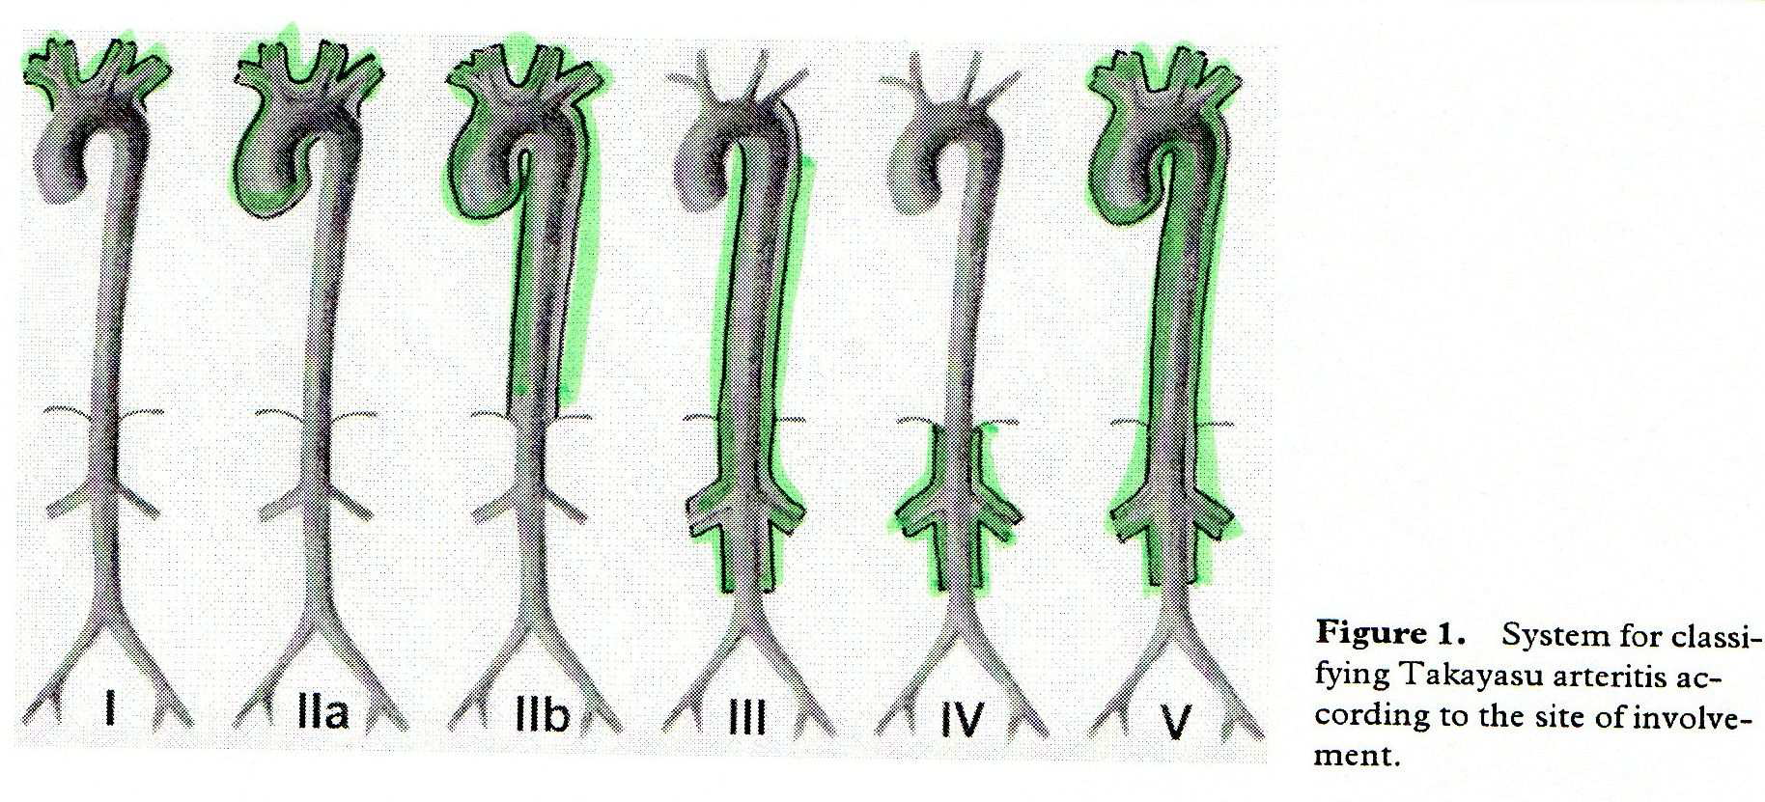

Slide 39
Disease Activity
New onset or worsening of 2 or more of the following features indicates active disease:
Systemic features: Fever and arthralgias (no identified cause).
Elevated ESR.
Features of vascular ischemia or inflammation → claudication, diminished or absent pulse, bruit, carotodynia, or asymmetrical blood pressure in either the upper or lower limbs (or both).
Typical angiographic features.

Slide 40
Histologic Findings
The early stage: continuous or patchy granulomatous inflammatory reaction involving macrophages, lymphocytes, and multinucleated giant cells.
Inflammation initially occurs in the vasa vasorum → artery wall becomes irregularly thickened and the lumen becoming narrowed.
Takayasu arteritis progresses to a sclerotic stage, with intimal and adventitial fibrosis and scarring of the media.
Lesions are initially inflammatory and later become occlusive.
Inflammatory cells—predominantly CD4 and CD8 lymphocytes, macrophages, plasma cells, histiocytes, and giant cells—invade the adventitia and media but not the intima.

Slide 41
Treatment and Management
APPROACH
Medical management depends on:
  disease activity and
  the complications that develop.
The two most important aspects of treatment:
  controlling the inflammatory process and
  controlling hypertension.

Slide 42
Corticosteroids
Mainstay of therapy for active disease.
Some patients may require additional cytotoxic agents to achieve remission and taper of chronic corticosteroid treatment.
Oral corticosteroids - 1 mg/kg daily or divided twice daily and tapered over weeks to months as symptoms subside.
IL-6 receptor inhibitor
Humanized monoclonal antibody tocilizumab.
IL-6 as a major component in the proinflammatory process of large-vessel vasculitis.
Remission using tocilizumab as monotherapy. Then shifting to methotrexate for maintenance therapy.

Slide 43
B-cell depletion
Rituximab, a chimeric IgG1 antibody that binds to CD20 expressed on the surface of B cells, has shown to improve clinical signs and symptoms.
Cytotoxic agents
Used for patients whose disease is steroid resistant or relapsing.
Continued for at least 1 year after remission and are then tapered to discontinuation.
Methotrexate (0.3 mg/kg/week), azathioprine (1-2 mg/kg/day), and cyclophosphamide (1-2 mg/kg/day).
Cyclophosphamide should be reserved for patients with the most severe and refractory disease states.

Slide 44
Anti-tumor necrosis factor agents
Used in relapsing disease.
Initial dose of etanercept was 25 mg twice weekly (7 patients);
infliximab (11 patients [3 were switched from etanercept to infliximab]) was given at 3 mg/kg initially and at 2 weeks, 6 weeks, and then every 8 weeks thereafter.
In 9 of the 14 responders, an increase in the anti-TNF dosage was required to sustain remission.

Slide 45
Cardiovascular procedures
Bypass graft surgery: best long-term patency rate.
Percutaneous balloon angioplasty: good outcomes for short lesions.
Angioplasty and stenting: for recurrent stenosis.
Conventional stents: high failure rates.
Other procedures include aneurysm clipping and revascularization.
PTCA is followed by restenosis at the angioplasty site within 1-2 years in a substantial number of patients.

Slide 46
Surgical Therapy:
Critical stenotic lesions should be treated by angioplasty or surgical revascularization during periods of remission. Indications for surgical repair or angioplasty are as follows:
Renovascular stenosis causing hypertension
Coronary artery stenosis leading to myocardial ischemia
Extremity claudication induced by routine activity
Cerebral ischemia and/or critical stenosis of 3 or more cerebral vessels
Aortic regurgitation
Thoracic or abdominal aneurysms larger than 5 cm in diameter
Severe coarctation of the aorta

Slide 47
Bypass graft surgery
Critical thoracic aortic arch arterial stenosis, upper and lower extremity ischemia, cerebrovascular accidents, and renal artery stenosis.
Anastomotic stenosis or graft occlusion is a potential complication of surgery.
Usually, the graft is a saphenous vein graft.
Examples:
  Bypass of renal artery stenosis for renal salvage;
  Bypass of innominate or carotid artery;
  Bypass between subclavian-axillary and common carotid arteries;
  Extraintracranial bypass operations generally are performed for stenosis of the internal carotid or middle cerebral arteries.

Slide 48
Cardiovascular risk factors
STRICT CONTROL of dyslipidemia, hypertension, and lifestyle factors that increase the risk of cardiovascular disease. These complications are the major cause of death in Takayasu arteritis.
Aggressive therapy for hypertension.
Low-dose aspirin may have a therapeutic effect in large vessel vasculitis.
Antiplatelet agents and heparin may prove useful in preventing stroke.
Warfarin also has been used.
The literature reports a case of improvement in renal and systemic function with low-dose intravenous (IV) heparin therapy (10,000 U/d) followed by oral anticoagulant and antiplatelet agents.

Slide 49
Pregnancy
Important concern in Takayasu arteritis.
Aggressive treatment required.
Exacerbate hypertension and/or cardiovascular complications.
Increase risk for maternal and fetal morbidity and mortality.
Pregnancy may be safer during presumed remission of Takayasu arteritis.

Slide 50
Prognosis
Substantial morbidity and mortality.
Approximately 20% of patients have a monophasic and self-limited disease.
A National Institutes of Health (NIH) study of 60 patients with Takayasu arteritis:
  20% of patients had a monophasic illness, self-limiting illness and therefore did not require immunosuppressive treatment.
  Remaining 80% of patients, who did not have a monophasic illness and who experienced 1 exacerbation, immunosuppressive therapy resulted in remission in 60%.
  Of these, one half experienced relapse after immunosuppressive therapy was stopped.

Slide 51
Complications
Stroke
Intracranial haemorrhage
Seizures
Graft stenosis and/or occlusion
Ischemia
Organ failure
Complications of hypertension
Foetal injury
Valvular heart disease
Retinopathy
Renovascular hypertension
Long-term use of corticosteroids: infection, adrenal suppression, cataracts, hyperglycemia, hypertension (which complicates blood pressure control), osteoporosis, and aseptic necrosis.

Slide 52
Morbidity and mortality
Overall 10-year survival rate is approximately 90%.
Rate is reduced in the presence of major complications.
5- and 10-year survival rates are approximately 69% and 36%, respectively, in patients with 2 or more complications.
5- and 10-year survival rates associated with 1 or fewer complications are 100% and 96%, respectively.
Disease remission is the only factor that positively influences physical and mental quality of life.

Slide 53
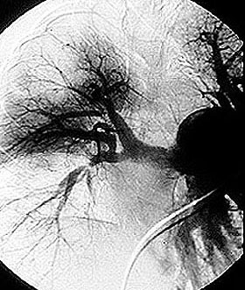
Lung Involvement
Pulmonary angiogram demonstrating beading and cut–off lesions of the RPA, and a large aneurysm of the LPA.

Slide 54
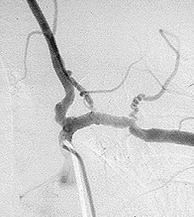
Close–up view of an angiogram of the left vertebral and subclavian arteries in a patient with Takayasu’s arteritis. Note the narrowing and irregularities that occur at several sites, and the “corkscrew” configuration of one vessel segment near the junction of the two arteries. These changes, caused by inflammation in the blood vessel wall, sometimes cause complete blockage of the artery.

Slide 55
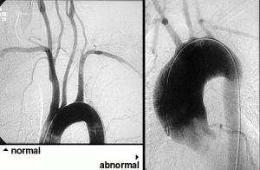
Normal aortic arch on the left, with narrow, smooth blood vessels.
On the right, an abnormal aortic arch in a patient with Takayasu’s, with obvious dilation of the ascending aorta.

Slide 56
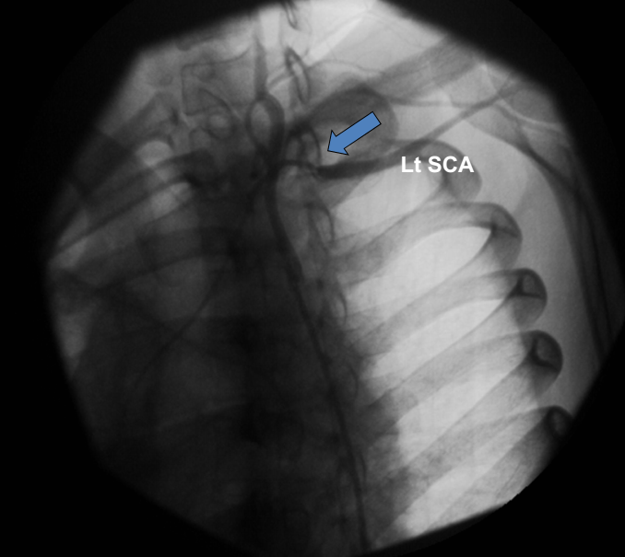

Slide 57
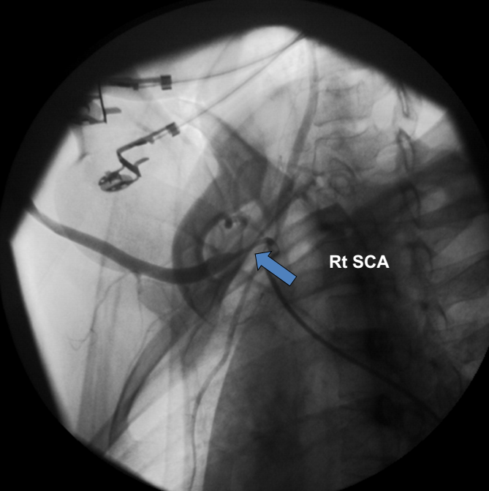

Slide 58
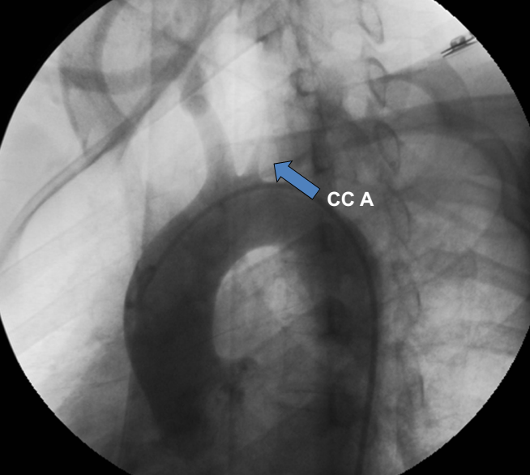

Slide 59
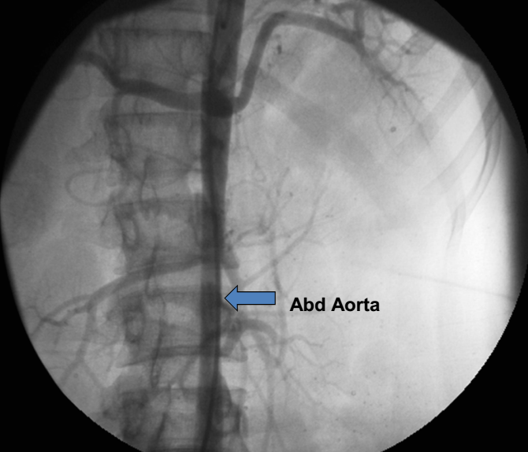

Slide 60
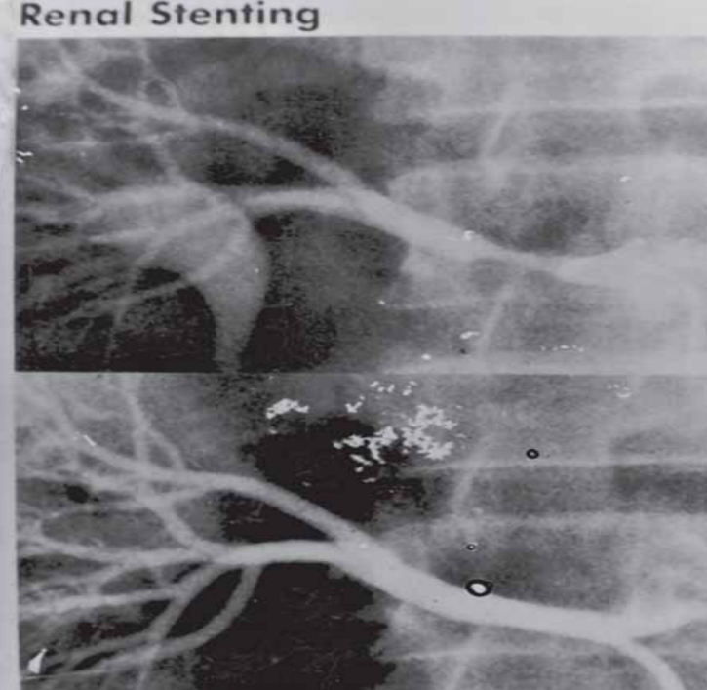

Slide 61
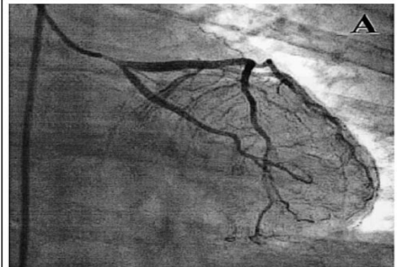
(A) Left coronary selective injection revealed 90% stenosis in the ostium of the left main coronary artery (LMCA).

Slide 62
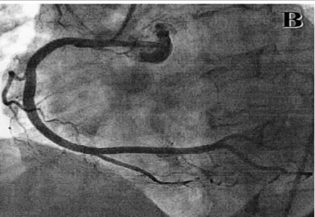
(B) Intact right coronary artery.

Slide 63
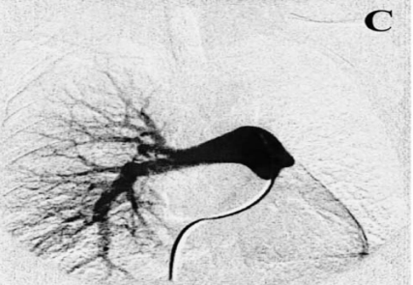
(C) Totally occluded left pulmonary artery.

Slide 64
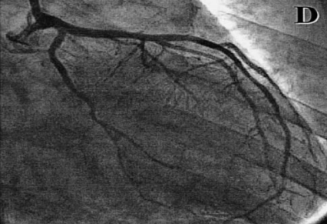
(D) Left coronary angiography after percutaneous coronary stenting. The 90% stenosis of the LMCA was successfully dilated to 0%.

Slide 65
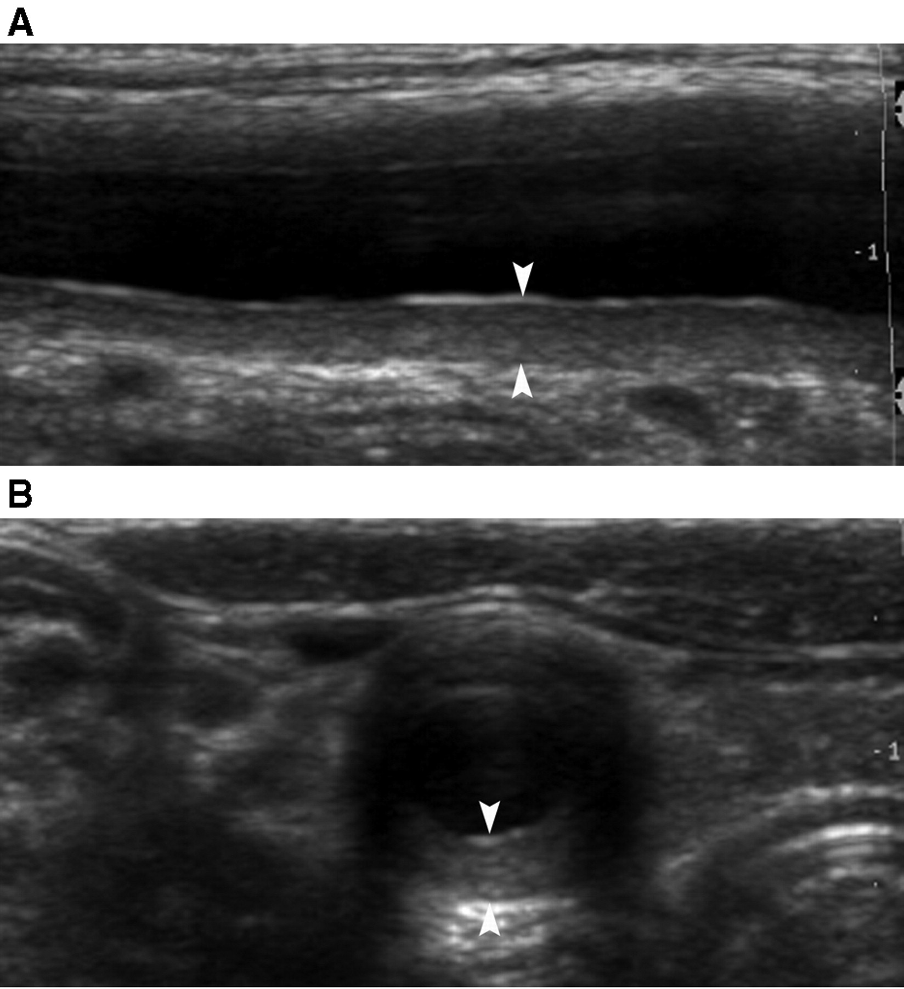
Ultrasound examination of the right carotid artery in
(A) longitudinal and (B) cross-section: marked echogenic mural thickening.

Slide 66
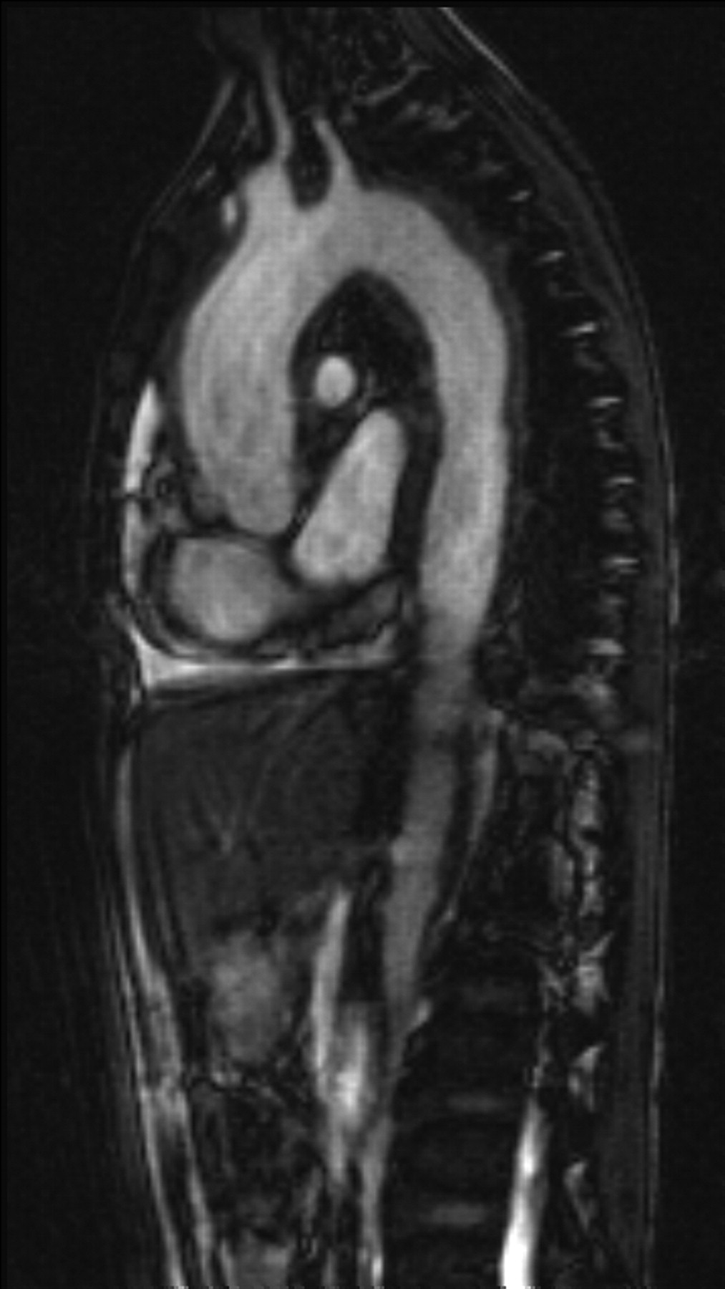
12-year-old girl with TA.
MRI: sagittal oblique section: pronounced thickening of the aortic wall in its entire length Ectasia of the ascending aorta, aortic arch and descending aorta.

Slide 67
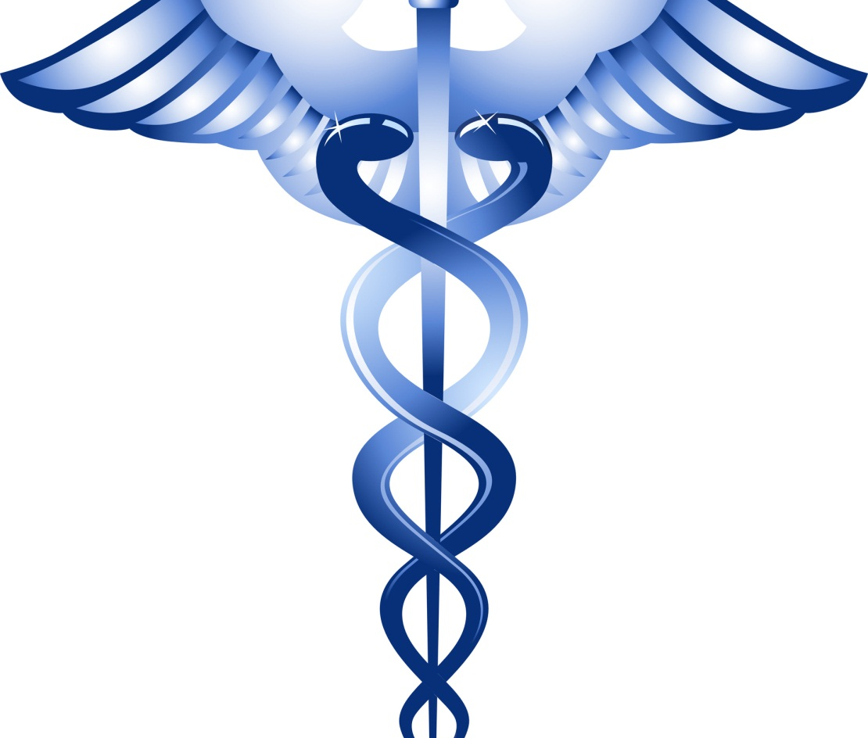
thank you

