Slide 1
Cardiac cycle with JVP

Slide 2
Cardiac cycle
Defined as the seqeunce of coordinated events which takes place during eac heartbeat called as cardiac cycle.
Divided in two stages:
(a) systole
(b) diastole

Slide 3
Systole:
(a) isovolumic contraction
(b) period of ejection
Diastole:
(a) isovolumic relaxation
(b) passive ventricular filling
(c) active ventricular filling

Slide 4
Semilunar
valves closed
Semilunar
valves opened
AV valves
closed
AV valves
closed
1. Systole: Period of isovolumic
contraction. Ventricular
contraction causes the AV valves
to close, which is the beginning
of ventricular systole. The
semilunar valves were closed in
the previous diastole and remain
closed during this period.
2. Systole: Period of ejection.
Continued ventricular
contraction pushes blood out of
the ventricles, causing the
semilunar valves to open.
Semilunar
valves closed
Semilunar
valves closed
AV valves
opened
AV valves
closed
5. Diastole: Active ventricular
filling. The atria contract
and complete ventricular
filling.
3. Diastole: Period of isovolumic
relaxation. Blood flowing back
toward the relaxed ventricles
causes the semilunar valves to
close, which is the beginning of
ventricular diastole. Note that
the AV valves closed, also.
4. Diastole: Passive ventricular
filling. The AV valves open and
blood flows into the relaxed
ventricles, accounting for most
of the ventricular filling.
Semilunar
valves closed
AV valves
opened

Slide 5
Jugular venous pressure
Defined as the height of oscillating column in right Internal Jugular Vein that reflects pressure changes in Right Atrium in cardiac cycle.

Slide 6
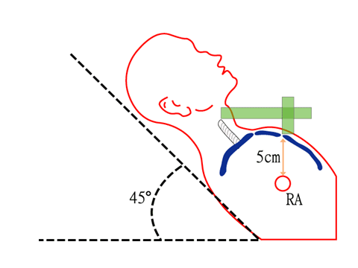
Method to examine JVP

Slide 7
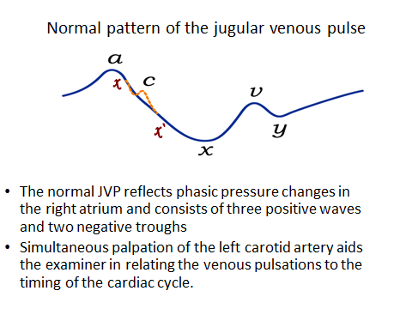

Slide 8
a WAVE:
Venous distension due to RA contraction
Synchronous with S1
Followed by P wave of ECG
Precede Carotid pulse
x descent:
X - Atrial relaxation
X` - Descent of the floor of the right atrium
during right ventricular systole.
Begins during systole and ends before S2

Slide 9
c wave:
Occurs simultaneously with the carotid pulse
Bulging of TV into RA during ICP
v wave
Rising right atrial pressure when blood flows into the right atrium during ventricular systole
Synchronous with Carotid pulse
Begins in early systole, Peaks after S2 and ends in early diastole

Slide 10
y DESCENT
The decline in right atrial pressure when the tricuspid valve reopens

Slide 12
Abnormalities of jugular venous pulse
Low jugular venous pressure
1. Hypovolaemia.

Slide 13
B. Elevated jugular venous pressure
1. Intravascular volume overload conditions
Right ventricular infarction
Left heart failure
Myocardial infarction.
Valvular Heart Disease
Cardiomyopathy
2. Constrictive pericarditis.
3. Pericardial effusion with tamponade

Slide 14
a wave abnormalities
Elevated
1.Tricuspid stenosis
2.R Heart Failure
3.PS
4.PAH
Absent
1. atrial fibrillation
Canon a wave
1.Complete heart block
2.VPC
3.Ventricular tachycardia
4.Ventricular pacing
5.Junctional rhythm
6.Junctional tachycardia.

Slide 15
v wave abnormalties
1. Tricuspid regurgitation.
2. Right ventricular failure.
3. Restrictive cardiomyopathy.
4. Cor Pulmonale

Slide 16
x wave abnormalities
Prominent “x” descent
Cardiac tamponade.
Constrictive Pericarditis
RVMI
Restrictive Cardiomyopathy
Atrial septal defect
Blunted “x” wave
1.Tricuspid regurgitation.
2. Right atrial ischaemia

Slide 17
y wave abmormalities
Prominent y descent
1.Constrictive pericarditis.
2. Tricuspid regurgitation.
3. Atrial septal defect.
Absent y descent
1.Cardiac tamponade.
2. Right ventricular infarction
3. Restrictive Cardiomyopathy
Slow y descent
1. Tricuspid stenosis.
2. Right atrial myxoma.

Slide 18
THANK YOU

