Slide 1
Management of Pulmonary Hypertension
Dr. Jayesh Rawal
MD, DM,
Interventional Cardiologist
Prof. and HOD Cardiology Dept.
Dhiraj Hospital

Slide 2
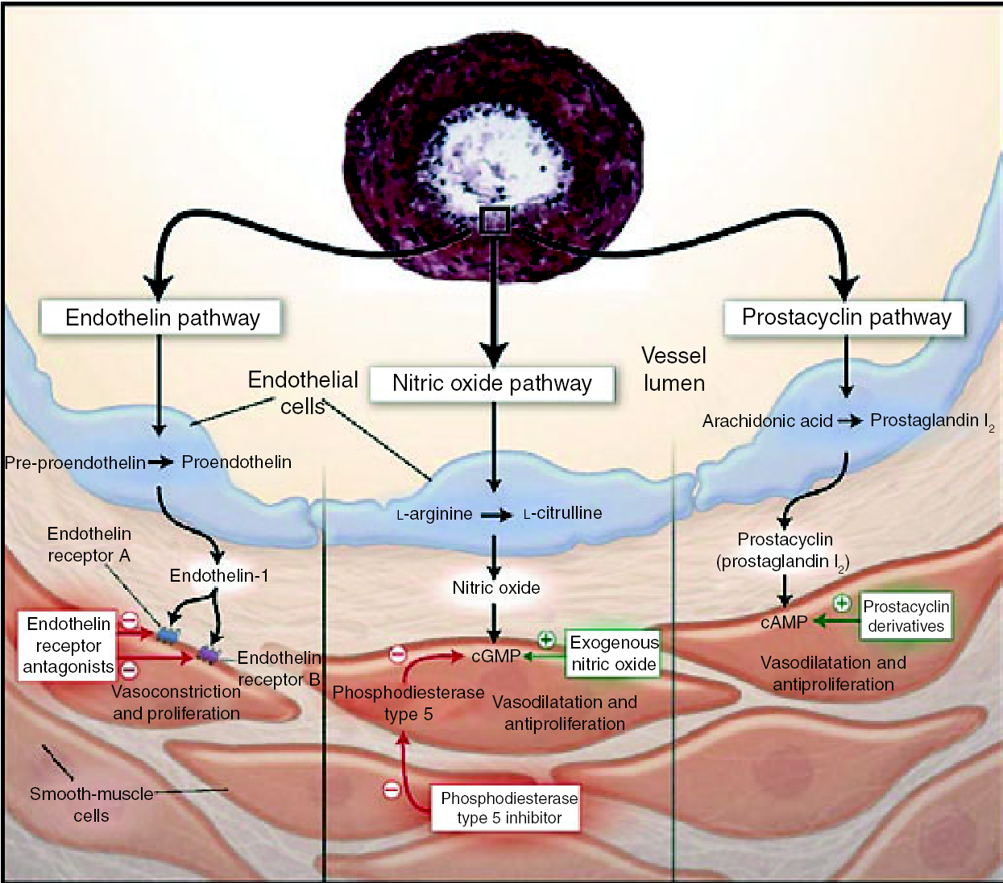
Pathogenic Pathways and Treatment Targets in PAH
Humbert M et al: N Eng J Med 2004; 351: 1425-1436
Notes:
2

Slide 3
Targeted Therapies for PAH
PAH Treatment
Endothelin Pathway
Nitric Oxide Pathway
Prostacyclin Pathway
Endothelin Receptor Antagonists
Phosphodiesterase 5 Inhibitors
Prostacyclin Derivatives
Epoprostenol,
Treprorostinil
Beraprost
Inhaled iloprost, Intravenous iloprost
Bosentan, Ambrisentan, Macitentan
Sildenafil, Tadalafil, Riociguat
N Engl J Med 2004; 351: 1425-1436

Slide 4
Evidence-based treatment algorithm: Part 1

Slide 5
Evidence-based treatment algorithm: Part 2
Initial Monotherapy
Initial Oral Combination
Initial Combination including PCA
Inadequate Clinical Response
Double or Triple Sequential Combination
Inadequate Clinical Response
Consider for Lung Transplantation

Slide 6
5th World Symposium on PH: Evidence-based treatment algorithm
Combination therapy and interventional procedures
Initial therapy with PAH approved drugs
Inadequate clinical response
Consider eligibility for
lung transplantation
Sequential combination
therapy (I-A)
Inadequate clinical
response on
maximal therapy
Referral for
LUNG TRANSPLANTATION
(I-C)
ERAs
+
+
Prostanoids
+
PDE-5i
or sGCS
BAS (IIa-C)
receptor antagonist; PDE-5i: phosphodiesterase-5 inhibitor;
sGCS: soluble guanylate cyclase stimulator
Galiè N, et al. J Am Coll Cardiol 2013; 62:D60-72.

Slide 7
Approval of PAH therapies
Beraprost†
1999
Iloprost inhaled
2004 – US
2003 – Europe
Iloprost i.v.
Only approved in New Zealand
Room-temperature stable epoprostenol i.v.
2012 – US, Switzerland & Canada
2013 – Japan & Europe*
Bosentan
2001 – US
2002 – Europe
Sildenafil
2005
Beraprost‡†
2007
1995
2000
2005
2010
2015
Epoprostenol i.v.
1995 – US
2001 – Europe
Treprostinil i.v. or s.c.
2002 – US
2005 – Europe
Ambrisentan
2007 – US
2008 – Europe
2013
Macitentan†
Treprostinil oral†
US
Riociguat†
2013 – US
2014 – Europe
2009
Treprostinil inhaled†
Tadalafil
2008 – Europe
2009 – US
*End of decentralised procedure in EU; local approvals ongoing
†Approval of these therapies varies by country, and thus they might not be approved in the indications mentioned in your country. Please refer to your local full SmPC before prescribing.
‡Prolonged release derivative

Slide 8
Classes of Recommendations: Predefined Scales
Eur Respir J. 2015 Aug 29. pii: ERJ-01032-2015

Slide 9
Level of Evidence: Predefined Scales
Eur Respir J. 2015 Aug 29. pii: ERJ-01032-2015

Slide 10
Recommendation for General Measures
Eur Respir J. 2015 Aug 29. pii: ERJ-01032-2015
Eur Respir J 2012; 40: 881–885
Eur Respir J 2009; 34: 669–675

Slide 11
Recommendation for Supportive Therapy
Eur Respir J. 2015 Aug 29. pii: ERJ-01032-2015
Am J Med 2001; 111: 577
Am J Respir Crit Care Med 2014; 189: A2464
J Am Coll Cardiol 2011; 58: 300–309

Slide 12
Recommendation for CCBs in Vasoreactive Patients
Eur Respir J. 2015 Aug 29. pii: ERJ-01032-2015
Circulation 2005; 111: 3105–3111
N Engl J Med 1992; 327: 76–81

Slide 13
Endothelin pathway :
Bosentan
Dual endothelin-A and –B receptor antagonist
Chemically - belongs to sulphonamide class of ERA
Bosentan has been evaluated in
  PAH (idiopathic, associated with connective tissue disease and Eisenmenger’s syndrome)
  In 5 RCTs (Study-351, BREATHE [Bosentan Randomised trial of Endothelin Antagonist THErapy]-1, BREATHE-2, BREATHE-5, and EARLY [Endothelin Antagonist trial in mildly symptomatic pulmonary arterial hypertension patients]
Bosentan has shown improvement in exercise capacity, functional class, hemodynamics, echocardiographic and Doppler variables, and time to clinical worsening

Slide 14
Bosentan
In approximately 10% of the subjects on bosentan, developed increases in hepatic aminotransferases which were found to be dose-dependent and reversible after dose reduction or discontinuation
Hence, monthly liver function testing is recommended in patients receiving bosentan

Slide 15
Ambrisentan
Selective for the endothelin-A receptor
Chemically belongs to nonsulfonamide, propanoic acid class of endothelin receptor antagonist (ERA)
Clinically studied in 2 large RCTs (ARIES [Ambrisentan in pulmonary arterial hypertension, Randomized, double-blind, placebocontrolled, multicentre, Efficacy Study]-1 and -2)
These studies have demonstrated positive efficacy of ambrisentan on symptoms, exercise capacity, hemodynamics, and time to clinical worsening of patients with idiopathic PAH and PAH associated with connective tissue disease and human immunodeficiency virus infection

Slide 16
Ambrisentan
Currently, approved for the treatment of patients with WHO-FC II and III
Unlike other ERA, ambrisentan shows no tendency for development of abnormal liver function tests and hence, monthly liver function assessment is not mandated
However, an increased incidence of peripheral edema has been reported with ambrisentan use

Slide 17
Macitentan
Macitentan is the latest approved dual ERA which was developed by modifying the structure of bosentan to its increase efficacy and safety.
Sustained receptor binding and enhanced tissue penetration are the key characteristics of macitentan.
In the event driven SERAPHIN (Study with an Endothelin Receptor Antagonist in Pulmonary Arterial Hypertension to Improve Clinical Outcome) study, 742 PAH patients were treated for an average of 100 weeks with 3 or 10 mg macitentan as compared with placebo.

Slide 18
Macitentan
Macitentan significantly reduced the time from the initiation of treatment to the first occurrence of a composite endpoint of death, atrial septostomy, lung transplantation, initiation of treatment with intravenous or subcutaneous prostanoids, or worsening of PAH with an increase in exercise capacity.
Macitentan caused no liver toxicity but a reduction in blood hemoglobin ≤8 g/dl was observed in 4.3% of patients receiving 10 mg.

Slide 19
Nitric Oxide Pathway
The pathogenesis of PAH involves, impairment of NO synthesis and signaling through the NO–soluble guanylate cyclase (sGC) – cyclic guanosine monophosphate (cGMP) pathway.
Soluble guanylate cyclase stimulators
  The sGC stimulators (riociguat) enhance cGMP production and are potentially effective also in conditions in which endogenous NO is depleted, unlike the PDE-5is (sildenafil, tadalafil) which enhance the NO–cGMP pathway thus slowing cGMP degradation. The sGC stimulators have shown antiproliferative and antiremodeling properties in various animal models in pre-clinical studies.
PDE-5is
  PDE-5is inhibits g enzyme PDE-5 which degrades the cyclic guanosine monophosphate resulting in vasodilation through the NO/cGMP pathway at sites expressing this enzyme. The potential clinical benefit of PDE-5i has been investigated in PAH because of the pulmonary vasculature contains substantial amounts of PDE-5.

Slide 20
Riociguat
Dual mode of action, acting in synergy with endogenous NO and also directly stimulating sGC independent of NO availability.
Riociguat is the latest approved drug acting on nitric oxide pathway
Riociguat has been evaluated in an RCT (PATENT [Pulmonary Arterial Hypertension Soluble Guanylate Cyclase–Stimulator Trial]-1) in 443 PAH patients (44% and 6% on background therapy with ERA or prostanoids, respectively) treated with riociguat up to 2.5 mg 3 times daily.

Slide 21
Riociguat
Riociguat has shown favourable results on exercise capacity, hemodynamics, WHO-FC, and time to clinical worsening.
Syncope was the most common serious adverse event in the placebo group and the 2.5 mg group was (4% and 1%, respectively).
Due to hypotension and other relevant side effects detected in the open-label phase of the PATENT-plus study, the combination of riociguat and PDE-5i is contraindicated.

Slide 22
Sildenafil
Orally active, potent, and selective PDE-5i.
Sildenafil has been studied in 5 RCTs in PAH patients treated with sildenafil, which have confirmed positive results on exercise capacity, symptoms, and/or hemodynamics.
Sildenafil show mild to moderate and mainly related to vasodilation (headache, flushing, and epistaxis).

Slide 23
Sildenafil
Sildenafil has been approved by the FDA and EMA as a bridge for PAH patients on long-term oral treatment who are temporarily unable to ingest tablets, on the basis of pharmacokinetic data an intravenous formulation
The approved dose of sildenafil is 20 mg three times daily

Slide 24
Tadalafil
Tadalafil is a once daily dispensed, selective PDE-5i
It has been studied in an RCT (PHIRST [Pulmonary arterial Hypertension and ReSponse to Tadalafil] trial) in 406 PAH patients (53% on background bosentan therapy) treated with tadalafil 2.5, 10, 20, or 40 mg once daily
Tadalafil has shown favorable results on exercise capacity, symptoms, hemodynamics, and time to clinical worsening at the highest dose
The side effect profile of tadalafil was similar to that of sildenafil

Slide 25
Prostacyclin Pathway
Prostacyclin, which is produced chiefly by endothelial cells, induces potent vasodilation of all vascular beds, inhibitory effect on platelet aggregation along with both cytoprotective and antiproliferative activities.
As evaluated, the reduction of prostacyclin synthase expression in the pulmonary arteries and of urinary metabolites of prostacyclin, the patients with PAH show dysregulation of the prostacyclin metabolic pathways.

Slide 26
Beraprost
Beraprost is the first chemically stable and orally active prostacyclin analogue
Beraprost is studied in the RCT ALPHABET (Arterial Pulmonary Hypertension and Beraprost European Trial) in Europe and a second study in the United States
Beraprost has shown an improvement in exercise capacity, which unfortunately continues only up to 3 to 6 months
Moreover, beraprost has shown no hemodynamic benefits
The most frequent adverse events shown by beraprost are headache, flushing, jaw pain, and diarrhea
Beraprost is approved for PAH in Japan and South Korea only

Slide 27
Epoprostenol
Epoprostenol is a synthetic prostacyclin with a short half-life (3 to 5 min) and is stable at room temperature for only 8 hours (requires cooling)
It is given by continuous administration through an infusion pump and a permanent tunnelled catheter
Epoprostenol (continuous intravenous (IV) administration) has been studied in 3 unblinded RCTs in patients with idiopathic PAH and in those with PAH associated with the scleroderma
Epoprostenol has shown to improve the symptoms, exercise capacity, and hemodynamics in both clinical conditions, and is the only treatment in PAH management to show a reduction in mortality in idiopathic PAH in a randomized study

Slide 28
Epoprostenol
Epoprostenol has shown serious adverse events associated with the delivery system like pump malfunction, local site infection, catheter obstruction, and sepsis
In the United States, Canada, Japan and in most of the European countries, a thermostable formulation of epoprostenol, which does not require cooling packs to maintain stability beyond 8 to 12 hours, is approved

Slide 29
Iloprost
Iloprost is a chemically stable prostacyclin analogue available in intravenous, oral, and inhaled formulations
The efficacy of inhaled iloprost has been evaluated in 1 RCT (AIR [Aerosolized Iloprost Randomized] study) which involved daily iloprost inhalations (6 to 9 times, 2.5 to 5 mg/inhalation, median 30 mg daily), compared with placebo inhalation in patients with PAH and CTEPH
Inhaled iloprost exhibited an increase in exercise capacity and improvement in symptoms, pulmonary vascular resistance (PVR) and clinical events in enrolled patients

Slide 30
Iloprost
2 additional RCTs (STEP [Safety and pilot efficacy Trial of inhaled iloprost in combination with bosentan for Evaluation in Pulmonary arterial hypertension] and COMBI [COMbination therapy of Bosentan and aerosolized Iloprost in idiopathic pulmonary arterial hypertension]) involving patients on bosentan, showed conflicting results of the addition of inhaled iloprost
Inhaled iloprost is well tolerated with the most common side-effect of flushing and jaw pain
In a small uncontrolled series of patients with PAH and CTEPH, continuous IV administration of iloprost showed similar efficacy as epoprostenol
Inhaled iloprost is approved for PAH while, the IV formulation is approved for PAH in New Zealand

Slide 31
Treprostinil
Treprostinil is a tricyclic benzidine analogue of epoprostenol, which is chemical stabile at ambient temperature
Treprostinil is available in IV, subcutaneous and oral formulations
The treprostinil is given by subcutaneous route via a microinfusion pump and a small subcutaneous catheter
The efficacy of treprostinil in PAH was studied in an RCT which showed improvements in exercise capacity, hemodynamics, and symptoms

Slide 32
Treprostinil
The most common adverse effect of treprostinil was the pain at infusion site pain which has resulted into discontinuation of the treatment in 8% of cases on active drug with limiting dose increase in an additional proportion of patients
Inhaled treprostinil was studied in an RCT (TRIUMPH [inhaled TReprostInil sodium in Patients with severe Pulmonary arterial Hypertension]) with PAH patients on background therapy with either bosentan or sildenafil
Inhaled treprostinil showed improvements in 6MWD by 20 m at peak dose, N-terminal pro– B-type natriuretic peptide (NT-proBNP) and quality-of-life measures

Slide 33
Treprostinil
The efficacy of oral treprostinil was evaluated in 2 RCTs in PAH patients on background therapy with bosentan and/or sildenafil (FREEDOM [Multicenter, Double-101 Blind, Randomized, Placebo-Controlled Study of the Efficacy and Safety of Oral treprostinil Sustained Release Tablets in Subjects With Pulmonary Arterial Hypertension] C1 and C2)
Oral treprostinil failed to show any statistical significance in the primary endpoint 6MWD in both the studies

Slide 34
Selexipag
Selexipag is an orally active, selective prostacyclin IP receptor agonist
Selexipag and its metabolite show similar modes of action to that of endogenous prostacyclin (IP receptor agonism) however, pharmacologically, they are chemically distinct from prostacyclin
Selexipag has shown to reduce PVR after 17 weeks, in a pilot RCT in PAH patients (receiving stable ERA and/or a PDE-5i therapy)
A large event-driven phase 3 RCT (GRIPHON [Prostocyclin (PGI2) Receptor Agonist in Pulmonary Arterial Hypertension] trial) is currently ongoing
Selexipag is currently approved for PAH

Slide 35
Evolution From Exercise Capacity to Morbidity and Mortality RCTs
6MWD Trials
Study 351
N=32
BREATHE-1
N=213
EARLY
N=185
ARIES-1
N=202
ARIES-2
N=192
SUPER-1
N=277
Treprostinil (2002)
N=470
STEP
N=67
PHIRST
N=405
PACES
N=267
AIR
N=203
Morbidity and Mortality Trials
*
SERAPHIN
N=742
Completed trials
GRIPHON
*
N=1150
AMBITION
†
N=545‡
0
20
40
60
80
100
120
140
160
Weeks
*Estimated mean study drug exposure. †Estimated median study drug exposure. ‡Estimated target enrollment.
PAH=pulmonary arterial hypertension; RCT=randomized controlled trial.
Channick RN et al. Lancet. 2001;358:1119-1123. Rubin LJ et al. N Engl J Med. 2002;346:896-903. Galiè N et al. Lancet. 2008;371:2093-2100. Galiè N et al. Circulation. 2008;117:3010-3019. Galiè N et al. N Engl J Med. 2005;353:2148-2157. Simonneau G et al. Am J Respir Crit Care Med. 2002;165:800-804. McLaughlin VV et al. Am J Respir Crit Care Med. 2006;174:1257-1263. Galiè N et al. Circulation. 2009;119:2894-2903. Simonneau G et al. Ann Intern Med. 2008;149:521-530. Olschewski H et al. N Engl J Med. 2002;347:322-329. SERAPHIN, GRIPHON, and AMBITION study designs available at: www.clinicaltrials.gov. Accessed 24 Sept 2012.

Slide 36
SERAPHIN has a novel and robust composite morbidity/mortality primary endpoint
All-cause death
A decrease in 6MWD of at least 15%, confirmed by 2 tests on different days
OR
Atrial septostomy
AND
Time to 1st morbidity or mortality event
OR
Worsening of PAH symptoms, which must include either:
An increase in FC, or
Appearance or worsening of symptoms of right heart failure
Lung transplantation
OR
Initiation of i.v. or s.c. prostanoids
AND
OR
Need for new PAH treatment(s):
Oral or inhaled prostanoids
Oral PDE-5 inhibitors
ERA after discontinuation of study drug
Intravenous diuretics
Other worsening
of PAH
Other worsening
of PAH
OR
All events adjudicated by a blinded clinical events committee
6MWD: 6-minute walk distance; ERA: endothelin receptor antagonist;
FC: functional class; PDE-5: phosphodiesterase-5
Pulido T, et al. N Engl J Med 2013; 369:809-18.

Slide 37
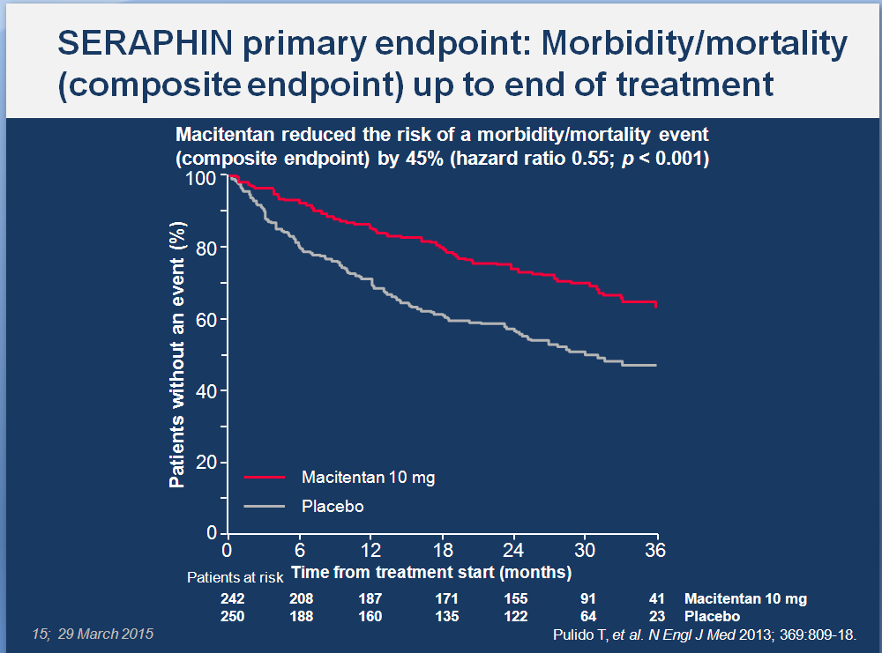

Slide 38
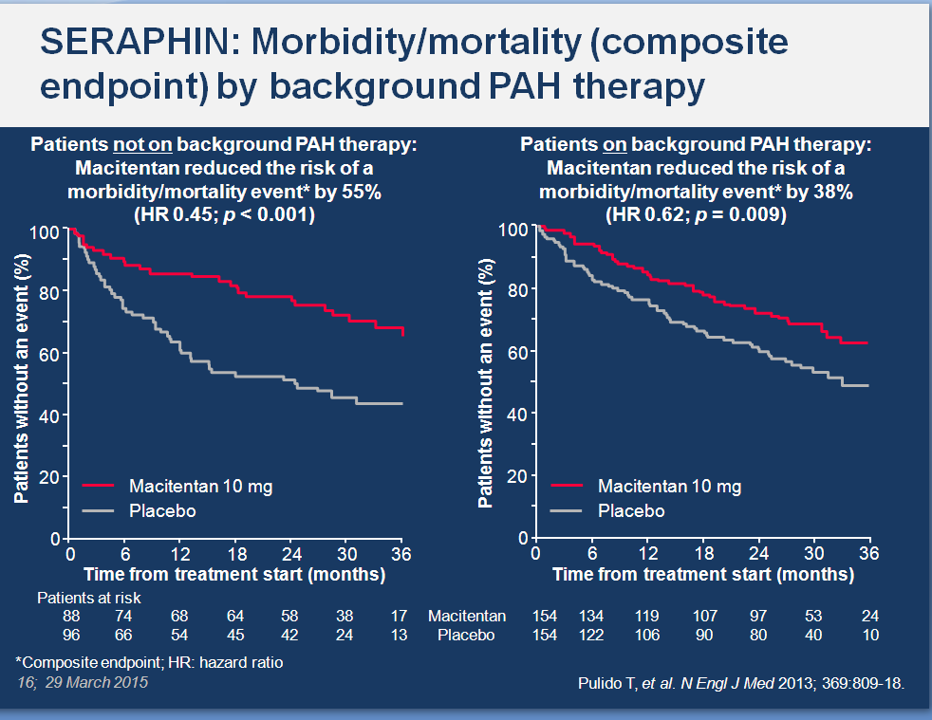

Slide 39
SERAPHIN: Morbidity/mortality events contributing to the composite primary endpoint
 | Placebo n = 250 | Macitentan 10 mg n = 242
Patients with event, n (%) | 116 (46.4) | 76 (31.4)
First event type, n (%)
Worsening of PAH | 93 (37.2) | 59 (24.4)
Death | 17 (6.8) | 16 (6.6)
i.v./s.c. prostanoid initiation | 6 (2.4) | 1 (0.4)
Lung transplantation | – | –
Atrial septostomy | – | –
Pulido T, et al. N Engl J Med 2013; 369:809-18.

Slide 40
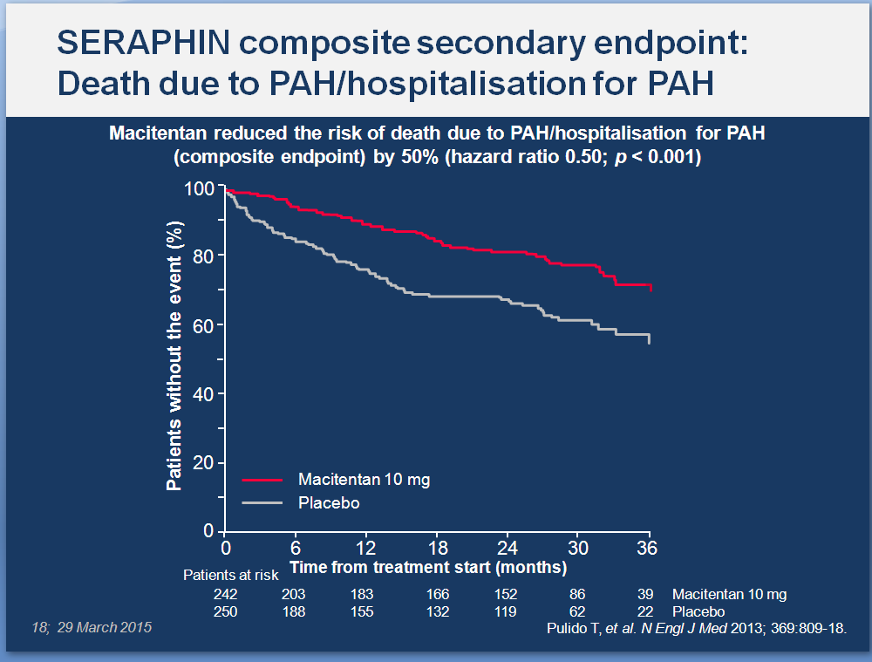

Slide 41
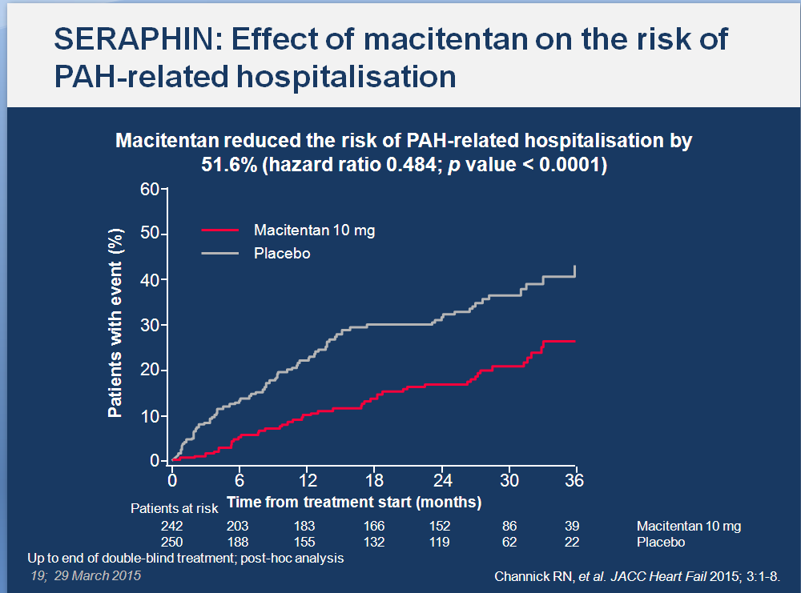

Slide 42
PACES-1: Prespecified Subgroup Analysis
According to Baseline 6MW
<325 meters
(n=75)
>325 meters
(n=192)
Treatment effect
(Sildenafil-placebo)
Treatment effect
(Sildenafil-placebo)
6min WD (m)
-2.3
+38.4
CO (L/min)
+1.3
+0.6
Deaths
Placebo 7/34
Sildenafil 0/41
Placebo 0/99
Sildenafil 0/91
Simonneau et al.(Ann Int Med 2008)
Notes:
42

Slide 43
Recommendations for Drug Monotherapy
Eur Respir J. 2015 Aug 29. pii: ERJ-01032-2015

Slide 44
Recommendations for Drug Monotherapy
Eur Respir J. 2015 Aug 29. pii: ERJ-01032-2015

Slide 45
Recommendations for Initial Drug Combination
Eur Respir J. 2015 Aug 29. pii: ERJ-01032-2015

Slide 46
Recommendations for Sequential Drug Combination
Eur Respir J. 2015 Aug 29. pii: ERJ-01032-2015

Slide 47
Investigational Treatment Combinations for PAH
Front-Line Combination Therapy vs. Monotherapy
AMBITION
Ambrisentan+Tadalafil
Ambrisentan+Placebo
Tadalafil+Placebo
Available at 1) www.clinicaltrials.gov/ct2/show/NCT00617305; 2) www.clinicaltrials.gov/ct2/show/NCT01042158.

Slide 48
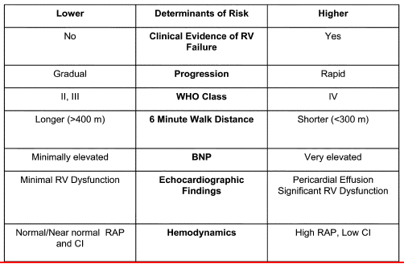
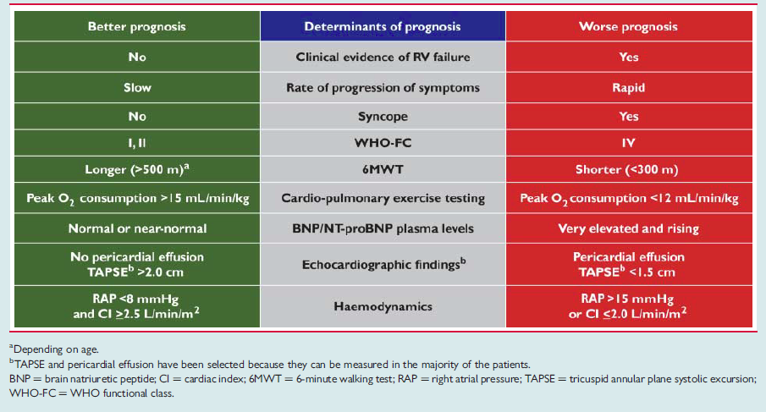
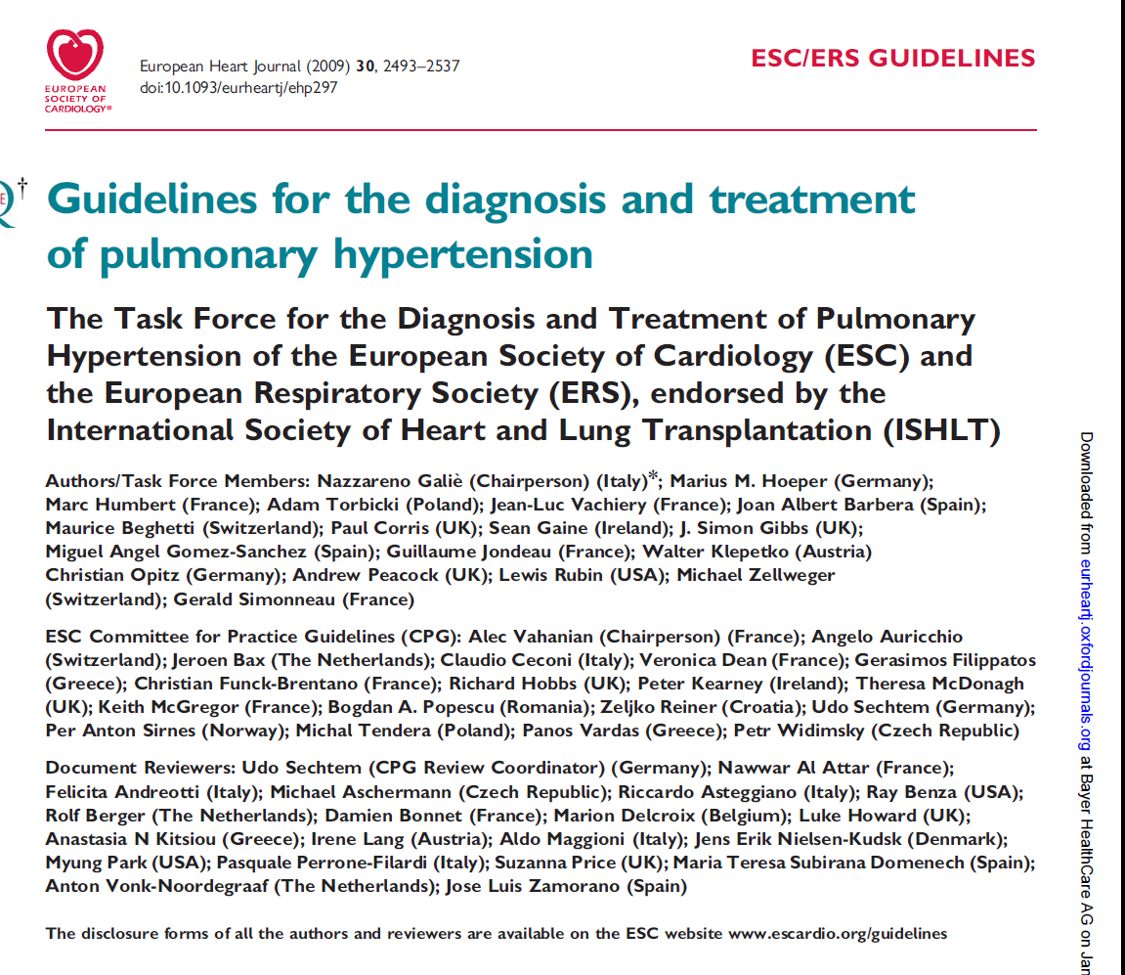
PAH: Parameters for Assessing Disease Severity, Stability and Prognosis
Lower Risk | Determinants of Risk | Higher Risk
No | Clinical evidence of RV failure | Yes
Slow | Rate of progression of symptoms | Rapid
No | Syncope | Yes
II, III | WHO-FC | IV
Longer (>500m) | 6MWT | Shorter (<300 m)
Peak O₂ consumption >15 mL/min/kg | Cardio-pulmonary exercise test | Peak O₂ consumption <12 mL/min/kg
Normal or near-normal | BNP/NT-proBNP plasma levels | Very elevated and rising
No pericardial effusion, TAPSE >2.0 cm | Echocardiographic findings | Pericardial effusion, TAPSE <1.5 cm
RAP <8 mmHg or CI ≥2.5 L/min/m² | Hemodynamics | RAP >15 mmHg or CI ≤2.0 L/min/m²
Can we clean this up??
Lower Risk | Determinants of Risk | Higher Risk
No | Clinical evidence of RV failure | Yes
Gradual | Progression | Rapid
II, III | WHO class | IV
Longer (>400m) | 6MWD | Shorter (<300 m)
Minimally elevated | BNP | Very elevated
Minimal RV dysfunction | Echocardiographic findings | Pericardial effusion, significant RV dysfunction
Normal/near normal RAP and CI | Hemodynamics | High RAP, low CI
ESC/ERS Guidelines for the diagnosis and treatment of PH; EHJ 2009, 30, 2493-2537, Adapted from McLaughlin and McGoon

Slide 49
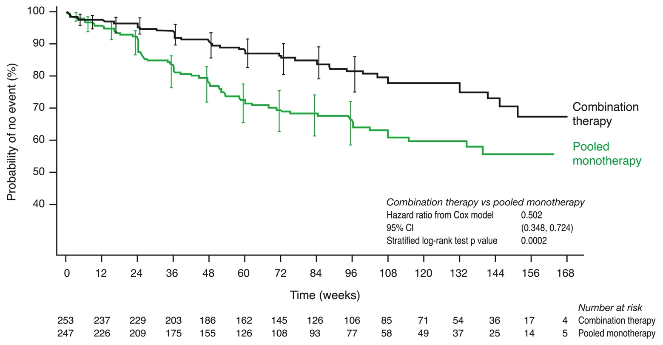
Kaplan-Meier cumulative curve for time to first adjudicated clinical failure
Primary Analysis Set
Combination vs pooled monotherapy
95% CIs (using log-log transform method) are presented for each treatment group at weeks 4, 8, 16, 24, and then every 12 weeks up to week 96.
Notes:
Difference at 24W-6Mo
Divergence up to 96 Mo -2 years
123 events

Slide 50
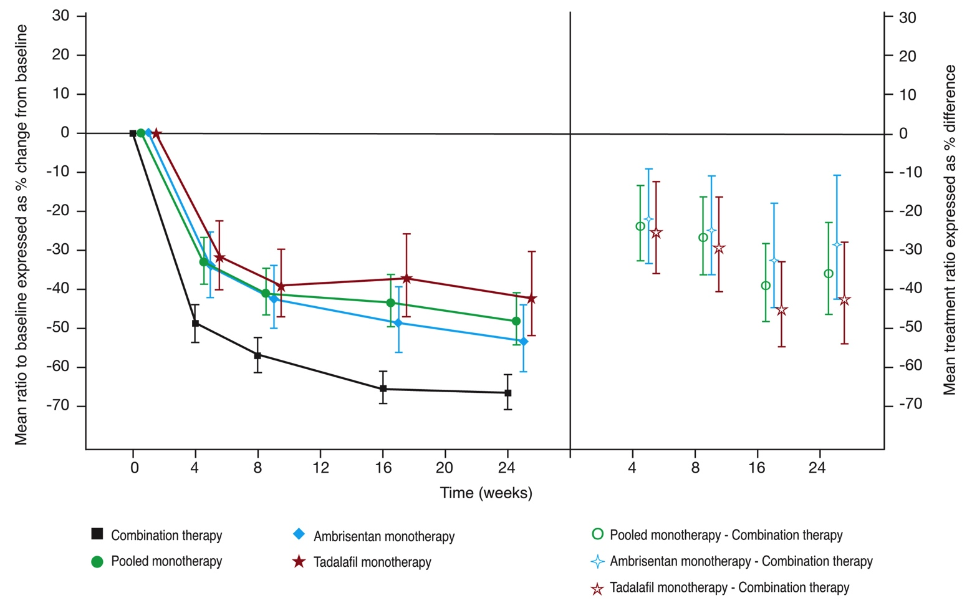
NT-proBNP: change from baseline to week 24 and treatment differences
Primary Analysis Set
Ratio of NT-proBNP (pg/ml) to BASELINE
Treatment ratios to COMBO
Week 24
Combo vs pooled mono p<0.0001
Combo vs ambrisentan mono p=0.0070
Combo vs tadalafil mono p<0.0001
Vertical bars represent 95% CIs. Graph is a mixed models repeated measures (MMRM) analysis adjusted for baseline aetiology of PAH (IPAH/HPAH vs non-IPAH), WHO FC (II vs III) and baseline, with no imputation for missing data.
Notes:
Source: Figure 1.35
First square: Mean % change from baseline
Second Square: Mean % treatment difference (effect) as compared with the combo arm for Pooled (green), Amb (blue), Tad (red) statistical analysis performed here (on the difference)

Slide 51
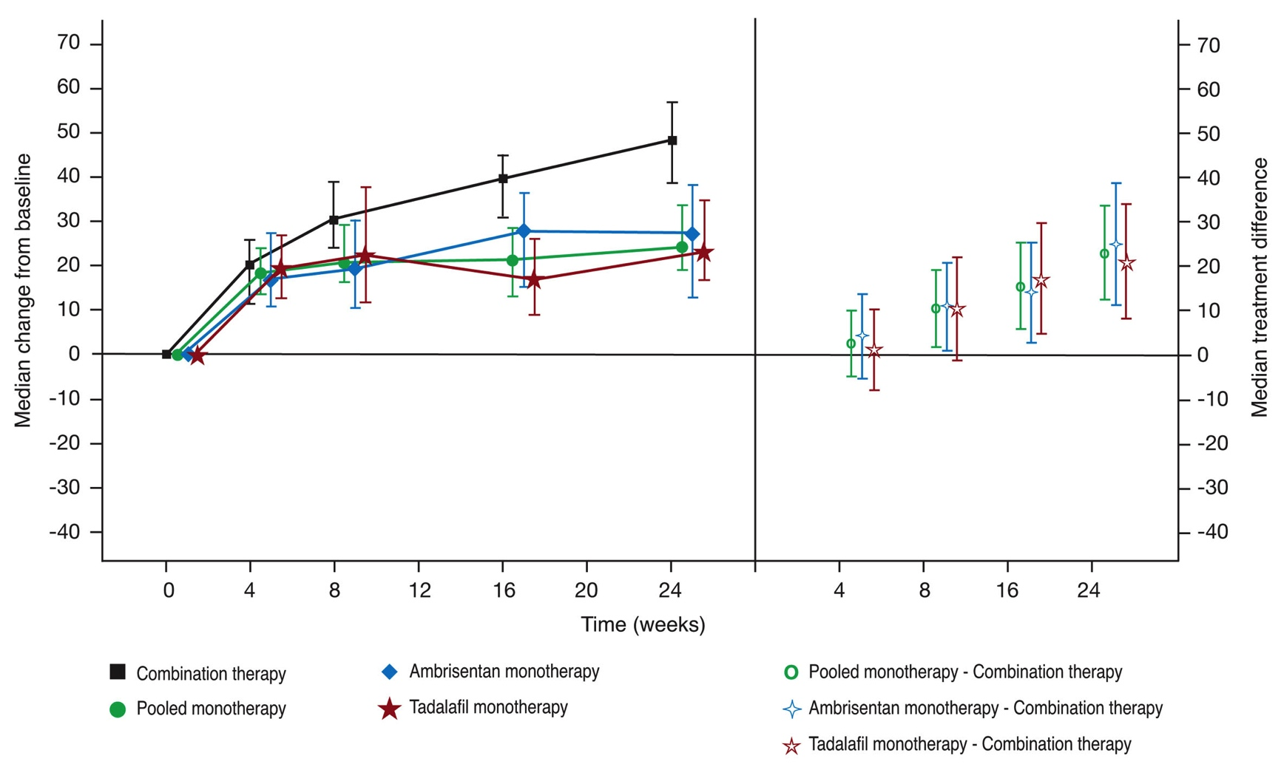
6MWD: change from baseline to week 24 and treatment differences
Primary Analysis Set
Median change in 6MWD (m) from baseline
Median treatment difference
with COMBO (m)
Week 24
Combination: +49.0m
Pooled mono: +23.8m
Ambrisentan mono: +27.0m
Tadalafil mono: +22.7m
Week 24
Combo vs pooled mono p<0.0001
Combo vs ambrisentan mono p=0.0005
Combo vs tadalafil mono p=0.0030
Vertical bars represent 95% CIs. Stratified Wilcoxon Rank Sum analysis. Worst rank scores were used for missing data following death or adjudicated hospitalisation; otherwise, LOCF imputation was used.”
Notes:
Source: Figure 1.36 (Delta = 23 meters)
First square: Median change from baseline
Second Square: Median treatment difference as compared with the combo arm for Pooled (green), Amb (blue), Tad (red) and 95% confidence iterval

Slide 52
5th World Symposium on PH:
Raising the bar on treatment goals
Variable | Treatment goal
FC | I or II
Echo/CMR | Normal/near normal RV size and function
Haemodynamics | Normalisation of RV function (RAP < 8 mmHg and CI > 2.5 to 3.0 l/min/m²)
6MWD | > 380 to 440 m; may not be aggressive enough for young individuals
CPET | Peak VO₂ > 15 ml/min/kg and EqCO₂ < 45 l/min/l/min
BNP level | Normal
No single parameter can fulfil the role of a reliable prognostic indicator, there is a need for multiple robust parameters that correlate with long-term outcomes
6MWD: 6-minute walk distance; BNP: brain natriuretic peptide; CI: cardiac index; CMR: cardiac magnetic resonance;
CPET: cardiopulmonary exercise testing; EqCO₂: ventilatory equivalent for CO₂; FC: functional class;
RAP: right atrial pressure; RV: right ventricular; VO₂: oxygen consumption
McLaughlin VV, et al. J Am Coll Cardiol 2013; 62:D73-81.

Slide 53
5th World Symposium on PH:
Variables used in clinical practice
Variable | Prognostic implications at baseline | Prognostic implications at follow-up
Exercise tolerance: Functional class (FC) 6-minute walk distance (6MWD) Peak oxygen consumption (peak VO₂) | ++++ ++++ + | +++
Haemodynamics: Right arterial pressure (RAP) Mean pulmonary arterial pressure (mPAP) Pulmonary vascular resistance (PVR) Cardiac output (CO)/Cardiac index (CI) Mixed venous oxygen saturation (SvO₂) | ++++ ++ + ++++ +++ | + + ++ ++
Echocardiographic variables: Tricuspid annular plane systolic excursion (TAPSE) Right ventricular strain Right atrial area Pericardial effusion | + + + ++
A multi-parameter approach is suggested
Table indicates the number of studies that have shown prognostic implications for each variable at baseline or follow-up
(+ = one study, ++ = two studies, +++ = three studies, ++++ = four or more studies).
Adapted from McLaughlin VV, et al. J Am Coll Cardiol 2013; 62:D73-81.

Slide 54
Summary
An updated clinical classification of PH has been proposed, which now applies to both adult and paediatric patients
There is a new haemodynamic definition for PAH, which now includes PVR
New screening recommendations for SSc patients have been proposed, including the use of the two-step DETECT screening algorithm
Treatment goals have been updated and the need to analyse multiple goals in order to correlate with long-term outcomes has been highlighted
An updated treatment algorithm has been provided
  Drugs with a morbidity and mortality primary endpoint in RCTs or drugs with a demonstrated reduction in all-cause mortality (prospectively defined) have been highlighted
  Sequential combination therapy is recommended for patients with an inadequate response to monotherapy
PVR: pulmonary vascular resistance; RCT: randomised controlled trial; SSc: systemic sclerosis

Slide 55
Challenges for the Future
To Develop:
New and novel approaches to therapy
Technologies to bridge to transplantation
New endpoints for clinical trials
Meaningful/useful biomarkers
Effective strategies for other forms of PH

Slide 56
Thank You

