Slide 1
Radiation protection in cath lab
Dr. Cinosh Mathew
Associate Prof
Department of Cardiology
Dhiraj Hospital, SBKSMIRC, Sumandeep Vidyapeeth

Slide 2
WHY?

Slide 3
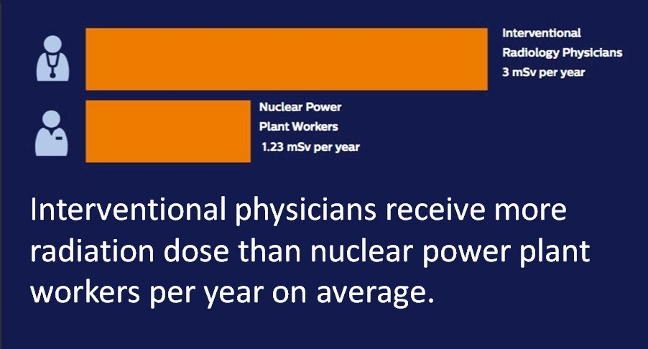

Slide 4
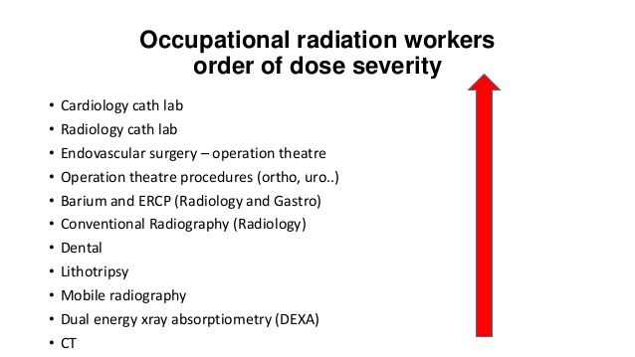

Slide 5
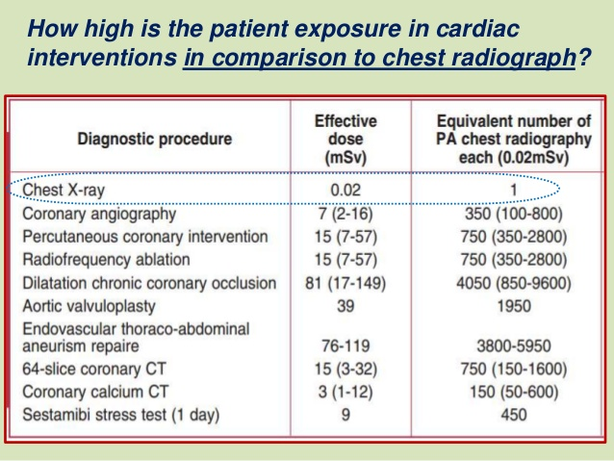

Slide 6
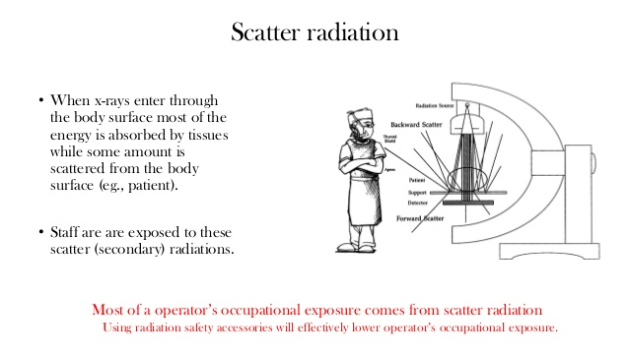

Slide 7
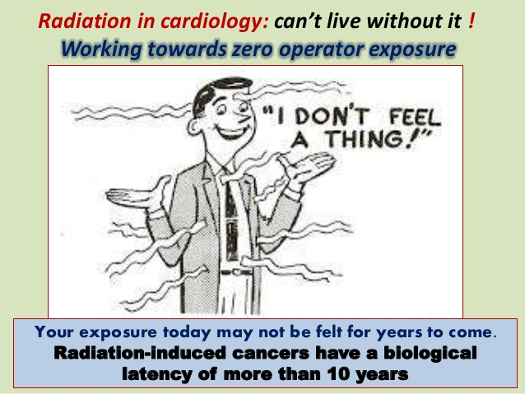

Slide 8
What Are X-rays?
X-rays are high-energy electro-magnetic waves generated by machines.
X-rays are exactly the same as visible light, only with 30,000 times more energy.
Because of their high energy X-rays can penetrate tissue, but they aren’t so good with bone.
The difference in penetration makes up the classic X-ray image.

Slide 9
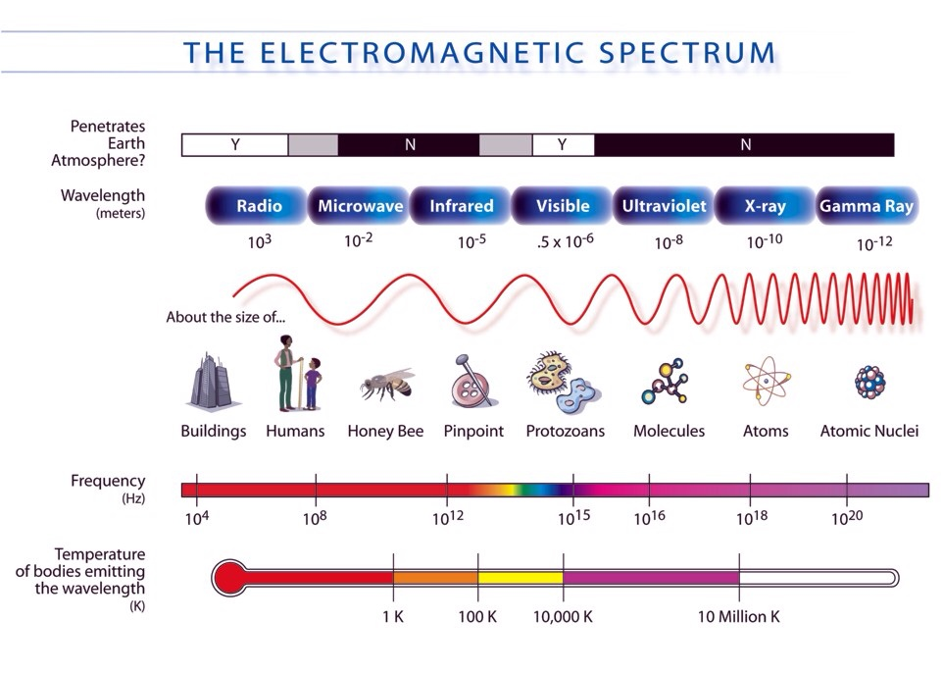

Slide 10
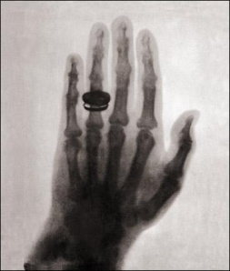
The Classic X-ray Image
The first X-ray image taken by Wilhelm Roentgen.
Incidentally, that’s Mrs. Roentgen’s hand.

Slide 11
Fluoroscopy
Fluoroscopy is real-time X-ray imaging.
Instead of a piece of film, the fluoroscope image is formed on an image intensifier (the “II”). It is displayed on a monitor.

Slide 12
Types of Fluoroscopes
General purpose fluoroscopes may have the X-ray head under or over the table.
Over-table units can be used for general radiology as well.
The II on an under-table unit is called the tower for an obvious reason.

Slide 13
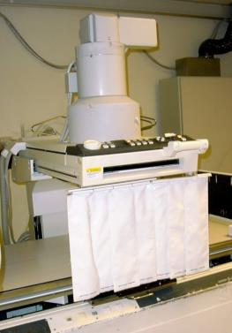
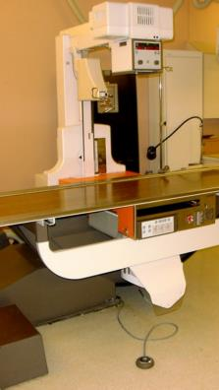
Stationary Fluoroscopes
Undertable
Over table
X-ray head
Image intensifier

Slide 14
Types of Fluoroscopes
If the X-ray head and II are linked together by a large C-shaped arm the fluoroscope is a called a C-arm.
Mobile C-arms can roll around. Mini C-arms are tiny fluoroscopes used only for extremities.

Slide 15
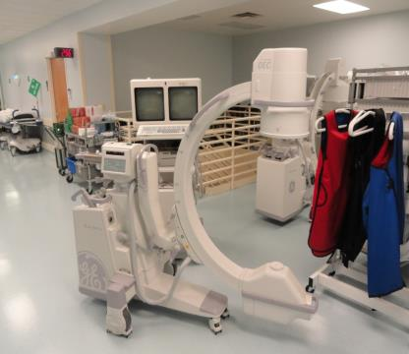
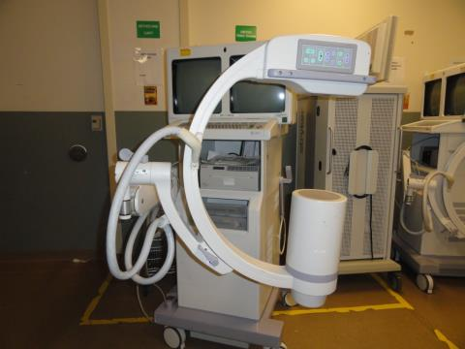
C-arms
Mobile C-arm
Mini C-arm

Slide 16
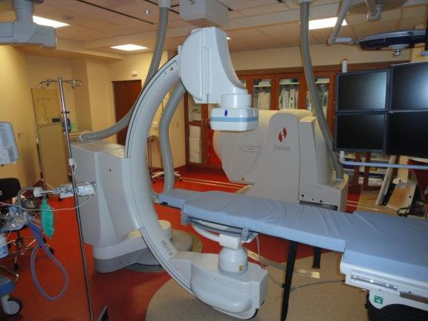
Fixed C-arm

Slide 17
Proper Positioning
Whenever possible, position the X-ray head under the patient. (This isn’t possible on an over-table unit.)
The X-ray source (inside the head) must be at least 12” away from the patient’s skin. This is built in to most fixed units. C-arms have spacer cones to keep the right distance.

Slide 18
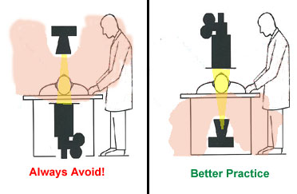
X-ray Tube Position
Image Intensifier
Position the X-ray tube under the patient not above the patient.
The largest amount of scatter radiation is produced where the x-ray beam enters the patient.
By positioning the x-ray tube below the patient, you decrease the amount of scatter radiation that reaches your upper body.
X-ray Tube

Slide 19
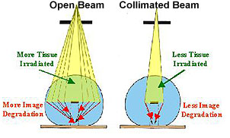
Collimation
Collimate tightly to the area of interest.
  Reduces the patient’s total entrance skin exposure.
  Improves image contrast.
  Scatter radiation to the operator will also decrease.

Slide 20
Foot Pedals
All fluoroscopes of any type are operated by a foot pedal.
The pedal is a “dead man” switch. The machine will only operate when there is pressure on the switch.

Slide 21
Image Intensifiers
The Image Intensifier (II) converts the radiographic image into a TV image and makes it considerably brighter.
The II may be a large vacuum device or a flat panel.
II’s can magnify the image.

Slide 22
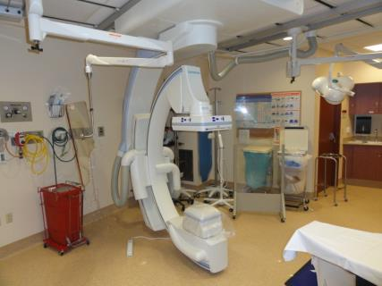
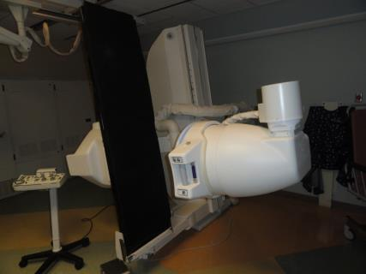
Image Intensifiers
Flat Panel
Tube

Slide 23
The Fluoroscopic Image
Compared to conventional X-ray images, fluoroscopic images are grainy.
This is because fluoro images use as little radiation as possible.
Less radiation = more noise (image grain)
More noise = harder to see fine detail

Slide 24
Image Noise
The grainy appearance of an image is called noise.
It’s just like static on the radio.
The main cause of noise is too little radiation.
Too much radiation makes a great image but overdoses the patient—and you.

Slide 25
Fine image resolution is needed to diagnose unknown conditions.
Fluoroscopy is rarely used for diagnosis.
Under fluoro you’re usually looking for something large or filled with contrast, and sometimes both.

Slide 26
X-Ray Tube Assembly
transmitted radiation
Absorbed radiation
Target (ie patient)
Scattered radiaion
filtration
electrons
anode
current
High voltage lead

Slide 27
X-ray Technique
The energy of the X-rays is determined by the voltage applied to the anode (commonly called the kilovoltage or kV).
The intensity of the X-rays is determined by the flow of electrons from the cathode to the anode.
The electron flow is often called the mAs (for milliamp-second).
Together the kV and mAs make up the X-ray technique.

Slide 28
X-ray Technique—kV
The kV determines how much energy gets through the subject.
Use high kV to penetrate bone, large people, or large boney people.
Use low kV to show soft tissues.

Slide 29
X-ray Technique—kV
kVs range from about 25 kV for mammography to 150 kV for chest X-rays.
Typical fluoroscope kVs are in the 50 kV to 80 kV range.

Slide 30
X-ray Technique—mAs
The mAs determines the total amount of radiation used to make an image.
In a conventional X-ray the time (s) is very short and the tube current (mA) is fairly large.
Fluoroscopy uses a small mA, but exposures may run for several seconds.
The result is a moving, but grainy image.

Slide 31
X-ray Technique—kV and mA
Typically, the kV is set to penetrate the chosen body part, and the mA is adjusted to give a suitable image.
In fluoroscopy this procedure is usually done automatically in a process called auto-fluoro.
Step on the pedal and the machine automatically adjusts the kV and mA to give a good image.
As you move the fluoroscope around the kV and mA automatically adjust.

Slide 32
Patient Dose
Only a small portion of the radiation from a fluoroscope makes it to the II.
The rest stays in the patient. This energy is the patient dose.
The patient dose is responsible for damage to a patient’s skin or increase in cancer risk.

Slide 33
Image quality
Automatic brightness control –automatically adjusted to maintain brightness
Collimation
  restrict the size of the x-ray field
Field Size and Magnification
  Field size decreases with magnification, therefore, the local patient radiation dose must increase to compensate for the loss of brightness
  Low magnification (9-11 inch)
  Intermediate magnification(6-7 inch)
  High magnification (4-5 inch)
Notes:
Fluoroscopy equipment automatically adjusts the kVp and mA to optimize image quality
This automatic exposure control (AEC) uses an electronic sensor to maintain brightness
Equipment designed so that x-rays cannot be produced unless image intensifier is in position to intercept the entire beam
These collimators restrict the size of the x-ray field
Used to manually adjust the field size to the area of interest
Generally, Image intensifiers utilize 3 field sizes and modes of magnification to optically adjust the field size and magnification. As field size decreases with magnification the local patient radiation dose rate must increase to compensate for the loss of brightness from the image intensifier. Scatter decreases and image quality improves. Changing Table or intensifier height can also rpoduce optical manigfication.

Slide 34
Image Intensifier Magnification Modes
Same area
Output phosphor
Input Phosphor
9 inch field
6.5 inch field

Slide 35
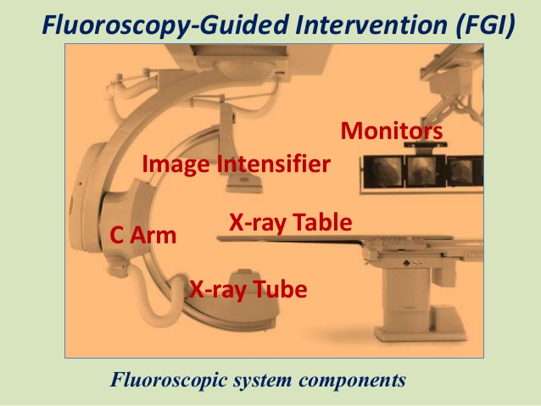

Slide 36
Cine Angiography
Ciné was originally a term for film movies made with fluoroscopy.
The term is still used for high-resolution digital moving images.
Ciné requires intense, short bursts of radiation.
The exposure level can easily be 5 to 10 times higher than normal fluoroscopy.

Slide 37
Cine Angiography
Standard cameras use 35mm film at frame rates of 15-60frames/sec (15-30fps for angiography and 60fps for ventriculography)
Notes:
Higher frame rates have higher radiation doses
Digital image acquistion will soon replace cine film due to lower radiation doses and opportunities for image processing.

Slide 38
The Units
(the m before a unit stands for milli-, or 1/1000th)
Old Units
Exposure—Roentgen (R, mR)
Dose—rad (r, mrad)
Effective dose—rem (rem, mrem)
New Units
Exposure—Air Kerma (no accepted abbreviation yet)
Dose—Gray (Gy, mGy)
Effective dose—Sievert (Sv, mSv)

Slide 39
The dose (sometimes called organ dose) is calculated to determine the effect of radiation on a particular organ. This is used a lot in radiation therapy treatment planning.
The effective dose is calculated from the exposure of a film badge and reported as part of your monthly badge reading.

Slide 40
Biological Effect of Radiation
Radiation ionizes (knocks off electrons from) atoms.
In the human body, mostly it ionizes water.
The ionized water breaks up into radicals that break DNA chains.

Slide 41
If left alone long enough, a broken DNA chain can repair itself. No harm done.
If the cell divides before the chain repairs itself, the cell dies.
Cells die when they divide too fast to repair themselves or when the radiation is coming in too fast to give them a chance.

Slide 42
Radiation Sensitivity
Rapidly dividing cells (most sensitive)
  sperm
  lymphocytes
  small intestine
  stomach
Slowly dividing cells (least sensitive)
  bone
  skin
  nerves
  colon

Slide 43
The Nature of Radiation Damage
Radiation damage seldom appears at the time of irradiation.
Visible effects occur later, from several hours to nearly a year.
The first (almost) visible effect is a drop in the white blood count.
The first external visible effect is a skin burn.

Slide 44
Radiation Biology
Deterministic effects – those in which the number of cells lost in an organ or tissue is so great that there is a loss of tissue function
  IE skin erythema and ulceration
Stochastic effects– occur if an irradiated cell is modified rather than killed and then goes on to reproduce
  Do not appear to have a threshold and the probability of the effect occurring is related to the radiation dose

Slide 45
Radiation Damage
Radiation damage is not apparent at the time of irradiation.
There is no physical sensation to being irradiated!
The severity of the effect depends on how much area was irradiated.
Small areas can tolerate higher doses.

Slide 46
Damage and Repair
Injury produced by large amounts of energy transferred to individual molecules
  Causes ejection of electrons
  Initiates physical and chemical effects on tissues especially DNA
  Failure of repair mechanism leads to:
    Cell death or
    Mutation

Slide 47
Somatic Effects
Observed early (days to weeks)
  Early effects develop in proliferating cell systems (most radiosensitive skin, ocular lens, testes, intestines, esophagus)
OR
Observed late (months to years)
  Carcinogenesis is the most important delayed somatic effect
  Delayed effects often seen in nerves, muscles and other radioresistant tissues

Slide 48
Recommended Dose Limits for Occupational Exposure to Ionizing Radiation
Effective Dose Limits - Occupational
  Annual 5000 millirem
  Cummulative 1000 millirem x age
Annual Dose Limits for Tissues – Occupational
  Lens of eye 15,000 millirem
  Skin, hands, feet 50,000 millirem
  Embryo fetus, total 500 millirem
  Embryo fetus, monthly 50 millirem
Annual Public Exposure – Nonoccupational
  Annual effective dose 100-500 millirem
  Lens of the eye 1500 millirem
  Skin, hands, feet 5000 millirem

Slide 49
Skin Erythema
Characterized by a blue or mauve discoloration of the skin
Increases during the first week
Usually fades during the second week
May return 2-3 weeks after the initial insult and last for 20-30 days
Acute doses in excess of 8 Gy will produce exudative and erosive changes in the skin
Penetrating doses in excess of 20 Gy: there is usually a nonhealing ulceration

Slide 50
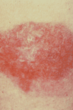
56-year-old man with obstructing lesion of right coronary artery.
Posterolateral chest wall at 10 weeks after percutaneous transluminal coronary angioplasty shows 12 x 6.5 cm hyperpigmented plaque with hyperkeratosis below right axilla.

Slide 51
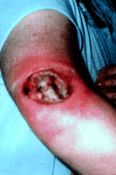
49-year-old woman with 8-year history of refractory supraventricular tachycardia.
Sharply demarcated ulceration above elbow 5 months after radiofrequency cardiac catheter ablation.

Slide 52
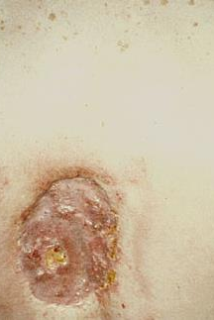
Skin wound caused by an estimated 2 hours of fluoroscope time during coronary angioplasty.
The first symptoms appeared six to eight weeks after the procedure. The wound appeared to heal spontaneously and then reappeared. This photograph was taken 18 to 21 months following the procedure.

Slide 53
A Subtle Effect
Any radiation exposure increases a person’s likelihood of developing cancer eventually.
The effect is very small and takes about 20 years to manifest itself.
This is not much of a concern for older adults, but is a real problem with children.
Always use dose-reduction techniques (to be discussed) during a pediatric case.

Slide 54
A More Immediate Effect
The eyes are fairly sensitive to radiation
About 200 rad (2 Gy) can induce temporary cataracts
About 500 rad (5 Gy) can make them permanent
THESE VALUES ARE WELL WITHIN THE REALM OF POSSIBILITY, ESPECIALLY OVER A LONG TIME!
Studies suggest that people who use fluoroscopy extensively have a higher rate of cataracts.

Slide 55
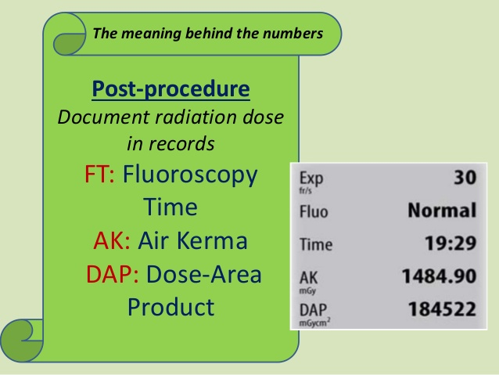

Slide 56
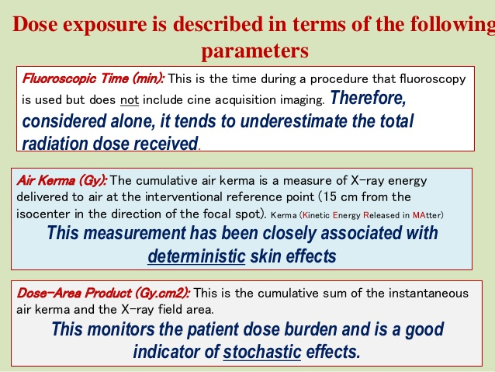

Slide 57
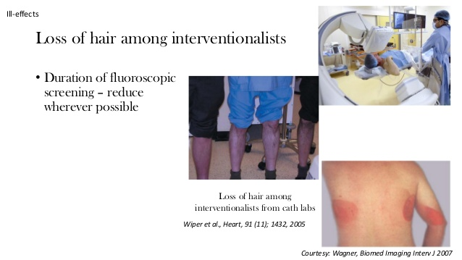

Slide 58
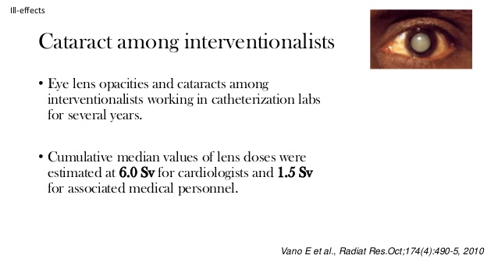

Slide 59
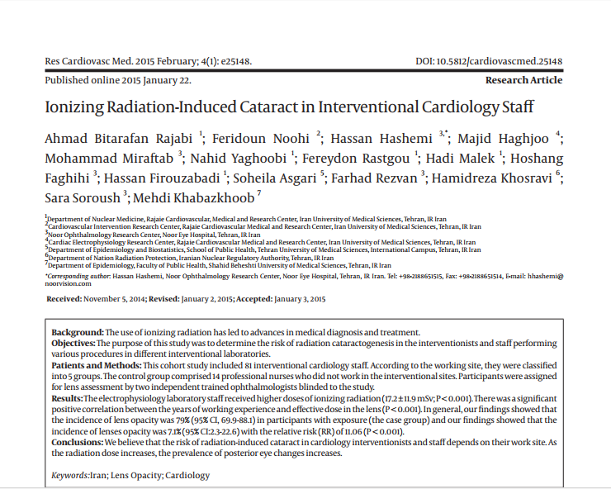

Slide 60
Your Dose
The only three things that mitigate the dose to you are time, distance, and shielding.
We measure your dose with a film badge (actually a personal dosimeter—they don’t use film anymore).

Slide 61
Film Badges
A film badge only records how much radiation you’ve received. It doesn’t protect you.
A film badge only works if you wear it.
If you don’t wear it, we won’t know how much radiation we’ve got and would’nt find out about the dangerous situation.

Slide 62
Radiation Safety and Protection
Personal protection
  Time
  Distance
  Shielding

Slide 63
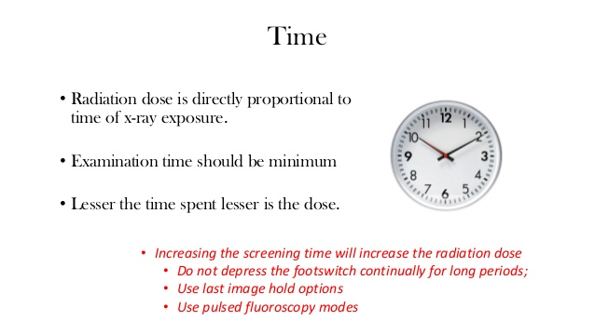

Slide 64
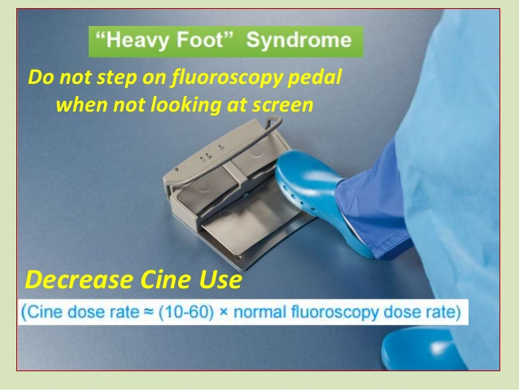

Slide 65
Radiation Safety and Protection
Time
  Radiation dose is proportional to exposure duration
Distance
  Radiation dose is inversely proportional to the square root of the distance from the patient (or staff)

Slide 66
The Effect of Distance
Radiation intensity follows the inverse square law: The intensity drops as 1 over the square of distance from the source.
If you are 1 foot from an X-ray source and you move to 2 feet away, your exposure drops by a factor of 4. Move 3 feet away and it drops by 9.

Slide 67
But. . .
. . . it works the other way, too. Exposure increases as you move closer to the source.
If you are 12 inches from an X-ray source and you move 3½ inches closer, your exposure doubles.
Moral: Stay back from X-ray sources.

Slide 68
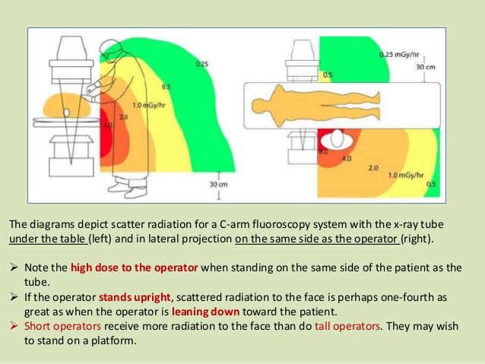

Slide 69
Radiation Safety and Protection
Lab specific
  Constructed with 1.5mm of lead or equivalent shielding to protect individuals in the control room and adjacent areas

Slide 70
Radiation Safety
Shielding
  Lead is the most common material used
  A lead apron with an equivalent of 0.5mm of lead in front panel is mandatory
  Lead in the back panel provides additional protection
  Thyroid shield (0.5mm equivalence) is recommended to shield the sternum, upper breast and thyroid gland

Slide 71
Radiation Safety
Shielding continued
  Leaded eyeglasses with the side shields reduce the exposure to the eyes and may improve visual acuity
  Recommended for staff with collar-badge doses approaching 15rem per year and for interventionalist’s in training

Slide 72
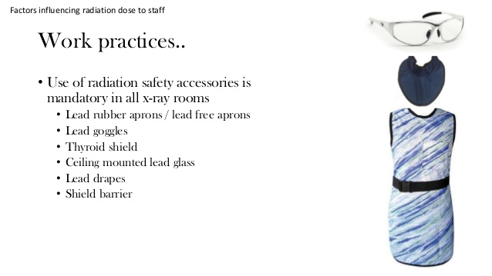

Slide 73
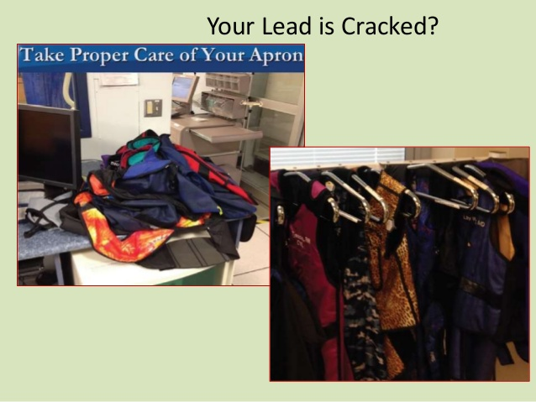

Slide 74
Radiation Safety
Shielding continued
  Hands receive the highest radiation dose, but are relatively insensitive to radiation
  Supplemental lead shielding to reduce exposure to scatter is available in the form of table mounted lead drapes, ceiling mounted lead acrylic shields and rolling lead acrylic shields

Slide 75
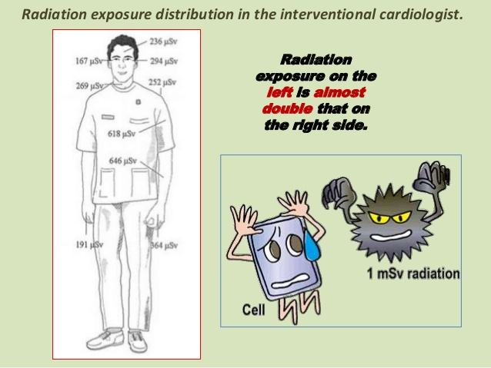

Slide 76
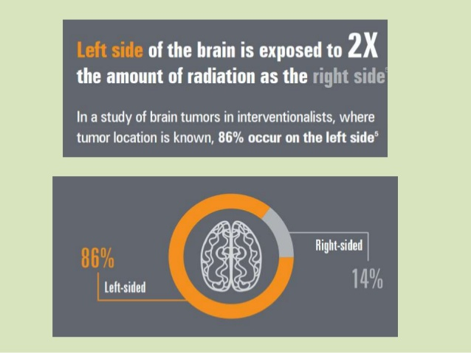

Slide 77
Personnel Dosimetry
Interventionalists commonly assigned 2 radiation badges
  One on collar
  Second underneath lead apron
    Lead apron reduces the radiation dose at the waist to 10% of dose at collar at 75kVp.
    Effective dose equivalent best estimated by averaging the 2 dosimeters
  Mean dose equivalent per procedure 4 +/- 2 millirem, highest doses were delivered to physicians in training (5 rem per year)*
Notes:
Study based on 15,000 cardiac procedures from 1984-1988. Renaud L. A 5-y follow-up of the radiation exposure to in-room personnel during cardiac catheterization. Health Physics 1992; 62(1):10-15.

Slide 78
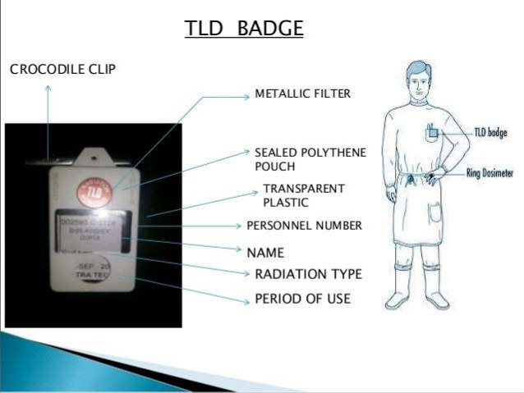

Slide 79
How to Mitigate Radiation Exposure
Use fluoroscopy sparingly. Never let the fluoroscope run while you’re thinking about what to do next.
Keep the X-ray head away from the patient. Keep the patient as close to the II as possible. (That gives a better image anyway.)
Keep the fluoroscope moving. Radiation does less damage if it’s spread over a larger area.

Slide 80
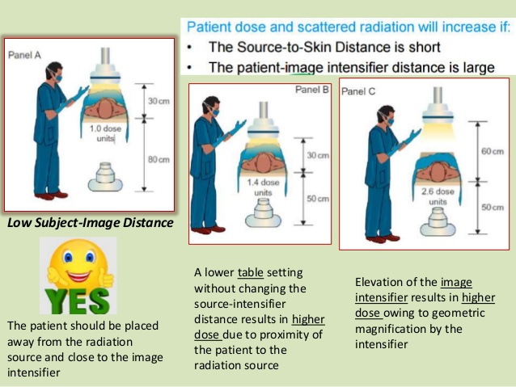

Slide 81
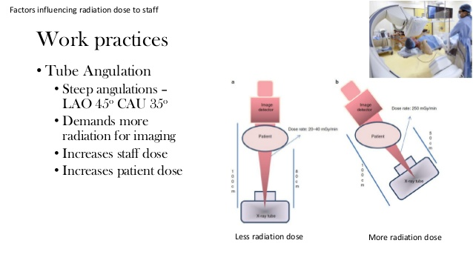

Slide 82
How to Mitigate Radiation Exposure
Always use a appropriate kV and high filtration to lessen the dose to the patient. Mostly this is handled automatically by the machine.
Use pulsed modes. You don’t always need a continuous image.(DSA mode)
Collimate the beam only to the area you are using.

Slide 83
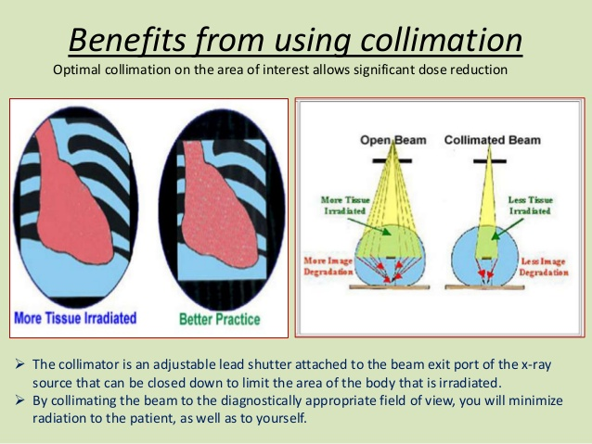

Slide 84
How to Mitigate Radiation Exposure
Use magnification sparingly
Magnification modes increase the output of the machine and dose to the patient, but don’t provide that much more information.
Use stent boost preferably
Never apply radiation unless you know exactly what you’re trying to accomplish.
IVUS, OCT, FFR.

Slide 85
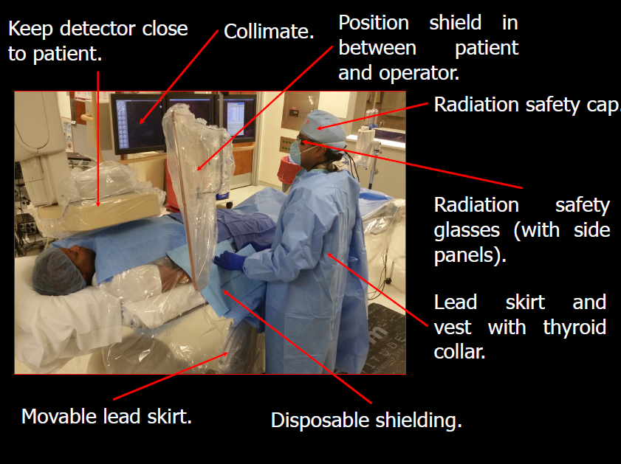

Slide 86
One Last Thing
The patient may get the brunt of the radiation, but the staff—including the physician—is also being irradiated at the same time by scatter.
When you protect the patient you protect yourself.

Slide 87
ALARA
Always keep the radiation dose
As
Low
As
Reasonably
Achievable.

