Slide 1
Conduction block
Faculty : Dr. Sanjay Prakash

Slide 2
Conduction block
Defn: a substantial decrease in the amplitude of AP on proximal, compared to distal stimulation, that is not due to dispersion, nerve anomalies or technical factors
Conduction block is failure of nerve impulse to propagate through structurally intact axon
Can either be partial or total

Slide 3
Introduction
It causes a very focal conduction change, restricted to the site of injury
Hence, if the nerve is stimulated only distal to it no abnormalities are seen

Slide 4
History of conduction block
The phenomenon was first reported by Duchenne de Boulogne (1861) and Erb (1876)
The clinical expression consists in a sensory-motor deficit that is reversible in less than 1 to 2 months when it relates to a lesion of the myelin sheath.

Slide 5
History of conduction block
Until the beginning of the eighties, a focal neuropathy was the almost exclusive sign of an entrapment syndrome
Persistent conduction blocks were recent observations and the underlying mechanisms were unknown

Slide 6
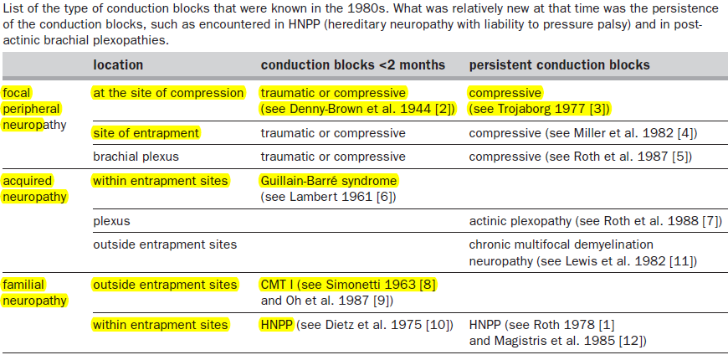

Slide 7
History of conduction block
In 1978 G. Roth was the first to report the observation of “persistent CBs” in what was later known as HNPP
In 1984 Roth described 2 patients initially diagnosed as ALS, associated with chronic persistence of blocked nerves, progression of weakness and incessant fasciculations

Slide 8

History of conduction block
It was published under the title ‘Motor neuropathy with proximal multifocal persistent conduction block, fasciculations and myokymia and evolution to tetraplegia’
Later named as MMNCB

Slide 9
Introduction
Most conduction blocks seen in the EDX laboratory are due to either axon loss or focal demyelination, mainly the latter.

Slide 10
Physiology of normal conduction
RMP of -70mv inside the cell is maintained by Na-K pump
At rest it is impermeable to Na+ but is selectively permeable to K+
During AP, membrane potential goes from the -70 mV to +60mv

Slide 11
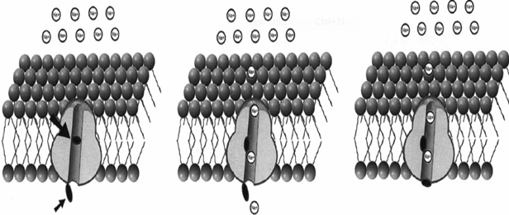
Physiology of normal conduction
This occurs by opening of Na channels which gets inactivated rapidly
The K channels then open; inside of membrane once again becomes negative

Slide 12
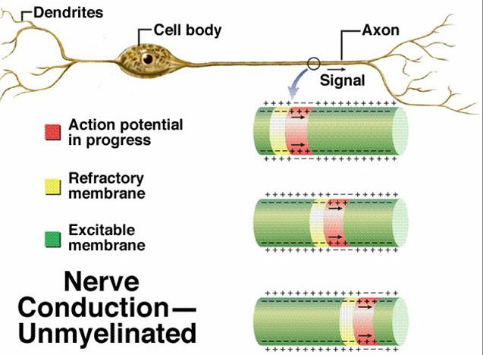

Slide 13
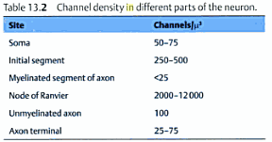
Saltatory conduction
Saltatory conduction is made possible by the myelin, which normally provides high impedance and low capacitance, preventing leakage of current through the internodal membrane
Action current through Na channels at node of Ranvier produces `inward ionic current', which subsequently causes `outward capacitative current' at the next node
This in turn depolarizes the nodal membrane to threshold

Slide 14
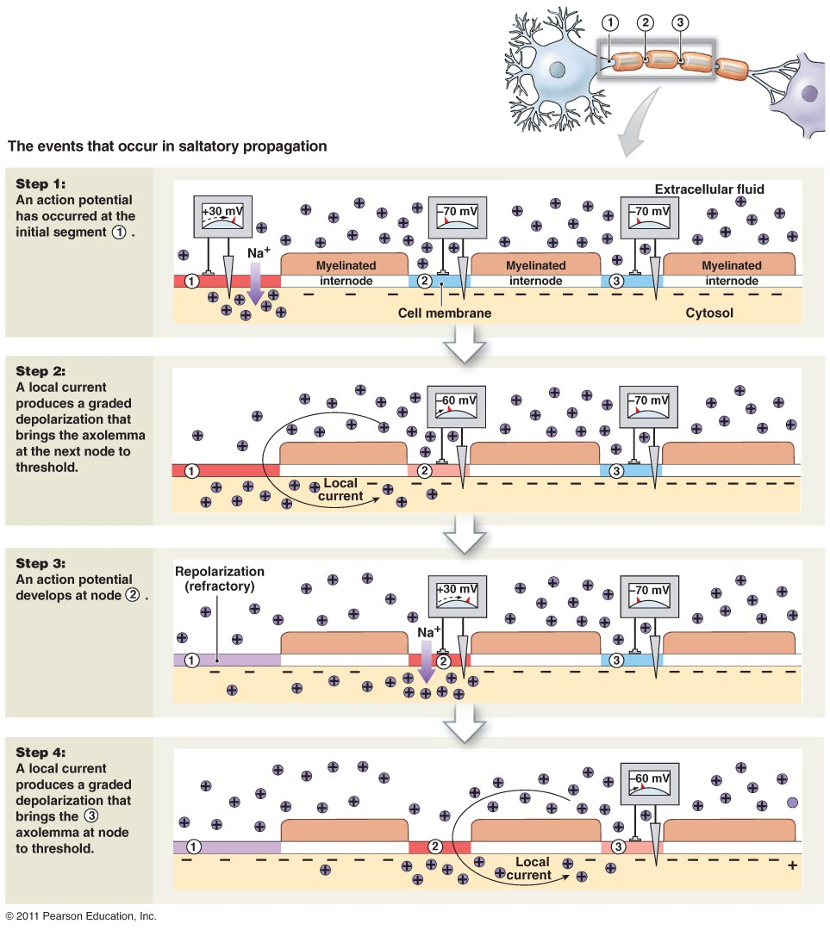

Slide 15
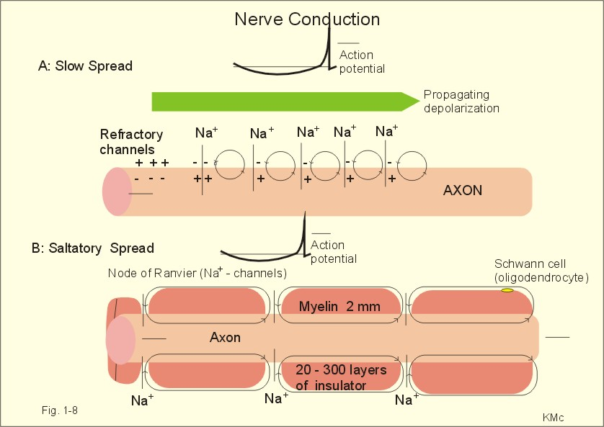
Saltatory conduction
Thus, the AP currents “jump” from node to node at conduction velocities of 50­60 m/s, in contrast to continuous conduction along unmyelinated fibers

Slide 16

Safety factor of transmission
Is the ratio of driving current (ie current available to excite a node) to threshold current (current required to excite it)

Slide 17
Safety factor
Safety factor in normal myelinated fibre is 5
Any mechanism that causes a fall in safety factor < 1 results in conduction failure

Slide 18
Pathology of demyelination
Demyelination results in alteration of normal cable properties of axon
Results in increased nodal capacitance
This increases conduction time as the driving current takes extra time to charge the internodal region

Slide 19
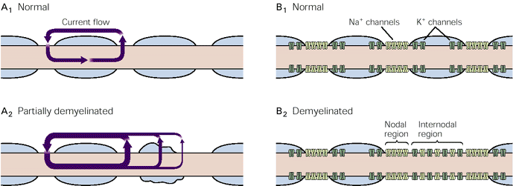
Loss of safety factor
Myelin disrupted →action current dissipates→fall in driving current→safety factor<1
Consequently a reduction of trans-nodal membrane current resulting in CB
Notes:
The length of axons' myelinated segments is important to the success of saltatory conduction. They should be as long as possible to maximize the speed of conduction, but not so long that the arriving signal is too weak to provoke an action potential at the next node of Ranvier. In nature, myelinated segments are generally long enough for the passively propagated signal to travel for at least two nodes while retaining enough amplitude to fire an action potential at the second or third node. Thus, the safety factor of saltatory conduction is high, allowing transmission to bypass nodes in case of injury

Slide 20
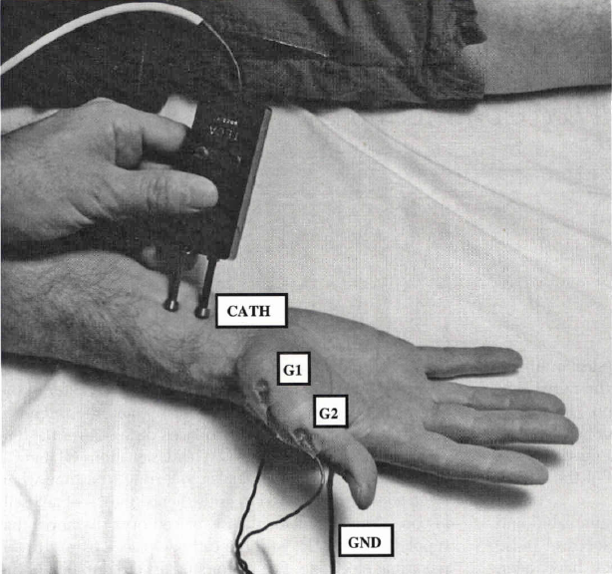
Normal Electrophysiology
Peripheral nerves can be stimulated and brought to AP with a brief electrical pulse applied to the overlying skin
The recorded AP is called CMAP/SNAP

Slide 21
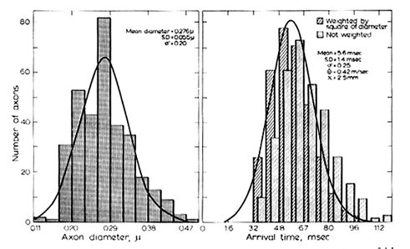
Normal Electrophysiology
AP is the summation of large, medium, and smaller myelinated fibers which depolarize at different rates & amplitudes
And hence there is a normal variation in the size of individual action potentials

Slide 22
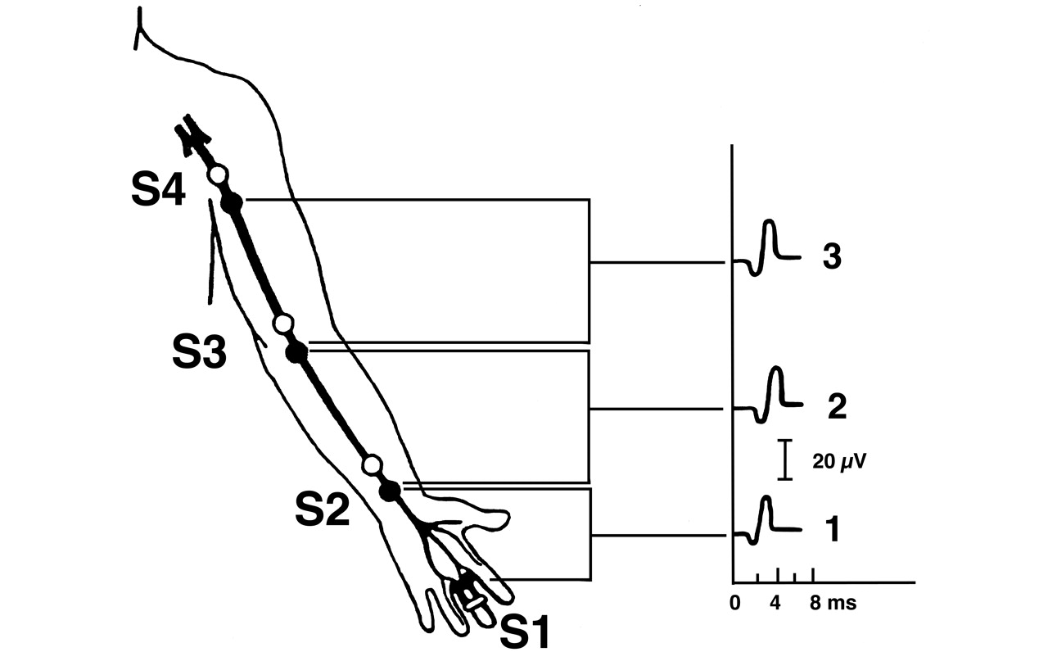
Normal Electrophysiology
During routine studies, proximal and distal stimulations are nearly identical in configuration

Slide 23
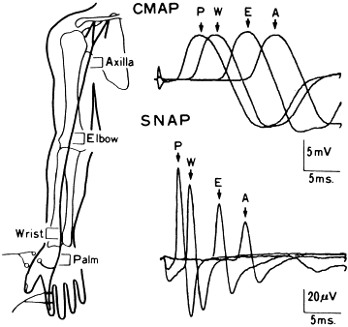
Normal Electrophysiology
But if measured carefully, the proximal AP duration may increase slightly, and both the area and amplitude may fall slightly
More evident for the shorter duration SNAP

Slide 24
Temporal dispersion and phase cancellation
Normal findings that result from a combination of temporal dispersion and phase cancellation
Due to normal variation in the size of individual fibre AP with larger fibres generally having larger amplitudes
Thus at proximal stimulation there is more dispersion(spread out) and less for distal stimulation

Slide 25
Temporal dispersion & Phase cancellation
Also APs have either a biphasic or triphasic configuration
When overlap occurs between the positive phase of one AP and negative phase of another, phase cancellation occurs, resulting in a smaller summated potential

Slide 26
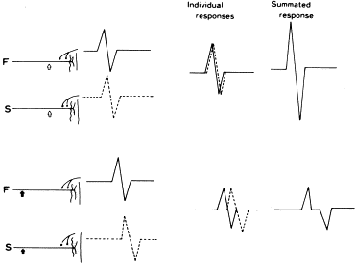

Slide 27
Temporal dispersion
Temporal dispersion is a physiological or pathological process
Not been established to produce motor or sensory deficits
But contribute to some non-disabling features of demyelinating neuropathies such as areflexia and lost vibration sense.

Slide 28
Temporal dispersion
Physiological temporal dispersion occurs diffusely along the length of a nerve to a minor degree in normal subjects
Pathological temporal dispersion is the result of an abnormally increased range of conduction velocities among the individual axons of a nerve.

Slide 29
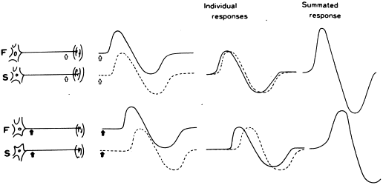
Temporal dispersion

Slide 30
Phase cancellation
Abnormal decrement may arise because increased TD; yields desynchronized arrival as well as increased cancellation between the positive and negative phases
Phase cancellation will be exaggerated when MUAPs are polyphasic due to collateral reinnervation following partial denervation

Slide 31
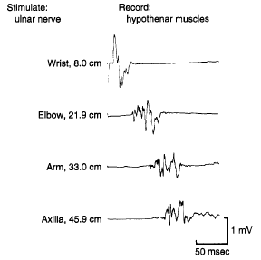

Slide 32
Focal nerve lesion pathophysiology: NCS recognition
A great variety of mechanisms—compression, traction, laceration, thermal, chemical, etc,—can injure the axons
Pathologic reactions of these axons to such focal injuries is quite limited- axon loss, demyelination, or a combination of both

Slide 33
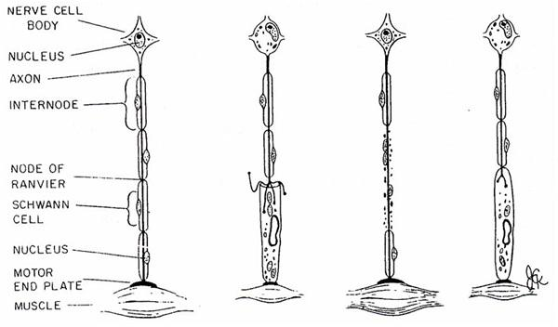
Axonal loss vs focal demyelination
The most defining is that focal demyelination remains strictly localized to the segment of nerve initially injured
With axon loss, in contrast, regardless of how minute the nerve segment initially damaged, Wallarian degeneration sets in

Slide 34
Focal nerve lesion pathophysiology
A total of four distinct pathophysiologic patterns, and combinations thereof, can be produced by these two pathologic processes

Slide 35
Patterns of conduction abnormalities in nerve lesions
Conduction failure pattern- in axonal loss
Conduction slowing pattern
- Differential slowing
- Focal synchronized slowing .
Conduction block pattern

Slide 36
Conduction failure pattern
All the amplitudes are reduced at all stimulation points- inelicitable or uniformly low in amplitude
By far the most common
Pattern seen with all axon loss lesions, of more than 7–10 days duration, the responsible lesion being anywhere along the nerve

Slide 37
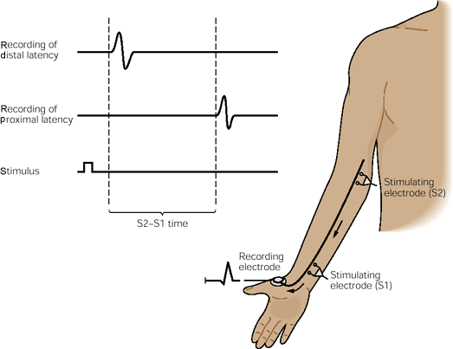
Conduction failure pattern
Can also be seen with demyelinating lesions which are situated distally along the nerve, between the most distal stimulating point and the recording site

Slide 38
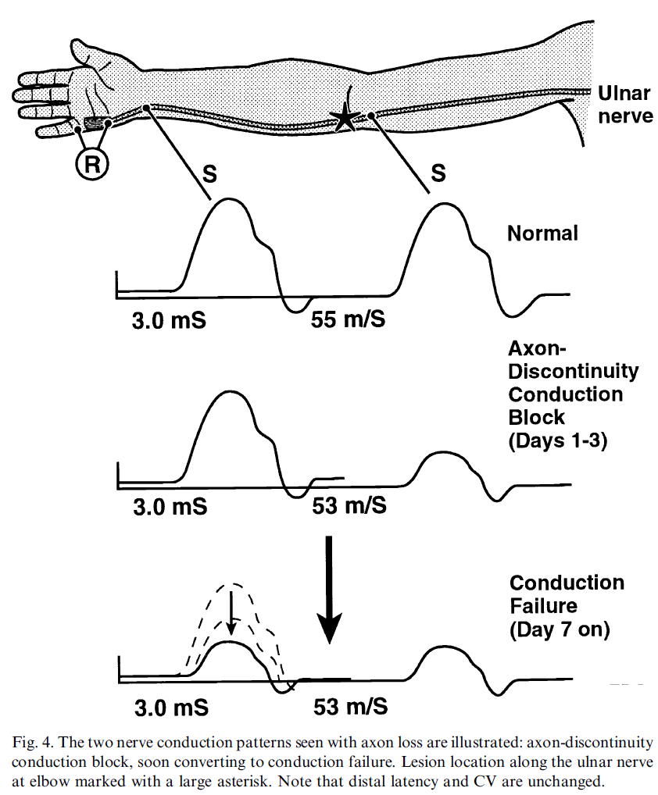

Slide 39
Conduction slowing
Conduction Slowing
Desynchronised slowing
Focal slowing

Slide 40
Differential/desynchronised slowing
Manifest as dispersed APs on all stimulations proximal to the lesion, with nondispersed responses on stimulations distal to it
As speed of impulse transmission is reduced variably along axons at the lesion site

Slide 41
Desynchronised slowing
At least some of the fastest conducting axons are not affected
Thus APs are dispersed, and often of low amplitude, the rate of conduction (the latencies or CVs) through the lesion is not reduced

Slide 42
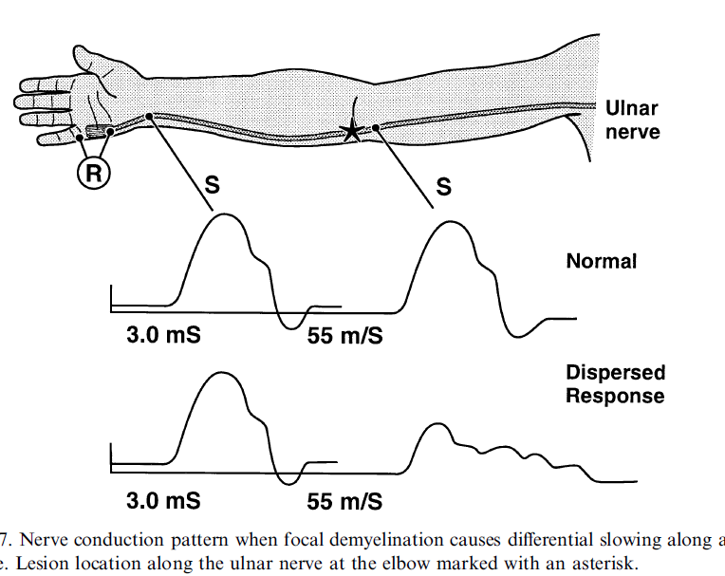

Slide 43
Focal/synchronised slowing
Here, the rate of conduction along all the large myelinated fibers is slowed, and to essentially the same degree
Manifested as either prolonged distal or peaked latencies, or slowed CV

Slide 44
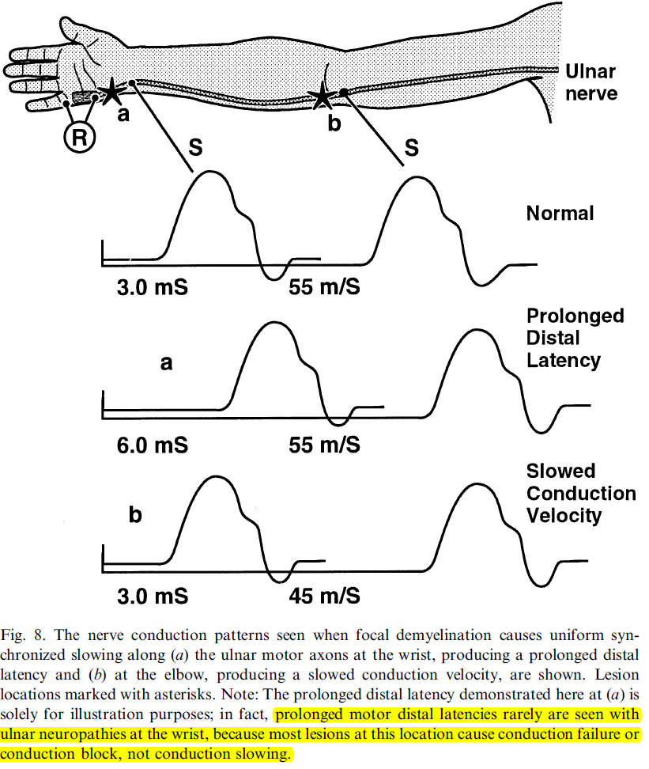

Slide 45
Focal slowing
Is an electrophysiologic phenomenon, which usually lacks a clinical counterpart, as all impulses traverse albeit at slower rate
Seen on regenerated nerves following remote, severe axon loss
Far more often, however, it is due to demyelination

Slide 46
To differentiate from conduction failure and conduction slowing
1. Conduction failure- (axonal loss) drop in CMAP amp in prox stimulation can be seen up to 1st wk.
2. Will never persist beyond 1st wk.
1. Conduction slowing- there will be no clinical weakness.
2. Differential slowing will result in TD.

Slide 47
Conduction failure pattern, which produces diffuse abnormalities along the nerve distal to the lesion
Conduction block pattern causes a very focal conduction change restricted to the site of injury.
NERVE LESION PATTERNS on NCS
CB can be differentiated from Conduction slowing by testing muscle power in the presence of low CMAP amplitudes.
Muscle power reduced in CB, but normal in slowing.

Slide 48
Conduction block
Focal loss of one or more myelin segment
Localised in between 2 stimulation points
Distal stimulation→ normal CMAP
Proximal stimulation →reduced amplitude (partial CB)→ absent response (complete CB)

Slide 49
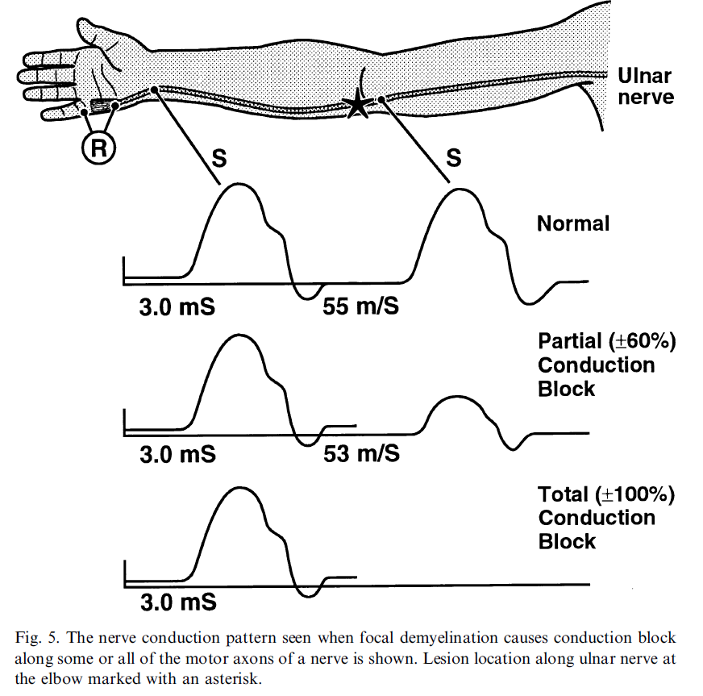

Slide 50
Mechanism of CB
The pathophysiology of CB include:
- segmental demyelination
- recent axonal interruption
- various axonal excitability abnormalities(ion channel dysfunction)
These processes can be related to compressive, ischemic or dysimmune inflammatory causes

Slide 51
Mechanism of CB
However, in contrast to axonal loss lesions, the underlying axon remains intact, and wallerian degeneration never occurs.
NCSs remain normal distally.
And if the nerve is stimulated above the lesion, electrophysiologic evidence of focal demyelination (Le., marked CV slowing, conduction block, or both) will be seen

Slide 52
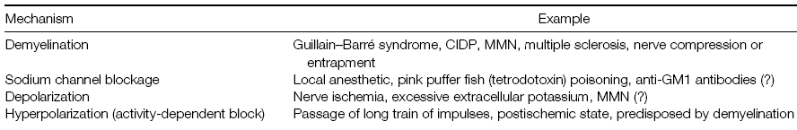

Slide 53
Pseudoconduction block
Acute axonal loss from any cause results in pseudo conduction block

Slide 54
Pseudoconduction block
But a CB pattern is never seen with a pure axon loss lesion more than 9–10 days after onset
This type of CB has had a number of names- including axonal, axon noncontinuity, early axon loss, axon discontinuity conduction block and pseudoconduction block

Slide 55
Types of CB depending on the duration
Rapid resolution CB (4-6 weeks)
Trauma-neuropraxia, AIDP .
Prolonged (6-12 months)
Recurrent trauma, tourniquet palsy.
Indefinite (years)
Radiation plexopathy, MMN,CIDP.

Slide 56
Clinical consequences of CB
Elevated thresholds and CB resulting in clinical weakness and sensory loss
Desynchronization of volleys, causing temporal dispersion of waveforms, loss of reflexes and reduced sensation
Prolonged refractory periods with frequency-dependent CB resulting in reduced strength during maximal voluntary effort

Slide 57
Clinical Features
With a conduction block, clinical numbness and weakness develop acutely
Exaggerated hyperpolarization after the passage of impulse, inducing CB even at low firing frequencies, possibly the cause of fatigue after sustained effort

Slide 58
Clinical features
Bursts of ectopic discharges at sites of focal demyelination responsible for facial myokymia and spontaneous or mechanically-induced paresthesias

Slide 59
Significance of finding CB
It implies that the clinical deficit is secondary to demyelination; better prognosis
The finding of conduction block can be used to localize the lesion
The presence of conduction block differentiates acquired from inherited conditions(uniform slowing)

Slide 60
Criteria for conduction block
Authors | Definite | Probable or Possible
Cornblath et al | >20% NP area and <15% change in duration | >20% NP area and >15% change in duration
Albers et al | > 50%  NP area | > 30%  amplitude
Brown and Feasby et al | >20% P-P amplitude and <15% change in N-P duration | >30% P-P amplitude and >15% change in N-P duration
Bromberg et al | > 30%  P-P amplitude | None
Shin J Oh et al | > 50%  NP amplitude or area <15% change in duration | 25 – 49%  in amplitude or area when 15-33% change in duration
Lange et al | >50%  NP amplitude and area and <30% duration prolongation | >50%  amplitude and area and >30% duration prolongation
Rhee et al | > 50%  NP amplitude

Slide 61
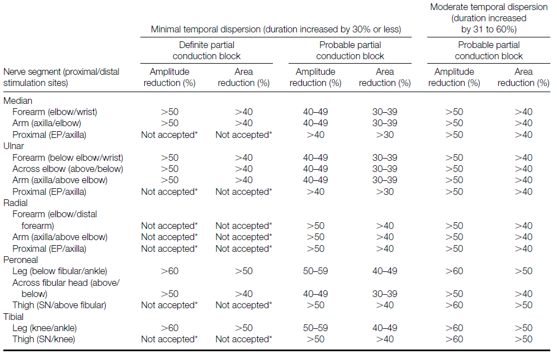
AANEM CRITERIA

Slide 62
Technical considerations
All measurement of amplitude, area, and duration refers to values for the negative peak of surface recorded CMAPs
Applied only to nerves in which the negative-peak amplitude of with distal stimulation is 20% or more of the lower limit of normal

Slide 63
Technical considerations
Applicable to ulnar nerve in the forearm only if median-to ulnar nerve crossover in the forearm (Martin- Gruber anastomosis) has been excluded
The criteria are more restrictive for the radial, peroneal, and tibial nerves than for the median and ulnar nerves

Slide 64
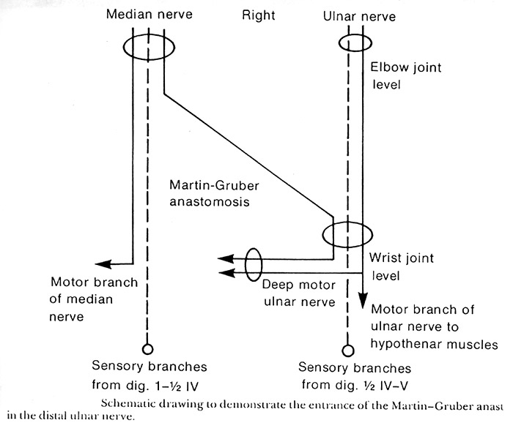
Martin Gruber anastamosis

Slide 65
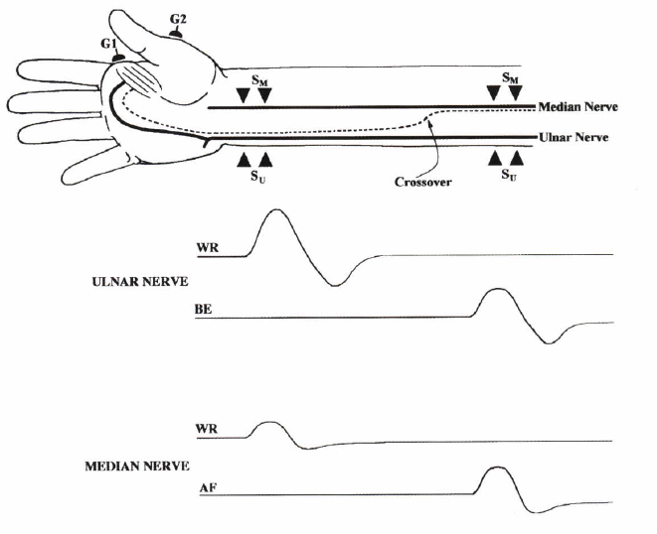

Slide 66
Technical considerations
Supramaximal stimulation to be used
But usage of excessive stimulation intensity at the wrist activates both median and ulnar nerves
Result in apparent partial CB in the forearm segment of the median nerve due to ulnar innervation of deep thenar muscles.

Slide 67
Technical considerations
Certain anatomical variations such as body weight and limb edema are difficult to quantify
Lack of correlation-weakness and CB- interphase cancellation or that site of CB lying more proximally

Slide 68
Role of temperature
Nerve impulse propagation slows by 2.4 m/sec, or approximately 5%, per degree centigrade from 38°C to 29°C of body temperature.
Also, cooling results in a higher CMAP and SNAP amplitude and longer response duration, because of slowed Na channel inactivation
Therefore, a CMAP or SNAP with high amplitude and slow distal latency or conduction velocity should raise the suspicion of a cool limb.

Slide 69
For practical purpose
See CMAP amplitude.
Definite CB : > 50% reduction, if CMAP duration is normal.
Probable CB : < 50% but > 40% reduction, if duration is normal.
Look for any prolongation of CMAP duration.
Increase in duration of >15% is significant.
  15-30% increase →minimal TD
  >30% increase→ moderate TD
If TD 30-60% only probable CB can be suggested.
If TD > 60 % even probable CB can not be commented.

Slide 70
CB vs Abnormal temporal dispersion

Slide 71
CB vs Abnormal temporal dispersion.

Slide 72
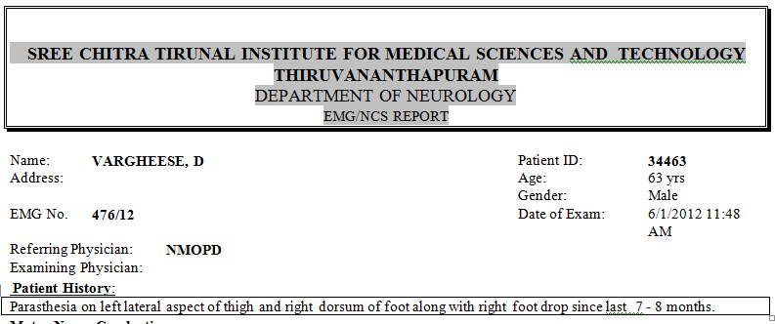
Example1

Slide 73
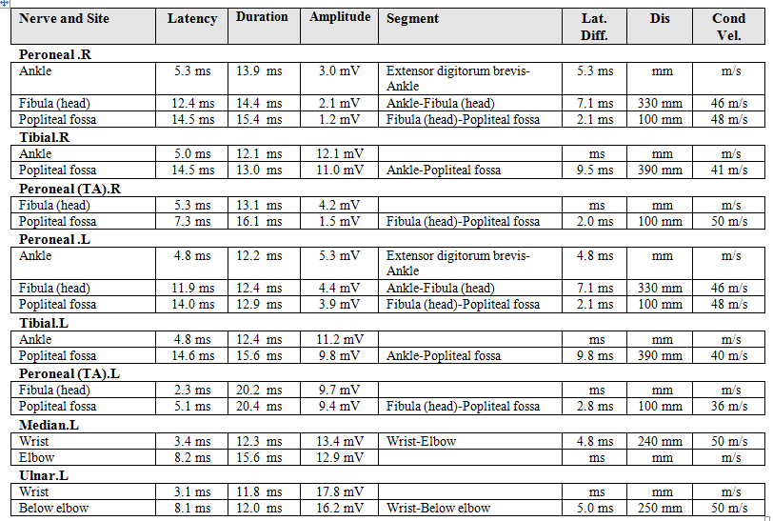

Slide 74
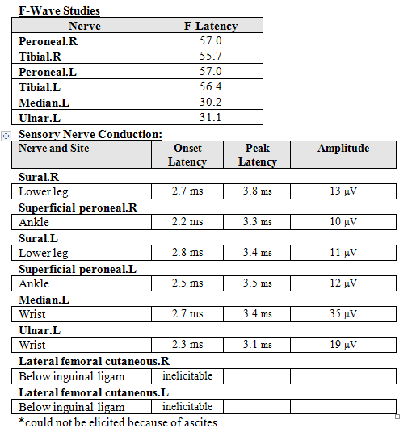

Slide 75
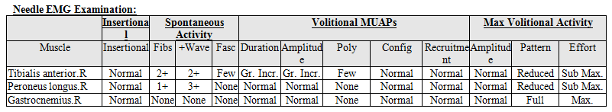
EMG

Slide 76
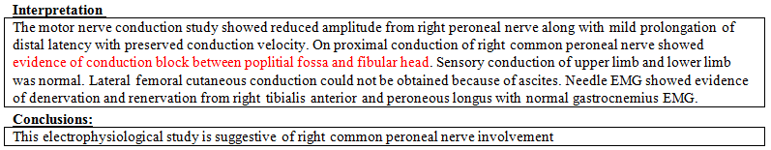

Slide 77
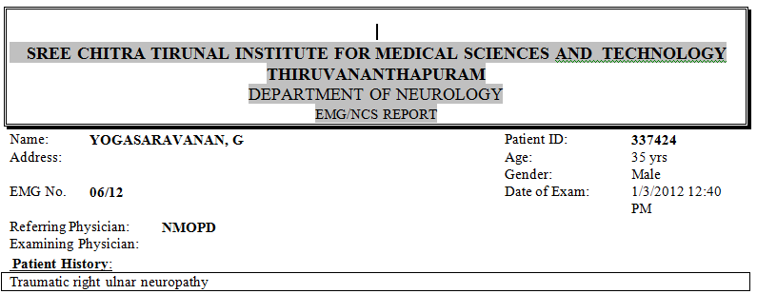
Example 2

Slide 78
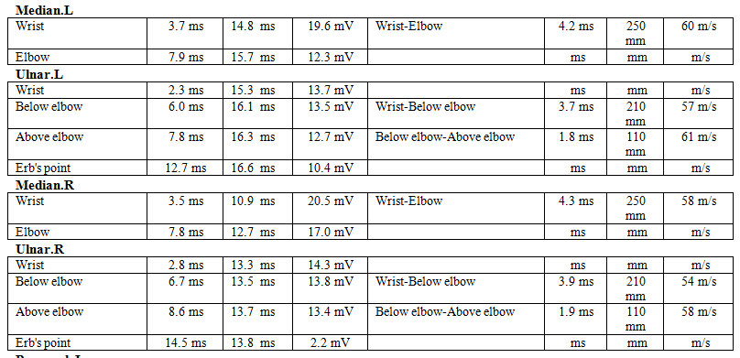

Slide 79
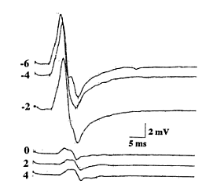
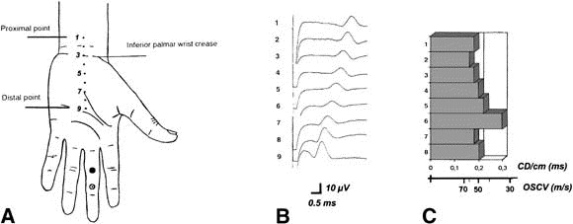
Short segment stimulation/Inching Technique
For precise localisation of pathology
Mainly used for focal neuropathy- ulnar nerve at elbow, peroneal nerve at fibular head and CTS
At 2cm distances and look for abrupt change

Slide 80
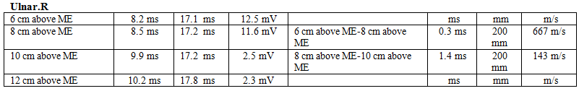
Inching technique

Slide 81
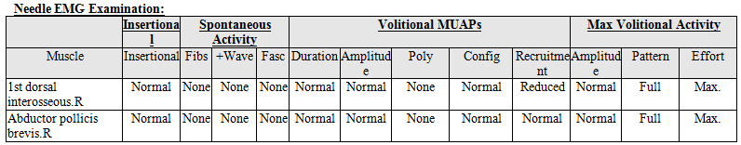
EMG

Slide 82
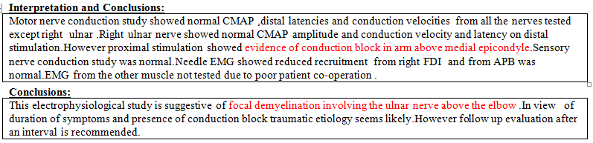

Slide 83

Conclusion
‘The presence of conduction block is confirmed if a shock applied distally to the nerve lesion in question elicits a normal or near-normal CMAP and a vigorous twitch of the clinically weak muscle’

Slide 84
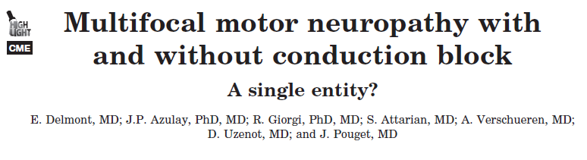

Slide 85
Introduction
Parry first described an MMN without CB, which improved with IVIg therapy
About 30 cases of MMN without CB have been reported so far with similar clinical features and a good response to IVIg

Slide 86
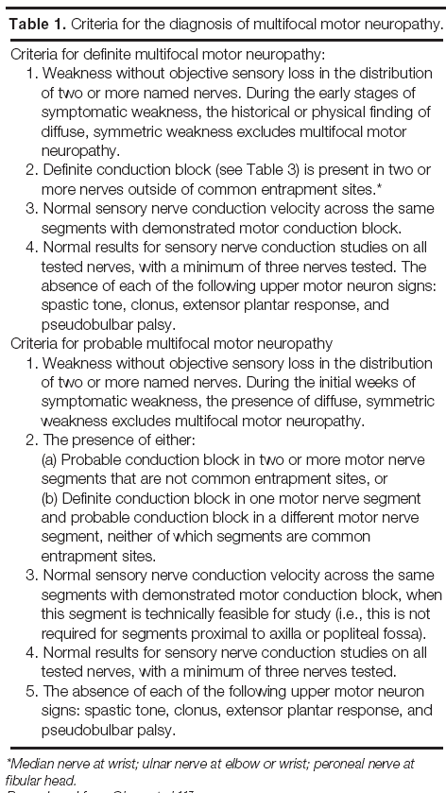

Slide 88
Aim
To compare the clinical features, prognosis and response to IVIg during long-term follow-up, with a view to determining whether MMN with and MMN without CB are similar or distinct diseases

Slide 89
Methods
Retrospectively analyzed all the patients showing clinical features of MMN ie chronic asymmetric purely motor weakness with a peripheral nerve distribution mainly affecting the upper limbs
Clinical exclusion criteria were sensory, bulbar, or respiratory signs and upper motor neuron involvement
Follow-up period during the disease was at least of 4 years to rule out the diagnosis of ALS.

Slide 90
Inclusion criteria
MMN without CB- Electrophysiologic examination did not reveal CB but could detect some demyelination features not fulfilling the criteria for CIDP
These patients were classified as having MMN without CB.

Slide 91
Inclusion criteria
In a second group, were included all the patients followed at the department who fulfilled AAEM and European diagnostic criteria for MMN with CB

Slide 92
Results
Among the 54 patients with a diagnosis of suspected MMN 33 had been followed for more than 4 years.
Twenty patients had MMN with CB and 13 had MMN without CB

Slide 93
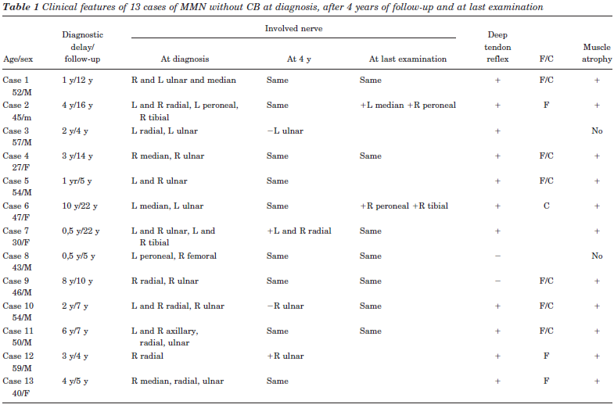

Slide 94
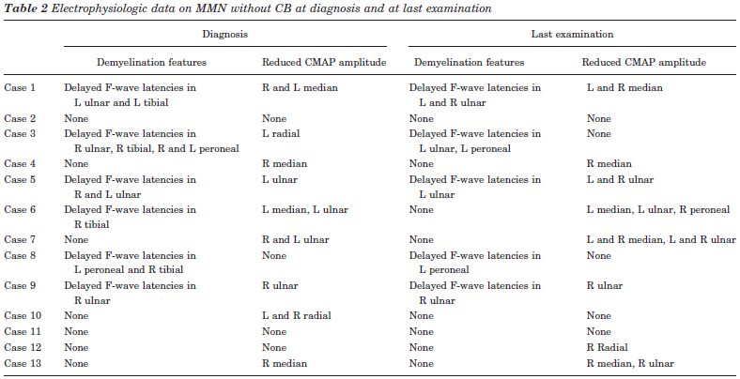

Slide 95
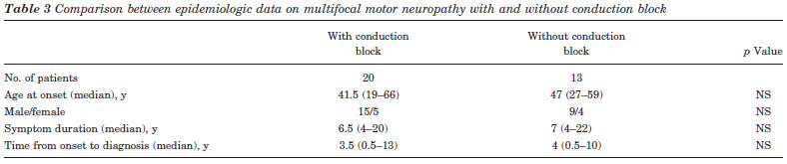

Slide 96
Comparison between MMN with and without conduction block
There was no difference in age, sex, time from onset to diagnosis, or duration of follow-up between the two groups
Nerve distribution, number of affected limb regions, predominance of the distal weakness in the upper extremities, asymmetric weakness, cramps, and fasciculations were comparable at diagnosis, after 4 years of follow-up, and at the last examination

Slide 97
Significant differences
In patients of MMN without CB involvement of median nerve was less frequent after 4 years of follow-up and at the last examination in patients without CB: 4 of 13(30%) after 4 years vs 14 of 20(70%) of the patients with CB

Slide 98
Significant differences
In the upper limbs, proximal weakness was less frequent in the patients with MMN without CB at the last examination: 0 of 13 vs 7 of 20(35%) of the patients with MMN with CB

Slide 99
Significant differences
The number of nerves involved was equal at diagnosis and after 4 years of follow-up but was smaller in patients without CB at the last examination: 2 (range 1 to 6) vs 4.5 (range 1 to 15) in patients with CB

Slide 100
CSF Analysis
Yielded similar data
Cell count median was 0/mm3 in the MMN group with CB and 1.5 mm3 in the MMN group without CB
Median protein level was 0.33g/L in the MMN group with CB and 0.49 g/L in the MMN group without CB

Slide 101
GM1 antibody data
7 of 20(35%) patients with MMN with CB had IgM anti-GM1 antibodies and 5 of 20(25%) had IgG anti-GM1 antibodies
3 of 13(23%) patients with MMN without CB had IgM anti-GM1 antibodies and 2 of 13(15.3%) had IgG anti-GM1 antibodies
Median titer of IgM and IgG anti-GM1 antibodies was 60 for patients with MMN with CB and 80 for patients with MMN without CB

Slide 102
Response to IVIG
The efficiency of the first course of IVIg treatment was similar :
14 of 20(70%) MNN patients with CB and 8 of 13(61.5%) without CB had a good response to IVIg, with an improvement of at least 1 point in MRC sum-scores

Slide 103
Non responders
Among IVIg nonresponders, two patients with CB and two patients without CB received cyclophosphamide therapy
One patient with CB had azathioprine treatment.
Immunosuppressive drugs were poorly efficient in these cases.

Slide 104
Discussion
Retrospectively compared the clinical, biologic, and electrophysiologic features of 20 patients with MMN with CB and 13 patients with MMN without CB

Slide 105
Discussion
During the follow-up period, the muscle weakness seemed more restricted in patients without CB, because proximal deficits, involvement of median nerve, and number of affected nerves were greater in patients with CB.

Slide 106
Discussion
Nerve distribution, number of affected limbs, predominance of weakness in the distal upper extremities, asymmetric weakness, cramps, fasciculations, GM1 antibody titers, and response to IVIg were all similar between the two groups at diagnosis, after 4 years of follow-up
The two groups can therefore be said to have the same characteristics.

Slide 107
Discussion
Based on these results, it can be suggested that MMN without CB is a motor neuropathy and not AHC disease
The strong similarities between MMN with and without CB favor the concept of a demyelinating motor neuropathy with undetected CB rather than a primary axonal neuropathic process

Slide 108
Discussion
The fast clinical improvement observed in some patients with MMN without CB in response to is more compatible with a reversal of the CB.

Slide 109
Discussion
In MMN with CB, a good response to IVIg is correlated with a greater number of definite CBs.
However, in our study, IVIg efficiency was the same in both patients with and without CB.

Slide 110
Conclusion
Only a few cases of MMN without CB have been reported so far
However, patients with and without conduction block showed similar clinical features and a similar response to IV immunoglobulin treatment

Slide 111
Thank You

Slide 112
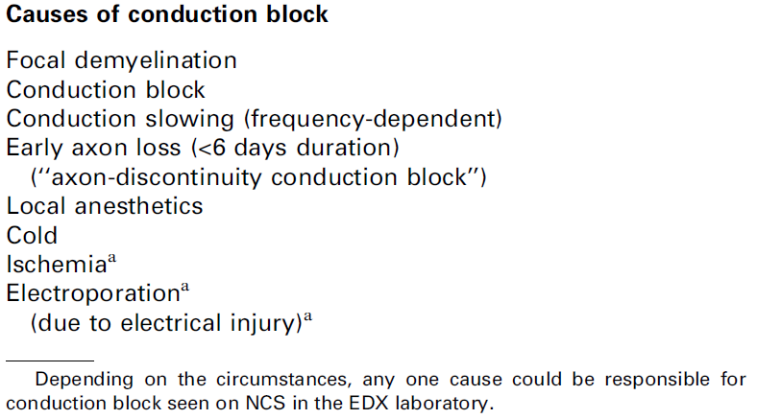

Slide 113
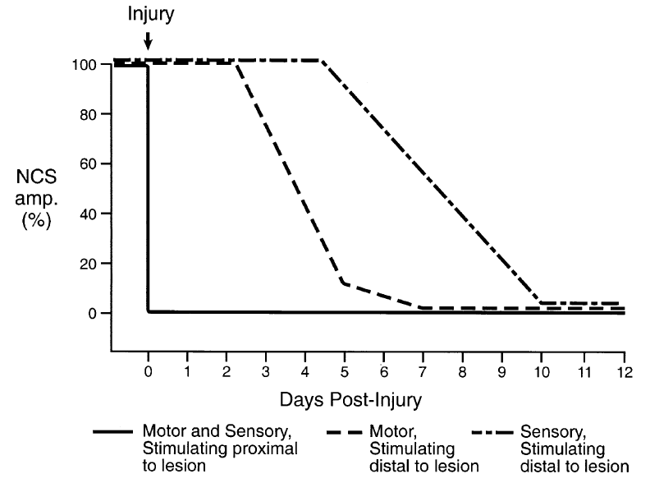

Slide 114
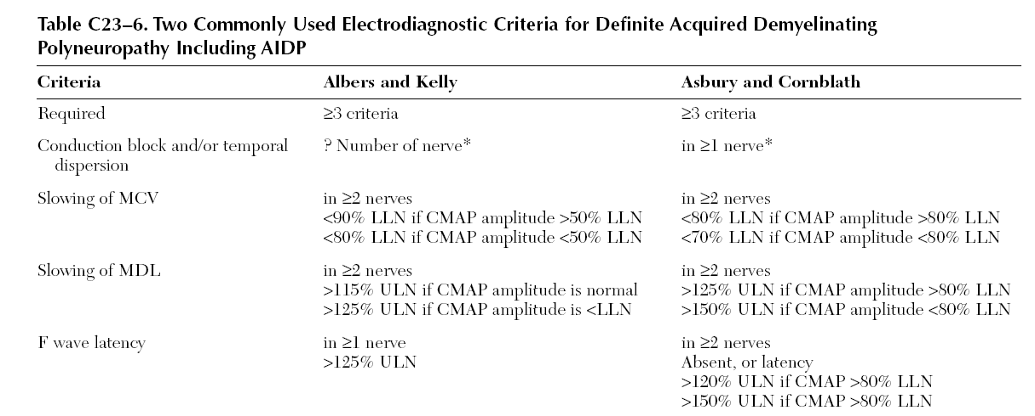
Criteria for aquired demyelination

Slide 115
Frequency dependent CB
Little is known about these so-called frequency-dependent conduction blocks in regard to their clinical manifestations
They are reported to cause ‘‘fatigue after mild but sustained effort”

Slide 116
Mechanism of activity dependent CB

