Slide 1
Congenital myopathies
Faculty : Dr. Sanjay Prakash

Slide 2
Scheme of presentation
Introduction
Epidemiology
Classification
Common clinical features
Differential diagnosis
Treatment
Unresolved issues
Conclusion

Slide 3
Introduction
Heterogeneous group of nm conditions defined by distinctive abnormalities in skeletal muscle.
Mostly genetic; few sporadic.
Present in infancy/early childhood; nonprogressive /slowly progressive with age.

Slide 4
The term congenital myopathy (CM) 1st introduced in the scientific literature in 1956, when Shy and Magee described a congenital nonprogressive myopathy, which was later termed ‘central core disease’.
Dubowitz coined the term ‘new myopathies’ in 1969 which was not sustained.

Slide 5
How common are these?
Rare
Precise epidemiologic data not existing.
Estimated incidence ~ 6 ⁄ 1,00,000 live births, or 1/10th of all cases of nm disorders.
Prevalence 3.5–5.0 ⁄ 100,000 in a pediatric population (Northern Ireland & Sweden study).

Slide 6
Indian scenario - AIIMS study (1998-2000)
Of 70 patients with floppy infant syndrome due to PNS involvement
  SMA - 37
  congenital myopathy -7,
  congenital muscular dystrophy- 5
  mitochondrial myopathy- 4
  neuropathies -5
  diaphragmatic SMA -1.
  Unclassified – 15.7%
  Indian Pediatr 2001; 38: 1236-1243

Slide 7
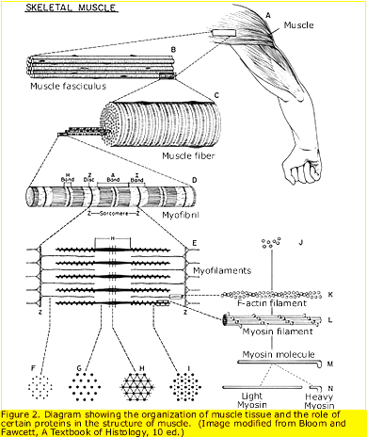
Structure of muscle

Slide 8
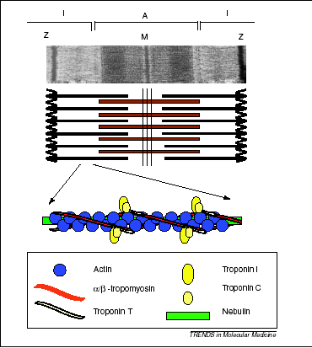

Slide 9
Classification
Structured types
Abnormalities of sarcomeres
  Central core
  Multi-minicore
  Hyaline body myopathy
  Actinopathy
  Cap disease
  Trilaminar fiber myopathy
  Broad A-band myopathy

Slide 10
Z-disk abnormalities
  Nemaline/rod myopathy
  Desmin related/myofibrillar myopathies
Nuclear abnormalities
  Myotubular
  Intranuclear rod
Abnormal inclusions
  Fingerprint body myopathy
  Zebra body
  Reducing body
  Cylindrical spirals

Slide 11
Abnormalities of organelles
  Sarcotubular
    Tubular aggregate
  Lysosome related vacuolar
Miscellaneous
  Minimal change myopathy
  Non specific cong myopathies in syndromes
Mixed
  Rod-core
  Cytoplasmic body-reducing body
  Multiminicore-centronuclear

Slide 12
Unstructured types.
  Congenital fiber type disproportion
  Microfiber myopathy

Slide 13
Congenital myopathies with identified genetic loci
Disorder | Gene | Protein | Inheritance
Nemaline | TPM3 NEM2 ACTA1 TPM2 TnT1 | α-tropomyosin nebulin skeletal muscle α-actinin β-tropomyosin Troponin T | AD,AR, AR AD,AR,sporadic AD AR
Central core | RYR1 | Ryanodine receptor | AD, rarely AR
Myotubular | MTM1 | Myotubularin | X-linked
Desminopathy/myofibrillar | DES | Desmin | AD & AR
Multi-minicore | RYR1 SEPN1 | Ryanodine receptor Selenoprotein N | AD, AR AR

Slide 14
Functions of mutated proteins
Ryanodine receptor, Selenoprotein N- maintain intracellular Ca2+ homeostasis.
Myotubularin- Protein-tyrosine phosphatase required for muscle cell differentiation.
Tropomyosin, nebulin, α-actinin & Troponin T - form ms contractile unit along with myosin & actin and stabilization of Z-disc.

Slide 15
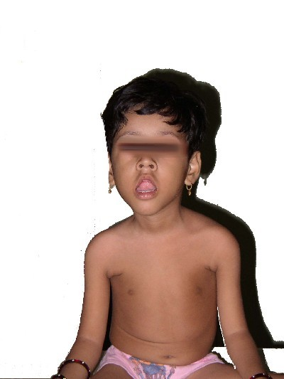
Common clinical features
Generalized weakness
Hypotonia- floppy infant
Hyporeflexia
Poor muscle bulk
Normal IQ
Skeletal abn sec to myopathy
  Elongated facies
  Pectus carinatum
  Scoliosis
  Foot deformities
  High arched palate
Elongated face
Open mouth

Slide 16
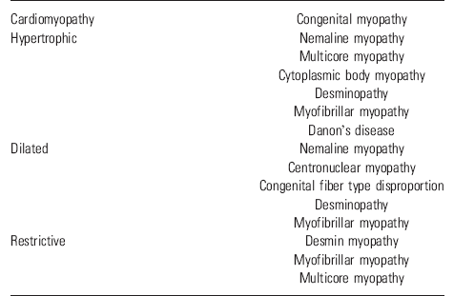
Cardiac involvement
conduction abn
cardiomyopathy
valve insufficiency

Slide 17
CK - N / mild↑
EMG – myopathic
Muscle biopsy-specific histologic / ultrastructural abn; does not demonstrate necrosis/fibrosis; no storage. Type I fiber predominance & preferential hypotrophy.
No. of fibers having characteristic pathology does not correlate with disease severity.

Slide 18
Central core disease (CCD)
Most common CM.
Onset-infancy to early childhood.
Distribution of weakness- proximal hip girdle, axial, mild facial.
Bulbar & EOM inv considered a clinical exclusion criterion by some authors, however, both features have been observed in recessive form.
Orthopaedic complications common- congenital dislocation of the hips, scoliosis, foot deformities like talipes equinovarus and pes planus & ligament laxity.
Contractures other than tendoachilles rare.

Slide 19
Cramps on exercise common.
Cardiomyopathy not a feature.
Respiratory involvement in severe neonatal cases (recessive form).
Course- static or only slowly progressive. Most achieve the ability to walk independently.

Slide 20
CCD & Malignant hyperthermia (MH)
Both MH and CCD are disorders of calcium release channels & linked to RYR1 gene.
Dominant RYR1 mutations affecting the cytoplasmic N-terminal and central domains of the protein give rise to the MH phenotype, whereas the CCD phenotype is closely associated with C-terminal mutations.
28% have MH susceptibility.
~50% develop MH on 1st exposure.
Should therefore be considered at risk for MH during general anaesthesia.

Slide 21
Genetics
Mode of inheritance- AD >>AR>sporadic
Gene- long arm of chr.19
Ryanodine receptor (RYR1)

Slide 22
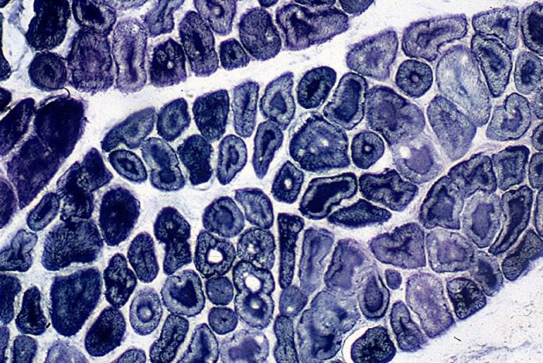
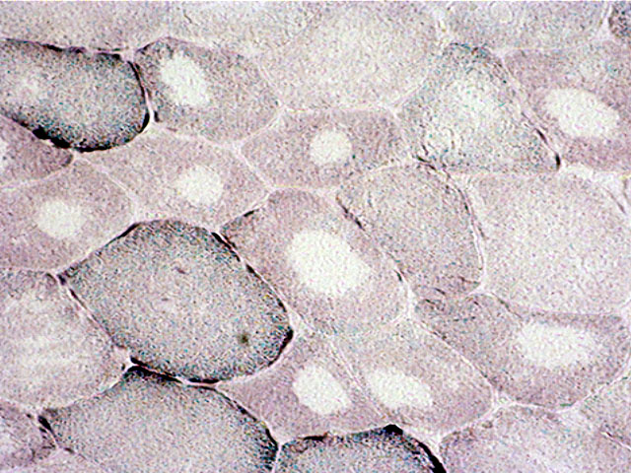
Pathology
Type I fiber predominance.
Central punched out unstained areas devoid of mitochondria & SR, disorganized myofibrils.
Best seen on oxidative stains (SDH/NADH/COX).
NADH stain
SDH stain

Slide 23
Muscle MRI in CCD
Jungbluth et al. reported muscle MRI findings of 11 patients from 8 families with RYR1 mutations who had cfs of a CCD.
Within thigh: selective involvement of vasti, sartorius, adductor magnus and relative sparing of rectus femoris, gracilis and adductor longus
Within leg: selective involvement of soleus, gastrocnemii and peroneii and relative sparing of the tibialis anterior.

Slide 24
Nemaline myopathy (NM)
‘Nema’ = thread like
Clinically 6 different forms
Classic ⁄ typical congenital type- floppy infant with additional facial and respiratory weakness
Severe congenital type- lack of movements, respiratory insufficiency, contractures, fractures and arthrogryposis multiplex
Intermediate congenital type- clinical severity apparent only later in childhood
Mild childhood or adolescent type
Adult onset type
A group with diverse features such as cardiomyopathy, ophthalmoplegia or rigid spine

Slide 25
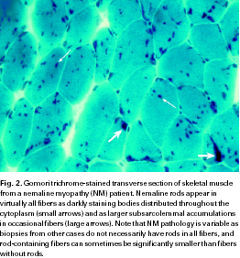

Slide 26
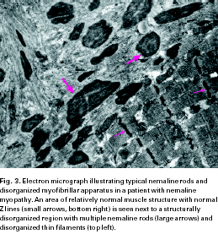

Slide 27
Usually non-progressive except severe neonatal form.
Cardiomyopathy can occur.
Rods occur most often in cytoplasm, however, presence of intranuclear rods is associated with severe infantile form (Goebel & Warlo, 1997).

Slide 28
Centronuclear myopathy (CNM)/ Myotubular myopathy
Inherited muscle disease defined by
numerous centrally placed nuclei on muscle biopsy
clinical features of a congenital myopathy.
  3 clinical types:
  Prenatal/neonatal onset - XLR
  Childhood onset - AR
  Adult onset mild – AD
  The term ‘Myotubular’ (resembling fetal myotubes) is used for 1 while 2,3 are usually termed ‘Centronuclear’.

Slide 29
X-linked myotubular myopathy (XL MTM)
Antenatal period -
h/o male neonatal deaths or miscarriages
reduced foetal movements, polyhydramnios and thinning of the ribs on chest radiographs (only rarely observed in other CMs)
Postnatal period -
Macrosomia, macrocephaly, micrognathia, ptosis, joint contractures, high-arched palate, cryptorchidism, club feet, arthrogryposis multiplex, hypotonia, birth asphyxia.
Course: majority fatal within the first months of life, small proportion may survive into their teens or beyond.

Slide 30
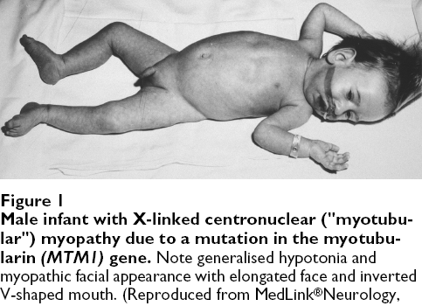

Slide 31
Extramuscular manifestations in XL MTM
vitamin K-dependent coagulopathy,
gastrointestinal bleeding,
pyloric stenosis,
cholestatis/cholelithiasis,
scoliosis and
nephrocalcinosis/kidney stones
Therefore, clinicians should carefully monitor patients for these potential complications.

Slide 32
AR CNM
Intermediate severity bet XL MTM & AD forms.
Onset in infancy/early childhood.
Delay in motor milestones.
Hypotonia, weak cry, resp & sucking diff, ophthalmoplegia, ptosis & facial diplegia.
Skeletal deformities – high arched palate and scoliosis.
Urinary incontinence (also seen in female carriers of XL MTM).
Cardiomyopathy in few cases.
Slowly progressive weakness. Few may lose ambulation by adolescence.

Slide 33
AD CNM
Adolescent or adult onset, normal motor milestones.
Proximal > distal weakness, external ophthalmoplegia and ptosis.
Calf hypertrophy (in some).
Exercise induced myalgia.
Slowly progressive course with loss of independent ambulation uncommon before the 6th decade.

Slide 34
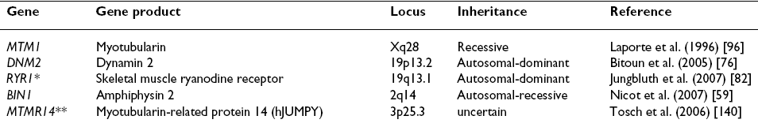
Genes identified so far

Slide 35
Investigations
EMG- spontaneous discharges (fibs, positive sharp waves, occ CRDs & rarely myotonic discharges).
Ms MRI- distinctive from CCD
CNM Involvement of- Rectus femoris Adductor longus Gastrocnemius Soleus Tibialis anterior Sparing of- Gracilis Sartorius Adductor magnus Vasti Peroneii | CCD Involvement of- Vasti Adductor magnus Sartorius Gastrocnemius Soleus Peroneii Sparing of- Gracilis Rectus femoris Adductor longus Tibialis anterior

Slide 36
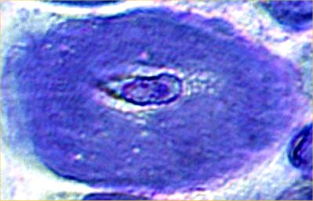
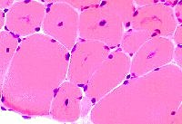
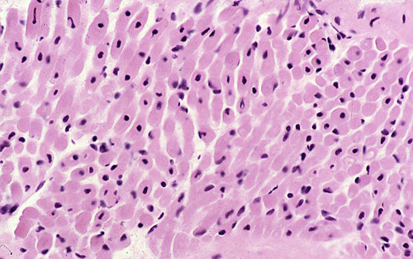
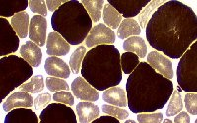
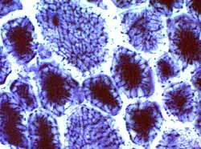
Myotubular/centronuclear-pathology
Toluidine stain
Centrally placed nuclei
Fiber size variation
Fetal myotube App
Myosin ATPase 9.4
NADH

Slide 37
Multiminicore myopathy (MMD)
‘Multicore disease, minicore disease, pleocore disease and MMD with external ophthalmoplegia’.
Spinal rigidity, scoliosis and respiratory impairment together with minicores on muscle biopsy – classic phenotype.
Onset usually early in life with hypotonia & feeding diff.
Axial muscle weakness, particularly neck and trunk flexors, is prominent & failure to acquire head control- early sign.
Muscle wasting mainly affects axial groups, shoulder girdle and inner thigh ("bracket-like appearance").
External ophthalmoplegia & cardiomyopathy.

Slide 38
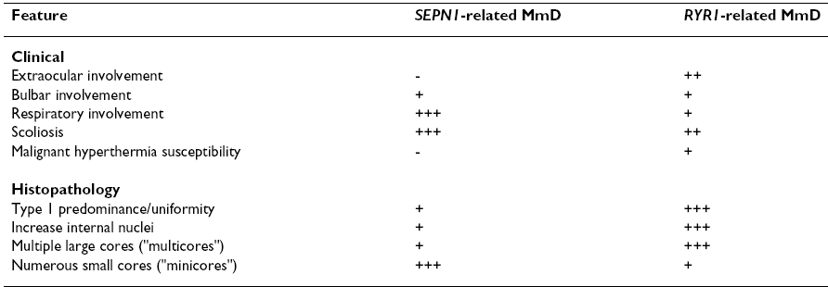
Classic genotypes
Ch 1
Ch 19

Slide 39
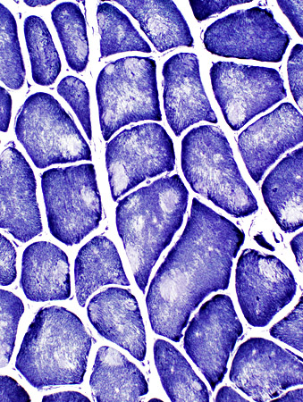
MMD pathology

Slide 40
Other rare types
Desminopathy-
desmin gene mutation on ch 2q35
2nd to 4th decades
distal LL muscle weakness & atrophy on presentation
Slowly progresses to involve axial & prox ms
cardiomyopathy
Hyaline body myopathy-
Rare, < 20 cases reported
Onset-infancy/childhood
No specific c/f
Pathology- subsarcolemmal hyalinized bodies
Sporadic/?AR/?AD

Slide 41
Congenital fiber type disproportion
Non-progressive, relatively good prognosis.
Most cases are autosomal dominant.
  Multiple joint contractures
  Short stature
  Long thin face
  High arched palate
  “fish mouth” appearance

Slide 42
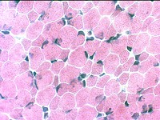
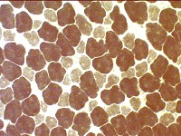
H& E stain-CFTD
Myosin ATPase at pH 9.4-CFTD
Predominance & preferential atrophy of Type I fibers.
The diagnosis should only be made when the size discrepancy between Type I & Type II fibers is greater than 45% and when more than 75% of the fibers are Type I.

Slide 43
D/D
Other conditions presenting with floppy infant syn
  SMA (Werdnig-hoffman)
  Congenital myotonic dystrophy
    Histologic similarities with CNM
    Must be ruled out by EMG of mother/DNA studies.
  Cong muscular dystrophies (severe contractures, MR, seizures, WM lucencies in brain, markedly elevated CPK)
  Congenital myasthenia (treatable condition)
  Motor neuropathies (eg., CHN)

Slide 44
Treatment of cong myopathies
No curative Rx for any form
In severe neonatal forms, the decision regarding the duration of respiratory support is not easy but as no firm prognostic criteria have yet been established, at least initially proactive stance should be taken and any respiratory management decision should be made on an individual basis rather than on diagnosis alone.
Mutidisciplinary approach
  Monitoring - for respiratory function & Rx of RTI, Mx of feeding.
  Rehabilitation-
  physiotherapy to preserve ms power & prevent contractures,
  endurance promoting exercises like swimming & riding,
  surgical Mx of contractures & scoliosis

Slide 45
In cases where walking can not be achieved without additional support, independent ambulation may be promoted by weight-bearing calipers.
  Risk Mx- special precaution during surgery, anaesthesia, childbirth, esp, in types where RYR1 mutations are common.
  Prevention- genetic counselling & prenatal diagnosis.

Slide 46
Pharmacologic agents
Pilot trial of salbutamol in central core and multi-minicore diseases.
Neuropediatrics, 2004.
10 pts (6 with central core and 4 with minicore disease) received oral salbutamol at a dose of 2 mg QID for 6 mo.
There were significant increases in myometry, MRC scores and forced vital capacity between baseline and the 6 mo assessments.
No significant adverse eff were noted.

Slide 47
Impaired neuromuscular transmission and response to acetylcholinesterase inhibitors in centronuclear myopathies.
3 CNM & 1 XLMTM cases showed EP features of a nm jn defect. Authors also studied nm junction structure and function in the MTM1 knockdown zebrafish model of XLMTM, demonstrating abnormal nm jn organization; anticholinesterase therapy resulted in marked clinical response. These observations suggest that a nm jn defect may accompany CNM and contribute to muscle weakness. Muscle biopsy should be considered in infants suspected to have CMS & no CMS gene mutation is identified. Treatment with acetylcholinesterase inh may benefit some CNM patients. This warrants further confirmation.
Neuromuscul disord, June 2011.

Slide 48
Unresolved issues
CCD and MH are closely associated with mutations in the RYR1 gene, but clear genotype-phenotype correlations are still not known.
Also not known is the pathogenesis of central cores.
The link between the mutated proteins and abnormal nuclear positioning remains unknown in CNM.
The precise mechanisms underlying diff genetic mutations producing almost similar phenotype is not known, eg., RYR1 & SEPN1 mutations in MMD.

Slide 49
Conclusion
Suspect congenital myopathy when typical facies, skeletal deformities and normal CPK are found irrespective of age of presentation.
Ms biopsy findings described in various CMs can occur in variety of other conditions, hence, a diagnosis of CM needs to be entertained only when clinically relevant weakness present.
Full cardiac work up needs to be done as cardiomyopathy & conduction defects are seen in many different types & can lead to sudden death.
A cautious approach is generally advisable for all cases of congenital myopathies considered for general anesthesia esp, those with RYR1 mutations (CCD, MMD, CNM rarely) or genetically unresolved cases.

Slide 50
Thank u

Slide 51
References
Bradley, 5th edition.
Congenital myopathies – a comprehensive update of recent advancements. Sharma et al., Acta Neurol Scand 2009: 119: 281–292.
Central core disease, a review. Jungbluth., Orphanet Journal of Rare Diseases, 2007.
Centronuclear (myotubular) myopathy, a review. Jungbluth et al., Orphanet Journal of Rare Diseases, 2008.
Multi-minicore Disease, a review. Jungbluth ., Orphanet Journal of Rare Diseases, 2007.
Myotubular/centronuclear myopathy and central core disease. Review article. Fujimura et al., Neurol India, 2008.

Slide 52
MCQs
Which is true regarding central core disease?
Most cases are sporadic.
Cardiomyopathy is not a feature.
Cores consist of abnormal accumulation of nuclei.
Severe infantile form never reported.
Succinylcholine safe for GA.

Slide 53
Ans= 2

Slide 54
Which is the correct option
Both central core disease
Fig 1= CCD, Fig 2= myotubular
Fig 1= myotubular, Fig 2= CCD
Both myotubular myopathy
1
Myosin ATPase 9.4
2
NADH

Slide 55
Ans=4

Slide 56
Which is false regarding CNM?
Severe infantile form demonstrates characteristic male to male transmission.
EMG can sometimes show myotonia.
No specific treatment available so far.
Risk with depolarizing neuromuscular blockers seen in few cases.

Slide 57
Ans=1

