Slide 1

CHILD GUIDANCE CLINIC
Presented By,
Mr. Nirmal Raj E V
Associate Professor
Department of Child Health Nursing, SNC

Slide 2
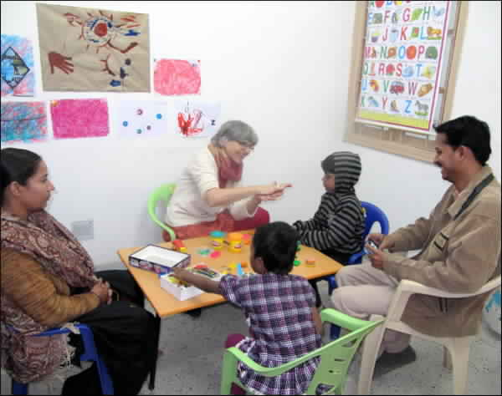
INTRODUCTION
The first child guidance clinic was started in Chicago in 1990.
.
The first CGC was started in India in 1939 at the TATA Institute Mumbai. The CGC in Delhi was started in 1955 at RAK CON, simultaneously with Madras.
As per WHO, there should be a CGC for every 1 lakh children.

Slide 3
Definition:
Child guidance clinic are specialized clinics that deal with children of normal and abnormal intelligence, exhibiting a range of behaviors and psychological problems which are summed up as maladjustments.
A child guidance clinic is one of the medico- socio amenities for the organized & scientific study & treatment of maladjustment in children.

Slide 4

Concept of CGC
For all-round development of a child the child’s physical & physiological functioning & & the environment to which is exposed at home & school should be taken care off. All this is possible through interaction with & counseling of the child & his family a health care team.

Slide 5
Objectives:
The child guidance clinic is to prevent children from the possibilities of becoming neurotics and psychotics in later life.
Providing help for children with behavioural problem like pica, bedwetting, sleep walking(somnambulism), breath holding spells, temper tantrums, habits(thumb sucking, nail biting, head banging, teeth grinding, stammering, autism, drug abuse and school phobia.
Providing care & guidance for children with mental retardation.
Providing counselling and guidance to parents regarding care & upbringing of children.

Slide 6
Contd.
Providing care and guidance for Emotional & mood disorders ex: depression, school refusal, fears. Adjustment reactions ex: school related problems, grief. Development disorders. Ex: autism bed wetting and soiling. Intellectual deficit.
School legal issues and problems ex: sexual offences, child abuse, and head injuries. Neuroses (anxiety, phobias, obsessions). Psychotic disorder (schizophrenia).

Slide 7
Team Members
Multidisciplinary team comprises of –
Psychiatrist
Clinical Pathologist
Educational Psychologist
Psychiatric Social Worker
Public Health Nurses
Pediatrician
Psychologist
Speech Therapist
Social Worker
Nurses
Teachers
Occupational Therapist
Neurologist
The Psychiatrist is the central figure who does the correct diagnosis and formulating the line of treatment

Slide 8
Contd.
The team meets regularly once in 2 weeks.
Screens all the children.
Early stimulation.
Gives a programme for the children who have not been intervened
Follow-up.
Reinforces by training the caretakers.

Slide 9
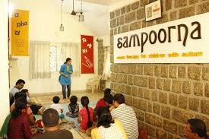
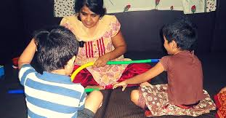

Slide 10
Services provided at CGC
Pediatrician takes care of the physical health of the child.
The psychiatrist is the central figure and is helped by others in arriving at a correct diagnosis and formulating the line of treatment.
The core of the therapy is psycho therapy to restore positive feelings of security in the child. In order to achieve this many methods are employed.

Slide 11
Medical treatment
Individual psycho therapy
Family and marital therapy
Behavior and cognitive therapy
Occupational therapy
Group therapy
Play therapy
Counseling
Suggestions
Change in the physical environment
Reconstruction of parental attitudes etc.

Slide 12
THANK YOU

