Slide 1
CORTICOBASAL SYNDROME
Faculty : Dr. Sanjay Prakash

Slide 2
Schema of presentation
History & epidemiology
CBD and CBS
Diagnostic criteria for CBD and CBS
Clinical features of CBS
CBS-pathological and CBD-clinical heterogeneity
Pathology of CBD
Pathogenesis of CBD
Imaging of CBS
Treatment of CBD
Future developments in CBD.

Slide 3
Corticobasal degeneration (CBD)
Cortico Basal Degeneration ( CBD) was originally described as a movement disorder.
The term CBD was introduced by Gibb et al., in 1989.

Slide 4
First description of CBD
In 1967, Rebeiz, Kolodny, and Richardson described three patients with a progressive asymmetric akinetic-rigid syndrome and apraxia and labelled these cases as “corticodentatonigral degeneration with neuronal achromasia”

Slide 5
Various names for the disease..
Corticodentatonigral degeneration with neuronal achromasia
Corticonigral degeneration (CND)
Cortical-basal ganglionic degeneration (CBGD)
Corticobasal degeneration syndrome
Pick complex
Progressive asymmetric rigidity and apraxia (PARA) syndrome
Asymmetric cortical degeneration syndrome–perceptual-motor type

Slide 6
Corticobasal syndrome (CBS)
Corticobasal syndrome (CBS) term used to characterize the constellation of clinical features initially considered the defining characteristics of corticobasal degeneration (CBD)
CBS also occurs in other CNS diseases.

Slide 7
Clinical to pathological correlation.
The patients with the clinical diagnosis of CBS at autopsy may show varying pathologies including the classical CBD, PSP, FTLD, and AD.
Pathology of CBD can lead to varying clinical presentations other than CBS ( PSP, bvFTLD, PPA, PCA).

Slide 8
Epidemiology of CBD

Slide 9
Prevalence of CBS
A minimum prevalence estimate is at least 2 per million (Olmstead county)

Slide 10
Other epidemiological studies
CBD has an estimated prevalence of 4.9–7.3 cases per 100,000 individuals.
An annual incidence rate of 0.02 cases per 100,000 individuals on the basis of an Eastern European and Asian population study.
These studies had no autopsy confirmation

Slide 11
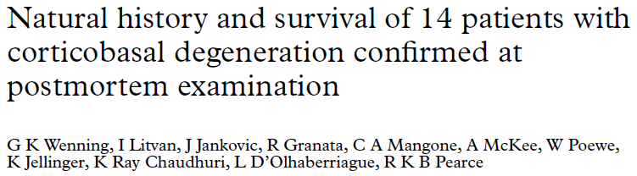

Natural history
Median survival was 7.9 (SD 0.7) (range, 2.5–12.5) years, and after the first clinic visit, 4.9 (SD 0.7) (range, 0.8–10) years.

Slide 12
Clinical Diagnostic criteria for CBD

Slide 13
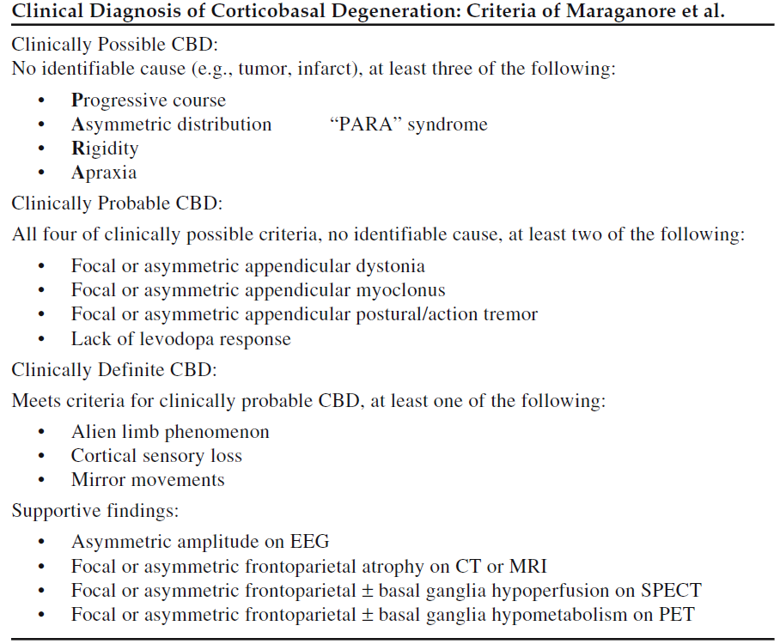
Clinical criteria for CBD

Slide 14
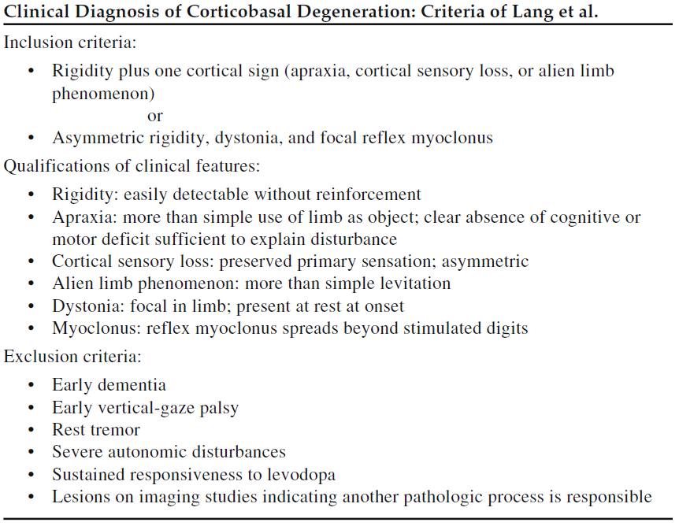
Clinical criteria for CBD

Slide 15
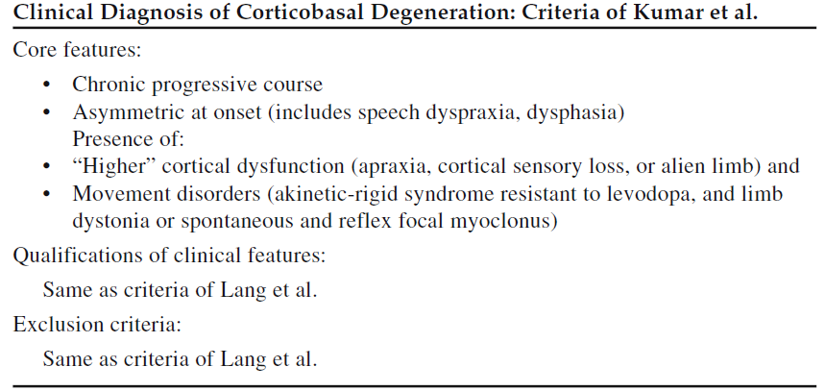
Clinical criteria for CBD

Slide 16
Clinical criteria for CBS

Slide 17
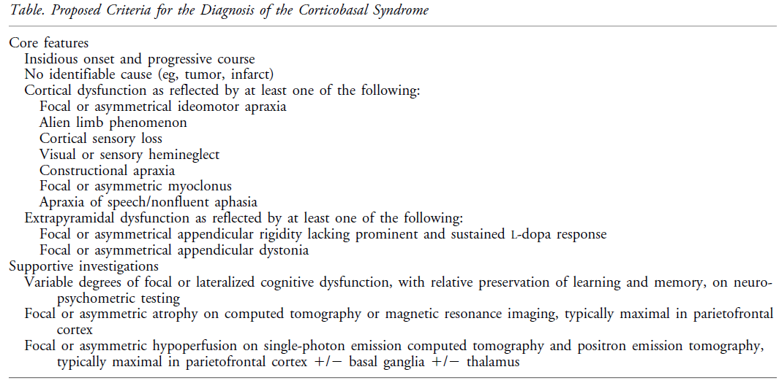
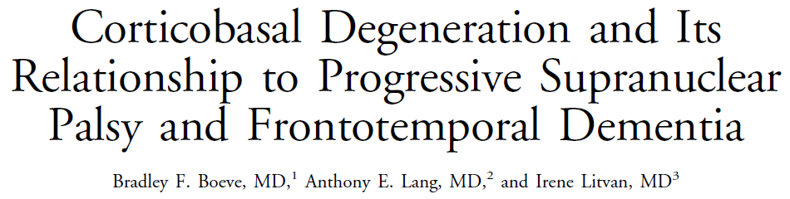


Slide 18
Pathological criteria for CBD.

Slide 19
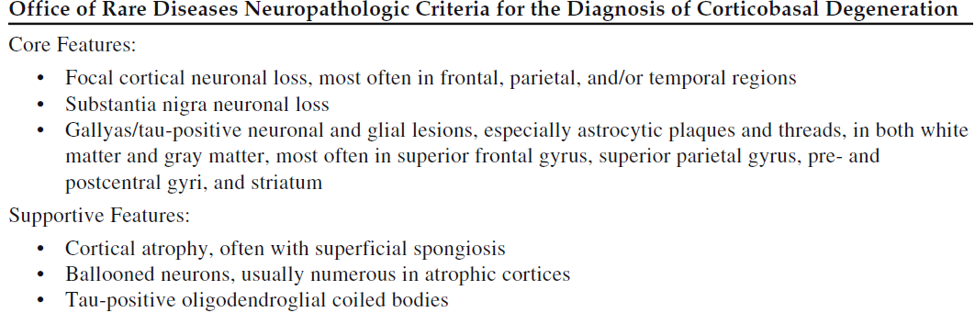
Journal of Neuropathology & Experimental Neurology:
November 2002 - Volume 61 - Issue 11 - p 935–946

Slide 20
Clinical features of CBS

Slide 21
Clinical spectrum of CBS
CBS can be seen in :-
  CBD.
  AD, Pick’s disease, PSP.
  Dementia lacking distinctive histopathology
  Creutzfeldt–Jakob disease
  Dementia with Lewy bodies
  Motor neuron inclusion body dementia
  Neurofilament inclusion body dementia

Slide 22
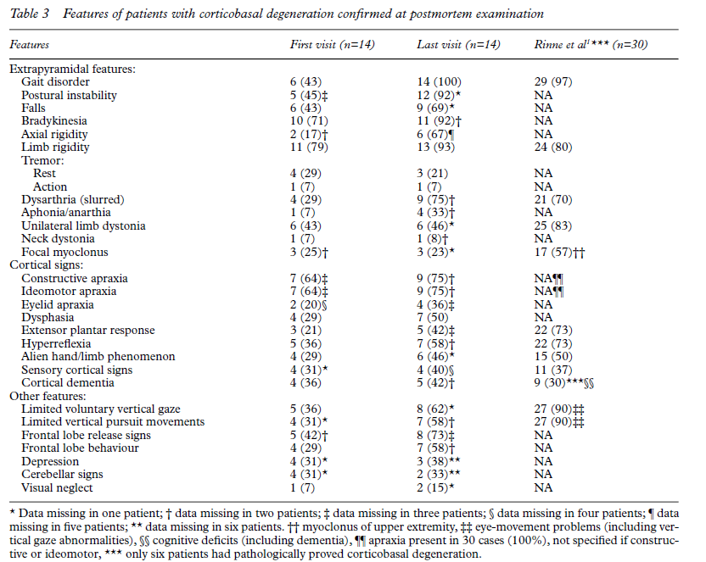
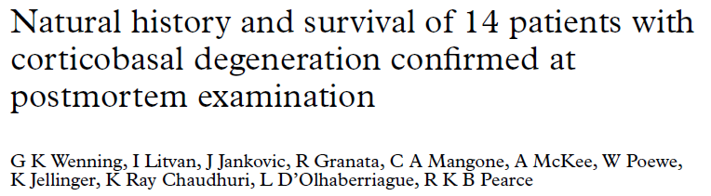

Slide 23
Asymmetrical involvement.
Pronounced asymmetry of limb involvement is a hallmark of the classical disorder

Slide 24
Progressive Asymmetric Rigidity and Apraxia
Symptoms typically begin in one limb
No apparent predilection for the right or left side.
“clumsy,” “incoordinated,” , “stiff.”
Mild to severe rigidity.
Adopts a dystonic posture.
Rigidity & spasticity can be present in the same affected limb.

Slide 25
Apraxia in CBS
Affected limb → profoundly apraxic.
Ideomotor apraxia(IMA):- develops with the inability to correctly perform or imitate gestures & simple activities.
Progressive asymmetric rigidity & apraxia is present in one of the upper limbs for at least 2 yr before the other limb gets involved.

Slide 26
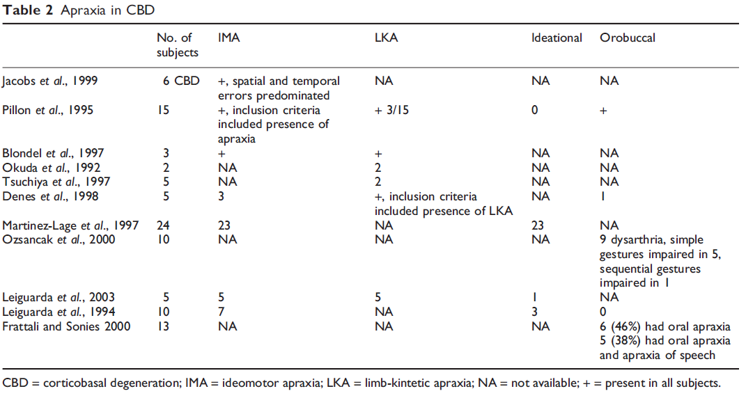
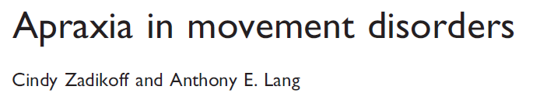

Types of apraxia in CBD

Slide 27
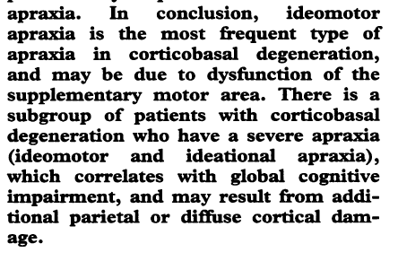
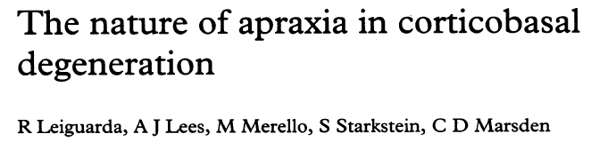
Apraxia in CBD

Slide 28
Alien Limb Phenomenon
The affected limb as “alien,” “uncontrollable,” or “having a mind of its own,”
Label the limb as “it” when describing the limb’s behaviour.

Slide 29
Alien limb phenomenon
Frontal ALP:-
  Occurs in the dominant hand,
  Characterized by a strong grasp reflex
  An uncontrollable tendency to reach for and manipulate objects.
Lesion’s:-
  Dominant medial prefrontal cortex
  SMA
  Anterior cingulate gyrus, and anterior corpus callosum.

Slide 30
Alien limb phenomenon
Callosal ALP :-
  Lesion in anterior or midbody corpus callosum
  Nondominant hand demonstrating intermanual conflict
  Diagonistic dyspraxia (acting at cross-purposes in tasks requiring both hands).

Slide 31
Mirror movements in CBS
Mirror movements:-
  The opposite limb involuntary performs the same activity as the one being examined.
Mirror movements → associated with the alien hand syndrome ( many patients have them without alien limb features).
Mirror movements are often found on examination ( pt. do not complain of it)

Slide 32
Cortical Sensory Loss in CBS
Manifest symptomatically as “numbness” or “tingling.”
Impaired joint position sense, impaired two-point discrimination, agraphasthesia, and astereognosis in the setting of intact primary sensory modalities.
somotosensory cortex +/- thalamus.

Slide 33
Myoclonus in CBS
Usually begins distally in one upper limb and may spread proximally.
The frequency and amplitude of myoclonic jerks typically increase with tactile stimulation (stimulus sensitive myoclonus) and action (action myoclonus).

Slide 34
Myoclonus in CBS
Application of light touch or pinprick stimuli usually elicits multiple flexion jerks that, although initially distal, with disease progression may affect the entire limb almost synchronously.

Slide 35
Myoclonus in CBS Vs cortical myoclonus
The features are distinct from most other forms of cortical reflex myoclonus:-
  Peripheral stimulus induced myoclonic jerks are not associated with an enhanced somatosensory evoked potential (SSEP).
  The latency from stimulus to jerk is brief (40 ms ).

Slide 36
Dystonia in CBS
Dystonic posturing of a limb is a common early manifestation.
Usually affecting one upper limb.
Posturing of the hand takes on a “fisted” appearance.
Hyperextension of one or more fingers .
Pain is often present (but do not always accompany the dystonia).

Slide 37
Dystonia in CBS
The “fisted hand sign”
  {may represent one of the most specific clinical features for underlying CBD in the CBS}.

Slide 38
Tremors in CBS
Postural and action tremor
Evolves to a more jerky tremor → myoclonus.
The tremor is amplified with activity and minimal at rest.
Classical Parkinsonian resting tremor is not a feature of CBS.

Slide 39
Gait & posture in CBS
With initial leg involvement or Early development of apraxia.
  shuffling, start hesitation, and freezing.
With progression, postural instability with falls becomes frequent.
  Postural instability (gait apraxia, bilateral lower limb parkinsonism, dystonia, vestibular involvement).
Isolated gait ignition failure is not a feature of CBD.

Slide 40
Eye movement abnormalities in CBD
Oculomotor apraxia:
  This includes difficulty initiating saccades and voluntary gaze
  Pursuit and optokinetic nystagmus are typically preserved.
CBS have normal speed and amplitude of the saccades.
May develop supranuclear gaze paresis that can be indistinguishable from PSP.
Eyelid opening/closing apraxia is also frequent.

Slide 41
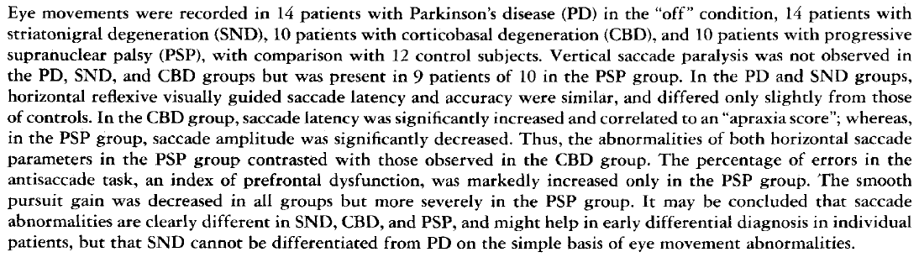
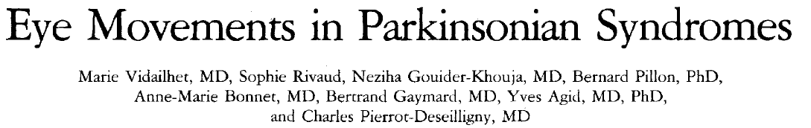
Eye movement abnormalities in CBD

Slide 42
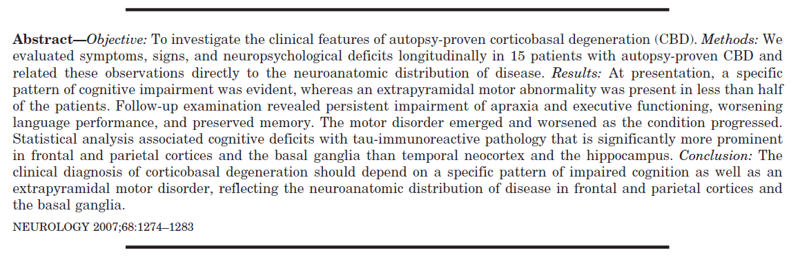
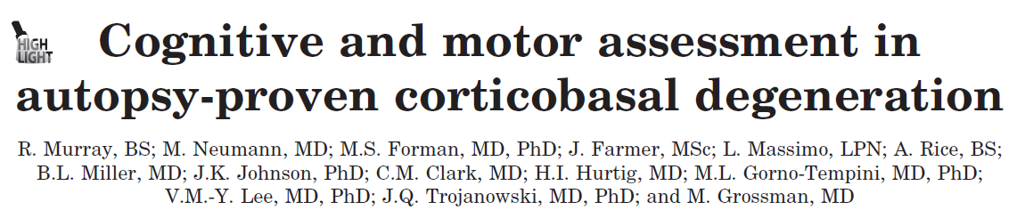
Cognition in CBD

Slide 43
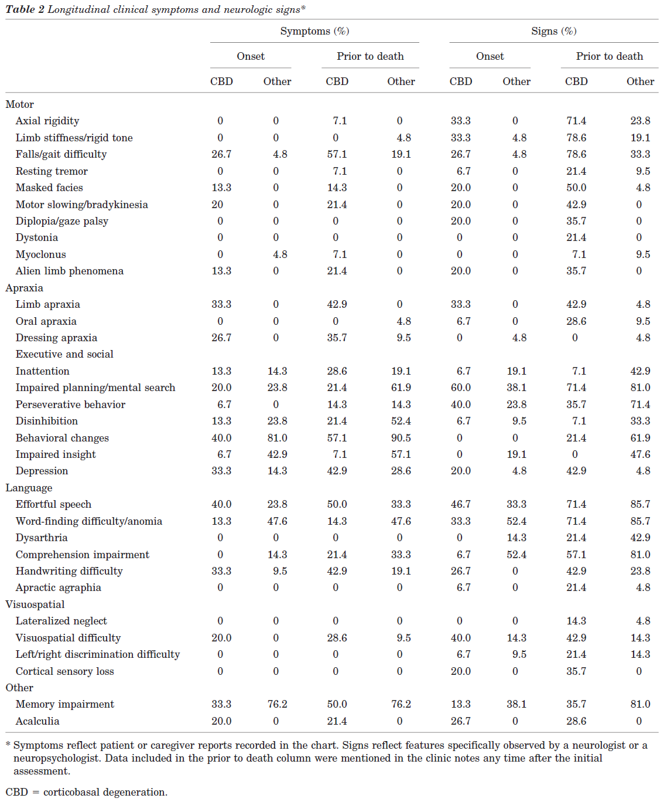
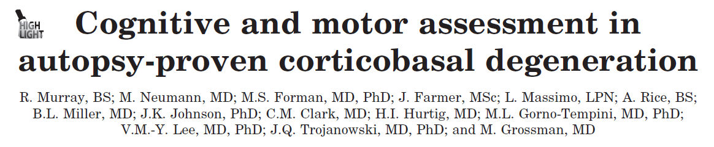

Slide 44
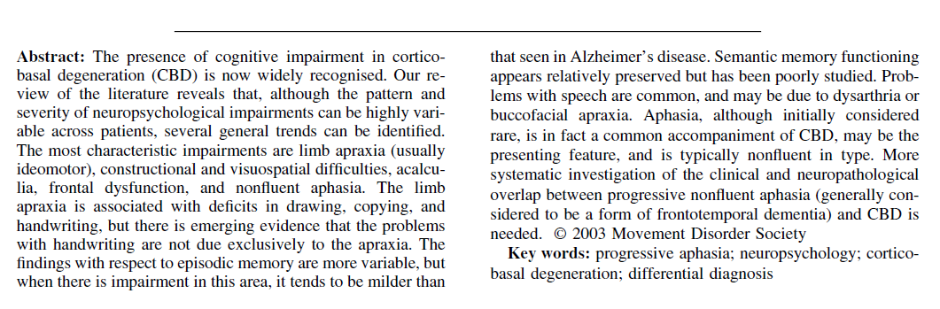
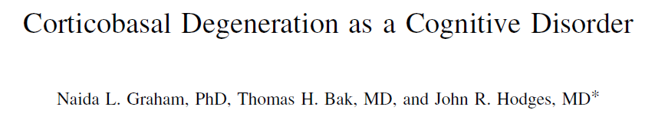

Cognitive dysfunction in CBD

Slide 45
Cognitive dsyfunction in CBD
Yes/No Reversals:-
Patients to shake their head and respond “yes” when they actually mean “no,”.
Due to frontosubcortical dysfunction, in which mental flexibility and inhibitory control is impaired.

Slide 46
Focal or Lateralized Cognitive Features in CBS
Aphasia (which is typically nonfluent).
Apraxia of speech and/or nonverbal oral apraxia are quite common.
Constructional dyspraxia on drawing tasks, particularly if the parietal lobe of the nondominant hemisphere
Other nondominant parietal lobe findings such as hemineglect and poor spatial orientation.

Slide 47
Focal or Lateralized Cognitive Features in CBS
Apraxic agraphia may result if the homologous region of the dominant hemisphere is dysfunctional.

Slide 48
Neuropsychiatric Features in CBS
Depression
Obsessive-compulsive symptomatology
“Frontal” behavioral disturbances .
Visual hallucinations and delusions are very rare.

Slide 49
Other findings in CBS
Frontal release signs
Hypokinetic dysarthria
Asymmetric hyperreflexia
Extensor planter responses .
Appendicular ataxia
Chorea
Blepharospasm .

Slide 50
Pathological (CBS) and clinical(CBD) heterogeneity

Slide 51
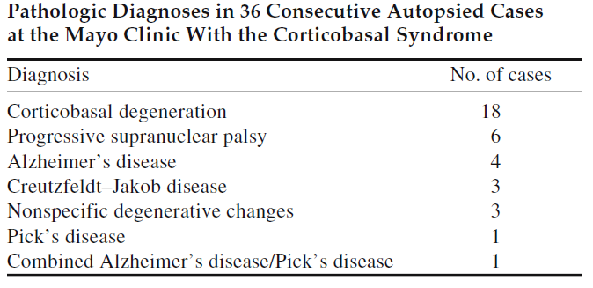
Pathological heterogeneity of CBS

Slide 52
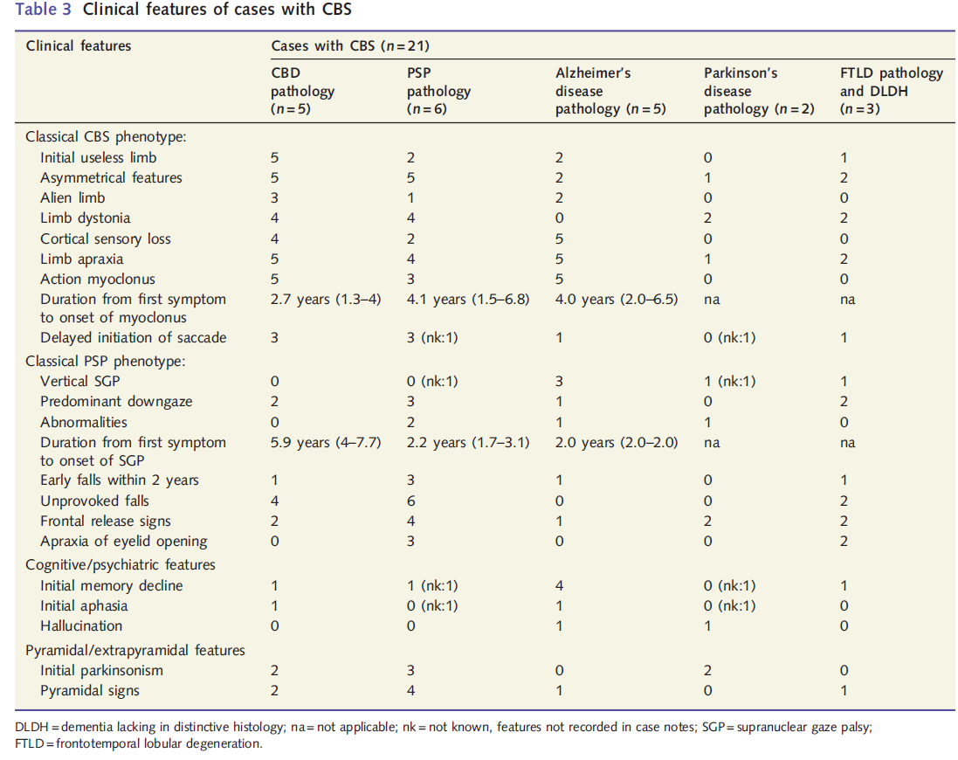

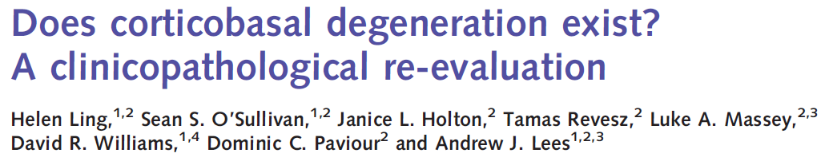
CBS and underlying pathological heterogeneity

Slide 53
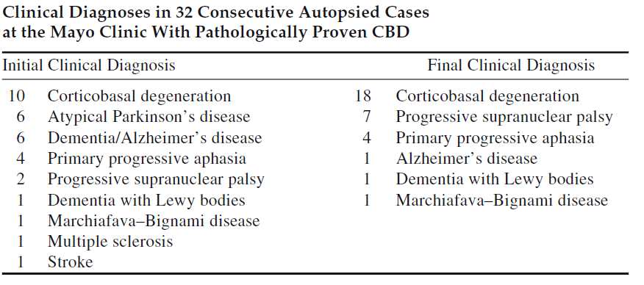
Clinical heterogeneity of CBD

Slide 54
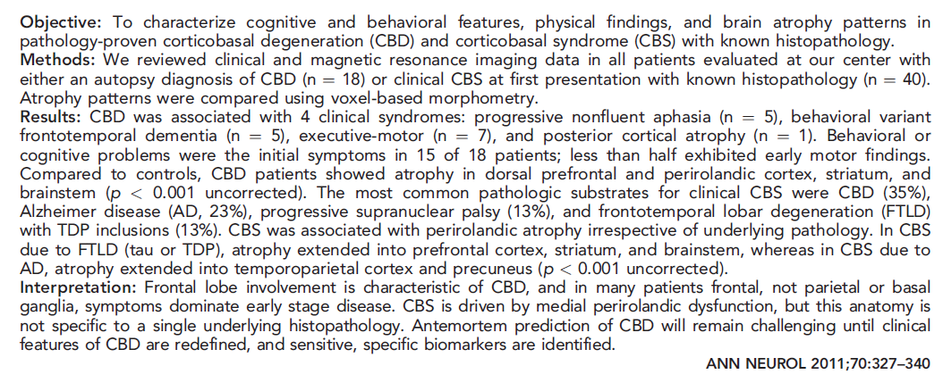
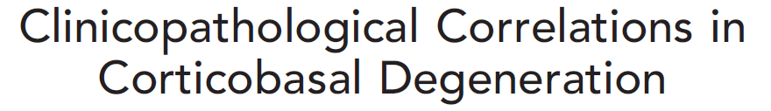
Clinical heterogeneity in CBD

Slide 55
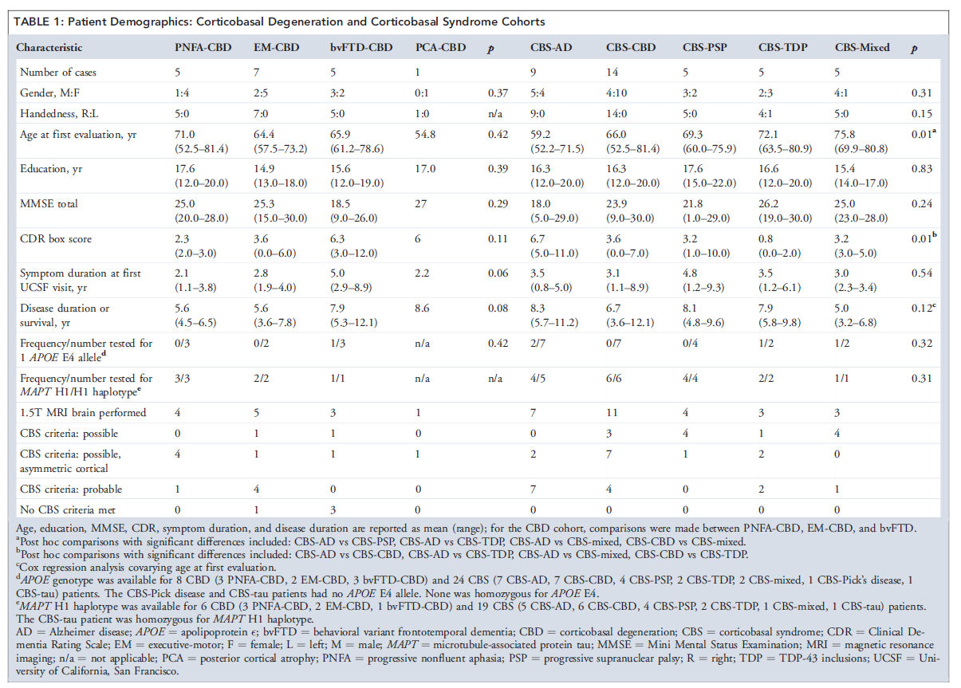
Clinical heterogeneity in CBD & pathological heterogeneity of CBS

Slide 56
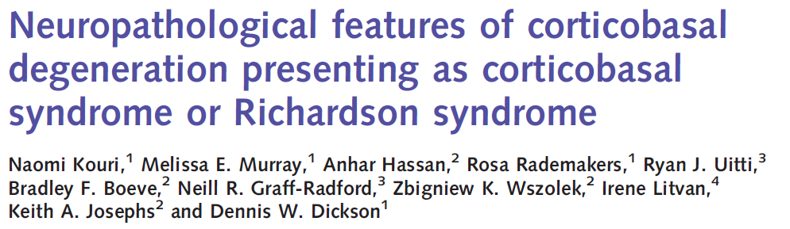

The varying phenotypes of CBD pathology
Classical CBS phenotype (36%)
PSP phenotype(CBD-Richardson type)(27%)
FTLD phenotype ( bvFTD, PNFA)
AD phenotype
PD phenotype
Posterior cortical atrophy phenotype

Slide 57
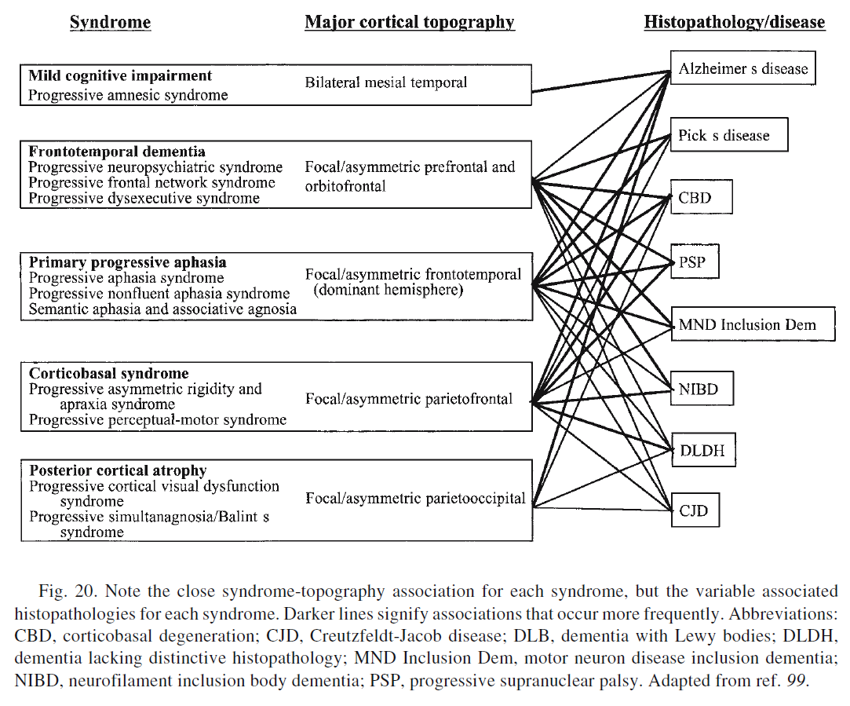

Slide 58
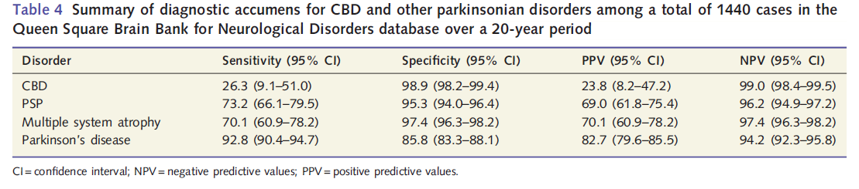
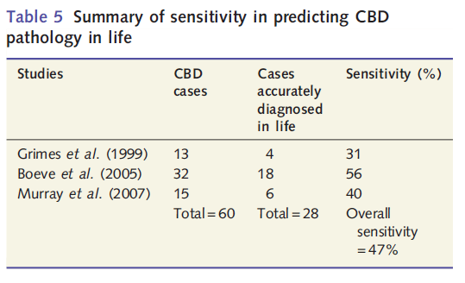
Predicting CBD from CBS phenotype.

Slide 59
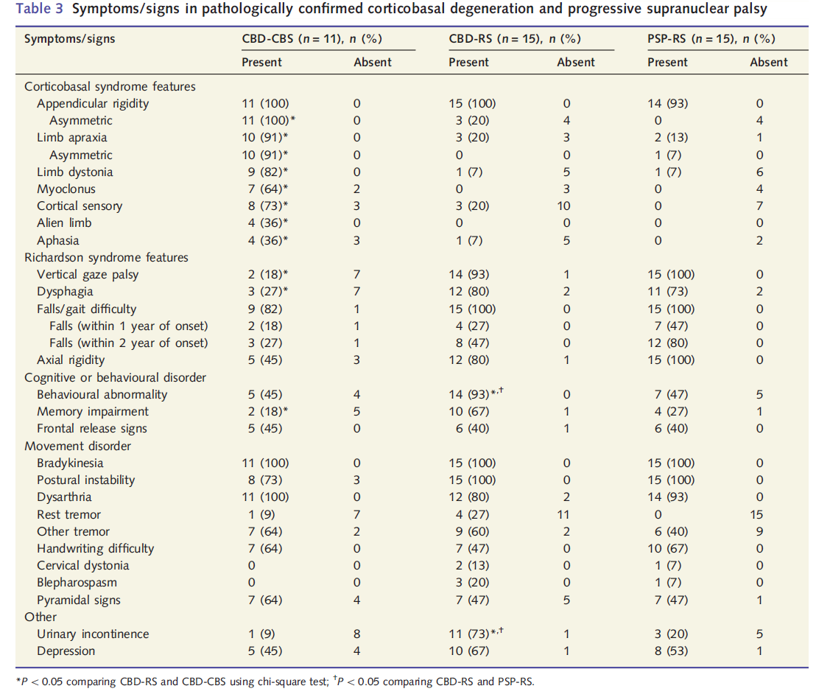
Factors favoring a CBD pathology in a CBS phenotype

Slide 60
Factors useful for excluding a CBD pathology in a CBS phenotype.
Three features helpful in excluding CBD in cases presenting with CBS:
  A sustained initial L-dopa response for over 2 years.
  Early vertical supranuclear gaze palsy within 2 years of first symptom onset
  A disease duration of over 10 years.

Slide 61
CBD and PSP.
Classical PSP phenotype noted in over a third of all CBD cases.
PSP was also the most common pathology underlying cases with CBS presentation.

Slide 62
Differentiating features CBD-RS from PSP-RS

Slide 63
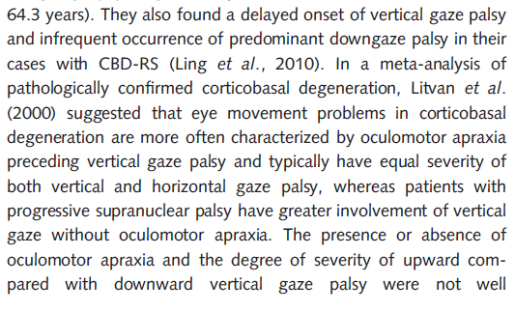
Eye movement to differentiate between CBD-CBS , CBD-RS and PSP-RS

Slide 64
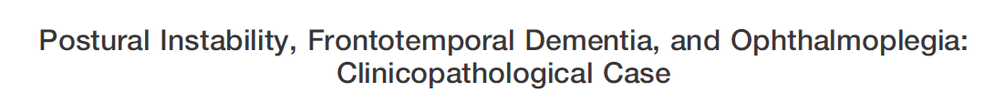

Eye movement to differentiate between CBD-CBS , and PSP-RS
Unlike PSP square wave jerks are not seen in CBS-CBD.
In CBD-CBD , there is an increased percentage of errors in the antisaccade task (frontal lobe pathology)

Slide 65
When to suspect a CBD pathology in a PSP phenotype?
Younger age of onset of disease.
Vertical supranuclear gaze palsy appearing late (3.4 years) in the course of the disease .
If Vertical supranuclear gaze palsy is not predominantly affecting downgaze.
Increased latency in initiation of saccades.

Slide 66
CBD presenting as PD phenotype
Odd points to suspect for a CBD pathology:-
  A poor L-dopa response
  Short duration of disease (4.5 and 5.7 years)
  Early onset of falls (0.1 and 2.8 years)
  Early wheelchair dependence (4 and 5 years).
  The hand tremor was coarse, jerky and more obvious on movement than at rest and neither patient had a classical pill-rolling resting tremor

Slide 67
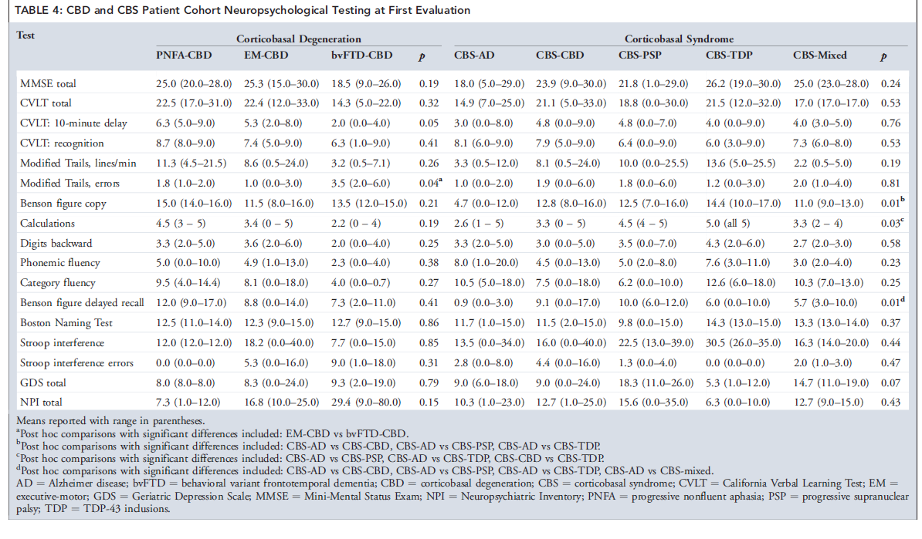
Neuropsychological points in differentiating varying pathology in CBS

Slide 68
When to suspect a different pathology in a CBS phenotype?
A very malignant disease course + rapid clinical progression:-
  Frontotemporal dementia-TDP43 with progranulin mutation
  Neurofilament inclusion body disease
  Prion disease .

Slide 69
When to suspect a different pathology in a CBS phenotype?
Slow symptom progression , long disease duration , sustained L-dopa response :-
  Parkinson’s disease.
When at least one first degree relative with CBS, dementia or primary progressive aphasia :-
  (MAPT) or progranulin mutation .

Slide 70
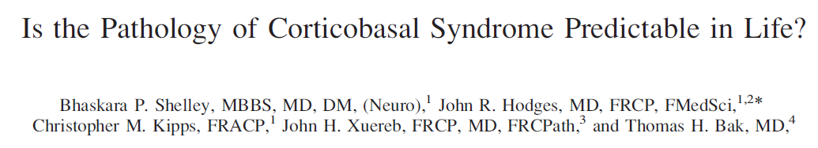

When to suspect a different pathology in a CBS phenotype?
  Initial episodic memory complaints, relative impairment in visuospatial function and visual memory (right parietal and medial temporal dysfunction)
  Alzheimer’s disease .
  {initial nonfluent language impairment,orobuccal apraxia, and presence of utilizationbehavior showed significant associations with CBD pathology during life}

Slide 71
When to suspect a different pathology in a CBS phenotype?
Early vertical supranuclear gaze palsy within 2 years of first symptom onset:-
  PSP
Prominent frontal dysfunction
  FTLD

Slide 72
Pathology of CBD

Slide 73
Macroscopic findings in CBD.
Asymmetric parietofrontal or frontotemporal cortical atrophy.
Pallor of the substantia nigra

Slide 74
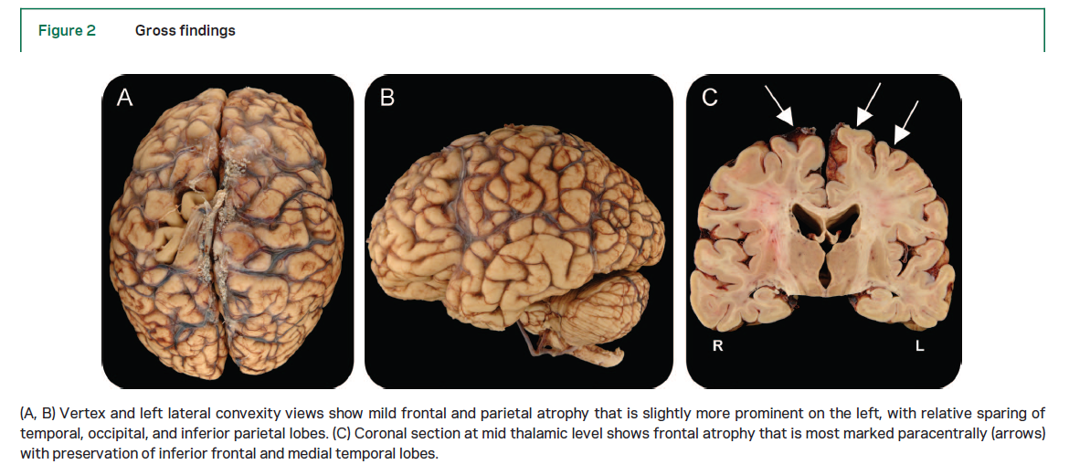
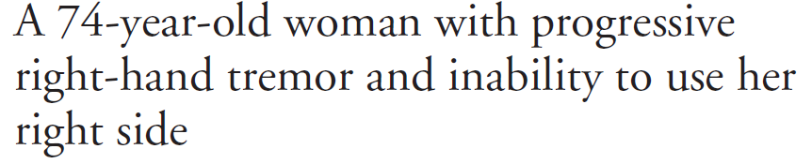

Slide 75
Microscopic picture in CBD
Neuronal loss, gliosis, and superficial spongiosus (maximally affected cortical gyri).
Immunocytochemistry with tau as well as phosphorylated neurofilament or alpha Beta-crystallin positive.

Slide 76
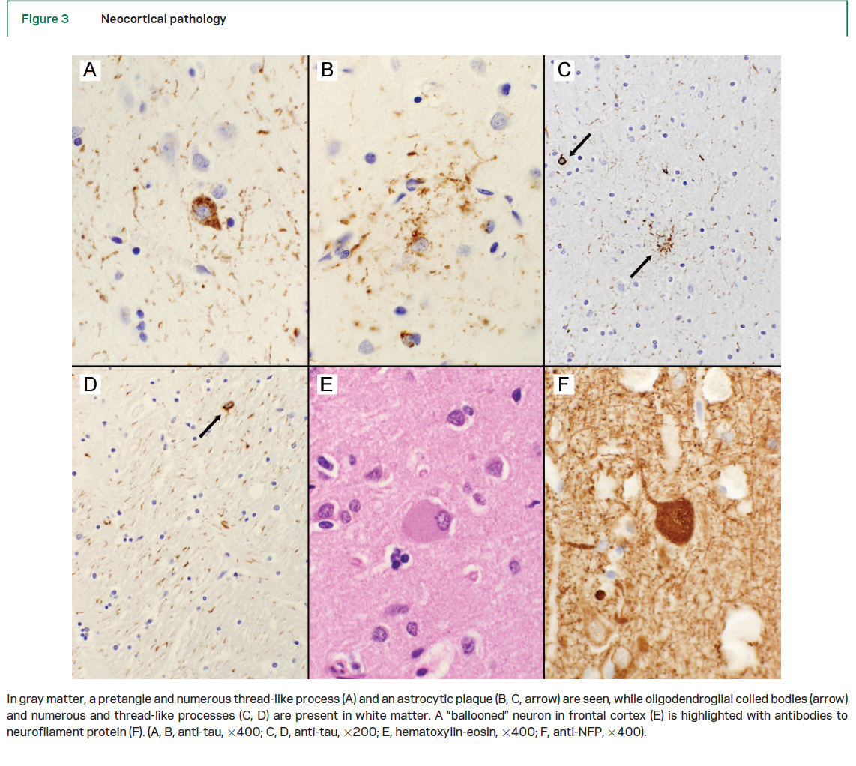

Slide 77
Microscopic pathology in CBD
Tau-positive (tau+) astrocytic plaques
Tau+ threadlike lesions in gray and white matter.
Most commonly seen in :-
  Superior frontal gyrus, Superior parietal gyrus, Pre- and postcentral gyri, and Striatum.

Slide 78
Microscopic pathology in CBD
Tau+ oligodendroglial coiled bodies.
Achromatic, ballooned neurons that are immunoreactive to phosphorylated neurofilament.

Slide 79
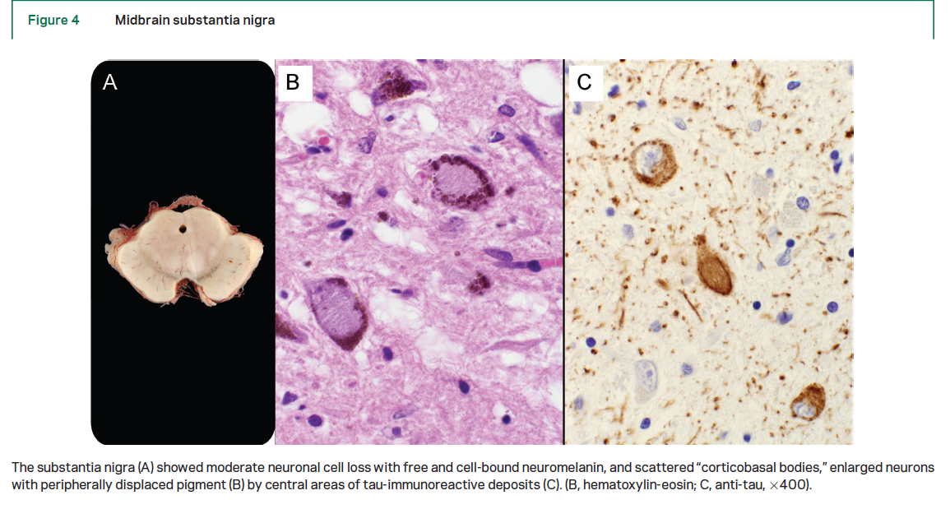
Microscopic pathology in CBD

Slide 80
Difference in the pathologies of Tau deposits in microglia in PSP and CBD
Pathognomonic astrocytic lesion in CBD :-Astrocytic plaque.
Tufted astrocytes are characteristic of PSP.

Slide 81
Varying pathology of Tau in CBD and PSP

Slide 82
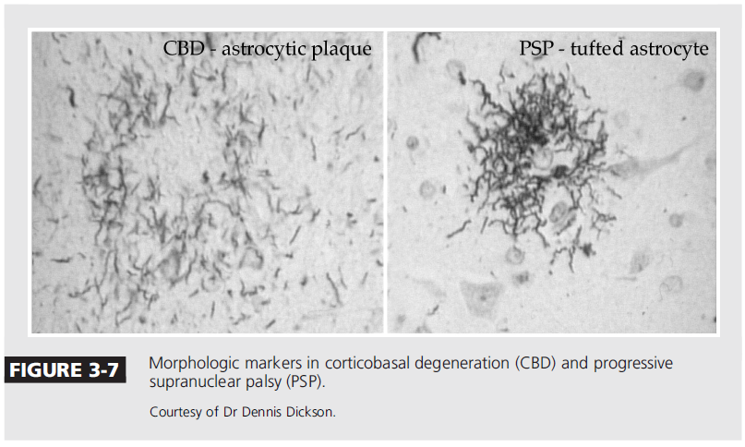
Difference of microglial pathology in CBD and PSP

Slide 83
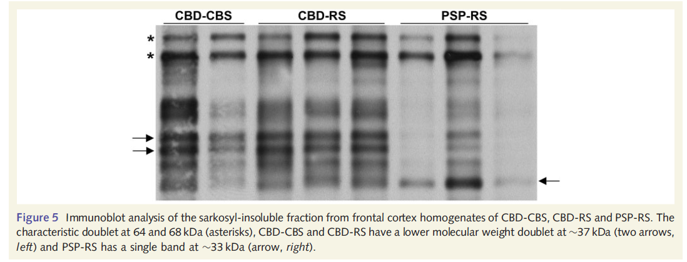
Tau in CBD-CBS, CBD-RS and PSP-RS

Slide 84
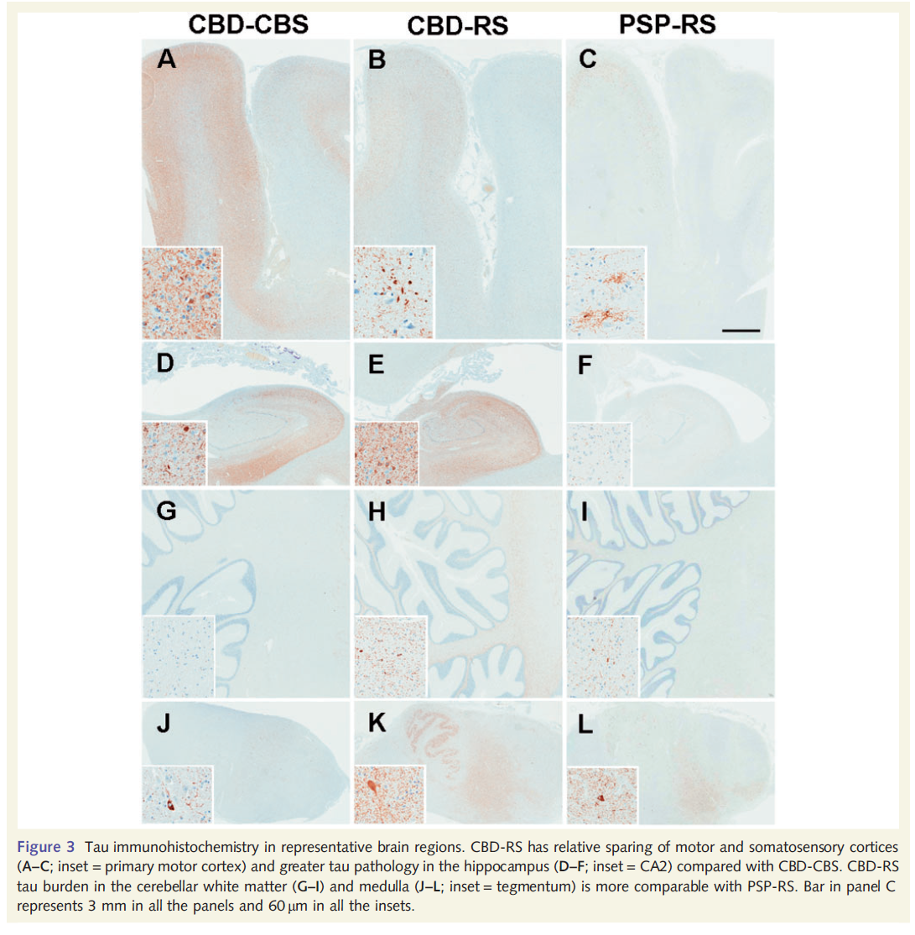

Slide 85
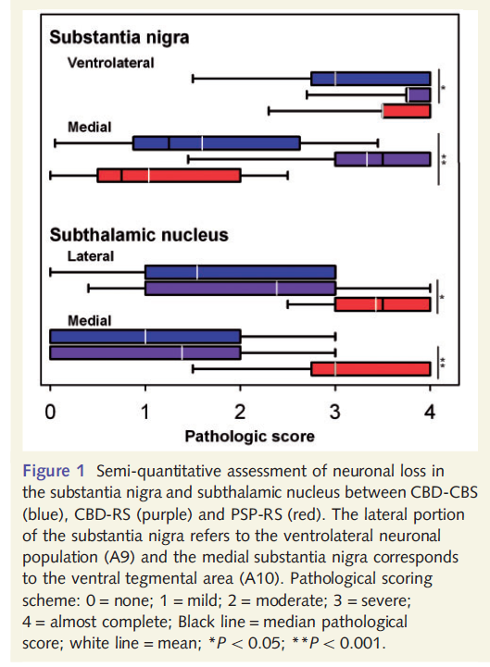
Neuronal loss pattern in CBD-CBS, CBD-RS and PSP-RS

Slide 86
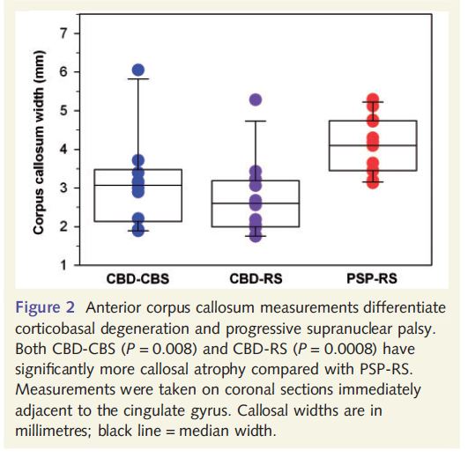
Corpus callosum width variation in CBD-CBS, CBD-RS and PSP-RS

Slide 87
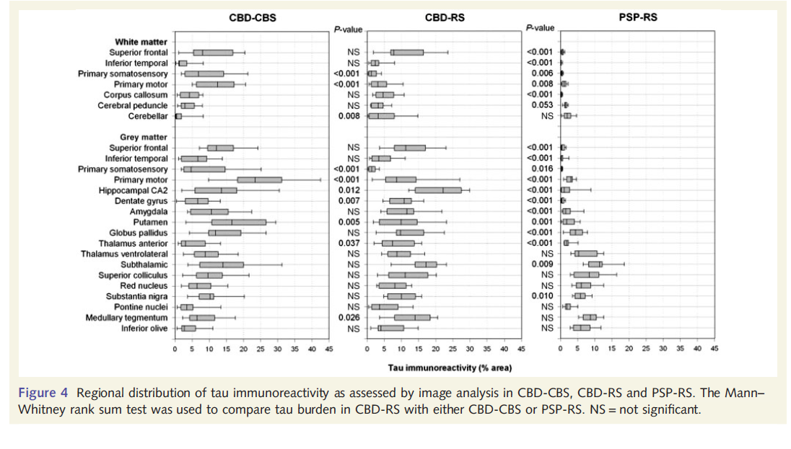
Tau density in CBD-CBS, CBD-RS and PSP-RS

Slide 88
If 4R Tau is common , why still PSP and CBD are considered separate disease?
The classical clinical presentations are strikingly different.
Varying pathology in glial tissue :- Astrocytic plaques in CBD , tufted astrocytes in PSP.
Distinct patterns of microglial activation and tau distribution in pathologically diagnosed CBD and PSP.

Slide 89
Pathogenesis of CBD

Slide 90
Tau
Microtubule-associated protein tau, encoded by the MAPT gene, is required for microtubule assembly and stability, and is highly expressed in neuronal axons.
The phosphorylation status of tau regulates its function.
In tauopathies, tau protein is aberrantly phosphorylated and has an abnormal conformation that favors aggregation and inclusion formation

Slide 91
Tau
The human MAPT gene is located on chromosome 17q21.3.
H1 haplotype or a specific H1 sub-haplotype (H1c) is associated with an increased risk of corticobasal degeneration or progressive supranuclear palsy.

Slide 92
Tau and microtubular dysfunction..
Under pathological conditions, tau becomes hyperphosphorylated, which reduces its binding affinity for microtubules.
This change leads to a loss of proper microtubule functioning and/or a toxic gain of function.
Dissociated tau has a greater propensity for multimerization than microtubule-bound tau.

Slide 93
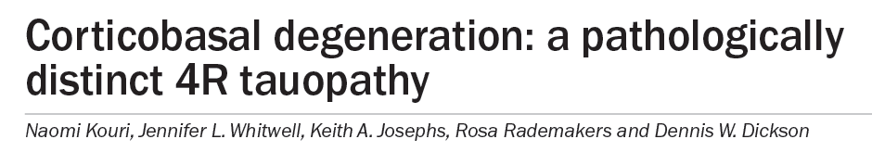
Tau leading to synaptic dysfunction
Localized tau deposition leads to dysfunction of the synapse
Synaptic dysfunction leading to NMDA mediated cellular toxicity.

Slide 94
Investigations for CBS

Slide 95
EEG
Electroencephalography (EEG) have varied from normal to marked dysrhythmic and delta slowing.
Asymmetric amplitudes of background alpha activity and sleep spindles.

Slide 96
EP study
Short reflex latency and reduced inhibition following magnetic stimulation over the cortex

Slide 97
Imaging in CBD

Slide 98
Magnetic Resonance Imaging
Asymmetric cortical atrophy (frontoparietal).
More prominent atrophy existing contralateral to the side most severely affected clinically.
Lateral ventricle in the maximally affected cerebral hemisphere can also be slightly larger than opposite one.
Atrophy of the middle or posterior segment of the corpus callosum

Slide 99
MRI
Asymmetric atrophy in the cerebral peduncles.
Hyperintense signal changes lateral to the putamen.
Atrophy of the Putamen
Subtle hyperintense subcortical signal changes in motor cortex.
Progressive atrophy of frontal + parietal cortex and middle+ posterior portion of corpus callosum occurs in serial MRI scans.

Slide 100
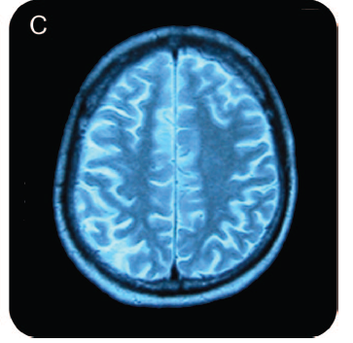
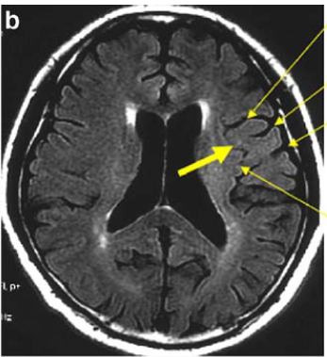



Slide 101



Slide 102


Slide 103


Slide 104


CBD pathology and MRI correlation
Whether the predominant clinical presentation was PNFA, EM, or bvFTD, all patients with CBD
  Showed atrophy in dorsal prefrontal cortex, SMA, perirolandic cortex, and striatum, suggesting that these are the core regions affected by CBD.

Slide 105
CBS phenotype and Imaging correlate
CBS was associated with posteromedial frontal and perirolandic cortex and dorsal insula atrophy.
This pattern, however, is not specific for any particular pathology.

Slide 106
Indicators of pathologies in CBS phenotype with Imaging
Anterior extension(frontal cortex &brainstem) suggestive of FTLD(FTLD tau).
If Frontal atrophy predominates:- CBD is the most likely cause of CBS
Brainstem & subcortical atrophy are out of proportion to cortical volume loss:- CBS-PSP.

Slide 107
Indicators of pathologies in CBS phenotype with Imaging
Posterior extension of atrophy (precuneus & temporoparietal ) :- suggests underlying AD.

Slide 108

Imaging correlation to varying pathology of CBS phenotype

Slide 109

Imaging of CBD with its varying clinical phenotypes

Slide 110
Functional Neuroimaging Findings
Parietofrontal cortex + basal ganglia
  Asymmetric hypoperfusion on SPECT.
  Asymmetric hypometabolism on PET
.

Slide 111
Functional imaging.
Reduction of striatal tracer uptake [greater contralateral to the clinically most affected side]
Uptake in the caudate is generally reduced to the same extent as in the putamen.

Slide 112
Treatment of CBD

Slide 113
Symptomatic care for pt.
Levodopa(at least 750 mg per day ) to provide an adequate trial.
Anticholinergic :- rarely improve dystonia, and their use is limited by side effects.
Botulinum toxin can alleviate pain owing to focal dystonia.
Propranolol or primidone:- tremor
Clonazepam +/- gabapentin :- myoclonus

Slide 114
Symptomatic care for CBD.
The mainstay of management is :- physical, occupational, and speech therapies.

Slide 115

Tau-directed therapeutics
  Compensating for the loss of tau function using microtubule-stabilizing agents.
  Reducing hyperphosphorylation of this protein through the inhibition of tau kinases.
  Inhibiting the toxic aggregation of tau fibrils using agents that block protein–protein interactions.
  Enhancing intracellular tau degradation by targeting proteins involved in the ubiquitin–proteasome system.

Slide 116
Tau directed therapy
Methylene blue.
Lithium chloride
An octapeptide known as NAP
Methylene blue:-
  First drug to demonstrate inhibition of tau aggregation
  Alter the structure of paired-helical filaments that make up neurofibrillary tangles

Slide 117
Tau directed therapy
Lithium chloride
  An inhibitor of glycogen synthase kinase 3β (GSK3β).
lithium chloride → attenuation of tau hyperphosphorylation + pathology in animal models .

Slide 118
Microtubule-stabilizing compounds
Paclitaxel:-
  Showed improved microtubule density
  Accelerated axonal transport
  Increased motor function in a mouse model of tauopathy.

Slide 119
Molecular markers for CBD

Slide 120
Tau as a biomarker..
Some of the studies reported an increase in total tau levels in patients with CBD compared with controls.

Slide 121
Summery
CBD refers to the pathology.
CBS refers to the clinical syndrome complex.
CBS can be due to varying pathologies like CBD, PSP, FTLD-TDP, AD.
CBD is a 4R Tauopathy.
The clinical presentation of CBD is heterogeneous:- CBS, PSP-RS, bvFTLD, PNFA, PCA, EM varient.

Slide 122
Thank you.

Slide 123
References.
Corticobasal degeneration: a pathologically distinct 4R tauopathy Naomi Kouri, Jennifer L. Whitwell, Keith A. Josephs, Rosa Rademakers and Dennis W. Dickson Nat. Rev. Neurol. 7, 263–272 (2011).
Accuracy of the clinical diagnosis of corticobasal degeneration: A clinicopathologic study I. Litvan, MD NEUROLOGY 1997;48:119-125
Update on Frontotemporal Dementia Zoe Arvanitakis, MD, MS The Neurologist • Volume 16, Number 1, January 2010
Clinicopathological Correlations in Corticobasal Degeneration Suzee E. Lee, MD, ANN NEUROL 2011;70:327–340
Does corticobasal degeneration exist? A clinicopathological re-evaluation Helen Ling, Brain 2010: 133; 2045–2057
Corticobasal Degeneration and Its Relationship to Progressive Supranuclear Palsy and Frontotemporal Dementia Bradley F. Boeve, MD,1 Anthony E. Lang, MD,2 and Irene Litvan, MD3 Annals of Neurology Vol 54 (suppl 5) 2003.
Corticobasal degeneration: Neuropathologic and clinical heterogeneity J.A. Schneider, MD; NEUROLOGY 1997;48:959-969
Clinicopathologic analysis of frontotemporal and corticobasal degenerations and PSP K.A. Josephs, MST, MD; NEUROLOGY 2006;66:41–48

Slide 124
Q&A
1. The point to differentiate CBS-RS from PSP-RS are all except:-
1. Early fall < 2year of disease onset
2.Response to L-DOPA treatment
3.Vertical supranuclear gaze palsy
4.Saccadic velocity.

Slide 125
Q&A
The point to suspect a AD pathology in a CBS phenotype is :-
Early Apraxia
Early behaviour changes
Alien limb phenomenon
Early episodic memory involvement.

Slide 126
Q&A
The glial pathology characteristic of CBD is:-
Tufted astrocytes
Ballooned achromatic neurons
NFT in white matter
Astrocytic plaques

