Slide 1
EVOLUTION OF DIAGNOSTIC CRITERIA FOR
MULTIPLE SCLEROSIS
Faculty : Dr. Sanjay Prakash

Slide 2
Multiple sclerosis
Immune-mediated inflammatory disease in which the myelin sheaths around the axons of the brain and spinal cord are damaged, leading to demyelination and scarring
Disease onset usually occurs in young adults, and it is more common in women

Slide 3
1996 the United States National Multiple Sclerosis Society standardized four subtype definitions
Relapsing remitting,
Secondary progressive,
Primary progressive, and
Progressive relapsing

Slide 4
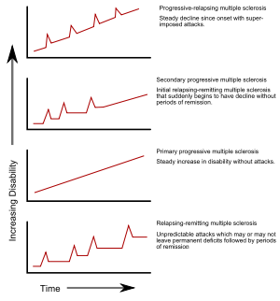

Slide 5

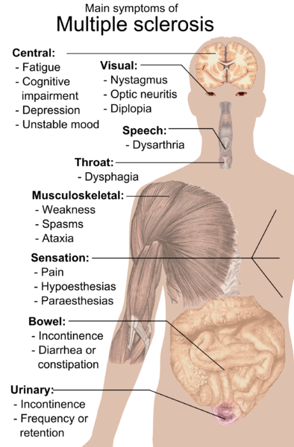

Slide 6
Multiple sclerosis is a common cause of neurological disability in young adults
Pathological processes involved
Inflammation Demyelination, remyelination, axonal loss and gliosis.
The evolution of diagnostic criteria reflects the use of laboratory examinations of various kinds facilitate the diagnosis and make it more reliable.

Slide 7
Diagnostic criteria for multiple sclerosis (MS) evolved to reflect
Advances in our understanding of the disease
Development of new diagnostic techniques
Purely clinical considerations
to
dependency upon imaging of the central nervous system

Slide 8
Introduction of long-term therapeutic
agents makes the accuracy of the diagnosis more imperative.

Slide 9
Jean-Martin Charcot
First to delineate diagnostic criteria for MS:
The triad of nystagmus,intention tremor and scanning speech
Leçons du mardi in 1868
Said to have been the symptoms exhibited by his housemaid.

Slide 10
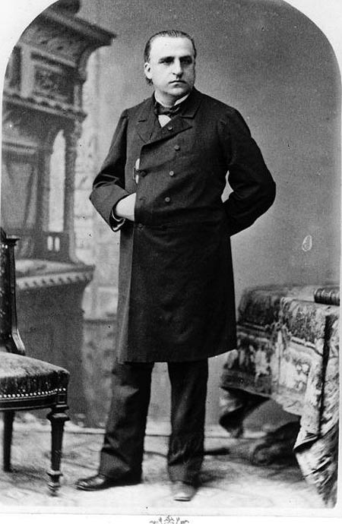

Slide 11
Otto Marburg(1906)
Combination of optic disk pallor (Uhthoff’s sign ), absence of abdominal reflexes and pyramidal tract signs were characteristic of MS.
This was the first hint of dissemination in space

Slide 12
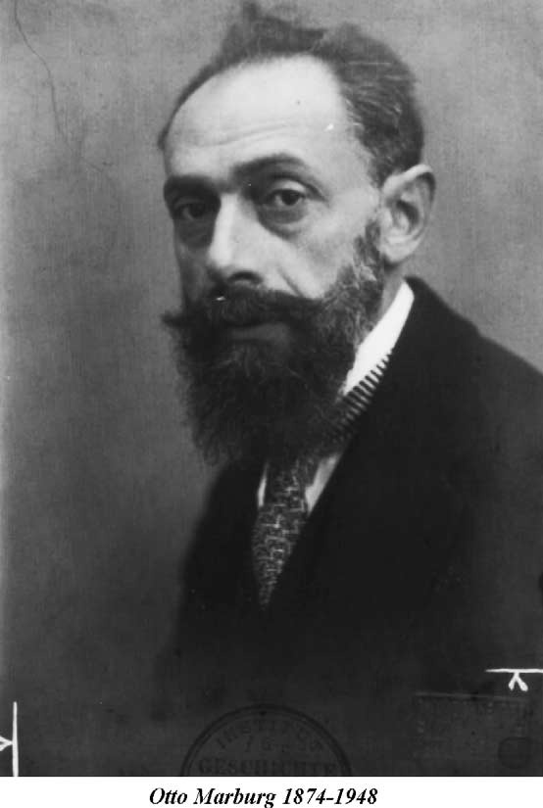

Slide 13
Sydney Allison(1931 )
(a) Typical cases of disseminated sclerosis
(b) Early cases in which DS is a probable diagnosis
(c) History of cases deceased or untraceable
(d) Doubtful cases; symptoms and signs inconclusive

Slide 14


Slide 15
Allison and Millar(1954)
Three categories: early, probable, and possible
disseminated sclerosis
Early- history of symptoms
Probable- there was to be some physical disablement, “usually a remitting quality in the history . . . and physical signs explicable only on the basis of MS.”

Slide 16
Possible- for cases “suggestive” of the
diagnosis.
Dissemination in time was definitely indicated, multiplicity of lesions was only hinted.

Slide 17
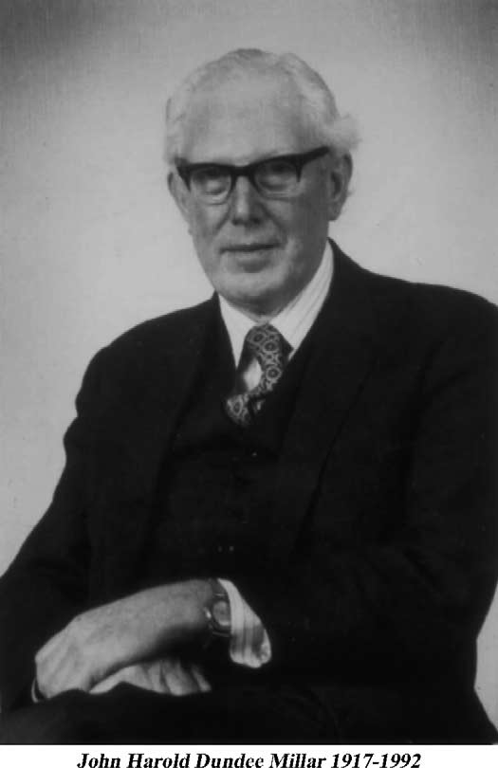

Slide 18
Broman et al.(1965)
Age of onset, the empiric significance of symptoms for an MS diagnosis, the multiplicity of lesions, the number of bouts, and the familial “recurrence” of MS.
The results of the newly described electrophoretic examination of CSF protein, the precursor of oligoclonal bands, were also
introduced

Slide 19
All other possible diagnoses were to be considered and, if possible, excluded.
For the first time they clearly stated the twin principles of dissemination in time and in space that to this day remain the fundamental criteria for the diagnosis of MS.

Slide 20
Schumacher et al. criteria(1965)
Clinically definite multiple sclerosis
1 Objective signs of dysfunction of the central nervous system; symptoms not acceptable
2 Evidence of damage to two or more sites
3 Predominantly damage to the white matter
4 (a) Two or more episodes of at least 24 h separated by at least 6 months
(b) Slow or stepwise progression over 6 months

Slide 21
5 Age of onset 10–50 years
6 Diagnosis by a neurologist; signs and cannot be explained by other disease

Slide 22
The Schumacher panel cautioned that “the diagnosis in most cases, even when termed ‘clinically definite’, must remain one merely of high probability because of the lack of specific diagnostic tests.”

Slide 23
They noted that no clinical or laboratory criteria could be substituted for clinical expertise, since the physician’s “feel” for the nature of the ailment, born of experience, would always play an important role in making the diagnosis of MS.

Slide 24
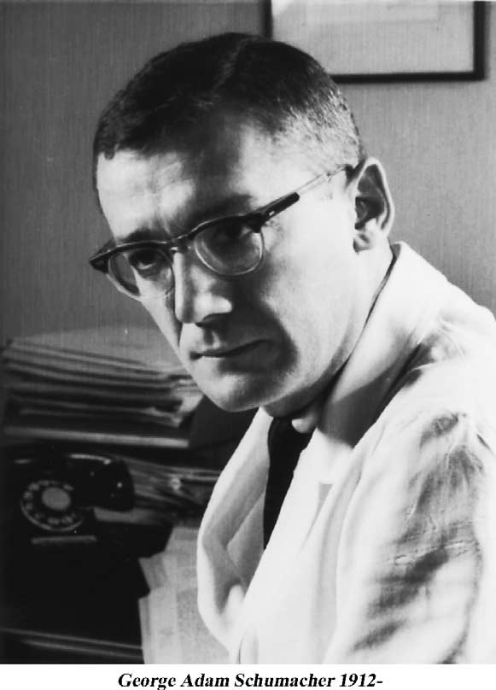

Slide 25
The Schumacher criteria rapidly became the gold standard for the diagnosis of MS and were particularly used in epidemiological studies all over the world.

Slide 26
(1970) Numerical scoring system
Clinical characteristics of 111 autopsy-proven MS cases from the United Kingdom,Norway, and the United States.
A numerical value was given to each item based on its frequency in the clinical histories.
Despite a respectable diagnostic accuracy of close to 80%,it has rarely been used

Slide 27
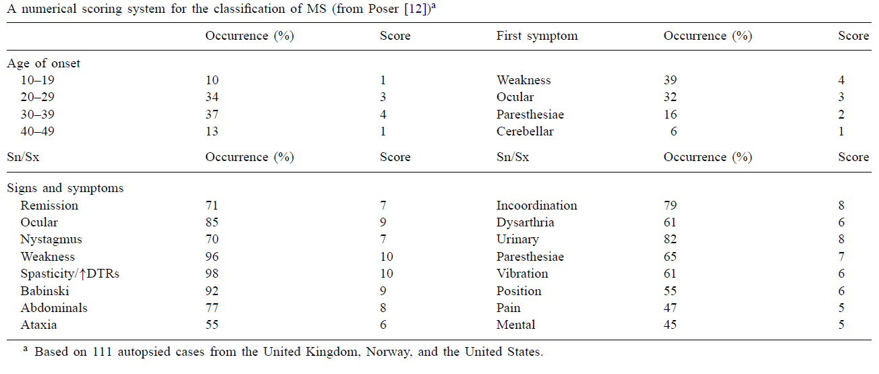

Slide 28
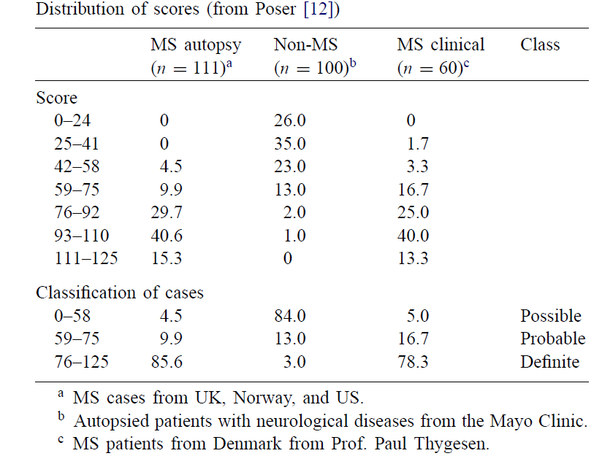

Slide 29
The McAlpine, Lumsden, and Acheson criteria(1972)
Latent probable,probable, and possible MS
A history of remitting symptoms was accepted, but the presence of physical signs and“evidence of MS in the past history”—a rather vague feature were required .

Slide 30
Statement in the probable category that “allowance must be made for those from whom it is impossible to obtain a reliable history”.
Changes in the CSF were mentioned,although poorly characterized.
Because of the prominence of the authors, this scheme was often used as an alternative to the Schumacher criteria.

Slide 31
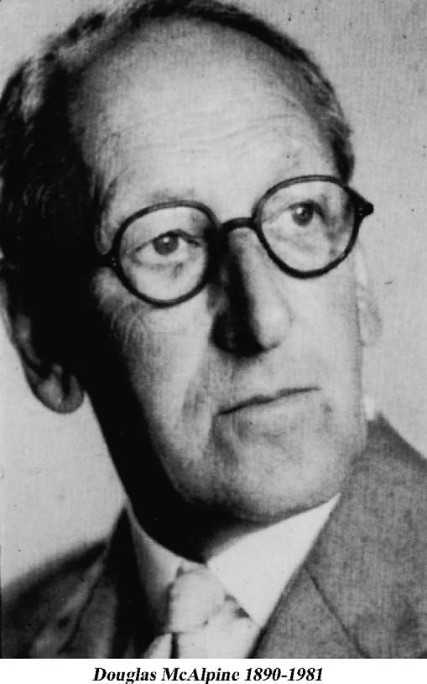

Slide 32
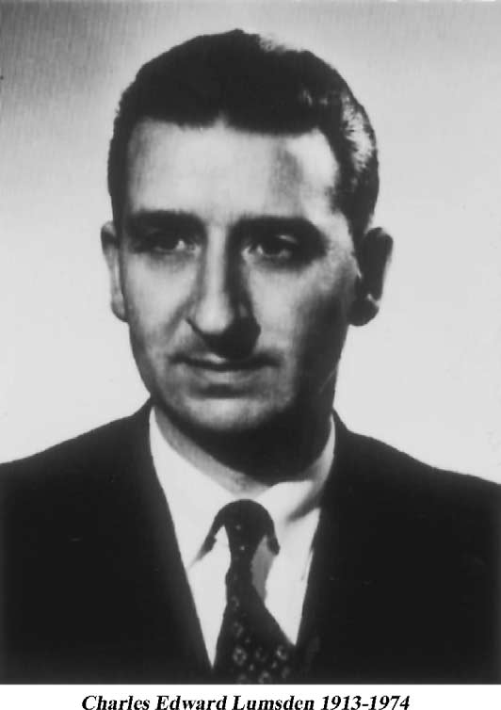

Slide 33
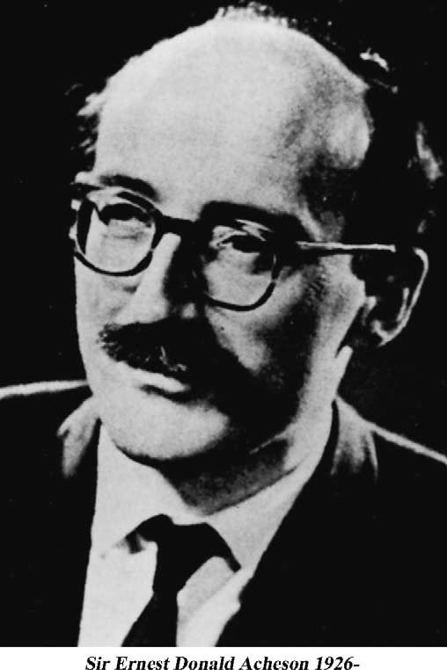

Slide 34
Kuroiwa and the MS Research Committee of Japan( 1972)
The category of possible MS included “acute demyelinating diseases,” including disseminated encephalomyelitis (DEM) and other leukoencephalopathies.
Neuromyelitis optica or Devic’s disease was also named

Slide 35
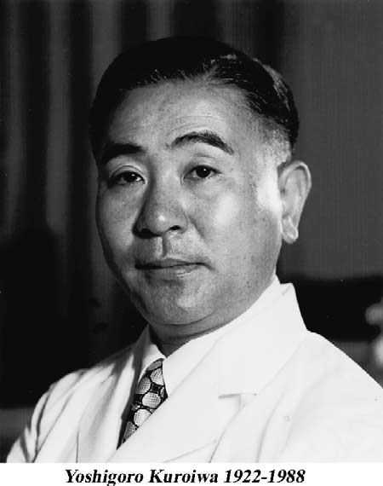

Slide 36
Bauer et al (1972)
A modification of the Schumacher criteria emerged from a world-wide investigation by Bauer based on the replies of 58 MS experts in 25 countries.
It was the first to incorporate CSF oligoclonal bands.

Slide 37


Slide 38
Rose et al.(1976)
Probable MS based on -Two episodes and signs at a single site
or
a single episode with signs of“widespread” disease.
Possible MS- two episodes with no or few signs

Slide 39


Slide 40
McDonald and Halliday ( 1977)
“Only way one could prove the diagnosis
of MS was by biopsy or autopsy, the former, however, being unreliable unless the specimen included the edge of the lesion, quite a rare event”.
Late probable or latent MS
Progressive probable or possible MS
Suspected MS

Slide 41


Slide 42
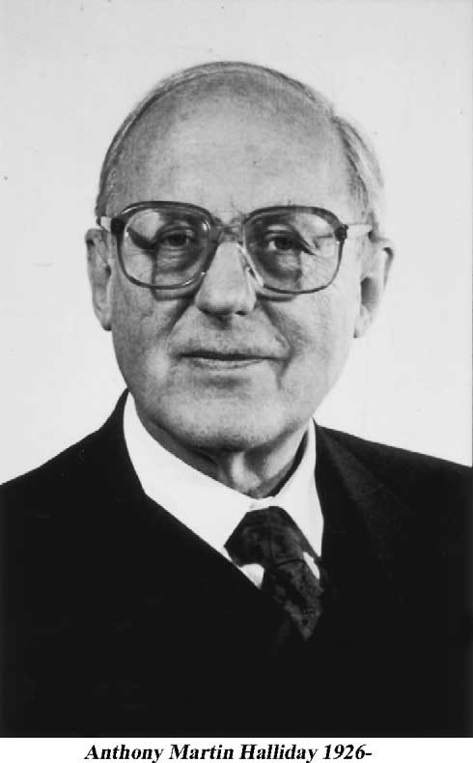

Slide 43
The Poser et al. criteria
The increasing availability in the late 1970s of evoked potentials and neuroimaging demanded adding them to the diagnostic process.

Slide 44

The Poser et al. criteria

Slide 45
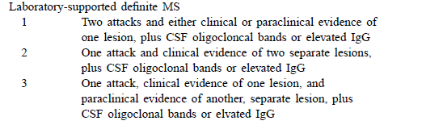

Slide 46
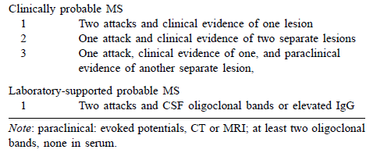

Slide 47
An attack (bout, episode,exacerbation) could consist of symptoms alone, and had to last at least 24 h.
The term “paraclinical” evidence was introduced to include the results of evoked response studies and neuroimaging.
A remission had to last at least 1 month.

Slide 48
A new category called “laboratory supported” applied only to the examination of CSF for oligoclonal bands (Obs) and increased production of immunoglobulin G (IgG).
Atleast two OBs in the CSF and none in serum.
The acceptable age of onset was raised to 59 years

Slide 49
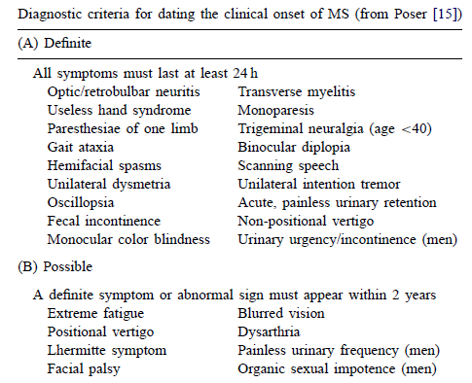

Slide 50
Extended and expensive investigations were not encouraged.
Other illnesses capable of producing signs and symptoms of multiple lesions of the CNS considered.
Major weakness of this scheme was the failure to incorporate consideration of primary progressive MS.

Slide 51
Pseudo-exacerbations
Donald Paty and George Ebers were the first
to call attention -1997
Recurrence of old symptoms
Short duration of symptoms
Toxic or metabolic changes -and disappearance of symptoms and signs when the
metabolic change has been corrected.
Single most frequent culprit is unsuspected urinary tract infection in women.

Slide 52
Magnetic resonance imaging
MRI by Young et al. in 1981
Frequent confusion of the various forms of DEM with MS.
Abnormalities were non-specific and non-diagnostic, and that the correlation between the number, size, and location of “lesions” and the clinical signs and symptoms were extremely poor, they were also unreliable indicators of disability and prognosis

Slide 53
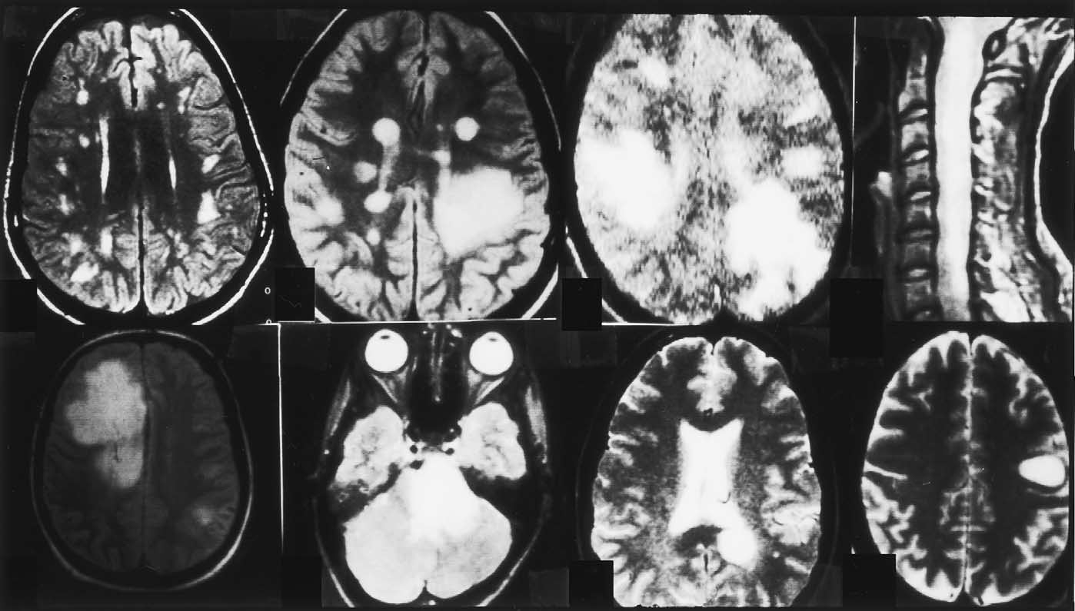

Slide 54
McDonald et al. diagnostic criteria
MRI criteria were incorporated into the scheme,and guidelines for the diagnosis of primary progressive MS were defined

Slide 55
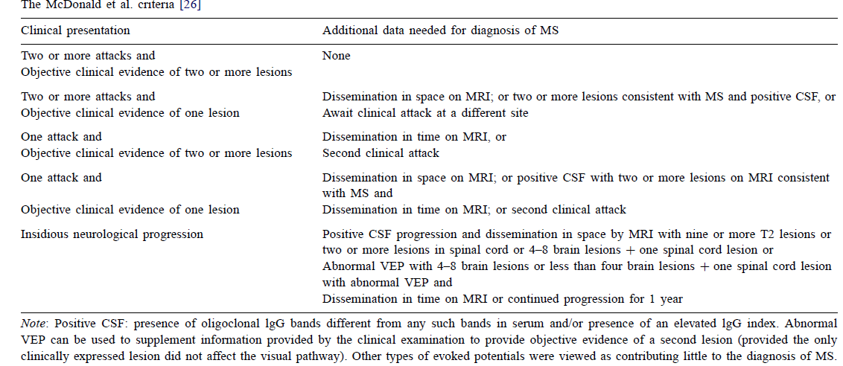

Slide 56
Reintroduction of the possible class -step backward, since such cases should not be included in epidemiological studies or clinical trial,and have no place in practice.
Requirement that only objective signs be considered; typical and frequent symptoms of MS that are often present without any objective signs would have to be disregarded

Slide 57
Clinically definite MS (CDMS), patients should experience two attacks of neurological dysfunction, occurring at different points in time and affecting different parts of the CNS.
Many years may elapse between the first and the second clinical attack, thereby delaying a diagnosis of CDMS.

Slide 58
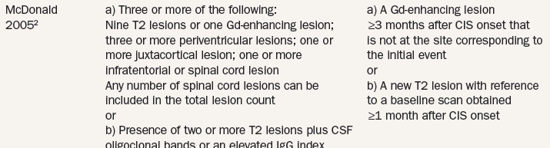

Slide 59
Clinically isolated syndrome (CIS)
First clinical episode of the disease
All interferon-b preparations and glatiramer acetate have shown that they can delay a
second attack of the disease for almost a year in about 14 of 100 patients .
This has emphasized the importance of an early diagnosis of MS for initiating treatment as early as possible

Slide 60
May 2010 in Dublin, Ireland, the International Panel on Diagnosis of MS
Requirements for demonstrating DIS and DIT
and to focus on application of the McDonald Criteria in pediatric, Asian, and Latin American populations.
Dr Polman, Department of Neurology, VU Medical Center Amsterdam

Slide 61
An attack (relapse, exacerbation)
Patient-reported symptoms or
objectively observed signs typical of an acute inflammatory demyelinating event in the CNS, current or historical,
with duration of at least 24 hours, in the absence of fever or infection.

Slide 62
Paroxysmal symptoms(historical or current) should consist of multiple episodes occurring over not less than 24 hours.
At least 1 attack must be corroborated by findings on neurological examination,
Visual evoked potentials in patients visual disturbance
MRI consistent with demyelination in the area of the CNS implicated in the historical report of neurological symptoms

Slide 63
Criteria related to the use and interpretation of imaging criteria for DIS and DIT was articulated by the published work from the MAGNIMS research group.
The European MAGNIMS multicenter collaborative research network, which studies
MRI in MS

Slide 64
MAGNETIC RESONANCE IMAGING CRITERIA FOR DIS.
DIS demonstrated by MRI was based on the Barkhof/Tintore´criteria.
MAGNIMS research group compared the Barkhof/Tintore´ criteria for DIS with simplified criteria developed by Swanton and
colleagues.

Slide 65
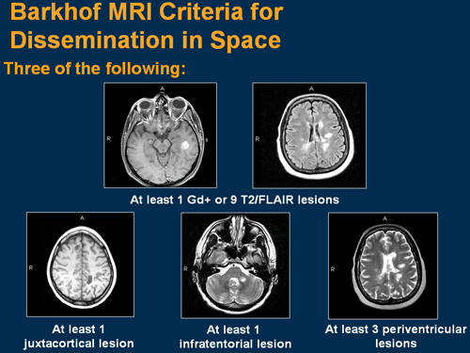

Slide 66
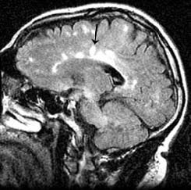

Slide 67
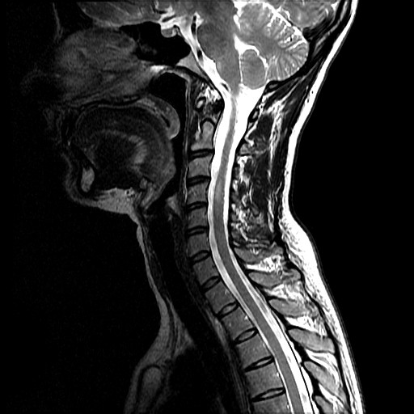

Slide 68
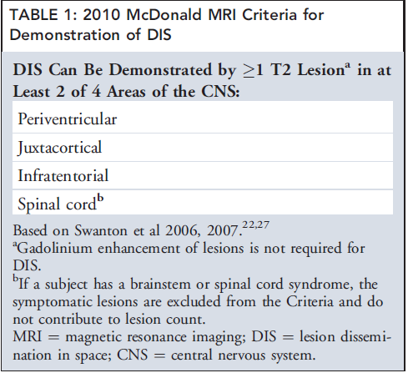

Slide 69
MRI CRITERIA FOR DIT
The 2005 revision of the McDonald Criteria simplified the MRI evidence required for DIT, basing it on the appearance of a new T2 lesion on a scan compared to a reference or baseline scan performed at least 30 days
after the onset of the initial clinical event

Slide 70
MAGNIMS group showed that in patients with typical CIS, a single brain MRI study that demonstrates DIS and both asymptomatic gadolinium-enhancing and nonenhancing
lesions is highly specific for predicting early
development of clinically definite MS (CDMS) and reliably substitutes for prior imaging criteria for DIT

Slide 71
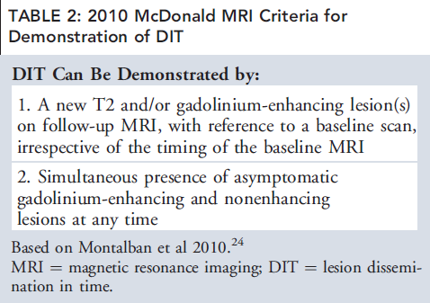

Slide 72
THE VALUE OF CSF FINDINGS IN DIAGNOSIS
CSF status was not evaluated for its contribution to the MAGNIMS criteria
for DIS and DIT

Slide 73
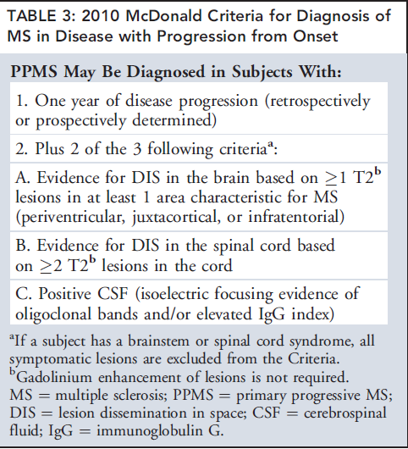

Slide 74
Pediatric MS
About 80% of pediatric cases, and nearly all adolescent onset cases, present with
attacks typical for adult CIS, with a similar or greater total T2 lesion burden.
In children younger than 11 years,
lesions are larger and more ill-defined than in teenagers.
Imaging criteria for demonstrating DIS in pediatric MS show high sensitivity and/or specificity.

Slide 75
15 to 20% of pediatric MS patients, most aged <11 years, present with encephalopathy
and multifocal neurological deficits difficult
to distinguish from acute disseminated encephalomyelitis

Slide 76
International consensus criteria for MS diagnosis in children with an ADEM like
first attack require confirmation by 2 or more non-ADEM like attacks, or 1 non-ADEM attack followed by accrual of clinically silent lesions.

Slide 77
MRI scans of children with monophasic ADEM typically demonstrate multiple variably enhancing lesions (often >2) typically located in the juxtacortical white matter, infratentorial space, and spinal cord.
Application of the revised MAGNIMS-based criteria for DIS and DIT on initial MRI would be inappropriate for such patients, and serial clinical and MRI observations are required to confirm a diagnosis of MS

Slide 78
Revised Wingerchuk Criteria for ‘‘definite’’NMO
Presence of optic neuritis,
Acute myelitis,
and at least 2 of 3 supportive paraclinical assessments
a contiguous spinal cord lesion at least 3 segments in length,
Brain MRI at onset that is nondiagnostic for
MS
NMO-IgG seropositivity

Slide 79
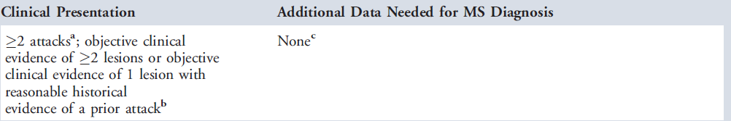
The 2010 McDonald Criteria for Diagnosis of MS

Slide 80
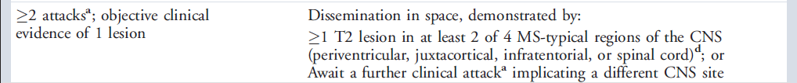

Slide 81
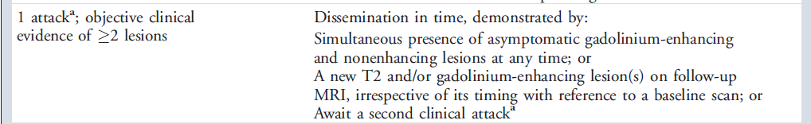

Slide 82
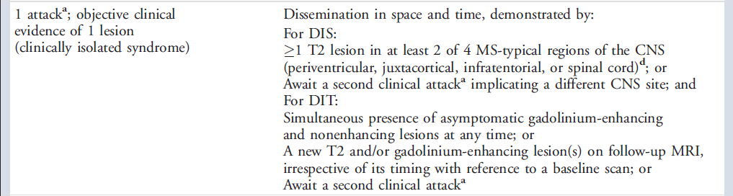

Slide 83
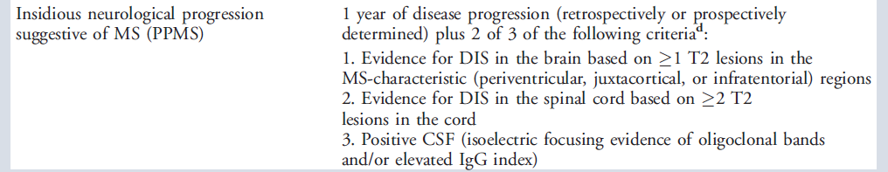

Slide 84
If the Criteria are fulfilled and there is no better explanation for the clinical presentation, the diagnosis is ‘‘MS’’;
If suspicious, but the Criteria are not completely met, the diagnosis is ‘‘possible MS’’
If another diagnosis arises during the evaluation that better explains the clinical presentation, then the diagnosis is ‘‘not MS.’’

Slide 85
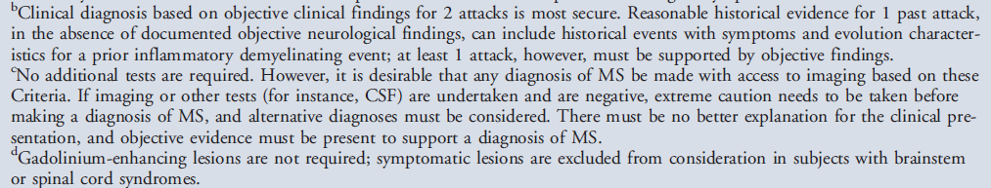

Slide 86
A proportion of patients with nonspecific symptoms (eg, fatigue, weakness, or dizziness)
and nonspecific MRI findings are referred to secondary and tertiary MS.
These revised McDonald Criteria for MS diagnosis should therefore be applied only when patients have experienced a typical CIS
or progressive paraparesis/cerebellar/cognitive syndrome in the case of suspected PPMS.

Slide 87
THANK YOU

Slide 88
References
Diagnostic Criteria for Multiple Sclerosis:
2010 Revisions to the McDonald Criteria
ANN NEUROL 2011;69:292–302
Diagnostic criteria for multiple sclerosis: an historical review
Charles M. Poser a, Vesna V. Brinar
Clinical Neurology and Neurosurgery 106 (2004) 147–158

Slide 89
Poser C. The pathogenesis of MS: a commentary. Clin Neurol Neurosurg
2000;102:191–4.
Swanton JK Fernando K, Dalton CM, et al. Modification of MRI criteriafor multiple sclerosis in patients with clinically isolated syndromes.J Neurol Neurosurg Psychiatry 2006;77:830–833.

Slide 90
According to 2010 revised McDonald criteria for DIS,true statement is
a)Based on Barkhof/Tintore´criteria
b)Gadolinium enhancement of lesion is required
c)CSF study is mandatory
d)One or more T2 lesions in 2 out of 4 CNS areas

Slide 91
According to 2010 revised McDonald criteria for DIT,true statement is
a)Based on Swanton et al criteria
b) New Gadolinium enhancing lesion at any time in follow up.
c)Single Gadolinium enhancing lesion is only required
d)CSF oligoclonal bands

Slide 92
According to 2010 revised McDonald criteria for PPMS,false statement is
a) One year of disease progression
b)Evidence for DIS in the brain based on
1 T2W lesions in at least 1 area characteristic for MS(periventricular, juxtacortical, or infratentorial)
c)Evidence for DIS in the spinal cord based
on 1 T2W lesions in the cord
d)Positive CSF oligoclonal bands and/or elevated IgG index

Slide 93
Revised Wingerchuk Criteria for ‘‘definite’’NMO,false statement is
a)Presence of optic neuritis
b)Acute myelitis
c)A contiguous spinal cord lesion at least 3 segments in length
d)NMO CSF IgG positivity

