Slide 1

DIFFERENCES BETWEEN CHILD AND ADULT
Presented By,
Mr. DAYANAD BELAGAVI
Assistant Professor
Department of Child Health Nursing, SNC

Slide 2

DIFFERENCES BETWEEN CHILD AND ADULT

Slide 3

INTRODUCTION
There are a many differences between children and adults like physiological, anatomical, cognitive, social and emotional.
These all impact on the way illness and disease present in children and young people, as well as the way healthcare is provided.
This awareness is essential to nurse for effective management of pediatric emergencies and to deliver the care accordingly.

Slide 4
Difference Between Child &Adult
Systemic Changes
Psychological Difference
Pathologic changes

Slide 5
Anatomic & Physiologic Difference
CHILDREN | ADULTS
New-born's head is larger & heavier as compared to his body | Adults head is not heavier than body
Children have thinner skin than adults. | Adult skin not as much thinner than children.
Children's cells divide more rapidly than adults | Normal cell division
No tears in early infancy | There is tears formation in eyes.
No voluntary control over the environment or activity | Voluntary control On body

Slide 6
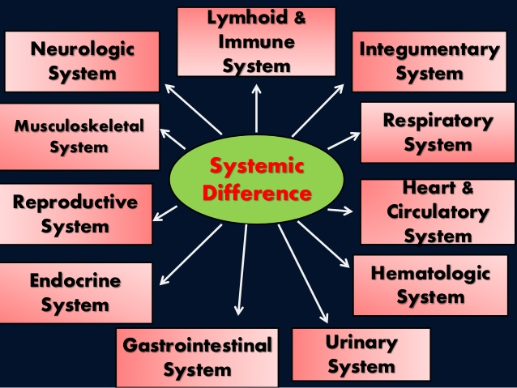

Slide 7
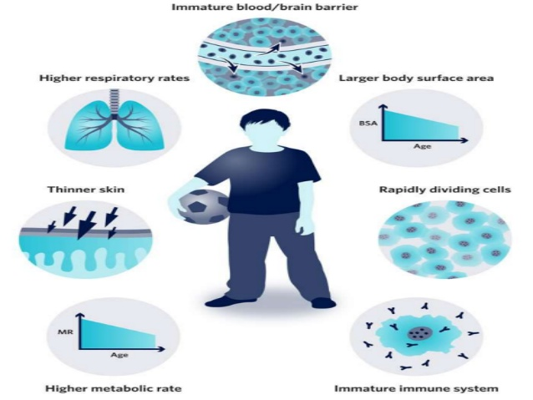

Slide 8
INTEGUMENTARY SYSTEM
CHILDREN | ADULTS
The apocrine sweat gland - small and non- functional from birth to preschool years. Start functioning at 8 years of age. | Apocrine gland are properly developed in axillae, areolae & genital area.
Skin Problems:- 1)lenier’s disease 2)sclerema neonatorum. 3)tinea capitis 4)tinea pedis. | This type of skin problems not seen in adult

Slide 9
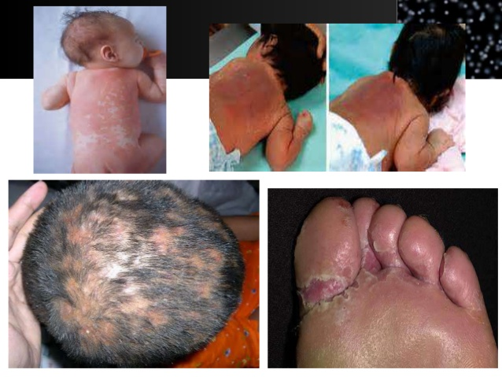
Lenier’s disease
Sclerema neonatorum
Tinea capitis
Tinea pedis

Slide 10
Respiratory System
CHILDREN | ADULTS
Respiration Rate :-30– 60 breath/min Heart Rate:-100-160 beats/min | Respiration Rate :-16- 20 breath/min Heart Rate/Pulse Rate:-60-80 beats/min
Tissues of respiratory tract are delicate & do not produce sufficient mucus. | Sufficient Amount of mucus
No protection from invasion of infectious microorganism | Protection from invasion of infectious microorganism

Slide 11
Difference between Adult and Fetal Circulation Characteristics
Characteristics | Fetal Circulation | Adult Circulation
Artery | Carries Non-oxygenated blood away from the fetal heart | Carries oxygenated blood away from the heart
Veins | Carries oxygenated blood back to the heart | Carries non- oxygenated blood towards the heart
Exchange of Gases | Takes place in the placenta | Takes place in the lungs
Pressure | Increase pressure on the right side of the heart | Increase pressure on the left side of the heart

Slide 12
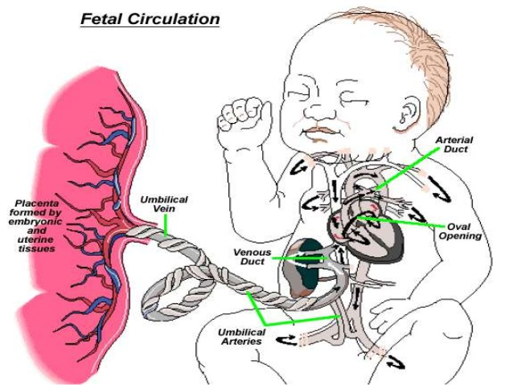

Slide 13
Hematologic System
CHILDREN | ADULTS
New-born RBC are Microcytic. Microcytic=MCV<80 | Adult RBC are Macrocytic. Macrocytic=MCV>100
Life Span of RBC are 60-90 days. | Life Span of RBC are 100-120 days.
BLOOD VOLUME: Neonate- 85 ml/kg of BW | BLOOD VOLUME: Adult- 60-70 ml/kg of BW.

Slide 14
URINARY SYSTEM
CHILDREN | ADULTS
Infant’s kidneys are immature with reduced ability to filtrate & concentrate urine. | Kidneys are mature enough for proper functioning.
Nephrons are not grown & functioning. | Nephrons are properly functioning.
Not under voluntary control. | Under voluntary control

Slide 15
Gastrointestinal System
CHILDREN | ADULTS
It is quite relaxed in infants resulting in frequent regurgitation & vomiting during infancy | The cardiac sphincter of stomach is fairly tight in adults
GI functioning is immature & involuntary Proper | GI functioning & voluntary control
Temporary teeth | Permanent teeth
Stool of neonate is loose Liver size:- 4% of body weight. | Stool of adult is hard. Liver is 12-13 times its birth weight.

Slide 16
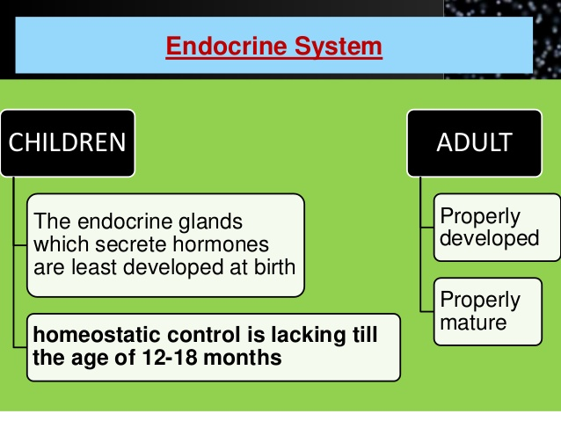

Slide 17
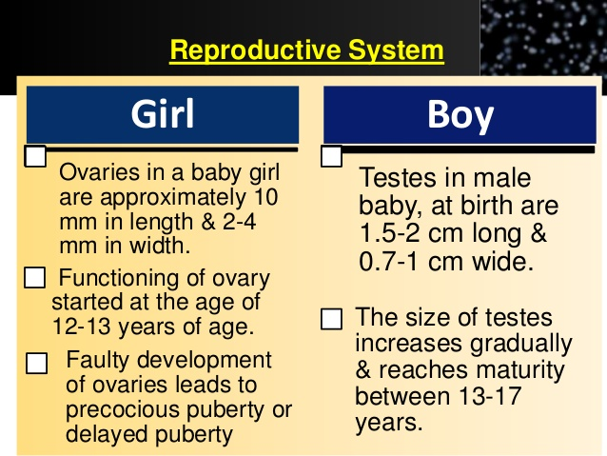

Slide 18
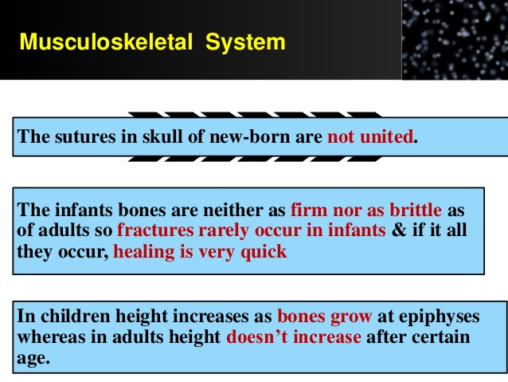

Slide 19
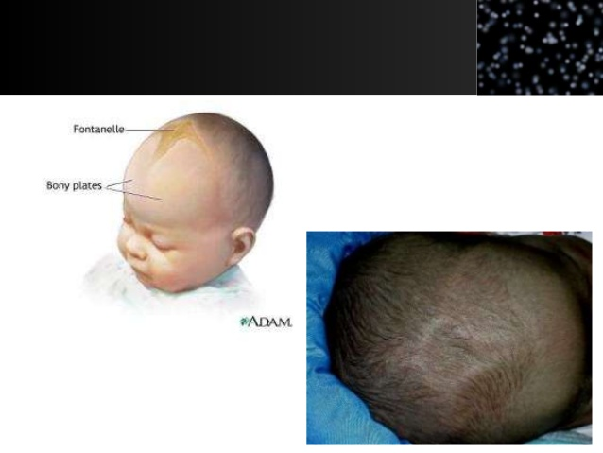

Slide 20
Neurologic System
CHILDREN | ADULTS
The weight of brain of neonates is about 300-500 grams | The weight of brain of adult is about 1,300 - 1,400 grams.
Reflex activities that are present during infancy | Disappear in adult as voluntary control is developed.
VISION:- eyes are not anatomically mature, not able to function. | VISION:- eyes are mature & function properly.
HEARING:- Neonate can heard loud noise at birth. | Adult can Listen softer & soothing sound.

Slide 21
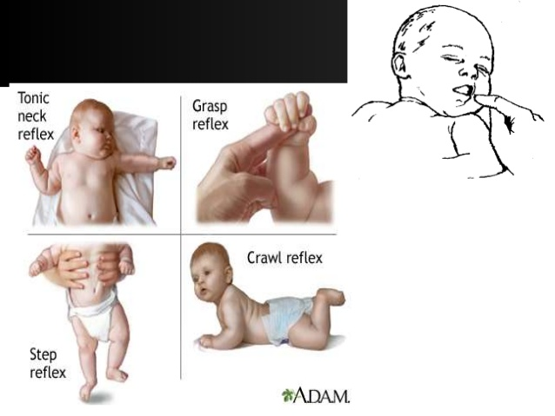

Slide 22
Lymphoid & Immune System
The maturation of lymphoid system varies with the child’s age.
The lymphoid tissue is small but well developed at birth.
It increase rapidly in size up to the age of 10-11 years.

Slide 23
PSYCHOLOGICAL DIFFERENCES
NEWBORN | Fear , escape and avoid strangers
INFANCY | more bonding with parents. Separation anxiety is very common.
TODLLER | Negativistic behaviors
PRESCHOOLER | short attention span, easily distract able.
SCHOOLER | Industry Vs. inferiority
ADOLESCENT | Identity of peer, confusion

Slide 24
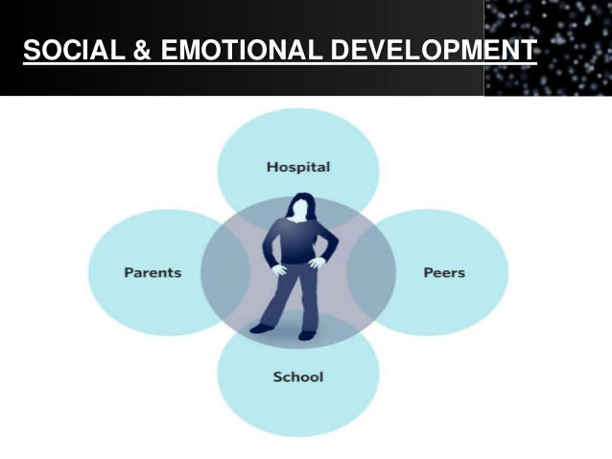

Slide 25
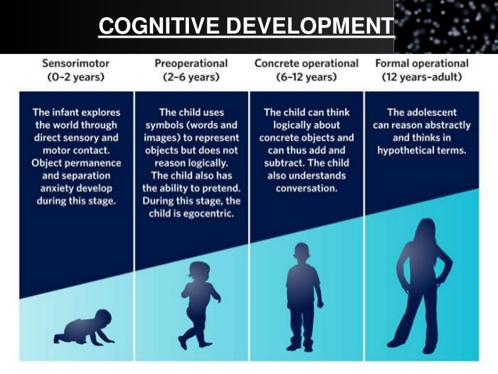

Slide 26
Pathologic changes
1)IMBALANCE OF FLUID & ELECTROLYE
• Child lose fluid easily as compared to adults in conditions like diarrhoea,vomitting,burns etc
• Child get dehydrate easily.
2) RESISTANCE TO DISEASES
• The baby gets immunity from mother which helps the baby fight against infections for first 3 months of life.
3) Sign & symptoms of disease in children are different from adults.

Slide 27
Summary
As well as the more obvious physiological and cognitive differences between children than adults, working with children and adolescents requires the consideration of future development- physical, social, emotional cognitive- as of primary importance. The need to be aware of the context in which a child or adolescent lives and functions is crucial for both the provision of appropriate management as well as planning for future healthcare.

Slide 28
BIBLIOGRAPHY
Rimple Sharma, ESSENTIAL OF PEDIATRIC NURSING, Jaypee publication India, page no- 31 to 34.
2) Manoj Yadav,” A TEXT BOOK OF CHILD HEALTH NURSING”, Pee Vee publication India, page no:- 42 to 46.
http://www.rch.org.au/studentorientation.

