Slide 1

MODERN CONCEPTS OF CHILD CARE
Presented By,
Mr. DAYANAD BELAGAVI
Assistant Professor
Department of Child Health Nursing, SNC
.

Slide 2
Pediatrics is a Greek word,
Pedia –Child
iatrike-Treatment
ics-Branch of medicine

Slide 3
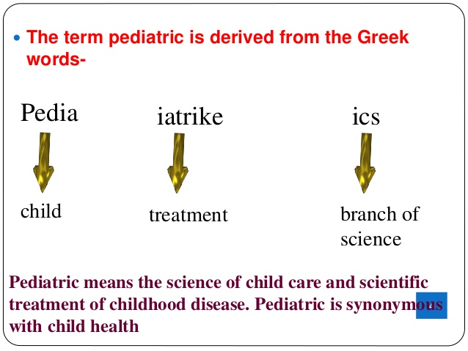

Slide 4
Definition
Pediatrics can be defined as the branch of medical science that deals with the care of children from conception to adolescence in health and illness. It is concerned with preventive, promotive, curative and rehabilitative care of children.

Slide 5
Importance of PEDIATRICS
Major consumers of health care.
35 – 40 of total population are children below the age of 15.
More vulnerable to various health problems.
Majority of Childs morbidity & mortality preventable.
Needs special care to survive & thrive.

Slide 6
Pediatric Nursing
Pediatric nursing is the specialized area of the nursing practice concerning the care of children during wellness and illness, which includes preventive, promotive, curative and rehabilitative care of children.

Slide 7
Historical backgroundof childhealth
Abraham Jacob is known as FATHER OF PEDIATRICS because of his contribution to pediatrics.
The first citation of quality of breast milk and child hygiene was 225 BC. in Indian SUSHRUTA SAMHITA.
Hippocrates a greek philosopher also known as father of modern medicine has made significant contribution to diseases found in children

Slide 8
The first Indian pediatrician were kashyapa and Jevaka, they worked on children diseases and child care.
The first manuscript on management of children diseases was written by kashyapa and Samhita.
Thereafter Sushruta and Samhita wrote about ayurvedik medicine that can be used for children. It was the first written record of pediatrics anywhere in the world.
Susruta was known as Indian Hippocrates. He wrote on child’s rearing practices , infant feeding and diseases of child hood.
Charak was the physician of Peshawar. He wrote on care and management of newborn in his Sansthan and Ashtanga –hridaya

Slide 9
In 1802 first pediatric hospital was opened in Paris.
Pediatrics as speciality came into being in 1860 when Dr. Abraham Jacob established first child clinic in New York and started giving special lectures on diseases of children.
In 1888 AD. The first department of pediatrics was established in Hardward medical school. At this time it was realized that diseases of the children are different from diseases of adult.
In the 19th century antenatal care and pediatric care developed. Slowly people started realizing about child’s needs. The Lady Chemsford All India League For Maternal And Child Welfare was established in 1920.
In 1920 the first crèche was opened in India to provide day care to children

Slide 10
Factors responsible for growth of modern pediatrics
Progress of medical science
Development of the field of basic science
Increasing interest in field of public health
Improved social laws.
Improved health facilities
Emphasis on disease prevention and health promotions
Separate pediatric hospitals
Child welfare programmes
Health promotion and disease prevention Growing realization of social needs of children
Changing attitude of society towards younger members of society

Slide 11
Principles
The nurse should begin to build working relationship with the parents and children from time of first contact with them.
The nurse should be aware that all behaviors of child is meaningful.
The nurse should accept the parents and child as they are
Empathy for parents and children.
Acknowledge the parents right to decision concerning to their children.
Use local language so parents can understand.
Answer all questions of parents

Slide 12
HEALTH CARE CHANGES AND ADVANCES
Concept of health and illness.
Concept is changing, complete overall wellbeing and not merely the absence of disease.
Illness, when the individual experience a disturbance in both physical and psychosocial characteristics.

Slide 13
2.Holistic view of health
Widely accepted term, “Wholeness”. It is a philosophy believes in an integration and harmonious balance of body, mind and spirit to maintain or regain health.

Slide 14
3.High level of wellness
Areas of wellness behaviour are
Physical Fitness
Optimal nutrition
Appropriate management of stress.
Awareness of environmental influences on the individual.
Responsibility for onset.

Slide 15
Children learn wellness and illness behaviour during their years of growth and development principally from parents.(Primary guardian of children’s health)
Orient the children early in life within home setting as per attitudes and habits.
Influence of other family members, siblings and health care professionals.

Slide 16
CONCEPT OF CHILD CARE
Health is a fundamental right of every human being “A healthy child becomes a healthy citizen and a healthy citizen makes a healthy nation”.

Slide 17
MODERN CONCEPT OF CHILD CARE
Child care has a prime importance as the mortality and morbidity rates are highest in this group and most of the diseases are preventable.
The goal of Pediatric nursing is to foster the growth and development of the child and promote an optimum state of health physically, mentally and socially, so that he may function at the peak of his capacity.

Slide 18
CONCEPTS RELATING TO CARE OF THE CHILD AND NURSES ROLE
Areas to be considered:
Health promotion
Prevention of illness
Health maintenance
Health restoration

Slide 19
CHANGING ROLE OF NURSE
The Pediatric Nurse provides all the care in the form of care giver, advocate, educator, researcher, manager and leader to provide a comprehensive health care services.
Additional specialized role include
  Pediatric Nurse Practitioner,
  clinical Nurse specialist and
  care manager after a specializes training.

Slide 20
NEW CONCEPTS
Child centered care.
Take care of the female child with immunization to TT.
Health education on planned parenthood and doing the maternal health assessment before conception.
Early identification and family counseling based on biochemical screening and chromosomal studies.

Slide 21
5. Caring the health care of the child from the day of conception.
6. Participate in the prevention of illness and health promotion activities.
7. Comprehensive care of the child in his home through community health centers.
8. Flexibility in hospital setting.
9. Health oriented.
10.Warmth and love oriented.

Slide 22
11. Health promotion activities, services related to fertility, sex education and counseling.
12. Safe guard and protect the childrens right by health providing, cultural practice and laws encouraging.

Slide 23
CURRENT CONCEPT OF PEDIATRIC NURSING
A- Advocate for child and family
C- Communicate for the child
A- Activate the Child’s activities
D- Disseminate information related to child health programmes
E- Educate the public about child health
M- Motivate people to participate in child care
I- Investigate available resources
C- Collaborate care

Slide 24
TRENDS IN PEDIATRIC NURSING
Flexible in visiting hours
Rooming – in
Parents support group
School teachers involved in care of hospitalized child
Play in school and hospital
Care by parents/Family centered care
Health and nursing team
Evidenced based practice
Prevention of disease and promotion of health

Slide 25
Current Trends In Pediatric Nursing Practice
Family-Centered Care
Atraumatic Care
Cost containment
Primary nursing
Case management
High technology care
Evidenced based practice
Child oriented environment

Slide 26
1. Family-Centered Care
Enabling
Based on quality care and promote physiological and psychological care of the family
Create opportunities and utilize their present abilities
Family education
Empowering
Foster the strength of the family to cope and withstand stress
Recognize family as atonomous individual
Decision making

Slide 27
2. Atraumatic care
“First Do no harm”
Atraumatic care is the provision of therapeutic care, in
Settings
Personnel
interventions

Slide 28
Therapeutic care: prevention, diagnosis, treatment and palliation of acute and chronic conditions
Settings: home, hospital or any other health care setting
Personnel : anyone directly involved in providing therapeutic care
Interventions:
Psychological :Preparing children for procedures
Physical: preparing space or room for the family
Psychological distress: Anxiety, Fear, Anger, Disappointment, Sadness, Shame or guilt
Physical distress:
Sleepless and immobilization

Slide 29
Three Principles in Atraumatic care
Prevent or minimize child’s separation from the family
Promote a sense of control
Prevent or minimize bodily injury or pain

Slide 30
3. Cost Containment
Reduce cost of hospitalization
Reduce mortality rates, hospital stay, complications
Increase family satisfaction
Intuitive and scientific care to patient and family

Slide 31
4. Primary Nursing
Care continuity
Commitment
Accountability
Responsibility

Slide 32
5. Case Management
Best possible care with minimal cost
Improve patient/family satisfaction
Decrease fragmentation of care
Ability to describe and measure outcomes from a homogenous group of patients

Slide 33
6. High Technology Care
Technologically versatile
Laboratory screening
Advance technology
Computer advancement
Continuing education
Computer skills

Slide 34
7. Evidenced Based Practice
Quality improvement
Systemic approach
Strong data

Slide 35
8. Child Oriented Environment
Friendly environment
Liberal visit hours
Child ward
Play material
Safety protection
Education

Slide 36
THANK YOU

