Slide 1

WELFARE SERVICES FOR
HANDICAPPED CHILDREN
Presented By,
Mr. Dayanand Belagavi
Assistant Professor
Department of Child Health Nursing, SNC

Slide 2
SCHEMES FOR WELFARE OF HANDICAPPED
DEENDAYAL DISABLED REHABILITATION SCHEME (DDRS)
ASSISTANCE TO DISABLEDPERSONS FOR PURCHASE/ FITTING OF AIDS AND APPLIANCES (ADIP)
NATIONAL INSTITUTIONS
THE NATIONAL HANDICAPPED FINANCE AND DEVELOPMENT CORPORATION
SCHEMES FOR IMPLANTATION OF PERSONS WITH DISABILITIES
SCHEME FOR INCENTIVES TO EMPLOYERS IN THE PRIVATE SECTOR FOR PROVIDING EMPLOYMENT TO PERSONS WITH DISABILITIES

Slide 3
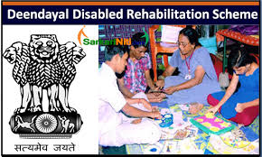
DEENDAYAL DISABLED REHABILITATION SCHEME (DDRS)

Slide 4
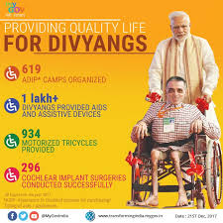

Slide 5


Slide 6
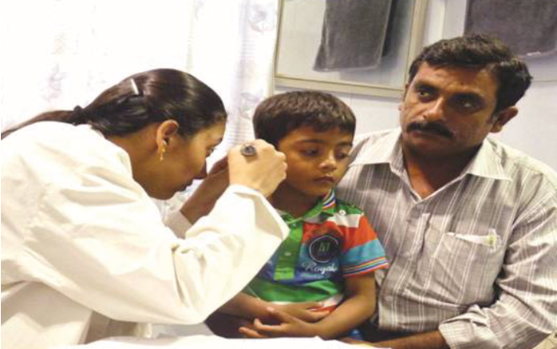

Slide 7
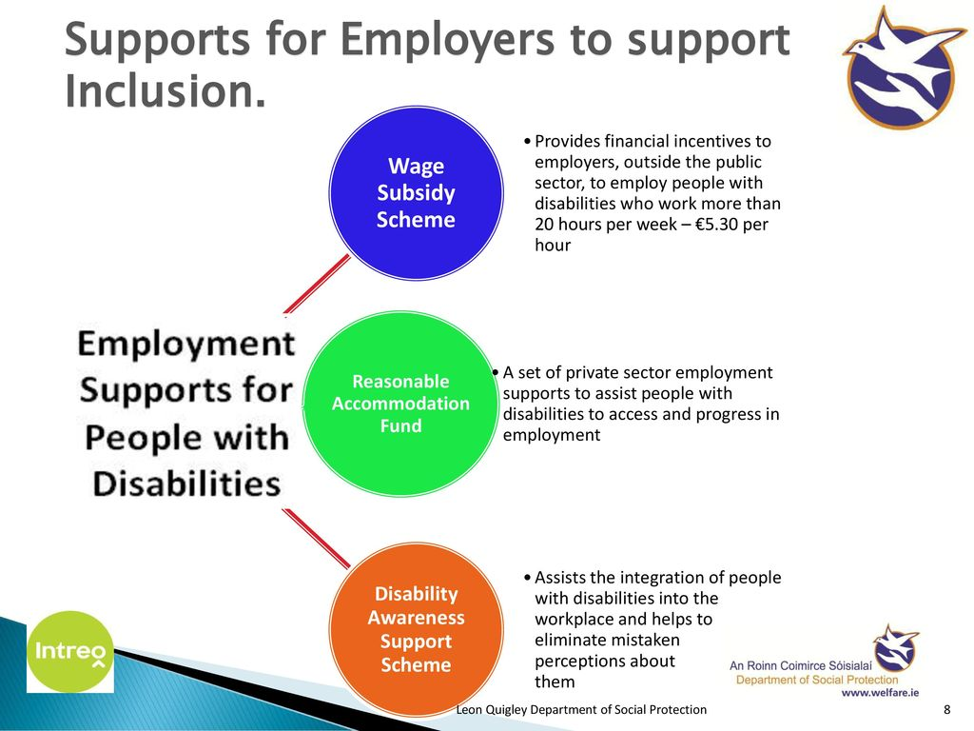

Slide 8
ORGANIZATIONS PROVIDING FACILITIES TO THE DISABLED
In central government, the ministry of welfare plays a major role in framing policies and programmes for the handicapped.
All state government and union territories in India have established department of social welfare of the handicapped.
The main focus is to providing
I. Educational &
II. Employment facilities of the handicapped

Slide 9
I. Educational facilities for handicapped
Integrated Education Scheme for Disabled operated by the Department of Education. The scheme provides:
a. The handicapped children are provided certain allowances.
b. The severely orthopedically handicapped children to bring one attendant is allowed.
c. Disabled children residing in school hostel, within the same institution may also be paid boarding.
d. Severely orthopedically handicapped children residing in school hostels may need the assistance of a helper.

Slide 10
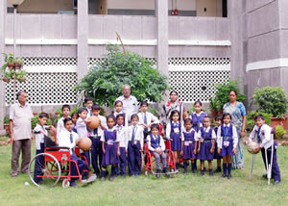

Slide 11


Slide 12
II. Self-Employment
Banks provide loans at low interest rates to promote self-employment.
Residential houses allotted to the handicapped persons.
Concessional tickets are available
Assistance for purchase and fitting of aids and appliances for physical rehabilitation.
The facilities and concessions are:
Schemes of integrated education
Job reservation in Government sector
Economic assistance
Welfare schemes
Travel concessions

Slide 13
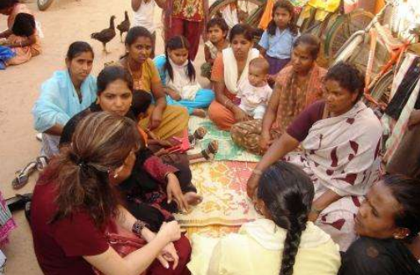

Slide 14
District Rehabilitation Centres
Under the scheme each village consisting of 1000 people has been assigned a village Rehabilitation worker to identify the needs of disabled persons.
Primary Rehabilitation Assistant for 0-30 villages.
PHC - vocational training, appropriate education and employment.
District Rehabilitation Centre
Regional Training Cantres

Slide 15
Vocational Rehabilitation Centres
Deaf, blind, orthopedically handicapped, mildly retarded and negative leprosy may avail the services provided by the VRC
Voluntary organization

Slide 16
