Slide 1


OBJECTIVE TYPE ASSESSMENT
Ms. Sujitha S.
Assistant Professor
Dept of Medical Surgical Nursing
Sumandeep Nursing College

Slide 2

DEFINITION
It is a systematic procedure for observing person& describing them with either numerical score & category system.

Slide 3
CATEGORIES OF OBJECTIVE TYPE TEST
1.selected response format
2.constructed response format

Slide 4
1.Selected Response format
1.MCQ
2.TRUE /FALSE
3.MATCHING TYPE

Slide 5
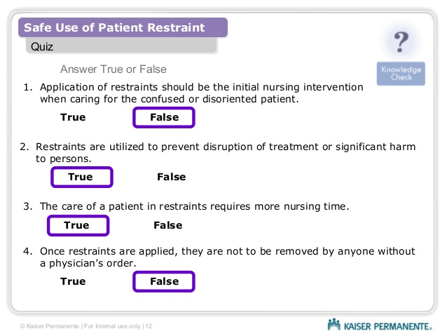
1.TRUE/FALSE
An objective test presented in the simple declarative statement. in that pupils respond indicating that is true or false. this can be apply in all areas of learning.

Slide 6
2.MULTIPLE CHOICE QUESTIONS
These are by far the most widely used type, and typically take the form of a short question or implied question (the stem) followed by four or five optional answers, one of which is unequivocally correct (the key) and all the others unequivocally wrong (the distracters).

Slide 7
1. the most stable measures of central tendency is the___
Mean
Median
Mean & median
Mode

Slide 8
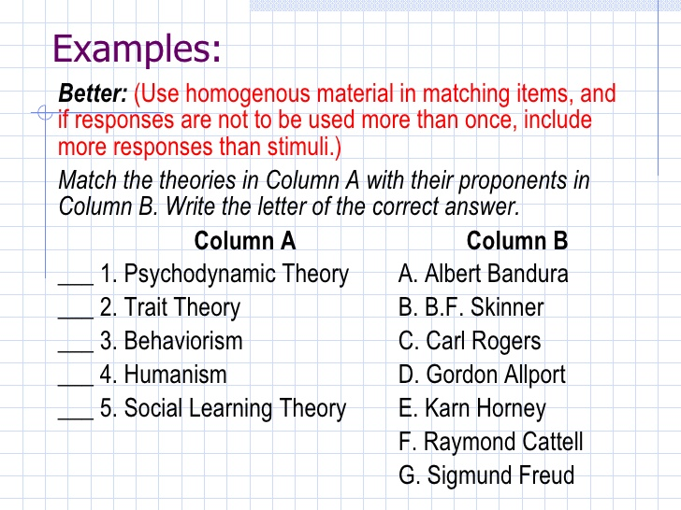
3.MATCHING TYPE
This consist 2 columns. each column “A” is matched with column “B” rationalized basis

Slide 9
2.Constructed type response
1.Completion type test
2.Simple recall type
3.Labelling type test

Slide 10
1.COMPLETION TYPE TEST
An objective type test that includes series of sentences which certain important words & phrase has been omitted for the pupils to fill in sentence may contain one or more blanks.
e.g: The father of educational testing

Slide 11
2.SIMPLE RECALL TEST
Objective type test that sometimes that requires the students to supply an answer to direct question & sometimes require him to complete a statement.
e.g.: who is the father of mental /morden testing?

Slide 12
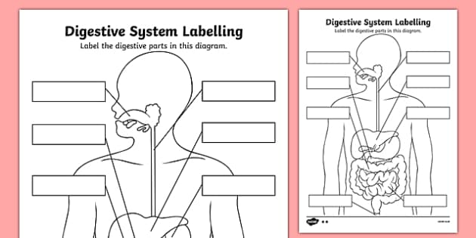
3.LABELLING TEST
An objective type test in which the names of parts of diagrams , map , drawing or picture are to be indicated.

Slide 13

ADVANTAGES :
1.Scoring is not subjective because response are simple words & phrases
2.The objective test is better prepared than the essay test because there are principle to construct the test.

Slide 14

DISDVANTAGES
1.It is harder to preapare
2.generally it measures factfull knowledge
3.it does not help the students to express their knowledge & their ideas.

Slide 15


Slide 16

Definition:
It is the process of applying standardized measurement of varying levels of acchivement in a course.

Slide 17
Types
of
Grading

Slide 18
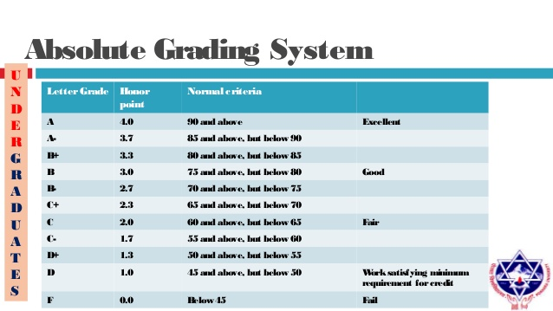
1.Absoulate grading
Based on definite set of standards when evaluating performance of standards

Slide 19
2.Relative grading
It is based on how students performance compared to others in group /class.

Slide 20
3.Self Referencing
It is based on teachers /raters perspectives of improvement ,growth & change that particular students has performed in comparison with his or her prior learning.

Slide 21
Advantages of grading:
advantages
1.Convienet method
2.Error can be minimized
3.Lead to better learning environment

Slide 22
Disadvantages of grading:
1.grades varies from teacher to teacher
2.Do not indicate students strength & weakness

Slide 23
Open-answer or/and multiple-choice test? Comparison of research results
The paper deals with the research comparing open-answer and multiple-choice test results monitoring learners' knowledge of English tenses. The research sample consisted of 295 participants. The research was held at the Faculty of Informatics and Management, University of Hradec Kralove, Czech Republic. The results proved slightly higher test scores in the multiple-choice test but the difference in comparison to the open-answer form was not significant.

Slide 24
PICO ANALYSIS
population | intervention | comparison | outcome
295 participants | No intervention | Comparision between open answer & mcq | The results proved slightly higher test scores in the multiple-choice test

Slide 25


Slide 26


