Slide 1


BELL’S PALSY
Presented By:
Ms. Sonal Patel
Assistant Professor
Sumandeep Nursing College
Sumandeep Vidyapeeth Deemed to be University

Slide 2
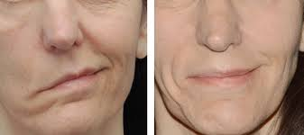
Bell’s palsy
Idiopathic Bell's palsy is an acute peripheral facial paralysis of the infra temporal portion of the seventh cranial nerve (facial) unilaterally. It is typically a self-limiting process that usually improves in 3 to 6 months

Slide 3
Bell’s palsy refers to a peripheral facial paralysis, acute benign cranial polyneuritis.
It is a disorder characterized by a disruption of the motor branches of the facial nerve (VII),or one side of the face absence of any disease such as stroke.

Slide 4
ETIOLOGY
Cause is unknown. Possible etiologies include sensory ganglionitis of the CNS with secondary muscle palsy, caused by inflammation, vascular ischemia, and autoimmune demyelination.
Most patients experience a viral prodrome (eg, upper respiratory infection 1 to 3 weeks before onset of symptoms).
The common cold sore virus, herpes simplex, and other herpes viruses are usually present before symptom onset.

Slide 5
Cont..
It is generally believed to be type of localized inflammatory reaction. There is an evidence that reactivated herpes simplex virus (HSV) may be involved in majority of cases.
The reactivation of HSV causes inflammation of oedema, ischemia and eventually demyelination of the nerve, creating pain and alter in motor and sensory function.

Slide 6
Conti...
Can affect anyone at any age; however, it disproportionately affects pregnant women and those who have diabetes or influenza.
Incidence of recurrence is less than 10%, especially among diabetics.

Slide 7
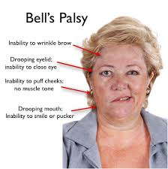
CLINICAL MANIFESTATIONS
Paralysis of side of face from vertex of scalp to chin; facial muscles weak throughout forehead, cheek, and chin; can affect speech, distort face

Slide 8
Conti....
Involvement of all branches of facial nerve: facial weakness, diminished taste from anterior two-thirds of tongue, decreased blink reflex, decreased lacrimation, inability to close eye, painful eye sensations; photophobia, drooling
Hyper acusis on the affected side
Distorted body image due to change in facial appearance

Slide 9
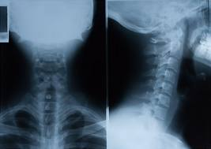
DIAGNOSTIC EVALUATION
History to determine previous illness, onset of paralysis
Physical examination for evaluation of seventh cranial nerve function and corneal sensation
Exclusion of lesions that mimic Bell's palsy, such as tumor, infection, trauma, or stroke.
Electrophysiologic testing,
specifically action potentials
and EMGs and nerve
conduction velocities,
to evaluate nerve function

Slide 10
MANAGEMENT
Corticosteroid therapy
Eye care to maintain lubrication and moisture if unable to close.
Physical therapy, electrical stimulation to maintain muscle tone.
Surgery to anastomose facial nerve to other cranial nerve .
Nonsteroidal anti-inflammatory drugs (NSAIDs) and analgesics to relieve pain.

Slide 11
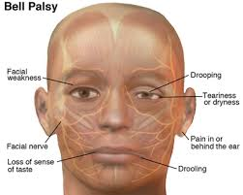
COMPLICATIONS
Corneal ulceration
Impairment of vision
Body image disturbance related to facial nerve paralysis

Slide 12
Nursing Assessment
Test motor components of facial nerve (VII) by assessing patient's smile, ability to whistle, purse lips, wrinkle forehead, and close eyes. Observe for facial asymmetry.
Observe patient's ability to handle secretions, food, fluids; observe for drooling.
Assess patient's ability to blink and speak clearly.
Assess effect of altered appearance on body image.

Slide 13
Nursing Diagnoses
Impaired Tissue Integrity related to loss of protective eye closure
Chronic Pain related to physiologic alterations of disorder
Disturbed Body Image related to facial nerve paralysis

Slide 14
Nursing Interventions
Protecting Corneal Integrity:-
Administer or teach patient to administer artificial tears and ophthalmic ointment as prescribed.
Patch eye to keep shut at night as directed.
Inspect eye for redness or discharge.
Advise patient to report eye pain immediately
Patient Education and Health Maintenance

Slide 15
Relieving Pain
Administer or teach patient to administer corticosteroids to reduce inflammation and nonopioid analgesics to relieve pain.
Teach patient to apply moist heat to face.
Perform or teach patient to perform facial massage to alleviate feelings of stiffness.

Slide 16
Enhancing Body Image
Encourage patient to express feelings related to body image disturbance.
Assist patient to use mirror as means to obtain feedback about actual versus perceived appearance and identify factors that impede or enhance.

Slide 17
Patient Education and Health Maintenance
Instruct the patient to wear wraparound sunglasses to decrease normal evaporation from the eye from sun and wind, to avoid eye irritants, and to increase environmental humidity.
Instruct the patient in use of ophthalmic drops and ointment, proper methods of lid closure, and patching of the eye.
Demonstrate facial exercises (eg, raise eyebrows, squeeze eyes shut, purse lips) and stress their importance to prevent muscle atrophy.

Slide 18
Evaluation
Cornea without redness, pain, or discharge
Reports adequate pain control
Verbalizes adjustment to body image disturbance

Slide 19


