Slide 1

Disorders MALE REPRODUCTIVE SYSTEM
Presented By:
Ms. Sonal Patel
Assistant Professor
Sumandeep Nursing College
Sumandeep Vidyapeeth Deemed to be University

Slide 2
MALE REPRODUCTIVE DISORDER
TESTIS AND SCROTAL DISORDERS
1. EPIDIDYMITIS
2.ORCHITIS
3.TESTICULAR TORSION
4.HYDROCELE
5. TESTICULAR CANCER
6.VERICOCELE

Slide 3
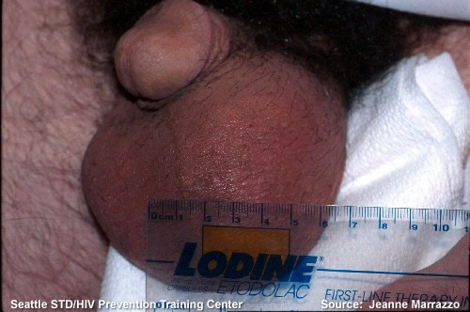
EPIDIDYMITIS:
A sterile or nonsterile inflammation of the epididymis.
Causes:-
A sterile inflammation may be caused by direct injury or reflux or urine down the vas deferens.
Nonsterile inflammation may occur as a complication of gonorrhea, chlamydia, mumps, tuberculosis, prostatitis, or urethritis.

Slide 4
Symptoms: -
sudden, severe pain
soreness in the in the inguinal canal and scrotum,
scrotal swelling,
fever,
dysuria, and pyuria.
The patient may experience chills and fever.

Slide 5
CONT…
Treatment:-
Antibiotics
Pain killers or anti-inflammatory drugs
Surgical removal of the epididymis is rarely necessary
NURSING MANAGEMENT:-
Elevation of the scrotum ( prevent traction) and cold compresses applied regularly to the scrotum may relieve the pain.
Sitz bath may help to resolve inflammation.
The nurse instructs the patient to avoid straining, lifting, and sexual stimulation until the infection under control.

Slide 6
ORCHITIS
Orchitis is an inflammation of one or both of the testicles, often caused by infection.
Causes:-
Orchitis can be related to epididymitis infection that has spread to the testicles (then called "epididymo-orchitis"),
sexually transmitted diseases chlamydia and gonorrhea.
males infected with brucellosis.
Orchitis can also be seen during active mumps, particularly in adolescent boys.
Ischemic Orchitis may result from damage to the blood vessels of the spermatic cord during inguinal herniorrhaphy, and may in the worst event lead to testicular atrophy.

Slide 7
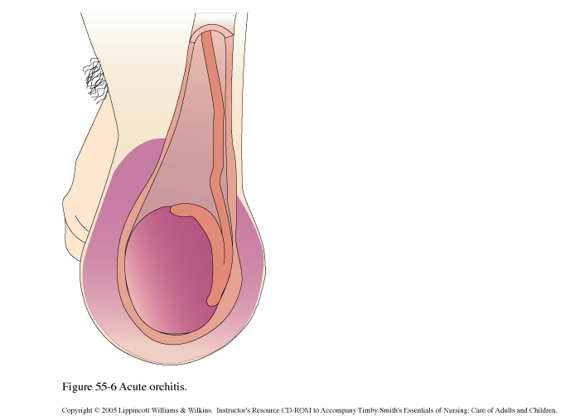
CONT..
Symptoms
Scrotal swelling
Tender, swollen, heavy feeling in the testicle
Fever
Discharge from penis
Pain with urination (dysuria)
Pain with intercourse or ejaculation
Groin pain
Testicle pain aggravated by bowel movement or straining
Blood in the semen
Treatment
Oral antibiotic, Pain medications and anti-inflammatory
Mumps vaccination

Slide 8
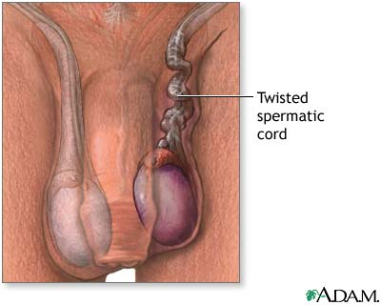
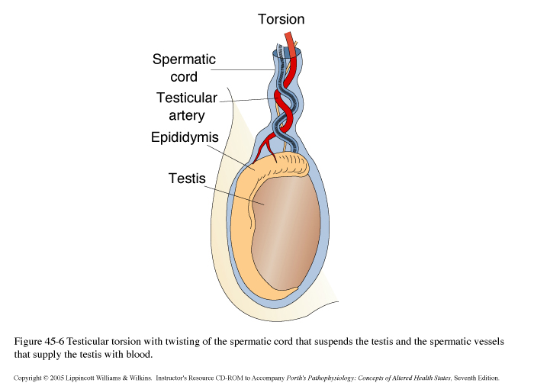
TESTICULAR TORSION
Testicular torsion is the twisting of the spermatic cord, which cuts off the blood supply to the testicle and surrounding structures within the scrotum
CAUSES:-
Inadequate connective tissue
trauma to the scrotum, particularly if significant swelling occurs.
After strenuous exercise or may not have an obvious cause.

Slide 9
CONT…
Symptoms
  Sudden onset of severe pain in one testicle.
  Swelling within one side of the scrotum
  Nausea or vomiting
  Light headedness
  Testicle lump
  Blood in Semen
Treatment:-
  Surgical correction

Slide 10
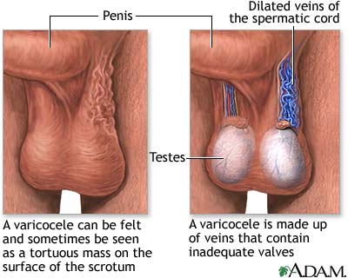
hydrocoele
A hydrocoele is a fluid-filled sack along the spermatic cord within the scrotum, generally in the tunica veginalis of the testis.
CAUSES:
During normal development, the testicles descend down a tract (tube) from the abdomen into the scrotum. Hydrocoeles result when this tube fails to close.
Hydrocoeles may also be caused by inflammation or trauma of the testicle or epididymis, or by fluid or blood obstruction within the spermatic cord. This type of hydrocoele is more common in older men.

Slide 11
CONT..
SYMPTOMS:-
Painful
Swelling
Discomfort in sitting and walking.
Hydrocoeles can be easily demonstrated by shining a flashlight through the enlarged portion of the scrotum. If the scrotum is full of clear fluid, as in a hydrocoele, the scrotum will light up.
Treatment:-
Hydrocelectomy – removal of the sac
aspiration (usually in children)
Drainage
Surgery: - The patient is advised to wear an athletic supporter postoperative for comfort and support.

Slide 12
VERICOCELE:
A vericocele is an abnormal dilation of the veins of the pampiniform venous plexus in the scrotum
Causes - the valve that regulates blood flow from the vein into the main circulatory system becomes damaged or defective. Inefficient blood flow causes enlargement (dilation) of the vein.

Slide 13
CONT..
Signs and Symptoms
Most men who have a varicocoele have no symptoms. Signs and symptoms may include the following:
Ache in the testicle
Feeling of heaviness in the testicle(s)
Infertility
Shrinkage (atrophy) of the testicle(s)
Visible or palpable (able to be felt) enlarged vein
Treatment
Asymptomatic or the symptoms are mild and infertility is not an issue, the condition can be managed by wearing an athletic supporter or snug-fitting underwear to provide the scrotum with support.
Surgery: varicocoelectomy (i.e., surgically "tying off" the affected spermatic veins).

Slide 14
Testicular cancer
Testicular cancer is the most common type of cancer in men aged 15 to 35.
There is a higher incidence in men who had or have a condition called an undescended testicle, who have fertility problems, and who've had a father with the disease

Slide 15
Symptoms include swelling and hardening of a testicle and a change in its shape or size.
Pain
Changes in the Testicles
Changes in the Lymph Nodes.
Fever
Weight Loss without Trying
Gnawing Abdominal Pain and Depression
Fatigue
Persistent Cough
Difficulty Swallowing
Changes in the Skin
Mouth Changes
Urinary Problems:-
Indigestion

Slide 16
Treatment:
Surgery:-radical inguinal orchiectomy
Chemotherapy
Radiotherapy
Adjuvant therapy which is given to patients after the surgery.
watchful surveillance. The latter includes regular checkups, scans and consultation with the doctor.

Slide 17
C.DISEASE OF PROSTATE
1.PROSTITIS
Prostatitis is an inflammation of the prostate gland, in men.
Causes - bacterial infection, E-coli is the most commonly isolated organism. Micro-organisms are usually carried to prostate from the urethra.
Other causes are Recently have had a medical instrument, such as a urinary catheter , Engage in rectal intercourse, Have an abnormal urinary tract, Have had a recent bladder infection Have an enlarged prostate

Slide 18
Diagnosis:-
  Digital rectal examination.
  Urinalysis determines the presence of white blood cells (leukocytes) in the urine
  Urine culture to identify bacteria
Symptoms: - painful urination and ejaculation, perineal discomfort, urgency, frequency. Acute bacterial infection may produce sudden fever and chills , perineal rectal and low back pain.
Treatment:-
Antibiotic, Anti-inflammatory medicines, Pain medications, Muscle relaxants.
Surgical removal of the infected portions of the prostate.
Supportive therapies for chronic prostatitis, including stool softeners and prostate massage.

Slide 19
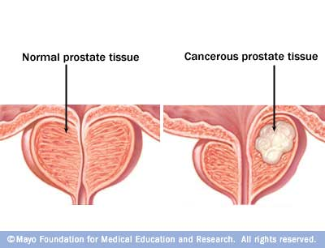
Prostate cancer
Prostate cancer is the second most common cancer in men after lung cancer
Causes:-
Prostate cancer commonly occurs in men over age 50
Twice as common in black men as it is in whites.
The likelihood of developing prostate cancer doubles if there is a family history.
High level of serum testosterone.

Slide 20
SYMPTOMS:-
Prostate cancer usually does not give rise to any symptoms.
Some prostate cancers may be found because of symptoms such as slowing or weakening of the urinary stream or the need to urinate more often. These symptoms, however, can also be caused by benign diseases of the prostate. Symptoms of advanced prostate cancer include blood in the urine, impotence, and pain in the pelvis, spine, hips, or ribs. These symptoms, again, may also be present with other diseases.
INVESTIGATION
1. Prostate-specific antigen blood test
2. Digital rectal examination
3. Transrectal ultrasound
4. The prostate biopsy
5. Serum alkaline phosphatase – increased if bone metastasis.
6. Bone scan – metastasis
7. MRI, CT scan

Slide 21
Treatment:-
‘Radical Prostatectomy'.
Hormonal therapy or removal of testis
The treatment options for organ-confined prostate cancer or locally advanced prostate cancer usually include surgery, radiation therapy, hormonal therapy, cryotherapy, combinations of some of these treatments, and watchful waiting.
A cure for metastatic prostate cancer is, unfortunately, unattainable at the present time. The treatments for metastatic prostate cancer, which include hormonal therapy and chemotherapy,

Slide 22


