Slide 1
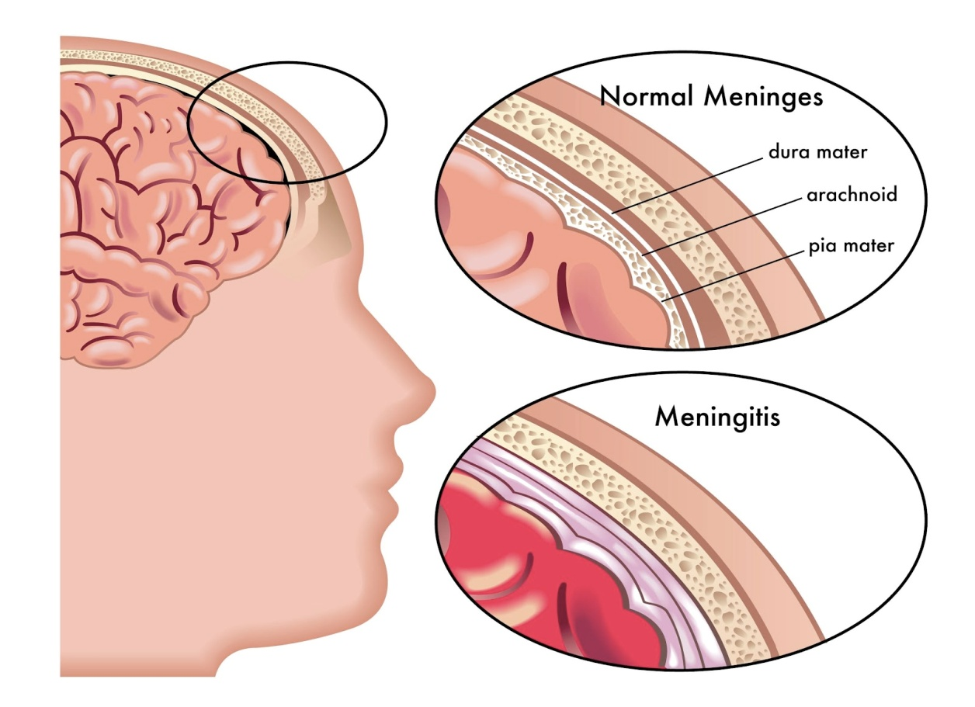
MENINGITIS
BY
MS EKTA S PATEL
ASSISTANT PROFESSOR

Slide 2
Introduction:

Slide 3
Meningitis is always cerebrospinal infection. Meningitis is a rare infection that affects the delicate membranes -- called meninges -- that cover the brain and spinal cord.
There are several types of this disease, including bacterial, viral, and fungal.
Bacterial meningitis can be life-threatening and spreads between people in close contact with each other.

Slide 4
Definition:

Slide 5
Meningitis is defined as an acute inflammation of the pia mater and the arachnoid membrane surrounding the brain and spinal cord.

Slide 6
Aetiology and risk factors:

Slide 7
Bacterial infections are the most common cause of meningitis, followed by bacterial infections and, rarely, fungal infections. Because bacterial infections can be life-threatening, identifying the cause is essential.

Slide 8
Bacterial meningitis:
Bacteria that enter the bloodstream and travel to the brain and spinal cord cause acute bacterial meningitis. But it can also occur when bacteria directly invade the meninges. This may be caused by an ear or sinus infection, a skull fracture, or, rarely, after some surgeries.

Slide 9
Several strains of bacteria can cause acute bacterial meningitis, most commonly:
Streptococcus pneumoniae (pneumococcus).
Neisseria meningitidis (meningococcus).
Haemophilus influenzae (haemophilus).
Listeria monocytogenes (listeria).

Slide 10
Viral meningitis:
Viral meningitis is usually mild and often clears on its own.
Enteroviruses, which are most common in late summer and early fall. Viruses such as herpes simplex virus, HIV, mumps, West Nile virus and others also can cause viral meningitis.

Slide 11
Chronic meningitis:
Slow-growing organisms (such as fungi and Mycobacterium tuberculosis) that invade the membranes and fluid surrounding your brain cause chronic meningitis.
Chronic meningitis develops over two weeks or more. The symptoms of chronic meningitis — headaches, fever, vomiting and mental cloudiness — are similar to those of acute meningitis.

Slide 12
Fungal meningitis:
Fungal meningitis is relatively uncommon and causes chronic meningitis. It may mimic acute bacterial meningitis.
Fungal meningitis isn't contagious from person to person. Cryptococcal meningitis is a common fungal form of the disease that affects people with immune deficiencies, such as AIDS. It's life-threatening if not treated with an antifungal medication.

Slide 13
Other meningitis causes:
Meningitis can also result from noninfectious causes, such as chemical reactions, drug allergies, some types of cancer and inflammatory diseases such as sarcoidosis.

Slide 14
Risk factors for meningitis include:
Skipping vaccinations. Risk rises for anyone who hasn't completed the recommended childhood or adult vaccination schedule.
Age. Most cases of viral meningitis occur in children younger than age 5. Bacterial meningitis is common in those under age 20.

Slide 15
Living in a community setting. College students living in dormitories, personnel on military bases, and children in boarding schools and child care facilities are at greater risk of meningococcal meningitis. This is probably because the bacterium is spread by the respiratory route, and spreads quickly through large groups.

Slide 16
Pregnancy. Pregnancy increases the risk of listeriosis — an infection caused by listeria bacteria, which also may cause meningitis. Listeriosis increases the risk of miscarriage, stillbirth and premature delivery.

Slide 17
Compromised immune system. AIDS, alcoholism, diabetes, use of immunosuppressant drugs and other factors that affect your immune system also make you more susceptible to meningitis. Having your spleen removed also increases your risk, and patients without a spleen should get vaccinated to minimize that risk.

Slide 18
Pathophysiology:

Slide 19
Microorganism and virus reach the nervous system by many routes. The most common route is blood stream and bacteria in nasopharynx may either the blood stream during upper respiratory infections.
Once the microorganisms reaches to the brain, CSF in subarachnoid space and arachnoids membrane become infected.
The infection then spreads rapidly throughout the meninges and eventually invades the ventricles.
The inflammatory response to infection tends to increases the CSF production with the moderate increase in pressure.
In the bacterial meningitis, the purulent secretions produced quickly spreads to other areas of through CSF.
Hydrocephalus may caused by exudates blocking the small passage between ventricles.
Pathological alteration includes hyperaemia of the meningeal vessels, edema of brain tissues, increase ICP and generalized inflammatory reactions with the exudation of WBC into subarachnoid.
If this process extends into the brain, parenchyma or if concurrent encephalitis is present, cerebral oedema and increase intracranial pressure become more problem.

Slide 20
Clinical manifestation:

Slide 21
Fever
Severe headache
Nausea and vomiting
Nuchal rigidity
Positive Kerning’s sign
Positive Brudzinski’s sign
Photophobia
A decreased level of consciousness
Signs of increase ICP
Coma

Slide 22
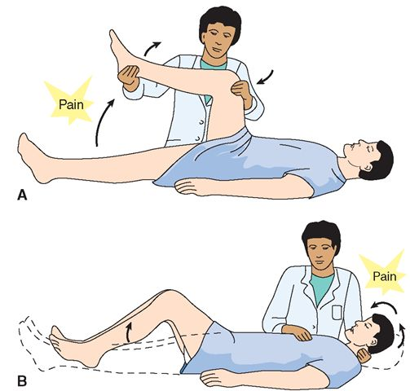

Slide 23
Diagnostic evaluation:

Slide 24
Blood cultures:
Blood samples are placed in a special dish to see if it grows microorganisms, particularly bacteria. A sample may also be placed on a slide and stained (Gram's stain), then studied under a microscope for bacteria.

Slide 25
Imaging:
Computerized tomography (CT) or magnetic resonance (MR) scans of the head may show swelling or inflammation. X-rays or CT scans of the chest or sinuses may also show infection in other areas that may be associated with meningitis.

Slide 26
Spinal tap (lumbar puncture).
For a definitive diagnosis of meningitis, you'll need a spinal tap to collect cerebrospinal fluid (CSF). In people with meningitis, the CSF often shows a low sugar (glucose) level along with an increased white blood cell count and increased protein.

Slide 27
  CSF analysis may also help your doctor identify which bacterium caused the meningitis. If your doctor suspects viral meningitis, he or she may order a DNA-based test known as a polymerase chain reaction (PCR) amplification or a test to check for antibodies against certain viruses to determine the specific cause and determine proper treatment.

Slide 28
Management:

Slide 29
The assessment and management of meningitis should be approached through a team effort with nursing, infectious diseases specialists, neurology, internal medicine, and otolaryngology specialists, and laboratory and diagnostic staff.

Slide 30
Most patients are given I.V. antibiotics until the laboratory findings determine the type of meningitis (eg, viral, bacterial). However, cultures should be taken before initiating antibiotics.

Slide 31
To manage inflammation, dexamethasone (Decadron) or another corticosteroid is given I.V.
  This may result in GI bleeding and mask clinical responses to treatments (eg, resolved fever).
  This steroid should be used before or with the first dose of antibiotics (I.V. 0.6 mg/kg/day in four divided doses for the first 4 days of antibiotics), and should be confined to patients older than age 6 weeks.
  Plasmapheresis may be used experimentally to remove cytokines in some cases.

Slide 32
Temozolomide (Temodar), a second-generation alkylating agent, is effective against many cancers that result in neoplastic meningitis. External beam radiation may be used in conjunction with chemotherapy (eg, intrathecal thiotepa or methotrexate).

Slide 33
Cochlear implantation rehabilitation due to deafness caused by meningitis should be considered. Realistic goals must be set, as the patient may develop only environmental sound awareness and still have to deal with learning disabilities.

Slide 34
If meningitis is suspected after neurosurgical procedures, potential I.V. line bacteremia, CSF leak, or immunosuppression, therapy is also indicated for S. aureus and gram-negative bacilli.

Slide 35
Antifungal agents, such as amphotericin B (Fungizone) and the triazoles, fluconazole (Diflucan) and itraconazole (Sporanox), are indicated for cryptococcal meningitis. Relapse is common if the patient does not have chronic suppressive therapy with fluconazole or another antifungal agent.

Slide 36
Empiric antituberculosis drugs must be initiated if infection by Mycobacterium tuberculosis is suspected.

Slide 37
Complications:

Slide 38
Bacterial meningitis, particularly in children, may result in deafness, learning difficulties, spasticity, paresis, or cranial nerve disorders.
Increased ICP in AIDS patients with cryptococcal meningitis has resulted in severe visual losses.

Slide 39
Seizures occur in 20% to 30% of patients.
Increased ICP may result in cerebral edema, decreased perfusion, and tissue damage.
Severe brain edema may result in herniation or compression of the brain stem.
Purpura may be associated with disseminated intravascular coagulation.

Slide 40
Nursing Assessment:

Slide 41
Obtain a history of recent infections such as upper respiratory infection, and exposure to causative agents.
Assess neurologic status and vital signs.
Evaluate for signs of meningeal irritation.
Assess sensorineural hearing loss (vision and hearing), cranial nerve damage (eg, facial nerve palsy), and diminished cognitive function.

Slide 42
Nursing Diagnoses:

Slide 43
Hyperthermia related to the infectious process and cerebral edema
Risk for Imbalanced Fluid Volume related to fever and decreased intake
Ineffective Tissue Perfusion (cerebral) related to infectious process and cerebral edema
Acute Pain related to meningeal irritation
Impaired Physical Mobility related to prolonged bed rest.

Slide 44
Nursing Interventions:

Slide 45
Reducing Fever:
Administer antimicrobial agents on time to maintain optimal blood levels.
Monitor temperature frequently or continuously, and administer antipyretics as ordered.
Institute other cooling measures, such as a hypothermia blanket, as indicated.

Slide 46
Maintaining Fluid Balance:
Prevent I.V. fluid overload, which may worsen cerebral edema.
Monitor intake and output closely.
Monitor CVP frequently.

Slide 47
Enhancing Cerebral Perfusion:
Assess LOC, vital signs, and neurologic parameters frequently. Observe for signs and symptoms of ICP (eg, decreased LOC, dilated pupils, widening pulse pressure).
Maintain a quiet, calm environment to prevent agitation, which may cause an increased ICP.

Slide 48
Prepare patient for a lumbar puncture for CSF evaluation, and repeat spinal tap, if indicated. Lumbar puncture typically precedes neuroimaging (see page 471).
Notify the health care provider of signs of deterioration: increasing temperature, decreasing LOC, seizure activity, or altered respirations.

Slide 49
Reducing Pain:
Administer analgesics as ordered; monitor for response and adverse reactions. Avoid opioids, which may mask a decreasing LOC.
Darken the room if photophobia is present.
Assist with position of comfort for neck stiffness, and turn patient slowly and carefully with head and neck in alignment.
Elevate the head of the bed to decrease ICP and reduce pain.

Slide 50
Promoting Return to Optimal Level of Functioning
Implement rehabilitation interventions after admission (eg, turning, positioning).
Progress from passive to active exercises based on the patient's neurologic status.

Slide 51
Community and Home Care Considerations

Slide 52
Prevent bacterial meningitis by eliminating colonization and infection with the offending organism.
  Administer vaccines against H. influenzae type B for children; N. meningitidis serogroups A, C, Y, and W135 for patients at high risk (especially college students, those without spleens, immunodeficient); and S. pneumoniae for patients with chronic illnesses and the elderly.

Slide 53
  Administer vaccines for travelers to countries with a high incidence of meningococcal disease and household contacts of someone who has had meningitis.
  Chemoprophylaxis for meningococcal disease, most commonly with rifampin, may be necessary for health care workers, household contacts in the community, day care centers, and other highly susceptible populations.

Slide 54
If maintenance antifungal prophylaxis is initiated for patients with low CD4⁺ counts, as seen in some patients with AIDS, the patient must understand the importance of long-term pharmacologic therapy.

Slide 55
Patient Education and Health Maintenance:

Slide 56
Advise close contacts of the patient with meningitis that prophylactic treatment may be indicated; they should check with their health care providers or the local public health department.
Encourage the patient to follow medication regimen as directed to fully eradicate the infectious agent.
Encourage follow-up and prompt attention to infections in future.

