Slide 1


Quality Assurance In
Nursing
Mr. Jitendra .S
Department of Medical Surgical Nursing
Sumandeep Nursing College

Slide 2
Definitions
QUALITY
“Quality is defined as the degree to which health services for the individuals and populations increase the likelihood of the desired health outcomes and are consistent with current professional knowledge”.
-Joint Commission on Accreditation of Healthcare Organizations (2002)
“Quality of a service is defined as the totality of features and
characteristics of a service that bear on its ability to satisfy the stated and implied needs of the patients.”
-International Organization for Standardization (ISO 8402)

Slide 3

Definitions
QUALITY ASSURANCE
“Quality Assurance is an on-going, systematic comprehensive evaluation of health care services and the impact of those services on health care services.
- Kozier.
Quality assurance is defined as all activities undertaken to predate and prevent poor quality.
-Neetvert(1992)

Slide 4
KEY TERMS RELATED TO QUALITY ASSURANCE
Quality improvement
Total Quality Management/ Continuous Quality Improvement
Quality Control
Quality circles

Slide 5
OBJECTIVES OF QUALITY ASSURANCE
According to Jonas (2000), the two main objectives are;
To ensure the delivery of quality client care
To demonstrate the efforts of the health care providers to provide the best possible results

Slide 6
Other specific objectives are;
Formulate plan of care
Attend the patients physical and non-physical needs
Evaluate achievement of nursing care
Support delivery of nursing care with administrative and managerial services

Slide 7

PRINCIPLES OF QUALITY ASSURANCE
Customer focus
Leadership
Involvement of people
Process approach
System approach to management
Continual improvement
Factual approach to decision making
Mutually beneficial supplier relationship

Slide 8

COMPONENTS OF QUALITY ASSURANCE
STRUCTURE EVALUATION
PROCESS EVALUATION
OUTCOME EVALUATION

Slide 9
QUALITY ASSURANCE PROCESS
1.
2.
3.
4.
5.
criteria
Establishment of standards or criteria
Identify the information relevant to criteria Determine ways to collect information Collect and analyze the information
Compare collected information with established

Slide 10
Cont..
Make a judgment about quality
Provide information and if necessary, take corrective action regarding findings of appropriate sources
Determine ways to collect the information

Slide 11





MODELS OF QUALITY ASSURANCE

Slide 12
1. System Model
Input
Throughput
Output
Feedback

Slide 13
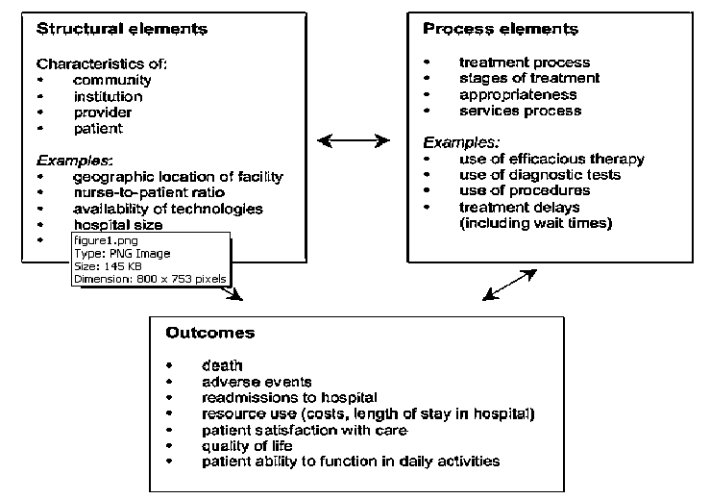
Donabedian Model
13

Slide 14
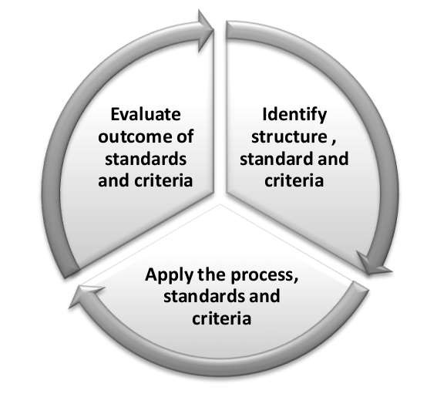
ANA Quality Assurance Model

Slide 15


Plan, Do, Study, Act cycle

Slide 16

LEVELS OF EVALUATION OF QUALITY OF CARE
National Level
Trust or organization level
Local Level

Slide 17

APPROACHES OF QUALITY IMPROVEMENT
General Approaches
Credentialing
Licensure
Accreditation
Certification
Charter
Academic Degrees

Slide 18
Cont…
Specific Approaches
Peer Review Committees (Staff Review Committees)
Standard as a device for quality assurance

Slide 19

FACTORS AFFECTING QUALITY ASSURANCE IN NURSING PRACTICE
Lack of resources
Personnel problem
Improper maintenance
Unreasonable patients and attendants
Absence of well-informed population
Absence of accreditation laws
Lack of incident review procedure

Slide 20
cont
Lack of good hospital information system
Absence of patient Satisfaction Surveys
Lack of nursing care research
Miscellaneous Factors

Slide 21
BARRIERS OF QUALITY IMPROVEMENT EFFORTS
The Nurse Manager might become pre occupied with quality assessment
It is impossible to identify all factors that influence nursing care quality.
Difficulty in defining outcome criteria that result solely from nursing intervention
Nurse’s documentation of care measures is at times
vague, incomplete and lacking in objectivity
There is still no single, all purpose, all site quality assessment tool that is universally appropriate for all health agencies.
High cost

Slide 22

ROLE OF NURSES IN QUALITY ASSURANCE
Nurses are the active participant of interdisciplinary quality improvement team
Develop mechanism for continually monitoring the effectiveness of nursing care both a collaborative and an individual professional activity.
Contribute innovations and improvement of
patient care
Participating in improvement projects and patient safety initiatives
•
•
•

Slide 23
Cont….
Participate continuing educational programs and in- service educational programs for continuing professional development
Periodic and continuing appraisal and evaluation of health care situation of the patient
Participate research works related to quality assurance Identify any area of needed improvement in delivery of
care.
•
•
•

Slide 24

Thank you
24

