Slide 1
PULMONARY
EMBOLISM

Slide 2
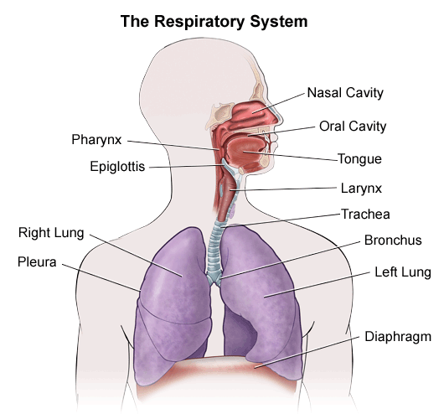
ANATOMY AND PHYSIOLOGY OF RESPIRATORY SYSTEM

Slide 3
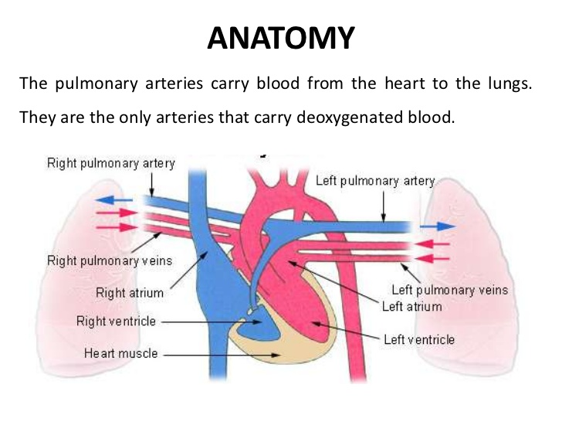

Slide 4
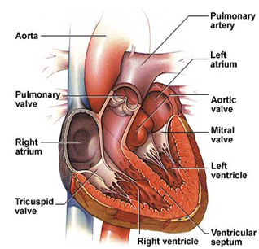

Slide 5
INTRODUCTION OF PULMONARY EMBOLISM
Pulmonary embolism (PE) refers to the obstruction of the pulmonary artery or one of its branches by a thrombus (or thrombi) that originates somewhere in the venous system or in the right side of the heart. Most commonly, pulmonary embolism is due to a blood clot or thrombus.

Slide 6
DEFINITION-
Pulmonary embolism is a sudden blockage in a lung artery. The blockage usually due to a blood clot that traveled to the lungs from a vein in the leg.

Slide 7
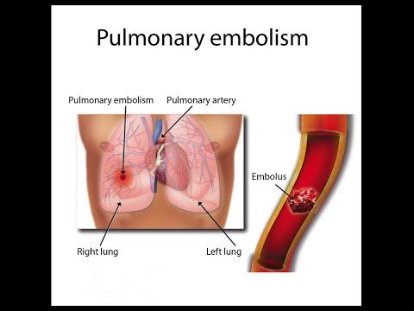

Slide 8
EMBOLUS
a clot that forms in one part of the body and travels in the bloodstream to another part of the body is called embolus

Slide 9
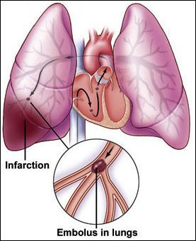

Slide 10
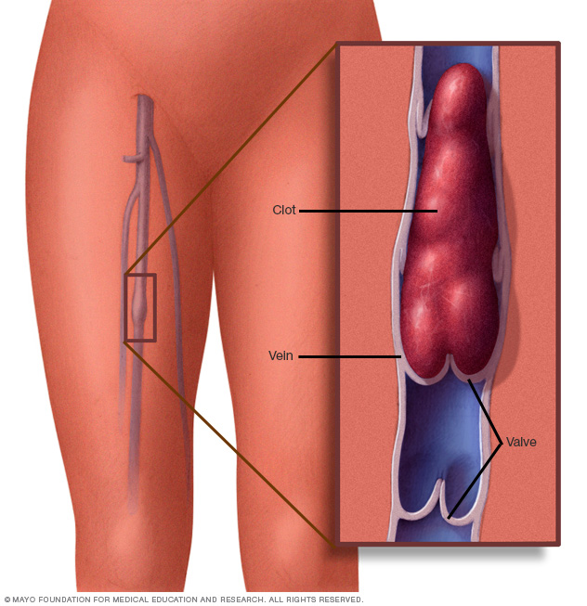

Slide 11
PATHOPHYSIOLOGY
Pulmonary embolus
Pulmonary artery obstruction
Increased PA pressure and RV pressure
Increased RV dilation
Decreased RV dysfunction

Slide 12
Continue….
Decreased RV dysfunction
Decreased RV Out put
Tissue edema

Slide 13
CONTINUE
Decreased RV dysfunction
Decreased left ventricle preload
Decreased cardiac output
Systemic hypotension

Slide 14
SIGN AND SYMPTOM
Chest pain And shortness of breath.
Anxiety or apprehension
Cough : Usually, this cough is dry, but it may be associated with blood.
Sweating.
Low levels of oxygen in the blood.
Loss of consciousness.
Cyanosis
Elevated heart rate

Slide 15
DIAGNOSTIC EVALUTION
History of physical examination
Chest x-ray
Electrocardiogram
Echocardiogram
MRI(magnetic resonance imaging)
Ultrasound ( venous Doppler study)
Pulmonary angiogram
D-dimer blood test
Computerized tomography

Slide 16
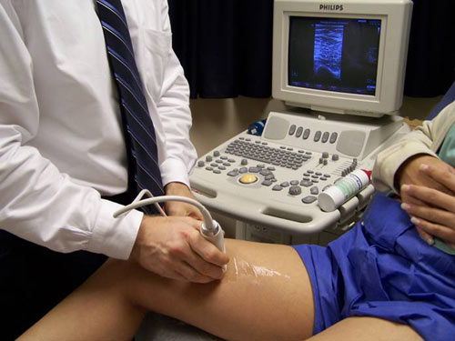

Slide 17
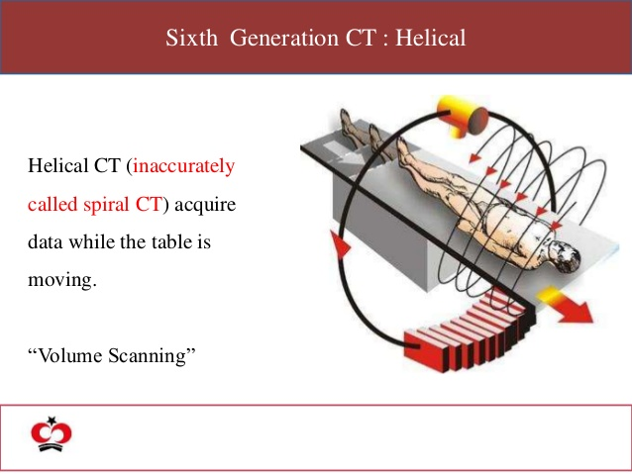

Slide 18
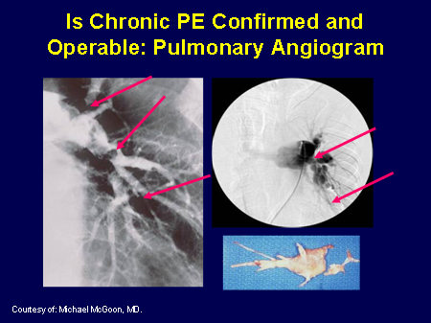

Slide 19
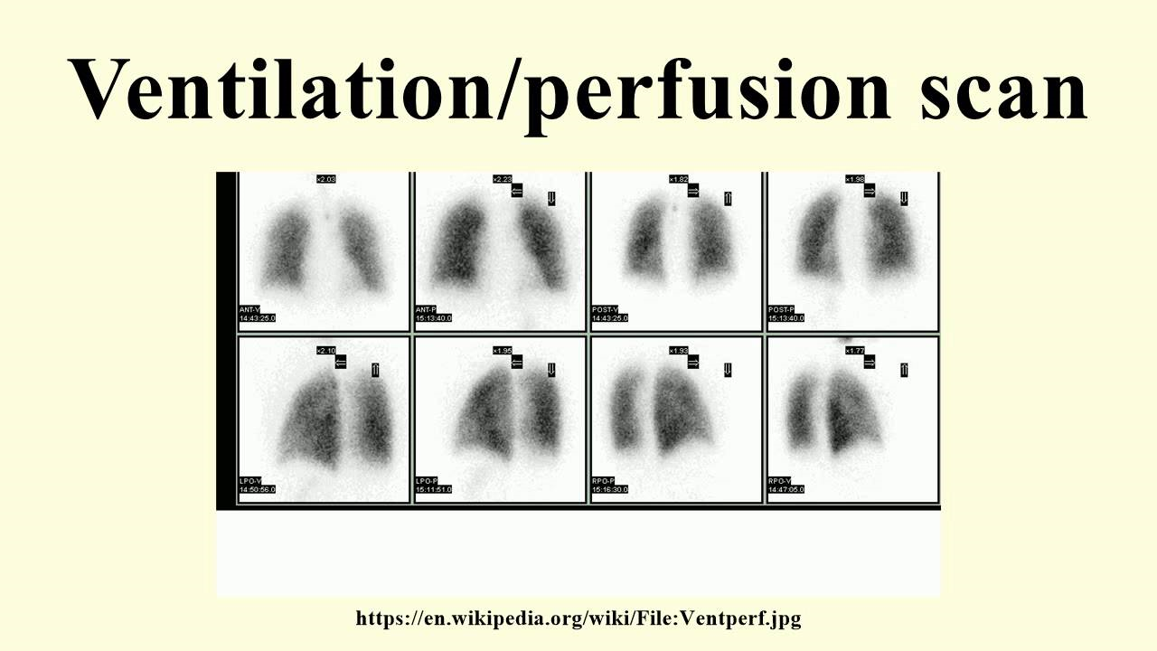

Slide 20
MEDICAL MANAGEMENT
• Anticoagulation therapy
Heparin
Enoxaparin
Warfrin
• Thrombolytic therapy

Slide 21
SURGICAL MANAGEMENT
Embolectomy
Inferior vena cava filter

Slide 22
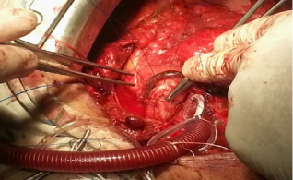

Slide 23
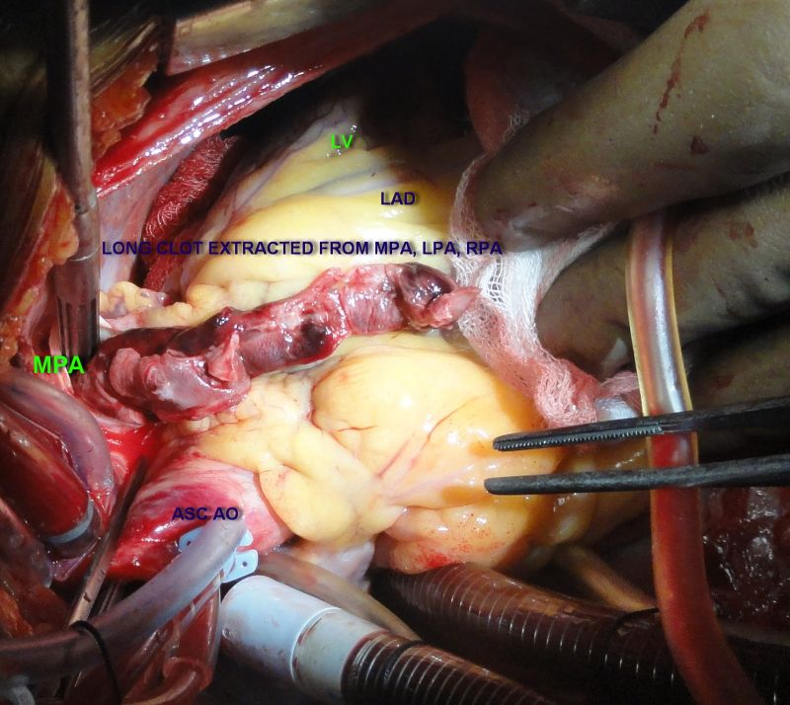

Slide 24
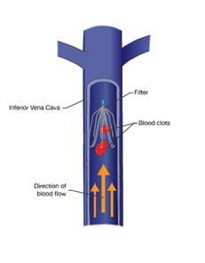

Slide 25
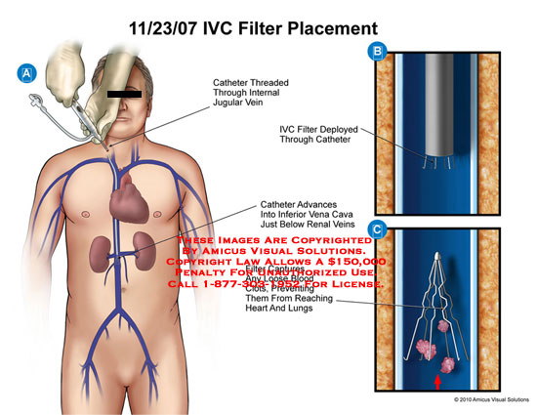

Slide 26
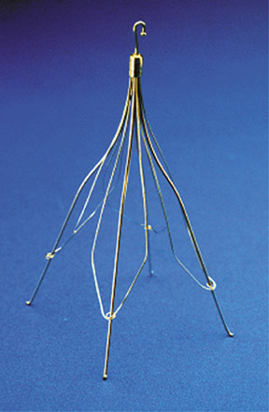

Slide 27
NURSING MANAGEMENT
Minimizing the risk of pulmonary embolism
Preventing thrombus formation
Assessing potential for pulmonary embolism.
Monitoring thrombolytic therapy
Managing pain
Managing oxygen therapy
Relieving anxiety
Monitoring for complications
Providing post operative nursing care

Slide 28
PULMONARY EMBOLISM PREVENTION
Graduated compression stockings.
Use of pneumatic compression
Physical activity
Drink plenty of fluid.

Slide 29
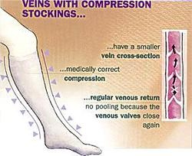

Slide 30
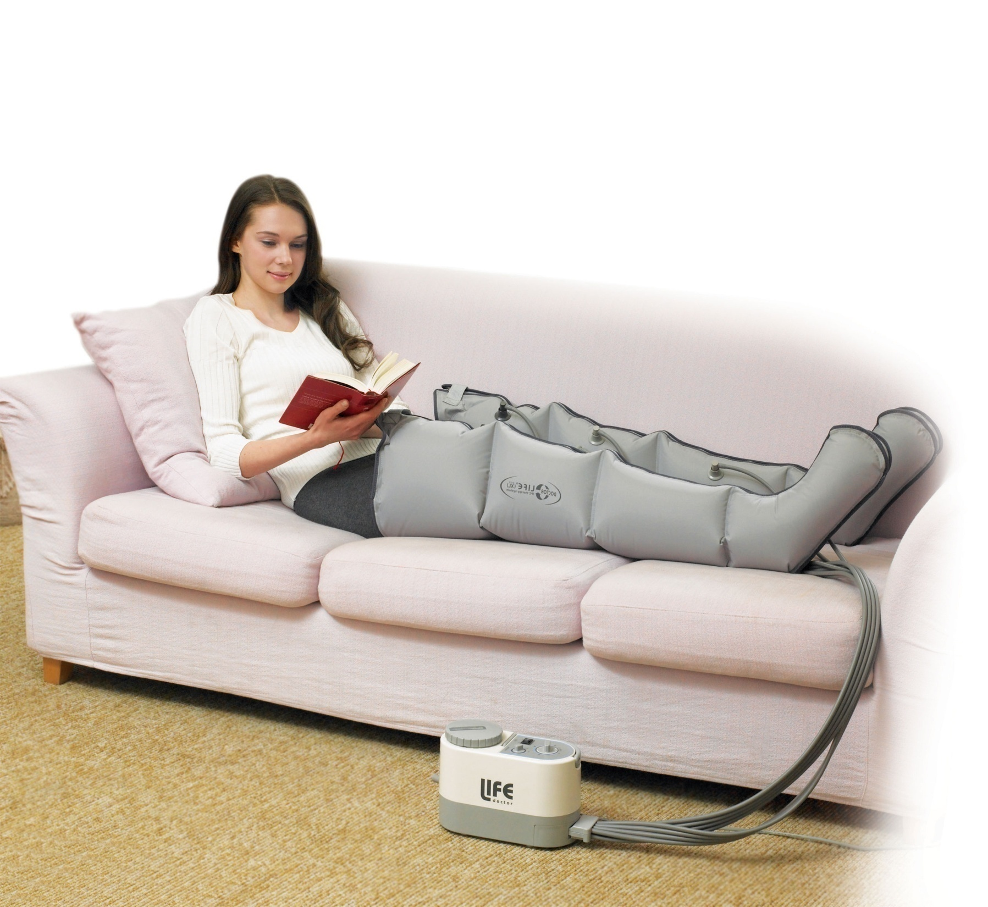

Slide 31
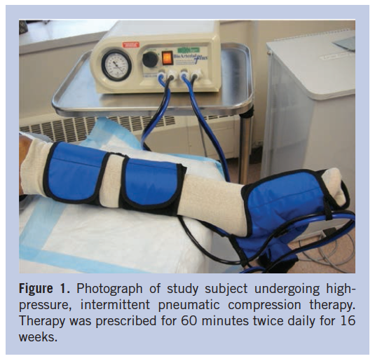

Slide 32
PROGNOSIS
Some people may die immediately when a blood clot breaks loose and goes to the lung. Still others die in a short time period because of inability to get oxygen into the blood or from blood pressure collapse.

Slide 33
summary
At the end of lecture student will be understand about
Anatomy physiology of respiratory system
Definition of pulmonary embolism
Causes of pulmonary embolism
Pathophysiology of pulmonary embolism
Sign and symptom of pulmonary embolism
Medical surgical & nursing management of pulmonary embolism.
Prevention and prognosis of pulmonary embolism.

Slide 34
Assignment-
Write any two nursing diagnosis with intervention of pulmonary embolism disease.

Slide 35

Thank you

