Slide 1

QUALITY ASSURANCE IN ICCU AND ICTU

Slide 2
INTRODUCTION
Quality assurance is a management system designed to give maximum guarantee and ensure confidence that the service provided is upto the given accepted level of quality, the standards prescribed for that service which is being achieved with a minimum of total expenditure.

Slide 3
DEFINITIONS
“Quality is defined as the degree to which health services for the individuals and populations increase the likelihood of the desired health outcomes and are consistent with current professional knowledge.”
-Joint Commission on Accreditation of Healthcare Organizations (2002)

Slide 4
“Assurance is statement or indication that inspires confidence.”
“Quality Assurance is an on-going, systematic comprehensive evaluation of health care services and the impact of those services on health care services.”
-Kozier.

Slide 5
KEY TERMS RELATED TO QUALITY ASSURANCE
Quality improvement
Total Quality Management/ Continuous Quality Improvement
Quality Control
Quality circles

Slide 6
OBJECTIVES OF QUALITY ASSURANCE
• To ensure the delivery of quality client care in ICU.
• To demonstrate the efforts of the health care providers to provide the best possible results.
To ensure the delivery of quality client care in ICU.
To demonstrate the efforts of the health care providers to provide the best possible results
To prevent hospital acquired infections in ICU.
To prepare staff nurse for implementation quality assurance model in nursing in ICU.
To evaluate achievement of nursing care in ICU.

Slide 7
PRINCIPLES OF QUALITY ASSURANCE
1. Customer focus:-
It focuses on patient’s care with standard & recent medical knowledge.
2. Leadership:-
It helps to inculcate qualities of leadership in staff.
3. Involvement of people:-
It should involve maximum nursing staff so that standards can be maintained.

Slide 8
4. Process approach:-
There should be a systematic & planned approach to provide quality care.
5. Factual approach to decision making:-
There should be fact or appropriate reason in taking certain decision for quality assurance of patient.
6. System approach to management
7. Continual improvement
8. Mutually beneficial supplier relationship

Slide 9
PLANNING AND ORGANIZATION OF ICCU/ICTU
1.DECISION MAKING
The planning committee will take the following decisions :
Critical care need of the hospital.
Type and size of the ICU.
Appointment of ICU in charge.
Appointment of ICU Matron.
Planning, designing and physical facilities.
Guide lines, policies and procedure in ICU functioning.
2.PRE-REQUISITE
Training of Nursing and Medical Staff
Procurement of beds and equipments
Developing protocols for monitoring and life support techniques
Training of supporting staff
Commissioning and opening

Slide 10
3.LOCATION:
Should be centrally located with easy access to emergency and other wards, OT and OPD.
Easily approachable
Away from general hospital traffic.
Restricted entry
4.SIZE:
Size of ICU depends on the type of services provided.
In super specialty hospital 10% of the total beds.
In general hospitals 2% of hospital beds.
Optimum size is 14 beds, minimum 4 beds.
If no. of beds required is more than 14, two ICUs be opened. Ideal ICU is 10 bedded.

Slide 11
5.LAY OUT DESIGNING
Circular placement of beds with Central Nursing Station
Rectangular with Central Monitoring System.
Semi circular with monitoring station at the front.
The lay out design depends on the availability of space.
6.BED SPACE
Sufficient space is required for each bed for free movement and keeping ventilator, monitoring system and other equipments.
They are required for each bed 100-120 sq ft in open ICU and 140-180 sq ft in cubicle.
Minimum 15 sq ft of clear area.
Head wall space 1-2 feet.
Space between two beds 5- 8 ft.
The cubicles must have glass partitions or transparent curtains for clear observation from monitoring station.

Slide 12
7.BED HEAD FIXTURES AND CALL BELL SYSTEM
High intensity spot light connected to generator.
Wall panels and call button near the bed.
Sufficient electric sockets for plugging.
Wall suction tubes and piped oxygen supply.
Small Wash Basin
No extension wire to be used.
Equipments with CV stabilizer/ UPS.
8.EQUIPMENTS
Ventilators, fluids stand
Defibrillator, pulse oximeter
Monitor and minor procedure trolley
Infusion pump, bop and dialysis machine

Slide 13
9.NURSING STATION
Central Monitoring System
Counter, case records and essential drugs
Complete visibility of all patients
Two way communication/ paging/ intercom system
10.AUXILLARY AREA
The working area is equal to total bed area and separated by clean corridor from patient area. This area has the 14 sq yards area comprises of
Washing, utility area
Securable Cabinets for staff room
Clean Supply Room
Work room with separate sink
Toilet, dirty utility
X-ray viewing, special examination/ procedure 24 hours lab, radiology and pharmacy

Slide 14
11.ANCILLARY AREA
Office space and record room
Staff lounges, toilets
Telephone Facility
Staff Rest Room
Janitor’s Room
ICU Matron’s Office
12.MEDICAL ENVIRONMENT
ICU must be air conditioned
Temp. maintained at 25 0 – 27 0 C & 40-50 % humidity.
Plenty of sunlight, large windows
Filters less than 10 microns
Positive pressure flow from patient area to outside
Proper Lighting
Provision of dimmer lights

Slide 15
13.STAFF REQUIRED PER SHIFT
NURSING STAFF:
Ideally 1:1 ratio during day and 1:2 during night
Broadly 4 to 5 nurses per bed including reliever
One ANS for administration
MEDICAL STAFF:
One physician per 5 beds
Consultant ICU - One
Senior Resident - Two
Junior Resident - Two Per Shift
TECHNICAL STAFF:
Respiratory Therapist - One
Physiotherapist - One
ICU Technician - One
Lab. Technician - One
OT Assistant – One
Safety Officer – One Per Shift
ANCILLARY STAFF:
Receptionist - One
Ward Boys – Four
Stretcher Bearer - Two
Safaiwala - TwoPer Shift

Slide 16
14.ADMISSION CRITERIA
There should be fixed admission criteria for admission.
Priority to be given to the patients, who have fair chance of reversible condition or chances of improvement.
15.TREATMENT POLICY
Responsibility lies with the in charge of unit admitting the case.
A vacant bed is allocated in original ward for patient return.
No direct admission to ICU but transferred from unit.
Admission only on recommendation of ICU director subjected to available of bed.
20% beds to be kept vacant for emergency admission.
Continuity of treatment is the per view of ICU in charge in consultation with unit in charge.

Slide 17
16.POLICIES AND PROCEDURES
Standard treatment protocol to be followed.
Silence to be observed
All new admission/ discharge to be informed to ICU in charge.
All admissions/ discharges to be registered
17.STAFF STANDING ORDER
Joint round at the time of shift change and proper handing/ taking.
Instruction and maintenance of input- output chart.
Cleaning and maintenance of equipments.
Checking and replacement of essential drugs.
Proper maintenance of records.
Daily round of physician and I/c ICU combined to take decision for change in treatment.

Slide 18
18.DISCHARGE POLICY
Decision to discharge is taken in consultation with in- charge parent unit.
Patients who have recovered, stable and does not require artificial ventilation can be shifted to intermediate care or high dependency area.
Patient who are not progressing and chances of recovery is remote to be discharged for allotting bed to patient having fair chance of recovery when demand is acute.
When there is no demand, patient is kept in ICU till death .

Slide 19
QUALITY INDICATORS/PARAMETERS OF ICCU/ICTU
Efficiency of any healthcare unit is judged by its quality indicators. However in our country monitoring the outcome through quality indicators is not yet institutionalized because of many reasons including the fact that majority of ICUs in India are being run as open or semi closed units, with unaccountable custodians.

Slide 20
Length of Stay (LOS)
Medication error
Decubitus (Pressure) ulcer
Compliance to protocol
ICU readmission
Patients' Fall
Adverse Events
Needle Stick Injury
Reintubation Rate
Ventilator Associated Pneumonia (VAP)
Blood Stream Infection Due to Central Line
Urinary Catheter Related Infection
Iatrogenic pneumothorax
Incidence of severe Acute Renal Failure
Overall Employee Satisfaction
Patient Satisfaction

Slide 21
OTHER QUALITY INDICATORS OF ICCU/ICTU
Compliance with hand hygiene protocols
Providing information to families of patients in the ICU
Appropriate sedation
Appropriate pain management
Early enteral nutrition
Sepsis prevention
Prophylaxis for GI bleed in those undergoing invasive mechanical ventilation
Inappropriate transfusion of packed cells
Semirecumbent position for patients on invasive mechanical ventilation

Slide 22
Ventilator associated pneumonia
Prevention of thromboembolism
Early administration of acetyl salicylic acid in acute coronary syndrome
Early reperfusion therapy in STEMI
Monitoring ICP in severe traumatic brain injury with CT findings
Surgical intervention in traumatic brain injury with subdural and/or epidural hematoma
Protocols and implementation of withholding / withdrawing life support
Organ donation
Perceived Quality Survey at discharge from ICU
Presence of an intensivist in the ICU
Maintaining an adverse events register

Slide 23
CLINICAL MANAGEMENT BUNDLES IN ICCU/ICTU
“A bundle is a group of evidence-based care components for a given disease that, when executed together, may result in better outcomes than if implemented individually.”

Slide 24
BUNDLE IN CRITICAL CARE UNIT
Ventilator Bundle
Central Line Bundle
Severe Sepsis Bundles

Slide 25
VENTILATOR BUNDLE
DVT prophylaxis
GI prophylaxis
Head of bed (HOB) elevated to 30-45°
Daily Sedation Vacation
Daily Spontaneous Breathing Trial

Slide 26
CENTRAL LINE BUNDLE
Hand Hygiene
Maximal Barrier Precautions Upon Insertion
Chlorhexidine Skin Antisepsis
Optimal Catheter Site Selection, with
Avoidance of the Femoral Vein
Daily Review of Line Necessity with Prompt
Removal of Unnecessary Lines

Slide 27
SEVERE SEPSIS BUNDLES
1) Measure lactate level
2) Obtain blood cultures prior to administration of antibiotics
3) Administer broad spectrum antibiotics
4) Administer 30 mL/kg crystalloid for hypotension or lactate
4 mmol/L
5) Apply vasopressors (for hypotension that does not respond to
initial fluid resuscitation
to maintain a mean arterial pressure [MAP] 65 mm Hg)
6) In the event of persistent arterial hypotension despite volume
resuscitation (septic shock) or initial lactate ≥ 4 mmol/L (36 mg/dL):
-Measure central venous pressure (CVP)
-Measure central venous oxygen saturation (ScvO2)

Slide 28
COMPONENTS OF QUALITY ASSURANCE
STRUCTURE
EVALUATION
PROCESS
EVALUATION
OUTCOME
EVALUATION

Slide 29
Structure: This includes architectural design, staffing, nurse: patient ratio, bed occupancy and all other components of structure related to quality.
Process refers to the current practice of care delivery, hand washing and implementation of other guidelines.
Outcome: Indicators of outcome such as nosocomial infection rates, mortality stratified to severity of illness and other outcome measures are the most valuable and readily recognised indicators of quality.

Slide 30
QUALITY ASSURANCE PROCESS
Establishment of standards or criteria.
Identify the information relevant to criteria.
Determine ways to collect information.
Collect and analyze the information.
Compare collected information with established criteria.
Make a judgment about quality.
Provide information and if necessary, take corrective action regarding findings of appropriate sources.
Determine ways to collect the information.

Slide 31
MODELS OF QUALITY ASSURANCE
1) GENERAL SYSTEM MODEL
Input
Throughput
Output
Feedback

Slide 32
2) DONABEDIAN MODEL
STRUCTURE
PROCESS
OUTCOME

Slide 33

3) ANA QUALITY ASSURANCE MODEL

Slide 34
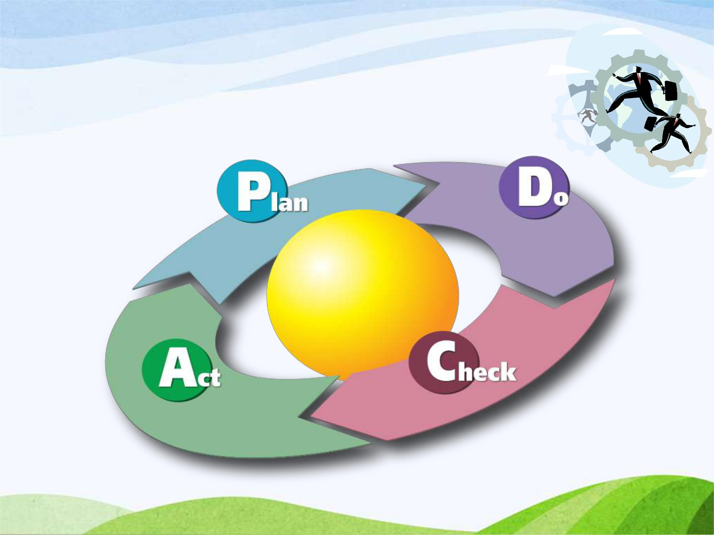
4) PLAN, DO, CHECK, ACT CYCLE

Slide 35
LEVELS OF EVALUATION OF QUALITY OF CARE
National Level
Trust or organization level
Local Level

Slide 36
APPROACHES OF QUALITY IMPROVEMENT
1.GENERAL APPROACHES
It involves large governing or official bodies evaluating a person or agencies ability to meet established criteria or standard during a given time.

Slide 37
Credentialing:- It is the formal recognition of professional or technical competence and attainment of minimum standards by a person and agency.
Licensure:- It is a contract between the profession and the state in which the profession is granted control over entry into an exit from the profession and over quality of professional practice.
Accreditation:- It is a process in which certification of competency, authority or credibility is presented to an organization with necessary standards.
Charter:- It is a mechanism by which a state government agency under state law grants corporate state to institutions with or without right to award degrees.
Recognition:- It is defined as a process whereby one agency accepts the credentialing states of and the credential by another.

Slide 38
2.SPECIFIC APPROACHES
These are methods used to evaluate identified instances of provider and client interactions.

Slide 39
Audit:- It is an independent review conducted to compare some aspect of quality performance, with a standard for that performance.
Direct observation:-Structured or unstructured based on presence of set criteria.
Appropriateness evaluation:-The extent to which the managed care organization provides timely, necessary care at right levels of service.
Peer review:- Comparison of individual provider’s practice either with practice by the provider’s peer or with an acceptable standard of care.

Slide 40
Bench marking:- A process used in performance improvement to compare oneself with best practice.
Services:- Evaluates care delivered by an institution rather than by an individual provider.
Staging:- It is the measurement of adverse outcomes and the investigation of its antecedence.
Sentinal:- It involves maintaining of factors that may result in disease, disability or complications.

Slide 41
FACTORS AFFECTING QUALITY ASSURANCE IN NURSING PRACTICE
Lack of resources
Personnel problem
Improper maintenance
Unreasonable patients and attendants
Absence of well-informed population
Absence of accreditation laws
Lack of incident review procedure
Lack of good hospital information system
Absence of patient Satisfaction Surveys
Lack of nursing care research
Miscellaneous Factors

Slide 42
BARRIERS OF QUALITY IMPROVEMENT EFFORTS
The Nurse Manager might become pre occupied with quality assessment.
It is impossible to identify all factors that influence nursing care quality.
Difficulty in defining outcome criteria that result solely from nursing intervention.
Nurse’s documentation of care measures is at times vague, incomplete and lacking in objectivity.
There is still no single, all purpose, all site quality assessment tool that is universally appropriate for all health agencies.
High cost.

Slide 43
ROLE OF NURSES IN QUALITY ASSURANCE
Nurses are the active participant of interdisciplinary quality improvement team.
Develop mechanism for continually monitoring the effectiveness of nursing care both a collaborative and an individual professional activity.
Contribute innovations and improvement of patient care.
Participating in improvement projects and patient safety initiatives.

Slide 44
Participate continuing educational programs and in-service educational programs for continuing professional development.
Periodic and continuing appraisal and evaluation of health care situation of the patient.
Participate research works related to quality assurance.
Identify any area of needed improvement in delivery of care.

Slide 45
SPECIFIC NURSING MANAGEMENT OF PATIENTS IN ICCU/ICTU
Respiratory care
Cardiovascular care
Gastrointestinal / nutritional care
Neuromuscular care
Comfort and reassurance
Communication with the patient
Venous thrombosis prophylaxis
Infection control
Skin care, general hygiene and mouth care
Fluid electrolytes and glucose balance
Bladder care
Dressing and wound care
Communication with relatives

Slide 46
SUMMARY

Slide 47

THANK YOU

