Slide 1


COGNITIVE BEHAVIOUR
THERAPY
Prepared by:
Mrs. Bhoomika Patel
Assistant Professor
Department of Mental health nursing
Sumandeep Nursing college

Slide 2
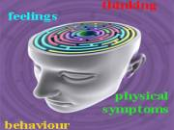
Cognitive behaviour therapy

Slide 3

Cognitive behaviour therapy
Cognitive
Relating to the mental processes of thinking and reasoning.

Slide 4


Introduction:
1960s research on depression conducted by Aaron Beck (1963; 1964).

Slide 5

Definitions
“it is a psycho therapeutic approach that aims to solve the cognitive and behavioural problems.”
“it is the type of psychotherapeutic treatment that helps patients understands the thoughts and feelings that influence the behaviour.”

Slide 6


Conti....
Cognitive therapy is a type of psychotherapy based on the concept of pathological mental processing. The focus of treatment is on the modification of distorted cognitions and maladaptive behaviours.”
It is a form of treatment that focus on examining the relationships between thoughts, feeling and behaviour.”

Slide 7

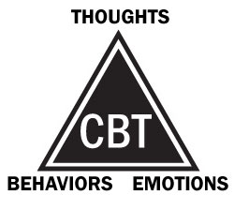

Concept

Slide 8
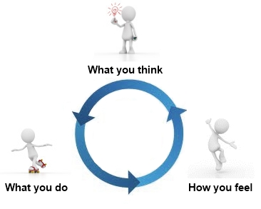
Conti…

Slide 9

example,
situation (See a dog )
Thoughts (that dog will bite me!)
Behaviors Feelings
(Afraid) (Run away)

Slide 10

example,
situation (See a dog )
Thoughts (What a nice dog! )
Behaviors Feelings
(Happy) (Pet the dog)

Slide 11
Principles and Elements of CBT
Brief and Time Limited
Present Centered
Thought Focused
Practice and Homework
Sound Therapeutic Relationship

Slide 12

Indications
anxiety
Depression
panic,
stress,
bulimia,
OCD
bipolar disorder,
substance abuse,
tic and psychotic disorders.
post-traumatic stress disorder
phobias

Slide 13
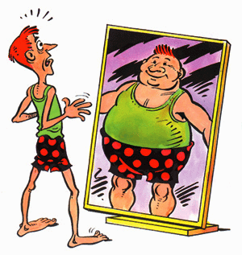
Cognitive Profile of Psychiatric Disorders
Disorder | Core Belief
Depression | Negative view of self
Hypo manic | Inflated view of self
Anxiety | Fear of physical or psychological danger
Phobias | Danger in specific, avoidable situations
OCD | Repeated warning or doubting about safety and repetitive acts to ward off threat
Suicidal behaviour | Hopelessness and deficit in problem solving
Anorexia nervosa | Fear of being fat or unshapely
Hypochondriasis | Attribution of serious medical disorder

Slide 14
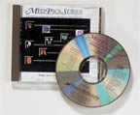
Techniques
1.Didactic (Educational) Aspects
The therapist provides information to the client about what cognitive therapy is, how it works, and the structure of the cognitive process.
Explanation about expectations of both client and therapist is provided.
Reading assignments are given in order to reinforce learning.
Some therapists use audiotape or videotape sessions to teach clients about cognitive therapy.
A full explanation about the relationship between depression (or anxiety, or whatever maladaptive response the client is experiencing) and distorted thinking patterns is an essential part of cognitive therapy.

Slide 15

2. Recognizing Automatic Thoughts
1.
Socratic Question-ing.
2.
Imagery and Role Play.
3.
Thought Record-
ing

Slide 16

1.Socratic Questioning.
In Socratic questioning (also called guided discovery), the therapist questions the client about his or her situation. With Socratic questioning, the client is asked to describe feelings associated with specific situations. Questions are stated in a way that may stimulate in the client recognition of possible dysfunctional thinking and produce dissonance about the validity of the thoughts.

Slide 17

2.Imagery and Role Play.
When Socratic questioning does not produce the desired results, the therapist may choose to guide the client through imagery exercises or role play in an effort to elicit automatic thoughts. Through guided imagery, the client is asked to “relive” the stressful situation by imagining the setting in which it occurred. Where did it occur? Who was there? What happened just prior to the stressful situation? What feelings did the client experience in association with the situation?

Slide 18

3.Thought Recording.
This technique, one of the most frequently used methods of recognizing automatic thoughts, is taught to and discussed with the client in the therapy session. Thought recording is assigned as home- work for the client outside of therapy. In thought recording, the client is asked to keep a written record of situations that occur and the automatic thoughts that are elicited by the situation. This is called a “two-column” thought recording. Some therapists ask their clients to keep a “three-column” recording, which includes a description of the emotional response also associated with the situation.

Slide 19


3.Modifying
Automatic
Thoughts
Examining the Evidence.
Generating Alternatives
Cognitive Rehearsal

Slide 20

4.Behavioural Interventions
Behavioural Interventions
I. Activity Scheduling
II. Graded Task Assignments.
III. Behavioural Rehearsal.
IV. Distraction.
V. Miscellaneous Techniques.

Slide 21

Application to nursing
The scope of contemporary psychiatric nursing practice is expanding, and although psychiatric nurses have been using some of these techniques in various degrees within their practices for years, it is important that knowledge and skills related to this type of therapy be promoted further. The value of cognitive therapy as a useful and cost -effective tool has been observed in a number of inpatient and community outpatient mental health settings.

Slide 22

Any query???

Slide 23


Summary.....

Slide 24
Assignment

Slide 25




