Slide 1


INTRODUCTION
Prepared by:
Mr. Suresh V.
Associate Professor
Department of Mental health nursing
Sumandeep Nursing college

Slide 2
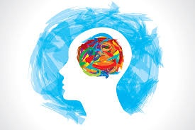
MENTAL HEALTH
It’s a state of balance between the individual and surrounding world.
A state of harmony between oneself and others.
A co-existence between the realities of self and that of other people and the environment.

Slide 3
DEFINITION
An adjustment of human beings to the world and to each other with the maximum of effectiveness and happiness.

Slide 4
COMPONENTS OF MENTAL HEALTH
The ability to accept self:
Mentally healthy individual feels comfortable about himself.
he has a self respect.
The capacity to feel right towards others:
The good mentally health is able to be sincerely interested in others welfare.

Slide 5
The ability to fulfill life’s task:
    Mentally healthy person is able to think for himself, set reasonable goals and take his own decision
    He should shoulder his daily responsibility.

Slide 6
CHARACTERISTICS OF MENTALLY
HEALTHY PERSON
He has an ability to make adjustments.
He has a sense of personal worth.
He solves his problems by his own effort and his decisions.
He has a sense of personal security and feels secure in a group.
He has a sense of responsibility
He can give and accept the love.

Slide 7
He lives in a world of reality rather than fantasy.
he should have emotional maturity (tolerate frustration)
He should have variety of interest.

Slide 8
Mental illness
Mental illness is maladjustment in living. It produces a disharmony in the persons and ability to meet human needs comfortably.
In general
  The person’s behavior is causing distress and suffering to self and others.
  The person’s behavior is causing disturbances in his day-to-day activities, job and interpersonal relationship.

Slide 9
Definition
Mental and behavioral disorders are understood as clinically significant conditions characterized by alteration in thinking, mood or behavior associated with personal distress and impaired function.

Slide 10
Characteristics of mentally illness
Changes in ones thinking, memory, perception, feeling and judgment resulting in changes in talk and behavior which appear to be deviant from the previous personality.
The changes in the behavior cause distress and suffering to the individual and others.
The changes in behavior cause disturbances in his day-to-day activities, work and interpersonal relationship.

Slide 11
Evolution of mental health services and treatment

Slide 12
Pythagoras (580-510 BC) developed the concept that the brain is the seat of intellectual activity.
Hippocrates (460-370 BC) described mental illness as hysteria, mania and depression.
Plato identified the relationship between mind and body.
Asciepiades, who is referred to as the father of psychiatry, made use of simple hygienic measures, diet, bath and massage in place of mechanical restraint.

Slide 13
The Greeks were the first study mental illness scientifically.
The Greek philosopher emphasized on the release of repressed emotions for the effective treatment of mental illness. He suggested catharsis and music therapy for the patient with melancholia.
During middle ages St. Augustine, who believed that although God acted directly in human affairs, people were responsible for their own actions.

Slide 14
In Euroup (1300-1600) this represent the saddest chapter in the history of psychiatry. When it was believed that demons were the cause of hallucinations, delusions and sexual activity and the treatment was torture and even death.

Slide 15
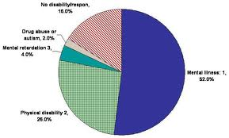
Prevalence and incidence of mental health problems and disorders

Slide 16

During the last two decades, many epidemiological studies have been conducted in India. Which shows that the prevalence of major psychiatric disorder is about the same all over the world.
The prevalence report from these studies range from the population of 18-207 per 1000 with the median 65.4 per 1000.

Slide 17
Most of the patients live in the rural areas.
A large number of adult patients coming to general OPD are not diagnosed mentally ill.
However, these patients are usually missed because either medical officer or general practitioner at the primary health care unit does not ask detailed medical history.
According to health information of India 2005, mental morbidity rate is not less than 18-20/1000 ant the type of illness and their prevalence are very much the same as in other part of the world.

Slide 18

Analysis of fifteen epidemiological studies shows prevalence rates as follows.
All mental disorders -73/1000 population.
Schizophrenia -2.5/1000 population.
Affective disorder -34/1000 population.
Anxiety neurosis -16.5/1000 population.
Hysteria-3.3/1000.
Mental retardation- 5.3/1000.

Slide 19
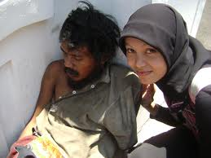
The common psychiatric illnesses encountered in a clinic of general hospital are neurotic disorders (eg; OCD, anxiety, reactive depression)
The psychosomatic disorders (eg; hypertension, DM, peptic ulcer, tension head ache)
Functional psychosis (eg; schizophrenia, mania, depression and organic psychosis)

Slide 20
In child guidance clinic, the common mental illnesses include mental retardation, conduct disorder, hyperkinetic syndrome, enuresis.
In a geriatric clinic the common disorders are depression , dementia and delusional disorders.
In the psychosexual clinic the common problems includes dhat syndrome, premature ejaculation, erectile impotence.

Slide 21
NATIONAL MENTAL HEALTH PROGRAMME
PREPARED BY
RATHOD ZANKHANA S.
F.Y.M.SC.NURSING

Slide 22
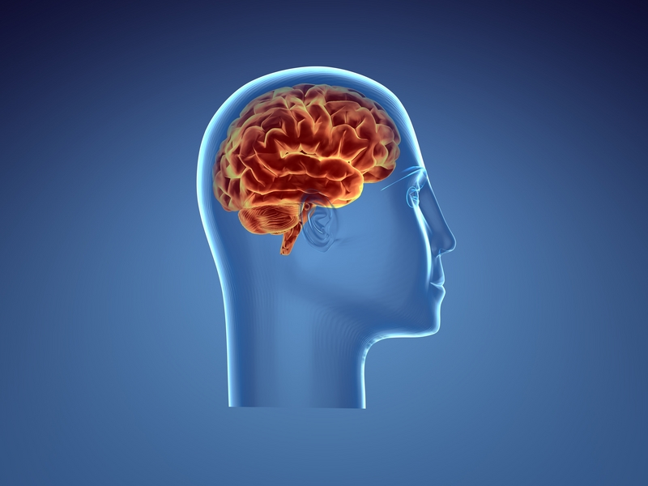
AIMS OF NMHP
To ensure treatment and prevention of mental and neurological disorder.
Use of mental health technology
Application of mental health principles in total national development to improve quality of life.

Slide 23
OBJECTIVES
To ensure availabilty and accessibility of minimum mental health care for all in the foreseeable future, particularly to the most vulnerable and under privileged sections of population.
To encourage application of mental health knowledge in general health care and in the social development.
To promote community participation in mental health services development , and to stimulate efforts towards self help in the community.

Slide 24
strategies
Integration of mental health with primary health care through the national mental health program.
Provision of tertiary care institutions for treatment of mental disorders.
Eradication stigmatization of mentally ill patients and protecting their rights through regulatory institutions like the central mental health authority, and state mental health.

Slide 25

APPROACHES
Intergration of the mental health
care services with the existing
general health services.
To utilize the existing infrastructure of health services and also to deliver the minimum mental health care services.
To provide appropriate task oriented training to the existing health staff.
To link health services with the existing community development programe.

Slide 26

COMPONENTS OF PROGRAME
TREATMENT: MULTIPLE LEVELS
-village and sub center
-Primary health center
-District hospital
-Mental hospital and teaching
psychiatric units.
REHABLITATION
PREVENTION

Slide 27
NURSES ROLE IN NATIONAL MENTAL HEALTH PROGARM:
The National Mental Health Program For India (1982) recommended the formation of a district mental health team (DMHT),In order to decentralize mental health care at the distract level, with two qualified psycahiric nurses and one psychiatrist.
to provide care to the in-patents.
to conducting occupational therapy, recreational therapy and individual and group therapy,

Slide 28
NATIONAL HEALTH POLICY
NHP was formulated in 1983 and revised in 2001.
Main objectives:
To achive an acceptable standard of good health amongst the general population in the country.
The approach would be to increase access to the decentralized public health system by establishing new infrastructure in deficient areas and by upgrading the infrastructure in deficient areas and by upgrading the infrastructures in the existing institution.

Slide 29
NATIONAL MENTAL HEALTH POLICY (2001)
According to WHO “Mental Health policies describe the objective , value and strategies of the government to reduce the Mental health burden and to improve mental health .
Policies specify the standards that need to be applied across all programs and services ,linking them all with a common vision , objectives and purposes .without this overall coordination ,programs and services are likely to be inefficient and fragmented.

Slide 30
OBJECTIVES:
To redesigned the district mental health program (DMHP) .
To strengthening the medical college psychiatry departments.
To streamlining and modernization of mental hospitals to transform them from the present .
To Strengthening of central and state mental health authorities in order that they may effectively fulfill their role of monitoring ongoing mental health programs.
To research and training aimed at build up an extensive database of epidemiological information.

Slide 31
GOALS
District mental health program will be extended to one district attached to each of the 100 medical college in the country , thereby covering 100 districts in the first phases, there by expanding it across the country.
Streamlining and modernization of mental hospital with the aim of reduction in chronicity through intensive therapeutic intervention using non-conventional anti-psychotic medication ,promoting care of chronically mentally ill patients in the community using outreach maintains modalities.

Slide 32
INTERDISCIPLINARY TEAM
Psychiatrist:
The psychiatrist is a physician certified in psychiatry by the American Board of Psychiatry and Neurology, which requires a 3-year residency, 2 years of clinical practice, and completion of an examination.
The primary function of the psychiatrist is diagnosis of mental disorders and prescription of medical treatments.
• Psychologist:
The clinical psychologist has a doctorate (Ph.D.) in clinical psychology and is prepared to practice therapy, conduct research, and interpret psychological tests. Psychologists may also participate in the design of therapy programs for groups of individuals.

Slide 33
Psychiatric social worker:
Most psychiatric social workers are prepared at the master’s level, and they are licensed in some states. Social workers may practice therapy and often have the primary responsibility for working with families, community support, and referral.
• Occupational therapist:
Occupational therapists may have an associate degree (certified occupational therapy assistant) or a baccalaureate degree (certified occupational therapist). Occupational therapy focuses on the functional abilities of the client and ways to improve client functioning such as working with arts and crafts and focusing on psychomotor skills.

Slide 34
Psychiatric nurse:
The registered nurse gains experience in working with clients with psychiatric disorders after graduation from an accredited program of nursing and completion of the licensure examination.

Slide 35
Role of psychiatric nurse
Role of generalist
Role of specialist
community mental health nurse
psychaitric home care nurse
forensic psychaitric nurse
psychiatric consultation
case manager
geropsychaitric nurse
parish nurse
telehealth / telenurse
nures researcher
psychaitric nurse educator
nurse administrator / manager
psychopharmacologist

Slide 36
Functions of nurse
in various setting

Slide 37
Inpatient psychiatric wards.
Outpatient dept
ECT treatment setting
Psychotherapy unit (establish therapeutic relationship)
Day care centers
Family therapy units
Child psychiatric ward.

Slide 38
Home setting.
Community mental health centers
Hospice care centers
Emergency departments.
Medical inpatient wards
Industrial medical centers hospital for criminal insane, jail and prisons.

Slide 39
QUALITIES OF PSYCHIATRIC NURSE
&
PRINCIPLES OF PSYCHIATRIC NURSING

Slide 40
PSYCHIATRY
It is branch of medicine that deals with the diagnosis, treatment & prevention of mental illness.
PSYCHIATRIC NURSING
It is specialized area of nursing practice employing theories of human behavior as it is a science and the professional use of self as it is an art, in the diagnosis & treatment of human responses to actual or potential mental health problem.

Slide 41
Qualities of psychiatric nurse
Self-awareness
Self-acceptance
Accepting the client
Being sincerely interested in patient care
Being available
Reliability
Professionalism
Accountability
Ability to think critically

Slide 42
Therapeutic roles of psychiatric nurse
Direct care provider
Therapeutic environment provider
Teacher/ educator
Coordinator
Advocate
Collaborator
Case manager
researcher

Slide 43
Principles of psychiatric nursing
1. Patient is accepted exactly as he is
    Being Non-judgmental and non-punitive
    Recognizing and reflecting on feelings which patient may express
    Talk with purpose
    Listening
    Permitting patient to express strongly –held feelings
2. Use self-understanding as a therapeutic tool
3. Consistency is used to contribute to patient’s security.

Slide 44
4. Reassurance should be given in a subtle and acceptable manner
5. Patient’s behavior is changed through emotional experience and not by rational interpretation
6. Unnecessary increase in patient's anxiety should be avoided
7. Objective observation of patient to understand his behavior
8. Maintain realistic nurse-patient relationship
9. Avoid physical verbal forces as much as possible

Slide 45
10. Nursing care is centered on the patient as a person and not on the control of symptoms
11. All explanation of procedures and other routines are given according to the patient’s levels of understanding
12. Many procedures are modified but basic principles remain unaltered

Slide 46
Misconception of mental illness
1.People with mental illness are violent
2. They’re unpredictable
3. They don’t get better
4. Most People With Mental Illnesses are on Welfare or Homeless
5. People With Mental Illnesses Would Rather Not Talk About it.
6. Young people and children don't suffer from mental health problems

Slide 47
7. People who need psychiatric care should be locked away in institutions
8. Mentally Ill persons are dangerous.
9. Prevention doesn’t work. It is impossible to prevent mental illnesses.

