Slide 1

PERSONALITY DISORDER
Prepared by:
Mrs. Bhoomika Patel
Assistant Professor
Department of Mental health nursing
Sumandeep Nursing college

Slide 2
What is Personality?
People differ from
each other in
meaningful ways
People seem to show some consistency in behavior
Personality is defined as distinctive and relatively enduring ways of thinking, feeling, and acting

Slide 3
Definition
Personality consists of the distinctive patterns of behavior including thoughts and emotions that characterize each individuals adaptation to the situations of his or her life.

Slide 4
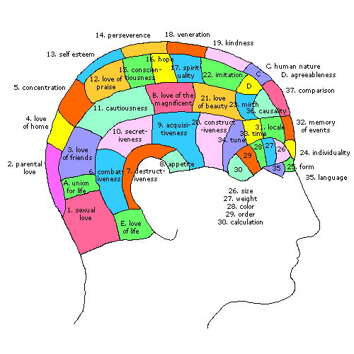

Slide 5
Topography of personality
One of the most important characteristics of personality is that it is a product of heredity and environment.
A child though not born with a personality develops the same in course of continuous interaction with the environment.
Personality includes the cognitive, affective and psychomotor behaviors and covers all the conscious, Sub-conscious and unconscious also.

Slide 6
It’s a specific and unique for each and every individual.
It is not Static but dynamic in nature.

Slide 7
Components of personality
Physical appearance
Character (it refers to ethical or moral)
Temperament (Deep rooted emotion)
Interest (Felt needs of an individual)
Ability (Special natural power)
Sociability (Individual to socialize himself)
Emotionality (Mature emotional)

Slide 8
Introduction
The word personality is derived from the Greek term persona. It was originally used to describe the theatrical mask worn by some dramatic actors at the time. Over the years, it lost its connotation of pretense and illusion and came to represent the person behind the mask—the “real” person.

Slide 9
DEFINITION
The totality of emotional and behavioral characteristics that are particular to a specific person and that remain somewhat stable and predictable over time

Slide 10
HISTORICAL PERSPECTIVES

Slide 11
HIPPOCRATES
Yellow bile : irritable and hostile choleric
Black bile : pessimistic melancholic
Blood : overly optimistic and extroverted sanguine
Phlegm : apathetic phlegmatic
19th century term Moral Insanity and now P.D

Slide 12
Factors influencing personality
Biological
Environmental

Slide 13
HEREDITORY
NERVOUS SYSTEM
PHYSIQUE
ENDOCRINE GLANDS
BIOLOGICAL

Slide 14
ENVIRONMENTAL
FAMILY
SCHOOL
TEACHER
PEER GROUP
MASS MEDIA
CULTURE
SIBLING RELATIO SHIP

Slide 15
THEORIES
PSYCHOANALYTICAL THEORY- 1961 BY FRUED
INTERPERSONAL THEORY – 1953 BY SULLIVAN
PSYCHOSOCIAL EVELOPMENT – 1963 ERIK ERIKSON
OBJECT RELATION – 1975 BY MARGARET MAHLER
COGNITIVE DEVELOPMENT – 1969 BY PIAGET
MORAL DEVELOPMENT – 1968 BY KOHLBERG

Slide 16
The Structure of Personality
ID
EGO
SUPEREGO
Notes:
Psychoanalytic theory concerns how people cope with their sexual and aggressive instincts within the constraints of a civilized society. One part of the mind creates urges, another has a sense of what civilized society expects, and another part of the mind tries to satisfy the urges within the bounds of reality and society. These parts of the mind are in constant interaction. They have different goals, provoking internal conflicts within an individual.

Slide 17
3 Levels of Awareness
Conscious
Preconscious
Unconscious

Slide 18
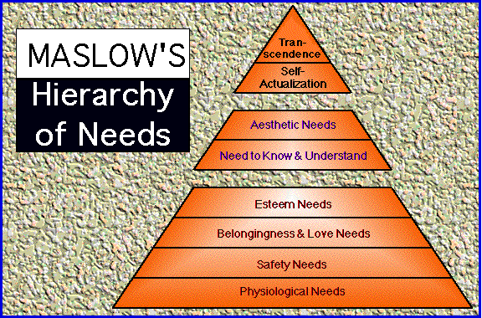
Maslow’s Hierarchy of Needs
Notes:
2
2

Slide 19
Cluster A: Behaviors described as odd or eccentric
a. Paranoid personality disorder
b. Schizoid personality disorder
c. Schizotypal personality disorder
Cluster B: Behaviors described as dramatic, emotional, or erratic
a. Antisocial personality disorder
b. Borderline personality disorder
c. Histrionic personality disorder
d. Narcissistic personality disorder
Cluster C : Behaviors described as anxious or fearful
a. Avoidant personality disorder
b. Dependent personality disorder

Slide 20

PARANOID PERSONALITY DISORDER
INTRODUCTION
Paranoid personality disorder is characterized by a distrust of others and a constant suspicion that people around you.
Prevalence is difficult.
More common in men then in women

Slide 21

Symptoms
Guard hypervigilant ready for threat
Tense and irritable
Insensitive to others feelings
Avoid interaction
Oversensitive
Mistrustful and always “testing” honesty of others
Anger , aggression and violence
This outburst are brief and soon regains the external control, rationalize the behavior and use defenses
Not accept responsibility, always project to others.

Slide 22
Predisposing factors
Hereditary
Psychosocial

Slide 23
DIAGNOSTIC CRIETERIA
Any 4 or more symptoms out of 7
(1) Suspects, without sufficient basis, that others are exploiting, harming, or deceiving him or her
(2) Is preoccupied with unjustified doubts about the loyalty or trustworthiness of friends or associates
(3) Is reluctant to confide in others because of unwarranted fear that the information will be used maliciously against him or her
(4) Reads hidden demeaning or threatening meanings into benign remarks or events

Slide 24
(5) Persistently bears grudges
(6) Perceives attacks on his or her character or reputation that are not apparent to others and is quick to react angrily or to counterattack
(7) Has recurrent suspicions, without justification, regarding fidelity of spouse or sexual partner
B. Does not occur exclusively during the course of psychotic or medical condition.

Slide 25
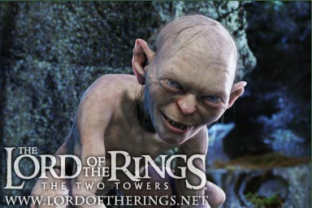
Schizoid Personality Disorder
People with schizoid personality disorder avoid relationships and do not show much emotion
They genuinely prefer to be alone and do not secretly wish for popularity
Prevalence is 3 to 7.5 %
in general population
Gender ration unknown but
Mostly in man

Slide 26
SYMPTOMS
They tend to seek jobs that require little social contact
Their social skills are often weak and they do not show a need for attention or acceptance
They are perceived as humorless and distant and often are termed "loners."

Slide 27
Emotionally cold
Shy, anxious or uneasy
Difficulty in managing lighthearted manner
No spontaneity
Unable to experience pleasure
Affect – bland and constricted
Aloof
Detached
Humorless
Introspective

Slide 28
PREDISPOSING FACTORS
Hereditary
psychosocial

Slide 29
DIAGNOSTIC CRITERIA
4 or more Symptoms
Neither desires nor enjoys close relationships, including being part of a family
(2) Almost always chooses solitary activities
(3) Has little, if any, interest in having sexual experiences with another person
(4) Takes pleasure in few, if any, activities

Slide 30
5) lacks close friends or confidants other than first-degree relatives
(6) appears indifferent to the praise or criticism of others
B. Does not occur exclusively during the course of other psychotic disorder

Slide 31
Schizotypal Personality Disorder
Before : described as “latent schizophrenics”
Characterized by a need for social isolation, odd behavior and thinking, and often unconventional beliefs such as being convinced of having extra sensory abilities.
Some people believe that schizotypal personality disorder is a mild form of schizophrenia
3 % population

Slide 32
SYMPTOMS
Inappropriate affect.( laughing at own situatuion)
Behavior or appearance that is odd , eccentric, or peculiar.
Poor rapport with other and a tendency to social withdrawal.
Suspiciousness or paranoid ideas.
Unusual perceptual experiences including magical thinking, idea of reference ,illusion, depersonalization or Derealization
Speech : bizzare, not orient to own thought leads to lost in personal irrelevancies.

Slide 33
Hereditary
Biological
Family dynamics

Slide 34
DIGNOSTIC CRITERIA
4 or more
Ideas of reference
2. Odd beliefs or magical thinking that influences behavior and is inconsistent with subcultural norms
3. Unusual perceptual experiences, including bodily illusions.
4. Odd thinking and speech
5. Suspiciousness or paranoid ideation

Slide 35
6. Inappropriate or constricted affect
7. Behavior or appearance that is odd, eccentric, or peculiar
8. Lack of close friends or confidants other than first-degree relatives
9. Excessive social anxiety
B. Does not exclusively during the course of other psychotic disorder

Slide 36

Antisocial Personality
Disorder
Antisocial personality disorder is characterized by a lack of conscience(sense of right or wrong)
socially irresponsible, exploitative, and guiltless behavior
People with this disorder are prone
to criminal behavior, believing that
their victims are weak . They tend to
lie and steal
They are often aggressive and are much more concerned with their own needs than the needs of others.
3 percent in men to about1 percent in women.

Slide 37
Common way to avoid legal consequence
Sometime admitted by court for psychological evaluation
Mostly encountered in prisons, jails, and rehabilitation centers

Slide 38
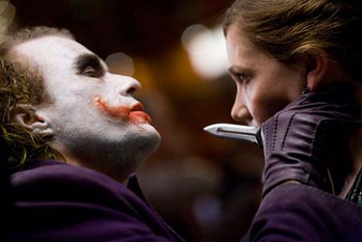
SYMPTOMS
Gross and persistent attitude of irresponsibility and disregard for social norms, rules and obligation.
Very low tolerance to
frustration and low
threshold
for discharge of aggression,
including violence.
Incapacity to experience guilt and to profit from experience, particularly punishment.

Slide 39
Cold and callous with brusque and belligerant manner
Restless and easily bored
Sometimes act cheerful, gracious and charming
First inclination is demean and dominate.
Exploits others for ownself
No trace of shame
Use projection
Ignore conventional authority and rules

Slide 40
Biological influences : Alcoholism, temperament, ADHD, Conduct
Abnormality in prefrontal brain, reduced autonomic activity
Family dynamics:
Abused, absence of discipline, extreme poverty, growing without parents, being rescued in every situation, maternal deprivation

Slide 41
DIAGNOSTIC CRIETERIA
A. as indicated by three (or more) of the following:
Failure to conform to social norms with respect to lawful behaviors as indicated by repeatedly performing acts that are grounds for arrest
2. Deceitfulness, as indicated by repeated lying, use of aliases, or conning others for personal profit or pleasure
3. Impulsivity or failure to plan ahead
4. Irritability and aggressiveness, as indicated by repeated physical fights or assaults

Slide 42
5. Reckless disregard for safety of self or others .
6. Consistent irresponsibility
7. Lack of remorse, as indicated by being indifferent to or rationalizing having hurt, mistreated, or stolen from another
B. The individual is at least age 18 years.
C. There is evidence of Conduct Disorder with onset before age 15 years.
D. The occurrence of antisocial behavior is not exclusively during the course of Schizophrenia or a Manic Episode.

Slide 43
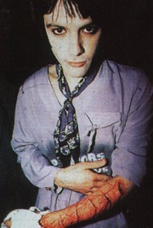
Borderline Personality Disorder
Characterized by mood instability and poor self-image
People with this disorder are prone to
constant mood swings and bouts of anger.
They will take their anger out on
themselves, causing themselves
Injury
They are quick to anger when their
expectations are not met.
1 -2 % of population, more in women. Female to male ratio is 4 to 1

Slide 44
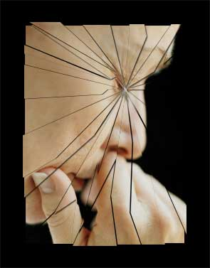
SYMPTOMS
Unstable relationship
Impulsive behavior
Variable mood
Lack of control on anger
Recurrent suicidal behavior
Uncertainly about personal
Identity
Chronic feeling of emptiness
Chronic depression
Inability to be alone

Slide 45
Frantic efforts to avoid real or imagined abandonment
Unstable and intense relationship
Identity disturbances
Others
Emotional
Behavior
Interpersonal relationship
Cognitive problems

Slide 46
PATTERN OF INTERECTION
1, Clanging and distancing
2. Splitting
3. Manipulation
4. Self destructive behavior
5. Impulsivity

Slide 47
PREDISPISING FACTORS
Genetics: mood disorder
BIOCHEMICAL : SEROTONERGIC DEFECT
Neurobiological factors : Medial and orbitofrontal abnormality
Adverse childhood experience : Chaotic envt, trauma, neglect, abuse
Other developmental factors : object relation theory, fixation in rapproachment

Slide 48
DIAGNOSTIC CRITERIA
as indicated by five (or more) of the following:
Frantic Efforts To Avoid Real Or Imagined Abandonment.
(2) A Pattern Of Unstable And Intense Interpersonal Relationships Characterized By Alternating Between Extremes Of Idealization And Devaluation
(3) Identity Disturbance: Markedly And Persistently Unstable Self-Image Or Sense Of Self
(4) Impulsivity In At Least Two Areas That Are Potentially Self-Damaging

Slide 49
(5) Recurrent Suicidal Behavior, Gestures, Or Threats, Or Self-Mutilating Behavior
(6) Affective Instability Due To A Marked Reactivity Of Mood
(7) Chronic Feelings Of Emptiness
(8) Inappropriate, Intense Anger Or Difficulty Controlling Anger
(9) Transient, Stress-Related Paranoid Ideation Or Severe Dissociative Symptoms

Slide 50
Histrionic Personality Disorder
Constant attention seekers
They need to be the center of attention all the time, often interrupting others in order to dominate the conversation.
More common in females
They also tend to exaggerate friendships and relationships, believing that everyone loves them

Slide 51
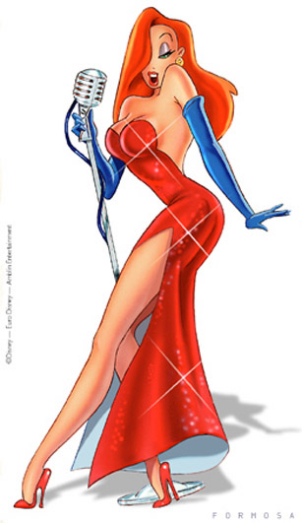
SYMPTOMS
Self dramatizing, attention seeking,
seductive
Dramatic emotionality
Craving for novelty and excitement
Shallow and labile affectivity
Over concern with physical attraction
Flighty by nature
Difficulty in paying attention
Highly suggestible, impressionable.
IPR superficial

Slide 52
Self-dramatization, theatrically, exaggerated expression of emotion
Suggestibility, easily influenced by others or circumstances.
Shallow and labile affectivity.
Continual seeking for excitement, appreciation other and activities in which the person is the center (attention seeking attitude)
Over concern with physical attractiveness.

Slide 53
ETIOLOGY
Neurobiological : high noradrenergic activity & slow serotonergic activity
Hereditary
Family influences: learning behaviour, neglect , deprivation, inattention

Slide 54
DIAGNOSTIC CRIETERIA
Is Uncomfortable In Situations In Which He Or She Is Not The Center Of Attention
(2) Interaction With Others Is Often Characterized By Inappropriate Sexually Seductive Or Provocative Behavior
(3) Displays Rapidly Shifting And Shallow Expression Of Emotions
(4) Consistently Uses Physical Appearance To Draw Attention To Self

Slide 55
(5) Has A Style Of Speech That Is Excessively Impressionistic And Lacking In Detail
(6) Shows Self-Dramatization, Theatricality, And Exaggerated Expression Of Emotion
(7) Is Suggestible, I.E., Easily Influenced By Others Or Circumstances
(8) Considers Relationships To Be More Intimate Than They Actually Are

Slide 56
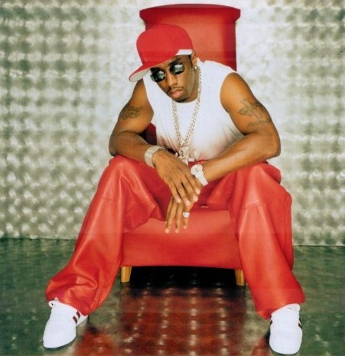
Narcissistic Personality Disorder
Characterized by self-centeredness
They exaggerate their achievements, expecting others to recognize them as being superior

Slide 57

They tend to be choosy about picking friends, since they believe that not just anyone is worthy of being their friend.
2- 16 % of population, men then women
They are generally uninterested in the feelings of others and may take advantage of them.

Slide 58
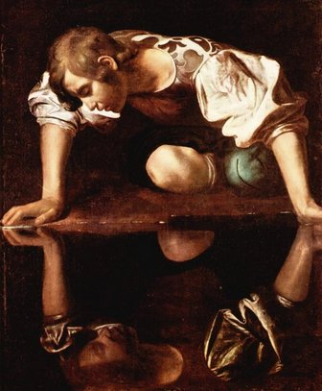
SYMPTOMS
Inflated sense of self importance
Attention seeking, dramatic behavior
Unable to face criticism
Lack of empathy
Exploitative behavior
Mood- optimistic, relaxed,
cheerful and carefree
Fragile self esteem
Choose who provide
positive feedback

Slide 59
Ideas of grandiosity and inflated sense of importance.
Preoccupation with fantasies of unlimited success.
Attention seeking, dramatic behavior, needs constant praise, and unable to face criticism.
Lack of empathy with other, with exploitative behavior.
Shaky self-esteem, underlying sense of inferiority, easily depressed by minor events.

Slide 60
ETIOLOGY
PSYCHODYNAMIC THEORIES
Demanding and perfectionistic

Slide 61
DIGNOSTIC CRITERIA
(1) Has A Grandiose Sense Of Self-Importance
(2) Is Preoccupied With Fantasies Of Unlimited Success, Power, Brilliance, Beauty, Or Ideal Love
(3) Believes That He Or She Is "Special" And Unique And Can Only Be Understood By, Or Should Associate With, Other Special Or High-Status People
(4) Requires Excessive Admiration
(5) Has A Sense Of Entitlement

Slide 62
(6) Is Interpersonally Exploitative, I.E., Takes Advantage Of Others To Achieve His Or Her Own Ends
(7) Lacks Empathy: Is Unwilling To Recognize Or Identify With The Feelings And Needs Of Others
(8) Is Often Envious Of Others Or Believes That Others Are Envious Of Him Or Her
(9) Shows Arrogant, Haughty Behaviors Or Attitudes

Slide 63
Avoidant personality disorder
Extremely sensitive to rejection and lead to social withdrawal.
Characterized by a pervasive pattern of social inhibition, feelings of inadequacy, and extreme sensitivity to negative evaluation.
0.5 to 1 %, equally in men and women
Consider themselves to be socially inept(hopeless) or personally unappealing, and avoid social interaction for fear of being ridiculed or humiliated.

Slide 64
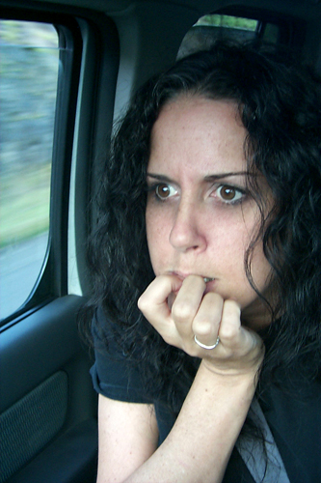
SYMPTOMS
Persistent feeling of tension
Inferiority complex
Fear of criticism, rejection
Unwillingness to become
Involved with people
Excessive preoccupation
with being criticized
Speech: slow and
Constrained, hesitation,
Confused.
Depression, anxiety and
anger own self

Slide 65
ETIOLOGY
Hereditary :
Psychosocial: parental rejection, criticized

Slide 66
DIAGNOSTIC CRIETERIA
Avoids Occupational Activities That Involve Significant Interpersonal Contact, Because Of Fears Of Criticism, Disapproval, Or Rejection
(2) Is Unwilling To Get Involved With People Unless Certain Of Being Liked
(3) Shows Restraint Within Intimate Relationships Because Of The Fear Of Being Shamed Or Ridiculed

Slide 67
(4) Is Preoccupied With Being Criticized Or Rejected In Social Situations
(5) Is Inhibited In New Interpersonal Situations Because Of Feelings Of Inadequacy
(6) Views Self As Socially Inept, Personally Unappealing, Or Inferior To Others
(7) Is Unusually Reluctant To Take Personal Risks Or To Engage In Any New Activities Because They May Prove Embarrassing

Slide 68
DEPENDENT PERSONALITY
Characterized by a pervasive psychological dependence on other people.
Has difficulty making everyday decisions without an excessive amount of advice and reassurance from others
Fail to function when require assertive or dominant behavior
Unwillingness to make even reasonable demands on other people
Feeling uncomfortable or helpless when alone
2.5 %, common in women, more common in youngest children of family

Slide 69
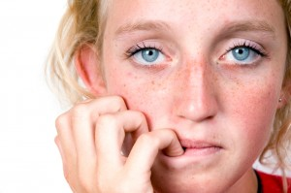
  SYMPTOMS
  Encouraging or allowing other to make most of one’s important life decision
  Preoccupation with
  fear of being abandoned by a
  person with whom one has a close
  relationship or and of being left to care for oneself
  Limited capacity to make everyday decisions without an excessive amount of advice and reassurance from other.

Slide 70
Lack of self confidence apparent in posture, voice and mannerisms.
Passive and acquiescent
When alone feel pessimistic, discouraged, and dejected.
Passive and submissive role in relations
Relation with who provides nurturance and guidance
Law self worth and easily hurt
Will do almost anything to earn the acceptance of others.

Slide 71
ETIOLOGY
GENETIC
PSYCHOSOCIAL : overprotective

Slide 72
DIAGNOSTIC CRIETERIA
Has Difficulty Making Everyday Decisions Without An Excessive Amount Of Advice And Reassurance From Others
(2) Needs Others To Assume Responsibility For Most Major Areas Of His Or Her Life
(3) Has Difficulty Expressing Disagreement With Others Because Of Fear Of Loss Of Support Or Approval.
(4) Has Difficulty Initiating Projects Or Doing Things On His Or Her Own

Slide 73
(5) Goes To Excessive Lengths To Obtain Nurturance And Support From Others, To The Point Of Volunteering To Do Things That Are Unpleasant
(6) Feels Uncomfortable Or Helpless When Alone Because Of Exaggerated Fears Of Being Unable To Care For Himself Or Herself
(7) Urgently Seeks Another Relationship As A Source Of Care And Support When A Close Relationship Ends
(8) Is Unrealistically Preoccupied With Fears Of Being Left To Take Care Of Himself Or Herself

Slide 74
Obsessive Compulsive Personality Disorder
Very serious and formal and difficulty in expressing emotions.
An intense fear of making mistakes lead to difficulty with decision making
Common in men, most commonly in oldest children
People with OCPD tend to stress perfectionism above all else, and feel anxious when they perceive that things aren't "right".

Slide 75
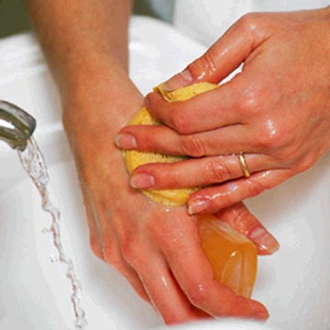
SYMPTOMS
Feeling of excessive doubt and caution
Preoccupation with rules, lists, order
Perfectionism
Rigidity
High standards
Rigid about rules
Social behavior
Is polite and formal
“rank conscious”
“bureaucratic personality”
Immature and irresponsible
Ambivalence, conflict and
Hostility
Defence mechanism used-
reaction formation, isolation,
intellectualization, rationalization,
undoing

Slide 76
ETIOLOGY
PSYCHOANALYTICAL THEORY : overcontrol

Slide 77
Diagnostic criteria
Preoccupied with details
Shows perfectionism
Excessively devoted to work
Over conscientious, scrupulous, inflexible
Unable to discard worthless object even without sentiment
Reluctant to delegate task to others
Money is viewed as to be hoarded for future
Shows rigidity and sttubornness

Slide 78
PASSIVE AGGRESSIVE
Negativistic attitudes and passive resistance to demands for adequate performance in social and occupational situations
People are passively expressing covert aggression

Slide 79
SYMPTOMS
Feel cheated and unappreciated
Demonstrate passive resistance and general obstructiveness
ETIOLOGY - Parental attitude and behavior, double blind communication

Slide 80
DIAGNOSTIC CRITERIA
1. Passive resistance to routine social or occupational obligations
2. Complains of being misunderstood or underappreciated
3. Complains of personal misfortune
4. Sullenness or belligerance
5. Highly critical of authority
6. Resents or is envious of those perceived as
being more fortunate
7. Alternates between hostile defiance and
contrition

Slide 81
MANAGEMENT
Interpersonal psychotherapy
Psychoanalytical psychotherapy (histrionic)
Milieu group therapy (antisocial)
CBT(OCD, passive aggressive, antisocial, avoidant)
Dialectical Behavior Therapy
Psychopharmacology ANTIPSYCHOTICS, SSRIS, MAOS, LITHIUM CARBONATE AND PROPRANODOL, ANXIOLYTICS

Slide 82
NURSING MANAGEMENT
1. Risk for self-mutilation/risk for self-directed other-directed violence related to parental emotional deprivation (unresolved fears of abandonment)
2. Complicated grieving related to maternal deprivation during rapprochement phase of development (internalized as a loss, with fixation in anger stage of grieving process) evidenced by depressed mood, acting-out behaviors.
3. Risk for other-directed violence related to rage reactions, negative role-modeling, inability to tolerate frustration

Slide 83
THANK
YOU

