Slide 1


SYMPTOMOLOGY IN MENTAL ILLNESS
Prepared by:
Mrs. Bhoomika Patel
Assistant Professor
Department of Mental health nursing
Sumandeep Nursing college

Slide 2
SYMPTOMOLOGY IN MENTAL ILLNESS
Pathological and psychiatric formulation where the client will experience and expresses the difficult situation or adaptation maintained to face the stress. The clinical manifestation is the end products of various forces of internal conflicts of the individual. .
The intensity and persistence of symptoms will indicate manifestation of the disease

Slide 3

Human behaviour consist of 3 domains…
Cognitive :- Knowledge , intellectual capacities of an individual
Conative :- Motor activity ( physical activity )
Affective activity :- Emotions, moods and feelings

Slide 4
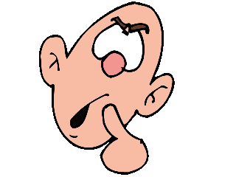
DISTURBANCE IN CONSCIOUSNESS
CONFUSION :
It is a disturbance of consciousness characterized by disturbance of orientation of place, person and time. There is also disturbance of associative functioning . The face of the patient presents a confused ,puzzled and at time surprised expression

Slide 5
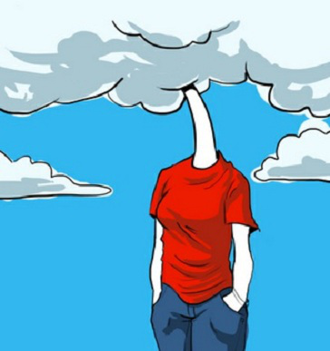
CLOUDING OF CONSCIOUSNESS
In this the patient has disturbance of clear mindedness . The capacity of think ,perceive, respond and remember is impaired. There is diminished in alertness

Slide 6

STUPOR:
A state in which the individual does not react to his surrounding and appears to be unaware of them . Commonly seen in catatonic and depressive disorders .

Slide 7

DELIRIUM
state of mental confusion and excitement that happens in a short period of time &is characterized by disorientation for time , place ,usually with illusion & hallucinations

Slide 8

DREAM STATE
It is an altered state of consciousness like dream state. it is accompanied by visual, auditory and olfactory hallucination and is believed to be associated with temporal lobe lesions . a characteristics features of the dream state is vague purposelessness. The period may last for 5 to 10 min. and it clears fairly or slowly after several min.

Slide 9
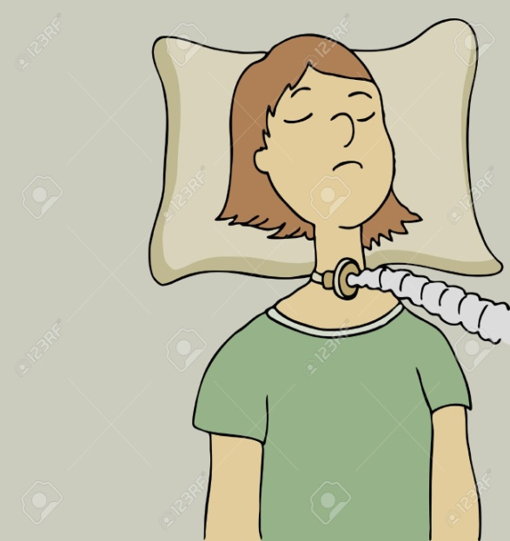

COMA
The patient is unconscious and is in a state of non-responsiveness to external stimuli (painful stimuli ). in deep coma the patient is no longer in a state of arousal even with painful stimuli and his reflexes are lost .

Slide 10
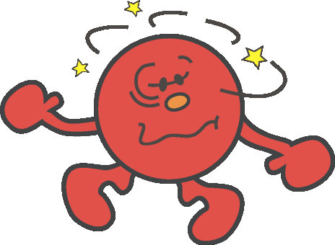
DROWSINESS
Through the patient appears awake he may slip into sleep unless constantly stimulated. The patient thinking is muddled , speech is slurred and activities are sluggish but all reflexes are lost

Slide 11

DISTURBANCE OF ACTIVITY
INCREASED ACTIVITY
There are mainly two type of excessive activity or hyperactivity . if an individual performs the activity with reason and purposes . he will be working hard in completing the activity , which is goal directed activity.
The person impulsively rushes about for an activity. The activity is not well organized and purposeless .these activities mostly associated with flights of idea ..
e.g, : mania.

Slide 12
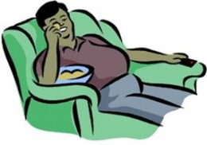
DECREASED ACTIVITY
Decreased motor activity is also known as decreased psychomotor activity or psychomotor retardation . the patient takes too long to start the activity . after starting the activity the patient takes too much time to complete it. He may not even complete it.

Slide 13
DYSACTIVITY :
Besides of decreased or increased activity , badly done, difficult or painful activities which are called dysactivities.
It includes repetitious activity , negativism, compulsion , autonomic behaviour, violence, suicide.
REPETITIOUS ACTIVITY : it is characterised by repetitious especially needless or Purposeless activity e.g. schizophrenia, compulsive disorders
STEREOTYPE ACTIVITY … it can be in form of position, movement, Speech.

Slide 14
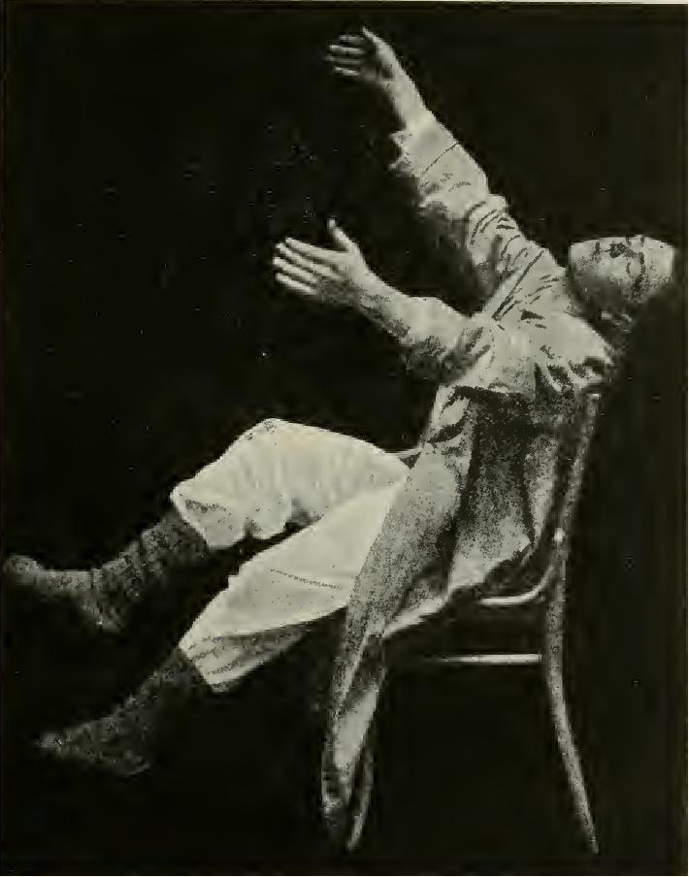
STEREOTYPE POSITION
It is constantly maintained position without any movement , it is also called catalepsy . catalepsy is also explained as cerea-flexibility, or waxy-flexibility.
  It is commonly seen in schizophrenia and hysteria patients.

Slide 15


STEREOTYPE MOVEMENT :
It is known as mannerism. When the movement repeated it is called mannerism .
Ex: repeatedly touching the neck while talking , lifting the shoulders, swallowing saliva while talking .
TICS :
irregular repeated movement of particular group of muscles .

Slide 16
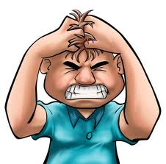
STEREOTYPE SPEECH
It is consist of repetition of words, phases or sentences . a patient with the catatonic form of schizophrenia kept repeating ‘muscles’ ,muscles, muscles ‘ in reply to all form of questioning . when the language or word are repeated they are called stereotype.
AGITATION :
presence of anxiety with severe motor restlessness

Slide 17

NEGATIVISM
: motiveless resistance to all attempts to be moved or to all instructions
Ex: patients closes his fits tightly when he is asked to open his hands, it is commonly seen in catatonic form of schizophrenia .

Slide 18

AUTOMATISMS:
Undirected behaviour that is not consciously controlled,
.the words or activities knowns as echolalia and echoprexia .
Ex. seizures
echolalia is the repetition of speech by another person.
echoprexia is the repetition of activity by another person.

Slide 19

COMPULSION :
Repeatedly performing an act which may look un reasonable to the Viewers and the individual himself is called compulsion .
Ex.: washing hands repeatedly , checking the locked doors

Slide 20

SUICIDE :
violence towards self may lead to suicide or an “act of killing oneself”. Suicide is commonly seen in depressive patient and at time in schizophrenic patient

Slide 21

Violence :
it is an aggressive behaviour in which physical force is exerted . violence is Used in war , assassination ,murder ,assault, rape and even suicide.

Slide 22
Multiple choice question
1. What is tics ?
Irregular repeated movement of particular group of muscles
Irregular thinking of moments
A & b both
Non of above
2.What is delirium
Disturbance of consciousness
Confusion state
Weakness stage
A & b both

Slide 23
3.What is Echolalia ?
Repetitions of speech by another person
Repetitions of action
A & b both
Non of above
4.What is echoprexia ?
(a) Constantly in motions
(b) repeatation of activity by another person
(c ) repetitions of speech
(d) A & C both
5. What is violence ?
Confused state
Aggressive state
A & b both
Non of above
Key ADABB

Slide 24
DISORDERS OF PERCEPTION
Perception refers to the way the world looks, sounds , feels ,tastes or smell. Perception is an individualistic experience and is interpreted by an individual depending upon the total psychological and biological surroundings.
Disorders of perception can be classified as illusion and hallucination .

Slide 25

PERCEPTUAL DISTURBANCE OF TIME AND SPACE
The passage of time is perceived as too slow as in depression and too fast as in mania
drug abuse Depressed person is normally thinking that time is standing still.
Anxious Person feeling that they are not able to complete task within time .

Slide 26
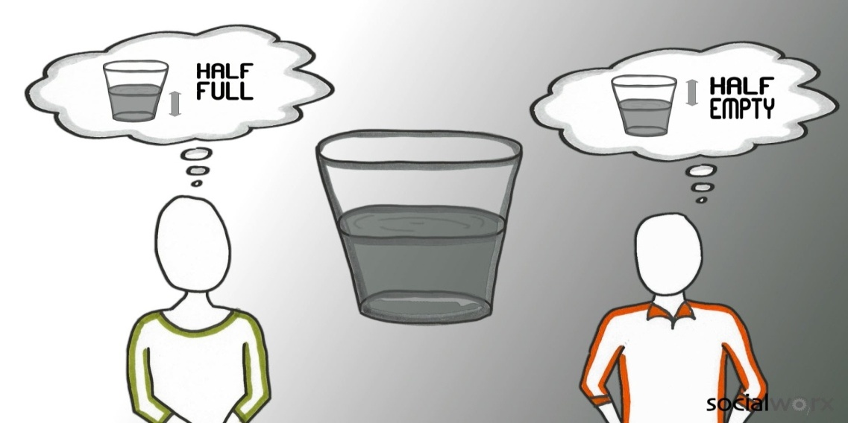
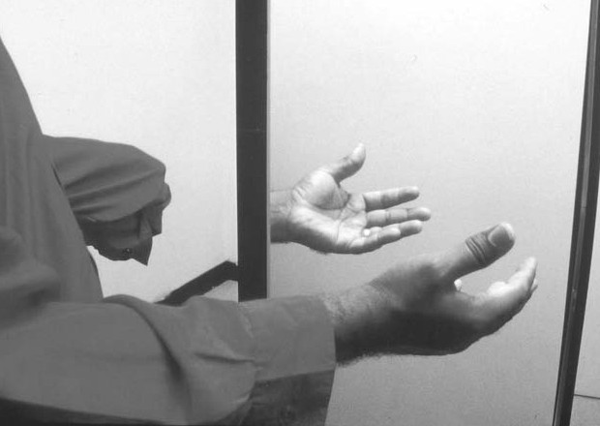
PERCEPTUAL DISTURBANCE OF IMAGE :
Person feeling disturbance of bodily experience like right –left disorientation ,
anosognasias. ( person ignoring his/her illness.)
autopagnosia (inability of recognize owns body parts)
Ex - alcoholic person.

Slide 27
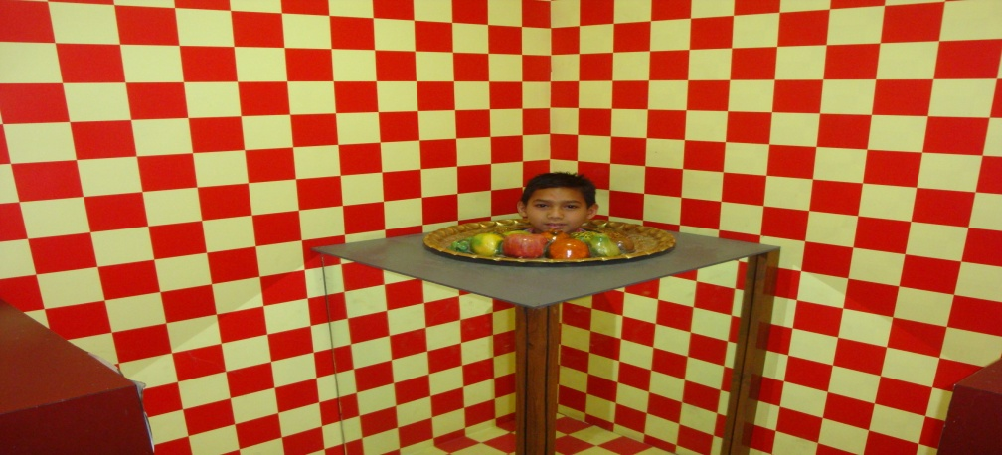
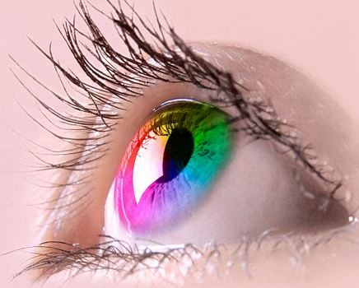
SENSORY DISTORTIONS
It is change in intensity and quality of sensory modalities ….
There is mainly 2 types.
Hyperesthesia :
It is present in person with strong emotions ,acute psychoses ,,,in these sensation become more vivid and intense , sounds appear more loud ,colour brighter .
Hypoesthesia :
Hypoesthesia present in person with depression and delirium .in these all senses are diminished .

Slide 28

SENSORY DECEPTION :
They can be classified in ,
1. Illusion.
2. Hallucination
ILLUSION: -
The misinterpretation of a real , external sensory experience. it is mental misperception of actual sensory stimuli.
Ex.: in the dark the rope which Is misinterpretation as snake.

Slide 29

HALLUCINATION
A false sensory perception in the absence of an actual external stimulus.
Ex.: hearing voices when actually nobody is talking in the surrounding area and the person actually believe the people are talking

Slide 30

AUDITORY HALLUCINATION
: it is also known as hallucination of hearing . this is the frequent form of perceptual disturbances when the patient hears the voices of people talking , buzzing noises or ill-defind sounds. Some time he may hear the noises , such as somebody is knocking at the door , someone is telling him not to eat food.

Slide 31
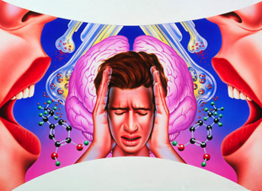
VISUAL HALLUCINATION
it is commonly known as hallucination of sight . the patient may have a frightful visual experiences or a pleasant one. Like patient look and said ,”some one is coming to kill me .”

Slide 32
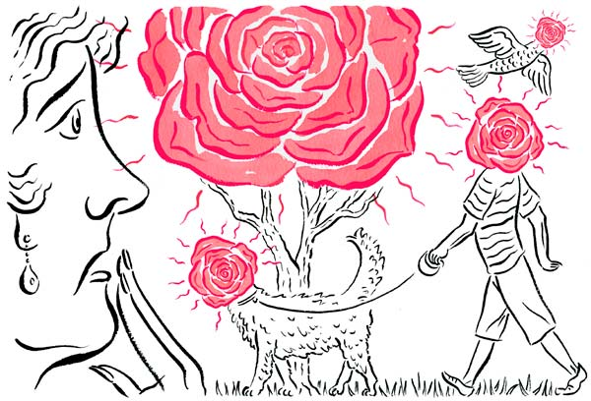
OLFACTORY HALLUCINATION
FALSE PERCEPTION OF SMELL
EX. SMELL OF VOMITS , BODIES BEING BURNT

Slide 33

GUSTATORY HALLUCINATION
The patient may say that something is added in his food which has a very bad taste. Most of the time gustatory hallucination are seen along with hallucination of smell.
FALSE PERCEPTION OF TASTE

Slide 34

TACTILE HALLUCINATION
it It s also known as hallucination of touch or hepatic hallucination .

Slide 35
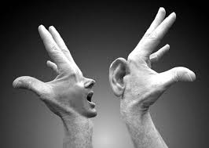
SOMATIC HALLUCINATION
The patient has phantom phenomenon that a part of his body is missing or distorted .
ex : person may say his legs is amputated.

Slide 36
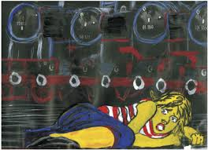
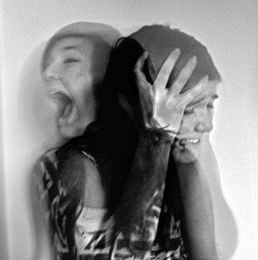
HYPOGONIC HALLUCINATION
it is occurs during the sleep .
HYPNOSOMATIC HALLUCINATION
its occurs while awake.

Slide 37
MULTIPLE CHOICE QUESTION
What happens in perceptual disturbance in depressed patient ?
Time is perceived too fast
Time is perceived too slow
Both A & B
None of the above
2. What is hypoesthesia?
Hypersensation is experienced
No sensation
Senses are diminished
None of the above

Slide 38
3. What is meant by kinesthetic hallucination?
Part of the body is distorted
Size of the objects are reduced
Something added in food
All of the above
4. What does the term Loosing of association means?
Link between the thought and process
No link between the thought and process
Unspoken thoughts are known to others
Too much link between thought and process

Slide 39
. What is meant by the term verbigeration?
Disorders or connected thinking
Progression of thought
Repeating the same words, phrases or sentences
Jumbled words
Key-ccabc

Slide 40

DISORDERS OF THOUGHTS AT FORMATION LEVEL
AUTISTIC THINKING
It is withdrawal of the child into the self and into the fantancy world of his own or her own creation .

Slide 41

DISORDERS OF PROGRESSION OF THOUGHT :
FLIGHTS OF IDEAS
In this the thinking processes appear too quickly ...shifting from one to another topic quickly .

Slide 42

THOUGHT RETARDATION :
In this the initiation and movement of thought are slow .the person speaks slowly in a low tone and takes a very long time to complete the answers.

Slide 43

PERSERVERATION
It is persistent repetition or continous in expression of an idea .
ex.: we ask the several question to person , but the answer of person is the same for all .

Slide 44
CIRCUMSTANTIALITY
The person finally reaches his objective but only after many unnecessary or trivial details.

Slide 45
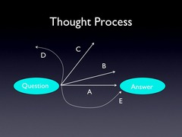
TANGENTIALITY
A form of thinking / speech in which the client tends to wander away from the intended point , & never returning to the original ideas

Slide 46

INCOHERENCE
There is disorders or disconnected thinking . one idea is run into another without connection ,thereby the speech also disjointed or disconnected.

Slide 47
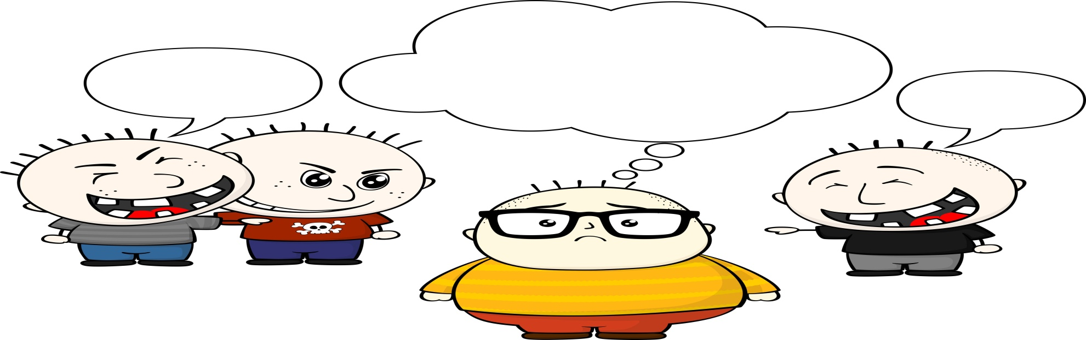
BLOCKING :
There is sudden cessation of thought in the midest of a sentence , the person unable to explain the reason for sudden stoppage .

Slide 48
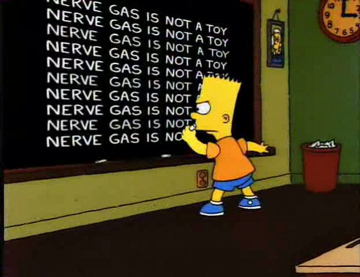
VERBIGERATION
Senseless repetition of some words or phrases over & over again .

Slide 49

WORD SALAD :
Meaningless & incoherent mixture of words or phrases

Slide 50

NEOLOGISM
a word newly coined or an everyday word used in a special way , Not readily understood by others

Slide 51
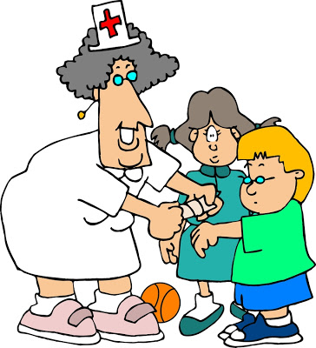
DISORDER OF THOUGHT AT CONTENT LEVEL
HYPOCHONDRIASIS :
Person has an abnormal concern for his health and feels ill without any actual medical basis or pathology .

Slide 52

OBSESSION :
Ideas , thought or impulses that cannot be eliminated from consciousness by logical efforts are called obsessive . Uncontrolled impulses toper form an act repetitively are known as compulsion .

Slide 53
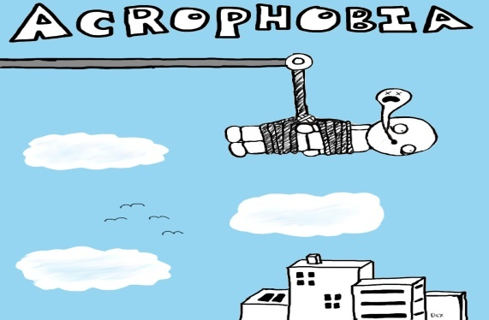
PHOBIAS :
It is an exaggerated pathological fear of a specific type of stimulus or situation.
Ex.: acrophobia , agoraphobia, ergophobia, clustered phobia, xenophobia, zoophobia.

Slide 54

DELUSION
It Is defined as a false unshakable fixed belief, which is not amenable to reasoning and is not keeping with the patient’s socio-cultural and educational background.

Slide 55

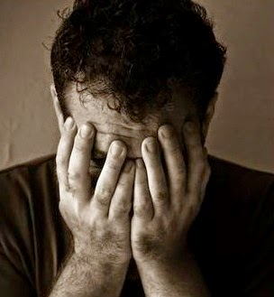
DELUSION OF GRANDEUR
it is also known as expensive delusion , person belief that he is grand one or great .
DELUSION OF SELF ACCUSATION/ GUILT
Belief that one is a sinner and is responsible for the ruin of his family or society

Slide 56
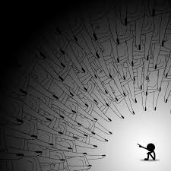
DELUSION OF REFERENCE
In these person falsely feels that he is being talked by others .

Slide 57
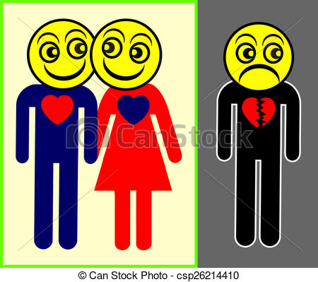
DELUSION OF JEALOUSY
This is the delusion that one’s lover is unfaithful to him/ her

Slide 58

DELUSION OF THOUGHT INSERTION. Clients with delusion will think that their thoughts are implanted by outside agency
DELUSION OF THOUGHT OF BROAD CASTING .
Unspoken thoughts are known to others through broadcasting means. (radio , telepathy )

Slide 59

NIHILISTIC DELUSION ;
these is also known as delusion of negation because that patient denies or dos not accept the existence of his body , his loved once and the world around him.

Slide 60

IDEAS OF CONTROL :
person may complain that people are controlling and reading his mind

Slide 61

DELUSION OF PERSECUTION :
the person has a false belief that members of his family , neighbours or friends are trying to kill him.
LOOSING OF ASSOCIATION :
No link between thoughts and its process .ex.: schizophrenia .

Slide 62
What is flight of ideas ?
To many thoughts came together at a time
Black of ideas
Speechless motion
A & b both
what is Tangentially ?
Patient never reaches the goal of answer
Patient finally reaches his objective
A & b both
Non of above
What do u mean by incoherence ?
Sadness of mood
Thought block
One idea is run into another without connection
Non of above

Slide 63
4. what is neologism ?
Mixing of word
Motiveless mood
Coining of new word
A & both
5. What is delusion ?
(a)False preservation with stimuli
(b) Aggressive
False , fixed belief
All of above
Key - AACCC

Slide 64
DISORDERS OF AFFECT
Affect and mood are used to explain the emotional condition of an individual. Affect can be called as the individual’s inner feeling at a given moment.
Disorders of affect can be as

Slide 65

PLEASURABLE AFFECT:
EUPHORIA :
Mild elevation of mood in which feeling of elevated mood with optimism self satisfaction not keeping with on going event. it is mostly seen in patient with hypomania episodes.
ELATION :
Moderate elevation . A feeling of confidence & enjoyment

Slide 66

EXHALTATION :
A feeling or state of severe happiness .delusion of grandeur
ECSTACY :
Very severe elevation of mood extreme well be associated with feeling of blush and grace

Slide 67
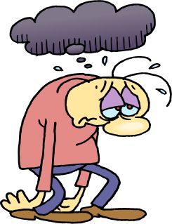
UNPLESURABLE AFFECT :
DEPRESSION
in these the person will be complete quiet , restrained , unhappy and pessimistic.

Slide 68

GRIEF OF MOURNING :
it should be differentiated from depression . it is due to loss of close personal association . this may be a feeling but when persist for a longer duration it becomes a disorders or affect.

Slide 69
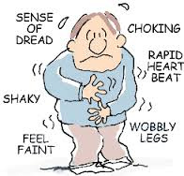
OTHER AFFECT
Anxiety :
it is an unplesurable reaction to an unreal or imaged danger , where is fear is a reaction to a real or threatened situation .
physiological characteristics such a alerted respiration rate , increased heart rate , pallor , dryness of mouth , incensed sweating and feeling of weakness.

Slide 70


PANIC :
it is a state of extreme , acute , intense anxiety accompanied by disorganization . of ego functions.
APATHY :
it is absence of affect . the person shows inadequate sensitiveness to the experience that normally give rise to pleasure or pain .

Slide 71

INAPPROPRIATE AFFECT
There is disharmony in feelings to a situation . person smile when the situation demands seriousness.

Slide 72
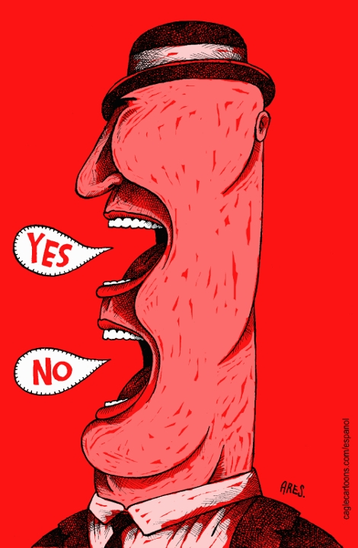
AMBIVALENCE
it is a term which means the individual has two contradictory ideas or feeling at the same time .
ex.: the child having the feeling of both love and hate to words his parents.

Slide 73
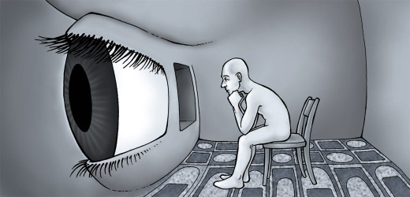
Depersonalization :
A persons subjective sense of being unreal , strange or unfamiliar.

Slide 74

LABILE THOUGHTS
Rapidly shifting emotions , unrelated to external stimuli.
DEREALIZATION
client feels that the outside the world is unreal .
BLUNT OF IDEAS
Reduced of emotions from normal variations.

Slide 75

DISTURBANCE IN SPEECH PATTERN
Mutism
not talking at all. Ex.: severe mental retardation
Aphonia
inability to produce sound because of paralysis of vocal cord.
Aphasia
inability to speak due to damage to the speech centre.

Slide 76
AMNESIA
it is also known as complete , partial ,continues or circumscribed absence of memory .
RETROGRADE AMNESIA
amnesia involves only past events not progressive.
when did you came to the hospital ? or we can ask “ when was your born ?
ANTEROGRADE AMNESIA:
it involves forgetting the recent events.
what did you have in morning breakfast ?
CIRCUMSCRIBED AMNESIA
: it involves forgetting some event or group of events which
we can tell short story and ask to recall after some time.

Slide 77
PARA AMNESIA
it is a false recollection where the patient talks about those events which never took place or gives a false colouring to those that did happen.

Slide 78
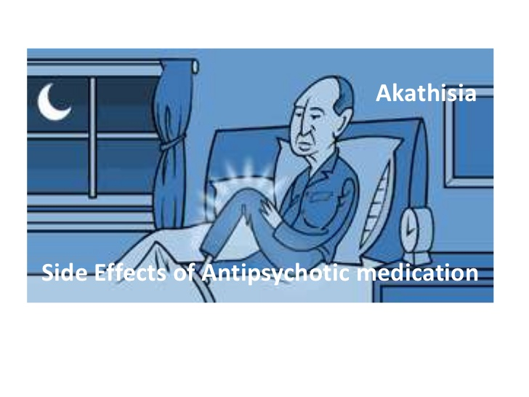
OTHERS
Akasthisia
It is known as motor restlessness, inability to sit still.
Anhedonia
Inability to experience pleasure in any activity.

Slide 79
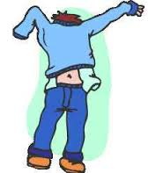

Apraxia:
Inability to carry out normal activities despite intact motor function.
Avolition :
It is known as lack of motivation

Slide 80

CLANG ASSOCIATION
Client uses two words with a similar sound.
(choice of words is determined by their sound and not by their meaning , which often reduces the intelligibility of speech .) it is mostly seen in patient with mania..

Slide 81
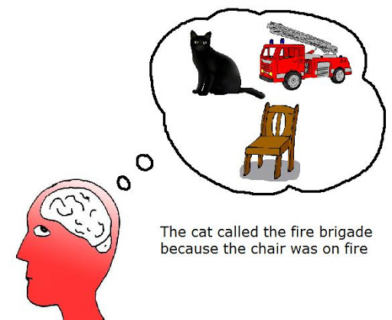
CONFABULATION
The unconscious filling of memory gaps by imagined or untrue experiences due to memory impairment. it is most often association with organic pathology .

Slide 82
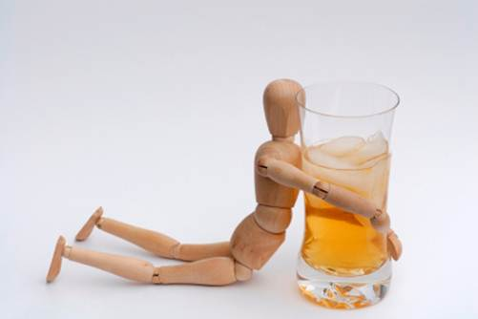
CRAVING
It is strong inner drive to use a substance in situations of substance dependence.

Slide 83
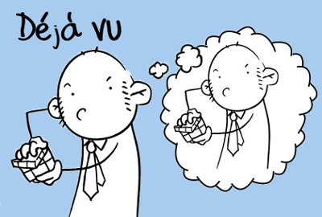
déjà vu
A subjective feeling that an experiences , which is occurring for the first time , has been experienced before.

Slide 84

DEMENTIA:
Global impairment of intellectual functions that usually is progressive and that interferes with normal social and occupational activities.

Slide 85
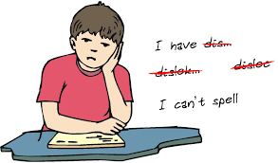
DYSLEXIA
Learning disorders in the reading domain.

Slide 86
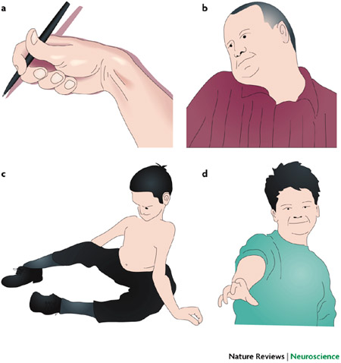
DYSTONIA
Muscles rigidity that affects posture , gait , eye movement .

Slide 87
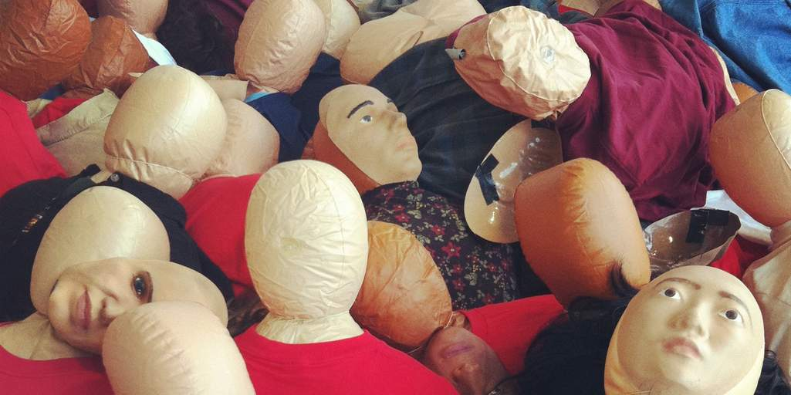

FETISHISM
Erotic stimulations or sexually arousing fantasies involving contact with non-living objects ,such as bras,underpents, shoes, gloves etc.
FLAT AFFECT
Absence or near absence of any sign of affective expression, voice monotonous, face immobile.

Slide 88

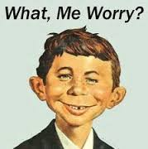
EUSTRESS
Positive and motivating stress shown by one’s confidence in the ability to master a challenges or stressor
FREE FLOTING ANXIETY
Occurs when a person is unable to connect the anxiety to a stimulus.

Slide 89

FUGUE
Dissociative disorders in which there is an inability to recall one’s past or identity accompanied by sudden and unexpected travel away from home.

Slide 90
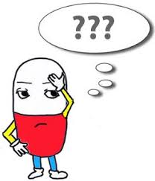
JAMAIS VU
Failure to recognize events that have been encountered before.

Slide 91
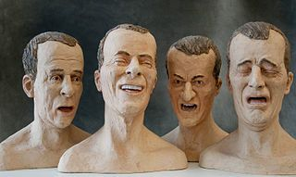
LABILE AFFECT
Rapidly shifting emotions ,unrelated to external stimuli.

Slide 92

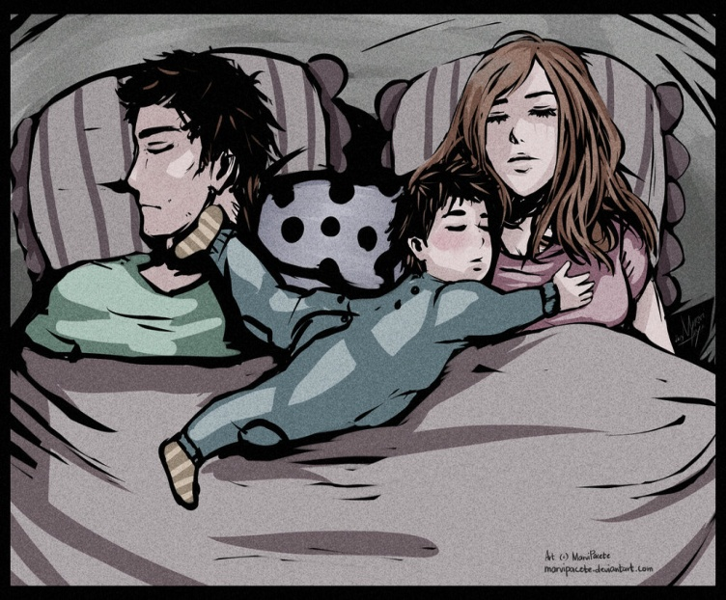
NARCISSISM:
Obsessive and exclusive interest in one’s own self.
OEDIPUS COMPLEX:
Attachment of the child to the parent of the opposite sex, accompanied by envious feelings towards the parent of the same sex.
.

Slide 93


PARANOID :
An adjective applied to individuals who are over –suspicious
PEDOPHILIA: Unnatural desire for sexual relation with children.

Slide 94

PANIC ATTACK :
Intense feelings of fear or terror that occur suddenly and intermittently without warning
POVERTY OF SPEECH :
Decreased speech production

Slide 95
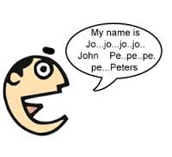
STUTTERING :
Repetitive or prolonged sounds or syllabus with pauses and monosyllabic broken words.

Slide 96
SUNDOWING SYNDROME :
A phenomenon in dementia in which the symptoms of restlessness and confusion seem to worsen in the late afternoon ,evening or during night hours.

Slide 97
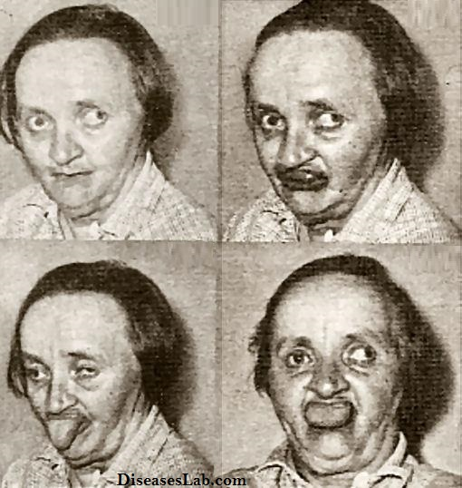
TARDIVE DYSKINESIA:
Syndrome of symptoms characterised by bizarre facial and tongue movements, a stiff neck ,and difficulty swallowing . it may occurs as an adverse effect of long term therapy with some antipsychotic medications

Slide 98
What is apathy ?
Absence of affect
Client feels that the outside the world is unreal
A & b both
Non of above
What is mutism ?
Excessively rapid thoughts
Not talking
Unconsciousness
A & C both

Slide 99
3. What is apraxia ?
Motor restlessness
Lack of motivation
Inability to carry out normal activities
All of above
4.What is dyslexia ?
Muscles rigidity
Learning disorders
Memory impairmnent
All of above

Slide 100
What you mean by labile affect ?
Rapidly shifting emotions,unrelated to external stimuli
Exaggerated sence of self worth
Inability to recall important personal information
A & c both
abcba

Slide 101



