Slide 1

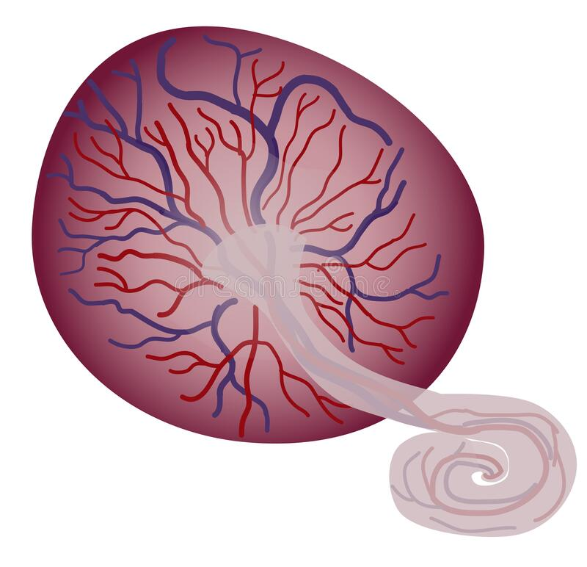

PLACENTAL DEVELOPMENT
PRIYANKA R. CHAUDHARY
Assistant professor, OBG Nursing
Sumandeep Nursing College

Slide 2

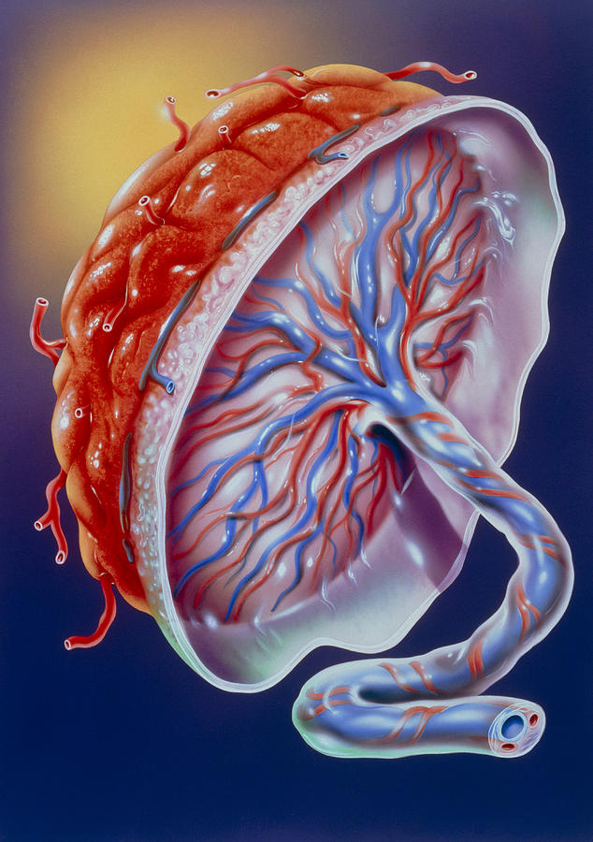
Definition of placenta
The placenta is an organ that develops in your uterus during pregnancy. This structure provides oxygen and nutrients to the growing fetus and removes waste products from fetal side.

Slide 3
Placental Implantation
placenta Begins to form on the 6th day after fertilization
Embedding of blastocyst in the wall of uterus
Disappearance of zona pellucida
Cells of the trophoblast stick to the endometrium
After implantation of the embryo, the uterine endometrium is called the decidua

Slide 4
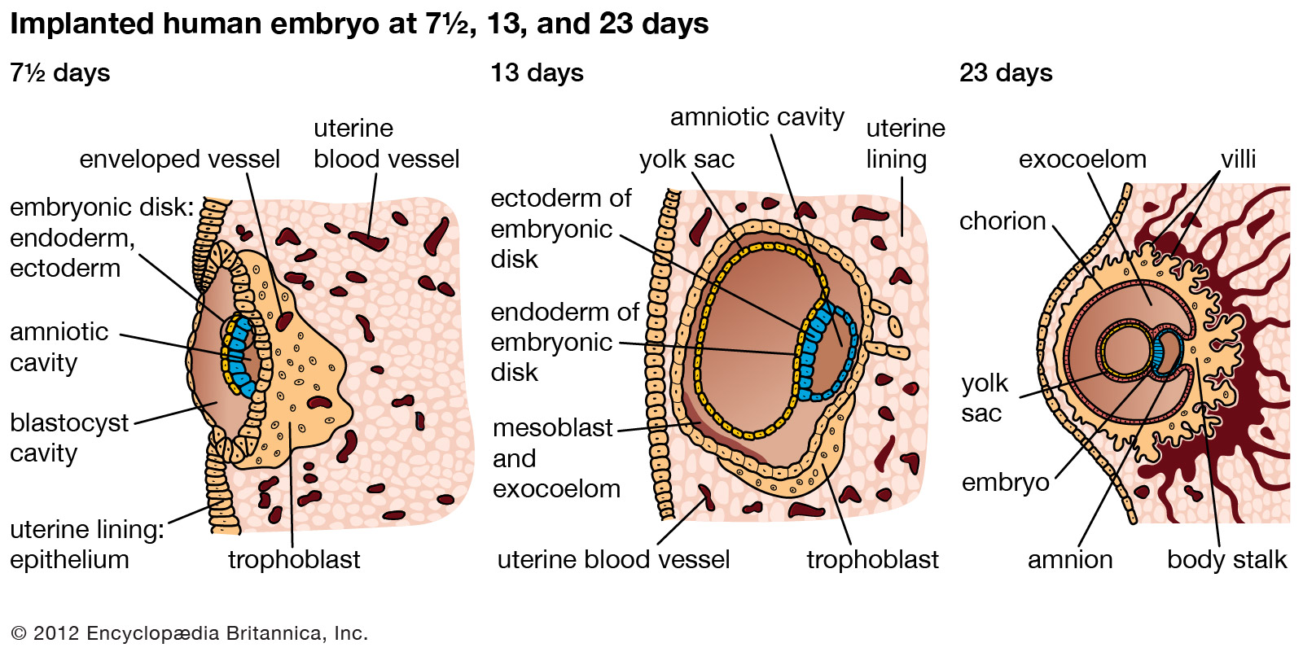
Implantation of placenta
Priyanka R. Waghmare, Asst. Prof. OBG Nsg, Sumnadeep Nursing college, SVDU

Slide 5
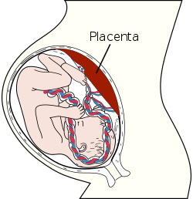
Site of placental implantation
Normally placenta develops at the junction of fundus and posterior wall of uterus
- At upper uterine segment

Slide 6
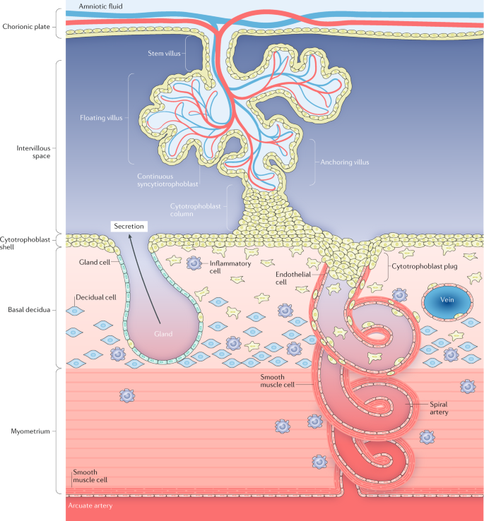
Priyanka R. Waghmare, Asst. Prof. OBG Nsg, Sumnadeep Nursing college, SVDU

Slide 7
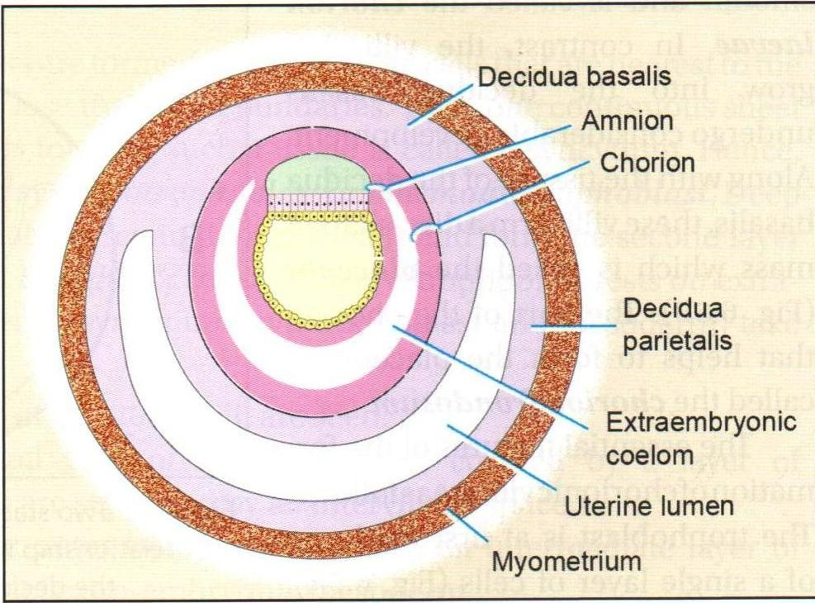
Priyanka R. Waghmare, Asst. Prof. OBG Nsg, Sumnadeep Nursing college, SVDU

Slide 8
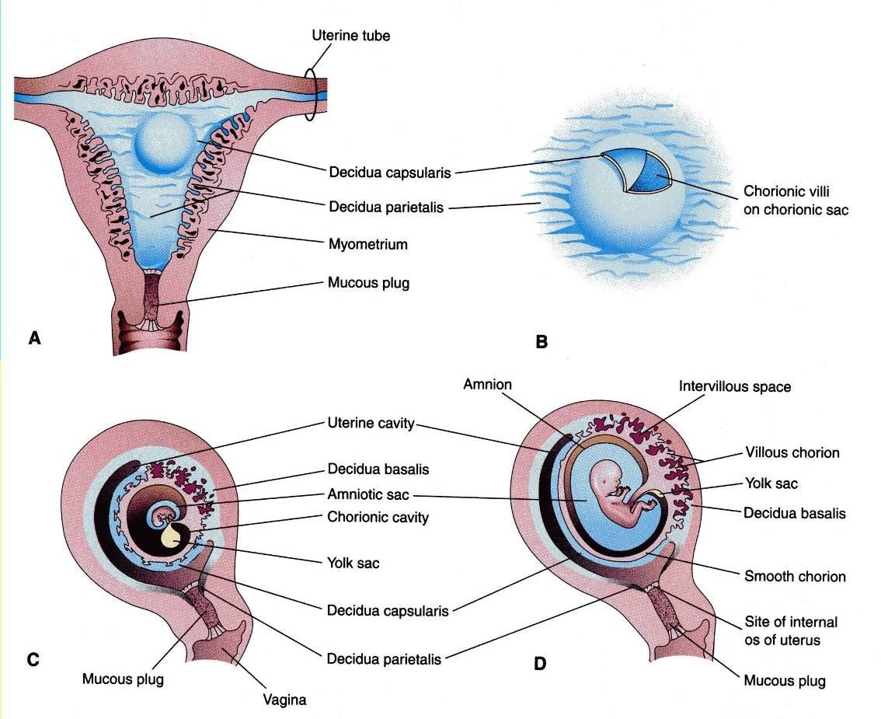
The Decidua
After implantation of the embryo, the uterine endometrium is called the decidua.
Priyanka R. Waghmare, Asst. Prof. OBG Nsg, Sumnadeep Nursing college, SVDU

Slide 9
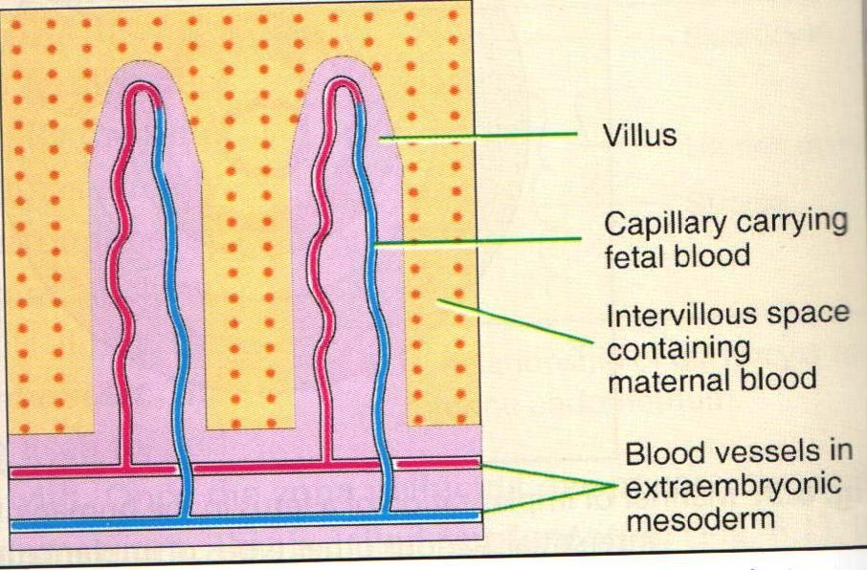
Chorionic Villi
Villi are the essential functional elements of the placenta.
Small finger like processes.
Surrounded by maternal blood.
Fetal blood circulates in their substance through capillaries.
Called as Chorionic villi as arises as offshoots from chorion.

Slide 10
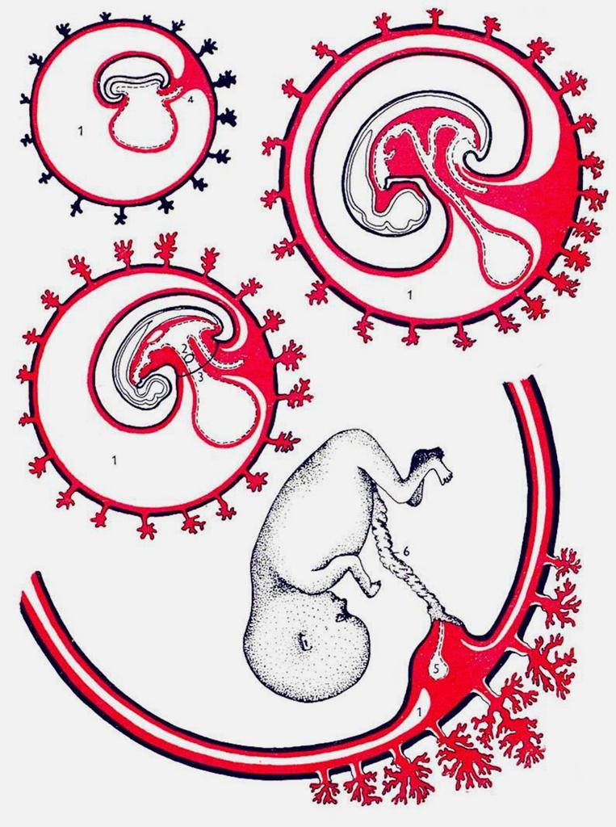
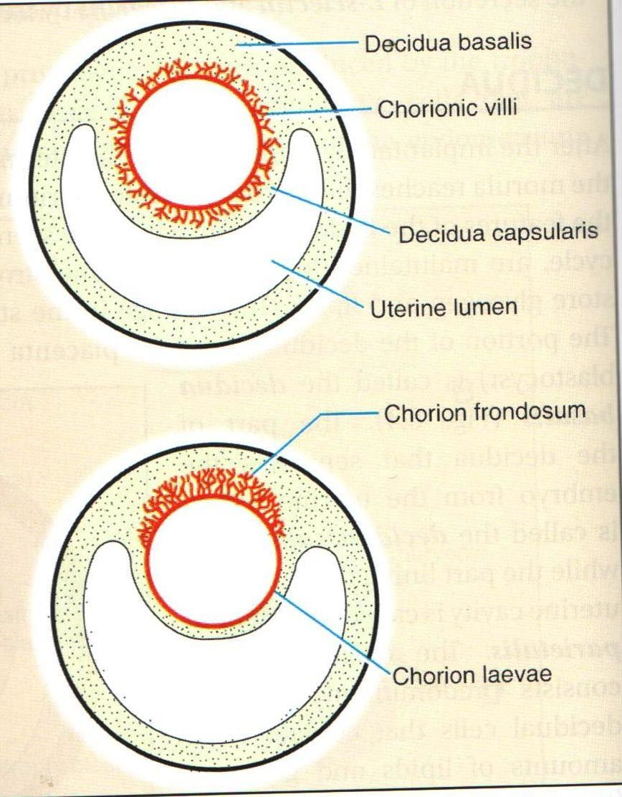
Priyanka R. Waghmare, Asst. Prof. OBG Nsg, Sumnadeep Nursing college, SVDU

Slide 11
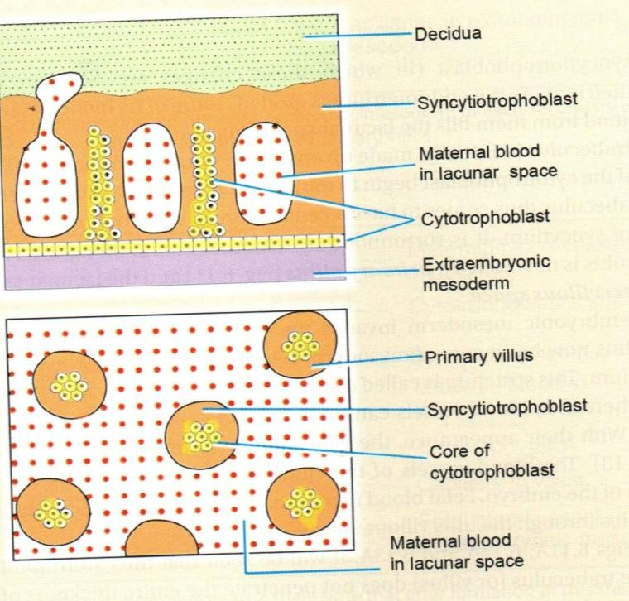
Primary Villus (Day 13-14)
All elements (syncytium, cytotrophoblast and extraembryonic mesoderm) take part in formation of chorionic villi. Three stages in formation of chorionic villi are seen:
Primary villus: central core of cytotrophoblast covered by a layer of syncytiotrophoblast. Adjoining villi are separated by an intervillous space.

Slide 12
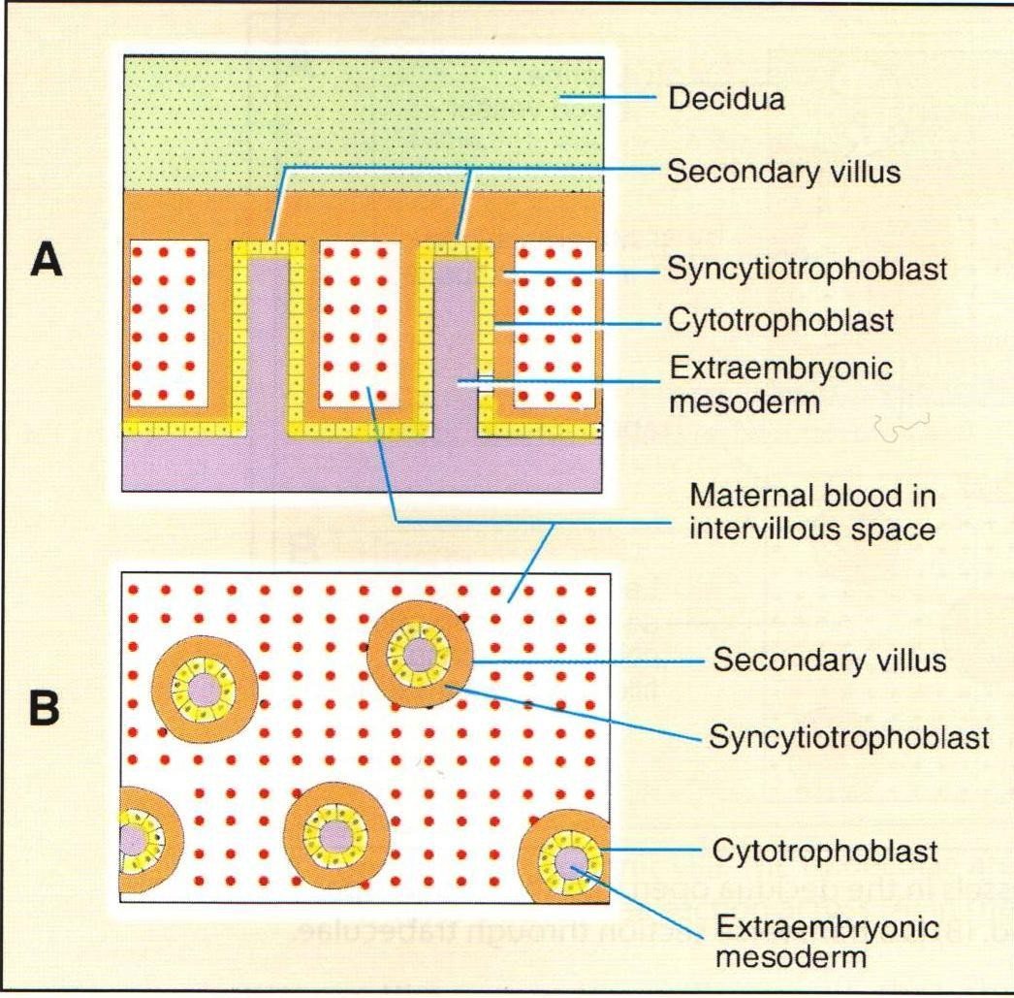
Secondary Villus (Early 3^{rdweek})
Central core
of
extraembryonic mesoderm covered successively by cyto and syncytiotrophoblasts.

Slide 13
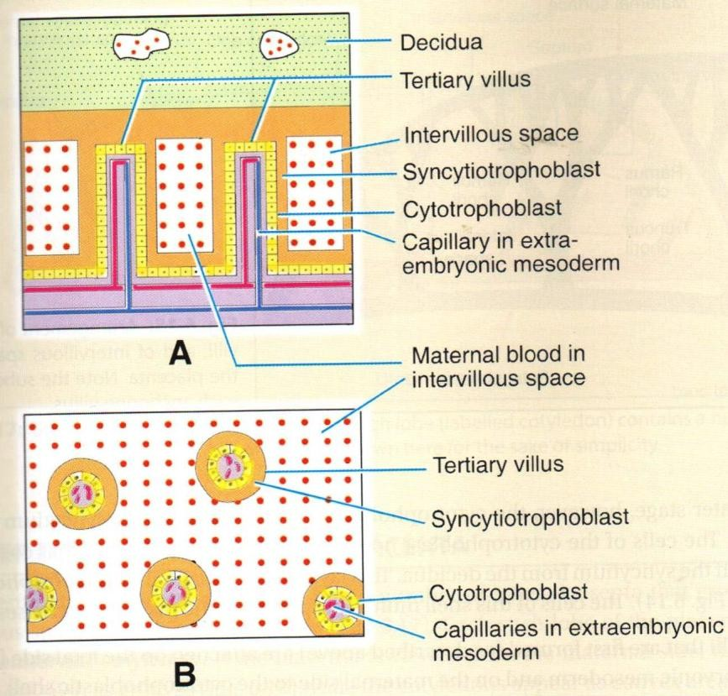
Tertiary Villus (End of 3^{rd WEEK})
Appearance of blood vessels in the mesoderm forming core of each villus.

Slide 14
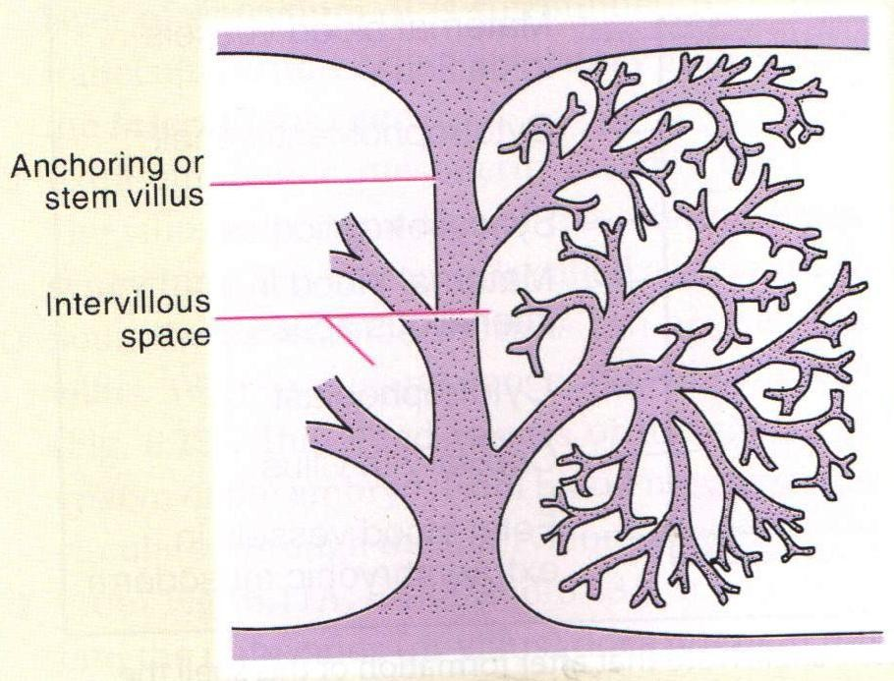
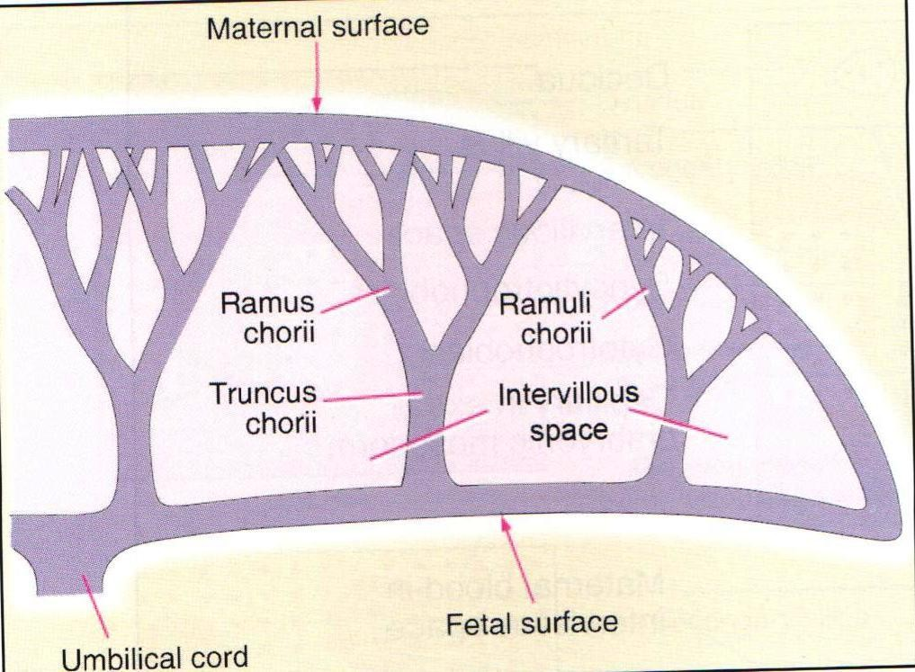
Anchoring villi & its subdivisions
Priyanka R. Waghmare, Asst. Prof. OBG Nsg, Sumnadeep Nursing college, SVDU

Slide 15
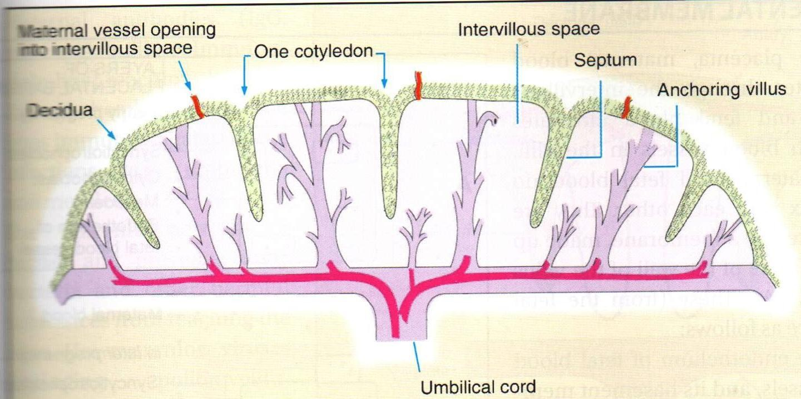
Fully formed Placenta (4th month)

Slide 16


Slide 17


