Slide 1

Rh INCOMPATIBILITY
BY:
Priyanka R. Waghmare
Assistant Professor, OBG Nsg
Sumandeep Nursing College, SVDU

Slide 2
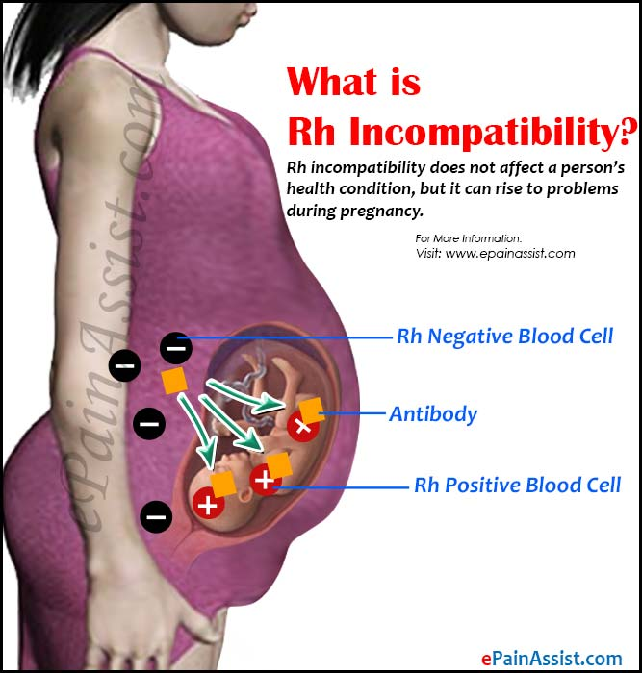

Slide 3
The ABO Blood Groups
Blood Group | Antigens on RBC s | Antibodies in Serum | Genotypes
A | A | ANTI-A | AA & AO
B | B | ANTI-B | BB &BO
AB | A&B | NEITHER | AB
O | NEITHER | ANTI-A & ANTI-B | OO

Slide 4
IF YOUR BLOOD TYPE IS . . .
Type | You Can Give Blood To | You Can Receive Blood From
A+ | A+ AB+ | A+ A- O+ O-
O+ | O+ A+ B+ AB+ | O+ O-
B+ | B+ AB+ | B+ B- O+ O-
AB+ | AB+ | Everyone
A- | A+ A- AB+ AB- | A- O-
O- | Everyone | O-
AB- | AB+ AB- | AB- A- B- O-
B- | B+ B- AB+ AB- | B- O-

Slide 5
    RH AND ABO INCOMPATIBILITY
RH INCOMPATIBILITY :-
RH Incompatibility can occur when a women an Rh negative blood type is carrying a baby with an Rh positive blood type. The individual having the antigen is called Rh positive & in whom it is not present , is called Rh negative.

Slide 6
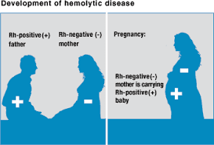

Slide 7
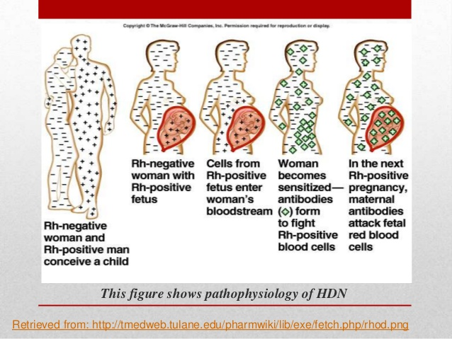

Slide 8
ABO INCOMPATIBILITY
ABO iso-immunisation occurs usually when the mother is blood group O and the baby is group A, or less often group B. type O blood contains both anti-A and ant-B antibodies. These antibodies are usually of the IgM class and are too large to cross the placenta. However, some women produce antibodies and can cross the placenta. Once in the fetal circulation, the IgG anti-A and anti-B antibodies attach to fetal red cells and destroy them.
)

Slide 9
INCIDENCE :-In India , the incidence is about 5-10% in hospital statistics.

Slide 10
TYPES OF ANTIBODIES
Saline agglutinin ( IgM):-
This type of antibody is the first to appear in the maternal circulation & agglutinates red cells containing D when suspended in saline .
Albumin agglutinin ( IgG):-
It is also called incomplete or blocking antibody. It will agglutinate the red cells containing D only when suspended in 20% albumin .

Slide 11
FETAL AFFECTION BY THE RH ANTIBODY
The antibody formed in the maternal system(IgM) cross the placental barrier & enters into the fetal circulation. The antibody will not have any effect on Rh –ve fetus. If the fetus is Rh +ve, the antibody becomes attached to the antigen sites on the surface of the fetal erythrocytes. The affected cells are rapidly removed from the circulation by the reticulo-endothelial system.

Slide 12
MANIFESTATIONS OF THE HAEMOLYTIC DISEASE
Clinical manifestations of the hemolytic disease of the fetus & neonate:-
Hydrops fetalis
Congenital anemia of the newborn

Slide 13
HYDROPSFETALIS: [Most serious]
Excessive destruction of fetal cell
Severe anemia, tissue anoxemia, metabolic acidosis.
Hyperplacia of placental tissue: increased transfer of O2, fetal anoxemia.
Damage liver. Hypoproteinemia, Generalised edema. Ascites [hydrops fetalis]
fetal death due to cardiac failure.

Slide 14
ICTERUS GRAVIS NEONATRUM:
Effect less hymolysis.
Baby is born alive without jaundice but arise in 24 hours of birth
Fetus in utero: destruction of fetal red cell Unconjugated bilirubin
Excrete through placenta enters in amniotic fluid
Baby becoms jaundiced.
If bilirubin increased and cross the blood brain barrier.
Kernicterus.

Slide 15
Affection of the mother
The mother may also be affected somewhat. The increase evidence of,
1) Pre-eclampsia
2) Polyhydramnios
3) Big size baby with hazards
4) Postpartum haemorrhage due to big placenta & blood coagulopathy.
5) Maternal syndrome – the salient features are generalised oedema, proteinuria and pruritis.

Slide 16
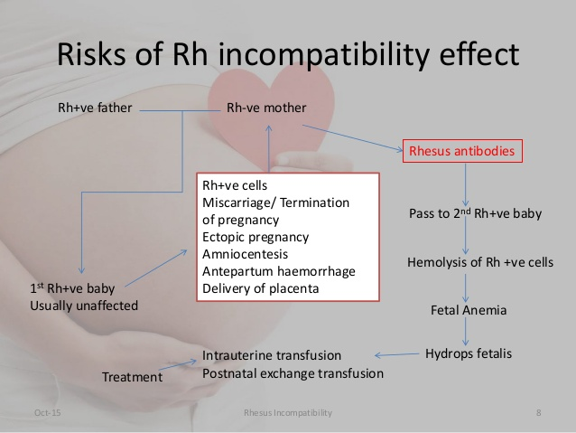

Slide 17
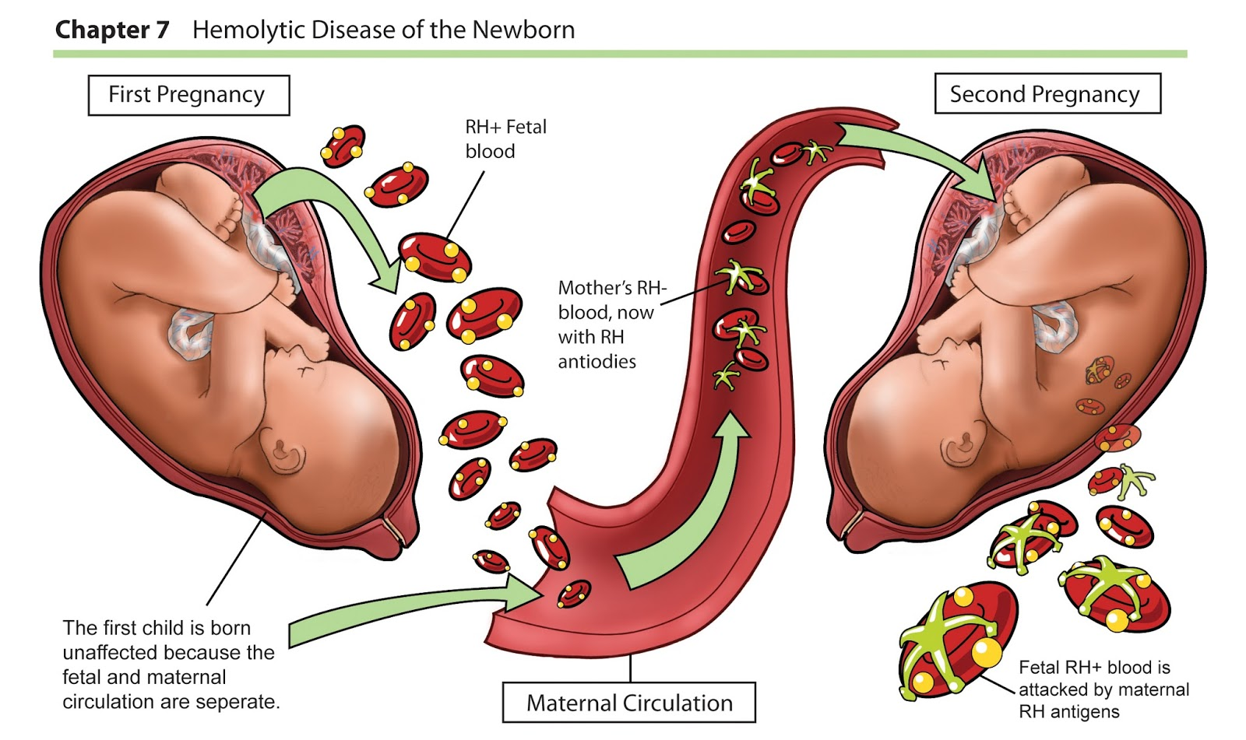

Slide 18
PREVENTION OF RH- IMMUNISATION
To prevent active immunsation.
To prevent or minimize feto-maternal bleed
To avoid mismatched transfusion.

Slide 19
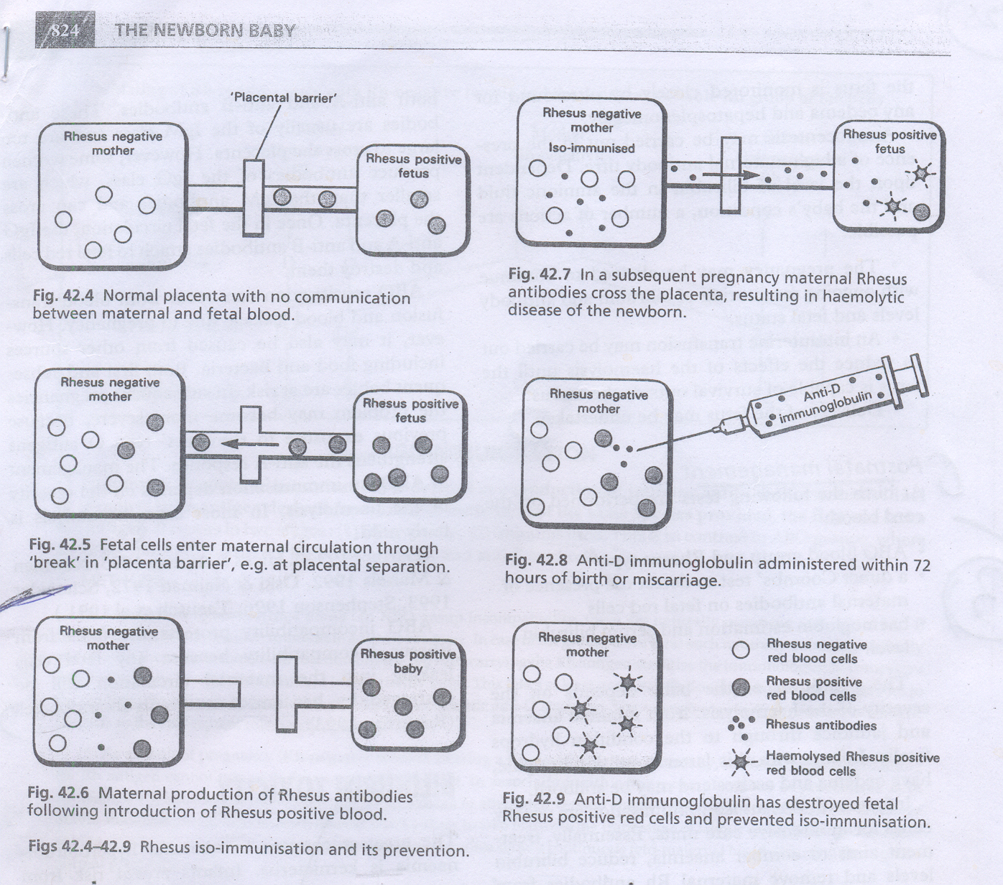

Slide 20
ANTENATAL INVESTIGATION PROTOCOL OF Rh NEGATIVE MOTHERS
Aims :
To detect whether the woman has already been immunized to Rh antigen.
To forecast the likely affection of the baby.
To anticipate and formulate the line of management of likely affected baby.

Slide 21
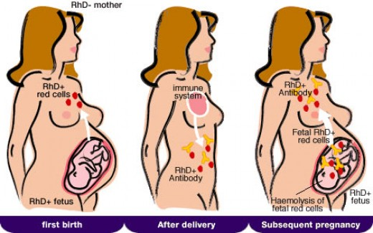

Slide 22
OBSTETRIC HISTORY
If the woman is a primigravida with no previous history of blood transfusion, it is quite unlikely that the baby will be affected.
In a parous woman, a detailed obstetric history has to be taken. The classic history of fetal affection in the form of stillbirth or neonatal death due to severe jaundice following one or two uneventful births is quite suggestive.

Slide 23
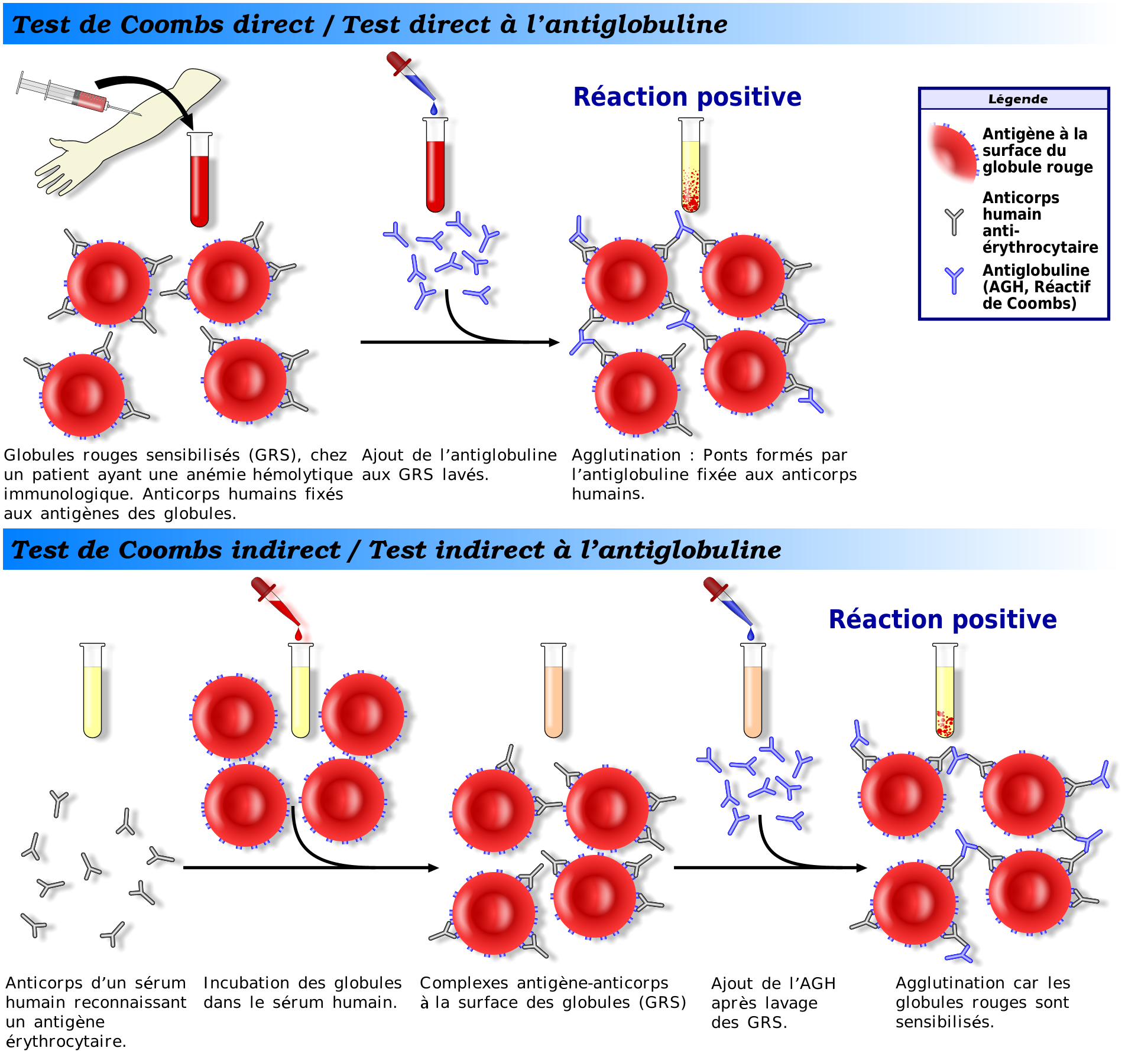
ANTIBODY DETECTION:
In all cases of Rh-negative women irrespective of blood grouping and parity, albumin antibody is detected by indirect coombs’. Test.

Slide 24
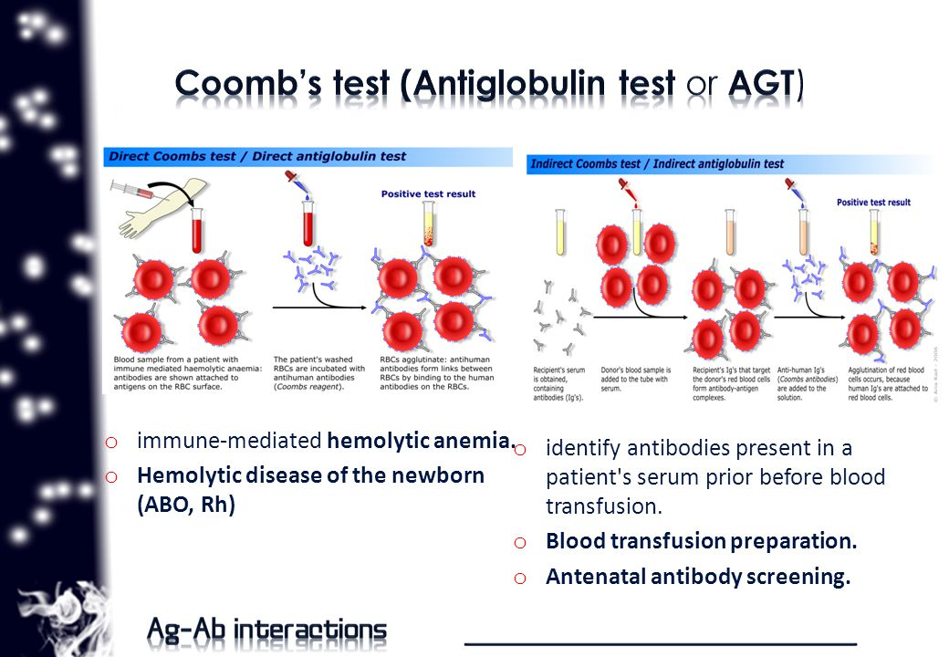

Slide 25
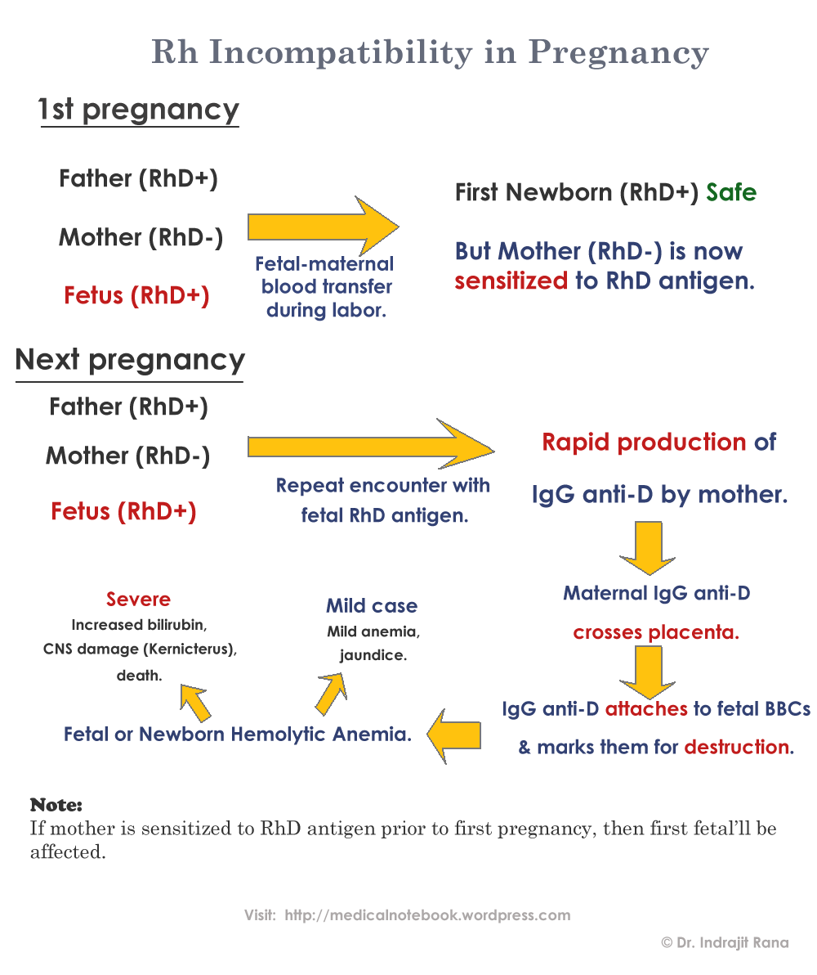

Slide 26
PLAN OF DELIVERY
Unimmunised mothers :
In cases where there is no detectable antibody found during pregnancy, an expectant attitude is followed till term. Tendency of pregnancy to overrun the expected date should not be allowed.
Immunized mothers :
As mentioned previously, whenever there is evidence of hemolytic process in the fetus in utero, the patient should be shifted to an equipped centre's a specialized to deal with Rh problem.

Slide 27
METHOD OF TERMINATION
Amniotomy (low rupture of the membranes) is quite effective, if termination is done near term, as most of the cases are parous women. Vaginal prostaglandin gel (PGE2) could be used to make the cervix ripe oxytocin drip may be added, if necessary, failing which caesarean section should be done.
Caesarean section – In cases when termination has to be done prematurely (say 34-37 weeks), the cervix will be unfavorable and considering the severity of affection and urgency of termination, caesarean section is a safe procedure.

Slide 28
ANTENATAL MANAGEMENT
During pregnancy all women have their blood grouped for ABO and Rhesus type. Women who are Rh negative are screened for Rhesus antibodies with an indirect Coombs’ test.
In the absence of antibodies the blood is retested at 28 and 34 weeks of pregnancy.
Amniocentesis may be carried out in the presence of a high maternal antibody titre. Dependent upon the level of bilirubin in the amniotic fluid and the baby’s condition.

Slide 29
CARE DURING DELIVERY
Vaginal delivery :
Careful fetal monitoring is to be done to detect at the earliest, evidences of distress.
Prophylactic ergometrine during second stage should be withheld.
Gentle handling of the uterus in the third stage
To take care of postpartum haemorrhage.

Slide 30
CAESAREAN SECTION
to avoid spillage of blood into the peritoneal cavity.
Routine manual removal of placenta should be withheld.
Clamping the umbilical cord
Collection of cord blood for investigation

Slide 31
POSTNATAL MANAGEMENT
At birth the following tests are performed on the cord blood :
ABO blood group and Rhesus type.
A direct coombs’ test to detect the presence of maternal antibodies on fetal red cells
Haemoglobin estimation and serum bilirubin level.

Slide 32
Dose of Rh- anti D (IgG):
    Anti D gamma globulin is administered intramuscularly to the mother 300 microgram following delivery,
    100 microgram following abortion,
    Beyond 20 weeks and 50 microgram following abortion, below 20 weeks and in case of ectopic.

Slide 33
NURSING DIAGNOSIS:
Risk for injury to neurons and cells in the kidney, pancreas and intestine related to the hyperbilirubenemia
Impaired gas exchange R/T hemolytic anemia
Risk for fluid volume deficit R/T phototheraphy
Risk for parental anxiety R/T hyperbilirubenemia, its management and potential sequales.
Risk for impaired skin integrity R/T increased stooling while undergoing phototheraphy.
Risk for ineffective thermoregulation (increased or decreased) R/T phototheraphy.

Slide 34
Thank You

