Slide 1

REPRODUCTIVE TRACT INFECTION & SEXUAL TRANSMITTED DISEASES
Priyanka R. Waghmare
Assistant Professor, OBG Nsg
Sumandeep Nursing College
SVDU

Slide 2
INTRODUCTION:
Reproductive tract infections (RTIs) are defined as any infections of the reproductive system. They include sexually transmitted infections (STIs) and other infections of the reproductive system that are not caused by sexual contact. These other infections may be the result of the overgrowth of the bacteria and other organisms that normally live in the vagina. RTIs also include infections that result from inadequate infection prevention practices by health care providers.

Slide 3
Sexual transmitted disease:
Group of communicable diseases transmitted by sexual contact.
Caused by a wide range of bacterial, viral
,protozoal and fungal agents and ectoparasites.
Previously known as veneral diseases

Slide 4
Etiology
Bacteria
Chlamydia
Viruses
Fungi
Protozoa
Parasites

Slide 5
Gonorrhea
An acute ,infectious sexually transmitted disease of mucous membranes of the genitourinary tract,eyes,rectum & throat.
Causative organism
Caused by gram-negative oxidase positive, diplococcus ,Neisseria gonorrhoea.
Microbiology: Gm -ve, coffee bean (kidney shape) intra & extracellular diplococci arranged in pairs or tetrads and are mostly intracellular

Slide 6

Mode of transmission:
Sexual intercourse during delivery causing conjunctivitis and corneal opacity to the masturbation
Polymorphonuclear
Leucocytes
Extrcellular diplococci
Intracellular

Slide 7
PATHOGENESIS
A venereal disease; name employed by Galen
First step in infection is adhesion of gonococci to urethra or other mucosal surface.
The incubation period is 2-8 days.
In men, the disease start as an acute urethritis with a discharge containing gonococci in large numbers. infection extends along the urethra to prostrate, seminal vescicle & epididymis

Slide 8
In women the initial infection involves urethra and cervix uteri.It may extend to Bartholin’sglands,endometrium&fallopian tube.pelvic inflamatory disease and salpingitis may lead to sterility.
Conjunctivitis may occur,usually due to autoinoculation by patients fingers
Blood invansion may occur from the primary site of infection & may lead to metastatic lesions such as arthritis,ulcerative endocarditis.
A non venereal infection is gonococcal opthalmia in newborn - direct infection during passage through birth canal.
-controlled by instilling 1% silver nitrate solutio
into the eyes of newborn.

Slide 9
GONORRHEA IN PREGNANCY:
The manifestations of the disease are the same as in the non-pregnant state.
If the infection takes place during pregnancy, it tends to be more acute.
Infection increases the risk of preterm labor,PROM, intrapartum and postpartum infection.
The baby may be affected during labor while passing through the infected birth canal resulting in ophthalmia neonatorum.

Slide 10
The diagnosis is to be confirmed by
bacteriological identification of intracellular Gram-negative diplococci from urethral or cervical smear.
Serological test is to be done to exclude concurrent syphilitic infection.
Test for cure
swabs from urethra, vagina, cervix.
Adequate treatment till at least one test of cure
Serologic tests for syphilis must be done after 3 months as it may be associated but suppressed by treatment of gonorrhea

Slide 11
In adult female:
* Sites commonly affected are: part of urethra and parauretheral gland, cervix, rectum and fallopian tube
* Sites less commonly affected are: vulva, vagina, and bladder
Complications:
- Bartholin or Skene's abscess
- Salpingitis
- Hydrosalpinx and pyosalpinx
- Tubal block
- Pelvic abscess
- Chronicity of infection

Slide 12
Clinical picture: 50% are asymptomatic and examination may reveal no abnormality
Local gonorrhea:
1-Offensive vaginal discharge
2- Rectal irritation
3-Uretheritis: dysuria
4- Bartholinitis: may proceed to bartholin abscess
5- Acute cervicitis: purulent cervical discharge from the ext. os. The cervix looks red
NB: PID is the most common complication. Rarely, the asymptomatic carrier develops a disseminated infection with polyarthralgia, tenosynovitis and dermatitis or meningitis or endocarditis.

Slide 13
Diagnosis:
By microscopic identification of gonococci in stained smear from vaginal and urethral discharge.
- Culture of N -Gonorrhea for vaginal and cervical discharge on Thayer-Martin medium
Treatment:
by a single oral dose of one of the following:
Ofloxacin 400 mg
- Cefixime 400 mg
- Amoxicillin 3 gm
- Ceftriaxone 125 mg
- Ciprofloxacin 500 mg
- Azithromycin 1 gm
.

Slide 14
CONTROL OF GONORRHEA
Consist of early detection of cases
,contact tracing,health education and other general measures.
As the disease does not confer any immunity vaccination has no place in prophylaxis.
30

Slide 15
2- Chlamydial infection
One of the most common STIs -caused by Chlamydia Trachomatis
Bacteriology
: Chlamydia is intermediate between bacteria and viruses. It is gm ‑ve, non motile, obligate intracellular.
Mode of transmission:
by sexual contact and transplacental (vertical transmission at delivery(
Incubation period :6-19-days
Pathology
: like gonorrhea, the organism infects columnar or transitional epithelium of the urethra and endocervix with
extension to the endometrium, endosalpinx and pelvic peritoneum

Slide 16
Clinical Picture:
Often Infection Is Asymptomatic Contributing To Spread Of The Disease.
Acute Bartholinitis
Cervicitis: Discharge (Mucopurulent ) &Cervical Friability
Acute Urethral Syndrome:
Painful Urination In Absence Of Significant Bacteriuria

Slide 17
Complications:
  PID (salpingoophritis & pelvic peritonitis(
  nfertility
  Ectopic pregnancy
  Abortion, S.B.
  Chorioamnionitis and preterm labour
  Neonatal complication as conjuctivitis
Diagnosis:
  - Direct fluorescein conjugated monoclonal antibody test: (available in kits form) is rapid sensitive and specific. It is the most frequently used test.
  Tissue culture is costly, delay diagnosis (need time), so it is used infrequently.

Slide 18
Chlamydial infection is becoming the common sexually transmitted pathogen. The
organisms are found in urethra, endocervix and rectum. C. trachomatis is an obligate intracellular bacteria.
The adverse effects in pregnancy are: Preterm labor, PROM, Chorioamnionitis, stillbirth, perihepatitis (Fitz-Hugh-
Curtis syndrome). Puerperal endometritis or acute salpingo-oophoritis may develop. Neonates may develop
conjunctivitis or pneumonia.

Slide 19
Treatment:
treatment is given routinely for both.chlamydia, gonorrhea It. Treatment by one of:
  - Doxycycline 100 mgm orally/ twice daily for 7 days.
  - Azithromycin 1 gram orally, single dose.
  Ofloxacin 300 mgm orally, twice daily for 7 days.
N.B. Erythromycin 500 mg orally / 6 hours or amoxicillin 500 mg orally t.d.s daily for 7 days are alternatives in pregnant patients
tetracycline or erythromycin ointment 1% is to be applied to the infant’s eyes soon
following birth. Neonatal infection is treated with erythromycin 50 mg/kg/day 4 times a day for 14–21 days.

Slide 20
SYPHILIS:
Syphilis is a sexually transmitted disease caused by Treponema pallidum. Incidence is rising due to upsurge of HIV infection and the IV drug abuse.

Slide 21
Syphilis
Bacteriology:
Treponema pallidum
(spirochete)
Incubation period:
10‑90 days

Slide 22
Primary stage:
  Chancre appear on genitals or extra genital sites in 2-4 weeks after exposure to infection
Initially the lesion is painless papule which ulcerates in the centre so t10 hat the fully developed chancre is an indurated
The canchre heals without scarring even in the absence of treatment.
Antibody tests are positive in 1-2 weeks after the appearance of canchre.

Slide 23
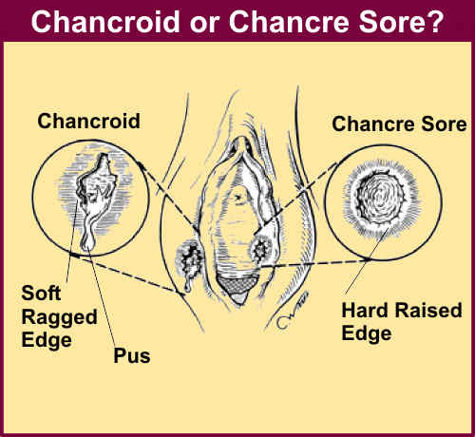
Secondary stage:
fever, generalized enlargement of lymph nodes and flat condylomata on the genital tract (condylomata lata is macular, papular or occasionally pustular and nodular type rashes). Lesion usually begin 6-8 weeks after the initial chancre
Tertiary stage:
characterized by general neourological, cardiovascular and bone lesions. Occur 1-2years after infection
The lesion is called Gumma which are nodular lesions characterized by granulomatous inflammation

Slide 24
MODE OF TRANSMISSION:
Sexual intercourse resulting in lesions on glans penis,vulva,vagina & cervix
Intimate person-to-person contact with lesions on lips,tongues or fingers
Transfusion of infected blood
Materno-foetal transmission in congenital syphilis if mother is infected
Trans-placental at any gestational age

Slide 25
􀂄 Clinical features of congenital syphilis:
Early: Maculopapular rash, rhinitis, hepatosplenomegaly, jaundice, lymphadenopathy,
chorioretinitis and pneumonia.
􀂄 Late: Hutchinson teeth, deafness, saddle nose, saber shins, hydrocephalus, mental retardation,
clutton joint, interstitial keratitis and optic nerve atrophy.

Slide 26
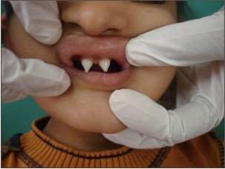
If the baby is stillborn, spirochetes may be detected from the fetal liver or spleen or from the intimal scraping of umbilical vein.

Slide 27
N.B. Without treatment/ pregnancy can end in abortion, still birth, perinatal fetal death or congenital infection.
Diagnosis
: by microscopical dark ground examination of a scrap from the ulcer to see the spirochete or by serological tests (the most sensitive is fluorescent treponemal antibody test(.
Treatment:
- Single dose of 2.4 million units of Benzathine penicillin G intramuscularly. For latent syphilis, 3 such doses are injected one week apart.
- I.M. penicillin:1.2 milion unit for 12 days
- Doxacyclin 100 mg twice daily for 14 days
- Erythromycin 500 mg four times for 14 days.

Slide 28
PREVENTION:
Abstinence from intimate physical contact with an infected person is effective , as is the proper use of a latex condom.
◆ Congenital syphilis - by screening mothers during early pregnancy and treating those who are infected
◆ The first-choice treatment for uncomplicated syphilis - single dose of im benzathine penicillin or a single dose of oral azithromycin.
◆ Doxycycline andtetracycline are alternative choices; but not recommended for pregnant women,due to risk of birth defects.

Slide 29
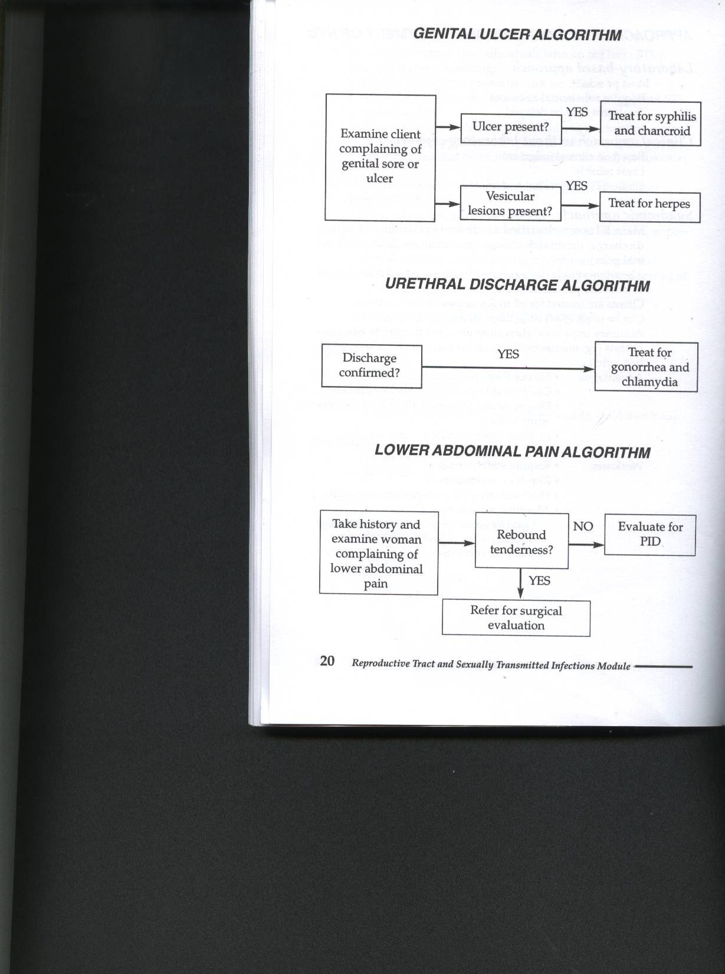
Genital ulcer algorithm
Urethral discharge algorithm

Slide 30


