Slide 1
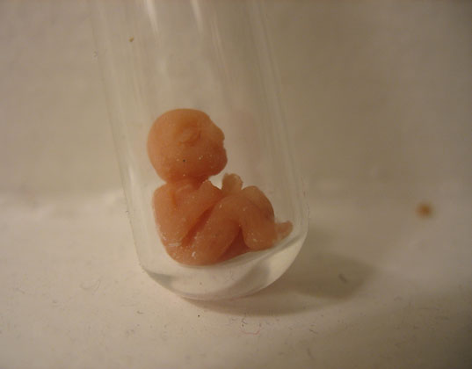

ASSISTED REPRODUCTIVE TECHNOLOGY
COUNSELLING,ETHICAL & LEGAL ASPECTS, RECENT ADVANCEMENT IN INFERTILITY MANAGMENT
Presented By:
Rachana Joshi, Assistant Professor, Sumandeep Nursing College, SVDU

Slide 2

Introduction
INFERTILITY
Infertility is fundamentally the inability to conceive a baby. Infertility also refers to a state of a women who is unable to carry a pregnancy to full term.

Slide 3
ASSISTED REPRODUCTIVE TECHNOLOGY
ART includes all fertility treatments in which both eggs and sperm are handled. In general, ART procedures involve surgically removing eggs from a woman’s ovaries, combining them with sperm in the laboratory, and returning them to the woman’s body or donating them to another woman. They do NOT include treatments in which only sperm are handled (i.e., intrauterine—or artificial—insemination) or procedures in which a woman takes medicine only to stimulate egg production without the intention of having eggs retrieved.

Slide 4
Who is eligible for ART ?
Women with tubal diseases
Unexplained infertility
Endometriosis
Immunologic causes for infertility
Women with premature ovarian failure
Individuals with male factor infertility (e.g., abnormalities in sperm production, function or transport or prior vasectomy)

Slide 5

TREATMENT MODALITIES

Slide 6
OVULATION INDUCTION
Commonly known as fertility drugs, ovulation induction medications can be taken either orally or through injections to stimulate a women’s ovaries to release multiple mature eggs. This improves chances for fertilization and ultimately pregnancy. These medications also control the time that ovulation occurs, fertilization can occur naturally through sexual intercourse or via intra uterine (artificial) inseminations or other in vitro procedures at the time that is most likely to result in conception. Common medication used is Clomiphene Citrate.

Slide 7
Intrauterine Insemination
Artificial insemination (AI) is the least complex of fertility procedures and is often tried first in uncomplicated cases of infertility. AI either involves placing the sperm directly in the cervix (called intracervical insemination) or into the uterus (called intrauterine insemination, or IUI). IUI is the standard AI procedure. IUI is less expensive and poses less risk for multiple births than the more advanced assisted reproductive technologies (ART), such as in vitro fertilization.

Slide 8
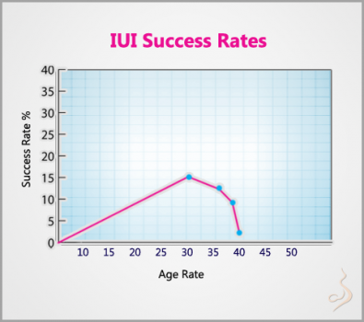

Slide 9
Intrauterine insemination may be used under the following circumstances:
When the woman's cervical mucus is unreceptive.
When donor sperm are required.
If the man's sperm count is very low.
If there is decreased sperm motility.
When unexplained infertility exists in both partners.
Those in whom artificial insemination fails, couples with specific fertility defects, or older women may be candidates for more advanced reproductive technologies.

Slide 10
The Artificial Insemination Procedure:
A woman usually (but not always) takes fertility drugs in advance.
The man must produce sperm at the time the woman is ovulating.
The sperm are subjected to certain so-called "washing" procedures. They are then inserted into the uterine cavity through a long, thin catheter.
The administration of fertility drugs and sperm retrieval is timed so that the process can coincide with time of ovulation.

Slide 11
Transvaginal ovum retrieval
Is the process whereby a small needle is inserted through the back of the vagina and guided via ultrasound into the ovarian follicles to collect the fluid that contains the eggs.

Slide 12
Embryo transfer
Is the step in the process whereby one or several embryos are placed into the uterus of the female with the intent to establish a pregnancy.

Slide 13
LESS COMMON TECHNIQUE USED IN IN-VITRO FERTILIZATION
Assisted zona hatching (AZH) is performed shortly before the embryo is transferred to the uterus. A small opening is made in the outer layer surrounding the egg in order to help the embryo hatch out and aid in the implantation process of the growing embryo.
Autologous endometrial coculture is a possible treatment for patients who have failed previous IVF attempts or who have poor embryo quality.

Slide 14
Egg donors are resources for women with no eggs due to surgery, chemotherapy, or genetic causes; or with poor egg quality, previously unsuccessful IVF cycles or advanced maternal age.
Sperm donation may provide the source for the sperm used in IVF procedures where the male partner produces no sperm or has an inheritable disease, or where the woman being treated has no male partner.

Slide 15
Intracytoplasmic sperm injection (ICSI)
Is often used for couples in which there are serious problems with the sperm. Sometimes it is also used for older couples or for those with failed IVF attempts. In ICSI, a single sperm is injected into a mature egg. Then the embryo is transferred to the uterus or Fallopian tube.

Slide 16
In vitro fertilization
IVF means fertilization outside of the body. IVF or in-vitro fertilization as its known is a fertilization process. IVF is the most effective ART. It is often used when a woman's Fallopian tubes are blocked or when a man produces too few sperm. Doctors treat the woman with a drug that causes the ovaries to produce multiple eggs. Once mature, the eggs are removed from the woman. They are put in a dish in the lab along with the man's sperm for fertilization. After 3 to 5 days, healthy embryos are implanted in the woman's uterus.
Since this fertilization is done in an external artificial environment hence it is refered to as “In-vitro” which in Latin means in glass.

Slide 17
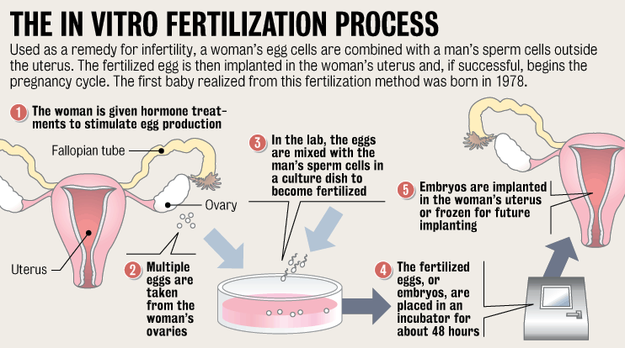

Slide 18

OTHER METHODS OF ART
Zygote intrafallopian transfer (ZIFT)
During zygote intrafallopian transfer (ZIFT), oocytes are retrieved similar to IVF and GIFT and they are allowed to fertilize in vitro in the laboratory as in IVF. A day after fertilization (2 cell stage), 3-4 embryos are transferred via laparoscopy into one of the fallopian tubes.

Slide 19
Gamete intrafallopian transfer (GIFT):
Was developed in 1984 for women with unexplained infertility. GIFT is much less utilized, but to certain religious and ethnic communities (in which fertilization inside the woman's body is the only type allowed), it is considered more acceptable. During this procedure, the patient undergoes a controlled ovarian hyperstimulation. The oocytes are retrieved transvaginally under ultrasonographic guidance, and 3-4 oocytes are placed via laparoscopy into one of the fallopian tubes along with sperm.

Slide 20
Surrogacy
Women with no eggs or unhealthy eggs might also want to consider surrogacy. A surrogate is a woman who agrees to become pregnant using the man's sperm and her own egg. The child will be genetically related to the surrogate and the male partner. After birth, the surrogate will give up the baby for adoption by the parents.

Slide 21
Gestational Carrier
Women with ovaries but no uterus may be able to use a gestational carrier. This may also be an option for women who shouldn't become pregnant because of a serious health problem. In this case, a woman uses her own egg. It is fertilized by the man's sperm and the embryo is placed inside the carrier's uterus. The carrier will not be related to the baby and gives him or her to the parents at birth.

Slide 22
Risks
RISK
Genetic disorders: DNA damage
Low birth weight
Preterm birth
visual impairment
cerebral palsy
Other risk factors are:
Membrane damage
postpartum depression

Slide 23
ETHICAL ISSUES

Slide 24
There are several ethical issues associated with infertility and its treatment.
High-cost treatments are out of financial reach for some couples.
Debate over whether health insurance companies (e.g. in the US) should be required to cover infertility treatment.
Allocation of medical resources that could be used elsewhere
The legal status of embryos fertilized in vitro and not transferred in vivo.
Pro-life opposition to the destruction of embryos not transferred in vivo.
IVF and other fertility treatments have resulted in an increase in multiple births, provoking ethical analysis because of the link between multiple pregnancies, premature birth, and a host of health problems.
Religious leaders' opinions on fertility treatments.

Slide 25
LEGAL ASPECTS

Slide 26
The Indian scenario in this field is quite bleak. Delhi artificial insemination (Human) Act 1995 is the only statutory act prevailing in India . Indian Infertility specialist have rather opposed the steps towards regulation of practice in this field.

Slide 27
Litigation against doctors –
Doctors can face few litigations like-
a. Not taking proper informed consent: After duly counseling the couple and / or oocytes / semen donor and informed and written consent should be taken from both the spouses as well as donor. They should be explained various risk factors including risks involve in ovarian hyper stimulation, anaesthetic procedures, invasive procedures like laparoscopy, aspiration of ovum etc. in simple language using the words that they can understand well. They should be explained the possibility of multiple pregnancies, ectopic gestation, increased rate of spontaneous abortion, premature birth, higher perinatal and infant mortality as well as growth related problems.

Slide 28
b. Following the birth of a defective child:
To avoid this, the donor's chromosomes must be thoroughly screened for possible genetic defect, and should also inform all the likely possibilities at the time of taking informed consent.

Slide 29
2. Legitimacy - The child born by ART is considered legitimate with all the rights of parentage, support and inheritance, provided he is born during lawful wedlock and with consent of both the spouses. Sperm or oocyte donors shall have no parental rights or duties in relation to the child. A child can be given status of legitimacy also by adoption.
In a case, on the wife's petition for divorce and custody of the child, a question was raised before the court: whether the child, who is born to her consequent to AID, consented to by husband, is legitimate and belongs to mother only? Court held that a child so conceived was not a child born in wedlock and therefore illegitimate. As such it was the child of mother alone and the husband had no rights or interest in the child, not even that of visitation. The husband is not the actual father of the child and, therefore the child is illegitimate.

Slide 30
3. Inheritance of property – Since the child is illegitimate if born out of AID, it cannot inherit the property of his father. Any attempt to conceal this fact by registering the husband, as the father amounts to perjury.
4. Consummation of marriage – Conception of the wife by AI (AIH or AID) does not amount to consummation of marriage, if there is no successful sexual act due to the impotency of husband. The decree of nullity may still be granted in favor of the wife on the ground of impotency of the husband or his willful refusal to consummate the marriage. However, such a decree could be excluded on the grounds of approbation. However in this situation the child will be illegitimate.

Slide 31
5. Rights of an unmarried woman to AID : There is no legal bar on an unmarried woman going for AID. A child born to a single woman through AID would be deemed to be legitimate. However, AID should normally be performed only on a married woman and that too, with the written consent of her husband, as a two-parent family would be always better for the child than a single parent one, and the child's interests must outweigh allother interests.
6. Ground for divorce and judicial separation : Mere AI is not a ground for nullity of marriage and divorce since sterility is not a ground, however if AI is due to impotence of husband, it becomes the ground. AID without husbands consent can be a ground for divorce and judicial separation.

Slide 32
7. Maintenance and custody of child – Under Hindu Adoption and Maintenance Act 1956 the maintenance of the dependents is the responsibility of the parents, whether legitimate or illegitimate, till the son remains minor and daughter is unmarried.
8. Insemination after the death of the husband – This is seen when semen of the husband is cryo-preserved by various methods and the women is inseminated after death of the husband. Such Posthumous child is said to be legitimate because the semen is of husband, although the complexity arises since conception is not during the continuance of marriage.

Slide 33
9. Relation between AIH / AID child with subsequent Natural / Adopted child of same family - If the child is born of natural course some times after the birth of the child through AI, the status will remain same for AI child but the natural child born will remain legitimate.
10. Charge of Adultery - AID does not amount to adultery, even if it was done without the consent of husband. For adultery to be committed both parties should be physically present and engage in sexual act and sexual union involving some degree of penetration of the female organ by the male organ should take place. AI is not equivalent to sexual intercourse.

Slide 34
Under section 497 of IPC 1860 , sexual intercourse with a person who is or whom he knows or has reason to believe to be wife of another person without the consent or connivance of that man. For the charge of adultery two things must be proved, sexual intercourse took place with another person's wife and no consent or connivance from another man was granted.
11. Incestous relationship – There is high risk of such relationship between naturally born child and child born out of AID of the same parent.

Slide 35
COUNSELLING

Slide 36

Counseling for infertility patient
A person suffering from infertility will face complex issues which span biological, psychological, social and ethical domains. Discussion of these issues in a counseling context is often beneficial for patients.

Slide 37
Purpose
The aims of counseling are to explore, understand and resolve issues arising from infertility and infertility treatment and to clarify ways of dealing with the problem more effectively.
To help make decisions regarding the continuation or termination of treatment.
It may be used to discuss alternatives to parenthood such as adoption

Slide 38
Tasks of counseling
Information gathering and analysis and implications and decision-making counseling : Providing sufficient information about the medical aspects of the treatment is primary responsibility. Counseling which focuses on information and implications should assist the patient in making decisions about the most appropriate course of action.

Slide 39
Support counseling :
Support counselling aims to give emotional support to patients experiencing distress. Distress can be caused by the frustration of the desire for a child, social and family pressure as well as by the reproductive technology employed and its limited success rate. Such distress motivates the need for emotional support from many sources (such as family members, partner, support groups).

Slide 40
Therapeutic counseling
Therapeutic counselling can focus on
  reflection of individual problems and (family) history,
  the acceptance of the situation,
  the meaning and impact of infertility, including grief work,
  work on alternative life and self-concepts for the future,
  the development of coping strategies and strategies to minimize
  problem and conflict solving, and/or
  specific issues such as sexual, marital and other interpersonal problems

Slide 41
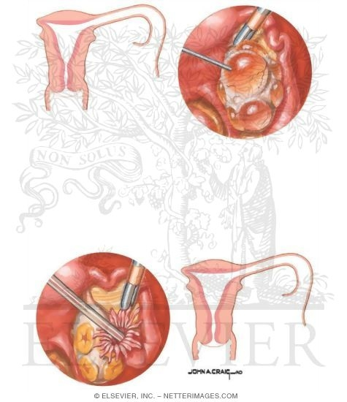
RECENT ADVANCEMENT IN INFERTILITY MANAGMENT

Slide 42
Recent Advancement In Infertility Management
Intracytoplasmic sperm injection (ICSI)
Ovary Transplants
Testicular sperm aspiration/extraction
Cryopreservation technique
Introduction of long & Short protocol

Slide 43
Indications for ICSI:
Sperm cell agglutinates availability
Azoospermia (in this case sperm cells are taken during testicular biopsy)
Unsatisfactory (absent) fertilization of oocytes during previous IvF (in vitro fertilization) attempts

Slide 44
Intracytoplasmic sperm injection (ICSI)
Is often used for couples in which there are serious problems with the sperm. Sometimes it is also used for older couples or for those with failed IVF attempts. The ICSI procedure involves a single sperm carefully injected into the center of an egg using a microneedle Then the embryo is transferred to the uterus or Fallopian tube. This method is also sometimes employed when donor sperm is used.

Slide 45
ICSI methodology includes the following stages:
oocytes preparation
sperm cells preparation
sperm cell introduction into oocyte cytoplasm using a glass micro-needle
ICSI is performed only with matured oocytes

Slide 46
Ovary Transplants
The world’s first ovary transplant surgery and a new method first developed by researchers in Japan called minimal stimulation.
The procedure involves the removal of an ovary which is frozen and placed in storage until required at a later date. This ovary is then thawed out slowly and transplanted back into the body.

Slide 47
Reasons for an ovary transplant
There are a variety of reasons why a woman may need an ovary transplant. These include:
Early menopause: there are some women who undergo an early menopause which results in infertility. This procedure could work if an early menopausal woman has a sister with an identical tissue match. In other words, the sister is able to donate ovarian tissue or even a whole ovary which matches hers.
Cancer treatment: radiation treatment or chemotherapy can result in infertility. So if an ovary could be removed before starting this treatment then theoretically, this could be transplanted back into their body and restore their fertility.

Slide 48
Organ transplants: kidney, heart and other types of transplants require the patient to take large doses of immunosuppressive drugs which can cause infertility.
Ideally, the woman would have an ovary removed before undergoing this treatment which would then be replaced at a later date.
Ovary transplant procedure
The ovary is removed via keyhole surgery which reduces recovery time. The ovary is then frozen until further notice.
The ovary to be transplanted is thawed out slowly beforehand. The transplant procedure is performed as open surgery this time and involves reconnecting tiny blood vessels to the ovary. This enables a steady blood flow to the ovary which is vital for it to function.

Slide 49
Testicular sperm aspiration/extraction (TESA/E)
The testicular sperm aspiration/extraction (TESA/E) involves the direct removal of sperm from the testicles, which can then be used in conjunction with Intracytoplasmic sperm injection (ICSI).
Obstructive azoospermia –Percutaneous testicular sperm retrieval
When dealing with obstructive azoospermia a simple percutaneous extraction of sperm is recommended. This procedure is performed under anesthesia (local or general) whereby a Tru Cut biopsy needle is utilized to extract a very small amount of testicular tissue. This tissue is then searched by a trained embryologist, who will then proceed with ICSI in order to fertilize your partner’s eggs. The wound is closed with a few small absorbable stitches.

Slide 50
Nonobstructive Azoospermia - Microscopic testicular sperm retrieval
In clinical scenarios in which the testes are not producing adequate amounts of sperm (testicular atrophy, Kleinfelter’s cases, post-chemotherapy/radiation) microsurgical testicular sperm extraction is performed. In this scenario, under general anesthesia an exhaustive search is performed under an operating microscope to search for testicular tubules that appear more developed and contain mature sperm. This procedure may take several hours and is done with direct input from the IVF embryology team. This procedure offers the most severe cases of male factor infertility the best chance of identifying sperm and proceeding with ICSI.

Slide 51
Indications Of TESA/E
There are many reasons why a TESA/E may need to be performed, but all involve an inability to produce an ejaculate with sperm sufficient for fertilization. Some examples are obstructive and non-obstructive azoospermia (NOA) and history of a vasectomy.

Slide 52
This is a method of embryos, eggs, and sperm preservation by freezing in liquid nitrogen.
Cryopreservation can be performed as oocyte cryopreservation before fertilisation, or as embryo cryopreservation after fertilisation.
The advantage is that patients who fail to conceive may become pregnant using such embryos without having to go through a full IVF cycle. Or, if pregnancy occurred, they could return later for another pregnancy. Spare oocytes or embryos resulting from fertility treatments may be used for oocyte donation or embryo donation to another woman or couple, and embryos may be created, frozen and stored specifically for transfer and donation by using donor eggs and sperm. Also, oocyte cryopreservation can be used for women who are likely to lose their ovarian reserve due to undergoing chemotherapy.
The outcome from using cryopreserved embryos has uniformly been positive with no increase in birth defects or development abnormalities.
Cryopreservation.

Slide 53
Introduction of long & short protocol analog
The other recent advances include the introduction of long protocol and short protocol hormone injections which is effective for a week as opposed to the need for having daily hormone injections administered which has very much simplified the IVF process.

Slide 54
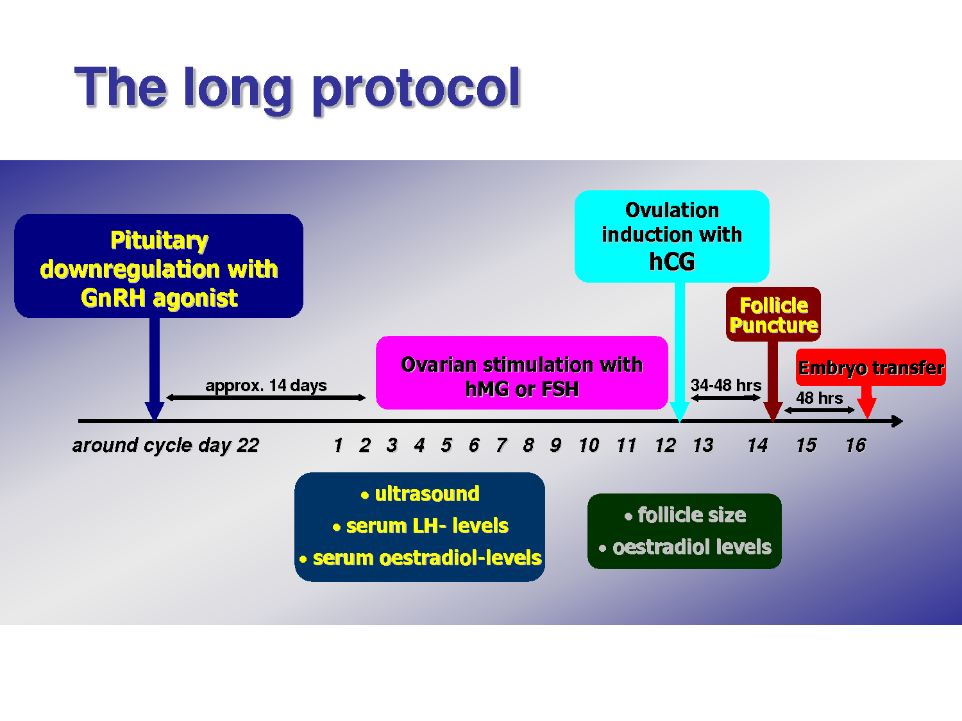

Slide 55
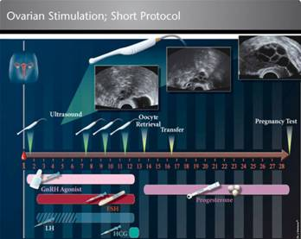

Slide 56
CONCLUSION
The recent and new advanced growth of assisted reproductive technology has shown remarkable growth in the improvement of the infertility rates. The best estimate is that the birth of a live baby occurs in approximately 15-25% of women in whom embryos are transferred into the uterus. Success varies with many factors, including the number of embryos that are transferred. Presently, the collection of oocytes, fertilization, and early embryo growth are accomplished with a high degree of efficiency.

