Slide 1
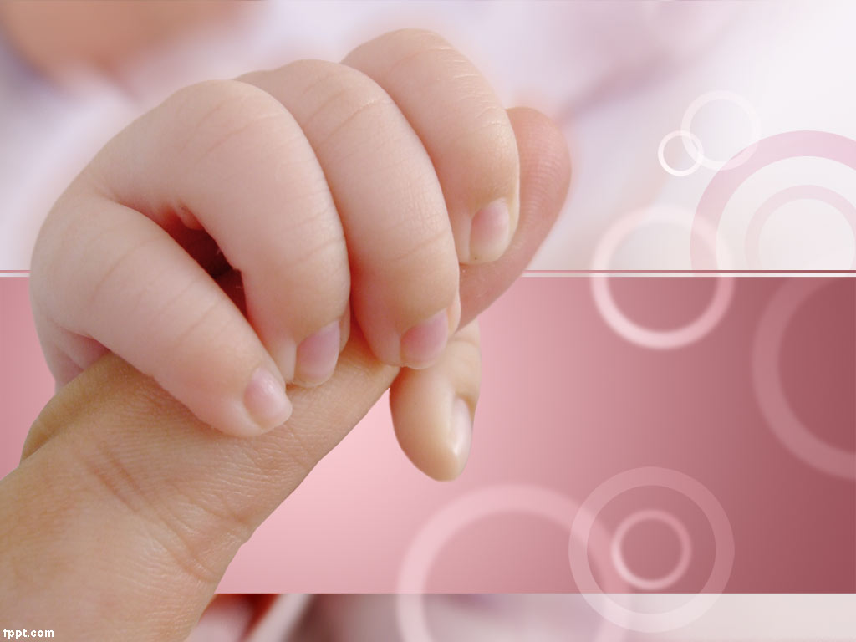

PRESENTED BY :
MS. VRUTI PATEL
ASST. PROFESSOR, SNC.
NORMAL PUPERPERIUM

Slide 2
DEFINITION
Puerperium is the period following childbirth during which the body tissues, specially the pelvic organs revert back approximately to the pre-pregnant state both anatomically and physiologically.
Involution is the process where by the genital organs revert back approximately to the state as they were before pregnancy.
The woman is termed as a puerpera.

Slide 3
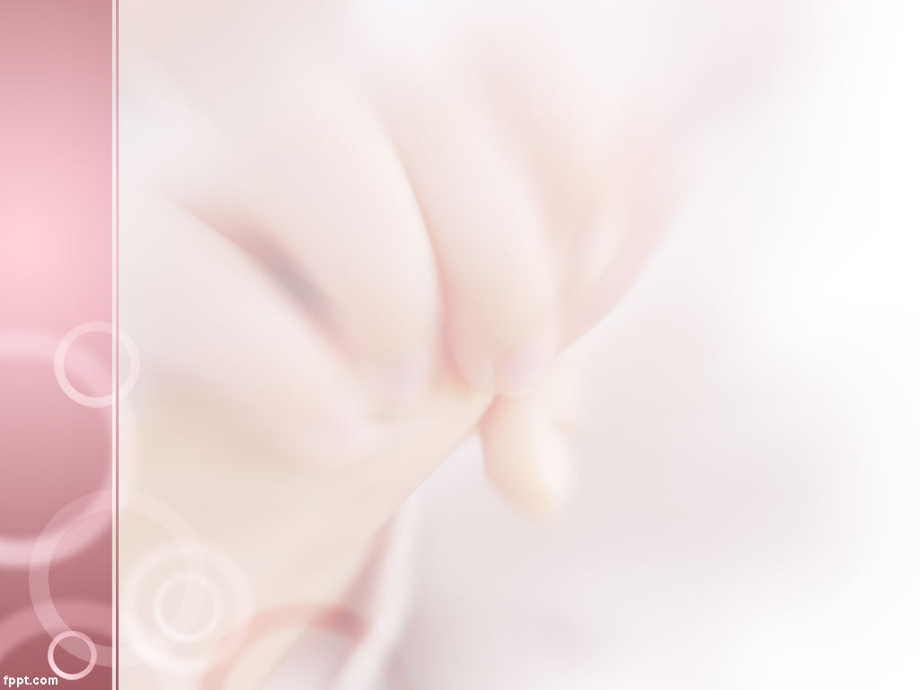
PUERPERIUM PERIOD
The post partum period has been divided into:
The immediate puerperium, the first 24 hours after parturition; when acute post anesthetic or post delivery complications may occur.
The early puerperium, which extends until the first week post partum.
The remote puerperium, which includes the period of time required for involution of the genital organs through the sixth weeks postpartum.

Slide 4
INVOLUTION OF UTERUS
Upper Uterine Segment
Immediately following delivery, the uterus becomes firm and retracted with alternate hardening and softening.
The uterus measures about 20X12X7.5 cm (length, breadth and thickness) and weight about 1000 gm.
At the end of 6 weeks, its it measurement is almost similar to that most 60 gm.

Slide 5
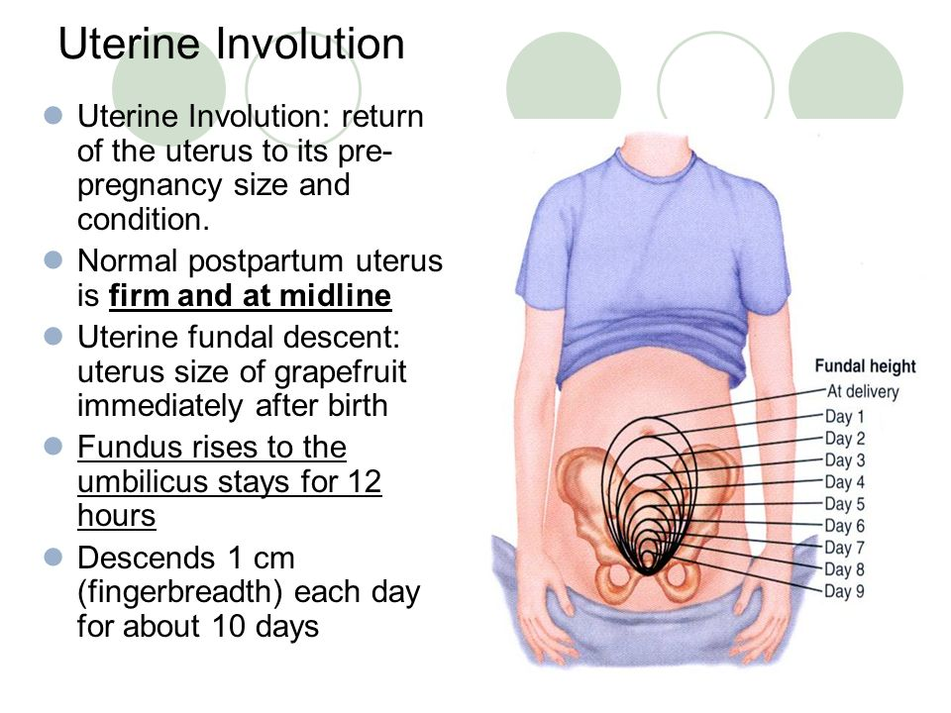
INVOLUTION OF UTERUS
Upper Uterine Segment
The placental site contracts rapidly presenting a raised surface with measures about 7.5 cm.
It remain elevated even at 6 weeks when it measures about 1.5 cm.

Slide 6
INVOLUTION OF UTERUS
Lower Uterine Segment
Immediately following delivery, the lower segment becomes a thin, flabby and collapsed structure.
Within few weeks it revert back to the normal shape and size of the isthmus, i.e. the part between the body of the uterus and internal os of the cervix.

Slide 7
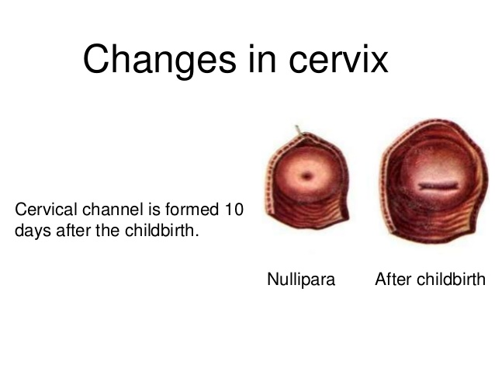
INVOLUTION OF UTERUS
Cervix
The cervix contracts slowly
The external os admits two fingers for a few days.
At the end of first week it narrows down to admit the tip of a finger only.
The contour of the cervix takes a longer time to regain (6 weeks).
The external os never reverts back to the nulliparous state.

Slide 8
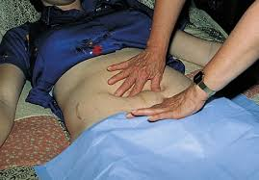
INVOLUTION OF UTERUS
Clinical Assessment
The rate of involution of the uterus can be assessed clinically by noting the height of the fundus of the uterus in relation to the symphysis pubis.
The measurement should be taken carefully at a fixed time every day, preferably by the same observer.
Bladder must be emptied before hand and preferably the bowel too as the , full bladder and the loaded bowel may raise the level of the fundus.

Slide 9
INVOLUTION OF UTERUS
Clinical Assessment
The uterus is to be centralized
With a measuring tape the fundal height is measured above the symphysis pubis.
Following delivery the fundus lies above 13.5cm (5 ½’) above the symphysis pubis.
During the first 24 hours , the level remain constant ;
There is a study decrease in height by 1.25 cm (1/2”) in 24 hours.
By the end of the second week it become a pelvic organ.

Slide 10
INVOLUTION OF UTERUS
Clinical Assessment
The involution may be affected adversely and is called sub-involution .
Some time the involution may be prolonged in woman who are lactating
The uterus may be smaller in size which is called as super-involution .
The uterus , however , returns to normal size if the lactation is withheld

Slide 11
INVOLUTION OF UTERUS
Physiological Consideration
MUSCLES
The individual muscle fiber enlarge to the extent of 10 times in length and 5 times in breadth during pregnancy.
During puerperium, the number of muscle fibers is not decreased but there is substantial reduction of the myometrial cell size.

Slide 12
INVOLUTION OF UTERUS
Physiological Consideration
MUSCLES
The connective tissues also undergo the some type of degeneration.
The condition which favors involution are –
a) Efficacy of the enzymatic action and
b) Relative anoxia induced by effective contraction and retraction of the uterus

Slide 13
INVOLUTION OF UTERUS
Physiological Consideration
Blood Vessels
The changes of the blood vessels are pronounced at the placental site.
The arteries are constricted by contraction of its wall and thickness of the intima followed by thrombosis.
New blood vessels grow inside the thrombi.
Fibrous tissue on the wall undergoes hyaline degeneration and the products are removed by macrophages.
There is also degeneration of the elastic tissue but some of them remain and affords a means of diagnosis of the existence of previous pregnancy.

Slide 14
INVOLUTION OF UTERUS
Physiological Consideration
Endometrium
Following delivery, the major part of the deciduas is cast off with the expulsion of the placenta and the membranes, more at the placement site.
The endometrium left behind varies in thickness from 2-5 mm.
The superficial part containing the degenerated deciduas, blood cell and bits of fetal membranes becomes necrotic and is cast off in lochia.
Regeneration of the epithelium is completed by 10th day and the entire endometrium is restored by the day 16,
The placental site takes about 6 weeks to regenerate completely.

Slide 15
INVOLUTION OF OTHER PELVIC STRUCTURES
VAGINA
The distensible vagina takes a long time (4-8 week) to involute .
It regains its tone but never to the virginal state.
The mucosa remain delicate for the first few week and submucous venous congestion persists even longer .
It is the reason to withhold surgery on puerperal vagina .
Rugae partially reappear at third week but never to the same degree as in pre- pregnant state.

Slide 16
INVOLUTION OF OTHER PELVIC STRUCTURES
VAGINA
The introitus remain permanently larger then the virginal state.
Hymen is lacerated and is represent the nodular tags- the carunculae, myrtiformes.
Board ligament and round ligaments require considerable time to recover from the stretching and laxation.
Pelvic floor and pelvic fascia takes a long time to involute from the stretching effect during parturition.

Slide 17
LOCHIA
It is the vaginal discharge for the first fortnight during.
The discharge originates from the uterine body cervix and vagina.
It has got a peculiar offensive fishy smell .
Its reaction is alkaline tending to become acid towards the end.
Depending upon the variation of the color of the discharge it is named as
Lochia Rubra ----- (red)-----1-4days
Lochia Serosa (5-9) days---the color is yellowish pink or pale brownish.
Lochia Alba----(pale white) -----10-15 days.
Composition Lochia Rubra consists or blood shred of fetal membranes and decidua, vernix caseaosa, lanugo and meconium

Slide 18
LOCHIA
Lochia Serosa consists of less RBC but more leucocytes wound excudate mucus from the cervix and microorganisms
Lochia Alba contain plenty of decidual cells, mucus cholestrin crystals, fatty and granular epithelial cells and micro organisms.
The average amount of discharge for the first 5-6 days is estimated to be 250 ml.
The normal duration may extend up to 3 week .
The red lochia may persist for longer duration specially in women who get up from the bed for the first time in later period
The discharge may be scanty specially following premature labour or may be excessive in twin delivery or hydramnios.

Slide 19
LOCHIA
The character of the lochial discharge gives useful information about the abnormal puerperal state .
The Vulval pads are to be inspected daily to get information .
Offensive odor indicate infection .
Retain plug or cotton piece inside the vagina should be kept in mind .
Amount : scantly or absent signifies infection or Lochiometra . If excessive indicate infection.
Color : persistence of red color beyond 3 week suggest local genital lesion.

Slide 20

GENERAL PHYSIOLOGICAL CHANGES
PULSE
For a few hour after delivery the pulse rate is likely to be raised which settle down to normal during the second day .
However the pulse rate often rises with after pain or excitement.

Slide 21
GENERAL PHYSIOLOGICAL CHANGES
PULSE
For a few hour after delivery the pulse rate is likely to be raised which settle down to normal during the second day . .
However the pulse rate often rises with after pain or excitement.
TEMPERATURE
The temperature should not be above 37.2 within the first 24 hour .
There may be slight raised of temperature due to breast engorgement which should not last for more then 24 hour .
However genito- urinary tract infection should be excluded if there is rise of temperature.

Slide 22
GENERAL PHYSIOLOGICAL CHANGES
URINARY TRACT
The bladder wall become edematous and hyperemic and often shows evidence of submucous extravasation of blood .
Because of trauma sustained to the nerve plexus during delivery the bladder may be over distended without any desire to pass urine.
Stagnation of the urine along with a devitalized bladder will contribute to the urinary tract infection in puerperium .
Dilated ureters and renal pelvis return to normal size within 8 week .
There is pronounced diuresis on the second or third day of the puerperium . Only clean catch sample of urine should be collect and sent for examination and contamination with lochia should be avoided .

Slide 23
GENERAL PHYSIOLOGICAL CHANGES
GASTRO-INTESTINAL TRACT
Increased thist in early puerperium is due to loss of fluid during labour, in the lochia, diuresis and perspiration .
Slight intestinal paresis leads to constipation.
WEIGHT LOSS
In addition to the weight loss as a consequence of the expulsion of the uterine contents a further loss of about 2 kg occurs during puerperium chiefly caused by diuresis.

Slide 24
GENERAL PHYSIOLOGICAL CHANGES
FLUID LOSS
There is net fluid loss of 2 liters during 1st week.
Additional 1.5 liter fluid loss occur in next 5 weeks.
The amount of loss depends on amount retained during pregnancy, dehydration and blood loss during labour.

Slide 25
GENERAL PHYSIOLOGICAL CHANGES
BLOOD VALUES
There is slight decrease in blood volume after delivery but it returns to pre-pregnant state by 2nd week.
Cardiac output rises soon after delivery to 60% but gradually returns to normal within one week.

Slide 26
GENERAL PHYSIOLOGICAL CHANGES
MENSTRUATION & OVULATION
In non lactating mothers ovulation may occurs as early by 4th weeks and the menstruation returns by 6th week following delivery.
Therefore it is possible for the mother to become pregnant before she menstruates following her confinement.
These mothers should use contraceptive measures after 3 weeks.

Slide 27
GENERAL PHYSIOLOGICAL CHANGES
MENSTRUATION & OVULATION
In lactating mother ovulation occur about after 10th weeks of delivery.
Contraceptive protection is about 98% up to 6 months post-partum for the women who is exclusively breastfeeding.
The lactating mother should use contraceptive methods after 3 months of delivery.

Slide 28
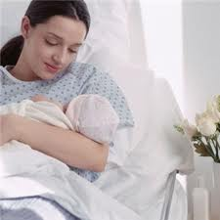
Care in puerperium

Slide 29
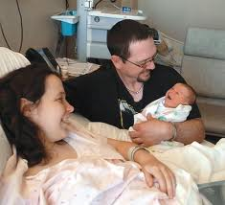
Immediate care
Observed for minimum 2hours in labor ward : vital signs, bleeding, micturition
Uterus : well contracted. Bleeding: within normal limits
Before shifting to ward:
>examine perineum, episiotomy site
>sterile dressing with antiseptic
Relatives, food, fluids, good sleep
Encourage early ambulation

Slide 30
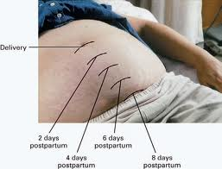
Involution of uterus
Assessed by noting height of fundus above symphysis pubis
Day after delivery: 12 cm above symphysis
1cm decrease per day
By end of 2nd week: no longer
palpable

Slide 31
Care of bladder
Encouraged to void soon after delivery
Doesn’t void within 6-8 hours : bladder atony
Retention : common in early puerperium (esp. in epidural analgesia & traumatic delivery with perineal lacerations)
: vulvovaginal hematoma
Uterine atony hemorrhage
Urinary infection
Local analgesics
Catheterization (for 24 hours) till tone restoration

Slide 32

Care of bowels
Constipation
Increase fluid intake & roughage
Prescription of mild laxatives

Slide 33

Diet
Immediately start normal diet
Plenty of fluids & milk daily : lactation
Calorie & protein intake
Additional daily requirement: 500kcal & 25g proteins
Fresh fruits & green leafy veg : vitamins
Iron: continued for 3 months / whole lactating period

Slide 34

Care of perineum
Regular antiseptic cleaning of episiotomy wound
Wash with warm water & use sterile pads
Analgesics
Severe pain: hematoma
Infection : antibiotics
Episiotomy wound: healed by 3 weeks

Slide 35
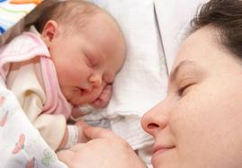
Sleep & rest
Must be adequate,
Rooming in : baby on mother’s cot
Early ambulation
Venous thrombosis & embolism

Slide 36
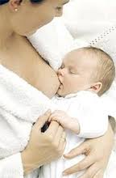
Care of breast
Baby breast fed as soon as possible
No frequent & early feeding engorged & painful
Correct positioning &clean nipples
Draw out retracted nipples
Cracked nipples: painful
: emollient creams after feeds

Slide 37
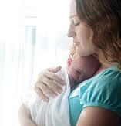
Discomfort
Episiotomy & perineal lacerations, breast engorgement & after pains ( uterine contraction )
Caesarean section: pain at incision site, post spinal headache
Analgesics

Slide 38

Mood changes
Common in early puerperium : postpartum blues
Reassurance & support
Hospital stay
Vaginal delivery: after 48hrs
Caesarian section : 4-5 days

Slide 39
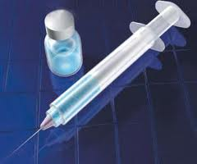
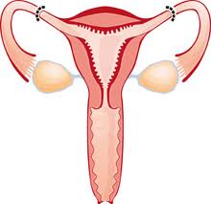
Advice on Discharge
Immunization of mother
Anti-D IgG within 72hrs
Rubella vaccine / MMR
2. Contraception
Post partum sterilization
Interval sterilization
Counseling

Slide 40
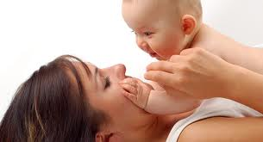
3. Medications
Adviced to avoid medications as far as possible
Take only on medical advice
4. Infant advice
Adequate follow up
Rooming in
BCG vaccine prior to going home
Immunisation schedule
Advice mother to feed on demand

Slide 41
4. Postnatal exercises
Early in puerperium
Move limbs, deep breathing exercises, abdominal muscle tightening exercises everyday
Repeated 3-4 times a day
Perineal muscle exercises: improve vaginal muscle tone, prevent vaginal laxity & stress incontinence
Back muscle toning

Slide 42
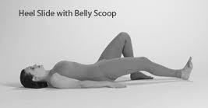
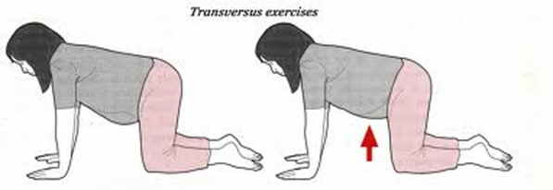

Slide 43
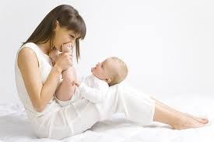
Postnatal check-up

Slide 44
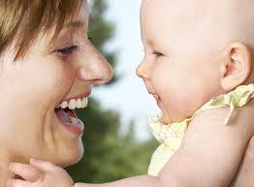
Scheduled at 6 weeks
Maternal problems discussed
Breast-feeding
Lochia & menses
Clinical examination, abdomen, breasts
Local examination : episiotomy & discharge
Pelvic examination
PIH, GDM
Any medical problems
Advice on resuming job, coitus,
other activities

Slide 45

Contraceptive advice
Breast feeding alone wont suffice as contraception
Various options given, partner included
IUCD inserted if acceptable
Other options which wont reduce breast milk amount
  Progesterone only pill
  Injectable progestogens
  (depot medroxy progesterone acetate)

Slide 46
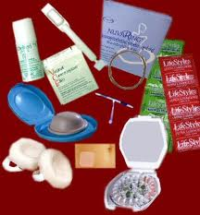
  Inform about possible side-effects
  Should avoid estrogen-pregesterone combination: affect quantity & quality of milk
  Permanent sterilizations: postpartum/ interval sterilization/

Slide 47

Infant
Seen by pediatrician
Checked for any problems
Weight , feeding problems
Reinforce immunization schedule

Slide 48
Principles of puerperal care
Restoration of maternal health to prepregnant state
Promotion of breast feeding
Correction of any problems arising due to delivery
Advice on baby care & immunization
Contraceptive advice

Slide 49
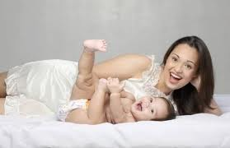
Thank you

Slide 50
TEMPERATURE
GENERAL PHYSIOLOGICAL CHANGES
The temperature should not be above 37.2 within the first 24 hour .
There may be slight raised of temperature due to breast engorgement which should not last for more then 24 hour .
However genito- urinary tract infection should be excluded if there is rise of temperature.

Slide 51
GENERAL PHYSIOLOGICAL CHANGES
URINARY TRACT
The bladder wall become edematous and hyperemic and often shows evidence of submucous extravasation of blood .
Because of trauma sustained to the nerve plexus during delivery the bladder may be over distended without any desire to pass urine.
Stagnation of the urine along with a devitalized bladder will contribute to the urinary tract infection in puerperium .
Dilated ureters and renal pelvis return to normal size within 8 week .
There is pronounced diuresis on the second or third day of the puerperium . Only clean catch sample of urine should be collect and sent for examination and contamination with lochia should be avoided .

Slide 52
GENERAL PHYSIOLOGICAL CHANGES
GASTRO-INTESTINAL TRACT
Increased thist in early puerperium is due to loss of fluid during labour, in the lochia, diuresis and perspiration .
Slight intestinal paresis leads to constipation.
WEIGHT LOSS
In addition to the weight loss as a consequence of the expulsion of the uterine contents a further loss of about 2 kg occurs during puerperium chiefly caused by diuresis.

Slide 53
GENERAL PHYSIOLOGICAL CHANGES
FLUID LOSS
There is net fluid loss of 2 liters during 1st week.
Additional 1.5 liter fluid loss occur in next 5 weeks.
The amount of loss depends on amount retained during pregnancy, dehydration and blood loss during labour.

Slide 54
GENERAL PHYSIOLOGICAL CHANGES
BLOOD VALUES
There is slight decrease in blood volume after delivery but it returns to pre-pregnant state by 2nd week.
Cardiac output rises soon after delivery to 60% but gradually returns to normal within one week.

Slide 55
GENERAL PHYSIOLOGICAL CHANGES
MENSTRUATION & OVULATION
In non lactating mothers ovulation may occurs as early by 4th weeks and the menstruation returns by 6th week following delivery.
Therefore it is possible for the mother to become pregnant before she menstruates following her confinement.
These mothers should use contraceptive measures after 3 weeks.

Slide 56
GENERAL PHYSIOLOGICAL CHANGES
MENSTRUATION & OVULATION
In lactating mother ovulation occur about after 10th weeks of delivery.
Contraceptive protection is about 98% up to 6 months post-partum for the women who is exclusively breastfeeding.
The lactating mother should use contraceptive methods after 3 months of delivery.

Slide 57
Deep Vein Thrombosis During Pregnancy and the Puerperium: A Meta-Analysis of the Period of Risk and the Leg of Presentation
Ray, J. G.; Chan, W. S.
Abstract
We performed a meta-analysis of all published studies of deep vein thrombosis during pregnancy and the puerperium using MEDLINE between 1966 and May 1998. Data were pooled using a random effects model. Fourteen studies included relevant information on deep vein thrombosis in pregnancy or the puerperium, and used objective testing to diagnose deep vein thrombosis. The pooled event rate for left sided or bilateral deep vein thrombosis was 82.2 percent (95 percent CI 75.1 to 87.5). There was no statistical evidence of heterogeneity for this figure (P = .08). Twelve studies reported on the trimester in which deep vein thrombosis was diagnosed. The deep vein thrombosis event rate during the first trimester was 21.9 percent (95 percent CI 17.4 to 27.3), 33.7 percent (95 percent CI 28.1 to 39.8) during the second trimester, and 47.6 percent (95 percent CI 39.2 to 56.2) for the third trimester. Heterogeneity testing was not significant. Nine studies compared deep vein thrombosis events between the antepartum and puerperium periods, with 65.5 percent (95 percent CI 58.1 to 72.1) arising during pregnancy, and 34.5 percent (95 percent CI 27.9 to 41.9) postpartum (P = .08, not heterogeneous). Using these figures, the estimated relative distribution of 100 deep vein thrombosis events during pregnancy and the puerperium would be 0.23 per day during pregnancy, and 0.82 per day in the postpartum period. During pregnancy and the puerperium, deep vein thrombosis is more likely to arise in the left leg. More than half of all deep vein thromboses during pregnancy occur during the first and second trimesters. Furthermore, during the puerperium, the risk of developing deep vein thrombosis is significantly higher than antepartum.

Slide 58
P | I | C | O | LOE
Deep Vein Thrombosis During Pregnancy and the Puerperium | performed a meta-analysis of all published studies of deep vein thrombosis during pregnancy and the puerperium using MEDLINE between 1966 and May 1998. Data were pooled using a random effects model. Fourteen studies included relevant information on deep vein thrombosis in pregnancy or the puerperium, and used objective testing to diagnose deep vein thrombosis. | - | The deep vein thrombosis event rate during the first trimester was 21.9 percent (95 percent CI 17.4 to 27.3), 33.7 percent (95 percent CI 28.1 to 39.8) during the second trimester, and 47.6 percent (95 percent CI 39.2 to 56.2) for the third trimester. Heterogeneity testing was not significant. Nine studies compared deep vein thrombosis events between the antepartum and puerperium periods, with 65.5 percent (95 percent CI 58.1 to 72.1) arising during pregnancy, and 34.5 percent (95 percent CI 27.9 to 41.9) postpartum (P = .08, not heterogeneous). Using these figures, the estimated relative distribution of 100 deep vein thrombosis events during pregnancy and the puerperium would be 0.23 per day during pregnancy, and 0.82 per day in the postpartum period. | 2

