Slide 1

ASSESSMENT
PRESENTED BY :
VRUTTI PATEL,
ASST. PROFESSOR,
SNC.

Slide 2
Measurement and assessment
Measurement: an evaluation expressed in quantitative (numerical) terms
Assessment: procedures used to obtain information about student performance

Slide 3
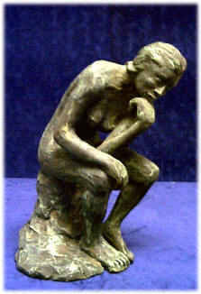
Assessment
Assessment includes many different possible activities, not just tests!
But, since tests are a large part of current assessment practices, this whole UNIT is dedicated to them.

Slide 4
Standardized tests
Standardization means uniformity of procedure in scoring, administering and interpreting the results.
Standardization test are instrument that measured and predict ability/ aptitude and achievement.

Slide 5
Standardized tests
Standardized test is a test that is administered and scored in a consistent, or “standard”, manner.
It presupposes certain standard objectives, or criteria, that are held constant across one form of the test to another.
Assessment instruments given to large samples of students under uniform conditions and scored according to uniform procedures.
For example: SAT, GRE, IELTS and many of the achievement tests you took in school.

Slide 6

Standardized tests are designed to have consistent
questions
administration procedures
scoring procedures

Slide 7

When a standardized test is administrated, is it done so according to
certain rules and specifications so that testing conditions are the
same for all test takers.

Slide 8



Standardized tests come in many forms, such as
standardized interviews
questionnaires
or directly administered intelligence test

Slide 9
Norms
Norm-referenced testing: testing in which scores are compared to guys named “Norm.” Just kidding. Testing in which scores are compared with the average performance of others.
An individual’s score on a standardized test is compared to some kind of “normal” group.
Norming group: the representative group of individuals whose standardized test scores are compiled for the purpose of constructing national norms.
National norms: scores on standardized tests earned by representative groups of students from around the nation to which an individual’s score is compared.
Your score on achievement tests such as SAT or ACT was compared to the scores of the norming group.

Slide 10
Criterion-referenced test interpretations
Testing in which scores are compared to a set performance standard.
The test you took to get a driver’s license was criterion-referenced.
Criterion-referenced tests measure mastery of concepts or skills.

Slide 11
Characteristics
Constructed by test experts and specialists.
Covers board or wide areas of objectives and content.
Selection of items will be done very carefully and the validity, reliability, usefulness of the rest is ascertained in a systemic way.
Procedure of administration is standardized.
Test has cleared directions and it will be motivating, encouraging students.

Slide 12
Characteristics
Scoring key is provided.
Test manual provides norms for the test.
Specific direction for administering and scoring the test.
It consist of standard content and procedures.
It provides standardized frame of reference determining individual performance.

Slide 13
Purposes
It is based on objective in this test can assist common achievement of individual performance like personality interest, intelligence, aptitude etc.
It is developed by professional experts and it provides reliability and validity.
It is based on individual capacity.

Slide 14
Uses of standardized tests
Selection and placement of students into various programs (gifted, special ed., admittance into college, etc.)
To diagnose specific strengths and weaknesses associated with learning, performance in school, emotional problems, etc.
How students are progressing compared to others and to measure the effectiveness of the instruction and curriculum of the school.

Slide 15
OBJECTIVITY
The objectivity is a prerequisite of reliability and validity.
The objectivity of test is increased by –
Using more objective items, e.g. MCQs, Short answers, true or false.
Preparing scoring key.
Two independent examiners evaluating test and using the average score of the two as final score.

Slide 16
VALIDITY
The accuracy/efficiency with which a test measures whatever it is intended/supposed to measure.
Validity is the most important consideration on the selection and use of testing procedure.
An evaluation procedure is valid to the extent that it provides an assessment of the degree to which students have achieved specific objectives, content matters and learning experiences.

Slide 17
Types of validity
Content validity : all major aspects of the content area must be adequately covered by the test items.
Predictive validity: the extent to which a test can predict the future performance of the students.
Concurrent validity: the relationship b/w scores on measuring tool and criteria available at the same time in the present situation. To diagnose the existing status of the individual rather than predicting about its future.

Slide 18
Types of validity
Constructive validity: refers to the extent to which a test reflects and seems to measure a hypothesized trait.
Face validity: when one looks at the test he thinks of the extent to which the test seems logically related to what is being tested. The face validity gives the approach of common sense.

Slide 19
RELIABILITY
The degree of accuracy, consistency with which an exam, test measures, what it seeks to measure a given variable.
The degree of consistency among tests scores.
The reliability of test also refers to stability of measurement over time.

Slide 20
Construction /Developing a Standardized Test
Planning a test
Developing test design
Preparation of blue print for the test
Construction of items
Organization of the test
On going validation studies
Scheme of evaluation

Slide 21
1. Planning a test / Determine the purpose and objectives of the Test
It is important for the test’s purpose and objectives to be stated specifically.
Concerned with determining the maximum marks, time and nature of the test.
To decide the unit/ units involved in testing. Ex.- single unit – 40-50 mins. Duration, with max. 20-25 marks.
TOEFL – its purpose is to evaluate English proficiency of people whose native language is not English.
ESLPT – designed to place already admitted students in an appropriate course in academic writing, with the secondary goal of placing students into courses in oral production and grammar-editing.

Slide 22
2. Developing test design
The objective, content, form of question and weightage of difficulty level are important factors to be considered while designing the test.
Each specs are not just stated that way, it should include what does it measures, what does it covers, and what material it uses.
This is the step of laying the foundation stones of the test.
Example: TOEFL – Specifications: 1. Listening Section
2. Structure Section
3. Reading Section
4. Writing Section

Slide 23
Design for a unit test weightage of Instructional
SR NO. | OBJECTIVE | MARKS | PERCENTAGE
1. | Knowledge | 10 | 20
2. | Understanding | 20 | 40
3. | Application | 8 | 16
4. | Analysis | 5 | 10
5. | Synthesis | 5 | 10
6. | Evaluation | 2 | 4
 | TOTAL | 50 | 100

Slide 24
Weightage to content areas
SR NO. | SUBJECT | MARKS | %
1. | I | 15 | 30
2. | II | 10 | 20
3. | III | 10 | 20
4. | IV | 5 | 10
5. | V | 10 | 20
 | TOTAL | 50 | 100

Slide 25
Weightage to content areas
SR NO. | FORMS OF QUESTIONS | NO. OF QUESTIONS | MARKS | %
1. | Objective type | 25 | 25 | 50
2. | Short Answer Type | 5 | 15 | 30
3. | Long essay type | 1 | 10 | 20
 | TOTAL | 31 | 50 | 100

Slide 26
Scheme of options : Options or no options for any type of questions.
Scheme of selection : The test will be in two section. Section A & B
A – Objective types
B – short answer type

Slide 27
3. Preparation of the blue print for the test
Prepare blue print according to the design.
Content | Level of knowledge
 | knowledge | Application | Analysis/ synthesis | Evaluation | Total items
Principles | 2 | 2 | 2 |  | 6
Factors aff. | 3 | 3 | 4 |  | 10
pathophysiology | 3 | 3 | 4 |  | 10
assessment | 1 | 3 | 4 | 2 | 10
Nursing measures |  | 3 | 3 | 4 | 10
Evaluation |  | 1 | 1 | 2 | 4
Total items | 9 | 15 | 18 | 8 | 50

Slide 28
4. Construction of items
Blue print gives definite ideas
While setting questions and making the final selection, care has to be taken to maintain weightage marks of difficult level.
Checked sufficient answers of asked questions.

Slide 29
5. Organization of the test
After finalizing the items it has to be arranged according to scheme of questions.
Exam, maximum marks and times, instruction etc. have to be written at appropriate places.

Slide 30
6. Preparation of scheme of evaluation
To maintain objectively, scoring should be done strictly.
For objective type items, a scoring key showing the no. of items and its connect answer is to be prepared.
Point method or rating method is used to evaluate essay questions.

Slide 31
7. Perform on going construct validation studies
No standardized instrument is expected to be used repeatedly without a rigorous program of on going construct validation.
Any standardized test, once developed, must be accompanied by systematic corroboration of its effectiveness and by steps towards its improvement.

Slide 32
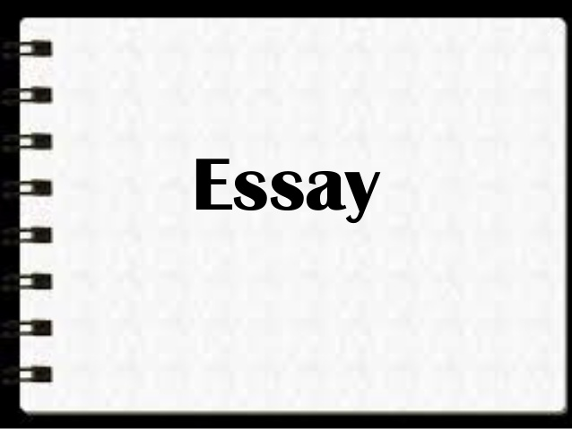

Slide 33
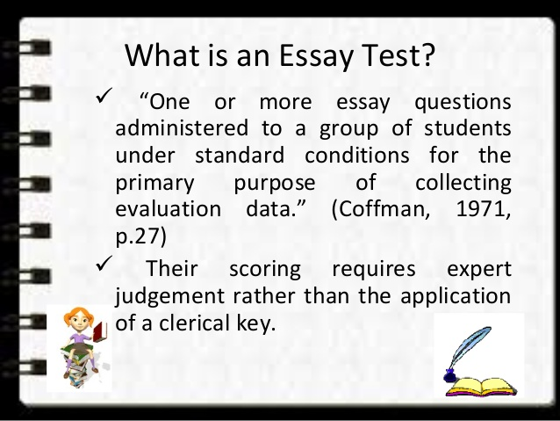

Slide 34
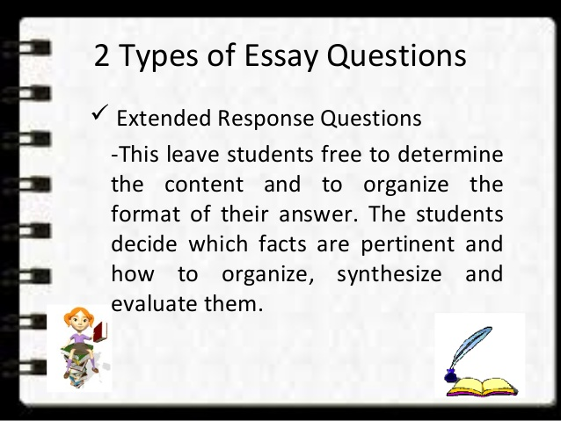

Slide 35
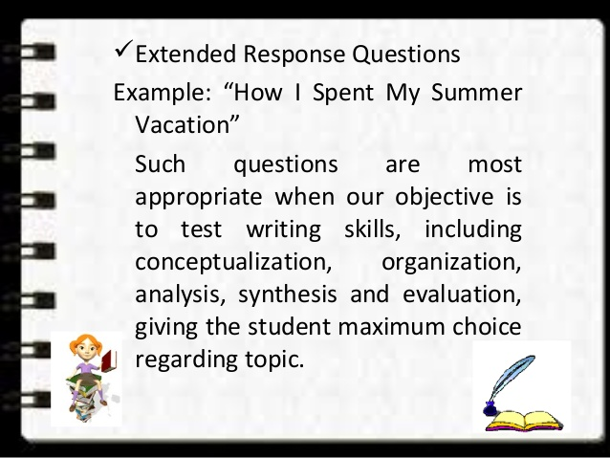

Slide 36
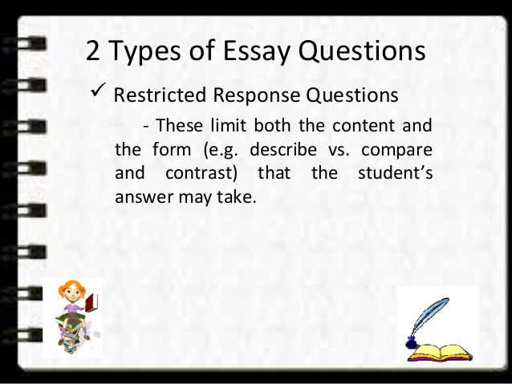

Slide 37
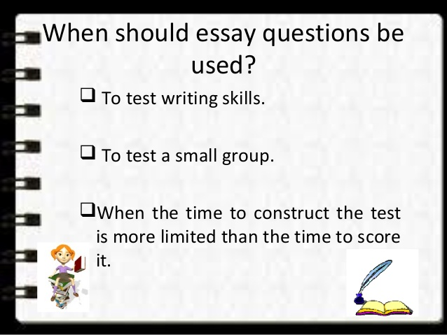

Slide 38
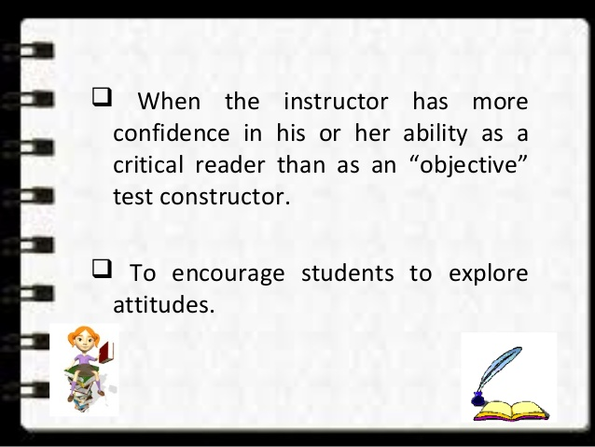

Slide 39
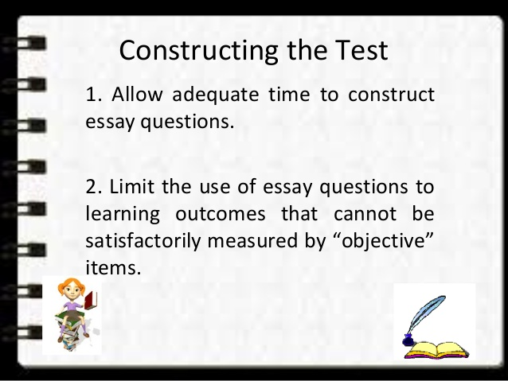

Slide 40
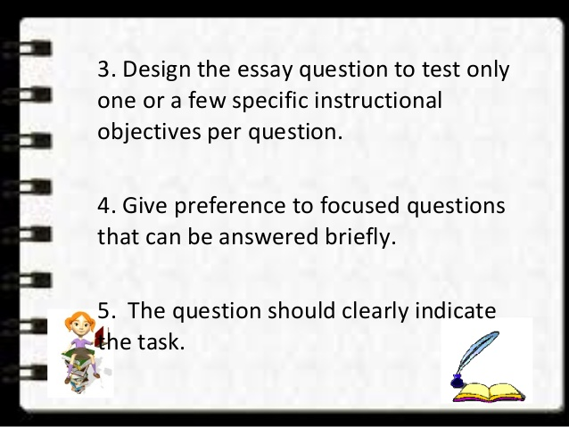

Slide 41
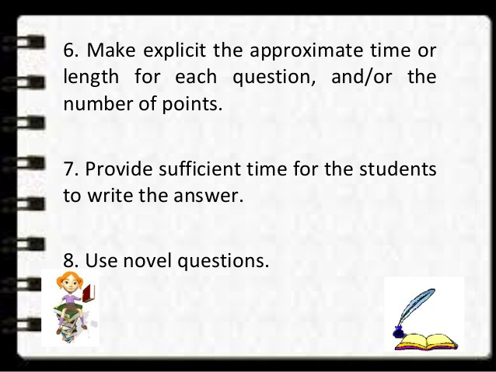

Slide 42
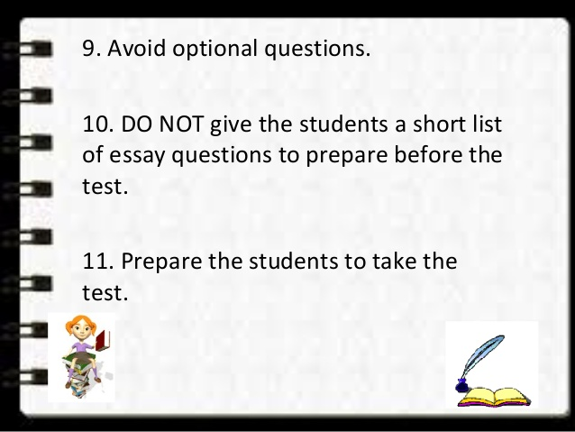

Slide 43
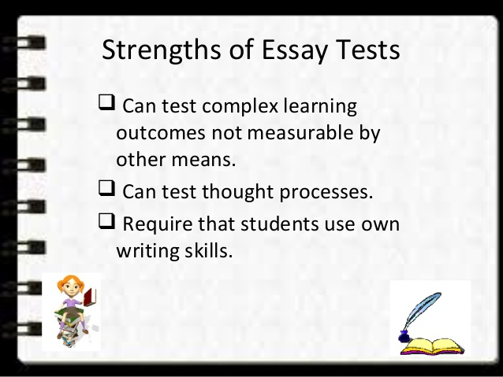

Slide 44
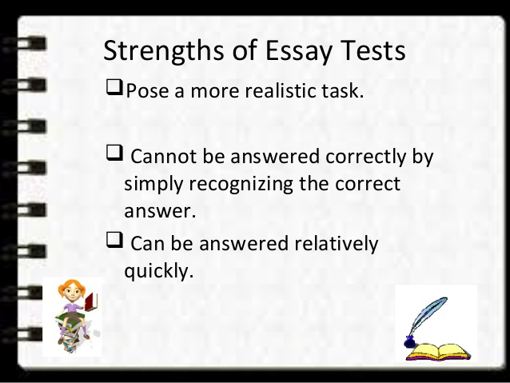

Slide 45
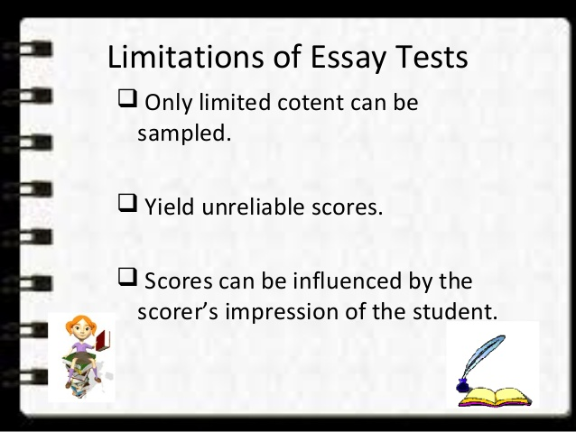

Slide 46
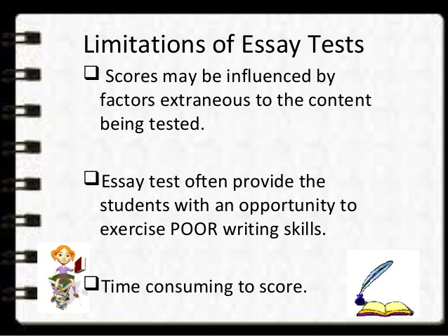

Slide 47
Objective test
Selection type
MCQ
Matching type
Supply type
Short answer
True – false
item
Completion type

Slide 48
SHORT ANSWER QUESTIONS
A short answer test items aim to test the knowledge by asking student to supply a word phrase, or number a question of complete a sentence.
The short answer item uses a direct question, whereas the completion of an incomplete statement.
Example : what is the name of the man discovered penicillin ?
Answer : the name of the person who discovered penicillin is Alexander Fleming

Slide 49
Principles for preparing short type item
Use action oriented precise verbs
Each item should deal with important content area
Use precise, simple and accurate language in relation to the subject matter
Provide the necessary space for answers below each question asked

Slide 50
Uses of short answer questions
Suitable for measuring a wide variety of relatively simple learning outcomes such as
knowledge of terminologies,
knowledge of specific facts,
knowledge of principles,
knowledge of methods or procedure and
simple interpretation of data.

Slide 51
Suggestions for constructing short answer questions
Word the item so that the required answer is both brief specific
Do not take statements directly from textbooks as a basis for SAQ
Blanks for answers should be equal in length and in a column to the right of the question.
When completion items are used, do not include too many blanks.

Slide 52
Advantages
Measure only simple learning outcomes
Easy to score
Reliability of the score is improved
Quick response
Little scope for the influence of handwriting and spelling etc.

Slide 53
Disadvantage
Not suitable for measuring complex learning outcome
Not suitable for judging the power of analyzing and reasoning of the student.

Slide 54
MULTIPLE CHOICE QUESTIONS
The most widely used and useful type of objective test item
It measures a variety of more complex outcome in the knowledge, understanding and application areas.
Respondents are asked to select the best possible answer (or answers) out of the choices form a list

Slide 55
According to Clegg and Cashin (1986), a multiple choice question contains three elements:
  Item stem: this is the problem statement. It contains all the information necessary to answer the multiple choice question.
  Correct option: this is the correct answer to the multiple choice question.
  Distractors: these are the incorrect answers presented as alternatives to the correct answer in a multiple choice question.

Slide 56
Sample Multiple Choice Question
What is the name of the prime minister?
  A. Mr. Kejriwal
  B. Mr. Pranab mukerjee
  C. Mr. Narendra Modi
  D. Mrs. Sonia Gandhi
Item stem: “What is the name of the prime minister?”
  Correct answer: C. Mr. Narendra Modi
Distractors: A, B, & D

Slide 57
Rules for Writing MCQs
Haladyna & Downing (1989) developed a set of rules one should follow when constructing MCQs. Some of them are:
Balance the key – this refers to where you place the correct answer in the response choices. You should vary where you place the correct answer.
Avoid the use of “None of the Above” – research has shown that these type of questions are more difficult and less reliable.

Slide 58
Avoid complex multiple choice items – you should not have complex response options that combine many smaller items or phrases (e.g., a. 1, 2, 3; b. 1 and 3; c. 2 and 4…).
Keep the length of responses options fairly consistent – all of your response options should be approximately the same length so students can’t easily figure out the correct answer just by looking at the length of the response.

Slide 59
Avoid grammatical clues – don’t use any grammatical clues that will let students know which is the correct answer (e.g., use a/an and not just the one for the correct answer).
Avoid the use of humor when developing options – you should not use humor when constructing your distractors. This eliminates a response right away.

Slide 60
Keep the stem simple – don’t add extra information to the stem to fill up space and/or confuse students.
Avoid using negative phrasing in the stem – don’t use negative phrases such as never, not, etc. in the stem. If you have to use negative phrasing then bold or capitalize the negative word.

Slide 61
Use plausible distractors – all of you options should be logical and related to the material you are trying to test. Don’t put in foolish or nonsense distractors.
Avoid using “All of the Above” – research shows that this type of question is more difficult and less discriminating.
Avoid the option “I don’t know” – research shows that this is not a valid option.

Slide 62
Each item should ask only one question – keep the stem simple. Don’t make it possible for students to correctly check more than one answer.
Use simple terminology or terminology that students should know – spell out acronyms and/or define difficult-to-understand terms.
Underline, italicize, or use bold print to draw attention to important terms – use this especially if you include negative words in the stem.

Slide 63
Additional Tips for Creating MCQs
Limit the number of options – use 3 or 4 options. Avoid using 2 or more than 4.
Don’t lift phrases directly from the text or lecture – this encourages simple recall and not understanding.
Make sure questions are not culturally biased or contain sexist terminology – avoid using phrases that could be construed as racist or sexist (e.g., calling women girls), or which have a cultural bias.

Slide 64
Write the correct answer before creating the distractors.
Include only one correct or best answer – don’t have multiple correct answers that students can choose from.
Put responses vertically below the stem – this makes it easier to read.
Avoid unnecessary repetition in the response options – if every response starts with the phrase “in the” then put “in the” as part of the stem.

Slide 65
MOST IMPORTANT RULE
HAVE OTHERS REVIEW YOUR QUESTIONS – IF POSSIBLE GET FEEDBACK FROM MORE THAN ONE PERSON. WORK IN TEAMS AND CRITIQUE EACH OTHERS QUESTIONS

Slide 66
Advantages of MCQs
Easy to score
Can tap in to different cognitive levels (see Bloom’s Taxonomy)
Useful for diagnosing student difficulties (e.g., when you use common errors as distractors)
Provides an excellent basis for post-test discussion (you should discuss why distractors are wrong)
Requires relatively little time to answer

Slide 67
Disadvantages of MCQs
Items are open to misinterpretation by students
It can be time-consuming to construct “good” test items
It is difficult to create questions that tap in to higher levels of learning (i.e., Evaluation)
Creativity cannot easily be tested
Students may find that items are too picky
They encourage guessing

Slide 68
Assessment techniques for affective and psychomotor domain
Scaling techniques
in social research, scaling techniques are used to measure the attitude and behaviour.
Definition : A scale is a continuum from highest to lowest points and has intermediate points in between these two extremes.

Slide 69

Rating scale is an important technique of evaluation. Rating is the assessments of a person by another person. This is one of the oldest methods of personality assessment. There are certain general approaches to assess personality like holistic or overall approach, projective test approach and trait approach. In this rating scales and inventories come under the trait approach.

Slide 70
RATING SCALES
A Rating scale is defined as a technique through which the observer or rater categorizes the objects, events or persons on a continuum represented by a series of continuous numerals. The experience may be direct or indirect or remembered. A rating scale usually has two, three, five, seven, nine or eleven points on a line with descriptive categories at both the ends followed sometimes with a descriptive category in the middle of the continuum, too. An illustration is given below:-
Positive end: middle: negative end:
Strongly agree neutral strongly disagree

Slide 71
PIONTS OF RATING SCALE:
Three point scale
Above average / Average / Below average
Five point scale
Excellent / Very good / Good / Average / Poor

Slide 72
RATING SCALES
Rating is the assessment of a person by another person.
Rating is a term applied to expression of opinion or judgment regarding some situation, object or character.
Rating scales records how much or how well it happened. Quantitative and qualitative terms will be used.

Slide 73
Items | Excellent | Very good | Good | Average | Poor
How good was the performance?
How was that seminar?

Slide 74
Uses of rating scale
To evaluate skills, product outcomes, activities, interests, attitudes and personnel characteristics.

Slide 75
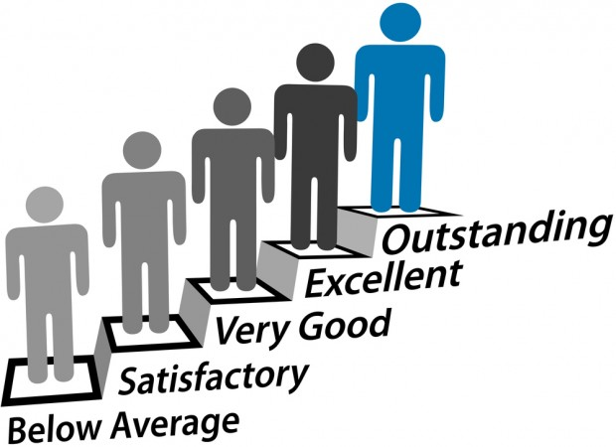
DESCRIPTIVE RATING SCALE
IN THIS DESCRIPTIVE TERMS OR PHRASES ARE ASSIGNED TO EACH TRAIL.THE RATER ENTERS THE APPROPRIATE PHRASES AFTER EACH NAME TO INDICATE JUDGEMENT OF THE PERSON.

Slide 76
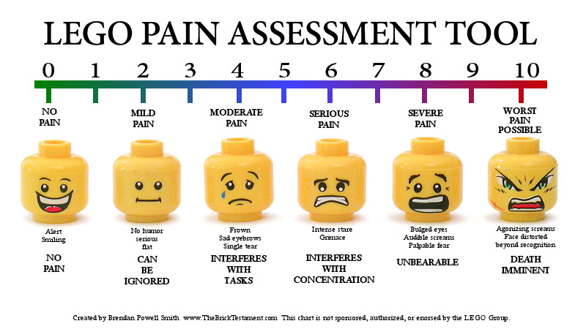
NUMERICAL RATING SCALE
In which numbers are assigned to each trait. If it is a seven point scale, the number 7 represents the maximum amount of that trait in the individual, and 4 represents the average. The rater merely enters the appropriate number after each name to indicate judgment of the person.

Slide 77
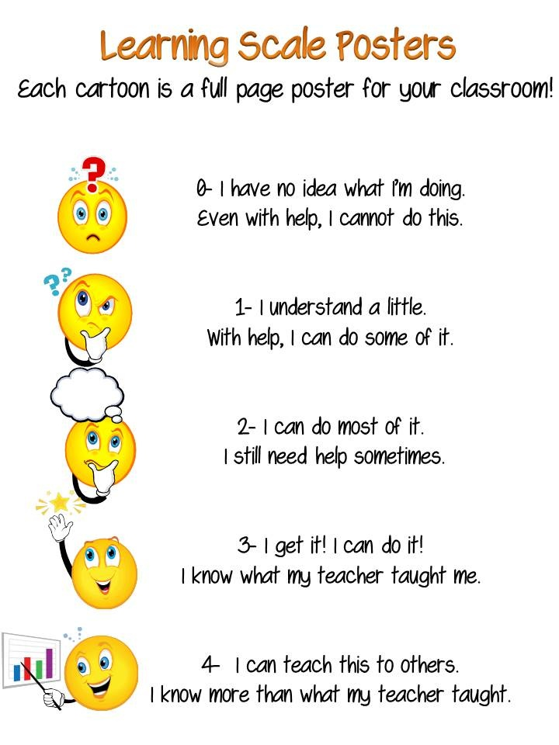
ACTIVITY:
HOW FAR DO YOU UNDERSTAND SUBJECTS IN NURSING?

Slide 78
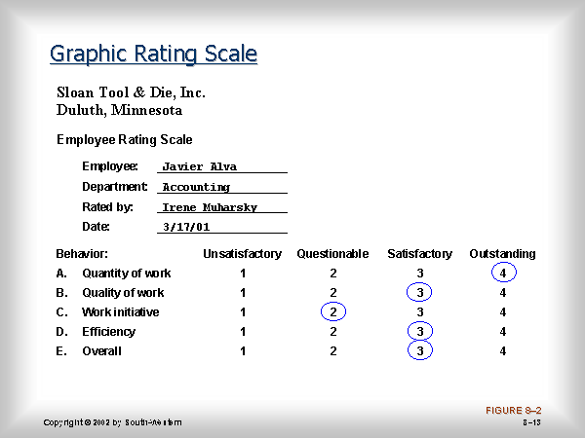
GRAPHIC RATING SCALE
A straight line, may be represented by descriptive phrases at various points. To rate the subject for a particular trait a check mark is made at the particular point.

Slide 79
COMPARATIVE RATING SCALE
IN THIS PERSON MAKES AJUDGEMENT ABOUT AN ATTIRE/ATTITUDE/OBJECT....... BY COMPARING IT WITH OTHERS/RANKING IT.

Slide 80
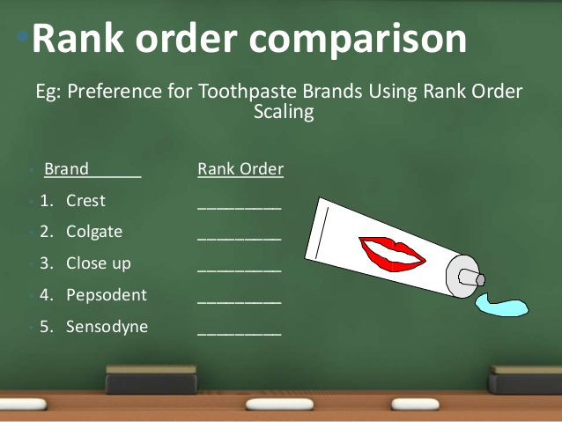

Slide 81
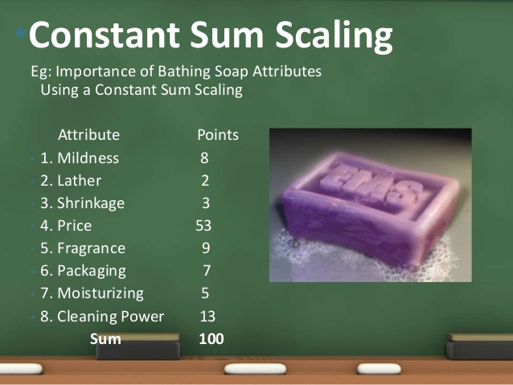

Slide 82
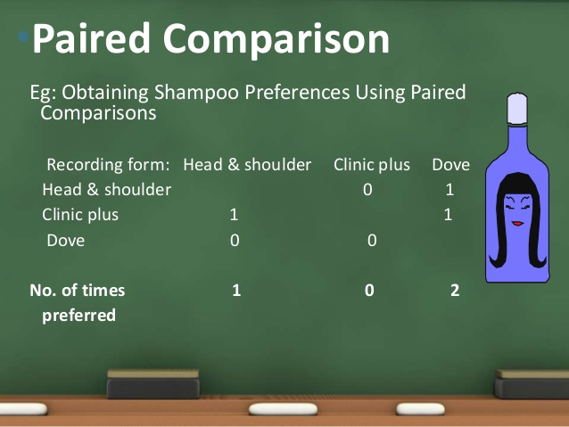

Slide 83
CHARACTERISTICS OF RATING SCALE:
1. These are value judgements about attributes of one person by another person.
2.These are most commonly used tools to carry out structured observations.
3. These are generally developed to make qualitative judgement about qualitative attributes.
4. Provide more flexibility to judge the level of performance.

Slide 84
Principles of preparing rating scale
Directly relates to learning objectives
Needs to be confined to performance areas that can be observed.
The trait or behavior should be readily observable.
Allow some space in the rating scale card for the rater to give supplementary remarks
3 to 7 rating positions may need to be provided.
The rater should be unbiased and trained.
All rater should be oriented to the specific scale as well as the process of rating in general.

Slide 85
Advantages
Easy to administer and to score
Can be used for a large group of students
Clarity of feedback to students

Slide 86
Disadvantages
Misuse can result in consequent decrease in objectivity.
Difficult to fix up rating.
Unscientific or unreliable.

Slide 87
CHECKLIST
A checklist consist of a listing of steps, activities or behavior which observer records when an incident occurs.
A checklist is a type of informational job aid used to reduce failure by compensating for potential limits of human memory and attention.
It helps to ensure consistency and completeness in carrying out a task.
A basic example is the “To do list”

Slide 88
Suggestions to follow
Should be relate directly to learning objectives.
Needs to be confirmed performance areas that can be assess sufficiently by examining positive and negative criteria.
Clearly specify the characteristics observed.
Have a separate checklist for each candidate.
The observer must be trained.
Students should be evaluated in the natural setting and real situation.
Should review individual strength and weakness of the performance.

Slide 89
Types of checklist
Procedural checklist
Steps must be followed in order.
Communication checklist
Schedule communication – billing, status
Unscheduled communication – scope, discussion
Project checklist
Have some flexibility
Project schedule, task list and work breakdown structures are checklists.
Procedural checklist

Slide 90
Advantages
Consolidate vast knowledge in parsimonious manner
Improve task performance
Reduce influence of halo and rorschach effects
Improve memory recall
Set out minimum necessary steps in a process

Slide 91
Disadvantages
Evaluation myopia
Inappropriate use
Fatigue resulting from overuse
Unnecessary complexity decreases reliability
Burdensome process

Slide 92
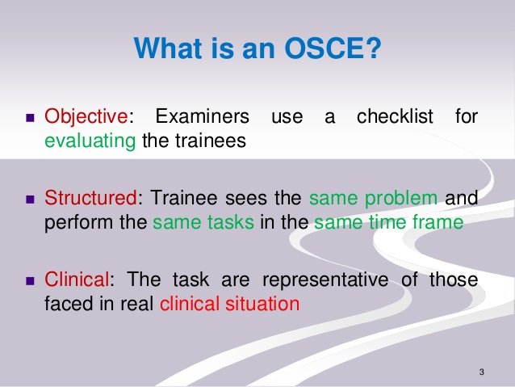

Slide 93
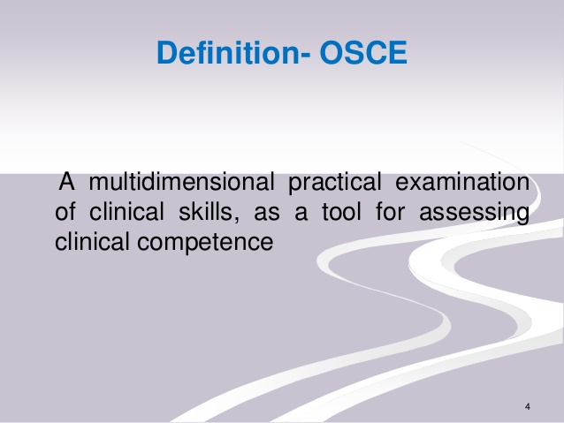

Slide 94
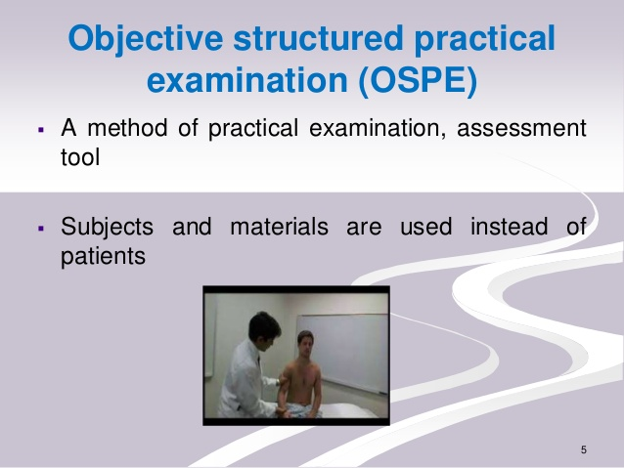

Slide 95
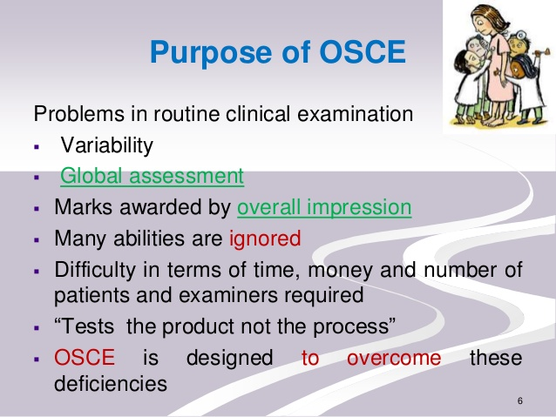

Slide 96
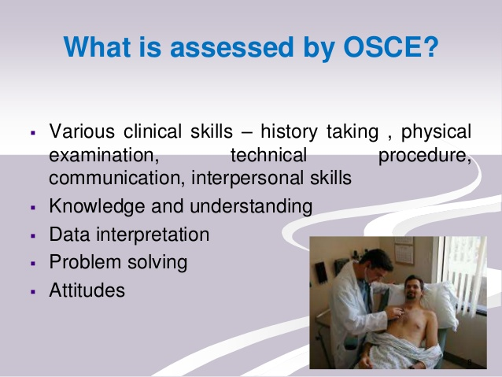

Slide 97
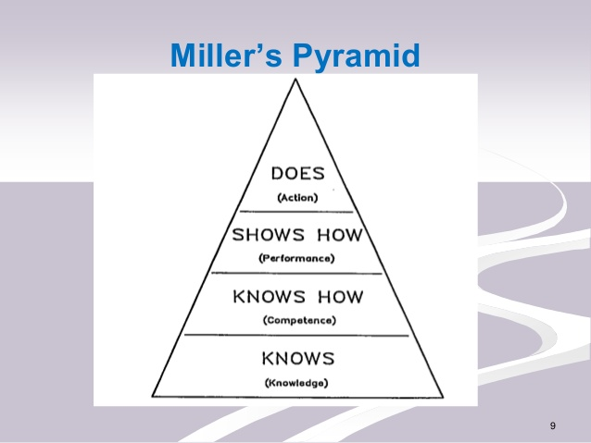

Slide 98


Slide 99
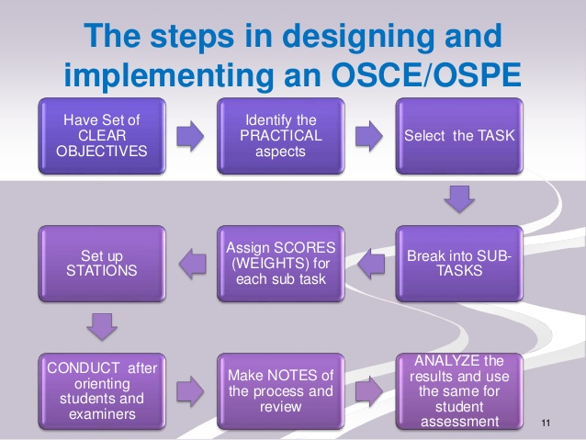

Slide 100
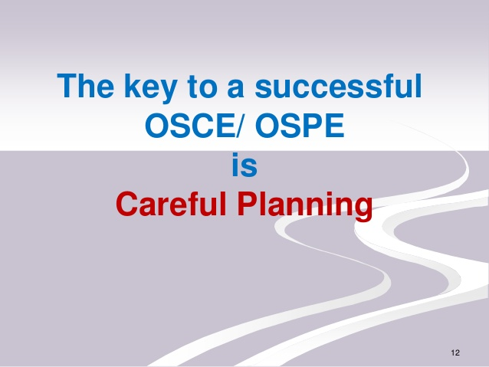

Slide 101
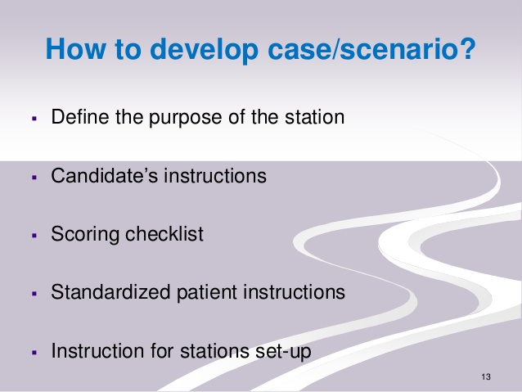

Slide 102
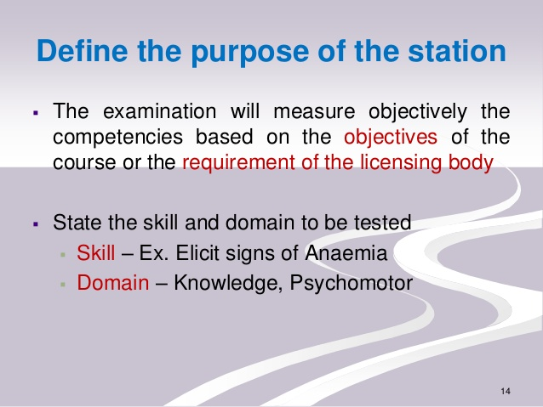

Slide 103
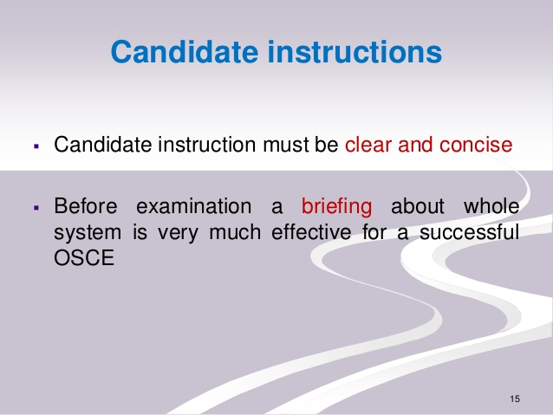

Slide 104
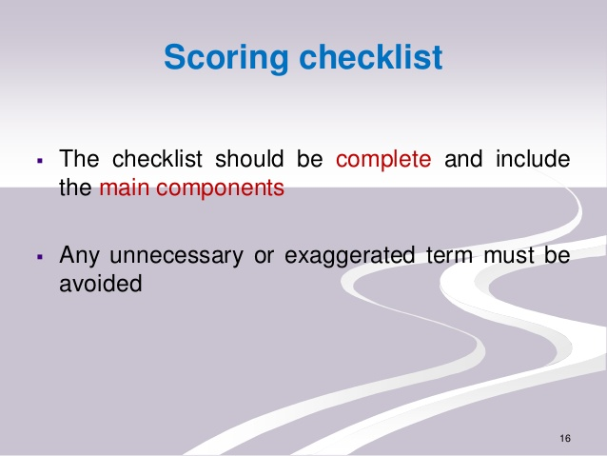

Slide 105
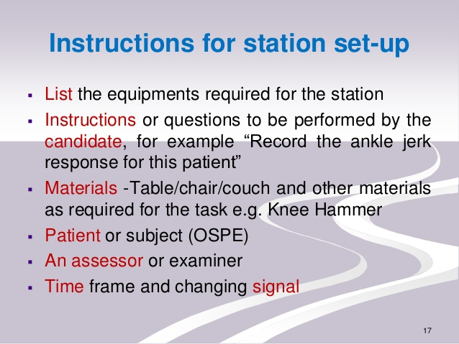

Slide 106
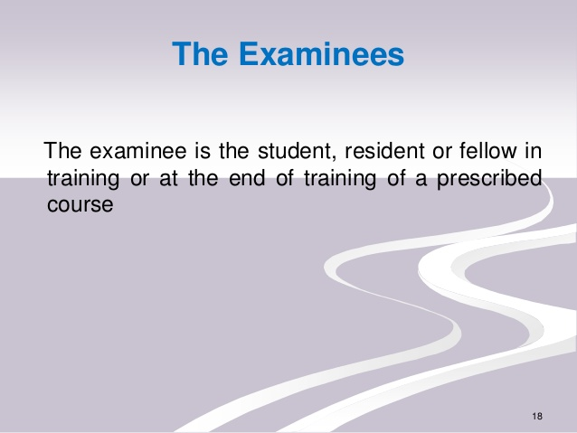

Slide 107
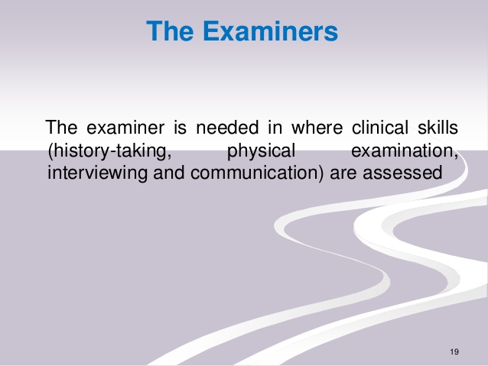

Slide 108
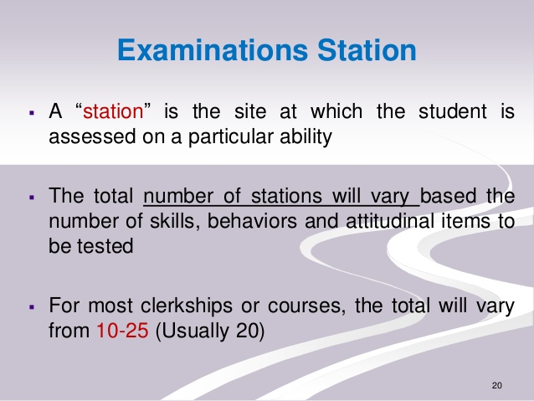

Slide 109
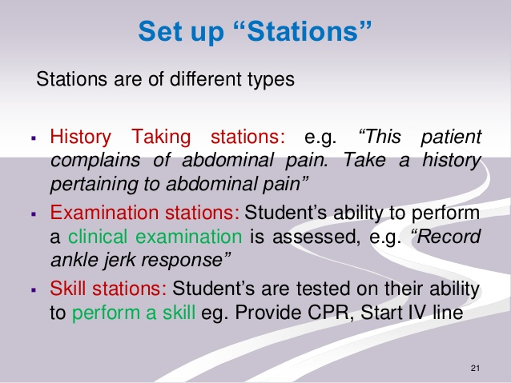

Slide 110
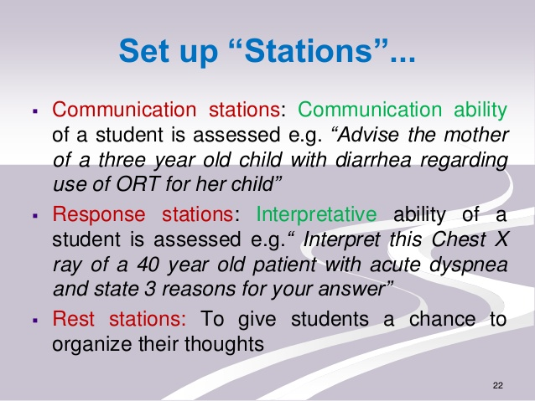

Slide 111
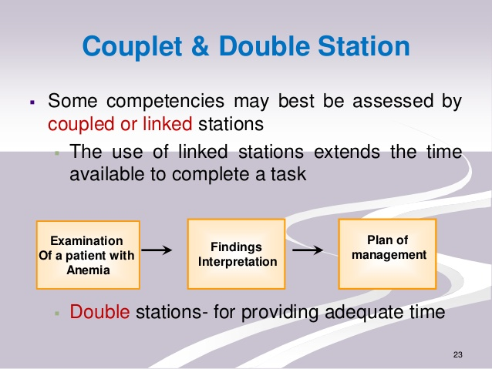

Slide 112
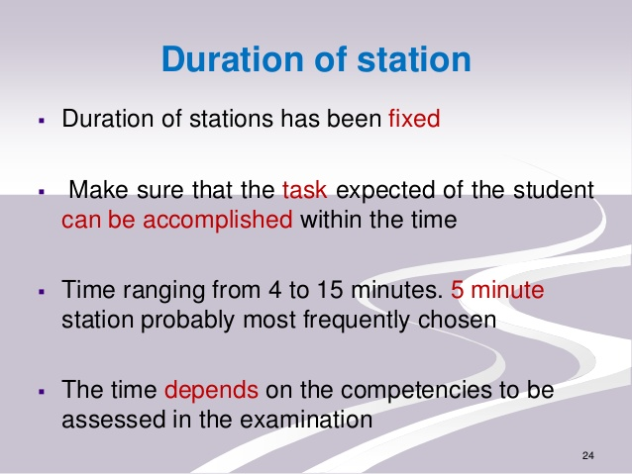

Slide 113
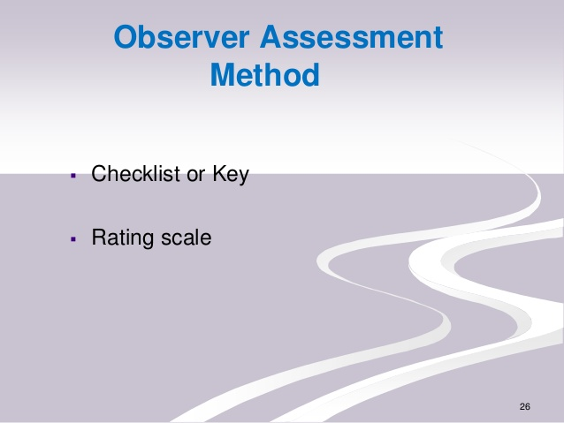

Slide 114
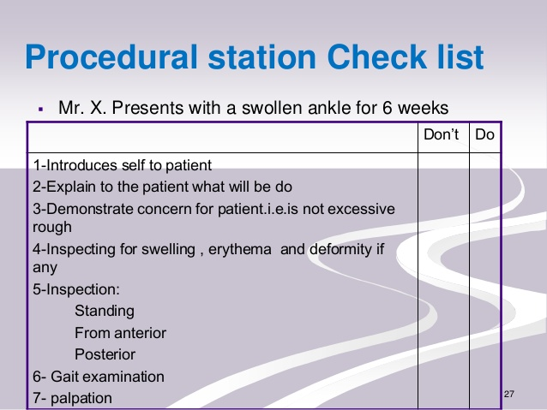

Slide 115
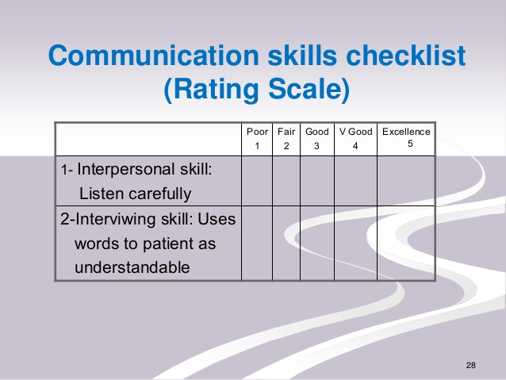

Slide 116
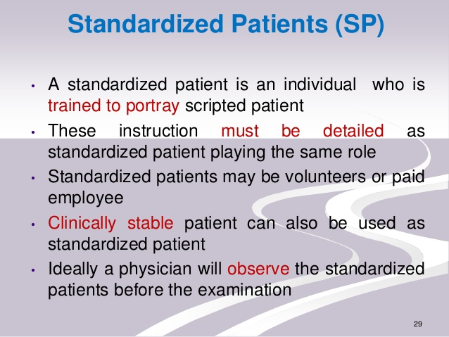

Slide 117
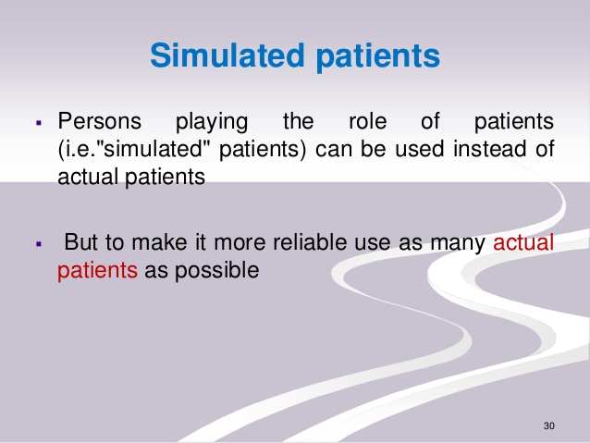

Slide 118
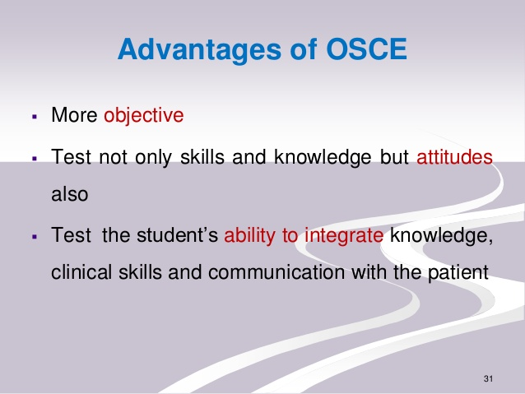

Slide 119
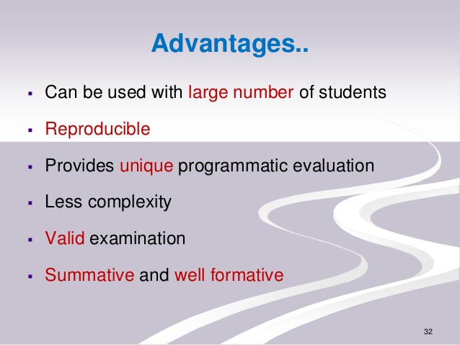

Slide 120


Slide 121


Slide 122
ATTITUDE SCALE:-
The word ‘scale’ come from the Latin word scala, meaning a ladder or flight of steps, a scale represents a series of ordered steps at fixed intervals used as a standard of measurement.
An attitude scale is a special type of questionnaire designed to produce scores indicating the intensity and direction (for or against) of a person’s feelings about an object or event.

Slide 123

An attitude scale, is a tool prepared for the purpose of measuring people's attitude to an issue is called attitude scale.
An attitude scale is designed to provide a valid, or accurate measure of an individual’s social attitude.

Slide 124
Structure of attitude:-
It has three components:-
Affective component:- The feelings or emotions towards objects.
Ex- I am scared of spiders.
Behavioural component:-the way the attitude we have influences how we act or behave.
Ex- I will avoid spiders and scream if i see one.

Slide 125

COGNITIVE COMPONENT:-
This involves a person’s belief / knowledge about an attitude object.
Ex- I believe spiders are dangerous.
This model is also known as ABC model of attitude.

Slide 126
ATTITUDE SCALE
Used for measuring social attitudes.
Questionnaire is prepared, by the items in the questionnaire are the attitudes of an individual towards a matter things, and object or system and score will be allotted for each item.
Some relevant or indirect statements will also be used to revels the attitude.

Slide 127
DIFFERENTIAL
SEMENTIC DIFFERNTIAL
POINT SCALE
SCALOGRAM
TYPES OF ATTITUDE SCALE
SUMMATED / LIKERT SCALE
Q-SORT SCALING

Slide 128
POINT SCALE
METHOD 1:
Select the words will give the opinion.
The respondents is to cross out every word that is more annoying than pleasing to him.
The attitude of respondents is known by calculating numbers of words crossed or not crossed.

Slide 129
METHOD 2:
Two sets of words indicating favorable and unfavorable opinion are given.
The unfavorable item may be crossed and favorable items and may be left unscored.

Slide 130
LL Thurstone /Differential scale
It is the first formal method designed to measure attitude.
It was developed by Louis Leon thurstone in 1928.
It is also known as method of equal appearing interval.
It is made up of statements about the particular issues.
consists of statements which have a range of weights from high (usually 11) to low (usually 1).
Subjects select the attitudinal statements they agree with most.

Slide 131

Construction of thurstone scale: -
Selection of statement: -
60 short statements regarding the issue under study was collected. (historically, 130). Statements were short, straightforward and unambiguous.
These statements should express opinions not facts.
Statements should express all shades of attitude from extremely favourable, through neutral , to extremely non-favourable.

Slide 132
For this example, statements about same sex marriage: -
It’s should be against the law.
There’s absolutely nothing wrong with it.
Marriage is between a man and a woman.
It should be a sin.
It’s perfectly appropriate for two consenting adults.
It should be legalized.
It can harm children.
Same sex couples should have the same legal rights as a male/female couple.
It’s just horrible. It can’t do any harm.

Slide 133

Selected statements were mimeographed on separate slips of paper .
Statements were sent out to about 30 judges( thurstone sent out to 300 judges) for sorting into 11 or 9 piles. Each statement should be put in one of the 11 or 9 piles.

Slide 134

Categories starting from extremely favourable to extremely unfavourable.

Slide 135

Computation of data:-
After the judges have categorized the statements, a frequency table to each statement is drawn separately, showing the number of judges put it in different categories.

Slide 136
For each statement, compute the Median and the Interquartile Range.
Median - is the value above and below which 50% of the ratings fall.
The first quartile (Q1) - is the value below which 25% of the cases fall and above which 75% of the cases fall - in other words, the 25th percentile.
The median is the 50th percentile.
The third quartile, Q3, is the 75th percentile. The Interquartile Range is the difference between third and first quartile, or Q3 - Q1.

Slide 137
If the judges cannot rate the item on its favourability or show a high degree of variability in their judgments, the item is eliminated.
The percentage of judges who placed each statement in the different category constitutes the basic data for computing the scale value of a statement.
The Median position (50th percentile or 2nd quartile) assigned by the judges to the statement is called the scale value of statement.

Slide 138
So, let’s assume that the average ratings among our judges are as below:
It’s should be against the law- 1.7
There’s absolutely nothing wrong with it- 6.8
Marriage is between a man and a woman- 2.4
It should be a sin- 1.3
It’s perfectly appropriate for two consenting adults - 8.4
It should be legalized - 9.1

Slide 139
Administration and scoring: -
Arranged in random order and administered.
Respondents tick mark the statements with which they agree and leave the rest.
The weights (favourability rating) for the checked statements are summed and divided by the number of statements checked.
Example- the respondent selected #2, #3, #5- his score will be- 6.8+ 2.4 + 8.4 / 3 = 5.8

Slide 140


Slide 141
Likert / Summated scale
The most popular attitude scale type.
It was given by Rensis Likert (1932).
It is also known as Summated rating scale.
Respondents indicate the extent to which they endorse the statements (e.g., agree / disagree).

Slide 142
Constructing a likert scale: -
Collect statement:-
This process does not require the categorization of items by a group of judges. Items (50 – 60) are selected on the basis of the response of subjects to whom they are administered in the course of developing the test.
The statements are arranged randomly and a have a five point rating scale- ‘strongly agree’ , ‘agree’, ‘uncertain’, ‘Disagree’ , ‘Strongly Disagree’.

Slide 143
The criteria for this test is only ‘internal consistency’.
The list is printed and sent out to a sample of about 200 members of the population concerned.
After the respondents have finished with the list, the statements are evaluated for the selection or rejection in the final draft.

Slide 144

The number of favourable and unfavourable statements should be approximately equal.
The sum of the statements credits represents the score of an individual.

Slide 145
Scripts are arranged in descending order of total scores.
Top 25 percent and bottom 25 percent scripts are taken out.
The mean scores and variances of each statement in the top and bottom piles are computed separately.
Significance of difference is tested by t-ratio.
Those statements for which the t-ratio is equal or greater than 1.96 are suitable for selection.

Slide 146
All the statements are sorted out and arranged in descending order of numerical value of t.
Then top 10 to 15 favourable and unfavourable statements are selected and arranged randomly to shape the final draft.

Slide 147
Administration and scoring: -
Final script administered.
Tick mark each of the statements.
Award marks- 1, 2, 3, 4, 5. ( reverse marks for reversal items).
The sum of the scores of a respondent represents his total score which can be interpreted in terms of empirically established norms.

Slide 148


Slide 149


