Slide 1
PATHOLOGY OF LUMBAR DISC DISEASE
DR BHAGWATI SALGOTRA

Slide 2
introduction
Lumbar disc disease is a disease of the intervertebral discs of the lumbar spine.
The most common form of disc disease is a herniated disc, and a lumbar herniated disc is one of the most common locations for disc herniations.
Lumbar disc herniation occurs 15 times more often than cervical (neck) disc herniation, and it is one of the most common causes of lower back pain.
Affects adults more commonly in there 3rd and 4th decade of life.
Spectrum of lumbar disc disease include ..low back pain, sciatica, progressive neurological deficit and
cauda equina syndrome.

Slide 3
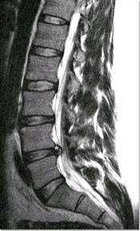
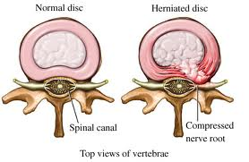
Lumbar disc disease

Slide 4
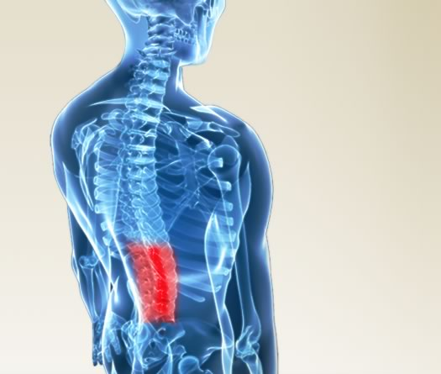
posture

Slide 5
The vertical human spine is subjected to much greater gravitational stress.
Schmorls node..i.e circumscribed protrusion of disc tissue in vertebral end plates are not found in quarupeds.
Wassilev ,dimova,cassidy et al 1988:experimentaly forced mice to walk upright by amputating their forelegs and intervertebral disc degeneration was seen withing a year .
Degeneration process starts as soon as child begins to stand and walk.
The incidence of lumbar disc herniation in adolescents and children accounts for 0.5% to 3.8% of cases .

Slide 6
HISTORY
Hippocrates: 460-377 BC: –description of sciatica as hip pain
Galen: 129-199 AD: lifestyle as cause of sciatica.
Andreas vesalius:1543:first description of intervertebral disc.
Sydenham 1624-1689: coined the term lumbago for low back pain
Cotugno:1736-1822: first description of sign and symptoms and treatment of sciatica.malum cotunii..cotugno disease.
Lasegue 1864:lasegues test.
Goldthwait: 1911:recognition of intervertebral disc as cause of sciatica and cauda equina.
Dandy:1919:pneumomyelography.demonstrated herniated disc
Sicard and forestier:1922: injected lipiodol for myelography.

Slide 7
Schmorl:1928:described schmorls nodes.
Mixter and barr:1934: suggested removal of herniated disc and hemilaminectomy.
Junghanns:1951: described biomechanical and biochemical nature of disc.
Smith:1964 :suggested intradiscal chymopapain.
Hounsfield:1973:CT scan
Lauterbur and mansfield:1973: MRI

Slide 8
Embrology of intervertebral disc
Intervertebral dics forms from notochord.
12mm embryo: primodial vertebral column with cartilaginous vertebral body with intervertebral disc can be seen.notochord traverses all segments.
30mm embryo: notochord is thickened at the level of intervertebral dics.
50mm embryo:notohcord disappears at the level of primodial vertebral bodies.
Ultimately notochord persists only as drop like remnants in the center of intervertebral disc as nucleus pulposus.
Primodial disc tissue surrounding the notochord forms outer and inner zone.outer zone forms annulus fibrosis.

Slide 9
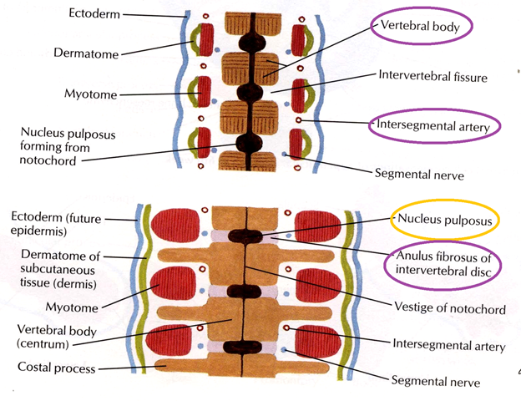

Slide 10
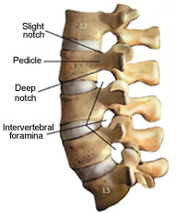
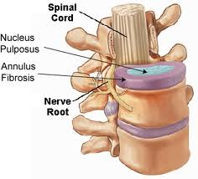
ANATOMY

Slide 11
anatomy
The intervertebral disc is composed of Nucleus pulposus: consists of scattered cells and thin collagen fibrils dispersed in a proteoglycan-rich ground substance.
Annulus fibrosus:The outer portion of the disc is the anulus fibrosis, and it is composed of concentric layers of intertwined anular bands. These anular bands are arranged in a specific pattern to resist forces placed on the lumbar spine. The anular bands are subdivided into inner fibers, which are connected to the cartilaginous endplate, and outer Sharpy fibers, which are attached to the VB:

Slide 12
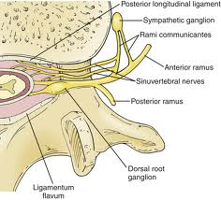
nerve supply

Slide 13
A meningeal branch of the spinal nerve, better known as the recurrent sinuvertebral nerve, innervates the area around the disc space .This nerve exits from the dorsal root ganglion and enters the foramen, where it then divides into a major ascending and lesser descending branch.[
It has been shown in animal studies that further afferent innervation to the sinuvertebral nerve arises via the rami communicantes from multiple superior and inferior dorsal root ganglia.
the outer anular regions are innervated, but the inner regions and nucleus pulposus are not innervated. In addition studies have demonstrated that the ALL also receives afferent innervation from branches that originate in the dorsal root ganglion. The PLL is richly innervated by nociceptive fibers from the major ascending branch of the sinuvertebral nerve. These nerves also innervate the adjacent outer layers of the anulus fibrosis. Degenerated human lumbar discs have been shown to contain more nerve tissue and to be more vascular than normal discs.

Slide 14
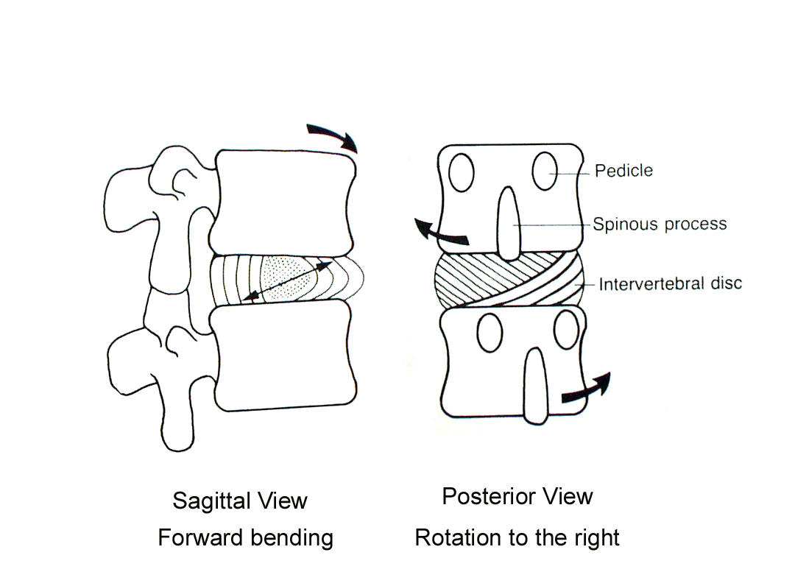
Biomechanics and stress
Six degrees of freedom
3 translational:
Forward-backward
Left-right
Up-down
3 rotational:
Flexion-extention
Lateral bending
Axial rotation

Slide 15
Biochemical changes in the disc
Dominant proteoglycan in disc is aggrecan which consists of core protein conjugated with keratan sulfate and chondroitin sulfate molecules.
The strength of the lumbar disc is related to the fluid and proteoglycan content of the disc.
Collagen in the disc is of type 1 and 2
Degenerated discs have been demonstrated to vary specifically in the degree of sulfation of chondroitin.Degenerated discs lacks adequate sulfation of chondroitin when compared with controls, . The specific disaccharide involved is chondroitin sulfate, which gets reduced to unsulfated chondroitin in degenerated sections.

Slide 16
In lumbar spine there is a large amount of flexion,extention ,rotational and translational movement as compared to the other regions of spine.
This accounts for the higher incidence of disc disease in L4 –L5 and L5-S1 disc level

Slide 17
EPIDEMIOLOGY of lumbar disc disease
Disc herniation can occur in any disc in the spine, but the two most common forms are lumbar disc herniation and cervical disc herniation. The former is the most common, causing lower back pain (lumbago) and often radicular leg pain as well, in which case it is commonly referred to as sciatica.
Lumbar disc herniation occurs 15 times more often than cervical (neck) disc herniation, and it is one of the most common causes of lower back pain. The cervical discs are affected 8% of the time and the upper-to-mid-back (thoracic) discs only 1 - 2% of the time.
] locations exempt from the risk of disc herniation: the upper two cervical intervertebral spaces, the sacrum and the coccyx
Most disc herniations occur when a person is in their thirties or forties when the nucleus pulposus is still a gelatin-like substance. With age the nucleus pulposus changes ("dries out") and the risk of herniation is greatly reduced. After age 50 or 60, osteoarthritic degeneration (spondylosis) or spinal stenosis are more likely causes of low back pain or leg pain.

Slide 18
Pathology of disc
Stages of disc degeneration(discosis)
First stage: adolescence and young adulthood:First stage begins with the regression of the intradiscal vessels between the age of 2yr -4yr.here after disc receives nutrition only by diffusion .
Second stage :middle age:20- 50 :by this stage poorly nourished fibroblasts and chondrocytes produce poor quality fibers that are no longer able to withstand the expansile pressure of the central disc.annulus fibrosis develops both radial and circular tear.segmental instability develops.
Third stage: old age: after 60 years the disc tissue loses water and becomes fibrotic and firm.less liable to displacement.calcification of ligaments ,spondylotic process contributes to further fixation of motion segments. net effect is partial stabilization

Slide 19
THOMPSON MORPHOLOGIC GRADING OF DISC DEGENERATION
GRADE | NUCLEUS | ANNULUS | END PLATE | VERTEBRAL BODY
1 | Bulging gel | Discrete fibrous lamellae | Hyline ,uniformly thick | Margine round
2 | White fibrous tissue peripherally | Mucinous materal btw lamellae | Thickness irregular | Margine pointed
3 | Consolidated fibrous tissue | Extensive mucinous infilatration loss of demarcation | Focal defect in cartilage | Early osteophytes
4 | Horizontal cleft parallel to end plate | Focal disruption | Irregularity and focal sclerosis in subchondral bone | Osteophytes smaller that 2mm
5 | Cleft extends through the annulus | Multiple tear | Diffuse sclerosis | Osteophytes larger than 2mm

Slide 20
PFIRRMANN GRADING OF DISC DEGENERATION BASED ON MRI
Grade | Structure | Distinction btw Nucleus and annulus | Signal intensity on mri | Disc height
1 | Homogeneous ,bright white | clear | hyperintense | normal
2 | Inhomogeneous With or without clear bands | clear | hyperintense | normal
3 | Inhomogeneous,gray | unclear | intermediate | Slightly decreased
4 | Inhomogeneous,gray to black | lost | Intermediate to hypointense | Moderately decreased
5 | Inhomogeneous,black | lost | hypointense | Collapsed disc space

Slide 21
Disk bulge - Annular fibers intact
Disk protrusion - Localized bulging with damage of some annular fibers
Disk extrusion - Extended bulge with loss of annular fibers, but disk remains intact
Disk sequestration - Fragment of disk broken off from the nucleus pulposus

Slide 22
genetics
GENE | GENE PRODUCT | CHROMOSOME
COL1A1 | COLLAGEN 1 a 1 SUBUNIT | 17q21
COL9A2 | COLLAGEN 9 a2 SUBUNIT | 1P33
COL9A3 | COLLAGEN 9 a 3 SUBUNIT | 20q13
VDR | VIT D RECEPTOR | 12q13.11
AGC-1/ACAN | AGGRECAN | 15q26
IL 1A | interleukins | 2q14
IL 1B | interleukins | 2q14
IL 6 | interleukins | 7p21
MMP3 | Matrix metaloproteinase | 15q22

Slide 23
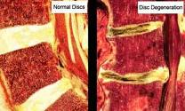


Slide 24

Journal of Korean Neurosurg Soc. 2010 December; 48(6): 538–540.
Published online 2010 December 31. doi:
Lumbar Disc Herniation in Tae Kwon Do Athletic Child
Sung Hoon Kim, M.D., Ph.D.,² Hyeun Sung Kim, M.D., Ph.D.,³ and Seok Won Kim, M.D., Ph.D.¹
¹Department of Neurosurgery, College of Medicine, Chosun University, Gwangju, Korea.
Case report.
A 7-year-old boy is reported who presented with low back pain and left leg radiating pain. The pain started seven days prior to presentation . Magnetic resonance imaging revealed a posterolateral disc herniation at the L3-4 level and multiple degenerative changes.

Slide 25
Lumbar disc disease
factors: disc degeneration
lifestyle and mechanical stress over spine
genetics
smoking

Slide 26
Chronic low back pain
Sciatica
Secondary canal stenosis
Cauda equina syndrome.

Slide 27
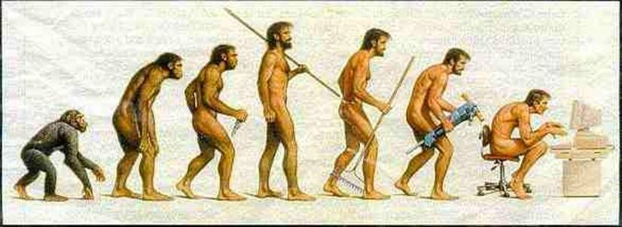
Lumbar disc disease is the price human pays for walking erect

Slide 28
THANK YOU

