Slide 1

Role of various health personnel
                Mr. Adithya S.
                Asst. Professor
                SNC

Slide 2
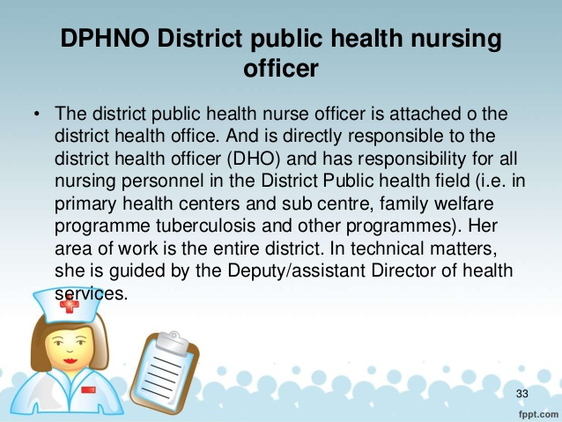

Slide 3
WORKING RELATIONSHIP
The public health nurse will assist the District Medical Officer/District Family Welfare Officer in planning, implementing and evaluating maternal & child health and nutrition program undertaken in the district. She will receive technical guidance from him and will be under the administrative control. She will work in collaboration with other functionaries in the district family welfare bureau like the mass media and the extension officer, health education officer, statistical officer, etc.

Slide 4
DUTIES & FUNCTIONS
      To help in the organization of maternal & child health program.
      To promote health & nutrition education activities through lady health visitors, auxiliary nurse midwives.
      To ensure that the lady health visitors/ ANMs/ female multipurpose workers, etc. integrated MCH family planning and health and nutrition/ education in their day to day activities.
      To help in developing school health program in the district.

Slide 5
      To review the periodical progress reports on MCH/FP work done by the LHVs/ANMs, female, multipurpose workers, etc. and put up to the District Medical Officer/ District Family Welfare Officer the points requiring attention and further action.
      To give technical guidance, supervision and support to the ANMs, female, multipurpose workers, LHVs, public health nurse working in MCH/FP program in the district and to review the annual confidential reports in respect of these functionaries.
      To investigate into complaints against female paramedical personnel in the district and submit reports/ recommend to District Medical Officer/ District Family Welfare Officer .

Slide 6
      To ensure regular supply of equipments, records, registers, drugs, vaccines, and other sundries necessary for MCH work in the primary health centers and sub-centers by assisting storekeeper in procuring and distributing the supplies.
      To ensure the maintenance of prescribed records and submission of periodical progress of MCH/FP/Nutrition work activities.
      To help the statistical officer in the District Family Welfare Bureau in compiling the periodical progress reports of MCH activities.

Slide 7
      To provide for continuing education of the female MCH/FP/functionaries in the district through short in-service training sources.
      To work together with the functionaries of other government departments like social welfare, Rural Development and education engaged in programs for women and children.
      To co-operate MCH/FP activities under taken through the voluntary organization in the district and provide health inputs to the possible extent for mothers and children organized in balwadis, anganwadis, etc.
      To tour for a minimum of 15 days in a month and visit primary health centers, sub-centers, village dais, balwadi, mahila mandals, etc.

Slide 8
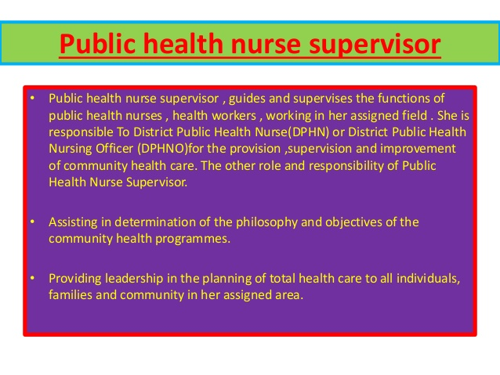

Slide 9
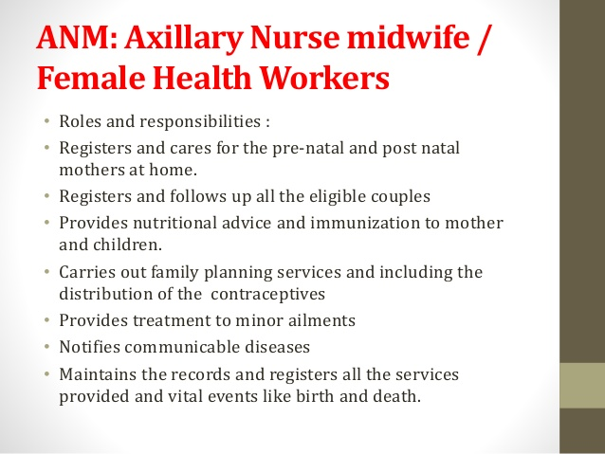

Slide 10
Health worker (male)
Malaria:-
Communicable diseases
Leprosy
Tuberculosis
Environmental sanitation
Universal immunization programme
Family planning
Health Education
Nutrition
Vitals Events

Slide 11
Lady health visitor
Rendering health care at private residencies and health centres.
Rendering antenatal care and advice expectant mother
Rendering post-natal care
Performing duties like weighing babies, distributing milk, tonics , etc.
Administering stock of medicine.
Supervising training and work of dias.
Ensuring vaccine.
Advising a personal and environmental hygiene.

