Slide 1


Slide 2


Slide 3


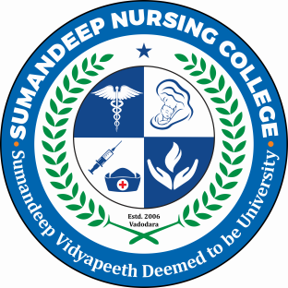


HISTORY OF NURSING PROFESSION
Mr. Adithya S.
Asst. Professor
SNC

Slide 4
Introduction
Treating the sick is nothing new. People have cared for the sick throughout history, beginning in ancient times
However, considering the long history of nursing, it was not until fairly recently that nurses received a formal nursing education.
Over hundreds of years, nursing has undergone an evolution, eventually transforming itself into the respected profession we all know of today.

Slide 5


NURSING IN ANCIENT TIMES
In some early cultures, the provision of nursing care was assigned to females, because women provided nurturing to their infants and it was assumed that they could provide the same type of care to the sick and injured.

Slide 6
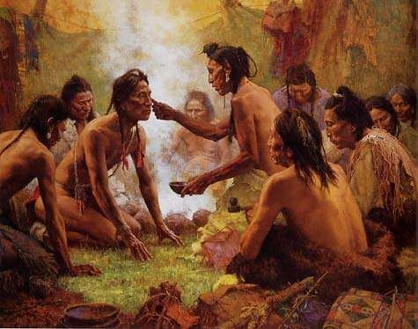
NURSING IN ANCIENT TIME
In other ancient societies, however, men were designated to care for the sick, because they were considered priests, spiritual guides or
“medicine men.”

Slide 7
NURSING IN ANCIENT TIME
There was no formal education available in primitive societies, so the earliest nurses learned the tricks of the trade via oral traditions that were passed down from one generation to the next.
They also learned how to nurse patients back to health through trial and error
and by observing others who cared for the sick.
The earliest nurses used plants and herbs to heal and believed that evil spirits and magic could affect one’s health.
Illness was often viewed as a sign that something was done to offend the priests
or gods.

Slide 8
CONT..
The Egyptian healthcare system was the first to maintain medical records starting at around 3000 B.C.
Egyptian society was also the first to classify medications and develop plans to maintain people’s health.
In ancient Rome, during the early Christian era, deaconesses were selected by the church to provide care for the sick.
Deaconesses had some education and were selected by the church’s bishops to visit and care for the sick in their homes. The deaconess Phoebe is considered to be the first “visiting nurse” who provided expert home nursing care.

Slide 9
NURSING IN MEDIEVAL AND EARLY MODERN EUROPE
During the Renaissance period from 1500 to 1700, a growing interest in science and technology led to advances in medicine and public health.
At the time, the rich paid for their sick to be cared for at home, while the poor were cared for in hospitals. By the time many poor people arrived at hospitals, they were already very ill, so they often died in the hospitals.
Being hospitalized had negative connotations for most people, as hospitals were considered places where people went to die.

Slide 10
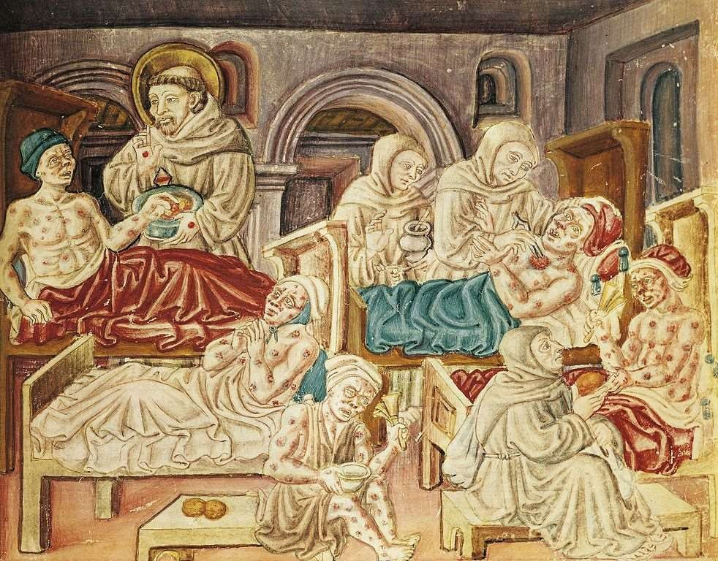

Slide 11
CONT..
Following the Protestant Reformation, monasteries and convents were closed, and the lands were seized. “Common” women who were too old or ill to find other jobs started caring for the sick.
Although there were a few hospitals in Protestant Europe, there were no regular system of nursing.
Female practitioners cared for neighbours and family, but their work was unpaid and unrecognized.
In Catholic areas, however, the tradition of nursing nuns continued uninterrupted.

Slide 12
Foundations of Modern Nursing
Modern nursing began in the 19th century in Germany and Britain.
The practice had spread worldwide by about 1900. British social reformers advocated for the formation of groups of religious women to staff existing hospitals in the first half of the 19th century.
Two influential women in the field of nursing during this time period were Elizabeth Fry and Florence Nightingale.

Slide 13
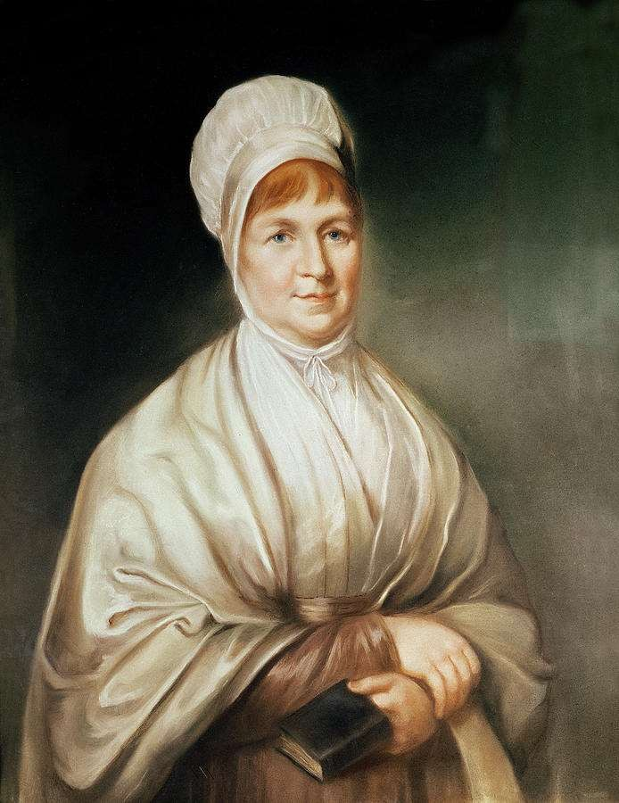
ELIZABETH FRY

Slide 14
ELIZABETH FRY
The Quaker Elizabeth Fry founded the Protestant Sisters of Charity in 1840.
Members of this sisterhood received a rudimentary education in nursing and observed patients at two London hospitals.
In 1848, the English Protestant sisterhood St. John’s House was founded. These sisters lived together as a community and participated in a two-year long nursing education program.
They were required to work for St. John’s House for five years in return for room and board plus a small salary.
They nursed for a few hours each day and spent the rest of the time in prayer and religious instruction.

Slide 15
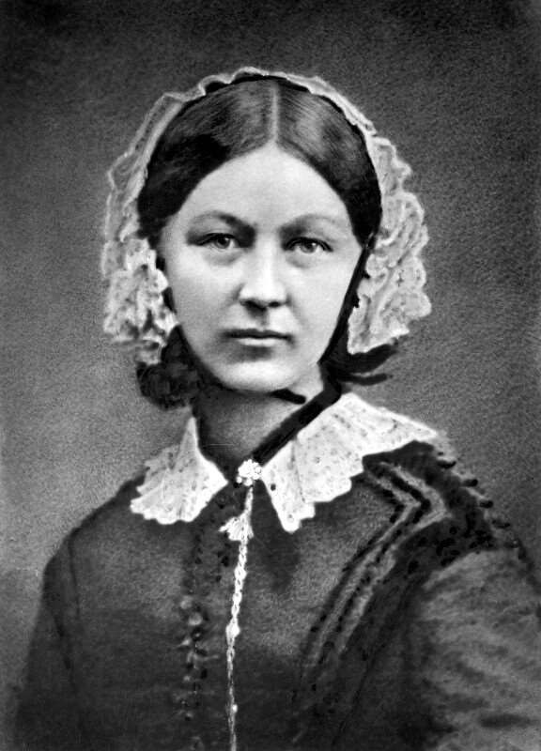

FLORENCE NIGHTINGALE

Slide 16

Florence Nightingale was a philanthropist from a wealthy English family who studied nursing under the direction of Pastor Fliedner in Germany.
Nightingale forever changed the practice of nursing.
At the time, it was unusual for an upper-class woman to care for the sick, but Nightingale felt a calling to serve humanity.
When the Crimea War broke out in 1854, Nightingale was appalled to discover that the mortality rate of British troops was 41% and that the British army lacked nurses.
Owing to Nightingale’s efforts, the number of deaths among British soldiers decreased
dramatically within months.
When Nightingale returned to England, she was hailed a heroine. She then established the Nightingale School of Nursing at St. Thomas’s Hospital in London, offering education for professional nurses.

Slide 17
The 19th and 20th Centuries
In the late 19th century, nursing professionalized rapidly in the United States.
Women who had served as nurses during the Civil War realized the importance of a formal nursing education and played a crucial role in establishing the first nurse training schools.
Hospitals began setting up nursing schools that attracted women from both working-class and middle-class backgrounds.

Slide 18
Cont..
The first permanent school of nursing founded in the United States was the nurse training school at the Women’s Hospital of Philadelphia, which was established in 1872.
During the second half of the 20th century, the number of graduate programs in nursing grew rapidly.
Graduate nursing programs focusing on clinical specialties laid the basis for the expansion of advanced practice nursing.
By the end of the 1960s, there were 1,343 nursing schools with 1,64,545 nursing
students enrolled, according to the National Student Nurses Association (NSNA)

Slide 19

Joining the future nursing
From the beginning of mankind, people have performed the functions we know now as nursing care.
Nursing has come a long way since its early days, when nurses were untrained and looked down upon by the rest of society.
Today’s nurses are well educated and have earned the trust and respect of the public.
The history of nursing shaped our current healthcare system, but nurses must continue to monitor developments in science and technology, as well as changes in society to determine how to help the needs of the future.

Slide 20

SUMMARY

Slide 21


Slide 22
BIBLIOGRAPHY
Indrani TK. History of nursing. 1st ed. New Delhi: Jaypee brothers medical publication (p) ltd; 2010. p.1-15.
Brar Navdeep Kaur, Rawat HC. Textbook of advance nursing practice. 1st ed. New Delhi: Jaypee brothers medial publishers (p) ltd; 2015. p.3-5.
Manelkar RK. History of nursing. 1st ed. Mumbai: vora medical publicaions; 2001.p. 2,25-27.
Annamma KV. A new textbook for nurses in India. 4th ed. New Delhi: B.I. publication pvt ltd; 2003.p.20-23.
Kaur Lakhwinder, Kaur Maninder. A textbook of nursing foundations.2nd ed. Panjab: s. vikash & company(medical publishers); 2014.p.51-54.

Slide 23


