Slide 1

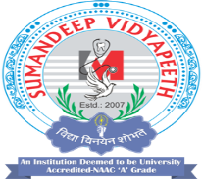
Midday Meal Scheme
Ms. Ekta M. Patel
Asst. Professor
Sumandeep Nursing College
Sumandeep Vidyapeeth Deemed To Be University
(Accredited ‘A’ Grade By Naac With A Cgpa Of 3.53 Out Of Four Point Scale)
Piparia, Waghodia, Vadodara, Gujarat

Slide 2
INTRODUCTION
The Midday Meal Scheme is a school meal programme of the government of India designed to improve the nutritional status of school-age children nationwide.
The programme supplies free lunches on working days for children in primary and upper primary classes in government, government aided, local body, Education Guarantee Scheme, and alternate innovative education centres.

Slide 3
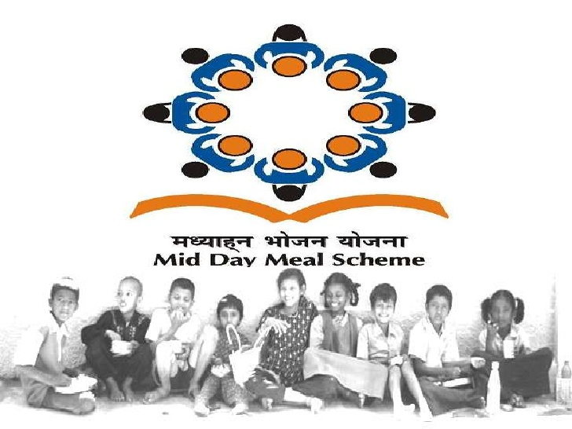

Slide 4
HISTORY
The roots of the programme can be traced back to the Pre-Independence era, when a mid day meal programme was introduced in 1925 in Madras Corporation by the British administration.
Tamil Nadu is a pioneer in introducing mid day meal programmes in India
Gujarat was the second state to introduce an MDM scheme in 1984, but it was later discontinued.
A midday meal scheme was introduced in Kerala in 1984, and was gradually expanded to include more schools and grades.
By 1990–91, twelve states were funding the scheme to all or most of the students in their area: Goa, Gujarat, Kerala, Madhya Pradesh, Maharashtra, Meghalaya, Mizoram, Nagaland, Sikkim, Tamil Nadu, Tripura and Uttar Pradesh.

Slide 5
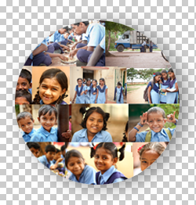
Mid-Day Meal
On November 28th, 2001 the Supreme Court of India passed an order stating:
"We direct the State Governments/Union Territories to implement the Mid-Day Meal Scheme by providing every child in every Government and Government assisted Primary School with a prepared mid-day meal."

Slide 6
SOME HIGHLIGHITING POINTS
The Government of India started Mid-Day Meal Scheme. With an aim to enhancing enrolment of children in schools, retention and increased attendance while also improving nutritional levels among children, the National Programme of Nutritional Support to Primary Education (NP-NSPE) was launched as a Centrally Sponsored Scheme on 15th August, 1995.
After some amendments there on, as per the expansion of the programme, the Government designed a set of rules and guidelines to be followed for implementation.
These include various aspects related to child health and growth like the quantity of calories and proteins required for children from specific age groups, the quantity of grains that can be allotted to each child and so on.

Slide 7
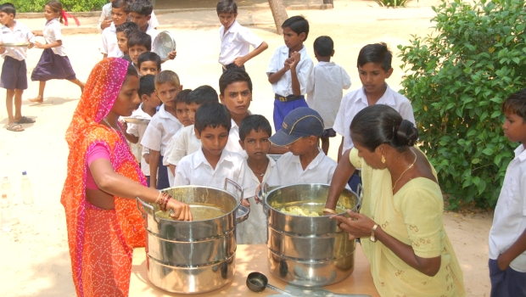
AIM
avoid classroom hunger
increase school enrolment
increase school attendance
improve socialisation among castes
address malnutrition and
empower women through employment

Slide 8
OBJECTIVES
Improving the nutritional status of children in classes I-V in Government, Local Body and Government aided schools, and EGS and AIE centres.
Encouraging poor children, belonging to disadvantaged sections, to attend school more regularly and help them concentrate on classroom activities.
Providing nutritional support to children of primary stage in drought affected areas during summer vacation.

Slide 9
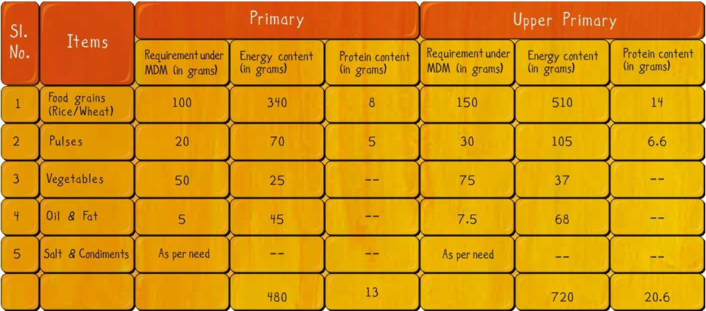
Nutrition

Slide 10
MID DAY MEAL PROGRAMME IMPLEMENTATION

Slide 11
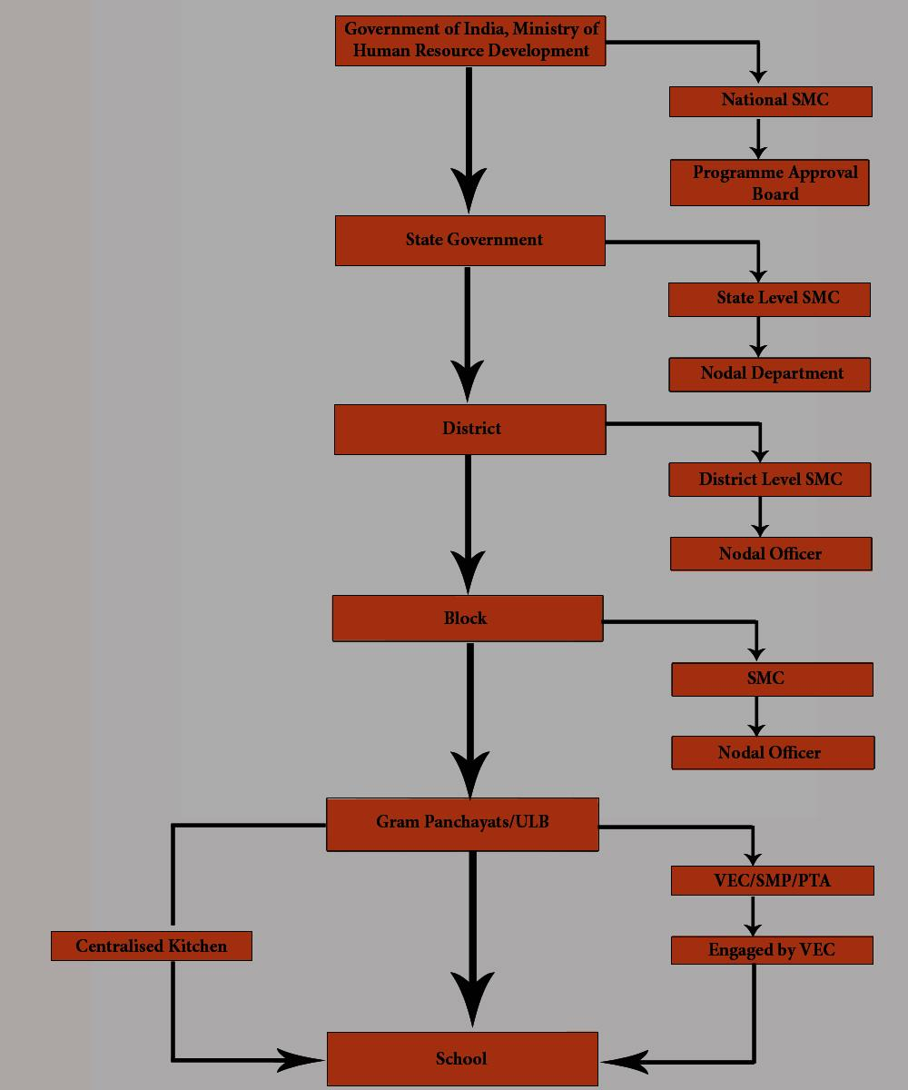

Slide 12
Flow of Funds
The Ministry of Human Resource Development is the nodal agency for sanctioning funds and supply of food grains (central assistance) to the states on behalf of the Government of India.

Slide 13
SAFETY & HYGIENE SPECIFICATION
Kitchen cum store is a vital part of the mid day meal scheme.
Kitchen cum stores should be separate from class rooms, preferably located at a safe distance.
It should have adequate light & ventilation.
There should be a raised platform for cooking and arrangement for drainage and waste disposal.

Slide 14
CONT…
Smokeless chullas should be used to the extent possible.
fuel (kerosene/ fuel wood/ charcol/ LPG) should be stored safely, so that there will no fire hazards.
Efforts should be made to discontinue the use of fire wood as far as possible in the interest of environment protection.
If kerosene / gas is used for cooking, the cooking staff should be specifically trained in safe handling of stoves/ gas cylinders etc.

Slide 15
CONT…
All cooks, helpers and other functionaries should also be trained in hygienic habits
e.g- regular cutting of nails, washing hands etc.
Ingredients used for cooking used only after proper cleaning and washing.
Cooking and serving utensils should be properly cleaned and dried every day after use.

Slide 16
PROBLEM | INTERVENTION | CONTROL | OUTCOME
ASSESSMENT OF THE NUTRITIONAL STATUS OF PRIMARY SCHOOL CHILDREN WHO ARE THE BENEFICIARIES OF MID-DAY MEAL SCHEME: A CROSS-SECTIONAL STUDY IN KANJIRAPPALLY BLOCK PANCHAYATH, KOTTAYAM | Cross-sectional survey was conducted among 322 children (171 boys and 151 girls) from government and aided schools in Kanjirappally Block panchayath, Kottayam using multi-stage random sampling. The information collected from children as well as their parents, and the anthropometric measurements of the children were observed. | NO CONTROL GROUP | The prevalence of CIAF was 45.7% and that of stunting, underweight and wasting were 13.4%, 38.8% and 30.7% respectively. Prevalence of over nutrition was only 1.5%. Birth weight of the child was the strongest determinant of CIAF and children’s preference to have lunch from school (like/dislike) was the strongest predictor of Mid-Day Meal utilization.

Slide 17
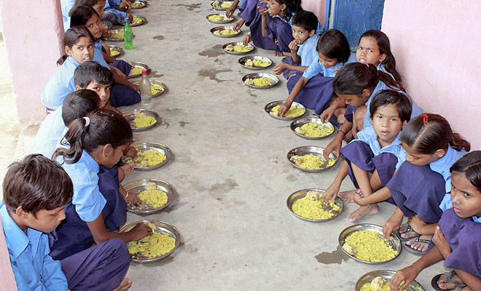
THANK YOU

