Slide 1


CONTACEPTIVE METHOD
Ms. Ekta M. Patel
Asst. Professor
Sumandeep Nursing College
Sumandeep Vidyapeeth Deemed To Be University
(Accredited ‘A’ Grade By Naac With A Cgpa Of 3.53 Out Of Four Point Scale)
Piparia, Waghodia, Vadodara, Gujarat

Slide 2
INTRODUCTI0N
People throughout the world are becoming increase aware of & concerned about the steadily rising population & the inherent effect this will have on the quality of life & the delicate balance of nature. There are a mainly Two types of Contraceptive Method. Temporary method Permanent method

Slide 3
DEFINITION OF FAMILY PLANNING:
According WHO (1971) , “Family planning as a way of thinking & living that is adopted voluntarily, upon the basis of knowledge, attitude & responsible decisions by individuals & couples, in order to promote the health & welfare of the family group & thus contribute effectively to the social development of the country.”

Slide 4
OBJECTIVES:
To avoid unwanted births To regulate the interval between pregnancies To control the time at which births occur in relation to the ages of the patient To determine the number of children in the family

Slide 5
METHODS OF CONTRACEPTIVES:
Methods of contraception (1) Temporary (2) Permanent 1.Natural Method Female- Tubectomy 2.Artificial Method Male -Vasectomy Barrier method IUCDs Hormonal/ steroidals Post conceptional methods

Slide 6
Temporary methods:
These are commonly used to postpone or to space births. However, these are also used frequently by couples who desire to have no more children.

Slide 7
1. Natural contraception: Rhythm method: The rhythm method is the only birth control method which is officially approved by the Roman Catholic Church. It is referred to as “safe period” or “temporary abstinence”. The method is based on the fact that a woman is fertile only around the time of ovulation & if she abstains from intercourse during that time, she is unlikely to conceive. Usually a woman ovulates once during each menstrual cycle. The ovum has an active life of 12 to 24 hrs during which it can be fertilized.

Slide 8
Sperm cells, once within the birth canal are viable for 72 hrs during which they can fertilize the ovum. Thus, there is a minimum total of 96 hours (4 days) during each cycle when conception is possible. To these 4 days, an additional margin of several days is added to allow for variation in the exact day of ovulation. The method to determine the approximate time of ovulation & the fertile period include: Recording of previous menstrual cycles (calendar method) Recording the basal body temperature (temperature rhythm) Taking note of the excessive mucoid vaginal discharge (mucus rhythm)

Slide 9
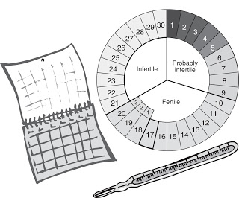

Slide 10
Advantages: No appliance is required No cost Disadvantages: Requires sufficient self-control by the men The woman may suffer anxiety, vaginismus or pelvic congestion Chance of pregnancy is more Pre-coital secretion may contain sperm Accidental chance of sperm deposition in the vagina Failure rate- 27/HWY

Slide 11
CERVICAL MUCOUS METHOD
Recognition of ovulation period is done on the basis of changes in the mucus of cervix.
At the time of ovulation mucus in cervix becomes watery, clear , smooth & slippery.
Abstinence is required before ovulation, at the time of ovulation & till 3 days after ovulation.

Slide 12
Temperature rhythm Users of the temperature rhythm require abstinence until the third day of the rise of temperature. This is because the basal temperature of woman is more or less constant during the first part of menstrual cycle until the day of ovulation. At that time, it drops slightly & then rises to a level somewhat higher level for the rest of the cycle. If there is no cold or infection to account for this elevation, the woman can consider beyond the fertile period when the elevation has persisted for three days.

Slide 13
SYMPTOTHERMIC METHOD
Combination of BBT & Cervical mucous method.

Slide 14
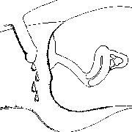
Coitus interruptus: It is the oldest & probably the most widely accepted contraceptive method used by man. It necessitates withdrawal of penis shortly before ejaculation.

Slide 15

Breast feeding: Prolonged & sustained breast feeding offers a natural protection of pregnancy. This is more effective in women who are ammenorrheic than those who are menstruating. The risk of pregnancy to a woman who is fully breast feeding & ammenorrheic is less than 2% in the six month. Otherwise failure rate is high. Thus during breast feeding, additional contraceptive support should be given by condom, IUCD or injectable steroid.

Slide 16
ABSTINENECE
This implies complete avoidance of sexual cohabit.
According to hindu philosophy abstinence is advocated before one get married at the age of 18 for girls & 21 for boys. (BHARAMCHARYA) then after menopausal period ( NIRVANA).
During GHRAHASTHA ASHARAM (18-48 girls & 21-50 Men ) sexual cohabit is advocated & in practice.
Complete abstinence during this period will help in birth control. But it is not practical.

Slide 17
Barrier methods: These methods prevent sperm deposition in the vagina or sperm penetration through cervical canal. The following are included: 1. Mechanical: Male: condom Female: condom, diaphragm, cervical cap 2. Chemical: Cream: Delfen Jelly: Koromex, Volpar paste Foam tablets: Aerosol foams, Chlorimin T, or contab

Slide 18
1. Male condom: Condoms are made of polyurethane or latex. Polyurethane condoms are thinner & suitable to those who are sensitive to latex rubber. It is the most widely practice method used by the male. A widely marketed brand in India is “Nirodh”. Protection against sexually transmitted disease is an additional advantage.

Slide 19
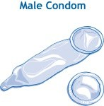
The method is suitable for couples who want to space their pregnancies & who have contraindication for the use of oral contraceptive or IUCD. These are also suitable to those who have infrequent sexual intercourse.

Slide 20
Advantages: Easily available & inexpensive No contraindications or side effects. Easy to carry, simple to use & disposable. Protective against sexually transmitted diseases like chlamydia, gonorrhea & HIV Protection against pelvic inflammatory diseases. Suitable for use during lactation, for teenagers & in cases where pills & IUCDs are contraindicated. Useful where sexual intercourse is infrequent & irregular.

Slide 21
Disadvantages: May accidentally break or slip off during coitus. Inadequate sexual pleasure Allergic reaction To discard after one coital act Failure rate – 15%

Slide 22
Female condom (Femidom): It is a pouch made of polyurethane which lines the vagina & also the external genitalia. It is 17cm in length with one flexible polyurethane ring at each end. Inner ring at the close end is smaller compared to the outer ring. Inner ring inserted at the apex of the vagina & the outer ring remains outside. It gives protection against sexually transmitted disease & pelvic inflammatory disease.

Slide 23
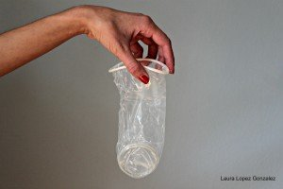
It is expensive. Multiple uses can be made with washing, drying & with lubrication. Failure rate is about 5-21/HWY

Slide 24
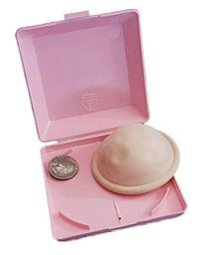
Diaphragm: It is intra vaginal device made of rubber with flexible metal or spring ring at the margin. Its diameter varies from 5-10 cm. It is not a popular method. It requires a medical person to measure the size required.

Slide 25
Instruction for use: The diaphragm of the right size is selected. It is inserted down with some spermicidal jelly within the cap & along the rim. The diaphragm is pinched between the thumb & index finger & released only after insertion into the vagina. The devices should be introduced up to three hours before intercourse & kept for at list six hours after last coital act. Fitting & accidental displacement during intercourse increase the failure rate.

Slide 26
Advantages: Inexpensive Can use repeatedly for long time Disadvantages: Require help of a physician to measure the size require. Risk of vaginal irritation & urinary tract infection More difficult to use than condom & require high degree of motivation for the user Not suitable for women with uterine prolapse

Slide 27
Chemicals or spermicides: Severe spermicidal agents are available in the market in the form of cream, jelly or foam tablet. These agents mostly cause sperm immobilization when they come in the contact & to some extent prevent sperm penetration through the cervical canal.

Slide 28
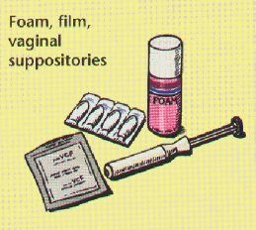
The cream or jelly is introduced high in the vagina with plastic applicators at least 15 min before sexual intercourse. Foam tablets are to be introduced high in the vagina at least 5 min prior to intercourse.

Slide 29
3. INTRA UTERINE CONTRACEPTIVE DEVICES: The intrauterine device have been used throughout the world. Intrauterine devices often referred to, as IUDs are small plastic or metal forms to which a ‘tail’ of nylon thread is usually attached. Types of IUD: There are two basic types of IUD, non-medicated & medicated. Both are usually made of polyethylene or other polymers; in addition, the medicated or bioactive IUD, release either metal ions (copper) or hormones (progesterone). The non-medicated IUDs are often referred to as first generation IUDs.

Slide 30
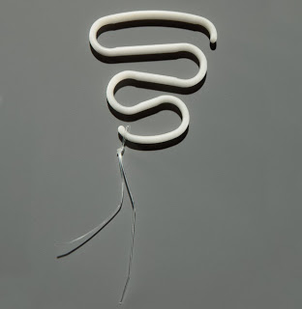
First generation IUDs: It include Lipper loop, Margulies spiral, and Safe-T-coil.

Slide 31
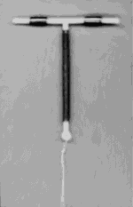
Second generation IUDs: It were introduced in the 1970s. It was found that metabolic copper had strong antifertility effect. A number of copper bearing devices are now available. Earlier devices: Copper-7 Copper T-200 Newer devices: Variants of the T devices Cu T-220 C Cu T-380 A or Ag

Slide 32
Advantages of copper devices: Lower expulsion rate Lower incidence of side effects, eg: pain & bleeding Easier to fit even in nulliparous women Better tolerated by nullipara Increased contraceptive effectiveness

Slide 33
Third generation IUDs:
These are based on still another principle, i.e. release of a hormone.
The most widely used hormonal device is progestasert.

Slide 34
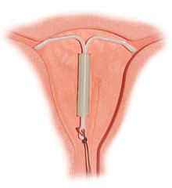
Time of insertion: During menstruation or within 10 days of the beginning of a menstrual period: During this period, insertion is technically easy because the diameter of the cervical canal is greater at this time than during the secretary phase. The uterus is relaxed & myometrial contractions, which might tend to cause expulsion are at a minimum In addition, the risk that a woman is pregnant is remote at this time.

Slide 35
Postpartum insertion: It is done 6 to 8 weeks after delivery. Post puerperal insertion has several advantages. It can be combined with the follow-up examination of the woman & her child. - Immediate postpartum IUD insertion can also be done during the first week after the delivery before the woman leaves the hospital. 2. Post abortion: Post abortion insertion can be taken up immediately after a legally induced first trimester abortion.

Slide 36
Complication: Immediate: Cramp like pain Syncopal attack Partial or complete perforation Remote: More or less pain Abnormal menstrual bleeding Pelvic infection (PID) Pain, abnormal uterine bleeding & PID are the principal factors related to its discontinuation (10-15%) Spontaneous expulsion (5%) Perforation of the uterus (1in 1000)

Slide 37
Advantages of third generation IUDs: Higher efficiency with lower pregnancy rate Significant reduction in menorrhagia, dysmenorrhea & premenstrual tension syndrome is observed Risk of ectopic pregnancy is significantly reduced. Risk of PID is reduced Longer duration of action (5-10 years) Low expulsion rate & fewer indications for medical removal. Disadvantages of third generation IUDs: Expensive Not available through government channel in India currently Deposition of calcium salts over the device on prolonged use may prevent the diffusion of copper Pregnancy (2 per 100 women in a year)

Slide 38
4. Steroidal contraception / Hormonal Methods Hormonal contraceptives when properly used are most effective spacing methods of contraception. Oral contraceptives of the combined type are almost 100% effective in preventing pregnancy. More than 65 million people in the world are estimated to be take “pill”, of which about 10 million are estimated to be in India. Classification: Hormonal contraceptives currently in use and/or under study are classified as follow: Oral pills Combined pills Progesterone only pill (mini pill) Post coital pill Once a month (long acting) pill Depot (slow releasing) formulation Injectable Subcutaneous implants Vaginal rings

Slide 39
Combined pill: The combination pill is one of the major spacing methods of contraception. Most formulations of the combined pill of the present time contain 30 to 35 microgram of synthetic estrogen & 0.5 to 1.0 mili gram of progesterone. The pill is given orally for 21 consecutive days beginning on the 5th day of the menstrual cycle, followed by a break of 7 days of no hormonal intake during which menstruation occurs. When bleeding occur, this is considered the first day of the next cycle. The bleeding is not like normal menstruation, but is an episode of uterine bleeding from an incompletely formed endometrium caused by withdrawal of exogenous hormones. Therefore, it is called “withdrawal bleeding” rather than menstruation.

Slide 40
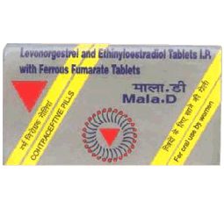

Types of pills: The department of family welfare, in the Ministry of Health & Family Welfare, Government of India has made available 2 types of low dose oral pills under the brand names of Mala N & Mala D. MALA N: Contain: Norgestrel 0.50 mg Ethinyl estradiol 0.04mg MALA D: Contain: D Norgestrel 1.0 mg Ethinyl estradiol – 0.03 mg

Slide 41
Mala D is available in a package of 28 pills -21 of oral contraceptive pills & 7 brown- ferrous iron coated tablets at a price of rupees 2 per packet. Mala N is supplied free of cost through all Primary Health Centers & Urban Family Welfare Centers. INDICATION The probable mechanism of contraception are: Inhibition of ovulation: Production of static endometrial hypoplacia: Alteration of the character of the cervical mucus: Thick, viscid & scanty to prevent sperm penetration.

Slide 42
Contraindications:. Absolute: Circulatory diseases: Arterial or venous thrombosis Severe hypertension Vulvar disease, ischemic heart disease, angina Hyperlipidemia Focal migraine Disease of liver: Active liver disease History of cholestatic jaundice in pregnancy Liver adenoma, carcinoma Others: Pregnancy Genital tract bleeding Breast cancer

Slide 43
Relative: Obesity Varicosities Epilepsy Bronchial Asthma Depression Mood fluctuation Age over 35 Smoking Nursing mothers who are in the first six months Follow up: The woman should be examined after three months, six months & then one a year. Women above 35 years should be checked more frequently. Any adverse symptoms are to be noted at each visit. Examination of breasts, weight, blood pressure, pelvic examination including cytology are to be done & compared with the previous records.

Slide 44
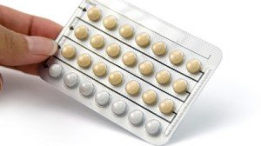
Progesterone only pill (POP): This pill is commonly referred to as the mini pill or micro pill. It contains very low dose of a progestin in any one of the following form: Levonorgestrel 75 micro gram Norethisterone 350 micro gram Lynestrenol 500 micro gram Norgestrel 30 micro gram

Slide 45
Mechanism of action: It works mainly by making cervical mucus thick & viscos, thereby prevents sperm penetration. Endometrium become atrophic. In about 2 % of cases, ovulation is inhibited. Advantages: No adverse effect on lactation & hence can suitably prescribed in lactating women & as such it is often called “Lactation Pill”. Easy to take as there is no “On & Off” regime. It may be prescribed in patient having medical disorders like hypertension, fibroid, diabetes, epilepsy, smoking & history of thromboembolism. Reduces the risk of PID & endometrial cancer. Disadvantages: There may be acne, mastalgia, headache, breakthrough bleeding or at times amenorrhea in about 20-30% cases. All the side effects, attributed to progestines may be evident Simple cysts of ovary may be seen, but they do not require any surgery. Failure rate is about 0.5-2 per 100 women years of use.

Slide 46
5. POST CONCEPTIONAL METHODS
1. MENSTRUAL REGULATION
2. MENSTRUAL INDUCTION
3. ABORTION/ MTP

Slide 47
PERMANENT METHODS

Slide 48
PERMANENT METHODS Ø Voluntary sterilization is a well-established contraceptive procedure for couples desiring no more children. Ø Currently female sterilizations account for 85% & male sterilizations for 10 to 15% of all sterilizations in India. Ø Voluntary sterilization is a surgical method whereby the reproductive function of an individual male or female is destroyed purposefully & permanently. Ø The operation done on male is vasectomy & that on female is tubal ligation or tubal occlusion.

Slide 49
Vasectomy or Male Sterilization: Ø It is permanent sterilization operation done in the male where a segment of vas deferens of both the sides are resected & the cut ends are ligated. Ø The ligated ends are then folded back on them & sutured into position so that the cut ends face away from each other. Following vasectomy, sperm production & hormone output are not affected.

Slide 50
The sperm produced are destroyed intra luminally by phagocytosis. Ø This is a normal process in the male genital tract, but the rate is increased after vasectomy. Ø The vasectomized person is not immediately sterile after operation, usually until approximately thirty ejaculations have taken place, as the semen is stored in the distal part of the vas deferens for about 2 or 3 months. Ø During this period, another contraceptive must be used.

Slide 51
o Advantages: 1. The vasectomy operation is simple & can be performed as an outpatient or outdoor procedure. 2. Complications are few 3. Failure rate is about 0.15% & there is a fair chance of success of reversal anastomosis operation. 4. The overall expenditure is minimal in terms of equipment, hospital stay & doctor’s training. Cost wise the ratio is about five vasectomies to one tubal ligation.

Slide 52
Post-operative advice: Ø Antibiotic is administered as a routine – injection penidure & an analgesic is prescribed. Ø Weight lifting, heavy work & cycling are restricted for about 2 weeks while usual activities can be performed forthwith. Ø To wear a scrotal support (T-bandage) for 15 days. Ø The patient should report for check up after one week or earlier, if any complication arise. Ø To have the stitches removed on the 5th day. Ø Additional contraceptive should be used for 3 months. Ø Semen should be examined once a month & if two consecutive semen analyzes show an absence of spermatozoa, the man is declared sterile. Until then additional contraceptive should be advices.

Slide 53
FEMALE STERILIZATION

Slide 54
ABSTRACT
A comparative study on attitude of contraceptive methods users towards common contraceptive methods. study samples included 378 women using common contraceptive methods as LD pills, IUD (intrauterine devices), condom, withdrawal, tubectomy (females sterilization) and vasectomy as well as withdrawal method. The highest frequency of the attitude scores about condom method (51.3%) was associated with the women with undesirable attitude and mean scores of the condom method was lower than other methods (IUD, tubectomy, vasectomy, withdrawal method) which could be due to reduction of sexual pleasure in men and women and also due to unpleasantness of the condom method

Slide 55
PROBLEM | INTERVENTION | CONTROL | OUTCOME
A comparative study on attitude of contraceptive methods users towards common contraceptive methods | - | No control group used | The highest frequency of the attitude scores about condom method (51.3%) was associated with the women with undesirable attitude and mean scores of the condom method was lower than other methods (IUD, tubectomy, vasectomy, withdrawal method) which could be due to reduction of sexual pleasure in men and women and also due to unpleasantness of the condom method

Slide 56


